Slide 1

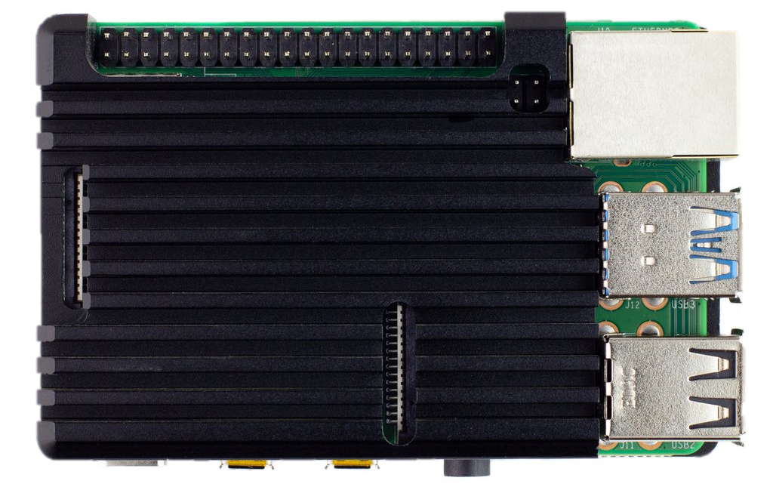
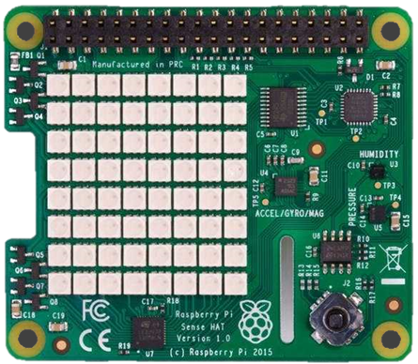
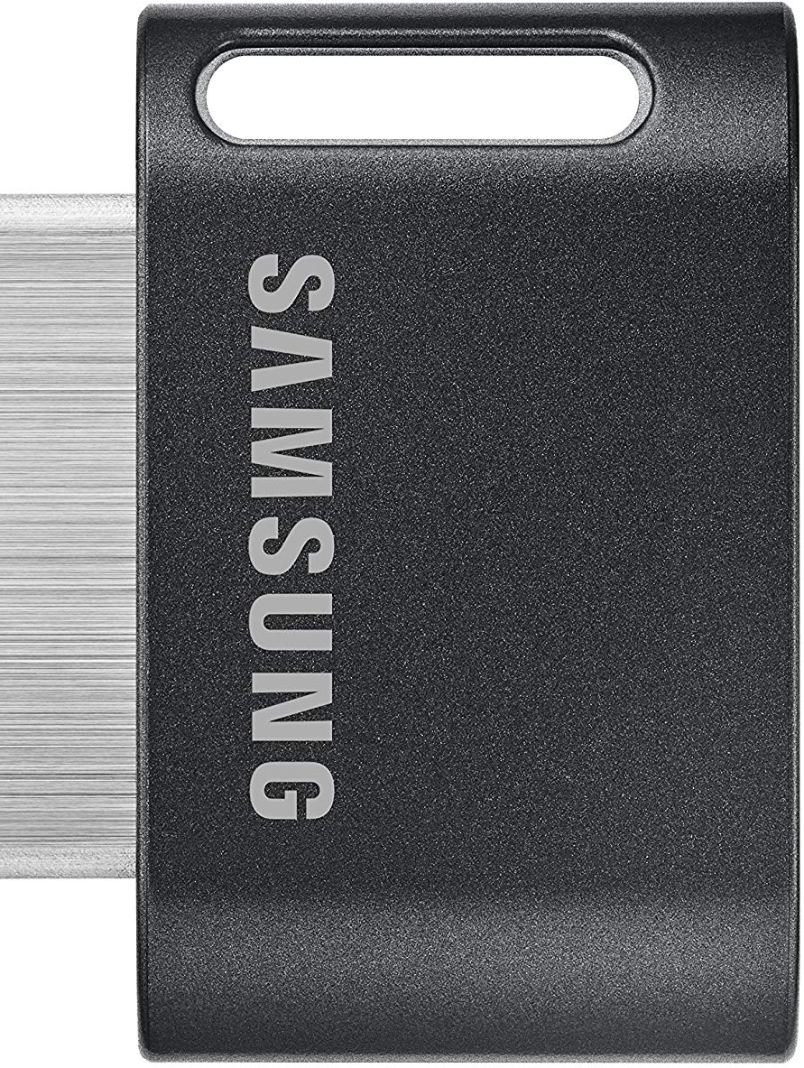
IoT, Python, and Visual Studio Code Hands on Lab
20 x Wi-Fi Connected Developers
1 x Raspberry Pi 4B 4GB

