Slide 1
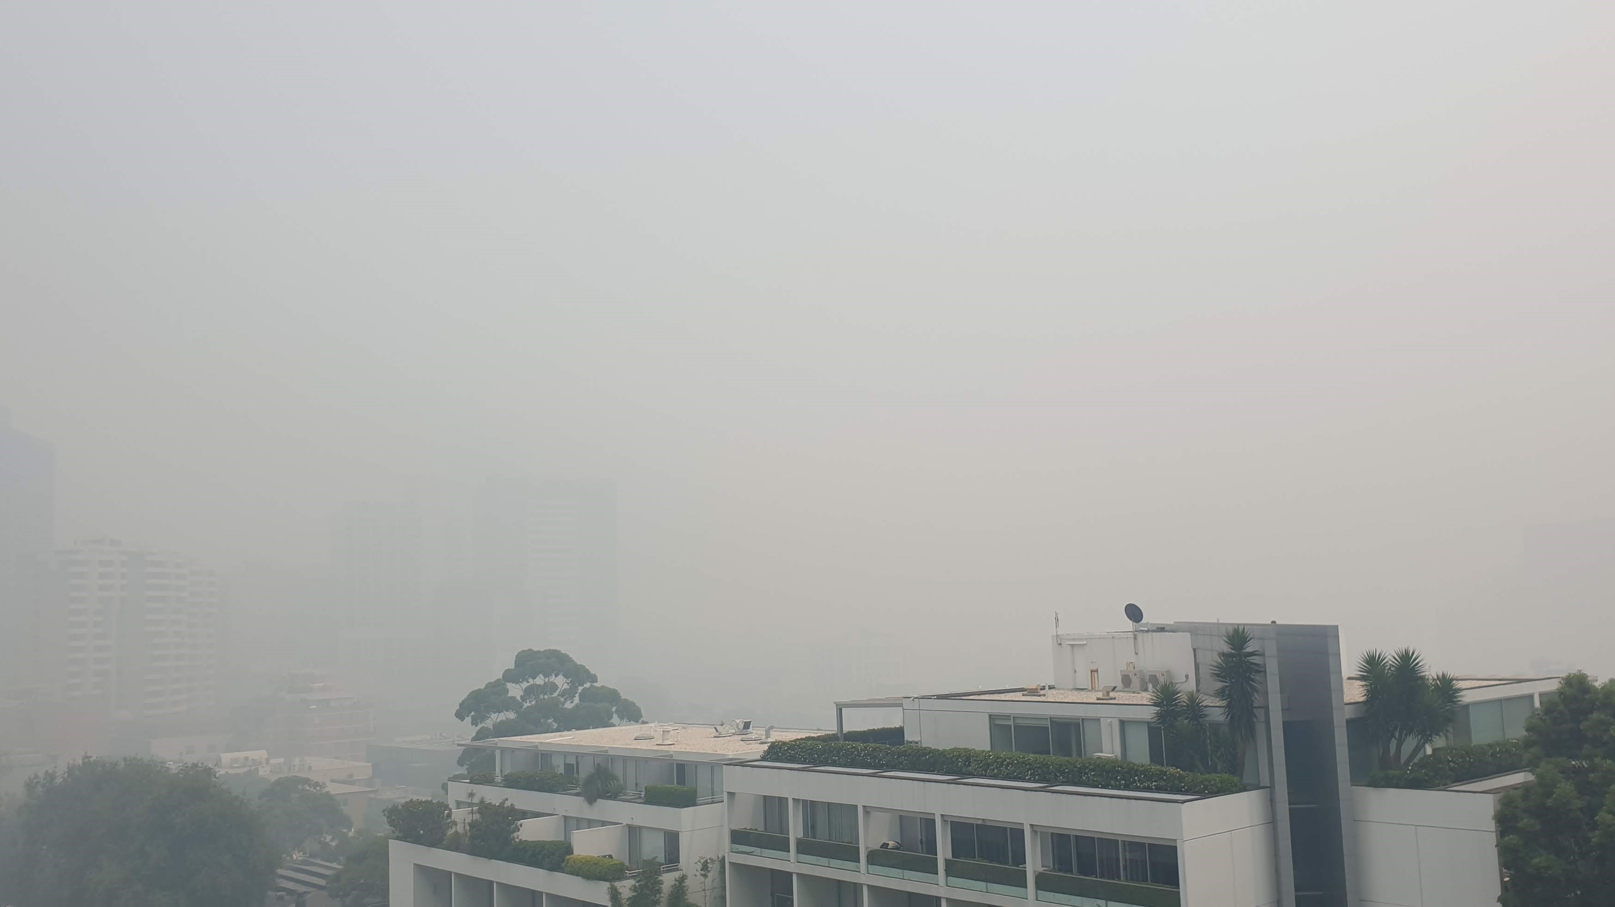
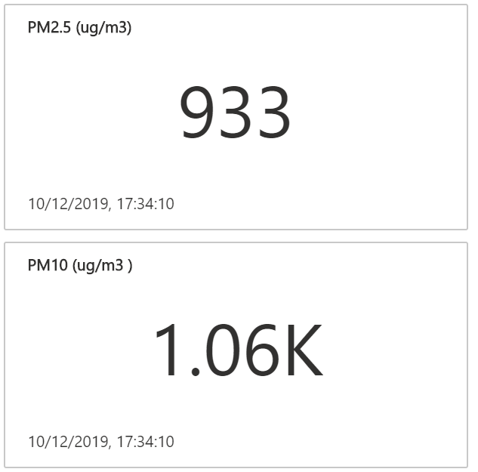
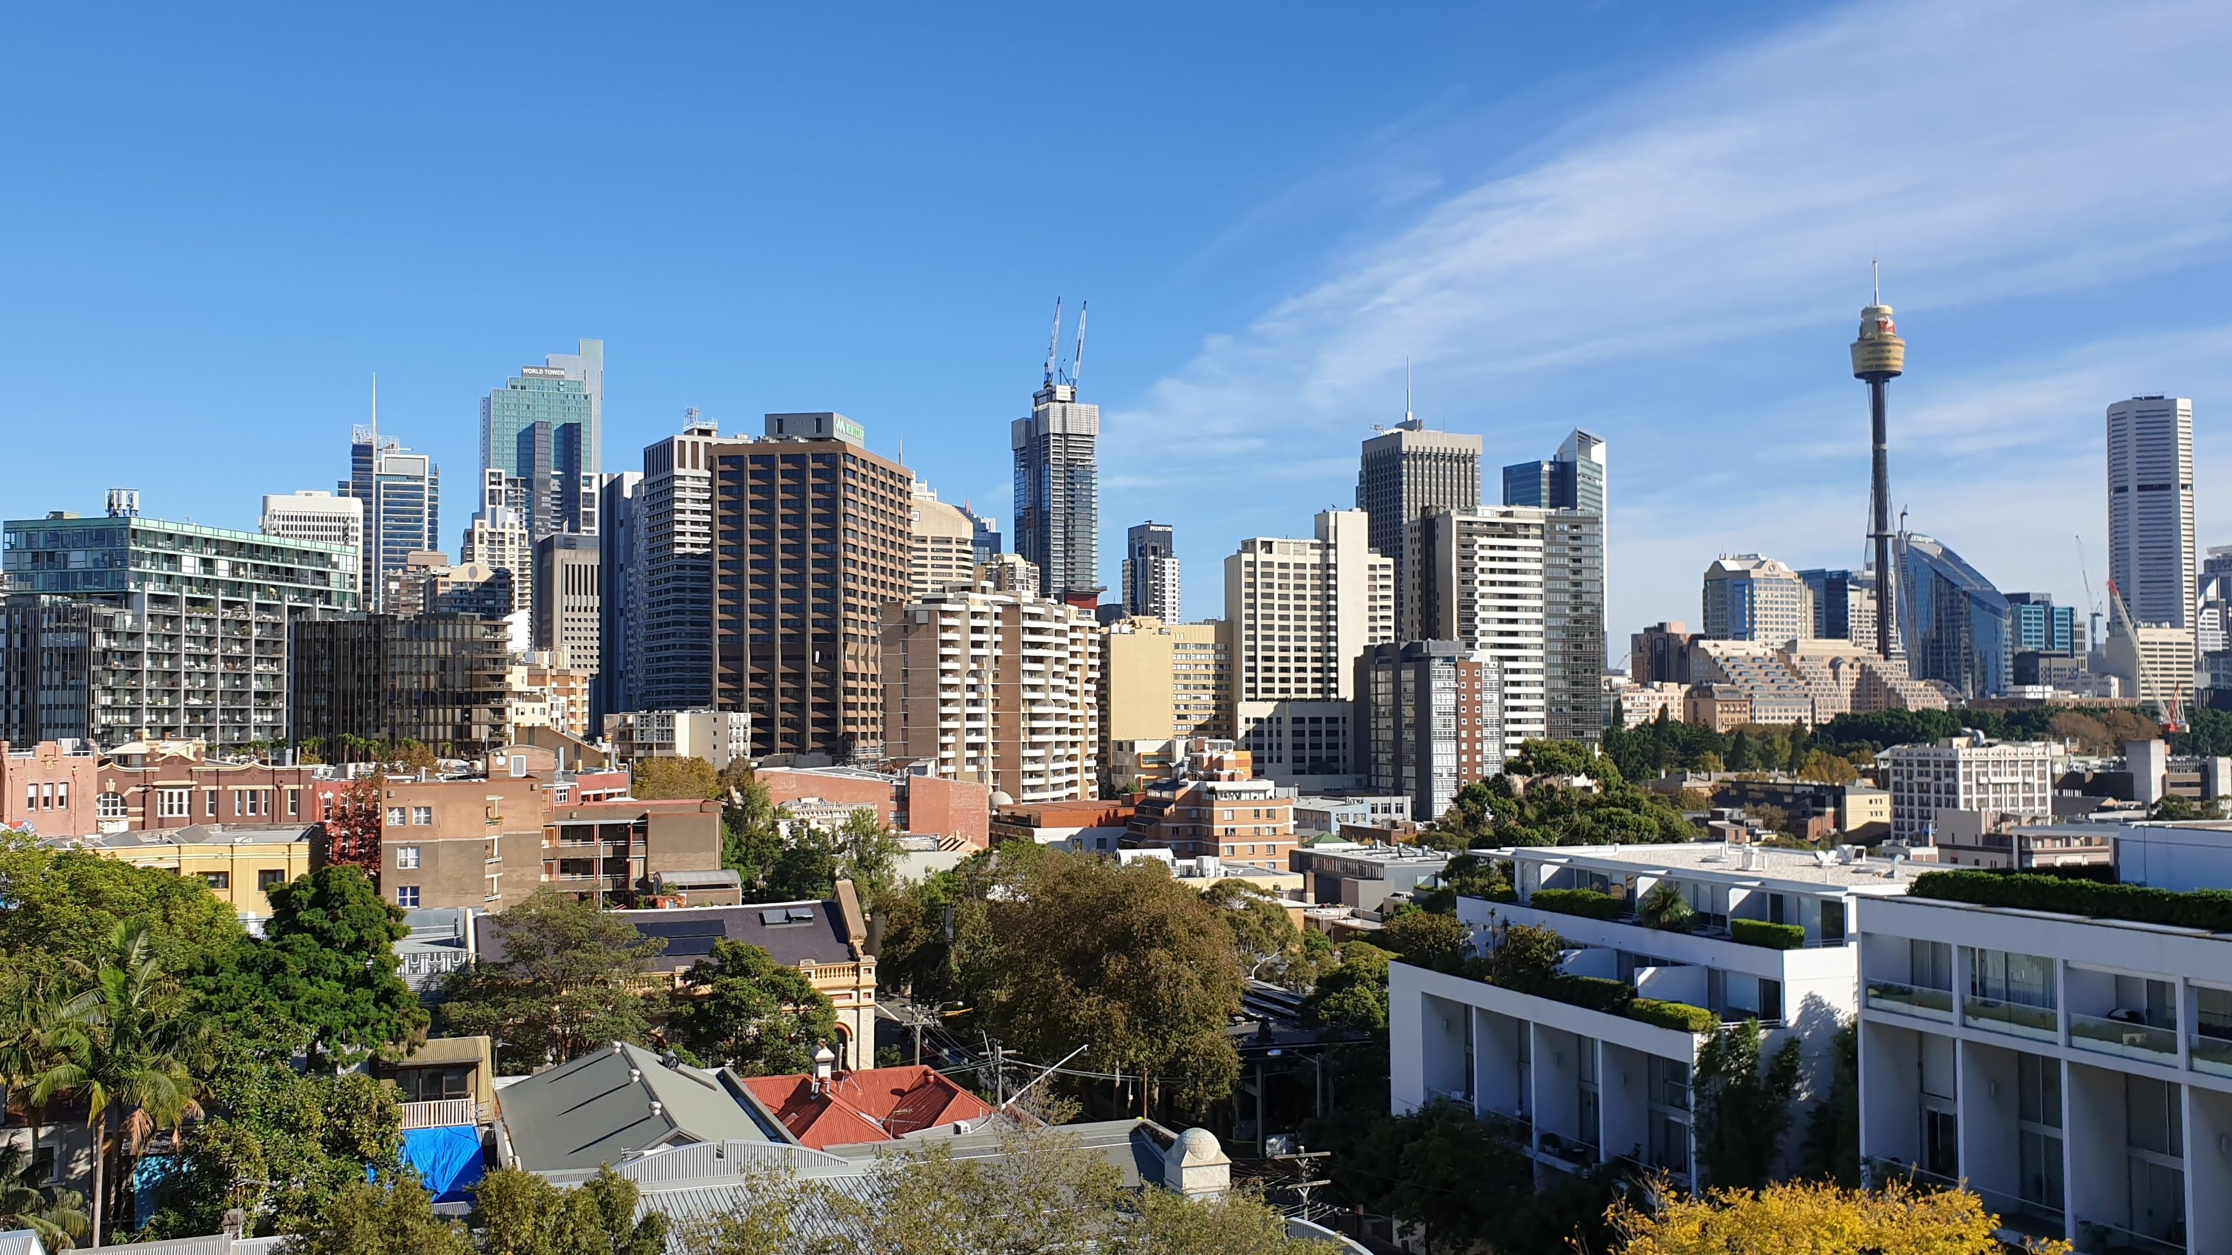
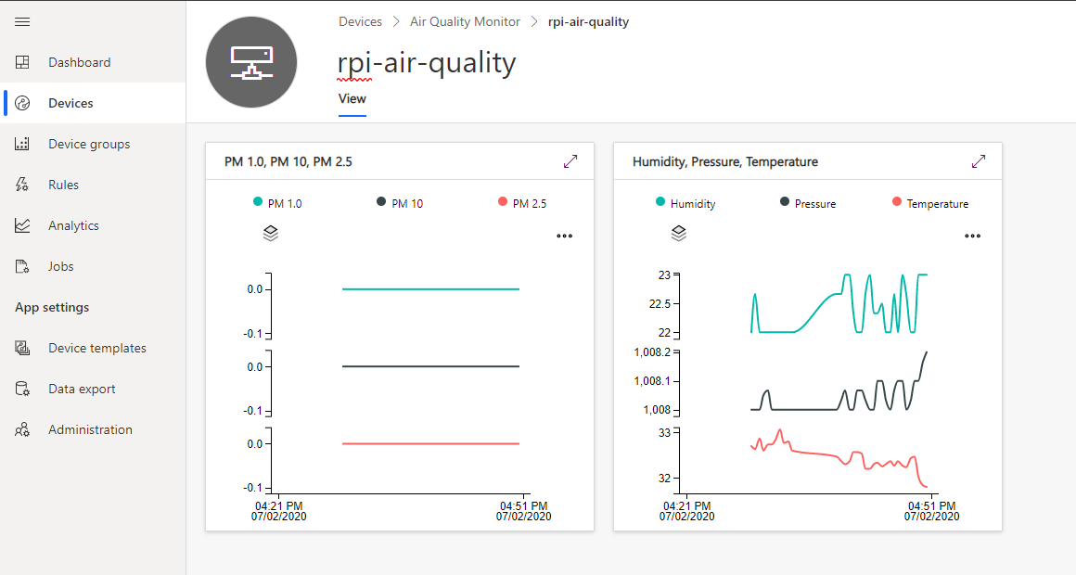
Photo taken from same location during bushfire and then during the COVID-19 pandemic lock down
Particulate Matter readings during the height of the bushfires. Healthy levels should be between 0 ~ 10.
Sydney Dec 2019
Sydney May 2020

