Slide 1



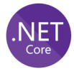
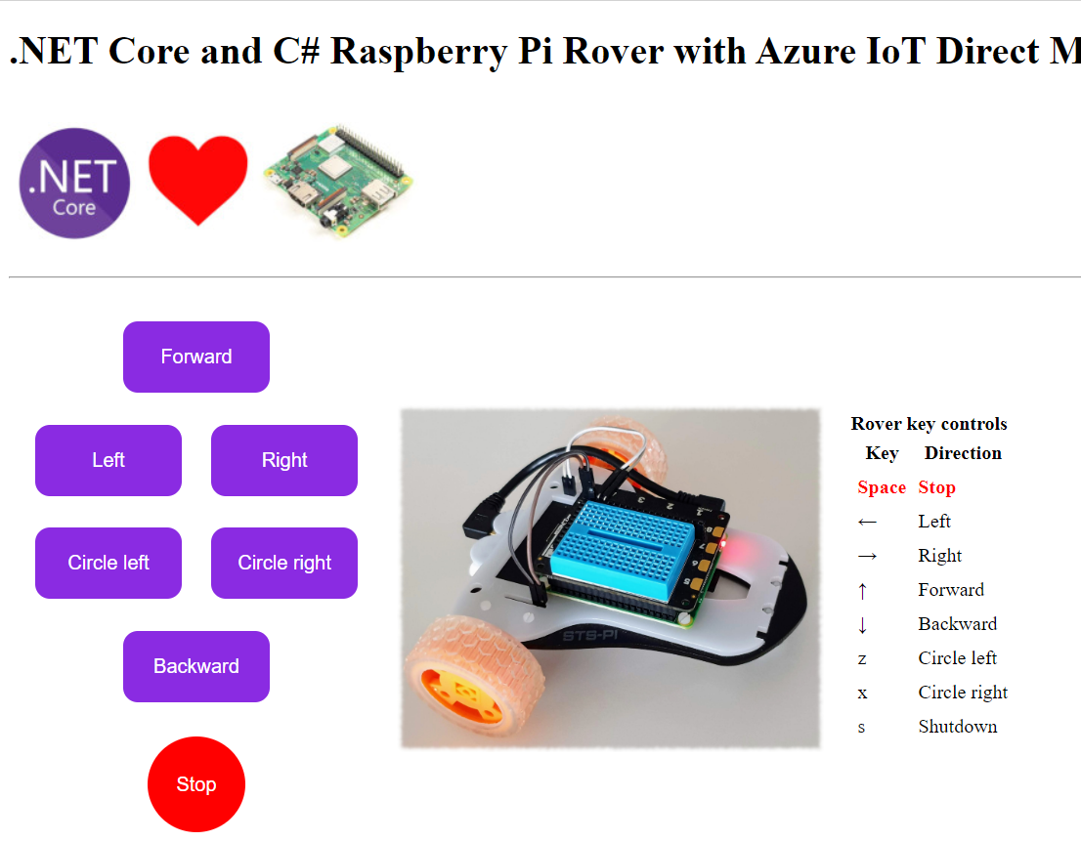
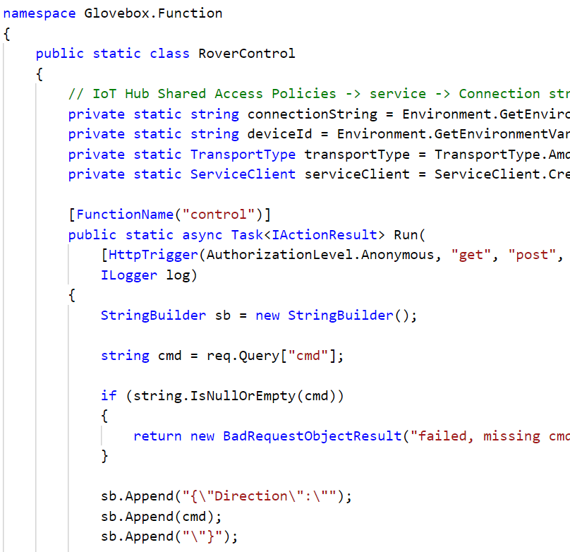
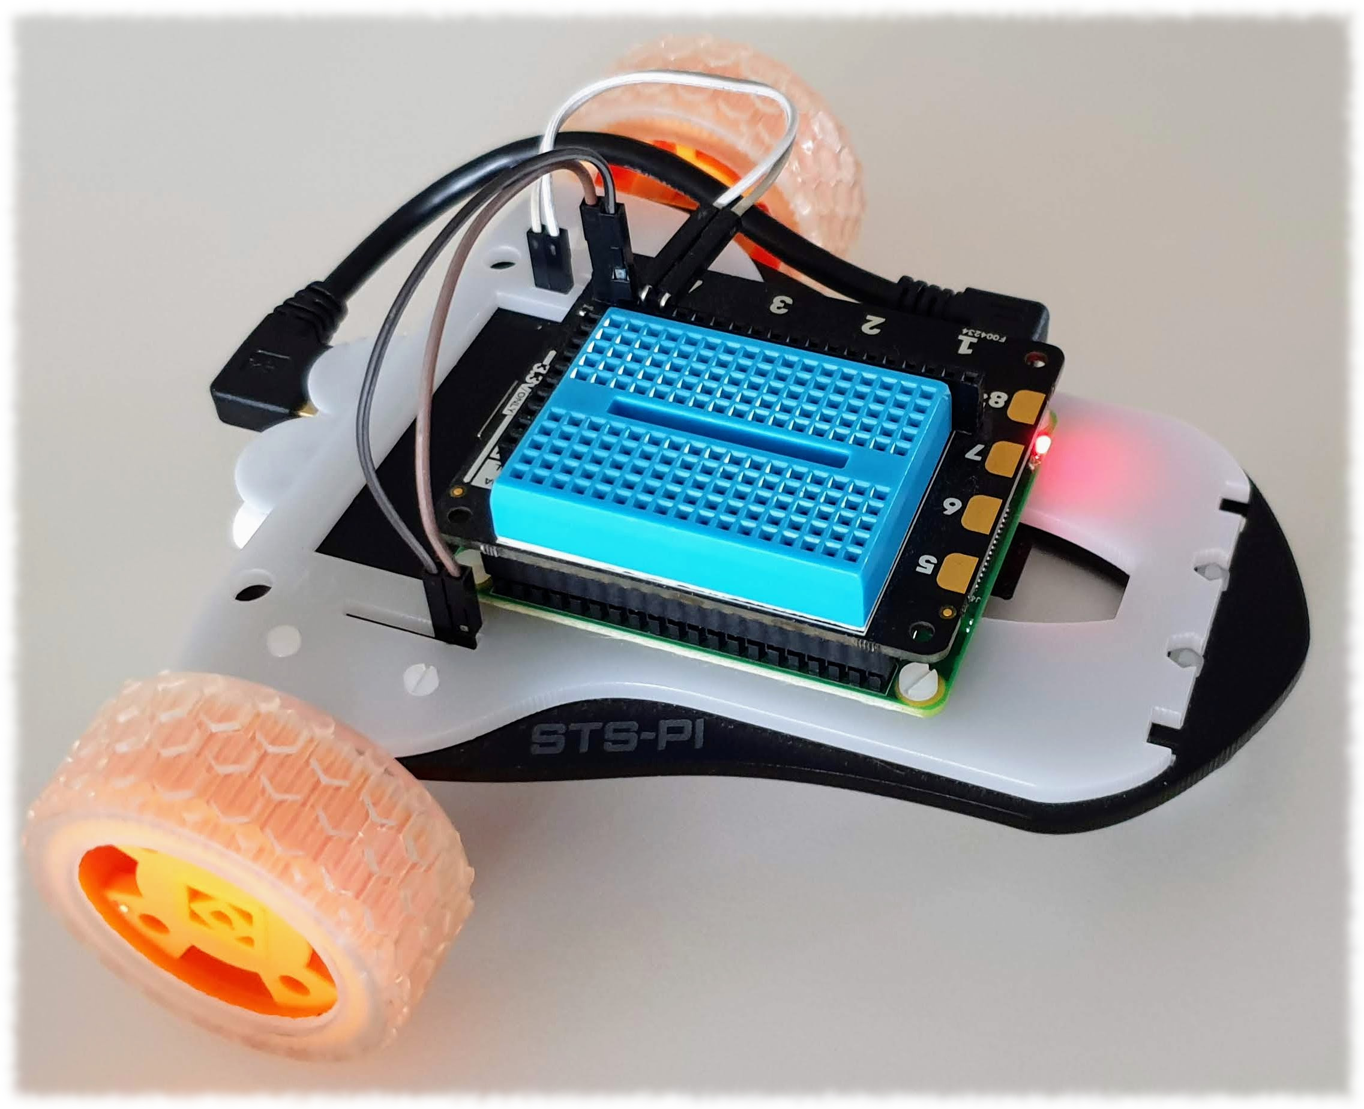
Azure Storage
Static Website
Azure Function “Control”
IoT Hub Direct Methods
Raspberry Pi
.NET Core
IoT Hub Client
Azure Function Control
RPi Rover
Invoke Direction direct method
1
Method Request
Direct method Direction handler function
2
Apply action
3
Method Response
Direct method handler response
4

