Slide 1
.NET Core: Overview and Tools
Notes:
Agenda
- Introduce .NET Core
- Development
- Deployment
- .NET CLI

Slide 2

.NET platform
DESKTOP
.NET FRAMEWORK
WINDOWS UWP
.NET CORE
ASP.NET CORE
MOBILE
CLOUD
XAMARIN
TOOLS
Visual Studio
.NET STANDARD LIBRARY
Visual Studio for Mac
COMMON INFRASTRUCTURE
Visual Studio Code
Compilers
Languages
Runtime components

Slide 3
.NET Core – Server and Cloud
DESKTOP
.NET FRAMEWORK
WINDOWS UWP
.NET CORE
ASP.NET CORE
MOBILE
CLOUD
XAMARIN
TOOLS
Visual Studio
.NET STANDARD LIBRARY
Visual Studio for Mac
COMMON INFRASTRUCTURE
Visual Studio Code
Compilers
Languages
Runtime components

Slide 4

.NET Core workloads
>
Web
Console
Notes:
TODO: Show web browser, console

Slide 5




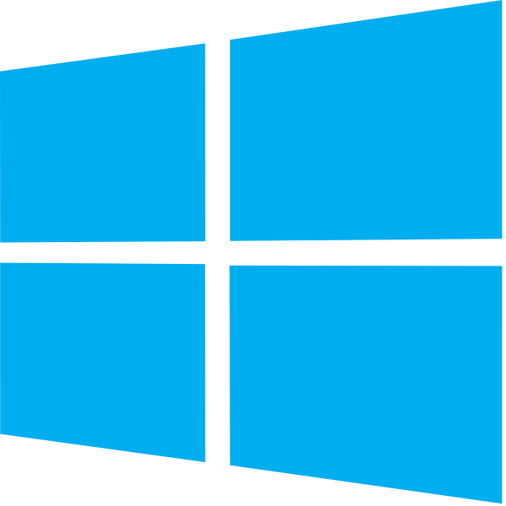



Developer tools
Visual Studio for Mac
Visual Studio Code
BYO Text Editor
.NET Core SDK (includes CLI)
Notes:
If you’re on Windows, we recommend Visual Studio
If you’re on Mac, we recommend Visual Studio for Mac
If you prefer a lightweight editor, we recommend Visual Studio Code
If you want to use another text editor, all you need is the .NET Core SDK which includes a CLI

Slide 6




.NET Core
Cross-platform
Windows, Linux and macOS
Fast
8x faster than Node.js in TechEmpower benchmark
Lightweight
No impact deployment and a modular development model perfect for containers
Open source
Runtime, libraries, compiler, languages and tools developed in the open in GitHub

Slide 7
Cross-platform

Slide 8
Supported OSes
Windows
Windows 7 SP1+, 8.1
Windows 10 Client
Server 2008 R2 SP1+
Server 2016 (incl. Nano)
macOS
Sierra (10.12)
High Sierra (10.13)
Linux
RHEL 7
Fedora 25, 26
Centos 7
Debian 8.7+
Ubuntu 14.04, 16.04, 17.04
Linux Mint 17, 18
openSUSE 42.2+
Oracle Linux 7
SUSE Enterprise Linux 12 SP2+
https://github.com/dotnet/core/blob/master/release-notes/2.0/2.0-supported-os.md

Slide 9
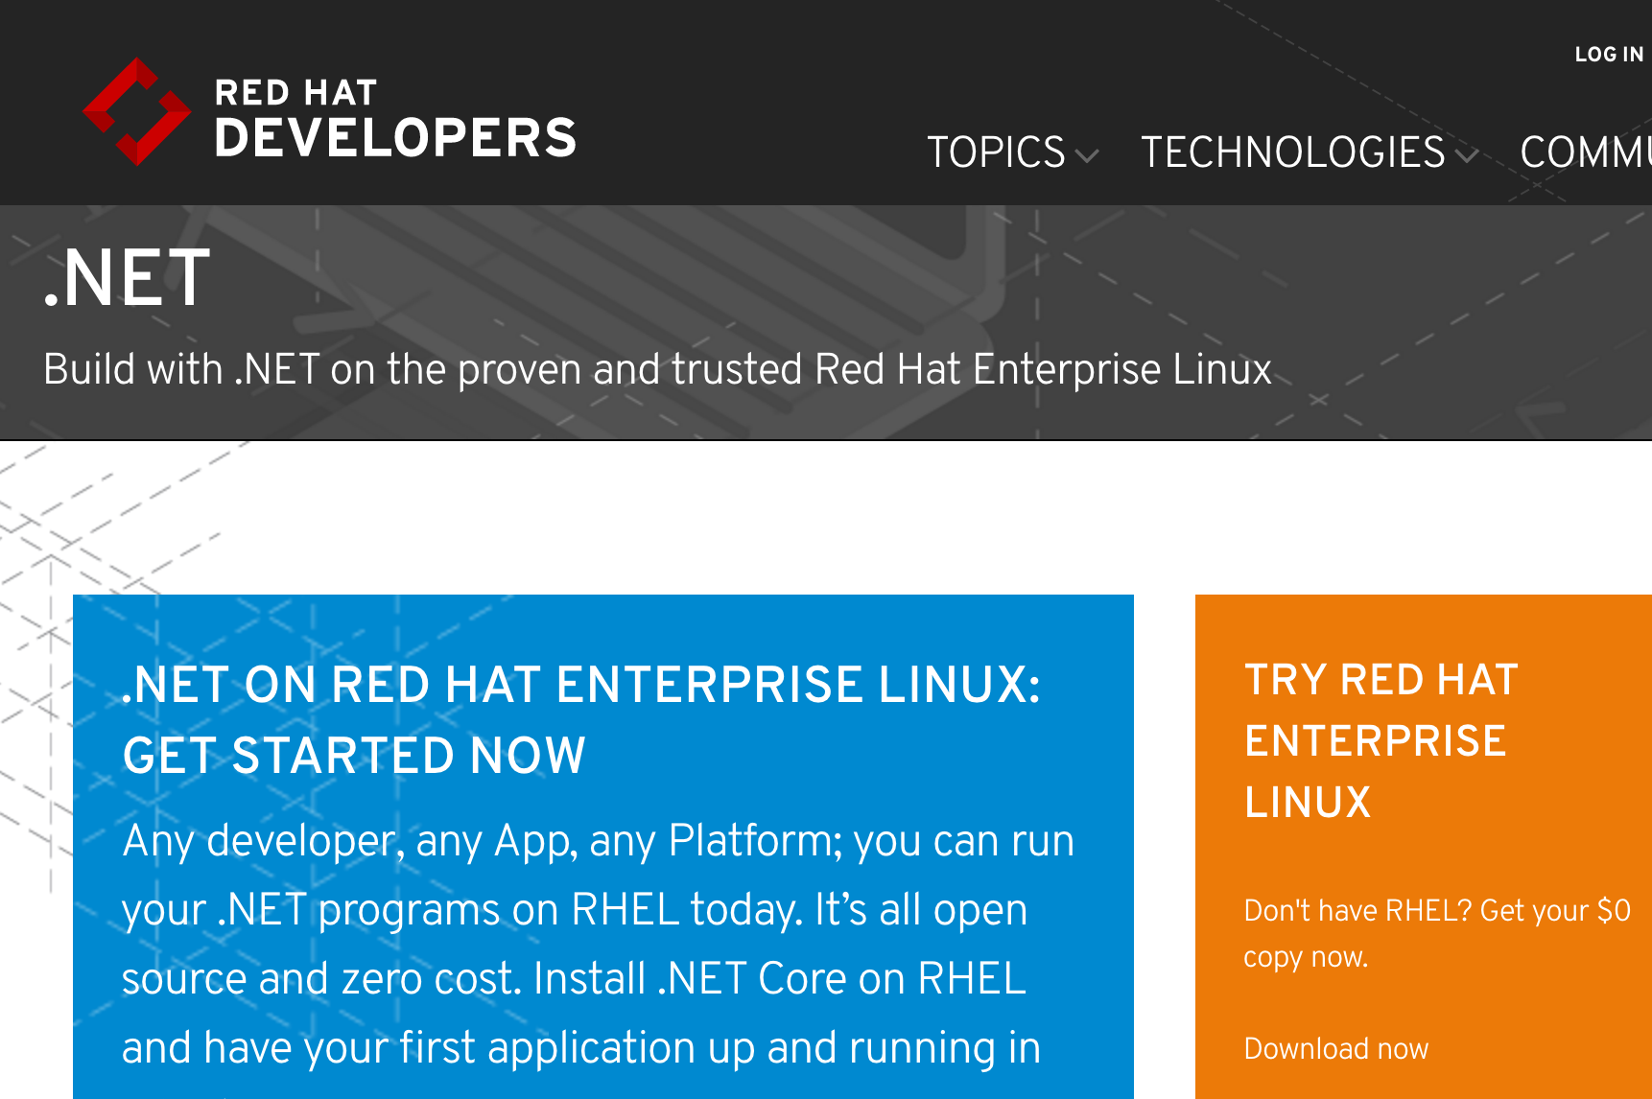
http://redhatloves.net

Slide 10
.NET Core is fast!

Slide 11
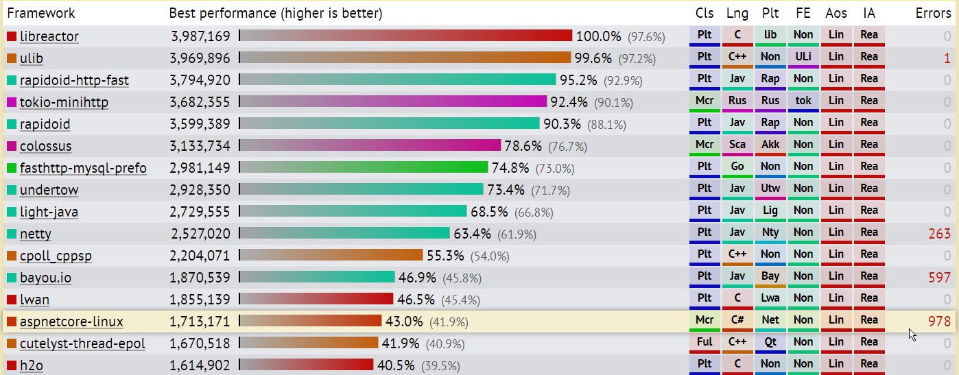
TechEmpower Framework Benchmarks – Round 14 – PlainText
https://techempower.com/benchmarks/

Slide 12
Modular and lightweight

Slide 13
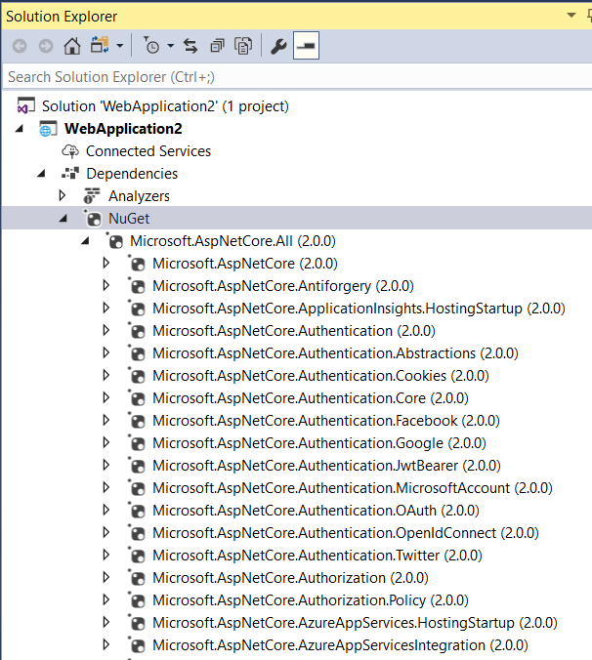



Everything in packages

Slide 14
.NET Core deployment options
Framework Dependent Deployment (FDD)
Self-contained Deployment (SCD)
.NET Runtime
.NET Runtime

Slide 15
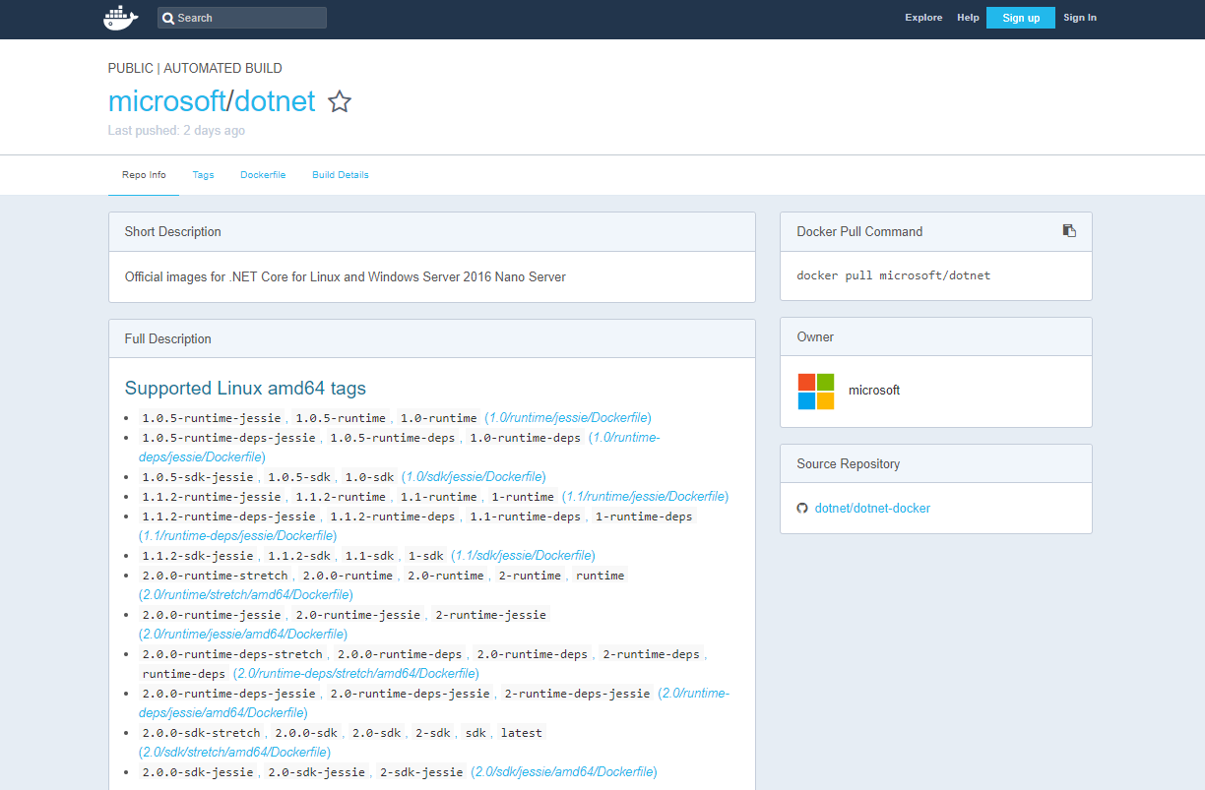
https://hub.docker.com/r/microsoft/dotnet/

Slide 16
50% of .NET Core contributions are from the community

Slide 17
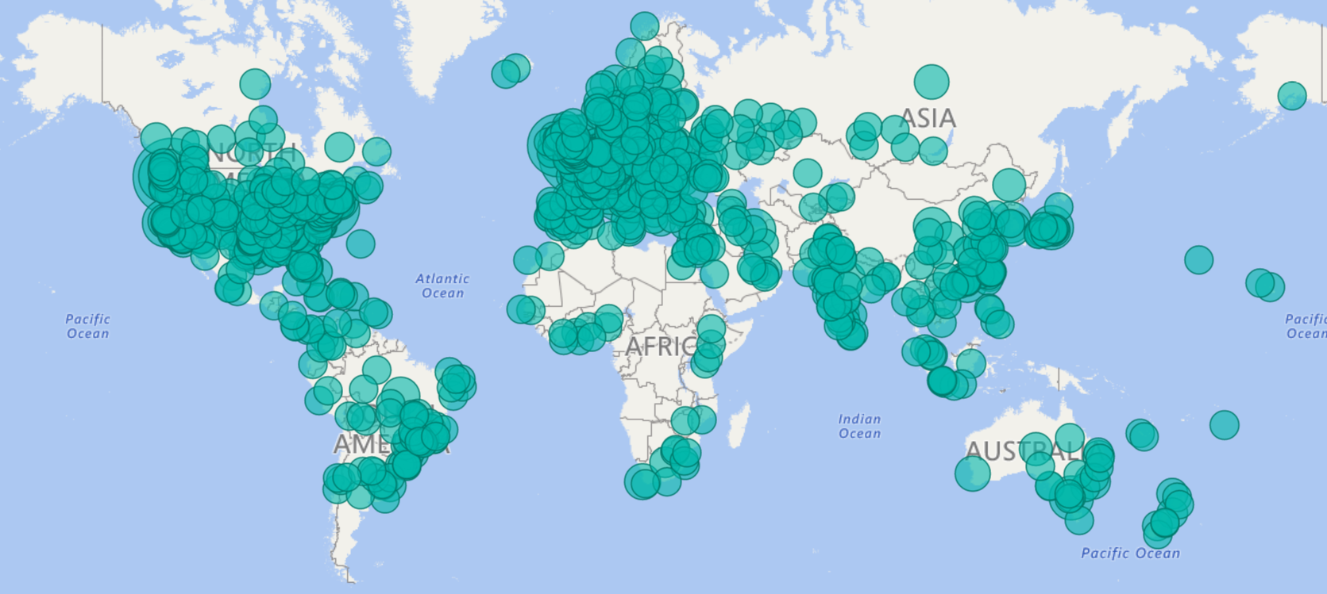
.NET Open Source Contributions as of 2017

Slide 18







Technical Steering Group
The following companies are helping to drive the future of .NET

Slide 19
.NET Core and .NET Framework
Similarities
Support the latest C#, VB.NET, F#
Implements .NET Standard API
Supports ASP.NET Core and EF Core
Best experience in Visual Studio
Great experience in Visual Studio Code
Can be used in/with Docker

Slide 20
.NET Core and .NET Framework
Differences
.NET Framework comes with Windows
.NET Core installs side-by-side
.NET Core is cross-platform and OSS
.NET Core works on Nano
.NET Core has a strong CLI experience
Notes:
F# and VB are coming for Core

Slide 21
.NET Core: Your First App

Slide 22
Sample Source Code
using System;
class Program
{
static void Main(string[] args)
{
Console.WriteLine("Hello World!");
}
}

Slide 23
CSProj – default console template
<Project Sdk="Microsoft.NET.Sdk">
<PropertyGroup>
<OutputType>Exe</OutputType>
<TargetFramework>netcoreapp2.0</TargetFramework>
</PropertyGroup>
</Project>
Notes:
Point out the following:
Microsoft.NET.SDK pulls in a set of default settings, such as including *.cs files in the project, and appropriate reference assemblies
Exe produces an EXE build. Libraries are the default
netcoreapp2.0 is the target framework, so defines the set of reference assemblies you get

Slide 24
CSProj – default Web template
<Project Sdk="Microsoft.NET.Sdk.Web">
<PropertyGroup>
<TargetFramework>netcoreapp2.0</TargetFramework>
</PropertyGroup>
<ItemGroup>
<Folder Include="wwwroot\" />
</ItemGroup>
<ItemGroup>
<PackageReference Include="Microsoft.AspNetCore.All" Version="2.0.0" />
</ItemGroup>
</Project>
Notes:
Point out the following:
Microsoft.NET.SDK.Web pulls in a set of default settings, including referencing Microsoft.Net.SDK under the hood
Demonstrates PackageReference syntax, the new way to reference NuGet packages. ASP.NET remains in NuGet.
Uses new AspNetCore.All metapackage

Slide 25
.NET Core CLI

Slide 26
What is the .NET Core CLI?
Cross-platform command-line set of tools that are…
…focused on building code…
…for both humans…
…and machines

Slide 27
.NET Core CLI commands
dotnet
build
--output [path]
the driver
verb (command)
verb arguments

Slide 28
NET Core CLI extensibility
Driver, dotnet, is invoked first, followed by a verb
The verb is a command that is implemented as:
A NuGet package
A binary in the $PATH
Driver invokes the command passing the arguments to it
The command is responsible for the arguments

Slide 29
.NET Core SDK Commandline Usage (1/2)
Command | Purpose
dotnet new | Initialize .NET projects.
dotnet restore | Restore dependencies specified in the .NET project.
dotnet run | Compiles and immediately executes a .NET project.
dotnet build | Builds a .NET project.
dotnet publish | Publishes a .NET project for deployment (incl. runtime).
dotnet test | Runs unit tests using the test runner specified in the project.
dotnet pack | Creates a NuGet package.
dotnet migrate | Migrates project.json project to msbuild based project.

Slide 30
.NET Core SDK Commandline Usage (2/2)
Command | Purpose
dotnet clean | Clean build output(s).
dotnet sln | Modify solution (SLN) files.
dotnet add | Add reference to the project.
dotnet remove | Remove reference from the project.
dotnet list | List reference in the project.
dotnet nuget | Provides additional NuGet commands.
dotnet msbuild | Runs Microsoft Build Engine (MSBuild).
dotnet vstest | Runs Microsoft Test Execution Command Line Tool.

Slide 31
Demo
.NET Core Getting Started
Notes:
// Get the bits
Show https://dot.net/core
Show https://visualstudio.com
// New
dotnet --version
dotnet new -h
dotnet new console -o myapp
cd myapp
code .
Discuss .csproj, Program.cs
dotnet run
dotnet build
dotnet bin\debug\netcoreapp2.0\myapp.dll
// Add
dotnet add package Newtonsoft.Json
dotnet restore
Show .nuget folder and /program files/dotnet/sdk/NuGetFallbackFolder
// Publish
dotnet publish
dotnet <published app>
// VS
Create new console app in Visual Studio
Right click -> Manage NuGet packages
Right click -> Publish

