Slide 1
ASP.NET Core
Notes:
Agenda
- Introduce .NET Core
- Development
- Deployment
- .NET CLI

Slide 2
ASP.NET Core
A new open-source and cross-platform framework for building modern cloud-based Web applications using .NET

Slide 3
Why ASP.NET Core?
Unified web stack for web UI and web APIs
Totally modular
Microservices & containers
Cloud ready
Choose your host
Fast

Slide 4



ASP.NET Core in a Nutshell
Web
Forms
MVC
Web API
ASP.NET Core (MVC + Razor Pages + API)
ASP.NET 4.6
(System.Web)
ASP.NET Core 2.1
(Microsoft.AspNetCore)
.NET Framework
.NET Core
Platform for .NET applications on Windows
Cross-platform, modular libraries & runtime optimized for server and cloud workloads

Slide 5
ASP.NET Core features
Hosting
Kestrel, Startup
Middleware
Built-in and custom
Dependency Injection
Configuration
Logging
Application frameworks
MVC, Razor Pages, Identity, SignalR (alpha release)

Slide 6
MVC + Web API + Web Pages = ASP.NET Core MVC

Slide 7
Previous ASP.NET frameworks - similar, but different
Web Pages
MVC
Web API
Razor
HTML Helpers
HTML Helpers
Controllers
Controllers
Actions
Actions
Filters
Filters
Model binding
Model binding
DI
DI

Slide 8
ASP.NET = A unified web stack
ASP.NET 4.6 (WebForms, MVC, Web API, Web Pages - present but separate)
ASP.NET Core 1.0 Web API + MVC
ASP.NET Core 2.0 Web API + MVC + Razor Pages
Web Forms
MVC
Web Pages
Web API

Slide 9
ASP.NET = A unified web stack
ASP.NET 4.6 (WebForms, MVC, Web API, Web Pages)
ASP.NET Core 1.0 Web API+MVC
ASP.NET Core 2.0 Web API+MVC+Razor Pages
ASP.NET Core 2.1 Web API+MVC+Razor Pages +SignalR

Slide 10
Getting Started with ASP.NET Core
Install .NET Core: https://dot.net/core
Install Visual Studio: https://visualstudio.com
Docs: https://docs.asp.net
Samples and code: https://github.com/aspnet

Slide 11
Your first ASP.NET Core app
It’s just a console app!
Define your app using Startup
Configure(IApplicationBuilder app): Request handling pipeline
ConfigureServices(IServiceCollection services): Services available through DI
Build your host and run it

Slide 12
Your first ASP.NET Core app
From Visual Studio
File->New project->ASP.NET Core Web App
From .NET Core CLI
dotnet new web
dotnet run

Slide 13
Your first ASP.NET Core app
Notes:
// From scratch
dotnet new console -o fromscratch
cd fromscratch
dotnet add package Microsoft.AspNetCore.All
WebHost.Start(context => context.Response.WriteAsync(“Hello from ASP.NET Core!”)).WaitForShutdown();
// Using CLI
dotnet new web
Discuss .csproj, Program.cs, Startup.cs
Add a page
// Visual Studio
File -> New Project -> Empty ASP.NET Core web app

Slide 14
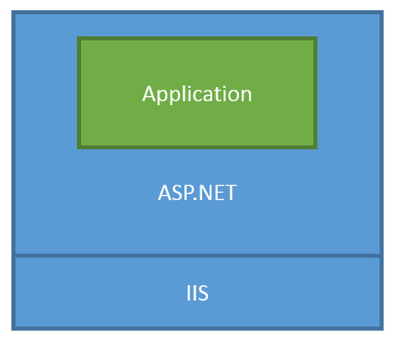
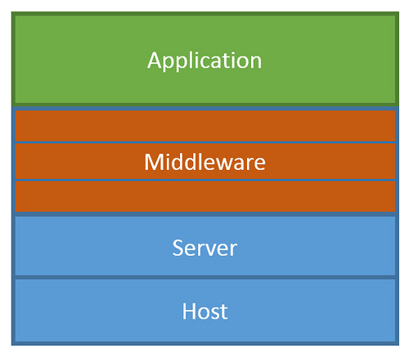
ASP.NET Core Middleware
Traditional ASP.NET app model
ASP.NET Core middleware

Slide 15
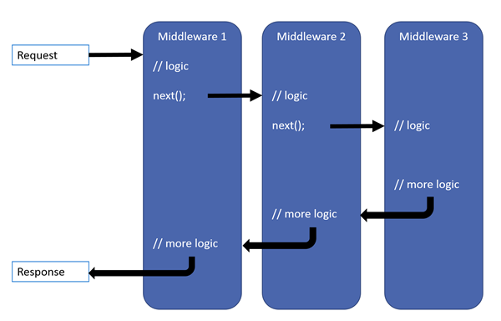
ASP.NET Core middleware

Slide 16
Built-in middleware
Routing
Authentication
Static files
Diagnostics
Error handling
Session
CORS
Localization
Response compression
Response caching
Forwarded headers
HTTP method overrides
WebSockets
URL rewrite
More to come!

Slide 17
Middleware
Notes:
Developer exception middleware
Static files
Routing
MVC (Razor Page)

Slide 18
Dependency injection (DI)
Services add in ConfigureServices are available through DI
Inject services in middleware, controllers, page models, filters, views, razor pages, other services
Service lifetimes
Singleton: There can be only one
Scoped: One per request
Transient: A new one every time
Simple built-in IoC container supports only ctor injection
Replace built-in IoC container with your preferred container

Slide 19
Building your host
Build your host using a WebHostBuilder
Important host properties and services:
Server: Which server to use to listen for requests (Kestrel, HTTP.SYS)
Server URLs: Addresses to listen on
Environment: Name of current environment (ex Development vs Production)
Content root: Location of your app content
Web root: Location of your static assets that should be requestable
Configuration: Setup available config data
Logging: Setup logging providers
Startup: Define your app
Use WebHost.CreateDefaultBuilder() to get started fast
Run the host! (ctrl-c to stop it)

Slide 20
Host provided services
IHostingEnvironment: Access host properties
ILogger<T>: Logger for the current type
IConfiguration: Configuration data

Slide 21
Hosting in production
Built-in web servers – kestrel, HTTP.SYS
Use a reverse proxy for process management
IIS, Nginx, Apache, HAProxy, etc
Proxy
Kestrel
Internet
Kestrel
Kestrel

Slide 22
Configuration, Logging, Environments
Notes:
Open webapp in VS
Add appsettings.json
Add a Message property
Read it from the page
Log a message from Startup
Change log level using config
Log the current environment
Change environment using env var
Override Message config value using env var

