Slide 1
Microsoft Azure Fundamentals
Cloud Concepts
Core Azure Services
Security, Privacy, Compliance, and Trust
Azure Pricing and Support
@rorypreddy

Slide 2
Cloud Concepts

Slide 3
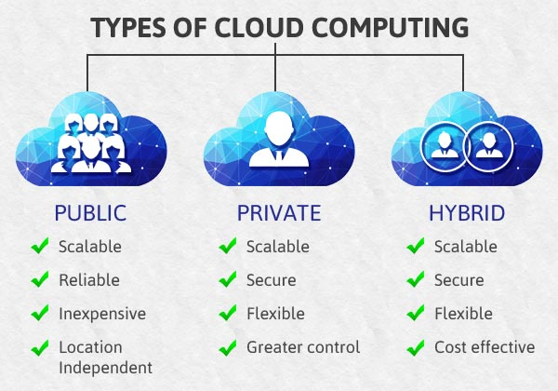
Notes:
Benefits and considerations of using cloud services
High Availability, Scalability, Elasticity, Agility, Fault Tolerance, and Disaster Recovery
Principles of economies of scale
Capital Expenditure (CapEx) and Operational Expenditure (OpEx)
Consumption-based model
Differences between Public, Private and Hybrid cloud models
Public cloud
Private cloud
Hybrid cloud

Slide 4
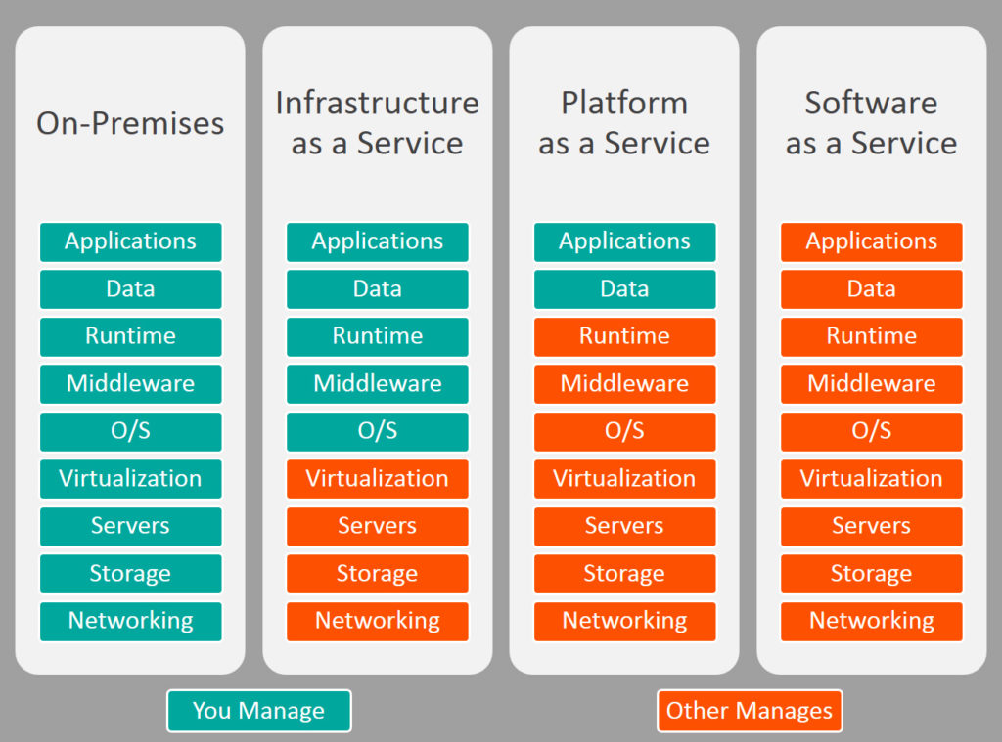
Notes:
Infrastructure-as-a-Service (IaaS), Platform-as-a-Service (PaaS) and Software-as-a-Service (SaaS)
Infrastructure-as-a-Service (IaaS)
Platform-as-a-Service (PaaS)
Software-as-a-Service (SaaS)
Azure management tools
Azure tools such as Azure CLI, PowerShell, and the Azure Portal
Azure Advisor

Slide 5
Core Azure Services

Slide 6
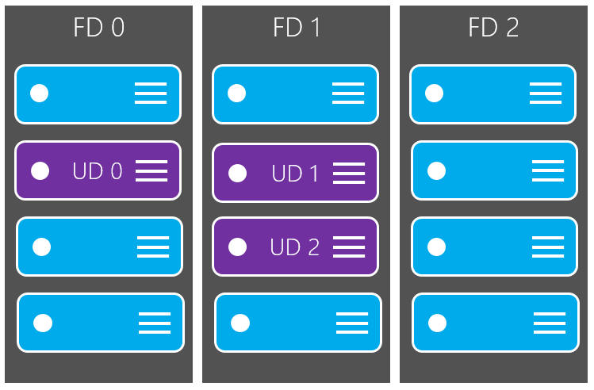
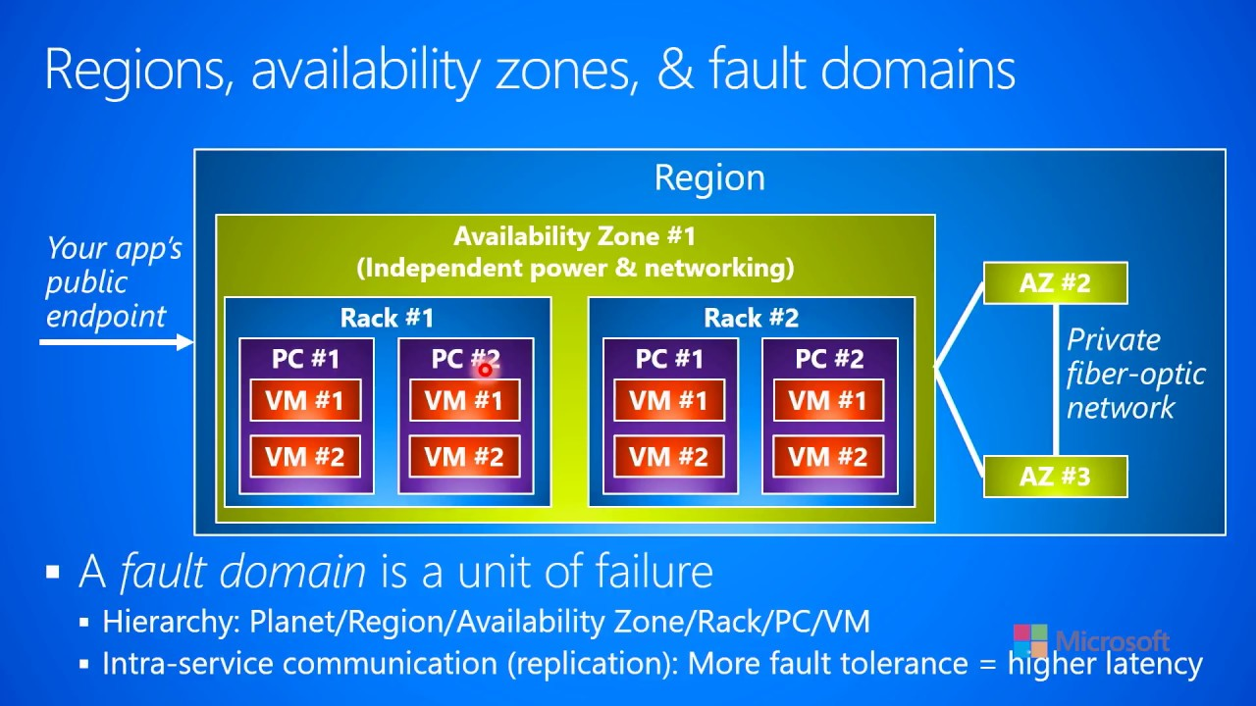
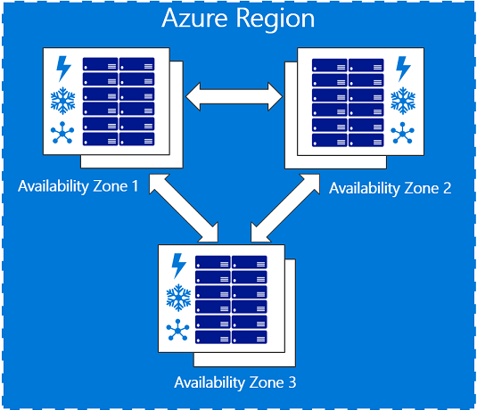
Availability set
Availability Region
Availability zone
Notes:
Core Azure architectural components
Regions
Availability Zones
Resource Groups
Azure Resource Manager

Slide 7
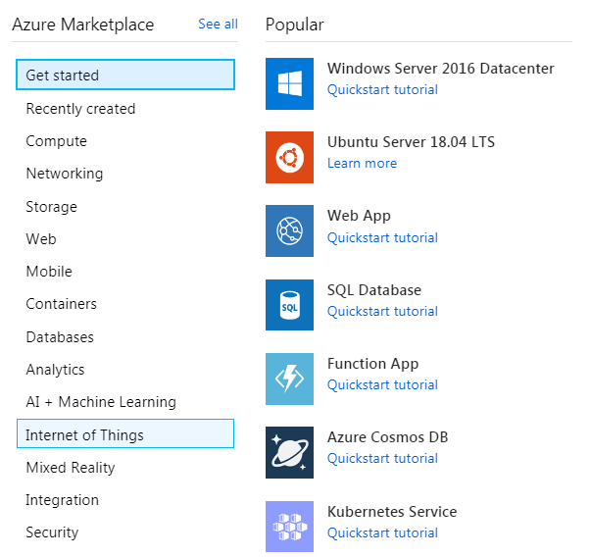
Notes:
Core products available in Azure
Compute such as Virtual Machines, Virtual Machine Scale Sets, App Service and Functions
Networking such as Virtual Network, Load Balancer, VPN Gateway, Application Gateway and Content Delivery Network
Storage such as Blob Storage, Disk Storage, File Storage, and Archive Storage
Databases such as CosmosDB, Azure SQL Database, Azure Database Migration service, and Azure SQL Data Warehouse
Azure Marketplace

Slide 8
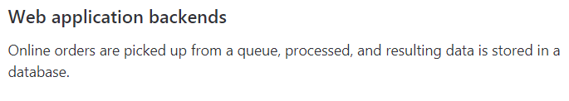
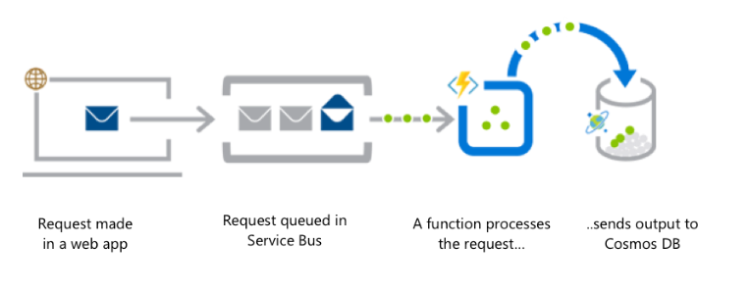
Notes:
Solutions available on Azure
Internet of Things (IoT) and products that are available for IoT on Azure such as IoT Fundamentals, IoT Hub and IoT Central
Big Data and Analytics and products that are available for Big Data and Analytics such as SQL Data Warehouse, HDInsight and Data Lake Analytics
Artificial Intelligence (AI) and products that are available for AI such as Azure Machine Learning Service and Studio
Serverless computing and Azure products that are available for serverless computing such as Azure Functions, Logic Apps and App grid

Slide 9
Security, Privacy, Compliance, and Trust

Slide 10
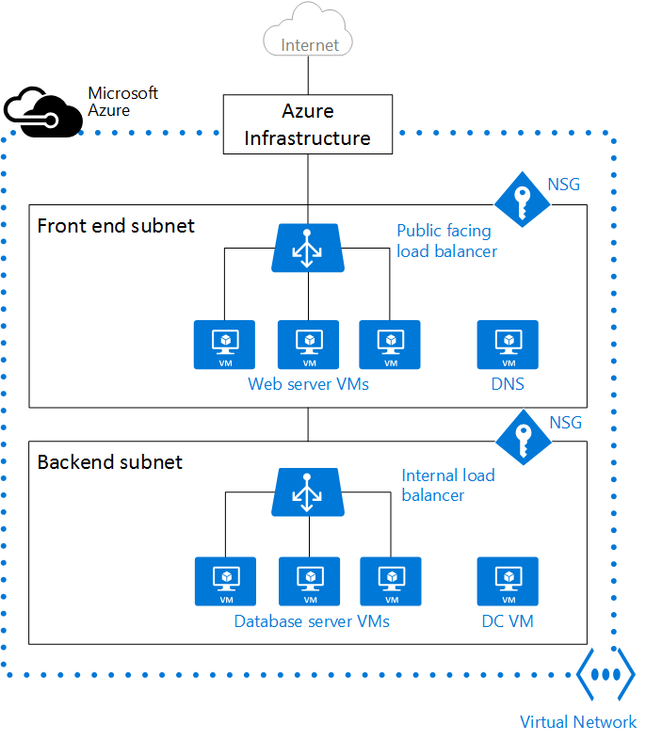
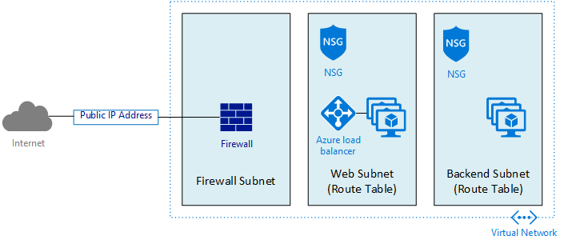
Network Security Group
Firewall
Notes:
Network security in Azure
Azure Firewall
Azure DDoS Protection
Network Security Group (NSG)
Azure security solution
Azure Identity services
Authentication and authorization
Azure Active Directory
Azure Multi-Factor Authentication

Slide 11
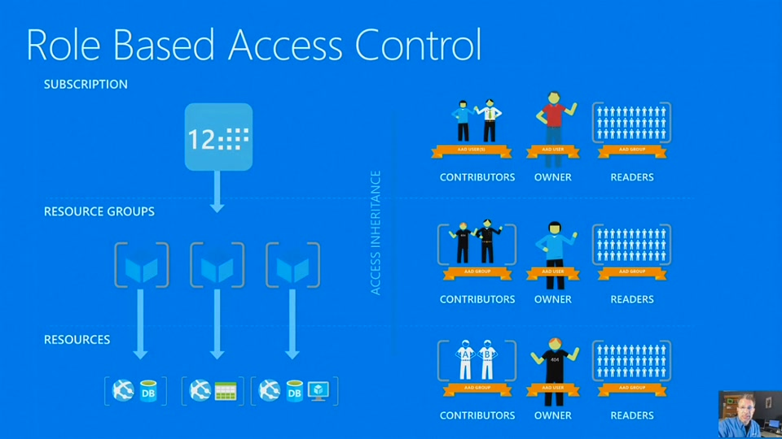
Notes:
Azure Security
Azure Security center usage scenarios
Key Vault
Azure Information Protection (AIP)
Azure Advanced Threat Protection (ATP)
Azure governance methodologies
Azure Policies
Initiatives
Role-Based Access Control (RBAC)
Locks
Azure Advisor security assistance

Slide 12
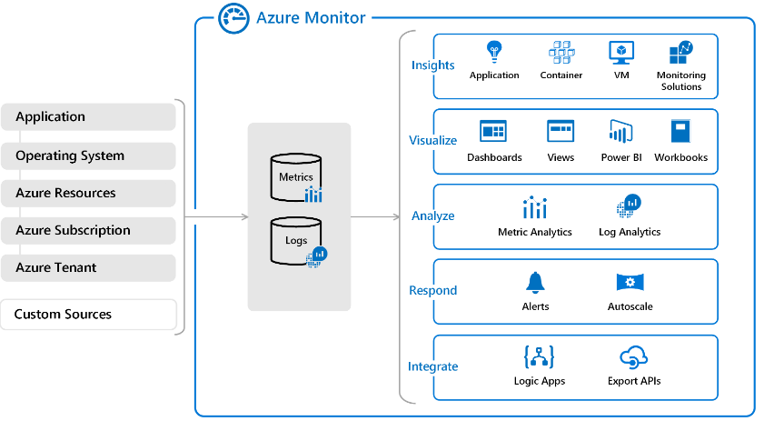
Azure Monitor overview
Notes:
Monitoring and reporting options in Azure
Azure Monitor
Azure Service Health
Privacy, compliance and data protection standards in Azure
Industry compliance terms such as GDPR, ISO and NIST
Microsoft Privacy Statement
Trust center
Service Trust Portal
Compliance Manager
Azure Government services
Azure Germany services

Slide 13
Azure Pricing and Support

Slide 14
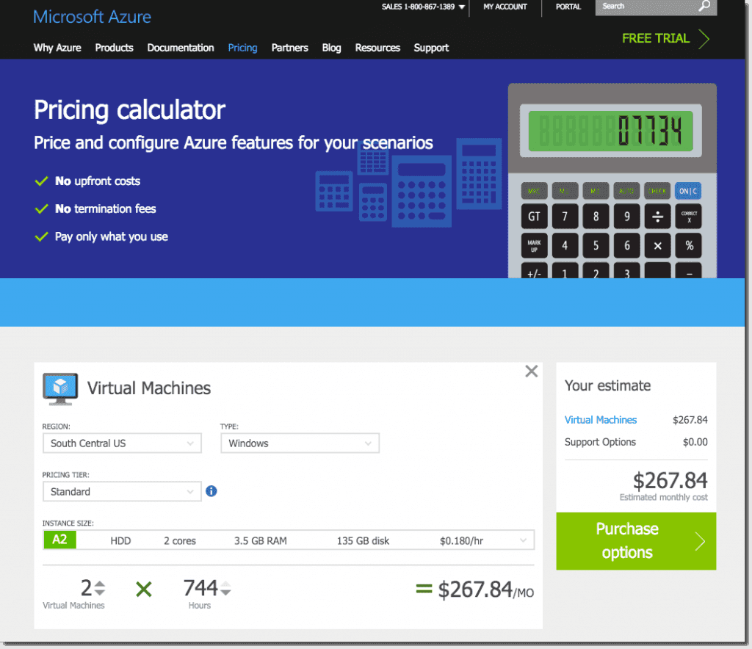
Notes:
Planning and management of costs
Options for purchasing Azure products and services
Options around Azure Free account
Factors affecting costs such as resource types, services, locations, ingress and egress traffic
Zones for billing purposes
the Pricing calculator
Total Cost of Ownership (TCO) calculator
Best practices for minimizing Azure costs such as performing cost analysis, creating spending limits and quotas, and using tags to identify cost owners; use Azure reservations; use Azure Advisor recommendations
Azure Cost Management

Slide 15
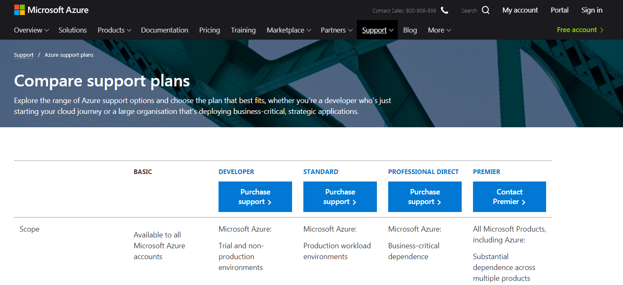
Notes:
Support options available with Azure
Support plans that are available such as Dev, Standard, Professional Direct and Premier
How to open a support ticket
Available support channels outside of support plan channels
Knowledge Center
Azure Service Level Agreements (SLAs)
Service Level Agreement (SLA)
Service lifecycle in Azure
Public and Private Preview features
How to access Preview features
The term General Availability (GA)
Monitor feature updates

Slide 16
Demo and Labs
https://roryp.github.io/azure_java_labs/

