Slide 1
.NET Core: Overview and Tools
Notes:
Agenda
- Introduce .NET Core
- Development
- Deployment
- .NET CLI

Slide 2
Introducing .NET Core

Slide 3

.NET platform
.NET FRAMEWORK
WINDOWS UWP
.NET CORE
ASP.NET
DESKTOP
XAMARIN
CLOUD
MOBILE
TOOLS
Visual Studio
.NET STANDARD LIBRARY
Visual Studio for Mac
COMMON INFRASTRUCTURE
Visual Studio Code
Compilers
Languages
Runtime components

Slide 4
.NET Core -- Cross-platform services
.NET FRAMEWORK
WINDOWS UWP
.NET CORE
ASP.NET
DESKTOP
XAMARIN
CLOUD
MOBILE
TOOLS
Visual Studio
.NET STANDARD LIBRARY
Visual Studio for Mac
COMMON INFRASTRUCTURE
Visual Studio Code
Compilers
Languages
Runtime components

Slide 5




.NET Core
Cross-platform
Windows, Linux and macOS
Fast
8x faster than Node.js in TechEmpower benchmark
Lightweight
No impact deployment and a modular development model perfect for containers
Open source
Runtime, libraries, compiler, languages and tools developed in the open in GitHub

Slide 6
.NET Standard

Slide 7
.NET today—reusing code
.NET FRAMEWORK
.NET CORE
XAMARIN
APP
MODELS
WPF
Windows Forms
UWP
iOS
Android
ASP.NET
ASP.NET Core
OS X
BASE
LIBRARIES
.NET Framework BCL
.NET Core BCL
Mono BCL
Notes:
Notes: Even if we are reusing a lot across components (especially with the open sourcing last year), the reality is that each platform has its own implementation of the base libraries.
Note: .NET Framework BCL and Mono BCL are the same APIs, different implementation. .NET Core “Core Library” is a similar set of APIs, but different.

Slide 8
.NET today—reusing code
.NET FRAMEWORK
.NET CORE
XAMARIN
CHALLENGES
Difficult to reuse skills
Need to master 3+1 base class libraries
Difficult to reuse code
Need to target a fairly small common denominator
Difficult to innovate
Need implementations on each platform
APP
MODELS
WPF
Windows Forms
UWP
iOS
Android
ASP.NET
ASP.NET Core
OS X
BASE
LIBRARIES
.NET Framework BCL
.NET Core BCL
Mono BCL
Notes:
Notes: Even if we are reusing a lot across components (especially with the open sourcing last year), the reality is that each platform has its own implementation of the base libraries.
Note: .NET Framework BCL and Mono BCL are the same APIs, different implementation. .NET Core “Core Library” is a similar set of APIs, but different.

Slide 9
.NET tomorrow
.NET FRAMEWORK
.NET CORE
XAMARIN
APP
MODELS
WPF
Windows Forms
UWP
iOS
Android
ASP.NET
ASP.NET Core
OS X
BASE
LIBRARIES
.NET Standard
Notes:
Notes: Even if we are reusing a lot across components (especially with the open sourcing last year), the reality is that each platform has its own implementation of the base libraries.
Note: .NET Framework BCL and Mono BCL are the same APIs, different implementation. .NET Core “Core Library” is a similar set of APIs, but different.

Slide 10
.NET tomorrow
.NET FRAMEWORK
.NET CORE
XAMARIN
BENEFITS
Reuse skills
Master one BCL, not a Venn diagram
Reuse code
Common denominator is much bigger
Faster innovation
Target .NET Standard & run anywhere
APP
MODELS
WPF
Windows Forms
UWP
iOS
Android
ASP.NET
ASP.NET Core
OS X
BASE
LIBRARIES
.NET Standard
Notes:
Notes: Even if we are reusing a lot across components (especially with the open sourcing last year), the reality is that each platform has its own implementation of the base libraries.
Note: .NET Framework BCL and Mono BCL are the same APIs, different implementation. .NET Core “Core Library” is a similar set of APIs, but different.

Slide 11
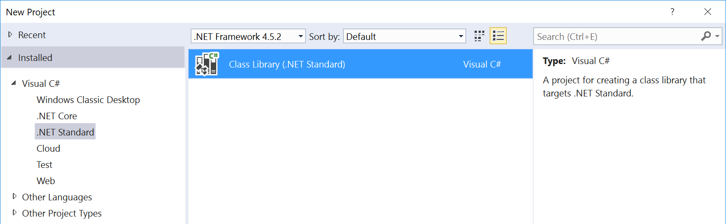
What is .NET Standard?
.NET Standard is a specification
A set of APIs that all .NET platforms have to implement
.NET Standard
.NET Framework
.NET Core
Xamarin
~
~
HTML specification
Browsers

Slide 12
.NET Standard 2.0
Has much bigger API surface
Extended to cover intersection between .NET Framework and Xamarin
Makes .NET Core 2.0 bigger as it implements .NET Standard 2.0
+20K
More APIs than
.NET Standard 1.x
Can reference .NET Framework libraries
Compat shim allows referencing existing .NET Framework code – without recompilation
Limited to libs that use APIs that are available for .NET Standard
~70%
of NuGet packages
are API compatible

Slide 13
ASP.NET Core

Slide 14
ASP.NET Core is Fast!

Slide 15
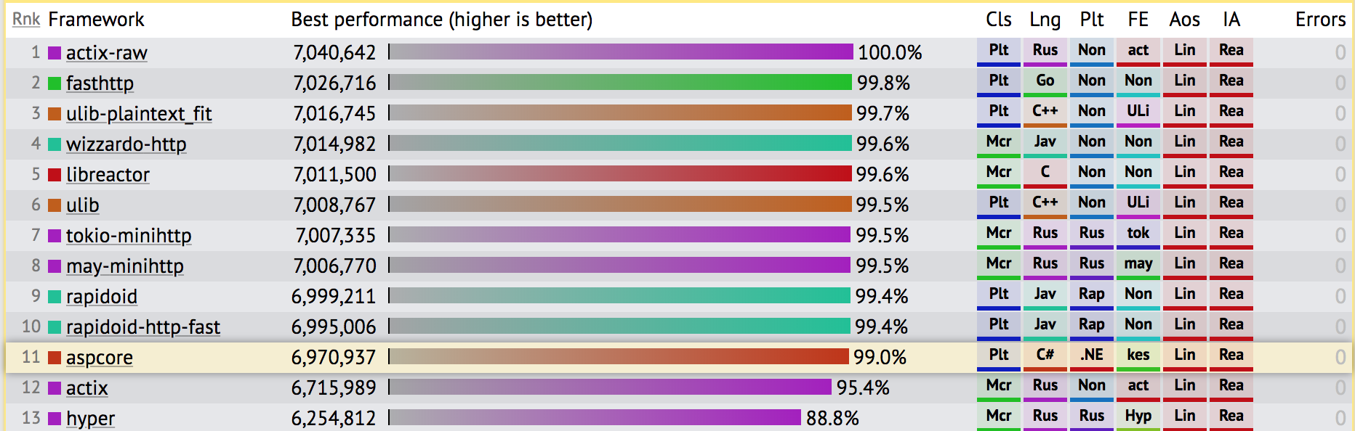
TechEmpower Framework Benchmarks – Round 16 – PlainText
https://techempower.com/benchmarks/

Slide 16
Modular and lightweight

Slide 17
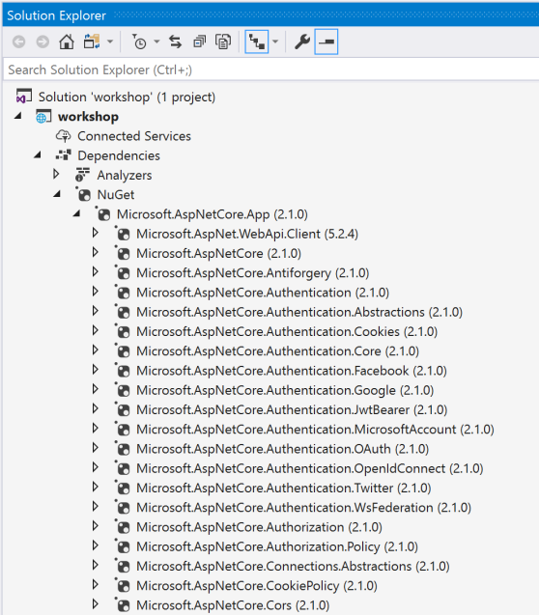



Everything in packages

Slide 18
50% of .NET Core contributions are from the community

Slide 19

.NET Open Source Contributions as of 2017

Slide 20







Technical Steering Group
The following companies are helping to drive the future of .NET

Slide 21
.NET Core: product shape

Slide 22
.NET Core Distributions
.NET Core SDK
.NET Core Runtime

Slide 23
.NET Core Runtime Deployment Options
Framework Dependent Deployment (FDD)
Self-contained Deployment (SCD)
.NET Runtime
.NET Runtime

Slide 24

Workloads
>
Web
Console
Notes:
TODO: Show web browser, console

Slide 25








Developer Experiences
Visual Studio for Mac
Visual Studio Code
BYO Text Editor
.NET Core SDK (includes CLI)
Notes:
If you’re on Windows, we recommend Visual Studio
If you’re on Mac, we recommend Visual Studio for Mac
If you prefer a lightweight editor, we recommend Visual Studio Code
If you want to use another text editor, all you need is the .NET Core SDK which includes a CLI

Slide 26
Supported OSes
Windows
Windows 7 SP1+, 8.1
Windows 10 Client
Server 2008 R2 SP1+
Server 2016 (incl. Nano)
macOS
Sierra (10.12+)
High Sierra (10.13)
Linux
RHEL 6,7
Fedora 27,28
Centos 7
Debian 9,8.7+
Ubuntu 18.04, 17.10, 16.04, 14.04
Linux Mint 17, 18
openSUSE 42.3+
Oracle Linux 7
SUSE Enterprise Linux 12 SP2+
Alpine Linux 3.7+
https://github.com/dotnet/core/blob/master/release-notes/2.1/2.1-supported-os.md

Slide 27

http://redhatloves.net

Slide 28
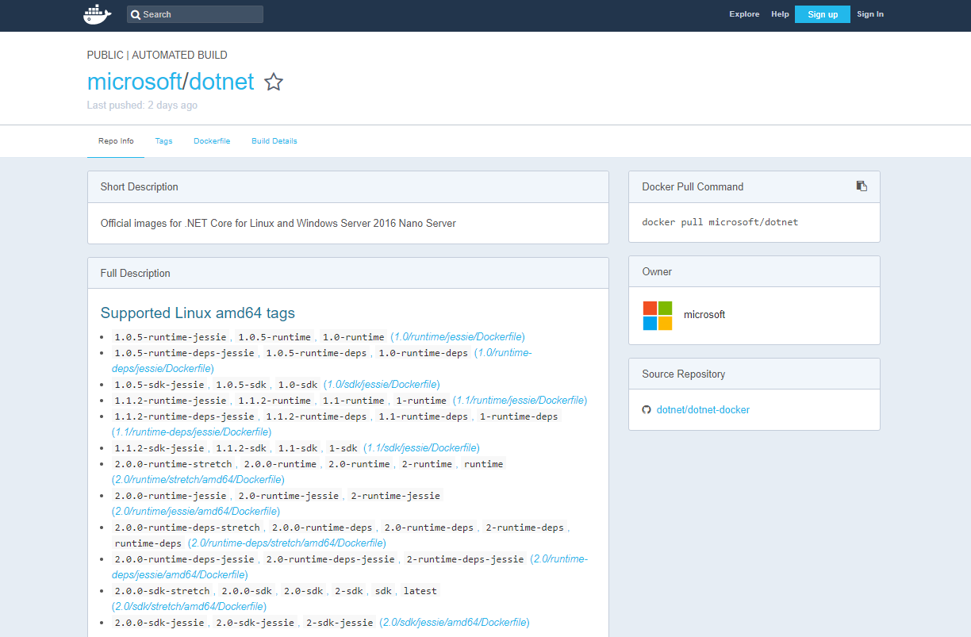
https://hub.docker.com/r/microsoft/dotnet/

Slide 29
.NET Core and .NET Framework
Similarities
Support the latest C#, VB.NET, F#
Implements .NET Standard API
Supports ASP.NET Core and EF Core
Best experience in Visual Studio
Great experience in Visual Studio Code
Can be used in/with Docker

Slide 30
.NET Core and .NET Framework
Differences
.NET Framework comes with Windows
.NET Core installs side-by-side
.NET Core is cross-platform and OSS
.NET Core works on Nano
.NET Core has a strong CLI experience
Notes:
F# and VB are coming for Core

Slide 31
.NET Core: Your First App

Slide 32
Sample Source Code
using System;
class Program
{
static void Main(string[] args)
{
Console.WriteLine("Hello World!");
}
}

Slide 33
CSProj – default console template
<Project Sdk="Microsoft.NET.Sdk">
<PropertyGroup>
<OutputType>Exe</OutputType>
<TargetFramework>netcoreapp2.1</TargetFramework>
</PropertyGroup>
</Project>
Notes:
Point out the following:
Microsoft.NET.SDK pulls in a set of default settings, such as including *.cs files in the project, and appropriate reference assemblies
Exe produces an EXE build. Libraries are the default
netcoreapp2.0 is the target framework, so defines the set of reference assemblies you get

Slide 34
CSProj – default Web template
<Project Sdk="Microsoft.NET.Sdk.Web">
<PropertyGroup>
<TargetFramework>netcoreapp2.1</TargetFramework>
</PropertyGroup>
<ItemGroup>
<Folder Include="wwwroot\" />
</ItemGroup>
<ItemGroup>
<PackageReference Include="Microsoft.AspNetCore.App" />
</ItemGroup>
</Project>
Notes:
Point out the following:
Microsoft.NET.SDK.Web pulls in a set of default settings, including referencing Microsoft.Net.SDK under the hood
Demonstrates PackageReference syntax, the new way to reference NuGet packages. ASP.NET remains in NuGet.
Uses new AspNetCore.All metapackage

Slide 35
.NET Core CLI

Slide 36
What are the .NET Core command-line tools?
Cross-platform command-line set of tools that are…
…focused on building code…
…for both humans…
…and machines

Slide 37
Principles of design
Several principles inform CLI design:
NuGet (and $PATH-based) extensibility
Every command is a verb (“compile”, “run”, “restore” etc.)
The driver knows enough to run the command(s) and no more
All core commands are consumable by humans and machines
Notes:
We are applying several principles when it comes to designing the CLI:
NuGet (and $PATH-based) extensibility
Every command is a verb (“compile”, “run”, “restore” etc.)
The driver knows enough to run the command(s) and no more
All core commands are consumable by humans and machines

Slide 38
CLI commands: basic architecture
dotnet
build
--output [path]
the driver
verb (command)
verb arguments

Slide 39
CLI commands: architecture explained
Driver, dotnet, is invoked first, followed by a verb
The verb is a command that is implemented as:
A NuGet package
A binary in the $PATH
Driver invokes the command passing the arguments to it
The command is responsible for the arguments

Slide 40
.NET Core SDK Commandline Usage (1/2)
Command | Purpose
dotnet new | Initialize .NET projects.
dotnet restore | Restore dependencies specified in the .NET project.
dotnet run | Compiles and immediately executes a .NET project.
dotnet build | Builds a .NET project.
dotnet publish | Publishes a .NET project for deployment (incl. runtime).
dotnet test | Runs unit tests using the test runner specified in the project.
dotnet pack | Creates a NuGet package.
dotnet migrate | Migrates project.json project to msbuild based project.

Slide 41
.NET Core SDK Commandline Usage (2/2)
Command | Purpose
dotnet clean | Clean build output(s).
dotnet sln | Modify solution (SLN) files.
dotnet add | Add reference to the project.
dotnet remove | Remove reference from the project.
dotnet list | List reference in the project.
dotnet nuget | Provides additional NuGet commands.
dotnet msbuild | Runs Microsoft Build Engine (MSBuild).
dotnet vstest | Runs Microsoft Test Execution Command Line Tool.

Slide 42
Demo
.NET Core Getting Started

