Slide 1
ASP.NET Core
Notes:
Agenda
- Introduce .NET Core
- Development
- Deployment
- .NET CLI

Slide 2



ASP.NET Core in a Nutshell
Web
Forms
MVC
Web API
ASP.NET Core (MVC + Razor Pages + API)
ASP.NET 4.6
(System.Web)
ASP.NET Core 2.0
(Microsoft.AspNetCore)
.NET Framework
.NET Core
Platform for .NET applications on Windows
Cross-platform, modular libraries & runtime optimized for server and cloud workloads

Slide 3
ASP.NET Core features
Hosting
Kestrel, Startup
Middleware
Routing, authentication, static files, diagnostics, error handling, session, CORS, localization, custom
Dependency Injection
Configuration
Logging
Application frameworks
Razor Pages, MVC, Identity, SignalR

Slide 4
Middleware

Slide 5
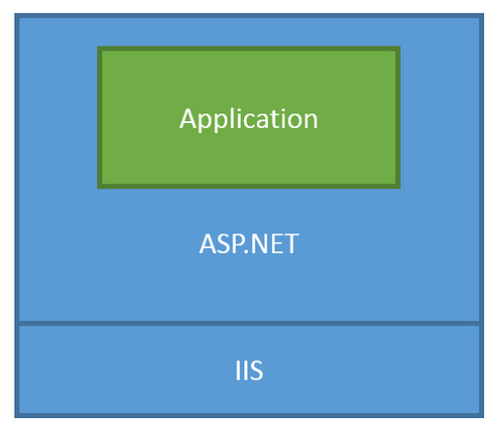
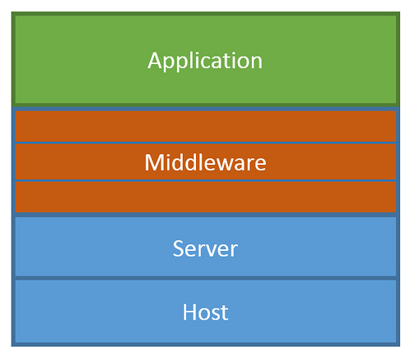
ASP.NET Core Middleware
Traditional ASP.NET Application Model
ASP.NET Core Middleware

Slide 6
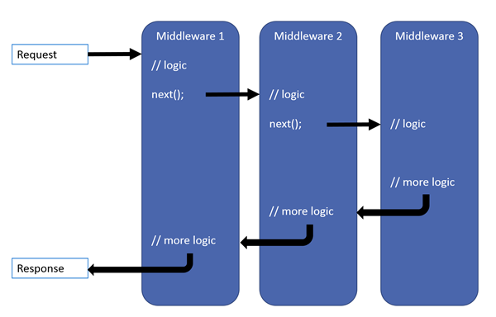
ASP.NET Core Middleware

Slide 7
MVC + Web API + Web Pages = ASP.NET Core MVC

Slide 8
Previous ASP.NET frameworks - similar, but different
Web Pages
MVC
Web API
Razor
HTML Helpers
HTML Helpers
Controllers
Controllers
Actions
Actions
Filters
Filters
Model binding
Model binding
DI
DI

Slide 9
ASP.NET = A unified web stack
ASP.NET 4.6 (WebForms, MVC, Web API, Web Pages - present but separate)
ASP.NET Core 1.0 Web API + MVC
ASP.NET Core 2.0 Web API + MVC + Razor Pages
Web Forms
MVC
Web Pages
Web API

Slide 10
ASP.NET = A unified web stack
ASP.NET 4.6 (WebForms, MVC, Web API, Web Pages)
ASP.NET Core 1.0 Web API+MVC
ASP.NET Core 2.0 Web API+MVC+Razor Pages
ASP.NET Core 2.1 Web API+MVC+Razor Pages +SignalR

Slide 11
Razor Pages

Slide 12
Razor Pages
Runs on all the same MVC infrastructure
Better encapsulation and grouping of UI details
Fewer folders and files
MVC
Razor Pages
/Controllers/CartController.cs
/ViewModels/CartViewModel.cs
/Views/Cart/Index.cshtml
3 Root Level Folders
/Pages/Cart/Index.cshtml
Index.cshtml.cs
1 Root Level Folder
Notes:
Reference (MSDN Magazine September 2017 - https://msdn.microsoft.com/en-us/magazine/mt842512)

Slide 13
@page
@using RazorPages
@model IndexModel
<p> @Model.Message </p>
using Microsoft.AspNetCore.Mvc.RazorPages;
using System;
namespace RazorPages {
public class IndexModel : PageModel
{
public string Message { get; private set; } = "Hello. ";
public void OnGet()
{
Message += $" Server time is { DateTime.Now }"; }
}
}
Notes:
https://docs.microsoft.com/en-us/aspnet/core/mvc/razor-pages/

Slide 14
MVC

Slide 15
What’s (pretty much) the same
MVC developer flow
Models / Views / Controllers
Routing / Attribute Routing
HTML Helpers

Slide 16
What’s Changed
No web.config (configuration)
No Global.asax or App_Start
No CSS / JS in project root (wwwroot)
bower and bowerrc
bundleconfig.json
New Program.cs / Startup.cs
Run with IISExpress / Kestrel

Slide 17
What’s new
(some aren’t MVC features but are useful for MVC dev)
Views get TagHelpers
DI more thoroughly integrated
Globalization / localization
MVC + APIs merged

Slide 18
TagHelpers
HTML helpers expressed as tags
Ex. Instead of:
@Html.LabelFor(m => m.UserName, new { @class = "col-md-2 control-label" })
Write this:
<label asp-for="UserName" class="col-md-2 control-label"></label>
Easier to customize with additional attributes
Work seamlessly with the HTML editor

Slide 19
TagHelpers
@using (Html.BeginForm(new { ReturnUrl = ViewBag.ReturnUrl })) {
@Html.AntiForgeryToken()
@Html.ValidationSummary(true)
<fieldset>
<legend>Log in Form</legend>
<ol>
<li>
@Html.LabelFor(m => m.UserName)
@Html.TextBoxFor(m => m.UserName)
@Html.ValidationMessageFor(m => m.UserName)
</li>

Slide 20
TagHelpers
<form anti-forgery=“true“ validation-summary=“true” action="Create“>
<fieldset>
<legend>Log in Form</legend>
<ol>
<li>
<label for=“UserName”>
<input for=“UserName”>
<span validation-for="Name" style="color:blue" />
</li>

Slide 21
TagHelpers: Create Your Own
public interface ITagHelper
{
int Order { get; }
Task ProcessAsync(TagHelperContext context, TagHelperOutput output);
}
Examples: https://github.com/aspnet/Mvc/tree/dev/src/Microsoft.AspNet.Mvc.TagHelpers

Slide 22
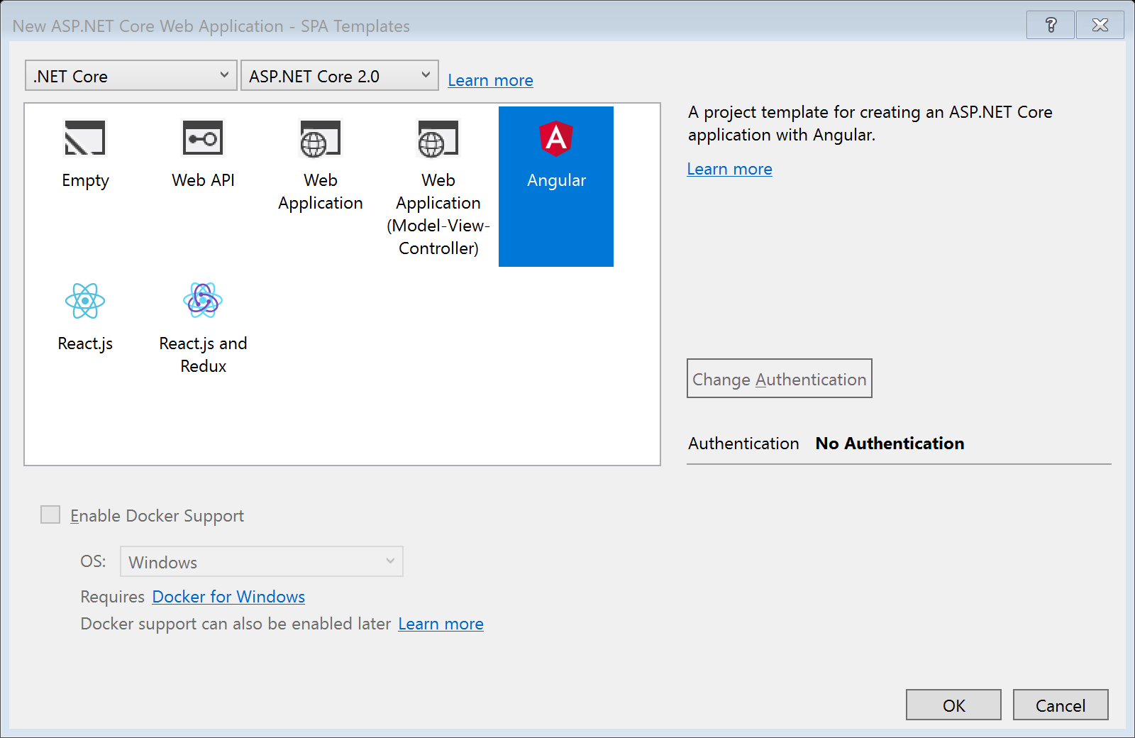
SPA Templates

Slide 23
SPA Templates: Built on JavaScriptServices
Useful infrastructure for SPA’s on ASP.NET Core
Hosts Webpack to compile and serve client-side code
Advanced features like Hot Module Reloading and client / server side routing integration
Can invoke arbitrary NPM packages from .NET code
https://github.com/aspnet/JavaScriptServices

Slide 24
Lab
Building an ASP.NET Core Site using CLI

Slide 25
Lab
Razor Pages

Slide 26
Lab
Tag Helpers

Slide 27
Lab
SPA Template

