Slide 1
Introduction to DevOps on Azure

Slide 2
Objectives
After completing this module, you will be able to:
Explain why and how modern DevOps practices fit within the Microsoft Azure platform.
Notes:
Title: Objectives
Length: 2 minutes
Participant Notes:
After completing this module, you will be able to:
Explain why and how modern DevOps practices fit within the Microsoft Azure Platform.
Make sure you address what this course will NOT cover based on experience.
Start Time xx:xx / Length: 2 minutes
Review the learning objectives.

Slide 3
Agenda
Welcome to the workshop!
Introduction to DevOps
DevOps + Azure

Slide 4
Day 1
8:00 AM | 1:00 | 9:00 AM | Introduction to DevOps
9:00 AM | 1:00 | 10:00 AM | Infrastructure as Code
10:00 AM | 0:15 | 10:15 AM | Break
10:15 AM | 0:45 | 11:00 AM | Configuration Management
11:00 AM | 1:00 | 12:00 PM | Infrastructure Lab
12:00 PM | 1:00 | 1:00 PM | Lunch
1:00 PM | 1:00 | 2:00 PM | Security
2:00 PM | 1:00 | 3:00 PM | Continuous Integration
3:00 PM | 0:15 | 3:15 PM | Break
3:15 PM | 1:00 | 4:15 PM | Automated Testing
4:15 PM | 1:00 | 5:15 PM | Automated Testing + CI Lab
5:15 PM | 0:15 | 5:30 PM | Open Panel

Slide 5
Day 2
8:00 AM | 1:00 | 9:00 AM | Release Management
9:00 AM | 1:00 | 10:00 AM | Continuous Deployment
10:00 AM | 0:15 | 10:15 AM | Break
10:15 AM | 1:00 | 11:15 AM | Continuous Deployment Lab
11:15 AM | 1:00 | 12:15 PM | Monitoring
12:15 PM | 1:00 | 1:15 PM | Lunch
1:15 PM | 1:00 | 2:15 PM | Monitoring Lab
2:15 PM | 1:00 | 3:15 PM | Open Source on Azure
3:15 PM | 0:15 | 3:30 PM | Break
3:30 PM | 1:00 | 4:30 PM | Open Source Lab
4:30 PM | 0:45 | 5:15 PM | DevOps Landscape
5:15 PM | 0:15 | 5:30 PM | Open Panel

Slide 6
Housekeeping
Restroom locations
Wireless network and power
Coffee and snacks
Lunch

Slide 7
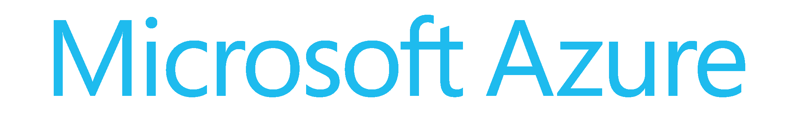
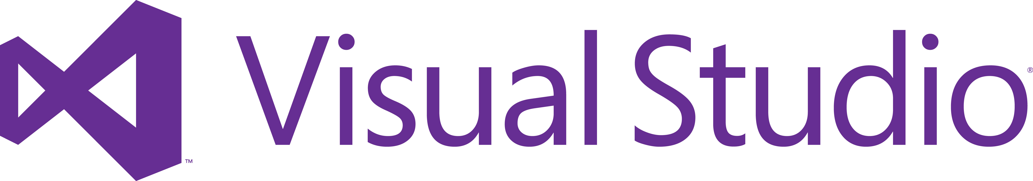

Lab preparation
Subscription & .NET SDK
2015 Enterprise
PowerShell

Slide 8
DevOps

Slide 9
DevOps history
Concept went mainstream around 2009
Ten deploys per day presentation (Dev and Ops at Flickr)
John Allspaw and Paul Hammond
Velocity Conference (https://www.youtube.com/watch?v=LdOe18KhtT4)
Phoenix project
Gene Kim
https://en.wikipedia.org/wiki/The_Phoenix_Project_(novel)
Devs say yes—Ops says no

Slide 10
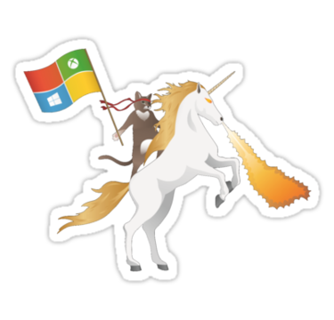
DevOp horses and unicorns
Horses—companies that follow safe, traditional, reliable methods
Low trust organizations
Shoot the messengers of bad news
Crush new ideas
Unicorns—classic DevOps superstar successes like Amazon, Netflix, and Etsy
High-trust environments
Empower bridging between functions
Encourage new ideas
“if there’s anything that all horses hate, it’s hearing stories about unicorns.”

Slide 11
What is DevOps and why now?
Is DevOps another phrase for Agile?
Who is responsible for deploying code?
When deployments fail, who gets blamed?
How many production deployments do you perform per year? Month? Day? Hour?
What is stopping you from deploying faster?
Notes:
Manual
Error prone, time consuming, does not scale!
Different deployment processes per environment
Coordination between Dev, Ops, and stakeholders is difficult

Slide 12
Common misconceptions
DevOps is for cloud only companies
DevOps is for developers
Ops resources need to learn how to code
DevOps is only for cloud deployments
It works for small deployments but ours is complex

Slide 13
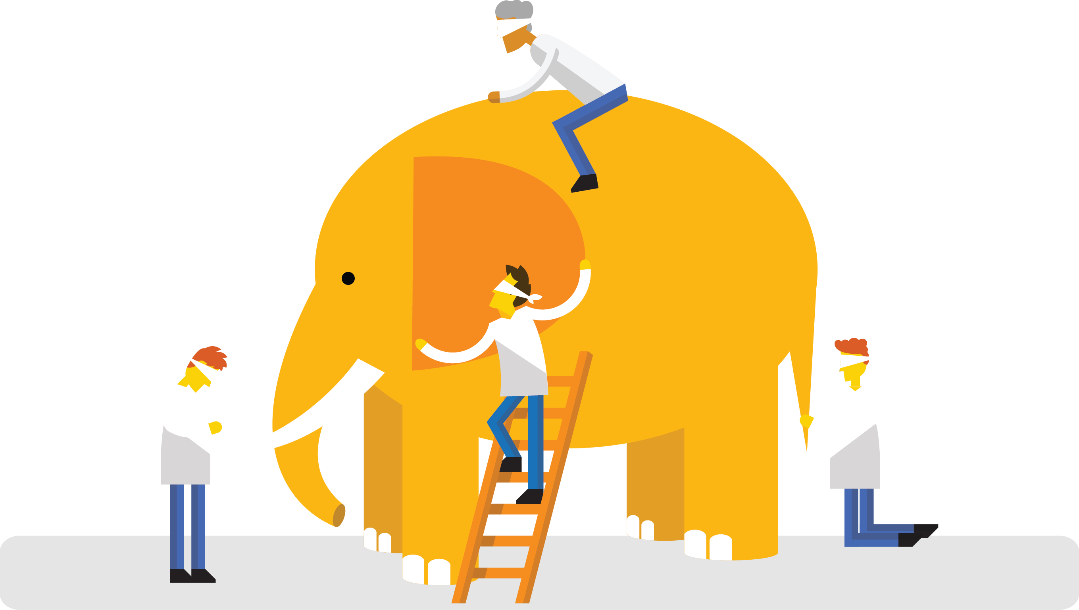
“DevOps is development and operations collaboration”
“DevOps is treating your infrastructure as code”
It is DevOps!
It is DevOps!
“DevOps is using automation”
It is DevOps!
“DevOps is feature switches”
It is DevOps!
“DevOps is small deployments”
“Kanban for Ops?”
Notes:
If several people were to look at dev ops, how would they describe it? Some would say its collaboration
Some would say:
Infrastructure as Code (IaC)
Continuous Integration
Automated Testing
Continuous Deployment
Release Management
App Performance Monitoring
Load Testing and Auto-Scale
Availability Monitoring
Capacity Management
Change/Configuration Management
Feature Flags
Automated Environment De-Provisioning
Self Service Environments
Automated Recovery (Rollback and Roll-Forward)
Hypothesis Driven Development
Testing in Production
Fault Injection
Usage Monitoring / User Telemetry
And the truth is, that dev ops is all of those things

Slide 14
List of DevOps Practices
Infrastructure as Code (IaC)
Continuous Integration
Automated Testing
Continuous Deployment
Release Management
App Performance Monitoring
Load Testing & Auto-Scale
Availability Monitoring
Change/Configuration Management
Feature Flags
Automated Environment De-Provisioning
Self Service Environments
Automated Recovery (Rollback & Roll-Forward)
http://www.itproguy.com/devops-practices/

Slide 15
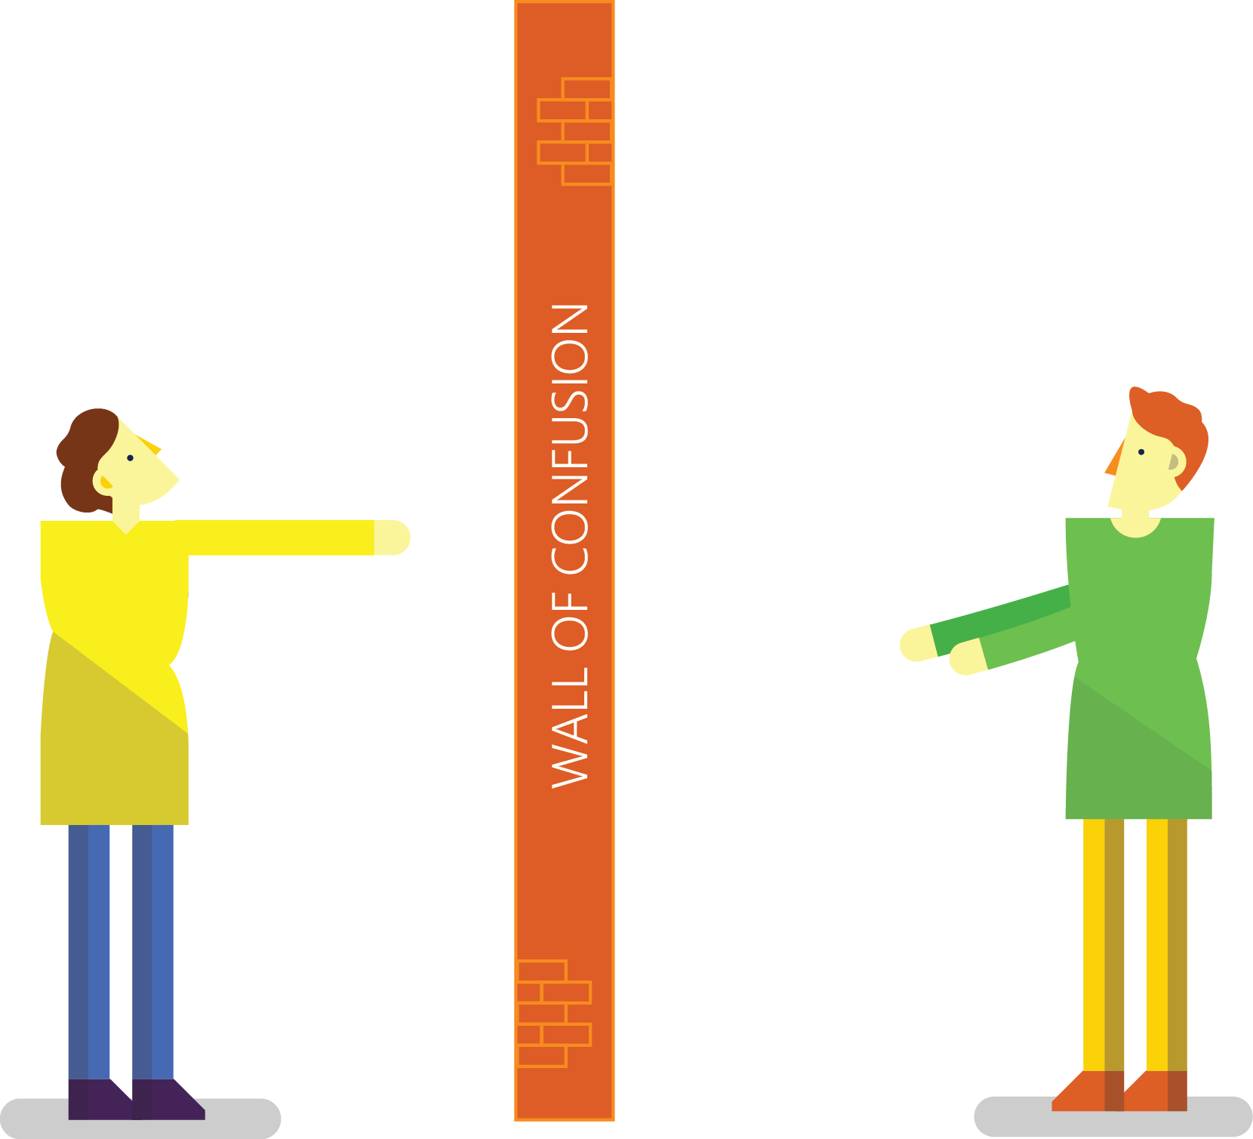

Traditional development and operations
DEV
OPS
Notes:
Taken from: http://dev2ops.org/2010/02/what-is-devops/
Development kicks things off by “tossing” a software release “over the wall” to Operations. Operations picks up the release artifacts and begins preparing for their deployment. Operations manually hacks the deployment scripts provided by the developers or creates their own scripts. They also hand edit configuration files to reflect the production environment, which is significantly different than the Development or QA environments. At best they are duplicating work that was already done in previous environments, at worst they are about to introduce or uncover new bugs.
Operations then embarks on what they understand to be the currently correct deployment process, which at this point is essentially being performed for the first time due to the script, configuration, process, and environment differences between Development and Operations. Of course, somewhere along the way a problem occurs and the developers are called in to help troubleshoot. Operations claims that Development gave them faulty artifacts. Developers respond by pointing out that it worked just fine in their environments, so it must be the case that Operations did something wrong. Developers are having a difficult time even diagnosing the problem because the configuration, file locations, and procedure used to get into this state is different then what they expect (if security policies even allow them to access the production servers!).
Time is running out on the change window and, of course, there isn’t a reliable way to roll the environment back to a previously known good state. So what should have been an eventless deployment ended up being an all-hands-on-deck fire drill where a lot of trial and error finally hacked the production environment into a usable state.

Slide 16
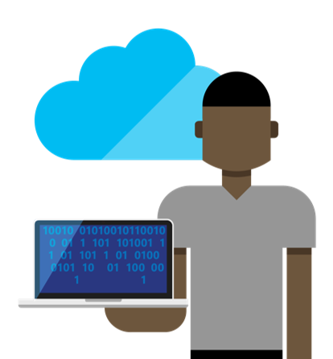
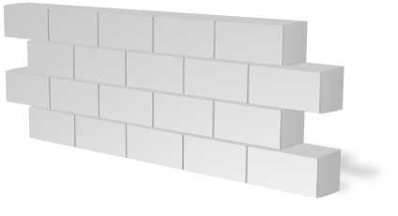


Consequences of inefficiency
Developers
IT Ops
Business
Partial Agility
Downtown Costs
Rework
Notes:
In the real world, there are real consequences if you are unable to deliver high-quality software quickly or build the wrong thing to begin with:
40% of implementations end up getting reworked because they don’t meet the users’ original requirements
The average cost of one hour downtime of a customer-facing app is calculated at 100.000 dollars per hour – and this does not take into account the damage to reputation, which can be even greater. Fixing such production issues takes on average 200 minutes per incident
Three quarters of development teams have adopted Agile methodologies today, enabling them to develop faster. While this is a great number, it does not help if a development team is Agile but deployment still takes weeks or months because IT Ops is perceived as not being Agile
These are just 3 very high-level examples but all the data we have today points toward the same conclusion – this is about more than just frustration or minor delays. Lack of collaboration between dev and ops can have substantial impact on a company’s bottom line and success

Slide 17
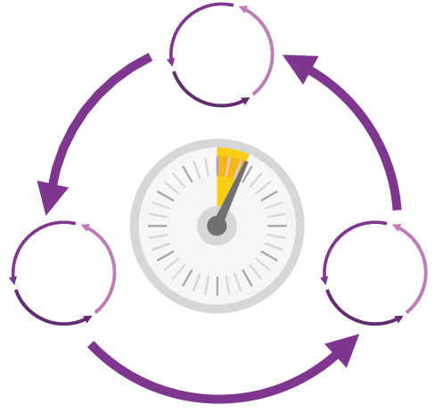
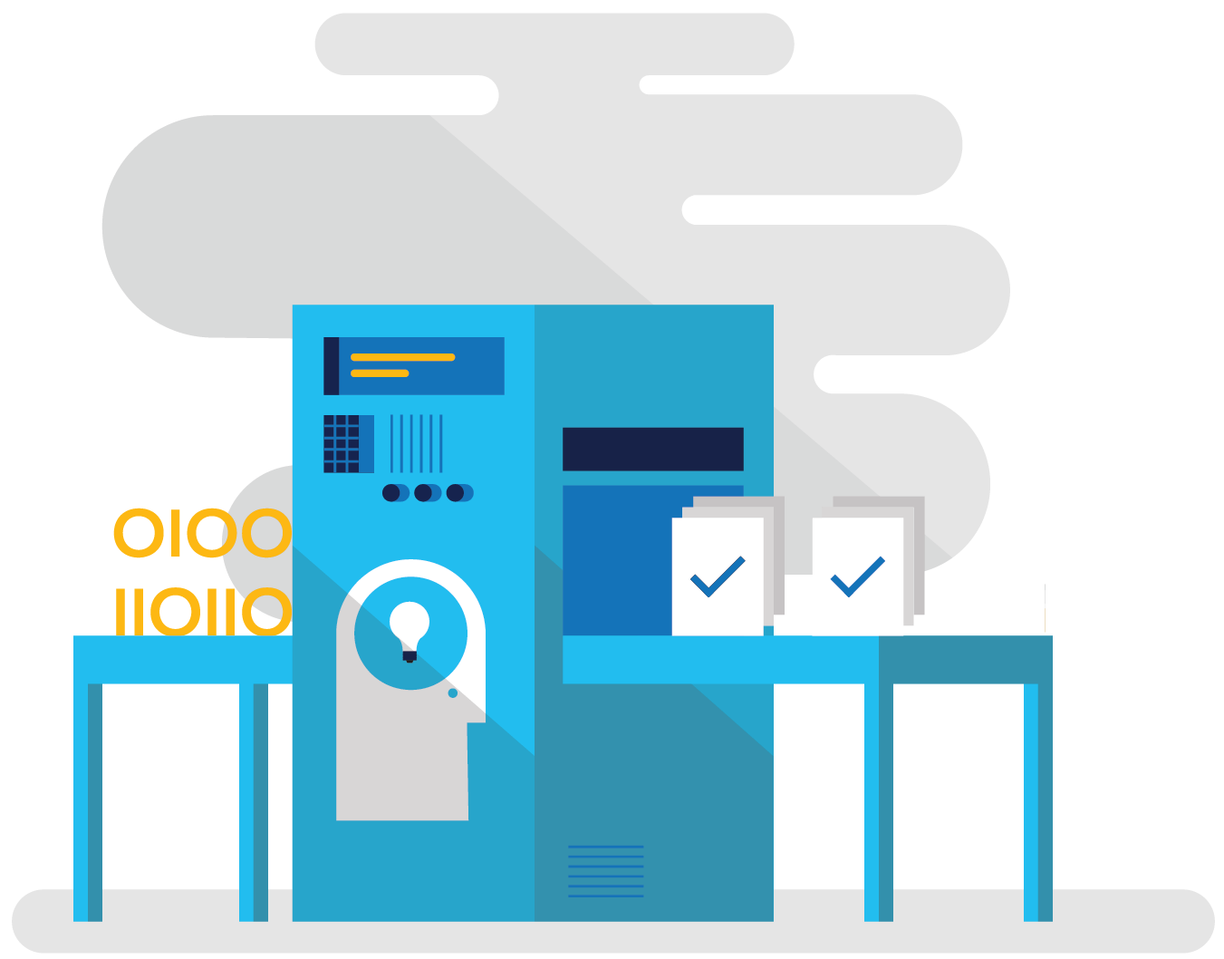
How DevOps can help
Shorten Cycle Times
Optimize Resources
Improve Quality and Availablilty
Speed up and increase traceability of each release by empowering your development and operations teams with advanced collaboration and automation tools.
Efficiently manage environments using technologies that support self-service provisioning in a secure way, in line with your IT governance standards.
Capture rich telemetry on application performance and usage so that you can make better decisions on future investments and anticipate issues in production before they impact your service.
Notes:
Shortening cycle times through advanced release management and automation tools
Optimizing resources and eliminating waste, and
Increasing quality and availability of your solutions

Slide 18


Agile
PRODUCT BACKLOG
DevOps
Operate
ITIL
Define
Define
Sprint
Monitor
Sprint
Deliver
Deliver
Automate!
Complex
CUSTOMERS
Error-prone
Chaotic
RELEASE PIPELINE

Slide 19


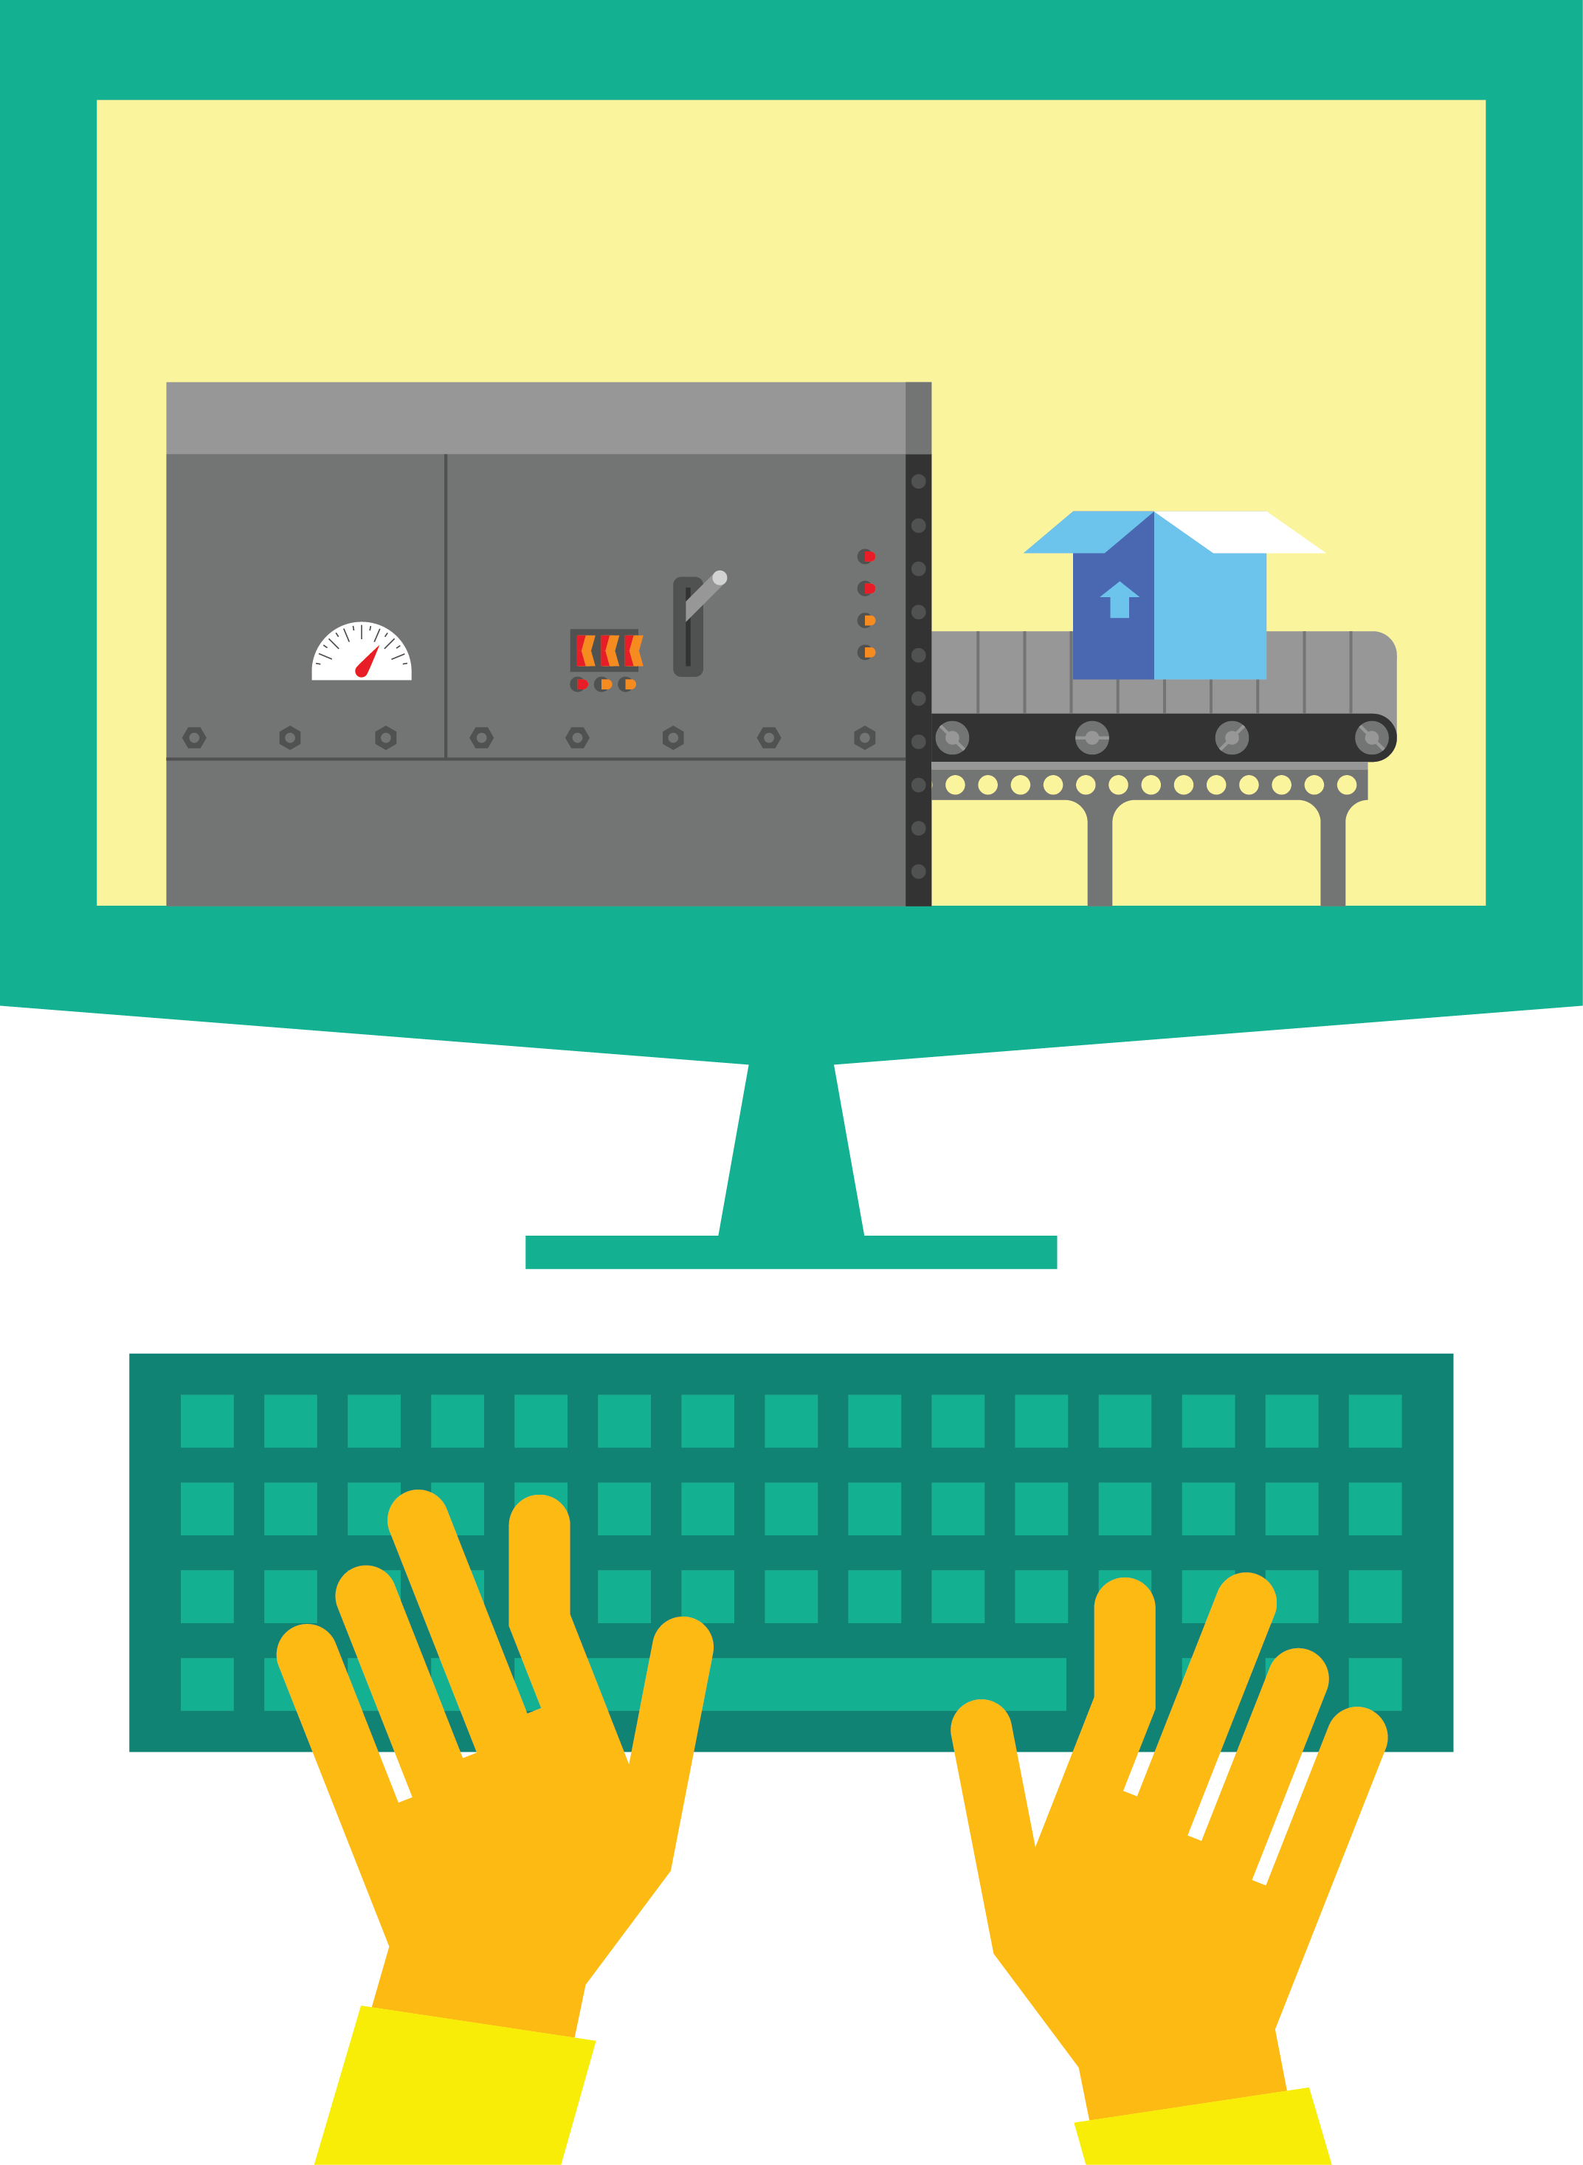

DevOps: the three stage conversation
1
People
2
Process
3
Products
Notes:
People = Culture
Fundamental attributes of successful cultures:
Shared mission and incentives: infrastructure as code, apps as services, DevOps/all as teams
You need to consider your hardware as a commodity, (don't give your servers names) , servers are like farm animals, it is just harder if you let the ids name them
Build deep instrumentation into services, push complexity up the stack
Rally around agile, shared metrics, CI, service owners on call, etc.
Changing the culture: any change takes time, changing culture is no exception and you can't do it alone, exploit compelling events to change culture: downtimes, cloud adoption, devops buzz
PROCESS Definition and design, compliance, and continuous improvement
PEOPLE Responsibilities, management, skills development, and discipline
Products Tools and infrastructure

Slide 20
DevOps basics
2) Code Repository
3) Build
4) Test
5) Deploy to Cloud
Contoso App
1) Developers
Azure
6) Monitor and Improve

Slide 21
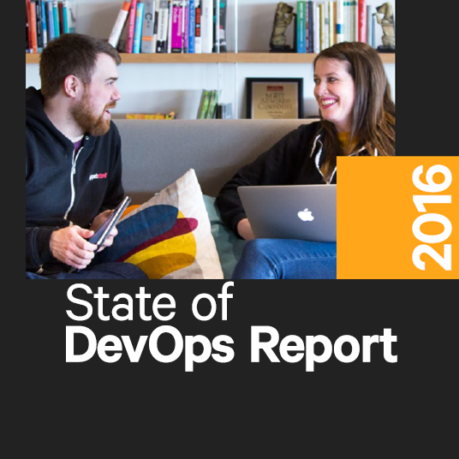
Organizations focused on DevOps…
Strong IT Performance is a competitive advantage
200x more frequent deployments
Firms with high-performing IT organizations were 2x as likely to exceed their profitability, market share, and productivity goals
and with 2,555x shorter lead time as compared to their lower-performing peers
Recover 24x faster from failures
DevOps Practices improve IT performance
and have a 3x lower change failure rate as compared to their lower-performing peers
https://puppet.com/resources/white-paper/2016-state-of-devops-report
Notes:
Over the past 5 years, the State of DevOps report has surveyed more than 25,000 technical professionals world wide with companies of ALL sizes and verticals.
Employees in high-performing teams were 2.2x more likely to recommend their organization as a great place to work. (2016 – employee Net Promoter Score)

Slide 22




DevOps
1
4
Plan
Monitor + Learn
Development
Production
2
3
Develop + Test
Release

Slide 23
DevOps + Azure

Slide 24

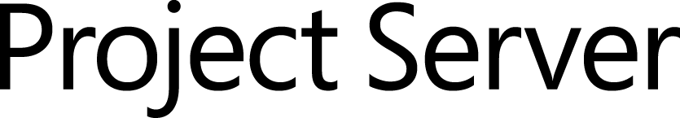
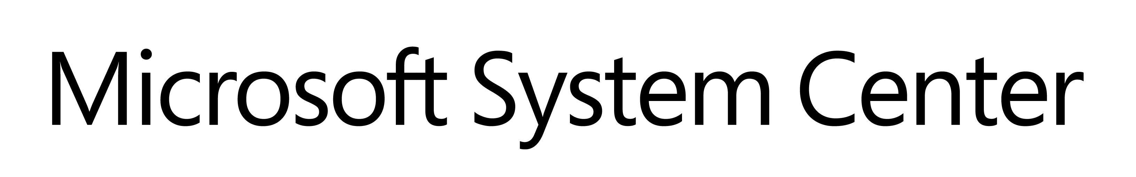


Our solution
Source control
Team Foundation
Server
Visual Studio
Team Services
Agile planning
Test case management
Build automation
Continuous deployment
Release management
Load testing
Lab management

Slide 25
Our solution
Source control
Team Foundation
Server
Visual Studio
Team Services
Agile planning
Test case management
Build automation
Continuous deployment
Release management
Load testing
Feedback management
Team collaboration
Application telemetry
Lab management

Slide 26
Manage the full stack
Telemetry
Application Insights
Monitor/Learn
Diagnostics
Application Insights
Performance
Application Insights
Notify Approvers
Release Management
Approve
Notify Approvers
Release Management
Manual Tests
Microsoft Test Manager
Test
Automated Tests
Coded UI, Web, Load
Create Test Data
BacPac with SSDT
Configure Application
Tokenization
App
Install Application
NuGet, WebDeploy, etc
Configure Environment
Desired State Configuration
Infra
Provision Environment
Azure Resource Manager
Tracking Work
TFS / VSTS
Plan
Planning Work
TFS / VSTS

Slide 27

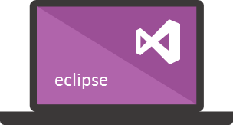




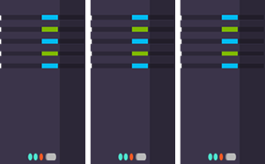
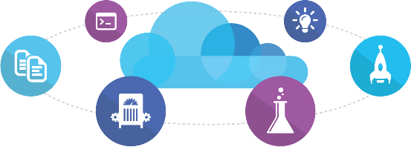
Microsoft ecosystem
People | Process | Tools
01
02
03
Developer Workstation
Build/CI
04
Release
Develop
Monitor
Build and Test
TFS / VSTS
Deploy
Release Management for Visual Studio
Release Management for Visual Studio
Team Collaboration
Test
Automation Service
Monitor and Learn
VSTS
TFS / VSTS
PowerShell | WAML
Application Insights
TFS / VSTS
Azure Resource Management
Microsoft Test Manager
xPlat Command Line
TFS
DEV
TEST
QA
Workstations - On-Premises | Hybrid | Cloud
ALM Services - On-Premises | Hybrid | Cloud
Environments - On-Premises | Hybrid | Cloud
Monitoring - On-Premises | Hybrid | Cloud

Slide 28
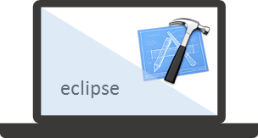


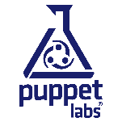




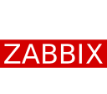





Mixed ecosystem
People | Process | Tools
01
02
03
Developer Workstation
Build/CI
04
Configuration
Develop
Monitor
Build and Test
Deploy
Team Collaboration
Release
Monitor and Learn
Test
This graphic shows OSS and partner products that are integrated with the Microsoft DevOps solution

Slide 29
Power of Azure with the control of the datacenter Introducing the Microsoft Azure Stack
App Innovation
Windows Server
Linux
Windows Server
Linux
Hybrid
Hyper-scale
Enterprise-grade
Portal
IaaS | PaaS services
Portal
IaaS | PaaS services
Cloud-inspired infrastructure
Powered by Windows Server, Hyper-V, System Center, and Azure technologies
Cloud infrastructure
Microsoft Azure Stack
Datacenter
Microsoft Azure
Notes:
Microsoft Azure Stack gives your organization the ability to do anything you can do in the public cloud via the new Azure Resource Manager API at portal.azure.com, on-premises in your own datacenter. So no matter whether you prefer to do your business in the cloud, hybrid, or on-premises, Microsoft has you covered.
https://channel9.msdn.com/Events/Ignite/2015/BRK2484

Slide 30
Architecture Decisions
Azure VMs (IaaS)
Containers
Azure Cloud Services
(PaaS)
Azure Websites (PaaS)
Most control, but most management overhead
Most cost
Puppet/Chef/DSC agent integration
Easier to port workloads from on-premises
Easiest portability from on-premises
Ecosystem of apps
Host OS abstracted, but still requires management
Startup tasks
More complex workloads
Do more than websites
APM compatible
Easy CI and CD setup
Easy Auto Recovery
Easy Testing in Prod
Easy deployments and scale
Efficient Cost
Only websites

Slide 31
Azure Programmatic Interfaces
√ = Current
√ = Resource Manager
SERVICES | POWERSHELL | XPLAT-CLI | MAML | REST | Chef, Puppet, Vagrant
Virtual Machine | √ | √ | √ | √ √ | C P V
Cloud Service | √ |  | √ | √ | C P V
Website | √ | √ | √ √ | √ √
Network | √ | √ | √ | √ √ | C P
Storage | √ | √ | √ √ | √ √ | C P V
SQL Database | √ | √ | √ √ | √ √ | P
Service Bus | √ | √ | √ | √
Resource Groups | √ | √ |  | √
Scheduler | √ |  | √ | √ √
Monitoring |  |  | √ | √ √
Search |  |  | √ | √ √
HDInsight | √ | √ |  | √
Mobile Services |  | √ |  | √
Azure AD | √ √ |  | √ | √
Not a complete list
Notes:
PowerShell & xPlat-CLI – http://azure.microsoft.com/en-us/documentation/articles/install-configure-powershell/
MAML – https://www.nuget.org/packages?q=Microsoft.WindowsAzure.Management&prerelease=true&sortOrder=relevance
Resource Groups -
Chef - http://channel9.msdn.com/Shows/Edge/Edge-Show-93-Chef-deployments-to-Windows-Azure
Puppet - http://blogs.msdn.com/b/interoperability/archive/2013/12/12/windows-azure-provisioning-of-linux-and-windows-via-puppet.aspx
Vagrant - https://github.com/MSOpenTech/vagrant-azure

Slide 32
Workshop notes
Leading with Microsoft tech
Mixture of developer and IT pro content
Use of hands-on-labs
Not boiling the ocean
Notes:
We will lead with Microsoft technologies, however be prepared for us to be broader. Sessions are going to talk about competitors

Slide 33
Module review
In this module, you learned how to:
Explain why and how modern DevOps practices fit within the Microsoft Azure platform.
Notes:
Title: Module Review
Length: 2 minutes
Participant Notes:
In this module, you learned how to:
Explain why and how modern DevOps practices fit within the Microsoft Azure platform.
Start Time xx:xx / Length: 2 minutes
Review the objectives for this module.
Ask participants to use the Text tool to write on the screen if they had any questions about the module.

