Slide 1
Infrastructure as Code (IaC)

Slide 2
Objectives
After completing this module, you will be able to:
Recognize how managing the provisioning of infrastructure is enhanced with Infrastructure as Code (IaC) concepts.
Notes:
Title: Objectives
Length: 2 minutes
Participant Notes:
After completing this module, you will be able to:
Recognize how managing the provisioning of infrastructure is enhanced with Infrastructure as Code (IaC) concepts.
Make sure you address what this course will NOT cover based on experience.
Start Time xx:xx/Length: 2 minutes
Review the learning objectives.

Slide 3
Agenda
Azure Resource Manager (ARM)
ARM templates
Authoring ARM templates
Deploying ARM templates
Desired State Configuration (DSC)

Slide 4
Azure Resource Manager (ARM)

Slide 5
Provisioning resources using ARM
Declarative model
Provision some resources in parallel
Idempotent

Slide 6










ARM architecture
Microsoft Azure
Azure Subscription
A resource always belongs to a resource group
Resource group is a unit of management
Role Based Access Control (RBAC)
Custom policies
Resource Group
LOB App
Resource Group
IaaS Workload
Resource Providers
Azure Resource Manager (ARM)
REST API Endpoints

Slide 7
ARM templates

Slide 8
Artifacts of a template
JSON Files—Infrastructure as Code (IaC)
Artifacts (optional depending on resources)
Configuration scripts used to configure resources
Application code
Third-party tools
Examples
Web Deployment Package
Desired State Configuration (DSC) script
DSC resources

Slide 9
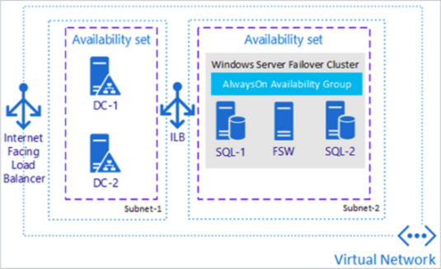
Taking advantage of existing templates
Azure quick-start templates
http://aka.ms/qst
Azure Marketplace (portal)
Examples
SQL Server Always-On Cluster
SharePoint 2013 HA Farm
Preconfigured DC/OS cluster

Slide 10
Azure Resource Manager templates

Slide 11
Authoring ARM templates

Slide 12
ARM template structure
{
"$schema": "https://schema.management.azure.com/schemas/2015-01-01/deploymentTemplate.json#",
"contentVersion": "1.0.0.0",
"parameters": {
// Parameters referenced by resources (parameterize your template)
},
"variables": {
// Variables referenced by resources
},
"resources": [
// Virtual Machine, Web App, Virtual Network, SQL Azure, Storage Account, etc.
],
"outputs": {
// Optional outputs from deployment
}
}

Slide 13
Common ARM template functions
concat() – string concatenation
uniqueString() – 64-bit hash of a given string
resourceGroup() – instance of a resource group
resourceId() – unique identifier of a resource
copyIndex() – looping construct
http://aka.ms/armfunc

Slide 14





Using Visual Studio to author ARM templates
Deployment template (JSON)
Deployment template
Describes the resources to deploy in a resource group
Deployment template parameters
Provides parameter values for parameters defined in the Deployment Template
Deployment script
PowerShell script to deploy the resources defined in the Deployment Template using the parameter values defined in the Deployment Template Parameters file
Deployment template parameters (JSON)
Deployment script (PowerShell)

Slide 15
Author an ARM template using Visual Studio

Slide 16
Deploying ARM templates

Slide 17
Methods for deploying ARM templates
PowerShell
Azure PowerShell Cmdlets 1.0 (or newer) - “AzureRM” cmdlets
Azure Command-Line Interface (CLI)
Cross-platform tools for Mac, Linux, and Windows
Visual Studio
Azure Tools/SDK
Azure portal
Template deployment
Continuous deployment

Slide 18
Deploying ARM templates
Deployment template (JSON)
Deployment template parameters (JSON)
Microsoft Azure
Deployment script (PowerShell)
Azure Subscription
Push Deployment template and parameters to ARM
Resource Group
Resource Group
ARM

Slide 19
Deploying ARM templates

Slide 20
Desired State Configuration (DSC)

Slide 21
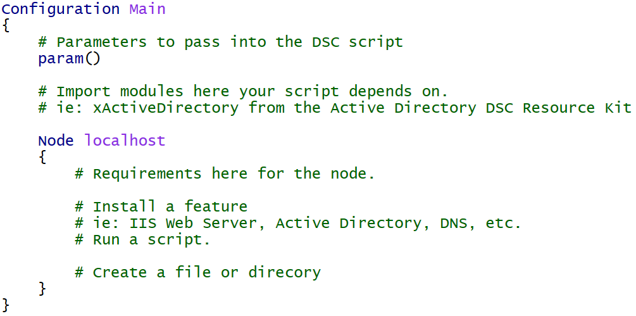
DSC for Azure
Declarative configuration of the virtual machine
Windows Features and Roles
Custom application configuration

Slide 22
DSC Example: Built-in Resources
Configuration Main {
Param ( [string] $nodeName )
Import-DscResource -ModuleName PSDesiredStateConfiguration
Node $nodeName {
WindowsFeature WebServerRole {
Name = "Web-Server"
Ensure = "Present"
}
Package InstallWebDeploy {
Ensure = "Present"
Path = "C:\WindowsAzure\WebDeploy_amd64_en-US.msi"
Name = "Microsoft Web Deploy 3.6"
ProductId = "{ED4CC1E5-043E-4157-8452-B5E533FE2BA1}"
Arguments = "ADDLOCAL=ALL"
}
Service StartWebDeploy {
Name = "WMSVC"
StartupType = "Automatic"
State = "Running"
DependsOn = "[Package]InstallWebDeploy"
}
}
}

Slide 23
DSC Resources
Built-in
WindowsFeature, File, Package, Service, Script, etc.
DSC Resource Kit (~500 resources)
https://blogs.msdn.microsoft.com/powershell/2016/02/11/dsc-resource-kit-gets-even-bigger/
Experimental Resources
xNetworking, xDisk, xSqlServer, xActiveDirectory, etc.
Community Resources
cUserRightsAssignment, cNtfsAccessControl, etc.

Slide 24
DSC Example: Resource-Kit Resources
Configuration Main {
Param ( [string] $nodeName )
Import-DscResource -ModuleName PSDesiredStateConfiguration, xNetworking, cUserRightsAssignment
Node $nodeName {
WindowsFeature DNS {
Ensure = "Present"
Name = "DNS"
}
xDnsServerAddress DnsServerAddress {
Address = "127.0.0.1"
InterfaceAlias = "Ethernet"
AddressFamily = "IPv4"
DependsOn = "[WindowsFeature]DNS"
}
cUserRight GrantIncreaseQuotaPrivilege
{
Ensure = "Present"
Constant = "SeIncreaseQuotaPrivilege"
Principal = "CONTOSO\AdminUser"
}
}
}

Slide 25
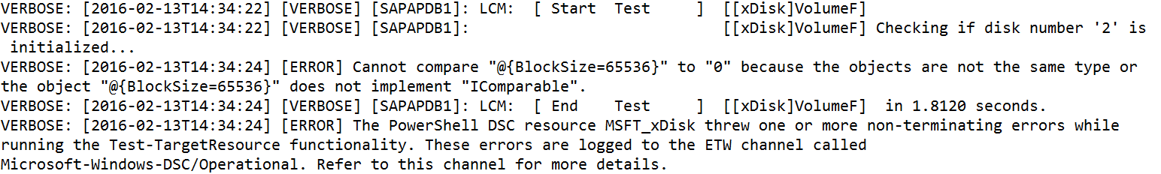
DSC Logs (on the virtual machine)
Provides details on the configuration (script) in the virtual machine
C:\WindowsAzure\Logs\Plugins\Microsoft.Powershell.DSC\<version>

Slide 26
Demo
Desired State Configuration

Slide 27
Module review
In this module, you learned how to:
Manage the provisioning of infrastructure is enhanced with Infrastructure as Code (IaC) concepts.
Notes:
Title: Module Review
Length: 2 minutes
Participant Notes:
In this module, you learned how to:
Manage the provisioning of infrastructure is enhanced with Infrastructure as Code (IaC) concepts.
Start Time xx:xx/Length: 2 minutes
Review the objectives for this module.
Ask participants to use the Text tool to write on the screen if they had any questions about the module.

