Slide 1
Configuration Management

Slide 2
Objectives
After completing this module, you will be able to:
Configure the “inside” of environments, using various configuration management tools.
Notes:
Title: Objectives
Length: 2 minutes
Participant Notes:
After completing this module, you will be able to:
Configure the “inside” of environments, using various configuration management tools such as PowerShell DSC, Chef, and Puppet.
Make sure you address what this course will NOT cover based on experience.
Start Time xx:xx/Length: 2 minutes
Review the learning objectives.

Slide 3




End-to-end DevOps
1
4
Plan
Monitor + Learn
Development
Operations
2
3
Develop + Test
Release
Notes:
Modern application lifecycle management practices enable teams to support a continuous delivery cadence that balances agility and quality, while removing the traditional silos separating developers from operations and business stakeholders.: This improves communication and collaboration within development teams, and drives connections between application and business outcomes. We see three key metrics that are critical to an organization’s ability to enable value delivery with agility and quality. First, the flow of business value must be measured and improved. Understanding what provides business value, and delivering those features on a sustained, regular cadence is key. The second is having the ability to identify and remove bottlenecks to shorten cycle times for delivering those business values. It’s not enough to simply deliver regularly, but also efficiently. And finally, identify and reduce sources of rework, such as bugs, incorrectly specified features, etc.

Slide 4
What is configuration management?
Wikipedia - “field of management that focuses on establishing and maintaining consistency of a system’s or product’s performance and its functional and physical attributes with its requirements, design, and operational information throughout its life. For information assurance, CM can be defined as the management of security features and assurances through control of changes made to hardware, software, firmware, documentation, test, test fixtures, and test documentation throughout the life cycle of an information system”
Puppet Labs – “the process of standardizing resource configurations and enforcing their state across IT infrastructure in an automated yet agile manner. Configuration management is critical to the success of other IT processes, including provisioning, change management, release management, patch management, compliance and security.”
Microsoft (J. Snover) – Configuration Management tools are an essential part of tools needed when migrating workloads to the cloud, because it enables scalability, flexibility, and it runs on PowerShell.

Slide 5

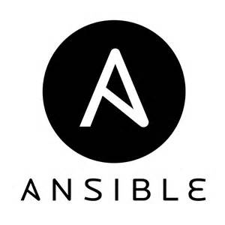

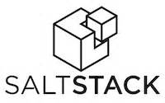
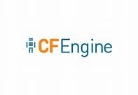






Configuration management toolbox
(Azure) OMS Automation
PowerShell DSC
Hudson
Jenkins
Grunt
Vagrant

Slide 6

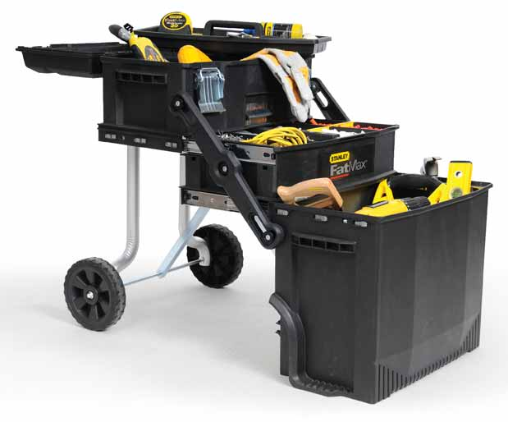
Configuration management toolbox
Use the appropriate tool(s) for getting the job done…

Slide 7
Configuration management stages
Document
Track
Configuration
What it does
Facilitates asset and inventory functions
How it works
Manual tracking of configuration data
Gathered from tools or physical inventory
Lives in spreadsheet or light CMDB
What it does
Facilitates asset and inventory functions
Informs change management
Automation against CMDB data
How it works
Automated tracking of configuration data (connectors)
Gathered exclusively from tools
Lives in a CMDB
What it does
Declaratively defined configuration deployment
Validation of deployed configurations based on tooling
Automation against CMDB data
Informs change management
How it works
Declarative configuration push/pull to targets based on a configuration file
Tracking of configuration data through tooling
Declarative configurations live in source control
Configuration database provides inventory data

Slide 8
Enabling configuration management
Source control (Visual Studio, Git,…)
Infrastructure as code (ARM)
Configuration language (PowerShell DSC, ARM)
Configuration tooling (Azure Automation DSC)
Configuration repository (Azure Automation DSC)
Configuration deployment mechanism (PowerShell DSC)
Configuration management database (OMS/SCSM)
Configuration
What it does
Declaratively defined configuration deployment
Validation of deployed configurations based on tooling
Automation against CMDB data
Informs change management
How it works
Declarative configuration push/pull to targets based on a configuration file
Tracking of configuration data through tooling
Declarative configurations live in source control
Configuration database provides inventory data

Slide 9
PowerShell DSC
Microsoft platform for configuration management replacing:
Group policy
Manual configuration
Nondeclarative scripting, batch files, etc.
Declarative configuration is applied on push or pull
Multi-platform (Microsoft, Linux)
Multi-location (on-premisis, Azure, AWS)
Facilitates re-application of configuration

Slide 10
PowerShell DSC components
Authoring
Written in PowerShell DSC syntax
Stored in a source repository
Staging
Declarative configuration creates MOF files (stored in Azure Automation DSC)
Configuration is built for all nodes requiring MOF
Apply
Configuration is “pulled” or “pushed” to targets of MOFs
Each configuration is declarative and will overwrite previous settings

Slide 11


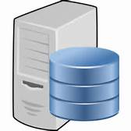
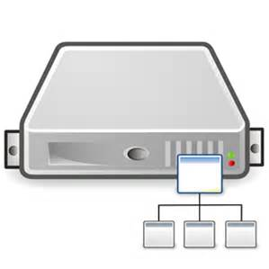
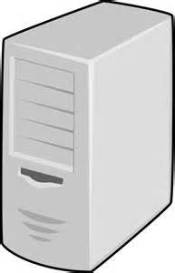
PowerShell DSC Components
1. Authoring : : 2. Staging 3. Apply
Configuration MyDscConfiguration {
: Node "TEST-PC1" {
: WindowsFeature MyFeatureInstance {: :
: Ensure = "Present"
: Name = "RSAT"
: }
: WindowsFeature My2ndFeatureInstance {: :
: Ensure = "Present"
: Name = "Bitlocker"
: }
}
}

Slide 12
PowerShell DSC in action

Slide 13

PowerShell DSC and Azure
Azure provides elasticity, dynamic provisioning
Same configuration, different environment, always at scale
Flexibility using Azure extensions
Multi-tenancy and isolation

Slide 14
PowerShell DSC and Azure
Resource Gallery
Azure Blob
(Azure) OMS Automation
AZURE VM
BootStrapper
BootStrapper
CLIENT
Script Extension
Configuration
Configuration
DSC Resources
Parse
VM Extensions

Slide 15
VM extensions
Software provided by both Microsoft and trusted third-party providers for Azure VMs to extend the functionality of the VM
Windows and Linux OS support
Deploy to a running or a new VM
Programmability support
Update life cycle that is independent of the VM
Enables dynamic composition on a VM
VM Extensions

Slide 16
PowerShell DSC in action in Azure

Slide 17
Chef on Azure
What is Chef? Chef is a configuration management tools for deploying and managing infrastructure and applications.
Infrastructure is code
Declarative interface to resource
Policy based configuration management.

Slide 18
Chef concepts
Knife: cmdline tool to manage infrastructure and bootstrap chef
Resource: Fundamental building block, piece of a system
Recipe: ‘code’ for managing the resource
Cookbook: Collection of recipes
Runlist: A policy which needs to be applied on the node.

Slide 19
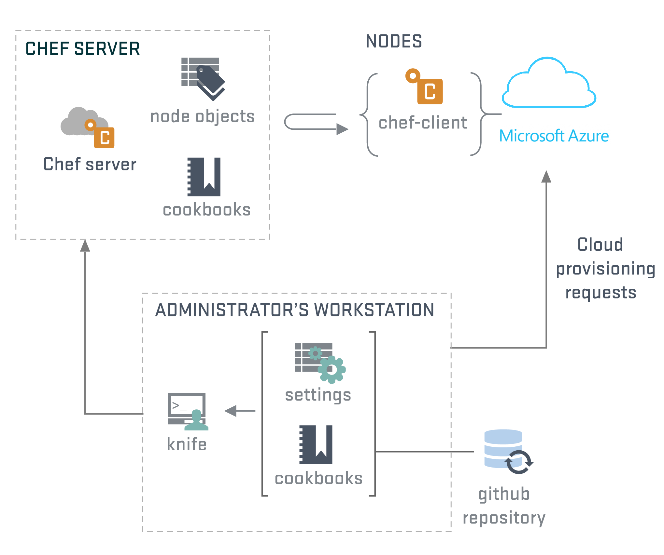
Chef architecture
Chef Options
Chef Workflow
Managing Azure VMs using Knife
Managing Infrastructure
Bootstrapping chef agent using Chef Extension
Bootstrap Agents
Leveraging DSC resources using Chef
Customize VM

Slide 20
Managing Azure infrastructure with Chef
Chef server account:
Sign up for Hosted Chef account
https://manage.opscode.com/signup
Setting up Chef workstation:
Download the starter kit from Chef server
Setup the workstation by downloading the chef-client: https://www.getchef.com/download-chef-client/
Install knife azure: gem install knife-azure
The workstation is now ready to manage VMs in Azure!

Slide 21
Managing infrastructure in Azure with Chef
Create a VM:
Download publish settings file from here: https://manage.windowsazure.com/publishsettings/index?client=powershell
Knife azure image list
--azure-publish-settings-file '/path/to/your/cert.publishsettingsfile' knife azure server create
--azure-publish-settings-file '/path/to/your/cert.publishsettingsfile'
--azure-dns-name 'myservice'
--azure-source-image 'windows-image-name'
--ssh-user ‘testuser'
--ssh-password ‘azuredemo'
--azure-service-location "West US"

Slide 22
Bootstrapping VM in Azure with Chef

Slide 23
Taking advantage of Chef with PowerShell DSC
Admins who manage a mix of both Windows and Linux deployments can take advantage of DSC using Chef.
Preview of DSC cookbook which exposes DSC resources as Chef resources is available: https://supermarket.getchef.com/cookbooks/dsc
All the DSC resources returned by get-dscresource can be managed by Chef using the cookbook.
Simple rules for transforming DSC resource into Chef resource published here: https://github.com/opscode-cookbooks/dsc/blob/master/README.md

Slide 24
Puppet on Azure
What is Puppet?: Puppet is a configuration management system that allows you to define the state of your IT infrastructure, then automatically enforces the correct state.
Key concepts
Supports easy to read declarative language.
Enforces desired state on the system.
Puppet Forge supports many ready to use modules.

Slide 25
Puppet concepts
Manifest: A file containing code written in the Puppet language and managing infrastructure and applications. Manifest contains resources and classes.
Resources: A unit of configuration, whose state can be managed by Puppet.
Module: A collection of classes, resource types, files, and templates organized around a particular purpose.
Catalog: A catalog is a document that describes the desired system state for one specific computer. Catalogs are compiled from manifests by a puppet master server and served to agent nodes.

Slide 26
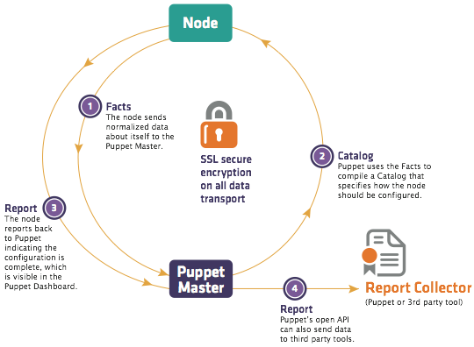
Puppet architecture
Puppet Options
Puppet Workflow
Provisioning using Azure Puppet Module
Managing Infrastructure
Bootstrapping Puppet agent using Puppet Extension
Bootstrap Agents
Leveraging DSC resources using Puppet
Customize VM

Slide 27
Install Puppet Master
Step1: Setting up Puppet Master
Select the Puppet Master Image from Azure Galler . Note: Provide a lowercase cloud service and VM name for the Puppet Master.
Add the following end points on the Puppet Master VM:
443 for HTTPS
8140 for Puppet
61613 for MCollective
Browse to the Puppet master VM and retrieve the user name and password for PE console:
User login is located in the file: /etc/puppetlabs/installer/answers.install (admin@<VM name>.cloudapp.net)
Password is located in the file /etc/puppetlabs/installer/database_info.install
Wait for 10 minutess and login to PE console: https://<cloudservicename>.cloudapp.net

Slide 28
Install Puppet Agent
Setting up Puppet agent from the Azure Portal
Select any windows VM, add Puppet extension with input: puppetmastername.cloudapp.net
Setting up Puppet Agent from Azure Powershell:
VM = get-AzureVM -ServiceName $svcName -Name $name
Set-AzureVMPuppetExtension –PuppetMasterServer $puppetmaster –VM: $vm
Update-AzureVM -VM $vm.VM -ServiceName $svcName -Name $name

Slide 29
Bootstrapping VM in Azure with Puppet

Slide 30
Module review
In this module, you learned how to:
Configure the “inside” of environments, using various configuration management tools.
Notes:
Title: Module Review
Length: 2 minutes
Participant Notes: <include summary of screen text as it may be hard to read in Participant Guide>
In this module, you learned how to:
Configure and manage the “inside” of environments using various configuration management tools such as PowerShell, DSC, Chef, and Puppet.
Start Time xx:xx/Length: 2 minutes
Review the objectives for this module.
Ask participants to use the Text tool to write on the screen if they had any questions about the module.:

