Slide 1
Security for Modern Applications

Slide 2
Objectives
After completing this module, you will understand
Security as an integral part of your tools and practices throughout the delivery pipeline
Notes:
Title: Objectives
Length: 5 minutes
Participant Notes:
After completing this module, you will be able to:
Identify common security patterns for modern application development.
Make sure you address what this course will NOT cover based on experience.
Start Time xx:xx / Length: 2 minutes
Review the learning objectives.

Slide 3
Agenda
Secure your Process
Secure your Environment
Secure your Code
Improve Visibility and Compliance

Slide 4
Secure Your Process

Slide 5
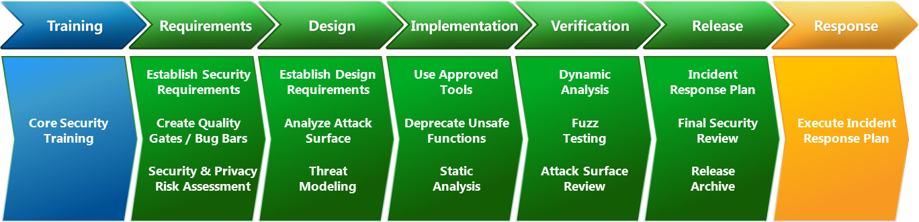
Security Development Lifecycle (SDL)
Security assurance process focused on software development
Emphasis on security and privacy throughout all phases of the development process
Three core concepts
Education
Continuous process improvement,
Accountability
Notes:
The ongoing education and training of technical job roles within a software development group is critical. The appropriate investment in knowledge transfer helps organizations to react appropriately to changes in technology and the threat landscape. Because security risk is not static, the SDL places heavy emphasis on understanding the cause and effect of security vulnerabilities and requires regular evaluation of SDL processes and introduction of changes in response to new technology advancements or new threats. Data is collected to assess training effectiveness, in-process metrics are used to confirm process compliance and post-release metrics help guide future changes. Finally, the SDL requires the archival of all data necessary to service an application in a crisis. When paired with detailed security response and communication plans, an organization can provide concise and cogent guidance to all affected parties.

Slide 6
Security throughout the release cycle
Release 1
Planning
Dev
Verify
Deploy
Design
Inception
Release 2
Planning
Dev
Verify
Deploy
Design
Inception
Release 3
Planning
Dev
Verify
Deploy
Design
Inception
Release n
Planning
Dev
Verify
Deploy
Design
Inception
Release n-1
Planning
Dev
Verify
Deploy
Design
Inception
Release …
Planning
Dev
Verify
Deploy
Design
Inception

Slide 7
Threat Modeling Tool
Identify and mitigate potential security issues early
Part of the design phase of the SDL
STRIDE-Approach to identify threats:
Spoofing
Tampering
Repudiation
Information Disclosure
Denial of Service
Elevation of Privilege
Diagram
Identify Threats
Mitigate
Validate
Notes:
Does data magically appear? - Data comes from external entities or data stores
Are there data sinks? - You write to a store for a reason: Someone uses it.
Data doesn’t flow magically - It goes through a process
Diagrams Should Not Resemble Flow charts, Class diagrams, Call graphs etc
Mitigation
To address or alleviate a problem
Protect customers
Design secure software
Four ways to address threats
Redesign to eliminate
Apply standard mitigations
What have similar software packages done and how has that worked out for them?
Invent new mitigations (riskier)
Accept vulnerability in design
SDL rules about what you can accept
Validate the whole threat model
Does diagram match final code?
Are threats enumerated?
Minimum: STRIDE per element that touches a trust boundary
Has Test / QA reviewed the model?
Tester approach often finds issues with threat model or details
Is each threat mitigated?
Are mitigations done right?

Slide 8
Threat modeling tool

Slide 9
Secure Your Environments

Slide 10
Data security
Data segregation
Data protection At-rest and In-transit
Encryption
Data redundancy
Data destruction
Notes:
Slide title: Data security
Azure provides customers with strong data security – both by default and as customer options.
Technological safeguards, such as encrypted communications, and operation processes help keep Customer Data secure. Customers have the flexibility to implement additional encryption and manage their own keys.
Data segregation/isolation. Azure is a multi-tenant service, meaning that multiple customers’ deployments and virtual machines are stored on the same physical hardware. Azure uses logical isolation to segregate each customer’s data from that of others. This provides the scale and economic benefits of multitenant services while rigorously preventing customers from accessing one another’s data.
Data at rest. Customers are responsible for ensuring that data stored in Azure is encrypted in accordance with their standards. Azure offers a wide range of encryption capabilities, giving customers the flexibility to choose the solution that best meets their needs.
Data in transit. For data in transit, customers can enable encryption for traffic between their own VMs and end users. Azure protects data in transit to or from outside components, as well as data in transit internally, such as between two virtual networks. Azure uses industry standard transport protocols such as TLS between user devices and Microsoft datacenters, and within datacenters themselves.
Encryption management. Encryption of data in storage and in transit can be used by Azure customers align with best practices for ensuring confidentiality and integrity of data. It is straightforward for customers to configure their Azure cloud services to use SSL to protect communications from the Internet and even between their Azure hosted VMs.
Data redundancy. Microsoft ensures data is protected in the event of a cyberattack or physical damage to a datacenter. Customers may opt for in-country storage for compliance or latency considerations or out-of-country storage for security or disaster recovery purposes. Data may be replicated within a selected geographic area for redundancy, but will not be transmitted outside it.
Data destruction. When customers delete data or leave Azure, Microsoft follows strict standards for overwriting storage resources before reuse, as well physical destruction of decommissioned hardware. Microsoft executes a complete deletion of data on customer request and on contract termination.

Slide 11
Data Control in Azure
Data location - Customers can specify the geographic areas where their customer data is stored
Data access - Access to customer data by Microsoft personnel is restricted; Microsoft provides cloud-service-specific privacy statements and strong contractual commitments to safeguard Customer Data
Data protection - Technical safeguards help keep Customer Data secure; Customers have the flexibility to implement additional encryption and manage their own keys
Access controls are verified by independent audit and certifications
11
Notes:
Data location: Customers can specify the geographic areas where their customer data is stored. Microsoft will not transfer data outside where the customer specifies, except where necessary to provide support, troubleshoot, or comply with local legal requirements.
Data access: Access to customer data by Microsoft personnel is restricted, and granted only when necessary for support, then revoked when no longer needed. Customers can also view access and usage reports.
Data protection: Technical safeguards help keep Customer Data secure; Azure gives customers the flexibility to implement additional encryption and manage their own keys. Microsoft Azure Key Vault offers an easy, cost-effective way to safeguard keys and other secrets in the cloud using Hardware Security Modules (HSMs).
Additional details:
Data location Slide script: Explain how Microsoft Azure makes multiple copies of your data in each location – so even if you have your data in one location, you still have 3 different copies.
Control over data location. For many customers, knowing and controlling the location of their data can be an important element of data privacy compliance and governance. Microsoft Azure customers can specify the geographic areas where their customer data is stored. Data may be replicated within a geographic area for redundancy, but will not be transmitted outside it. When customers delete data or leave Microsoft Azure, Microsoft follows strict standards for overwriting storage resources before reuse, as well physically destruction of decommissioned hardware. Microsoft Azure replicates data both locally and to different physical locations.
To guard against hardware failures and improve availability, every blob is replicated across three computers in a Microsoft Azure datacenter.
To ensure more robust backup, Windows offers geo-replicated storage
Microsoft may transfer Customer Data within a geo (e.g., within Europe) for data redundancy or other purposes. For example, Azure replicates Blob and Table data between two regions within the same geo for enhanced data durability in case of a major data center disaster. Microsoft will not transfer Customer Data outside the geo(s) customer specifies (for example, from Europe to U.S. or from U.S. to Asia) except where necessary for Microsoft to provide customer support, troubleshoot the service, or comply with legal requirements; or where customer configures the account to enable such transfer of Customer Data.
When customers entrust their data to Microsoft, they are not giving up control. For many customers, knowing and controlling the location of their data can be an important element of data privacy, compliance, and governance. Microsoft Azure offers an ever-expanding network of data centers across the globe. Most Azure services permit customers to specify the particular geography where their customer data will be stored. Data may be replicated within a selected geographic area for redundancy, but will not be transmitted outside it.
Data Access Slide script: Role-Based Access Control. Azure role-based access control enables customers to grant appropriate access to Azure AD users, groups, and services, by assigning roles to them on a subscription or resource group or individual resource level. The assigned role defines the level of access that the users, groups, or services have on the Azure resource.
Restricted data access and use. Access to customer data by Microsoft personnel is restricted. Customer Data is only accessed when necessary to support the customer’s use of Microsoft Azure. This may include troubleshooting aimed at preventing, detecting or repairing problems affecting the operation of Microsoft Azure and the improvement of features that involve the detection of, and protection against, emerging and evolving threats to the user (such as malware or spam). When granted, access is carefully controlled and logged. Strong authentication, including the use of multi-factor authentication, helps limit access to authorized personnel only. Access is revoked as soon as it is no longer needed.
Microsoft employee access management. Access to customer data by Microsoft personnel is restricted. Customer data is only accessed when necessary to support the customer’s use of Azure. This may include troubleshooting aimed at preventing, detecting, or repairing problems affecting the operation of Azure and the improvement of features that involve the detection of, and protection against, emerging and evolving threats to the user (such as malware or spam).
Contractual commitments. Microsoft is unique among major cloud service providers in providing cloud-service-specific privacy statements and making strong contractual commitments to safeguard customer data and protect privacy. Microsoft makes the standard contractual clauses created by the European Union (known as the “EU Model Clauses”) available to enterprise customers to provide additional contractual guarantees concerning transfers of personal data. Recently, Brad Smith announced that Microsoft’s cloud contracts have been validated by European Union data protection authorities as meeting the rigorous privacy standards that regulate companies operating in E.U. member states.
Restricted data access slide script:
Restricted access by Microsoft personnel. Access to customer data by Microsoft personnel is restricted. Customer data is only accessed when necessary to support the customer’s use of Azure. This may include troubleshooting aimed at preventing, detecting, or repairing problems affecting the operation of Azure and the improvement of features that involve the detection of, and protection against, emerging and evolving threats to the user (such as malware or spam). When granted, access is controlled and logged. Strong authentication, including the use of multi-factor authentication, helps limit access to authorized personnel only. Access is revoked as soon as it is no longer needed.
Strong Authentication. Microsoft Azure provides Multi-Factor Authentication (MFA) that delivers strong authentication via a range of easy verification options—phone call, text message, or mobile app notification—enabling users to choose the method they prefer.
Contractual commitments. Microsoft is unique among major cloud service providers in providing cloud-service-specific privacy statements and making strong contractual commitments to safeguard customer data and protect privacy. Microsoft makes the standard contractual clauses created by the European Union (known as the “EU Model Clauses”) available to enterprise customers to provide additional contractual guarantees concerning transfers of personal data.
ISO/IEC 27018 certification. Microsoft Azure services have incorporated the controls that embody ISO/IEC 27018, including a prohibition on the use of customer data for advertising and marketing purposes without the customer’s express consent. Microsoft will not use customer data for purposes unrelated to providing the cloud service.
Restricted data access and use. Access to customer data by Microsoft personnel is restricted. Customer Data is only accessed when necessary to support the customer’s use of Windows Azure. This may include troubleshooting aimed at preventing, detecting or repairing problems affecting the operation of Windows Azure and the improvement of features that involve the detection of, and protection against, emerging and evolving threats to the user (such as malware or spam). When granted, access is carefully controlled and logged. Strong authentication, including the use of multi-factor authentication, helps limit access to authorized personnel only. Access is revoked as soon as it is no longer needed. Azure does NOT share Customer Data with its advertiser-supported services, nor is customer data mined for advertising.
Notification of lawful requests for information. Microsoft does not disclose customer data to law enforcement unless required by law, and will notify customers when compelled to disclose. The Law Enforcement Request Report discloses details of requests every 6 months.
Transparency and simplicity of data use policies. Microsoft keeps customers informed about the processes to protect data privacy and security, including practices and policies. Microsoft also provides the summaries of independent audits of services, which help customers pursue their own compliance.

Slide 12
Role Based Access Control (RBAC)
Allows secure access with granular permissions
Assignable to users, groups, or service principals
Built-in roles make it easy to get started
Notes:
Slide title: Role-Based Access Control
Slide objectives: Provide an overview of data access with Microsoft Azure.
Slide script:
Role-Based Access Control: Microsoft provides an approach to restricting system access to authorized users based on role assignment, role authorization, and permission authorization. Tools in multiple Microsoft cloud services support authorization based on a user’s role, simplifying access control across defined groups of users.

Slide 13
Data encryption
Layer | Encryption Support
Application | .NET encryption API
 | Client side encryption with Azure Key Vault for Storage
 | SQL TDE/CLE on SQL server on Azure IaaS servers
Platform | SQL Azure Transparent Data Encryption (TDE), Dynamic Data Masking, Row-level security (RLS), Auditing & Threat Detection
 | StorSimple –A 256-bit Advanced Encryption Standard (AES) algorithm for encrypting data as it moves to and from the cloud
 | Azure Key Vault - Hardware Security Modules (HSMs)
System | BitLocker
 | Azure Disk Encryption for Windows and Linux IaaS VMs
 | Partner solutions for system volume encryption
Notes:
Slide title: Data encryption
Slide objective: Explain data encryption layers available with Microsoft Azure.
Slide script:
Application layer
.NET: The .NET Framework provides implementations of many standard cryptographic algorithms. These algorithms are easy to use and have the safest possible default properties. In addition, the .NET Framework cryptography model of object inheritance, stream design, and configuration is extremely extensible.
SQL TDE/CLE: Transparent data encryption (TDE) is designed to provide protection for the entire database at rest without affecting existing applications. Implementing encryption in a database traditionally involves complicated application changes such as modifying table schemas, removing functionality, and significant performance degradations. Microsoft SQL Server offers two levels of encryption: database-level and cell-level. Both use the key management hierarchy.
Platform Layer
SQL Azure: SQL Azure Transparent Data Encryption (TDE), Dynamic Data Masking, Row-level security (RLS), Auditing & Threat Detection
StorSimple: Instead of tape backup or remote replication, StorSimple arrays protect data automatically with cloud snapshots. Cloud snapshots are similar to local snapshots in other products, but are stored remotely in cloud storage where they can be quickly accessed online without the lengthy delays normally incurred with off-site storage.
Key Vault: Secure key management is essential to protecting data in the cloud. With Key Vault, you can encrypt keys and small secrets like passwords with keys stored Hardware Security Modules (HSMs). For added assurance, import or generate your keys in HSMs certified to FIPS 140-2 level 2 standards – so that your keys stay within the HSM boundary. Key Vault is designed so that Microsoft does not see or extract your keys.
System Layer
BitLocker: BitLocker Drive Encryption allows you to encrypt all data stored on the Windows operating system volume and configured data volumes. A Trusted Platform Module (TPM) is a microchip that is built into a computer. It is used to store cryptographic information, such as encryption keys. Information stored on the TPM can be more secure from external software attacks and physical theft. BitLocker uses the TPM to help protect the Windows operating system and user data and helps to ensure that a computer is not tampered with, even if it is left unattended, lost, or stolen.
Azure Disk Encryption for VM: Azure Disk Encryption is a new capability that lets you encrypt your Windows and Linux IaaS virtual machine disks. Azure Disk Encryption leverages the industry standard BitLocker feature of Windows and the DM-Crypt feature of Linux to provide volume encryption for the OS and the data disks. The solution is integrated with Azure Key Vault to help you control and manage the disk encryption keys and secrets in your key vault subscription, while ensuring that all data in the virtual machine disks are encrypted at rest in your Azure storage.
URL: https://azure.microsoft.com/en-us/documentation/articles/azure-security-disk-encryption/

Slide 14
Azure Key Vault
Offers encryption key management in the cloud, enabling customers to safeguard keys for use in applications
Create/import, store, and manage cryptographic keys
Secure keys in Hardware Security Modules (HSMs)
Maintain control over keys—grant and revoke use by applications as needed

Slide 15
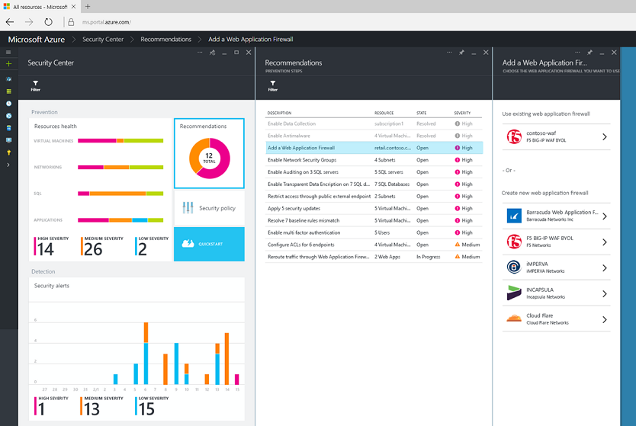
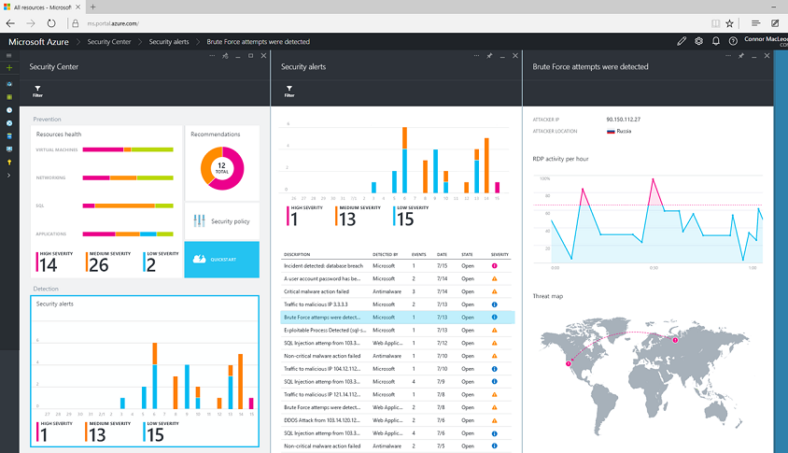
Azure Security Center
Gain visibility and control
Integrated security, monitoring, policy management
Built in threat detections and alerts
Notes:
Azure Security Center provides a unified view of your security state, so your team and/or your organization’s security specialists can get the information they need to evaluate risk across the workloads they run in the cloud. Based on customizable policy, the service can provide recommendations. For example, the policy might be that all web applications should be protected by a web application firewall. If so, the Azure Security Center will automatically detect when web apps you host in Azure don’t have a web application firewall configured, and provide a quick and direct workflow to get a firewall from one of our partners deployed and configured.
Of course, even with the best possible protection in place, attackers will still try to compromise systems. To address this problem and adopt an “assume breach” mindset, the Azure Security Center uses advanced analytics, including machine learning, along with Microsoft’s global threat intelligence network to look for and alert on attacks. Signals are automatically collected from your Azure resources, the network, and integrated security partner solutions and analyzed to identify cyber-attacks that might otherwise go undetected. Should an incident occur, security alerts offer insights into the attack and suggest ways to remediate and recover quickly. Security data and alerts can also be piped to existing Security Information and Events Management (SIEM) systems your organization has already purchased and is using on-premises.
No other cloud vendor provides the depth and breadth of these capabilities, and they are going to enable you to build even more secure applications in the cloud.

Slide 16
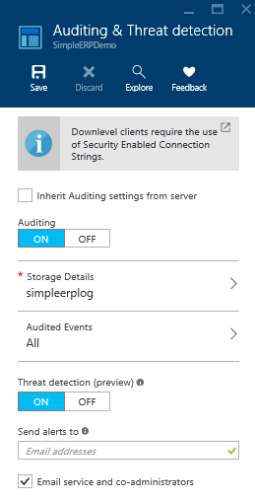
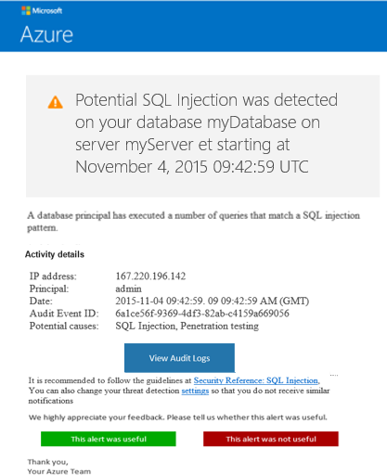
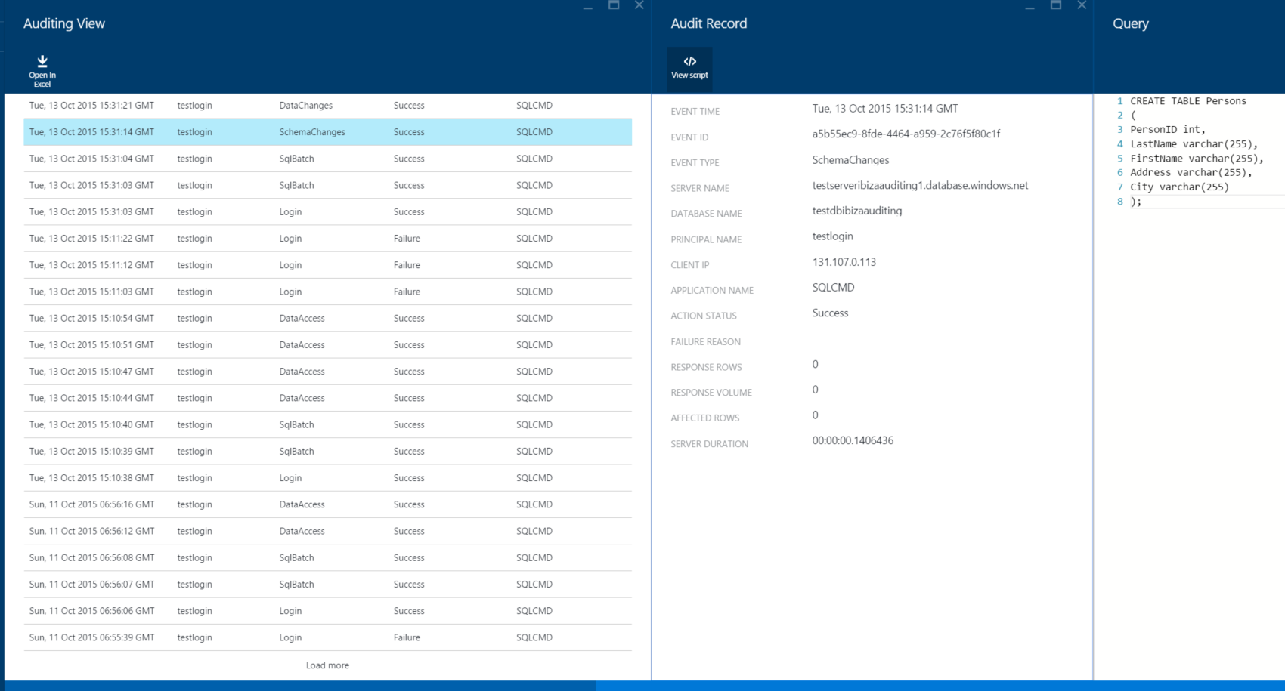
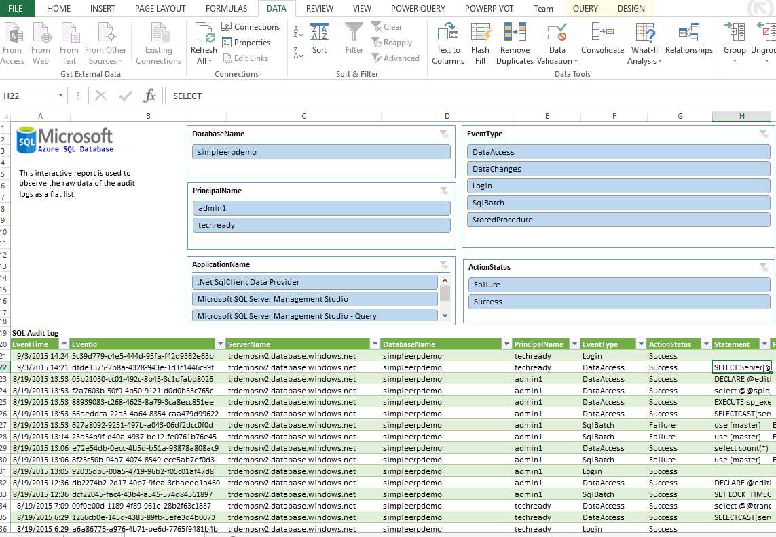



Azure SQL Threat Detection
Setup
Alert
Explore
Notes:
1) User navigates to Azure portal in enable auditing with threat detection
2 ) User receives a clear email notification with recommended action as they occur
User can investigate and mitigate threats using Azure portal (e.g inspect the audit log around the time of the event., update firewall setting ….)

Slide 17
Security features in Azure (RBAC, ARM & Key Vault, Security Center)

Slide 18
Secure Your Code

Slide 19
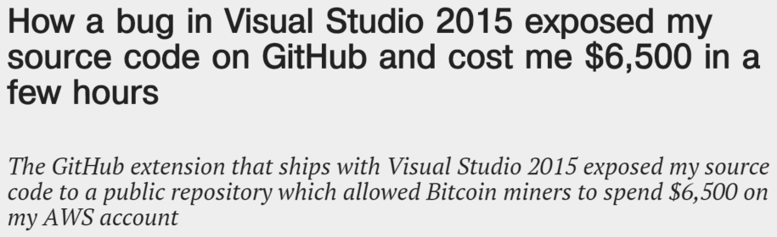
Secrets should not be in source (control)
http://bit.ly/1NJsckY
Notes:
Speaker Notes: talk about unfortunate case where heeding this simple advice could have saved this guy $6,500 (How a bug in Visual Studio 2015 exposed my source code on GitHub and cost me $6,500 in a few hours)

Slide 20
Deploying Credentials in Azure Web Apps

Slide 21
Improve Visibility and Compliance

Slide 22
DevOps - Help or Hinder Compliance
Increasingly detailed security and compliance requirements
DevOps tools and practices establish compliance through consistency and automation
Improve compliance by reducing complexity and variability within the environments
DevOps does more to help compliance than hurt it
Notes:
DevOps tools and practices establish compliance through consistency. They help improve compliance by reducing complexity and variability within the environments
For test and operations teams, configurations, tests and deployments can be automated to ensure execution is consistent. For development teams, consistent versions of binaries ensures use of compliant components, leading to more compliant applications. The automation capabilities of DevOps tools enable consistent, automated execution of compliant practices
DevOps can be a crucial element in simplifying and streamlining them
The key to making compliance an advantage is to specify compliance requirements as code, allowing it to be tested just like any other piece of code in the software development pipeline
Not only does DevOps introduce more consistency and reduced complexity of operations, it also allows for fast feedback loops when things are identified as out of compliance. Waterfall cycle times that might have required weeks or months to fit changes or corrections into systems can now be achieved in a fraction of the time in DevOps practices
It’s important for DevOps organizations to think a bit differently when it comes to compliance, though. They may be forced to implement the same types of controls using different tools or slightly different processes to conform with specific requirements

Slide 23



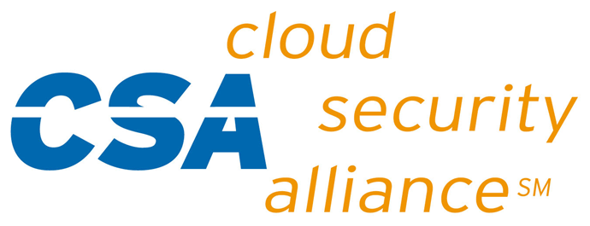





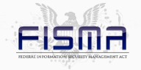

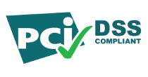

Azure Compliance
CSA Cloud Controls Matrix
HIPAA/ HITECH
AU IRAP Accreditation
Singapore MCTS
Microsoft Azure
SOC 1
SOC 2
UK G-Cloud OFFICIAL
CDSA
CJIS
2010
2011
2012
2013
2014
2015
ISO/IEC 27001:2005
FISMA
ATO
FedRAMP P-ATO
EU Data Protection Directive
PCI DSS Level 1
ISO/IEC 27018
Operations Security Assurance
Notes:
Slide title: Compliance
Slide objectives: Introduce the following section on compliance.
By providing customers with compliant, independently verified cloud services, Microsoft makes it easier for customers to achieve compliance for the infrastructure and applications they run in Azure. Microsoft provides Azure customers with detailed information about our security and compliance programs, including audit reports and compliance packages, to help customers assess our services against their own legal and regulatory requirements.
In addition, Microsoft has developed an extensible compliance framework that enables it to design and build services using a single set of controls to speed up and simplify compliance across a diverse set of regulations and rapidly adapt to changes in the regulatory landscape.

Slide 24
Azure Trust Center

Slide 25
Module Review
In this module, you learned to see
Security as an integral part of your tools and practices throughout the delivery pipeline
Notes:
Title: Module Review
Length: 2 minutes
Participant Notes:
In this module, you learned how to:
Identify common security patterns for modern application development.
Start Time xx:xx / Length: 2 minutes
Review the objectives for this module.
Ask participants to use the Text tool to write on the screen if they had any questions about the module.

