Slide 1
Automated Testing

Slide 2
Objectives
After completing this module, you will be able to:
Implement a thorough testing plan for cloud applications.
Notes:
Title: Objectives
Length: 2 minutes
Participant Notes:
After completing this module, you will be able to:
Implement a thorough testing plan for cloud applications.
Make sure you address what this course will NOT cover based on experience.
Start Time xx:xx / Length: 2 minutes
Review the learning objectives.

Slide 3
Agenda
Test automation concepts
Practical guidance
DevOps And how it impacts testing
Test automation with Microsoft Azure

Slide 4
Test automation concepts

Slide 5
Importance of automated testing
Easy quality indicator
Time to market
Write one, run anywhere
Accurate validation
Validate difficult scenarios
Clean architecture
Confirm product coverage
Notes:
Early quality indicator. Automated tests that run after every build of the source code provide early feedback about possible
quality issues in the product. For example, if a test that has historically executed successfully suddenly fails, a code change might
be the cause. Finding out about potential defects in existing functionality quickly is paramount to keep the quality of the product
high and reduce the cost of fixing the problem.
Time to market. By automating routine tasks such as manual regression tests, a team can ship software sooner and achieve or
maintain competitive advantage through increased efficiencies. Tests that execute in minutes could take a human being an order
of magnitude more to execute. Additionally, automated tests are not prone to human error and execute the same way every
time they are run.
Write once, run anywhere. Automated tests can run repeatedly with different configurations. For example, the same test can
validate different combinations of web browser and operating system for greater coverage of your test matrix. Running
automation many times in production (or equivalent) also implements a type of monitor for availability metrics.
Accurate validation. A test might be easy to execute or automate, but validating the results of the test could be time consuming.
Consider an accounting system that does complex calculations then generates a spreadsheet of results. A human might have
difficulty validating a result in a sea of numbers but automated validation might take a fraction of a second.
Validate difficult scenarios. Attempting to validate the scalability of a SaaS product without automation is extremely difficult.
How can you simulate thousands of simultaneous accesses to the product to find the realistic point of failure? Test automation
helps solve this by simulating many users accessing the software simultaneously, or over a lengthy period.
Clean architecture. Building test automation (and thinking “test first”) helps produce a clean software architecture. By building
testability into the design so that automated tests can call the right APIs to execute positive and negative paths, the architecture
inherently is more decoupled and has cleaner interfaces than if API level tests were never considered.
Confirm product coverage. Running automated tests at a regular cadence helps indicate how much of the code/product is
tested. Without automation in place, it’s difficult to obtain this data. Regular test automation runs compute code coverage and
provides feedback on where additional tests are needed. The coverage percentage should increase over time, providing
incremental confidence that regressions are minimized.

Slide 6
Important points to consider
Return on investment
Stable legacy components
Diagnosing test failures
Test automation requires technical skills
Developer automation
Test automation does not supplant testers
Notes:
Return on investment. For any suite of tests being considered for automation, determine how much effort it will take to develop
and maintain the test vs. the amount of effort involved in executing the test case manually. If the test case is not executed
frequently or requires some heavy configuration to automate, the effort expended in implementation might not be worthwhile.
Additionally, if the automated tests touch an area of the product that is under heavy development, the amount of maintenance
required to keep the test passing might not be warranted.
Stable legacy components. Some teams initiate a project to reduce technical debt and add automation to older parts of the
product. Even though this practice can be useful when that part of the product is under heavy churn, automating a stable
component that does not undergo frequent change is likely not worthwhile.
Diagnosing test failures. The pass/fail state of a test provides valuable data on quality. In the case of a failure, however,
engineers need to identify root cause as quickly as possible, so keep automated tests as granular and cohesive as possible, and
implement a solid product logging strategy.
Test automation requires technical skills. Not everyone has the skill set to implement test automation. While UI automation is
accessible to those without a development skill set, it is a brittle form of automation, particularly if the product is changing
regularly. Use UI automation strategically. API level automation is more robust, but requires development skills to implement. Do
not discount the training required, investigation into a suitable test framework, and the necessary infrastructure investments,
such as a QA structure in version control.
Developer automation. Generally, "test automation" refers to integration and functional tests. Unit tests, however, are also
classified as automated tests. Unit tests should be viewed as a mandatory task for all layers beneath the UI.
Test automation does not supplant testers. Although test automation has many benefits, it does not detect all problems. An
automated test has no idea how usable a product is, for example. Exploratory testing is still a best practice.

Slide 7
Must haves for test automation
Commitments and expectations are set
Automated build passes regularly
Test strategy in place
Build testability into architecture and design
Test framework vision and ownership
Core infrastructure in place
Test cases exist to create a starting point
Representative test data available
Notes:
Commitment and expectations are set. Automation is not implemented in a day. There has to be a commitment in place from
leadership and engineers that automated tests are a priority for the team and their implementation is part of the "done"
definition of an iteration or milestone. It is expected that automation requires a time and cost investment and that there is a
significant learning curve and barrier to becoming productive. The team understands the reasons for test automation and buys in
to the return on investment (ROI), dedicating time and resources towards its success.
Automated build passes regularly. A precursor to automated tests is an automated build. The automated build provides the first
feedback to quality — the product must build successfully in a deployable state. To automate the entire build/deploy/test cycle,
it starts with the build. After that, consider automated deployment and tests. Ideally, continuous integration is in place, but a
nightly build is a reasonable place to begin.
Test strategy in place. Create a general strategy for how to attack test automation. For example, what pieces of the product and
architecture are highest priority and why? What is the automation target coverage and goals/timeline for additions? Will
automation cover functional issues as well as customer experience and business requirements? What areas should be tested
using exploratory testing? Who is responsible for automation? Is it shared between a developer (unit tests) and QA engineer
(integration)? Will tests be automated using a UI-driven (record-and-click) approach or (ideally) API-level tests? Is the appropriate
team and skillset in place to accomplish the testing? What tools are being used to help with test automation? What is the
definition of success for automation? What is "just enough" test automation? Can we determine the hot areas of the product
where problems occur more frequently? How?
Build testability into architecture and design. It is difficult to write effective, quick, and reliable automated tests without a
software architecture or design that is testable. This concept implies that the right hooks are exposed for automation and that
components are small, communicate with a defined protocol, and do one thing (single responsibility). A tightly coupled
architecture without clean layers (for example, business logic in the UI) is difficult to test using automation. Some refactoring of
the code might be beneficial before creating automated tests.
Test framework vision and ownership. Whether starting with an off-the-shelf test framework or the team is organically building
one, the framework needs someone responsible and accountable for its creation and maintenance, such as a test architect.
This person sets the standards for the creation of tests, in the same way an architect or development leader establishes a coding
standard for the development team. Shared functionality across tests (such as login routines) must be thought out.
Core infrastructure (e.g. logging and reporting) in place. To get the most out of test automation, put a common logging and
tracing system in place so that product failures can be diagnosed quickly, increasing the ROI of the automation. Additionally,
automated tests driven by an orchestration engine (like TFS) have clear and rapid visibility into the existing progress or outcome
of test runs, including pass/fail rates and drill-down on test failures.
Test cases exist to create a starting point. Have an understanding of which automated tests will provide the largest return on
investment. The steps required to execute those tests in a manual fashion should be documented as test cases in a test case
management system. The engineer implementing the test can use the test case to achieve basic understanding of the scenario to
be automated. In addition to having test cases as a baseline, test cases are classified in priority buckets (e.g. P0, P1, P2…) so that
the highest ROI test cases are automated first.
Representative test data available. Automated tests should operate as realistically as possible. Securing real customer data to
execute against is recommended to validate real-world scenarios.

Slide 8
Should haves for test automation
Test environments in place
Automated deployment scripts created
Automated tests automatically invoked via orchestration
Code coverage results visible
Consider testing in production
Notes:
Test environments in place. Automation should execute in a known-good and maintained test environment. Many teams are
moving their infrastructure and virtualized environments to the cloud (like Azure or Amazon Web Services). Have a plan in place
for what environments are required, and managing those environments with respect to known-good snapshots and the
automated tests.
Automated deployment scripts created. The next logical step after automating the build is automating deployment of the
application to the appropriate environments. A hands-off deployment process sets up the appropriate environment
automatically for tests to execute.
Automated tests automatically invoked via orchestration. Avoid relying on the team to start an automation run - the execution
of automated tests should happen automatically as part of the build/deploy/test process.
Code coverage results visible. As part of automated test execution, consider measuring the code coverage. The feedback that
code coverage provides influences the decision on what further areas of the application require automation. Although code
coverage percentages are less useful than the specific blocks that are touched, specifying a target number for teams to hit
provides a natural goal to ensure wide automation coverage.
Consider testing in production. "Testing in production" involves monitoring and injecting certain scenarios during periods of light
usage against production systems and detecting, diagnosing and repairing issues as they arise. While not a requirement to get
started in automation, the close monitoring of even test environments can make diagnosing failures much more efficient. Here,
monitoring using tools like New Relic is the key — determining when there is a problem is quick and production logs provide
history on what happened.

Slide 9
What are the kinds of automated tests?
Unit testing
Functional testing
Integration testing
End-to-end scenario testing
Performance and load testing
Notes:
Unit testing. Unit Tests provide validation at the unit or method level. These tests are designed to help ensure small amount and
isolated code perform as expected.
Functional testing. These tests are used to validate functional requirements that can be verified with UI tests, API tests, etc.
Integration testing. These tests are used to validate that components function properly when integrated with other components.
This can involve UI tests as well.
End to end scenario testing. Scenario testing verifies the functionality through the system from the start to completion.
Performance / load testing. These tests help ensure the SUT can perform within a timeframe and/or function when the system
under heavier user loads to meet non-functional requirements (NFR) such as response time of a web page.

Slide 10
Does it make sense to automate all tests?
Smoke tests
Build verification tests
Functional tests
Low-severity tests

Slide 11
Measuring build quality
Build quality based on tests
Build quality based on bugs
Code coverage and metrics
Technical debt and backlog
Notes:
Build quality based on tests
What is our confidence in shipping this release?
Has anything broken with the most recent code changes?
Have we executed enough regression tests successfully to be ready for this release?
Build quality based on bugs
Are we ready to release the product?
Should we focus on improving quality vs. adding new functionality?
What types of bugs are our greatest enemy?
Code coverage and metrics
How complex is our code to maintain?
How thorough is our test coverage?
How much dead code do we have in the system that affects our development efficiency?
Technical debt and backlog
How many bugs are found by users?
How maintainable is our code?
Are customers happy with our software, company and/or brand?

Slide 12
Test frameworks
Module-based testing framework
Library architecture testing framework
Data-driven testing framework
Keyword-driven testing framework
Behavior-driven testing framework
Notes:
A “test automation framework” is scaffolding that is laid to provide an execution environment for the automation test scripts. The framework provides the user with various benefits that helps them to develop, execute and report the automation test scripts efficiently. It is more like a system that has created specifically to automate our tests.
A testing framework is always application independent, what means that it can be used with any application irrespective of the complications (like Technology stack, architecture etc.) of application under test.
Module-based testing framework. The framework divides the entire “Application Under Test” into number of logical and isolated modules. For each module, we create a separate and independent test script. Therefore, when these test scripts are taken together, they build a larger test script that represents more than one module.
Library architecture testing framework. The fundamental principle behind the framework is to determine the common steps, group them into functions under a library, and call those functions in the test scripts whenever required.
Data-driven testing framework. Data Driven Testing Framework helps you segregate the test script logic and the test data from each other. It lets the user store the test data into an external database. The external databases can be property files, XML files, Excel files, text files, CSV files, ODBC repositories, etc. The data is conventionally stored in “Key-Value” pairs. The key can be used to access and populate the data within the test scripts.
Keyword-driven testing framework. The Keyword driven testing framework is an extension to Data Driven Testing Framework in a sense that it not only segregates the test data from the scripts, it also keeps the specific set of code belonging to the test script into an external data file. Keywords provide an abstraction layer from the test code to interact with the UI so that non-developers can write automated tests. Actions can be UI level such as click or enter text. They can also represent a group of interaction with the UI such as Login. The keywords and the test data are stored in a tabular like structure, so it’s popularly regarded as Table driven Framework. Keywords and test data are entities independent of the automation tool being used.
Behavior-driven testing framework. Behavior Driven Development Framework allows automation of functional validations in a format that’s easily readable and understandable to Business Analysts, Developers, Testers, etc. It can be useful when Domain Driven Development and Test Driven Development practices are used during development cycle. It’s also important that both the development and the functional professionals who’ve committed to the project are knowledgeable about these practices and tools.

Slide 13
Test data in automated testing
Production copy
Tests populate required data
Tests select required data as part of run
Transaction reset
Notes:
Production Copy – is a full copy of the production data used for automation purposes. This copy is refreshed periodically.
Tests populate required data – requires each test or suite to insert the data it needs before the test is run so that the data is available to the test. After the test or suite finishes, the data is removed.
Tests select required data as part of run – each test performs a search on the test dataset before the run to find the data that they need, for example, a customer that has a foreign currency account with a balance greater than $50,000. If the search fails, then the test is failed.
Transaction Reset – A baseline dataset containing all required data is located. Each test is performed as a transaction that is rolled back upon completion, leaving the data unchanged

Slide 14
Practical Guidance

Slide 15
Testing goals
Friction free system supports automated test and update within 15 minutes of a check-in.
Fast and reliable tests allow us to test and react to test failures quickly.
Automated tests save time, increase accuracy and coverage, and perform what manual testing cannot.

Slide 16
Testing principles
Design for testability from the start
Lowest level
Deterministic tests
Regard test code as product code
Test against production deployment
Quarantine unreliable tests
Keep it simple!

Slide 17
Test automation for legacy applications
Focus on the current sprint/release
Ease of automation
Manual tests that often fail
Tedious manual tests
Tests with multiple configurations
Critical components
Notes:
For existing products, some of the questions remain largely the same. However, the emphasis needs to on the biggest wins for the least amount of effort. The strategy should focus heavily on what to automate, and, unit tests are often difficult to retrofit onto legacy code. If the code is well structured and supports unit testing then this is where the focus should be. However, if it is not, then we must turn to functional tests at the UI or API layers for scenarios that are churning with particular attention to bangs for the buck.

Slide 18
Prescriptive approaches to testing
Test Driven Development (TDD)
Acceptance Test Driven Development (ATDD)
Behavior Driven Development (BDD)
Notes:
A developer-focused activity, TDD involves writing a failing automated unit test case, writing the minimum amount of code to allow the test to pass, and then refactoring the code to an acceptable standard. This cycle is known as Red -> Green -> Refactor.
ATTD is a team-based approach to collaboratively discuss and distill requirements acceptance criteria into a set of explicit tests. These tests are defined before development starts and are usually automated using a framework such as SpecFlow , Concordion and Cucumber.
BDD is a combination of TDD and some concepts from Domain Driven Design. It’s a design activity that focuses on the language and interactions of the system and encourages different roles of a team to collaborate to the software project. Expected behavior is often expressed using the Gherkin Given-When-Then format. This format describes a pre-condition then some kind of action, which is followed by an observable system operation. The behavior is often specified “outside-in,” focusing on the user actions. Because the idea of BDD is, behind the scenes, very close to ATDD, we can also use SpecFlow, Concordion and Cucumber as a framework to implement it.

Slide 19
DevOps and how it affects testing

Slide 20
A good way to catch bugs more quickly and efficiently is to include automated tests in the build process.
Martin Fowler

Slide 21
Incorporating automated testing into the build
What are the required different types of testing?
How does manual testing fit in?
What are the ways to show real-time assessment of state of the product-under-test in order to take meaningful decisions for next deployment stage?
Which automated tests should be incorporated into the build?
How are these tests to be managed?

Slide 22
Which tests should be included?
Configure a proof-of-concept (POC) build environment for developing builds that run test automation.
Select a few smoke tests for the POC.
Expand the scope of the POC to include build verification tests and functional tests.
Implement the test automation into the real build system.
Before adding additional tests, ensure reliability and repeatability.

Slide 23
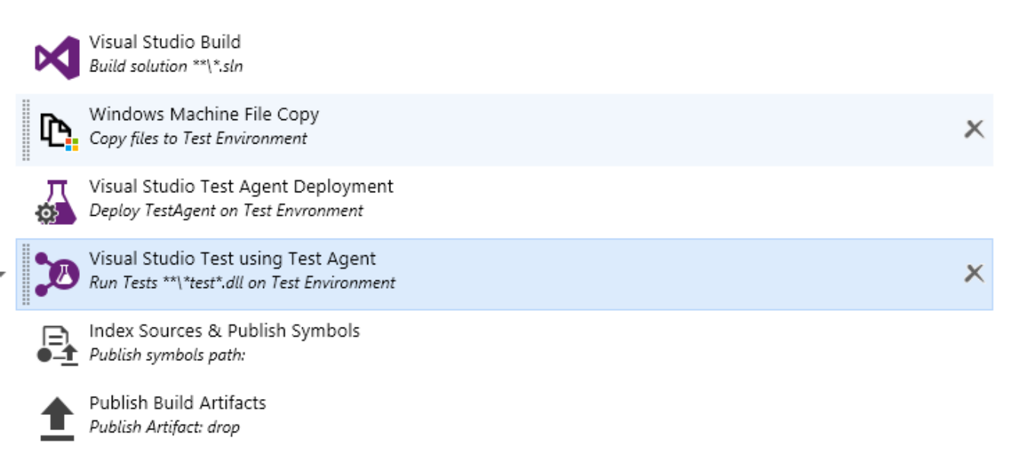
Build, deploy, and test in build (CI)

Slide 24
Test automation on Azure

Slide 25
Visual Studio Team Services (VSTS)
Version Control (Git or TFS)
Tools for agile teams
Continuous integration
Supported by a range of languages and tools
Open and extensible
Enterprise grade
Performance testing
Notes:
Store and collaborate on code with unlimited private repositories. Use Git for distributed version control to maximize collaboration or use Team Foundation version control (TFVC) for centralized version control. Collaborate on code easily with pull requests and code reviews, while defining and managing permissions to secure your repositories.
Be agile, on your terms. Capture, prioritize, and track work with backlogs and customizable Kanban boards. Work items link directly to code to ensure transparency, and can be used to build rich dashboards for easy reporting.
Catch quality issues early with continuous integration (CI) builds that compile and test your application automatically after any code change. Use continuous delivery to automatically deploy applications or websites that pass tests.
Use your favorite language and development tool. Version control supports any language, as well as any Git client (including Xcode). Java teams can access code and work items through free plugins for Eclipse and IntelliJ – and run continuous integration builds based on config files from Ant or Maven.
We make it easy to integrate your custom tool or third-party service with Visual Studio Team Services using open standards like REST APIs and OAuth 2.0. We also support a set of ready-made integrations that can be easily configured from your account dashboard.
Built on the enterprise-grade infrastructure of Microsoft Azure, and backed by a 99.9% SLA, your data can be stored in local datacenters to increase performance and safeguard compliance. Support for Azure Active Directory (AAD) makes it easy to manage entire organizations.
Make sure your code can stay up and running with cloud-based load testing. Generate tests from regions around the world to simulate the scale of hundreds of thousands of users.

Slide 26
Before you get started
Get an Azure subscription.
Link your Azure subscription with Visual Studio Team Services (VSTS).
Install Visual Studio 2015 (Community Edition is Free)

Slide 27
Azure testing scenarios
Taking advantage of Azure for apps to deploy to testing
Taking advantage of Azure for test lab
Taking advantage of Azure for load testing

Slide 28
Taking advantage of Azure for Applications to deploy to testing
Choose your build agent
Deploy your application
Deploy your test agent
Start testing!

Slide 29
Build agent options
Azure-hosted build agent
On-premises build agent
Special considerations and cross-platform build agents

Slide 30
Application deployment
Build task
Azure resource group task
Certificates
Test data

Slide 31
Test agent deployment
Test machine resource group
Debug or release configuration
X86 or x64
Run settings (variables, paths, etc.)
Drop location
Test/dependent assemblies
Test matrix
Test options (code coverage, filters, parameters, etc.)

Slide 32
Taking advantage of Azure for Test Labs
Challenges
Test machines
Azure testing infrastructure
Other considerations

Slide 33
Challenges
Some IT departments struggle with the demands that teams need to enable business agility.
Requesting hardware for testing can take a long time.
Automated testing, mostly UI testing, can be slow and require a large number of resources.
Corporate policies often lock down the machines too much.

Slide 34
Test machines
Elastic or scalable architecture for running tests allows teams to provision additional hardware as their automated testing needs grow.
Machines can be shut down when not in use and turned on at the beginning of a test run and then shut back off at the end.
Pay only for what you use.
Connectivity to on-premises resources without having to join Azure VMs to the domain.
MSDN for dev/test provides teams with a number of benefits.

Slide 35
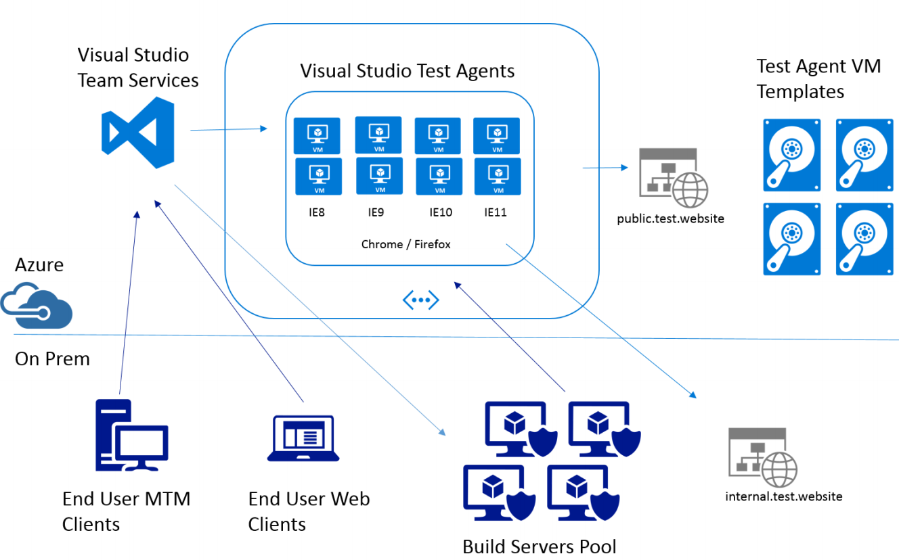
Azure testing infrastructure

Slide 36
Other considerations
Azure dev/test lab
System under test
Infrastructure as code (IaC)

Slide 37
Module review
In this module, you learned how to:
Implement a thorough testing plan for cloud applications.
Notes:
Title: Module Review
Length: 2 minutes
Participant Notes: <include summary of screen text as it may be hard to read in Participant Guide>
In this module, you learned how to:
Implement a thorough testing plan for cloud applications.
Start Time xx:xx / Length: 2 minutes
Review the objectives for this module.
Ask participants to use the Text tool to write on the screen if they had any questions about the module.

