Slide 1
Release Management

Slide 2
Objectives
After completing this module, you will be able to:
Process regular releases into a cloud first environment.
Notes:
Title: Objectives
Length: 2 minutes
Participant Notes:
After completing this module, you will be able to:
Process regular releases into a cloud first environment.
Make sure you address what this course will NOT cover based on experience.
Start Time xx:xx/Length: 2 minutes
Review the learning objectives.

Slide 3
Agenda
Release management overview
Stakeholders
Release management process

Slide 4




End-to-end DevOps
1
4
Plan
Monitor + Learn
Development
Operations
2
3
Develop + Test
Release
Notes:
Modern application lifecycle management practices enable teams to support a continuous delivery cadence that balances agility and quality, while removing the traditional silos separating developers from operations and business stakeholders.: This improves communication and collaboration within development teams, and drives connections between application and business outcomes. We see three key metrics that are critical to an organization’s ability to enable value delivery with agility and quality. First, the flow of business value must be measured and improved. Understanding what provides business value, and delivering those features on a sustained, regular cadence is key. The second is having the ability to identify and remove bottlenecks to shorten cycle times for delivering those business values. It’s not enough to simply deliver regularly, but also efficiently. And finally, identify and reduce sources of rework, such as bugs, incorrectly specified features, etc.

Slide 5
Release management definition
Release management encompasses the planning, design, build, configuration, and testing of hardware and software releases to create a defined set of release components.

Slide 6
Why Release Management matters
Agility help business adapt to change
Knowing what is deployed
Knowing when something is deployed
Notifying the users
Change breaks things
SLAs

Slide 7

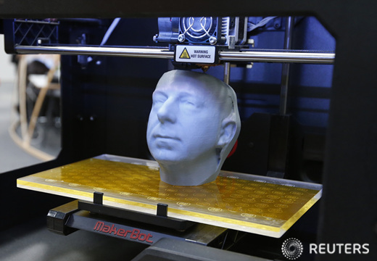
Release management and cloud
Previously
Long time between major releases
Adoption of latest versions lacking
Cloud
Continuous releases
Always in production

Slide 8
Release management
Development
Test/QA/Preproduction
Production
Release Management
Software design
Code coverage
Automated tests
Quality reviews
Performance tests
Validation

Slide 9
Release management stakeholders
Development team
Test team
Release management team
Operations team
End user/customer enablement team

Slide 10
Office release management Communication channels

Slide 11
Roles
Release management process owner
Aligns with the wider organization
Ensure executive support
Release manager
Develops release strategy
Works closely with test manager
Test manager
Ensures test coverage
Release owner
Owns the current release

Slide 12
Developing for release management

Slide 13
Development strategy
Coding guidelines
Commenting
modularity
build numbers
Instrumentation
Logging
Local versus cloud
Testing plans
Code coverage
Automated tests
Release to test

Slide 14
Instrumentation
To enable insight into the application’s performance/usage
Application Insights
HockeyApp
Will be covered in the monitoring module

Slide 15
Environments

Slide 16
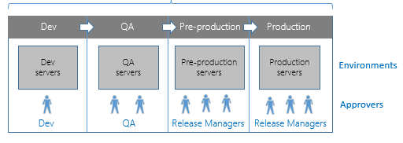
Environments
Dev
1:n Developer environments
Test
For feature test
QA
For functionality test
Preproduction
For production like usage with real data
Production

Slide 17
Environments
Mimic production
Use Azure Resource Manager templates
Precreate as needed
Things to look out for
AD/Azure AD integration
LoB integrations

Slide 18
Test and quality assurance

Slide 19
Testing and quality assurance
Quality assurance (QA) is a way of preventing mistakes or defects in manufactured products and avoiding problems when delivering solutions or services to customers
Software testing is an investigation conducted to provide stakeholders with information about the quality of the product or service under test

Slide 20
Testing
Provides the gates that the solution need to pass in order to be deployed to the next environment
Automated tests (software)
User Acceptance tests (people)
See the automated testing module for more information

Slide 21
Quality assurance
Validates that the solution meets the quality bars
All use cases can be met
The UX etc. is meeting the requirements
Typically done by testers (not automated)
All known defects are assessed

Slide 22
Release

Slide 23
Release
Deployment to the different environments
Test
QA
Preproduction
Manage configuration settings
Connection strings
Identities

Slide 24
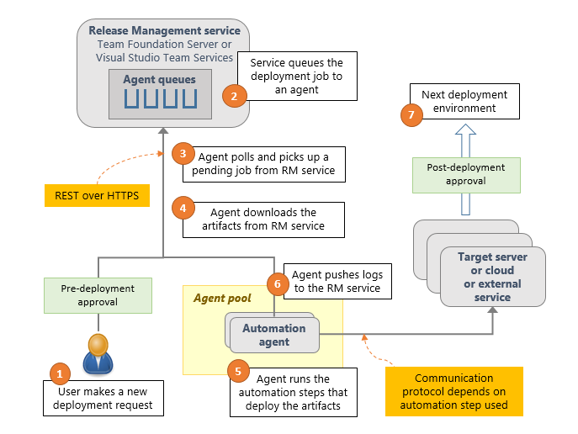
Release management workflow in VSTS

Slide 25
Release management workflow in VSTS
Create release definitions
Add environments
Add tasks.
Create and deploy releases
Track deployments

Slide 26
Module review
In this module, you learned how to:
Process regular releases into a cloud first environment.
Notes:
Title: Module Review
Length: 2 minutes
Participant Notes: <include summary of screen text as it may be hard to read in Participant Guide>
In this module, you learned how to:
Process regular releases into a cloud first environment.
Start Time xx:xx/Length: 2 minutes
Review the objectives for this module.
Ask participants to use the Text tool to write on the screen if they had any questions about the module.

