Slide 1
Continuous Deployment
Instructor: Wasim Bloch

Slide 2
Objectives
After completing this module, you will be able to:
Implement common use cases for continuous deployment on Microsoft Azure.
Notes:
Title: Objectives
Length: 2 minutes
Participant Notes:
After completing this module, you will be able to:
Implement common use cases for continuous deployment on Microsoft Azure.
Make sure you address what this course will NOT cover based on experience.
Start Time xx:xx / Length: 2 minutes
Review the learning objectives.

Slide 3
Agenda
Why continuous deployment?
Continuous delivery versus deployment
Package management and dependencies
Site slots
Demo
Summary and next steps

Slide 4
Why continuous deployment?
Reduced cost, time and risk
Rapid delivery of incremental changes
Improved business competency
Testing is not a phase
Reduced deployment times
Small incremental changes, faster business value
Releasing as frequently as possible
Collaboration
“Devops culture”
Developers, testers, systems and database administrators, managers.
Repeatable and reliable releases
“Push button” automation
Deployment to any environment
Source control for traceability
Humble, J. & Farley. D. (2010) Continuous Delivery: Reliable Software Releases through Build, Test and Automation Deployment, Addison-Wesley Professional; 1st edition (27 July 2010)
Notes:
Code rots if it doesn’t run somewhere. External dependencies are updated, server packages installed, API’s change or operating systems replaced. Often we do not have the ability to control every part of our infrastructure. We rely on other products and companies to maintain parts of our stack. All of these changes can break your app without you realizing it.
Continuous Delivery is another subset of agile which in which the team keeps its software ready for release at all times during development. It is different from “traditional” agile in that it does not involve stopping and making a special effort to create a releasable build.
Agile introduces the idea that the team should get their software ready for release throughout development. Many variations of agile (which I refer to as “traditional agile” in this post) believe this should be done at periodic intervals.
Scope: code, infrastructure, configuration, data platform
A standard practice with Continuous Delivery is automatically deploying every build that passes basic Continuous Integration to an environment that emulates production as closely as possible, using the same deployment process and tooling. This is essential to proving whether the code is ready for release on every commit, but this is more rigorous than many development teams are used to having in their CI.
Releasing as frequently as possible minimises changes between releases
Lean start-ups like IMVU release up to 50 times per day while modern companies like Google and Mozilla only take a couple of weeks in between releases

Slide 5
Continuous delivery versus deployment
Notes:
Continuous delivery is a series of practices designed to ensure that code can be rapidly and safely deployed to production by delivering every change to a production-like environment and ensuring business applications and services function as expected through rigorous automated testing. Since every change is delivered to a staging environment using complete automation, you can have confidence the application can be deployed to production with a push of a button when the business is ready.
Continuous deployment is the next step of continuous delivery: Every change that passes the automated tests is deployed to production automatically. Continuous deployment should be the goal of most companies that are not constrained by regulatory or other requirements.

Slide 6



Continuous Delivery
SOURCE and BUILD
QA ENVIRONMENT
Value
Optimized resources
Accelerate delivery
Measure
Deployment frequency
MTTR
Availability
DEV
OPS
Notes:
MTTR – Mean Time to Resolution - MTTR is an Industrial Age metric that measures the time from a problem arises to the time it solved from a problem arises to the time it solved

Slide 7
Continuous Deployment (Release)
SOURCE REPO
DEV
Value
Optimized Resources
Accelerate Delivery
STAGE
Measure
Deployment Frequency
MTTR
Availability
PRODUCTION
DEV
OPS

Slide 8
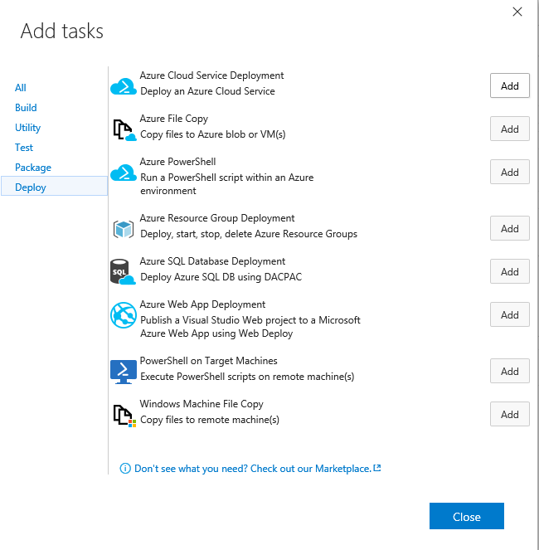
Enable continuous deployment with build
Add deployment tasks to your build pipeline
Configure and deploy to Azure site/slot
Notes:
Title: Questions?
Length: 5 minutes
Start Time xx:xx / Length: 5 minutes
Invite participants to ask final questions about the content or anything else they are concerned about.
“Before we discuss the homework assignment and conclude this session, does anyone have any final questions for me? If so, type your name or your question on the screen.”
Follow up with anyone who poses a question.

Slide 9
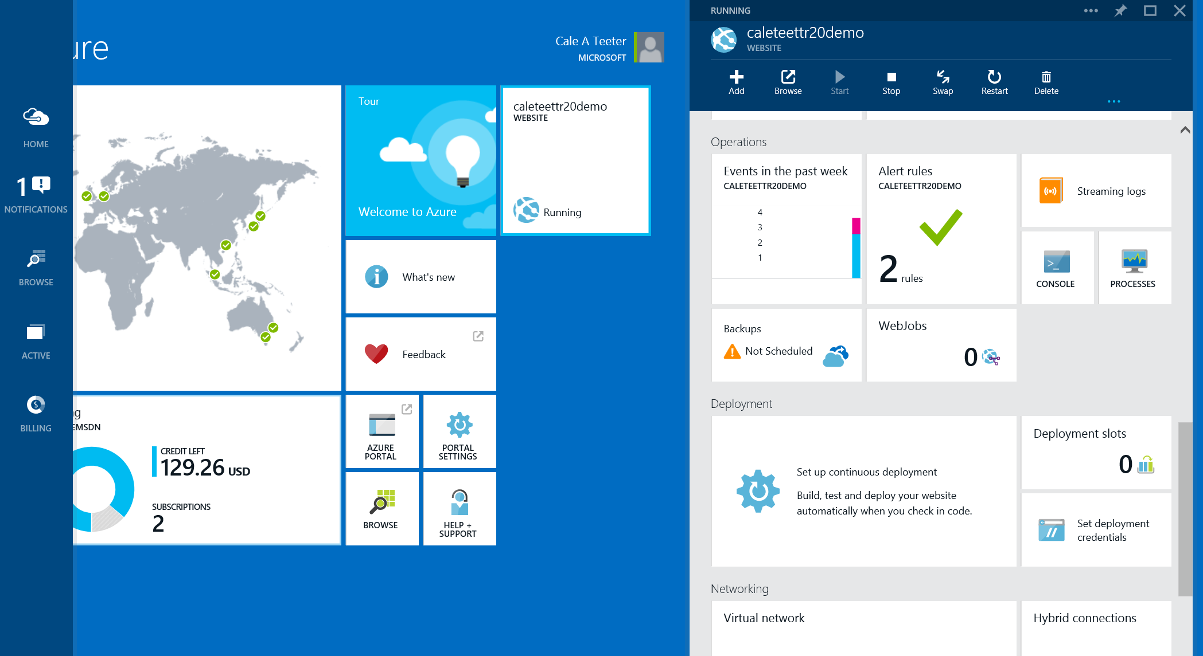
Azure websites—deployment slots
Live sites with own hostnames
Alpha numeric only! + hyphens
Requires standard mode plan
Can swap for prod
Swap the slots to rollback
Up to four additional deployment slots (for a total of five)
http://<yourWebsiteName>-<deploymentSlotName>.azurewebsites.net

Slide 10
Deployment slots/VIP swap
Swaps staged deployments
Called a Virtual IP or VIP swap as it swaps the addresses of two deployments
No downtime during VIP swap
Sites are warmed up behind the scenes prior to swap
Notes:
Talking Point: While it seems simple to never add an endpoint you need to explain that adding RDP will add an endpoint to your service which means if you want to use VIP swap you can’t enable/disable RDP that way!
Staged deployment allows you to deploy and test your service before going live in production. With VIP Swap, you are basically, swapping staging and production environment and vice versa. Emphasize that no downtime is incurred during the swap.
http://msdn.microsoft.com/en-us/library/ee460814.aspx
http://msdn.microsoft.com/en-us/library/ee517253.aspx

Slide 11
Continuous deployment with Azure

Slide 12
Module review
In this module, you learned how to:
Implement common use cases for continuous deployment on Microsoft Azure.
Notes:
Title: Module Review
Length: 2 minutes
Participant Notes:
In this module, you learned how to:
Implement common use cases for continuous deployment on Microsoft Azure.
Start Time xx:xx / Length: 2 minutes
Review the objectives for this module.
Ask participants to use the Text tool to write on the screen if they had any questions about the module.

