Slide 1
Modern Application Monitoring

Slide 2
If you can not measure something, you can not understand it. If you can not understand it, you can not control it. If you can not control it, you can not improve it. H. James Harrington, Productivity Guru
Notes:
Modern workloads and applications tap into a variety of services, and are often spread across on-premises servers and the public cloud. Monitoring these environments is a change from traditional systems. With all of the data being generated by our systems, how do we get our arms around what is happening? How do we leverage that data to make better informed decisions? How can we better understand? This is where monitoring and diagnostics techniques can help you to understand and support the users of your systems, and empower them to work more efficiently.

Slide 3
Objectives
After completing this module, you will be able to:
Integrate Microsoft Azure tools and techniques for managing telemetry within an application.
Notes:
Title: Objectives
Length: 2 minutes
Participant Notes:
After completing this module, you will be able to:
Integrate Microsoft Azure tools for managing telemetry within an application.
Make sure you address what this course will NOT cover based on experience.
Start Time xx:xx / Length: 2 minutes
Review the learning objectives.

Slide 4
Agenda
Out of the box platform capabilities
Monitoring environments from the outside in
Monitoring applications from the inside out

Slide 5
Out of the box

Slide 6
Service metrics
All Azure services track key metrics for monitoring health, performance, and availability
Can be viewed in the portal or via REST API
Toggle on diagnostics for some services
Configurable via ARM
Notes:
https://azure.microsoft.com/en-us/documentation/articles/insights-service-health/
http://azure.microsoft.com/en-us/documentation/articles/insights-receive-alert-notifications/
https://azure.microsoft.com/en-us/documentation/articles/insights-how-to-customize-monitoring/
All Azure services track key metrics that allow you to monitor the health, performance, availability and usage of your services. In the Azure Portal, you can configure rich, frequent, monitoring and diagnostics data about your resources. You can also use the REST API or .NET SDK to configure diagnostics programmatically.
Diagnostics, monitoring and metric data in Azure is saved into a Storage account of your choice. This allows you to use whatever tooling you want to read the data, from a storage explorer, to Power BI to third-party tooling.

Slide 7
Out of the box service monitoring

Slide 8
Monitoring from the outside in

Slide 9
Operations Management Suite
Big data solution for logs
Single pane of glass for monitoring VMs
Interact with log data via search and solutions
Customizable dashboards per user
Near real time log monitoring

Slide 10



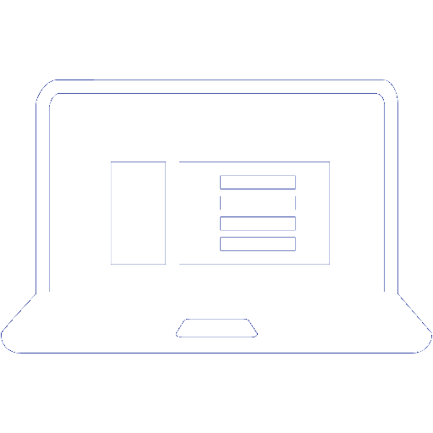
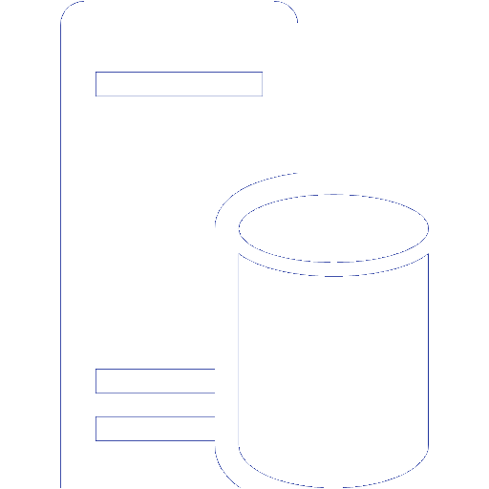
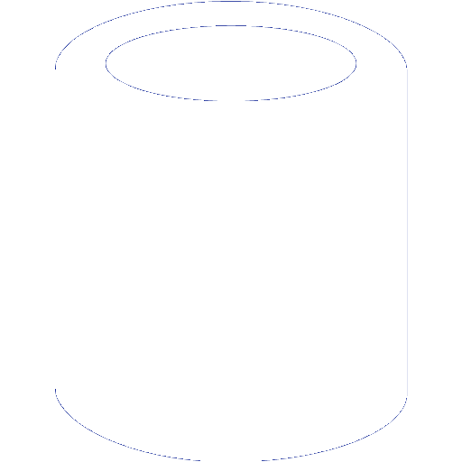



OMS architecture
OMS Workspace
VM with Agent
Azure VM with Agent
Other Clouds
OMS Service
VM with Agent
SCOM Management Server
Blob Storage
OMS Repository
VM with Agent
Clients
On Premises
Azure

Slide 11
Searching through data
Command syntax heavily influenced by PowerShell
Fast performance against millions of records
Easily export search results to CSV/Excel
Notes:
https://azure.microsoft.com/en-us/documentation/articles/operational-insights-search/
At the core of Microsoft Azure Operational Insights is the log search feature which allows you to combine and correlate any machine data from multiple sources within your environment. Solutions are also powered by log search to bring you metrics pivoted around a particular problem area.
On the Search page, you can create a query, and then when you search, you can filter the results by using facet controls. You can also create advanced queries to transform, filter, and report on your results.
Common log search queries appear on most solution pages. Throughout the Operational Insights console, you can click tiles or drill in to other items to view details about the item by using log search.

Slide 12
Solutions
Solutions are a set of data acquisition rules coupled with analytics logic and visualization that address key challenges for customers.

Slide 13
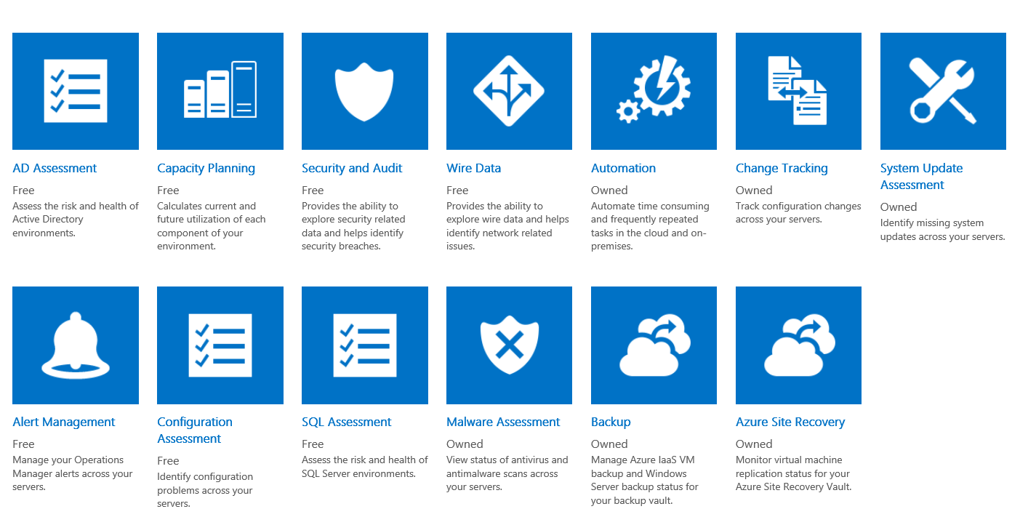
Solutions gallery
Notes:
The Solutions Gallery is a growing list of solutions designed to help customers address common scenarios. They are currently all built by Microsoft and free to use, but

Slide 14
Custom dashboards
Pin commonly used search queries and reports to your dashboard for a tailored experience that saves time and enhances focus
Notes:
https://azure.microsoft.com/en-us/documentation/articles/operational-insights-use-dashboards/

Slide 15
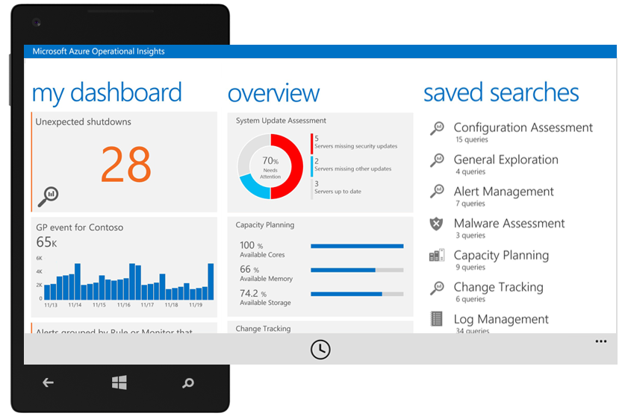
Monitoring on the go

Slide 16
Monitoring from the inside out

Slide 17
Application Insights
Consolidated analytics across server and client
Analyzes usage patterns
Detect, triage, and diagnose performance issues
Support for mobile and web applications
Built-in tooling for a variety of IDE’s and frameworks
Notes:
Built-in Analytics - Fully integrated with development tools across multiple platforms
Deep Insights - Explore and analyze across dimensions to make informed prioritization decisions
360° View - 360° view of your app with availability, performance and user behavior

Slide 18
Sources of telemetry data
Outside-in monitoring
Observed application behavior
1
4
URL pings and web tests from 16 global points of presence
No coding required—service dependencies, queries, response time, exceptions, logs, etc.
Observed user behavior
5
Infrastructure performance
2
Real user monitoring for deeper diagnostic insights
System performance counters
Developer traces and events
3
Whatever the developer would like to send to Application Insights

Slide 19


Controlling data flow
Application
Insights
Application
Adaptive Sampling
Fixed-Rate Sampling
Filtering
Application
Ingestion
Sampling
Application
Notes:
Sampling is the recommended way to reduce traffic while preserving accurate statistics. The filter selects items that are related so that you can navigate between items in diagnosis. Event counts are adjusted in metric explorer to compensate for the filtered items.
Adaptive sampling is recommended. It automatically adjusts the sampling percentage to achieve a specific volume of requests. Currently available for ASP.NET server-side telemetry only.
Fixed-rate sampling is also available. You specify the sampling percentage. Available for ASP.NET web app code and JavaScript web pages. The client and server will synchronize their sampling so that, in Search, you can navigate between related page views and requests.
Ingestion sampling operates as the telemetry is received at the Application Insights portal, and so it can be used no matter what SDK you're using. It doesn't reduce telemetry traffic on the network, but it reduces the volume processed and stored in Application Insights. Only the retained telemetry counts in your monthly quota.
Per https://azure.microsoft.com/en-us/documentation/articles/app-insights-api-filtering-sampling/#sampling

Slide 20
End to end telemetry with Application Insights

Slide 21






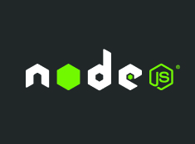


Supported platforms and languages
Any platform—any app
On-Prem, Azure, AWS, Google Cloud, App Stores
Open source SDKs https://github.com/Microsoft/ApplicationInsights-Home
Logging frameworks Log4Net, nLog, System.Diagnostics, Log4J, Logback
Notes:
Application Insights offers SDKs for a variety of programming languages, all available on GitHub.
Also, if you currently collect log data from services such as Log4Net, nLog, etc. you can send that data into App Insights for integration with data from other sources.
https://azure.microsoft.com/en-us/documentation/articles/app-insights-asp-net-trace-logs/

Slide 22
Module review
In this module, you learned how to:
Integrate Microsoft Azure tools for managing telemetry within an application.
Notes:
Title: Module Review
Length: 2 minutes
Participant Notes: <include summary of screen text as it may be hard to read in Participant Guide>
In this module, you learned how to:
Integrate out of the box performance metrics, Operations Management Suite, and Application Insights for managing telemetry with Azure solutions.
Start Time xx:xx / Length: 2 minutes
Review the objectives for this module.
Ask participants to use the Text tool to write on the screen if they had any questions about the module.

