Slide 1
DevOps Landscape

Slide 2
Objectives
After completing this module, you will be able to:
Apply common practices across the DevOps landscape.
Notes:
Title: Objectives
Length: 2 minutes
Participant Notes:
After completing this module, you will be able to:
Apply common practices across the DevOps landscape.
Make sure you address what this course will NOT cover based on experience.
Start Time xx:xx / Length: 2 minutes
Review the learning objectives.

Slide 3
Agenda
Discuss common DevOps adoption blockers
Introduce metrics and telemetry models

Slide 4




DevOps
1
4
Plan
Monitor + Learn
Development
Production
2
3
Develop + Test
Release

Slide 5
The Process and Culture
Common misconceptions
Ops now have to learn how to code
You are automating my job away
ITIL and ITSM does not work with DevOps
Webops
NoOps
Enterprise DevOps
Internet and web projects
Good for new projects
Good for no projects
Cross functional teams
Shared services
Small teams

Slide 6
Session takeaways
DevOps is about business value
DevOps is meant to increase production flow by reducing friction
DevOps will decrease risk by increasing quality

Slide 7
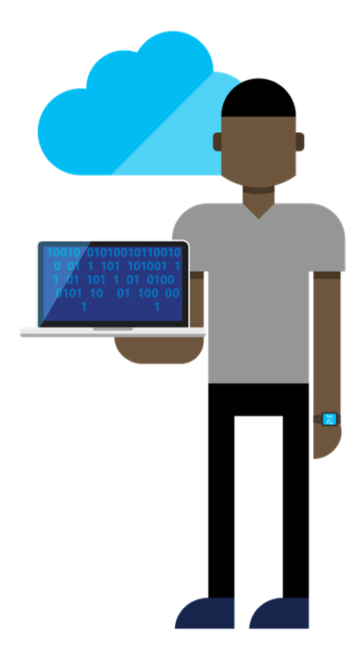

DevOps Capability Areas
Capacity management
Production management
Monitoring
Problem management
Change management
Service design
Service management
How much, big, far
Incident management
Problem resolution
Telemetry
Logs
Alerting
Trends, recurring issues
Root cause
Provisioning New/Updates
Configuration management
Orchestration
Architecture
SLAs and uptime
Costing and budgeting
Automation
Communication
Metrics and visualization
Scalability
Management
Security
Peer reviews
DEV
OPS
Notes:
From http://stories.visualstudio.com/devops/

Slide 8
Legacy Application
Notes:
Show the iBuySpy app. IaaS with sql and ASP net

Slide 9
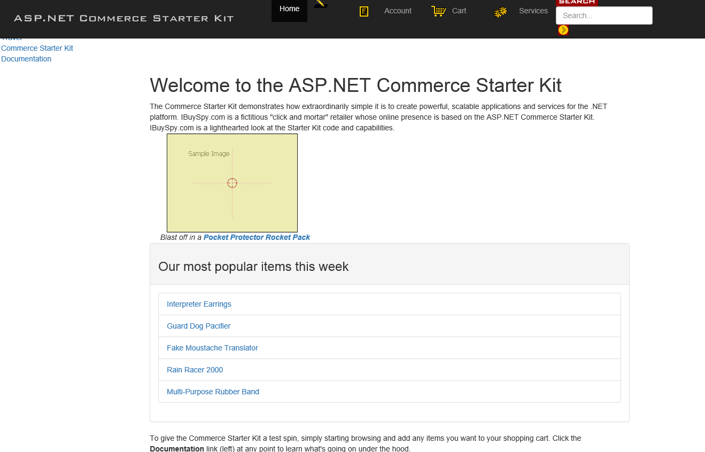

Slide 10
DevOps is about business value

Slide 11
How do businesses transform?
Do nothing
Start from scratch
Adopt modern ALM
People
Process
Tools
Notes:
Increase quality of feedback
Testing in an environment close to prod
Reduce time and resources between commit-to-prod
Improve deployment repeatability

Slide 12
Why business outcomes?
Budgets (Capital versus OpEx)
Design/architecture
Metrics
Success criteria
Telemetry and
monitors
Capture points
Data capture models
Dashboards
KPIs and ROI
Implementation
Requirements

Slide 13
IBuySpy - Business outcomes
Provide developers a faster release cycle
Predictable environment for testing
Blob storage
Provide Ops with better visibility into site health
Enable continuous integration
Add OMS for IaaS
Allow marketing to update product metadata and assets
Add App Insights
Refresh the UI with minimal impact
Feature flags with UI
Enable continuous deployment
Azure Functions for resizing
ARM templates
Sample Data

Slide 14
Getting Started
Notes:
Show legacy app deployed to IaaS
Show ARM templates, CI, and CD with PaaS
Minimal changes to app architecture, just CI and CD
Build pipeline

Slide 15
DevOps is meant to increase production flow by reducing friction

Slide 16
Where Do You start?
Business logic
Applications
Services
Infrastructure

Slide 17
Start with System Constraints (Pressures)
Constraints usually take one of three forms:
Resource constraints
Policy constraints
Permanent constraints
Typical bottlenecks
Immature processes
Environment procurement and creation
Development
Test setup and run
Tightly coupled architecture
Product management
Notes:
Resource constraints—resources such as one particular machine (or no. of workers, or cash) which blocks the flow based on it's limited capacity with respect to executable orders in hand.
Policy Constraints—policies, practices or metrics that artificially distort flow due to their poor alignment to the overall performance of the system.
Permanent Constraints—limiting factors that are always present in every business such as sales skill (the ability to charge higher prices for the exact same products), R&D/new product development/innovation (the ability to create amazing new products that customers love) and management attention (the ability of managers to focus on and solve the problem at hand).

Slide 18
IBuySpy - Identifying System Pressures
Code Updates
Dev
Dev
and
Ops
Operations
WFE
WFE
Asset Updates
Marketing
Code
Code
Support
UI Updates
Assets
Assets
Catalog Updates
Product managers
DB
Finance
Reporting
Orders
Inventory
People, processes, and tools

Slide 19
Reducing Constraints (Pressures)
Start with business objectives
Incremental process improvements
Learn and adjust—have patience
Tackle in layers—management, tooling, infrastructure
Notes:
Book—A Practical approach to large scale enterprise development

Slide 20
Code: Build a streamlined build pipeline
Develop
Build/integrate
Validate
Deploy
Operate

Slide 21
Code: Build a streamlined build pipeline
Have versioning and rollback strategies
Use loose coupling
Localize issues/offending code when possible
Use canary deployments
Test looks like prod
Microservices versus monolithic architectures
Use gated check-ins to reduce broken builds
Define a release cadence and synchronization
Consider a shared service for continuous delivery
Reduce batch size for changes

Slide 22
Code: Build Pipeline Components
Configuration management
Build platform
Compilation
Provisioning
Deploy and test

Slide 23
Operations: Better problem resolution
Problem
Fixed
Freaking out
Not talking
Finding fault
Blaming
CYA
Whining
Hiding
Hurt egos
Figuring it out
Fixing things
Time
Credit: John Allspaw, 10+ Deploys Per Day: Dev and Ops Cooperation at Flickr

Slide 24
Collaborative problem resolution
Problem
Fixed
Figuring it out
Fixing things
Feeling guilty
(RCA/Post mortem)
Move on with life
(Telemetry, process updates)
Time
Credit: John Allspaw, 10+ Deploys Per Day: Dev and Ops Cooperation at Flickr

Slide 25
Operations: ITIL, ITSM, and CM
Agree on what is a change?
Distinguish between planned versus unplanned work
Understand process versus approvals
Revisit old rules

Slide 26
Operations: Manage technical debt
Have a process for identification
Resolve early and often (reduce bug-only sprints)
Move from code-freezes to CI+CD
Communicate compliance, privacy, multilingual, and accessibility requirements
Implement a code review process
Create a plan for sample data

Slide 27
Operations: Define Incident flow
Detect
Triage
Communicate
Manage
Resolve
Review

Slide 28
Operations: Define Alerting model
Alert/
notify
Assess
Communicate
Diagnose
Mitigate
Root cause
Analyze

Slide 29
IaaS to PaaS migration with feature flags
Notes:
Add app insights
Start to separate functions, minimal impact
Introduce caching, move images to blob storage
Introduce caching and CDN
Introduce traffic manager and new PaaS catalog site

Slide 30
IBuySpy - Business outcomes
Provide developers a faster release cycle
Predictable environment for testing
Blob storage
Provide Ops with better visibility into site health
Enable continuous integration
Add OMS for IaaS
Allow marketing to update product metadata and assets
Add App Insights
Refresh the UI with minimal impact
Feature flags with UI
Enable continuous deployment
Azure Functions for resizing
ARM templates
Sample Data

Slide 31
Decreasing risk by increasing quality

Slide 32
Operational questions
How do I know I have a problem?
How do I isolate a problem?
How do I diagnose a problem?
How do I correlate a problem?

Slide 33
Building a telemetry health model
Developer
Define health model
Author alerts
Author diagnostics
Author reports
Tester
Define test plan
Validate telemetry
Operations
Training

Slide 34
VSO DevOps Live site—model overview
Telemetry
Alerts—define health alerts for failure modes
Diagnostics—deliver instrumentation data and operational reports
Troubleshooting guides—guidance for investigating and alert
Failure mode testing—ensuring alerts fire
Onboarding—new alerts
Incidents
Detection—health issues and start the fix process
Triage—critical alert confirmation and guidance
Escalation—On call rotation (Dev and Ops)
Incident management—troubleshooting and communication
Resolution—service restoration and root cause
Reviews
Goal—provide visibility
Cadence—weekly
Audience—leadership and key stakeholders
Ownership—dev and ops
Driving improvements—bugs, gaps, and repeat issues

Slide 35
Legacy app with PaaS

Slide 36
IBuySpy - Business outcomes
Provide developers a faster release cycle
Predictable environment for testing
Blob storage
Provide Ops with better visibility into site health
Enable continuous integration
Add OMS for IaaS
Allow marketing to update product metadata and assets
Add App Insights
Refresh the UI with minimal impact
Feature flags with UI
Enable continuous deployment
Azure Functions for resizing
ARM templates
Sample Data

Slide 37
Looking ahead

Slide 38
Incidents as work items and/or bugs
Details
Time stamp, detection method and source, category, state, severity
Timeline
Review
Impact
Root cause
Mitigation
Problem management
Notes and attachments

Slide 39
Open questions
DevOps with Azure AD
Azure ML
Stream analytics
Dev/Test labs
API versioning
DB versioning
Mixed environments
Polyglot languages
Mac/win
Mobile
Language and tools
Containers, IaaS, PaaS

Slide 40
Module review
In this module, you learned how to:
Apply common practices across the DevOps landscape.
Notes:
Title: Module Review
Length: 2 minutes
Participant Notes:
In this module, you learned:
Apply common practices across the DevOps landscape.
Start Time xx:xx / Length: 2 minutes
Review the objectives for this module.
Ask participants to use the Text tool to write on the screen if they had any questions about the module.

