Slide 1
Questions: brand@microsoft.com

Slide 2
Agenda
Code samples
Bot sample
Connector

Slide 3
Links
https://msdn.microsoft.com/en-us/microsoft-teams/teamsapps

Slide 4
Sideloading your app in a team

Slide 5
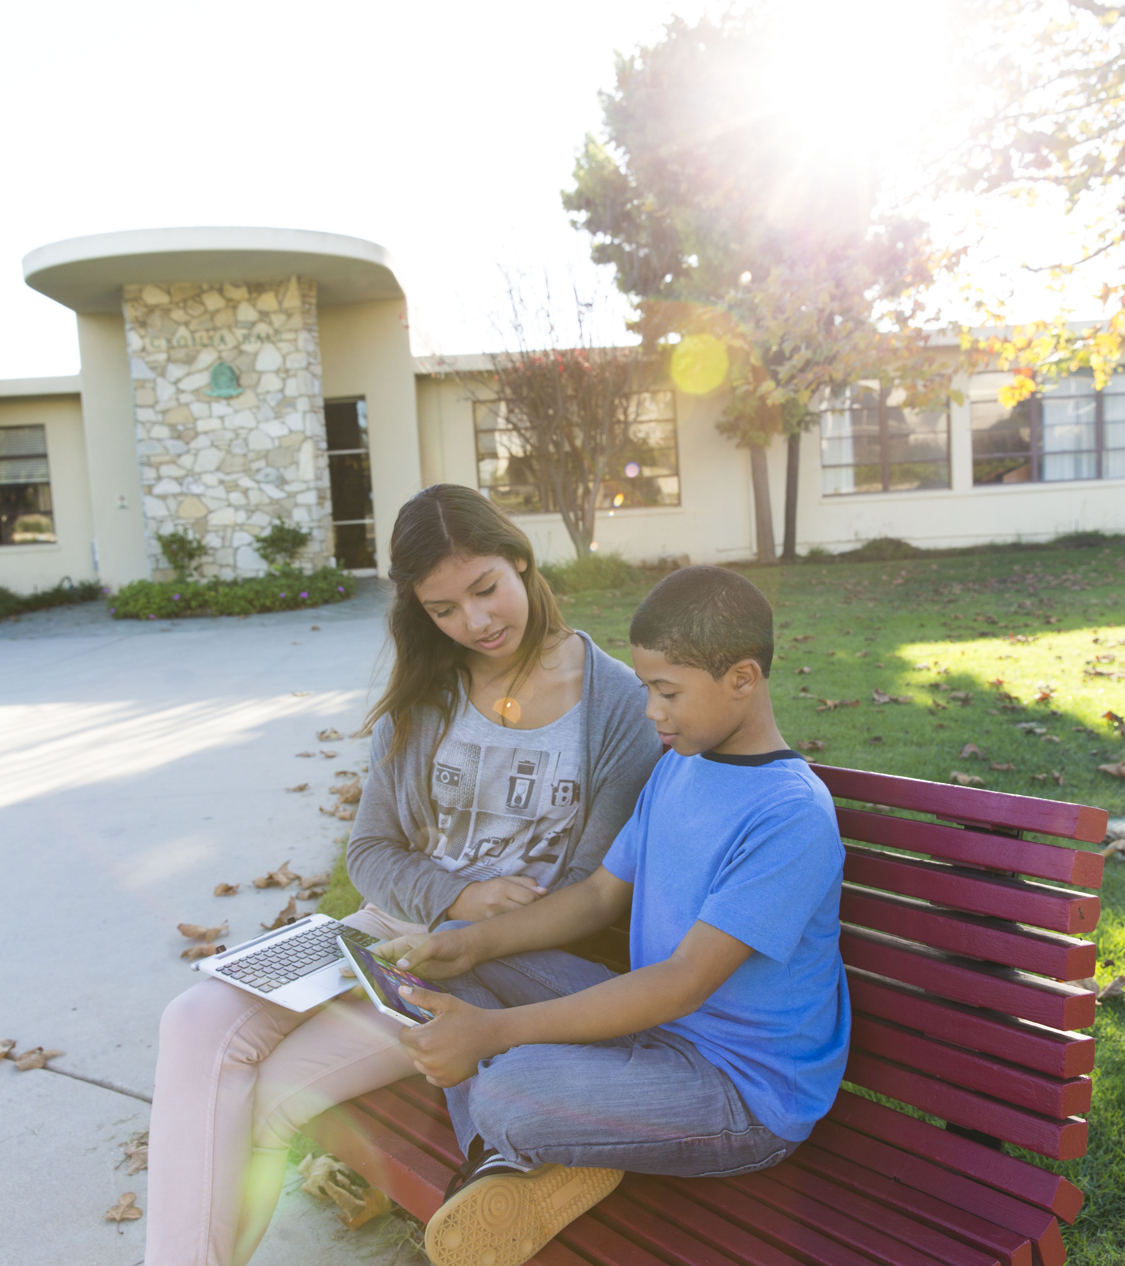
Questions?

