Slide 1
Internet of Things (IoT)
Notes:
Suggested introduction:
Faced with _______
We did _______
And discovered_______

Slide 2
Agenda
IoT on Azure
Devices
IoT Hub
Device Management
Analytics
Presentation
Security

Slide 3
IoT on Azure

Slide 4
Defining IoT
Things
Connectivity
Data
Analytics
Notes:
Talking Points
The truth is, there is no standard definition for the Internet of Things. If you have heard or read about IoT, chances are you’ve come across a number of different perspectives
Despite how complex IoT seems, it essentially comes down to four areas:
Physical “things” such as line of business assets, including industry devices or sensors
Those “things” have connectivity to the internet, to each other, and to people
Those “things” collect and communicate data—this may include information gathered from the environment or inputted by users
And then there are analytics performed on that data that enable people or machines to take action
Transition:
So how do you apply these components or building blocks to your business transformation journey

Slide 5
Transforming Business
How can we make it happen?
Prescriptive
What will happen?
OPTIMIZATION
Predictive
FORESIGHT
VALUE
Why did it happen?
Diagnostic
INSIGHT
What happened?
Descriptive
HINDSIGHT
INFORMATION
Traditional BI
IoT + Advanced Analytics
DIFFICULTY
Notes:
Our customers want to transform data to intelligent action and reinvent their business processes.
To do this they need to more easily analyze massive amounts of data – so they can move from seeing “what happened” and understanding “why it happened” to predicting “what will happen” and ultimately, knowing “what should I do”. Only then can they create the intelligent enterprise.
From reactive to proactive
From contemplating what happened in the past & historical data to predicting what might happen in the future
From people & process -heavy decision making to automated machine assisted decision automation
With Digital transformation , business must develop a true Data culture to allow everyone in the organization to become data-driven decision makers.
So they must establish a data lifecycle method that accelerates the flow of data across the organization and transform data into insights , decision and actions

Slide 6
Microsoft’s investment principles for IoT
The Internet of Things starts with your things
Provide connectivity to both existing and new devices
Facilitate new insights by harnessing power of untapped data
Enable fast solution development
Notes:
Talking Points
Basically Microsoft’s goal is to help customers connect their devices whether new devices or existing.
Once we can connect devices at scale then we can help capture the untapped data – and all in a fast timeframe allowing you to realize value faster.
By providing the platform to build and customize from – you can accelerate your IoT journey
Our focus here is simply to enable customers to build an enterprise grade internet of their things solutions. Our goal is to provide the best platform to do this.
Transition
Let’s look at some real world examples

Slide 7
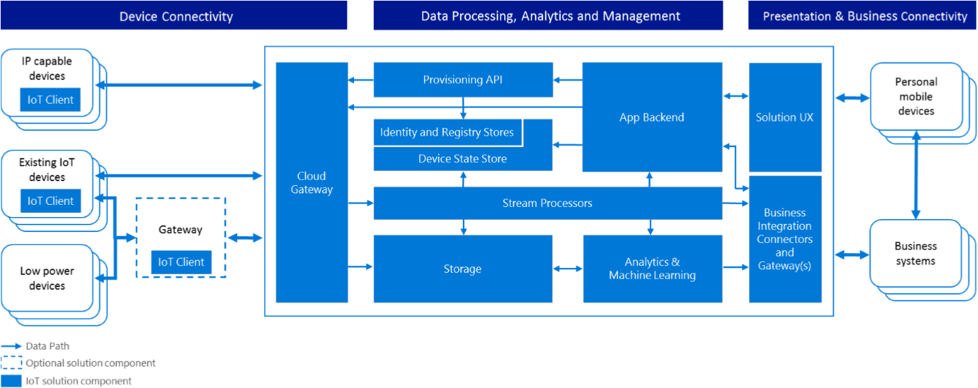
Azure IoT Reference Architecture
https://aka.ms/iotrefarch
Notes:
Describe the IoT Reference Architecture. How Microsoft views IoT. Point out that specific technologies are not identified meaning you have a great deal of flexibility to swap in/out Azure services and 3rd party solutions, including OSS.
As we go through this session we will be talking a lot about Azure IoT Suite and there you will see specific Azure services snapped to this reference architecture.

Slide 8
Azure IoT Suite

Slide 9

Microsoft Azure IoT Suite
Device Connectivity & Management
Data Ingestion and Command & Control
Stream Processing & Predictive Analytics
Workflow Automation
Dashboards and Visualization
Preconfigured Solutions
Notes:
Talking Points:
With the Microsoft Azure IoT Suite we give you a very comprehensive solution that’s designed to help you connect your devices, whether a few hundred or millions across the world, analyze all the data coming from these devices and take action from the insights by integrating with your back end systems. The Azure IoT Suite brings together and offer the following capabilities:
Device connectivity and management: Connect to millions of devices simultaneously. Enhance security of your IoT solutions by taking advantage of per-device authentication to communicate with devices that have the appropriate credentials. Revoke access rights to specific devices to maintain the integrity of your system.
Data Ingestion & Command & Control: Establish reliable, bi-directional communication with these assets, even if they are intermittently connected, and analyze—and act on—incoming telemetry data.
Workflow automation: Integrates with your company’s existing back-end systems to enable you to make the best use of the data and processes you already have. Whether it’s as simple as sending a text or integrating with your CRM or ERP system
Dashboards & Visualization: Create powerful and rich visualization experience and finally
Preconfigured solutions: One of the biggest value we can provide is helping you develop IoT solutions faster. This will not only allow you to do more PoCs and pilots, it will also help accelerate the long project cycles we spoke about earlier. We do this by offering preconfigured solutions for the more common IoT scenarios.

Slide 10
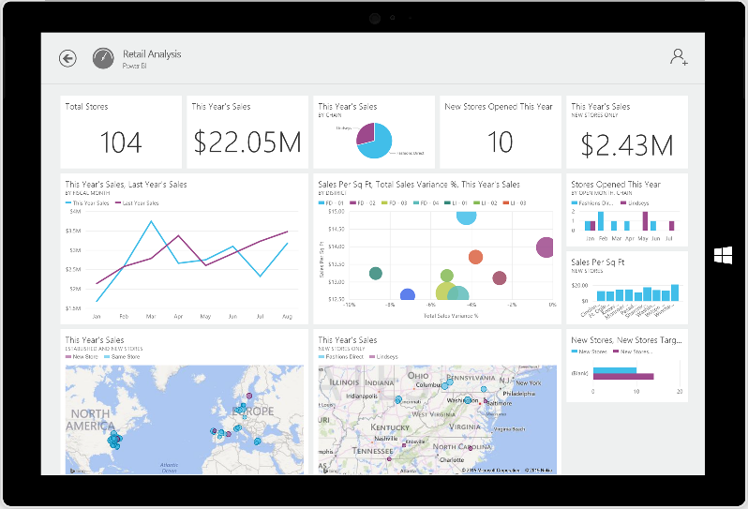
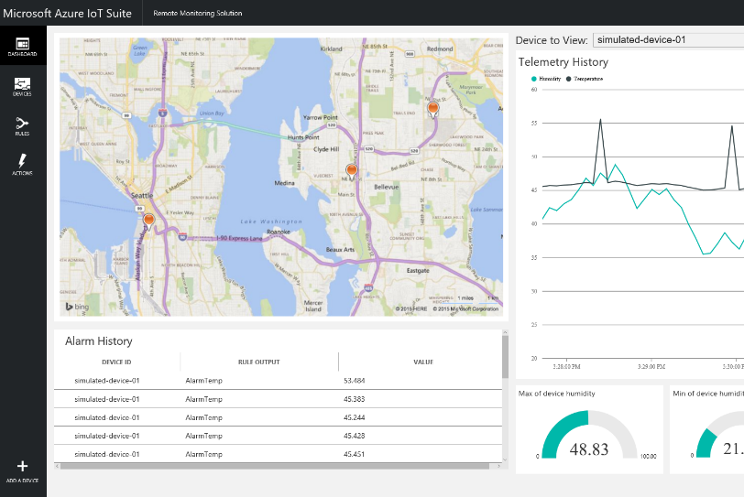
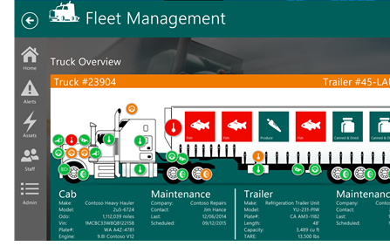
Azure IoT Suite – Preconfigured Solutions
Start quickly with preconfigured solutions
Finish with your Internet of Things application
Get started in minutes
Fine-tuned to specific assets and processes
Modify existing rules and alerts
Highly visual for your real-time operational data
Add your devices and begin tailor to your needs
Integrate with back-end systems

Slide 11
IoTSuite Remote Monitoring-Architecture
Azure IoT Suite Remote Monitoring
Web App / Portal
Power BI
Devices
(C# Simulator)
Back end systems and processes
Storage blobs
DocumentDB
IoT Hub
Stream Analytics
Event Hub
Web Jobs
Logic Apps
Azure
Active Directory

Slide 12
Introduction to Azure IoT Suite

Slide 13
Devices

Slide 14
Devices

Slide 15
IoT Hub

Slide 16
IoT Hub

Slide 17
IoT Hub Device Management (preview)

Slide 18
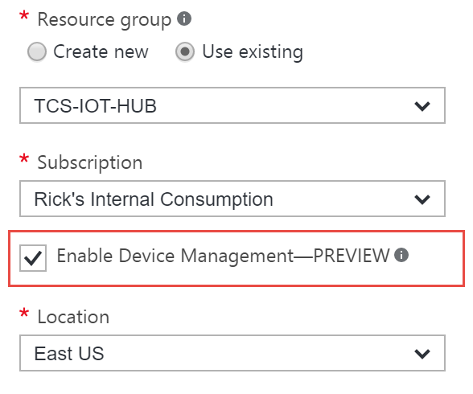
Device Management Concepts
Device Twin
Device Query
Device Job
Requires Device Management Capability in IoT Hub

Slide 19
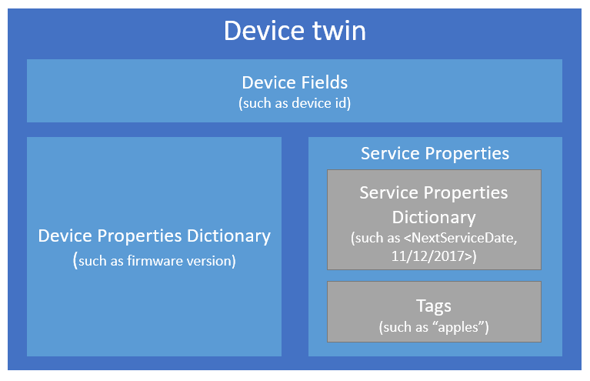
Device Twin
Devices fields used to identify and message to physical device
Device properties of the physical device (firmware, manufacturer, power level, etc.)
Service properties allow you to extend the schema for the physical device. Not synchronized to physical device.

Slide 20
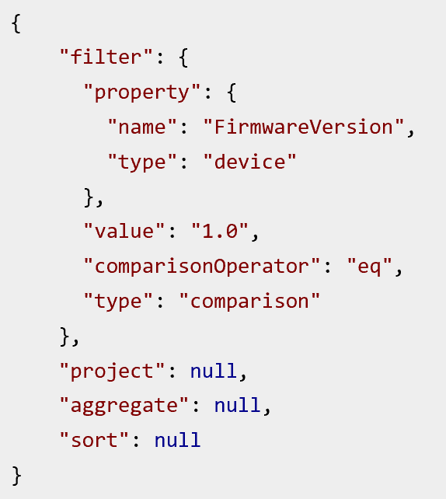
Device Query
Perform JSON query against device twin
Find device by querying device properties or tags in the device twin
Query device status (ex: firmware update)

Slide 21
Device Job Types
Firmware Update
Reboot
Factory Reset
Configuration Update
Read Property
Write Property

Slide 22
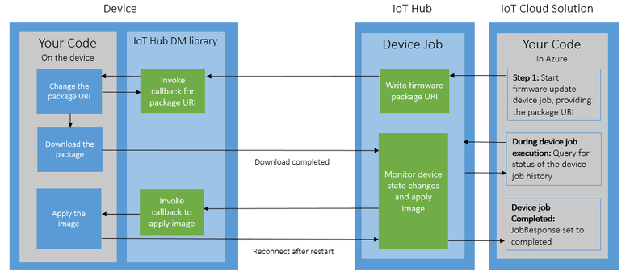
Device Firmware Update
https://aka.ms/iotfirmupdate

Slide 23
Analytics

Slide 24
Analytics

Slide 25
Presentation

Slide 26
Presentation

Slide 27
IoT Security Device-to-Cloud (D2C) Cloud-to-Device (C2D)

Slide 28
Defense Strategies
Will you defend a million tiny, underpowered, public network servers that must triage unsolicited traffic?
Or do you think they could use some help with defense?
Authentication Credentials Management
Authorization Policy Management
Denial of Service
Intrusion Detection
Auditing
Monitoring
Alerting
Notes:
Assume that breach can occur anywhere in your solution. And arguably the most vulnerable in an IoT solution is the device. Why? Devices often times don’t have the resources to protect themselves. They sit on cheap hardware and therefore usually lack sufficient power and compute resources to protect themselves. They may also be deployed in an untrusted physical space. This is particularly true in environments where devices already exist, such as brownfield scenarios.
Assuming this scenario for now, how would you defend the devices in a solution that scales to potentially millions of devices? Applying traditional techniques that we might apply to a server environment is not feasible. To meet this challenge, a service that is secure and hardened can be introduced to insure secure communication between devices. It can also facilitate secure communication to the cloud and potentially bi-directional messaging schemes.

Slide 29
Service Assisted Communication (SAC)
Principles used to establish trustworthy & bi-directional communication between systems & devices deployed in an untrusted physical space
Security trumps all other capabilities
Devices don’t listen for unsolicited traffic
Connections are device-initiated and outbound
System authentication and authorization must be based on device identity
Application data may be separately secured in transit through gateways
Notes:
So, the first pattern (or set of principles) that I want to bring to your attention is called Service Assisted Communication. These are principles that can be used to establish trustworthy and secure bi-directional communication to devices – even when devices are deployed in an untrusted physical space.
These principles and deeper insight into this concept are referenced at the end of this presentation in a blog post by Clemens Vasters who is a Principal PM in the product group responsible for Service Bus and IoT Hub.
The first principle shown here states that security trumps all other capabilities. What this means simply is that if you cannot implement a capability securely, don’t implement it. Use processes and tools to identify threats pertaining to a capability and most important, mitigate the threat before you release.
Another principle is that devices initiate outbound connections and don’t listen for unsolicited traffic. In other words, devices are not servers.
Authentication and authorization is based on per-device credentials; a device identity and a device key.
Use gateways to encrypt and decrypt data between devices and cloud services when device communication is not secure.

Slide 30



Security up to ingestion
Security Considerations
Device
Channel
Gateways
IoT Hub Endpoints
IOT Hub
IP Capable Devices
Cloud Gateway
Device Registry
Access Control Policies
Field Gateway
PAN Devices
Field
Cloud
Notes:
Security in an IoT Solution has many facets to it. Shown here is a simple reference architecture for a solution up to the point of ingestion using IoT Hub.
On the left are various categories of devices. For example, devices that are IP-capable and able to communicate directly to IoT Hub using protocols that IoT Hub speaks. To devices that may be sitting behind a field gateway and speaking proprietary protocols.
These gateways may be doing things like protocol translation, performing encryption and decryption needs, and facilitating bi-directional messaging
On the right is IoT Hub which includes things such as a device registry and access control policies to endpoints that IoT Hub provides.
So, where are the security considerations in this architecture?
<click>
At the most granular level is the security of individual devices. To what extent can a device protect itself? When applicable, how is its identity managed.
<click>
Another consideration are the channels that the devices, gateways, and IoT Hub use for communication. Neglecting to protect even one communication path makes the entire system vulnerable to manipulation and potentially harmful effects.
<click>
Security of gateways. When you have a solution that uses secure and bi-directional communication, a service assisted communication model may be implemented to protect devices that cannot properly protect themselves or in solutions where the number of devices scale to millions.
<click>
Finally, you have the endpoints that are surfaced from IoT Hub.
In the next few slides I will drill down into each of these areas, starting with device security.

Slide 31
Device Security
Authentication model is per device
Each device has it’s own identity and credential in the IoT Hub registry
Identity is a unique string you provide
Credential is a SAS token generated by IoT Hub
Device identity anti-spoofing capabilities
Each message is stamped with the device identity, generation ID, and authentication object
Notes:
As indicated earlier in earlier sessions, the authentication model for IoT Hub is one where authentication is done per device. When a device is registered with IoT Hub, the devices identity and key are stored in the device registry. This device and key is what the device uses to authenticate to the service.
One of the benefits of this model is the ability for IoT Hub to provide anti-spoofing capabilities for devices. To provide this capability, IoT Hub stamps each message with the device ID and an authentication object that is created during the initial authentication handshake with a device. It also stamps messages on the connection with a generation ID, which is an identifier assigned to the device when it is registered with Iot Hub. The generation ID exists to distinguish between identity registrations for the same Device ID. For example, if you create a device with a device ID 100. Then delete the device and later register it again with the same device ID 100, a new generation ID will be generated for the device.

Slide 32
Channel Security
Transport Layer Security (TLS) is always enforced
TLS Encryption
X509 certificates
TLS/PSK – Shared keys
TLS/RPK (on roadmap)
Protocols
HTTPS
AMQPS
MQTT
Notes:
For channel security, IoT Hub does not permit insecure connections. Transport Layer Security is always enforced.
There are a couple of ways transport security is implemented. One way is to use X509 certificates to encrypt the channel.
Another is to use a pre-shared key (or PSK). This eliminates the key exchange sequence that you have with X509 certifications and instead uses shared keys on either side of the connection. This is much lighter and makes the initial handshake quicker.
And finally, there is Raw Public Key (RPK). This is a future capability and is Intended for compute-constrained devices and situations where bandwidth is either limited or behind costly metered links.
The supported protocols today are HTTPS and AMQPS. MQTT is not natively supported today but can be implemented using a protocol gateway. There is an implementation of this on GitHub that you can use and I’ll share a link to this at the end of the presentation.
For AMQP, IoT Hub supports SASL PLAIN and Claims-Based-Security. The primary differences between the two is how credentials are shaped and how tokens are transported to the service, which is dictated by the specification.

Slide 33

Field Gateway Security
IoT Hub
Provides secure data between cloud and field devices
Devices are not publicly accessible
May perform protocol translation
Transparent or opaque
Opaque gateway
Gateway identity is the only identity in the IoT Hub identity registry
IoT Hub cannot provide device identity anti-spoofing
Secure comm. via AMQPS, HTTPS, MQTT
Gateway
Notes:
Field gateways may perform protocol translation for devices speaking protocols not supported by IoT Hub. For example, in manufacturing you likely would see OPC. In your home it may be AllJoyn. In addition to protocol translation, this also provides a secure edge between the devices and the cloud.
Field gateways are also useful for intermittent connectivity scenarios where data filtering and or batching of data can be applied.
Device management is another function that could be performed by the gateway; whereby it could stage firmware updates for devices and assist in device provisioning.
To IoT Hub, a field gateway is either transparent or opaque. If it is transparent, then the identity of devices flow through the gateway and IoT Hub can perform authorization checks using the device registry. For an opaque gateway, the only identity that IoT Hub knows about is that of the gateway. It does not know the identity of the devices. In scenarios such as this, be advised that IoT Hub cannot perform any device-level anti-spoofing measures because it doesn’t know about the devices.

Slide 34
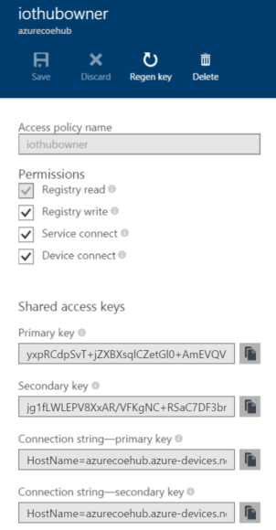
IoT Hub Endpoint Security
Endpoints are protected using shared access policies
Shared access policy is a combination of permissions
ServiceConnect
DeviceConnect
RegistryRead
RegistryWrite
Notes:
Security considerations for IoT Hub primarily come down to the shared access policies you define to protect the endpoints it exposes. You can define up to 20 shared access policies for your IoT Hub, where each policy is a combination of one or more permissions.
To the right of your screen is the shared access policy blade you will see in your IoT Hub instances. In this blade is where you can apply the appropriate permissions for your policy and regenerate keys associated with your policy.
The ServiceConnect permission grants access to the monitoring endpoints that a backend service would use. From this endpoint, the backend service could read messages from devices and also send messages to a device.
The DeviceConnect permission is used by devices to send and receive messages to the service.
The RegistryRead permission grants read access to the device registry. For example, a monitoring application would require this permission to display devices in the registry, what their connection status is, last activity time stamp, and other device properties.
Last is the RegistryWrite, which is allows writing to the device registry. If you saw Steve’s presentation earlier then you may recall the web portal he demonstrated to view and register devices in the system. That feature was enabled by a shared access policy with registry read/write permissions.

Slide 35
Custom authentication services
Why
Your IoT solution already has a custom device identity registry and/or authentication scheme
How
Create a token service (ie: cloud service) that uses a shared access policy with DeviceConnect permissions to create device-scoped tokens
Token Service
1. Request token
2. Return device-scoped token
3. Present token to IoT Hub
IoT Hub
Notes:
Earlier I mentioned custom authentication services so I want to briefly come back to this.
The reason you would do this is if you have an existing solution with a custom identity registry or perhaps a custom authentication mechanism. In this scenario, it would probably be cost prohibitive to try and update all the devices to use the IoT Hub authentication model. But, you can still use IoT Hub by creating a token service and injecting it into your solution.
The way this would work is your token service would perform authentication using whatever mechanism that already exists. After successfully authenticating, the token service would generate a device-scoped token and return it to the device. It will probably also do some logging for auditing purposes.
Next, the device would present the token to the device endpoint, which has the DeviceConnect permission applied, then proceed to send and receive messages.
In this scenario, the identity of the device is known by IoT Hub. So, the device anti-spoofing capabilities still apply.

Slide 36
IoT Challenges
Cost pressure on device hardware
Cheap sensors
Weak/no cryptography
Source of randomness
Analog Gap
Manipulations difficult to detect
Insecure Platforms
Tiny, real-time OS‘s
Legacy protocols
Policies, Procedures, Guidance
Cloud
Field Gateways
Devices
Data
Data
Data
Application
Edge
Application
Identity and Access Control
Global Network
Local Network
Local Network
Host
Host
Host
Physical
Physical
Physical
Notes:
The discussion up to this point hopefully as drawn attention to where the challenges exist when securing an IoT solution. Up to the point of ingestion, the challenges mostly exist at the physical level. Devices are vulnerable to their physical environment, they may communicate in unsecured channels, and lack the compute resources to protect themselves.
Field gateways are subject to some of these same pressures, but have the benefit of a host environment that can be hardened.
Once the boundary from field devices and gateways… to…. cloud gateways and IoT Hub ….has been successfully traversed, you’re at a point where you can benefit from the physical security that Microsoft Azure data centers provide.
This does not mean you can completely forget about security in your cloud environment. Yes, Azure provides an extremely secure and compliant environment for your applications and services.
But security is a shared responsibility in the cloud, regardless of who your cloud provider is. And Microsoft Azure provides additional services that you can use to secure your solution to meet your security requirements.

Slide 37
Security after ingestion
Azure Active Directory
Role Based Access Control (RBAC)
Multi-Factor Authentication
Azure Key Vault
Data encryption (TDE, Row-Level Security, Dynamic Data Masking, etc.)
Network and Virtual Machine Security (Antimalware extensions)
(Process) Attack surface analysis, threat modeling, incident response plans, etc.
Notes:
Key Vault can be used to provide public/private key exchanges for things like securely sharing configuration updates or firmware patches.
So, after ingestion, some of the services in Azure that are available to you are shown here.
For example, in Kirk’s demo earlier you saw how your Machine Learning workspace owner was linked back to an identity in Azure Active Directory. Azure Active Directory is the identity and access management service you can use to manage identities and access to resources.
Role-Based-Access-Control is a powerful feature to restrict access to resources based on user roles or even individual users.
For situations that demand higher security requirements, Multi-factor authentication can be applied to force users to authenticate using not only credentials (something they know), but also something they have ( a mobile phone for example).
These are just some of the things you can do and is by no means intended to be a complete list.
The last bullet here suggests that processes should be in place to identify vulnerabilities and to mitigate those vulnerabilities. This is part of the shared responsibility contract you have with the cloud and is the last thing I want to talk about.

Slide 38
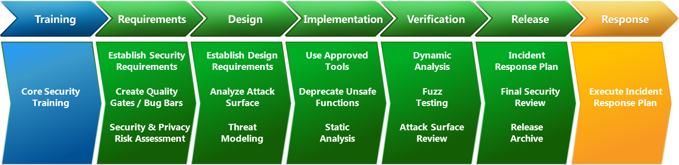
Security Development Lifecycle
Development process and tools for creating and running secure software as practiced at Microsoft
Notes:
The security development lifecycle is a software development process and set of tools that you can use to create and run secure software. These are the same processes that are practiced at Microsoft. The tools that are part of this kit include things like a Threat Modeling Tool, an Attack Surface Analyzer and more.
Shortly I will show a slide that provides the download link for this.

Slide 39
What can we do architecturally?
Service Assisted Communication (SAC)
Reduce the attack surface area for system and devices
Only accept commands to the device from a “trusted source”
Enforce secure channel
Machine Identity and Access Authorization
Authorize the sender
Data Streams and Processing Authorization
Authorize the receiver
Data Plausibility and Flow Authorization
Authorize the data stream
Data Attestation, Lineage, and Privacy Control
Authorize identification and association
Use SDL Threat Modeling Tool
S
Spoofing
T
Tampering
R
Repudiation
I
D
E
Information disclosure
Denial of Service
Elevation of privilege
Notes:
So, what can we do in our architectures to implement secure IoT Solutions?
We looked at the Service Assisted Communication principles as a way to reduce the attack surface for the system and for devices that are not capable of defending themselves; and we saw how this can be used to communicate over secure channels to the cloud.
Identify, authenticate, and authorize senders and receivers. The Device Registry in IoT Hub and the shared access policies you can define for your hub enable you to easily do this.
For Data Plausibility and Flow Authorization, consider what the data quality is and how reasonable is it considering the system context? Should the data be allowed to flow further into the system and for it to influence decisions downstream?
For Data Attestation, Lineage, and Privacy Control, consider where the data originated from, who participated in producing it, and can we answer these questions only in an authorized context.
Finally, employ the Security Development Lifecycle policies and in particular, use the threat modeling tool to identify threats in your architecture.

Slide 40
Reference Materials
Azure IoT Hub Developer Guide
http://bit.ly/1M7EGQU
Service Assisted Communication for Connected Devices - Clemens Vasters
http://bit.ly/1lypyT4
Microsoft Security Development Lifecycle
http://www.microsoft.com/sdl
Microsoft Azure Trust Center
https://azure.microsoft.com/en-us/support/trust-center/

Slide 41
Summary
Topic 1
Topic 2
Topic 3

