Slide 1
Networking

Slide 2
The Big Networking Picture
Virtual Network
“Bring Your Own Network”
Segment with subnets and security groups
Control traffic flow with User Defined Routes
Azure
Virtual Network
Users
Internet
Front-End Access
Dynamic/Reserved Public IP addresses
Direct VM access, ACLs for security
Load balancing
DNS services: hosting, traffic management
DDoS protection
Backend Connectivity
Point-to-site for dev / test
VPN Gateways for secure site-to-site connectivity
ExpressRoute for private enterprise grade connectivity
Backend Connectivity
ExpressRoute
VPN Gateways
Notes:
Let’s talk about the big networking picture.
Virtual network: An Azure virtual network (VNet) is a representation of your own network in the cloud.
Bring your own network: Microsoft lets you bring you own network (BYON) into Windows Azure. You can connect your local area network (LAN) to Azure and an unlimited number of computers on your corporate networks can seamlessly communicate with VMs in Azure. You can specify private network spaces (such as 192.168.x.x and 10.x.x.x) in any range, size, and starting number to suit your existing network topology.
Segment with subnets and security groups: You can also further segment your VNet into subnets and deploy Azure IaaS virtual machines (VMs) and PaaS role instances, in the same way you can deploy physical and virtual machines to your on-premises datacenter. Network Security Groups provide control over network traffic flowing in and out of your services running in Azure.
Control traffic flow with User Defined Routes: With user defined routes, you now have complete control over the traffic flow in your virtual network. Virtual network by default provides system routes for traffic flow between virtual machines. You can now customize the routing table by defining routes allowing you to direct traffic through network appliances.
<Click>
Front-End Access: for the front end access, Microsoft Azure Virtual Private Network (VPN) provides multiple options to secure and manage VPN like, dynamic/reserved public IP address, ACL for security, load balancing etc…
<Click>
Backend Connectivity: With Microsoft Azure Virtual Private Network (VPN), you can create point-to-site VPN for your dev/test, create secure site-to-site connectivity with Azure VPN gateways and can opt for ExpressRoute for private enterprise grade connectivity.

Slide 3
Agenda
Azure Virtual Network
Internet Connectivity
Securing Network
Cross Premises Connectivity

Slide 4
Azure Virtual Network
Notes:
An Azure virtual network (VNet) is a representation of your own network in the cloud. You can control your Azure network settings and define DHCP address blocks, DNS settings, security policies, and routing. You can also further segment your VNet into subnets and deploy Azure IaaS virtual machines (VMs) and PaaS role instances, in the same way you can deploy physical and virtual machines to your on-premises datacenter. In essence, you can expand your network to Azure, bringing your own IP address blocks.

Slide 5







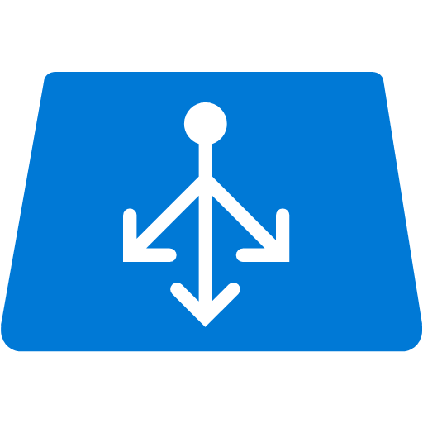


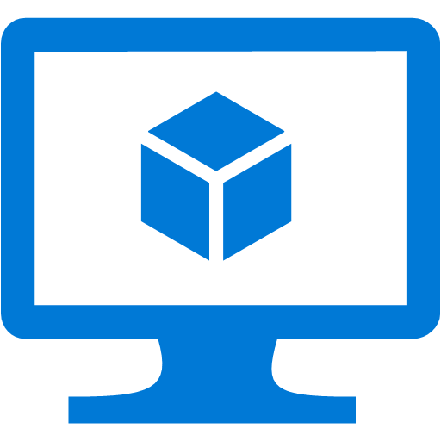
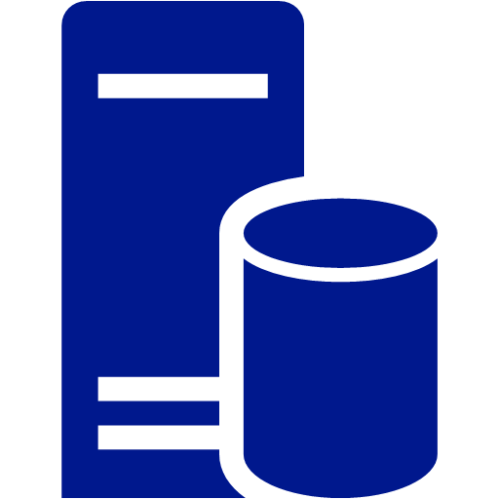
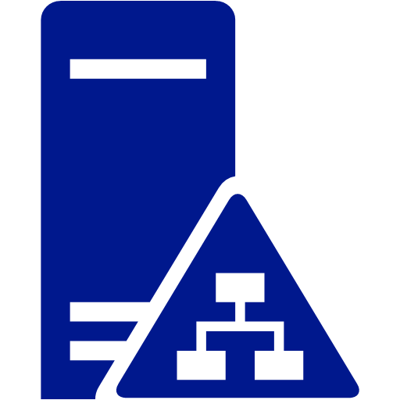
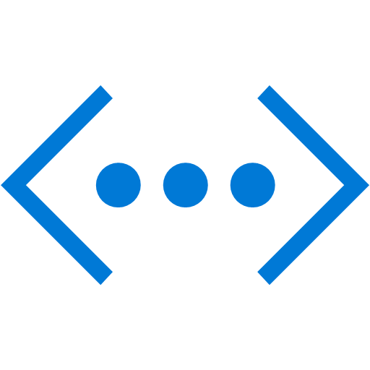
On-Premises (Physical) -2- Cloud (Virtual)
Internet
Router
Azure Infrastructure
Firewall
NSG
DMZ
Public Facing LB
Frontend Subnet
Public Facing LB
Web Servers
DNS
Web Server VM’s
DNS
Firewall
NSG
Backend Subnet
Internal LB
Internal
Internal LB
Database Server VM’s
DC VM
Database Servers
DC
Virtual Network
Notes:
An Azure virtual network (VNet) is a representation of your own network in the cloud. You can control your Azure network settings and define DHCP address blocks, DNS settings, security policies, and routing. You can also further segment your VNet into subnets and deploy Azure IaaS virtual machines (VMs) and PaaS role instances, in the same way you can deploy physical and virtual machines to your on-premises datacenter. In essence, you can expand your network to Azure, bringing your own IP address blocks.
To better understand VNets, take a look at the figure below, which shows a simplified on-premises network.
<Click>
The same network can be hosted in Azure as shown in the figure on right.

Slide 6

User Defined Routes (UDR)
Internet
Control traffic flow in your network with custom routes
Attach route tables to subnets
Set default route to force tunnel all traffic to on-premises or appliance
Appliance Subnet
3rd Party
Virtual
Appliance
UDR
UDR
Subnet A
Subnet B
System-defined Route
Virtual Network
Notes:
Details:
For each subnet you can attach a routing table
256 routes per subnet
Depending on address prefix – go to the next hop
Can build topologies where you can put things like virtual network appliance, your own firewalls, force certain traffic to certain places

Slide 7
User Defined Route
Notes:
Slide Title : Demo – User Defined Route
Details: Create user defined routes that specify the next hop for packets flowing to a specific subnet to go to your virtual appliance instead, and enabling IP forwarding for the VM running as the virtual appliance.
Speaker Notes: Create UDR and show how the packet are flowing through VM when requests are made from front end to back end.
Demo location: 3_UDR.docx

Slide 8
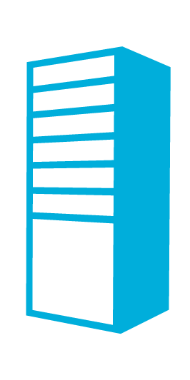

Inter-connected VNets
VNets can be connected through secure Azure gateways
VNets can be in different subscriptions
VNets in same or across regions can be connected
VNet East US
AD/DNS
Cross region secure channel
VNet West Europe
VNet East Asia

Slide 9
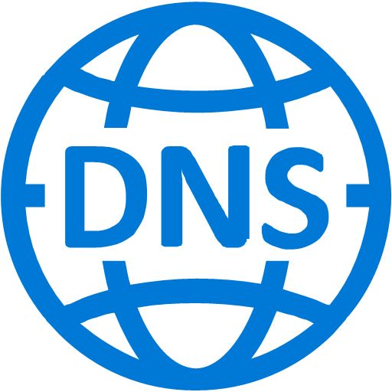
Domain Name Service (DNS)
Use Azure-provided name resolution within a virtual network
Deploy your own DNS servers
Use Azure DNS (Preview) to host your DNS domains in Azure

Slide 10


Azure Application Gateway
Azure-managed, first party virtual appliances
HTTP routing based on app-level policies
Cookies affinity
URL hash
SSL termination and caching
Customer Apps
Session
Affinity
HTTP
HTTPS
SSL
Notes:
Application load balancing enables IT administrators and developers to create routing rules for network traffic based on HTTP.
Application Gateway currently supports layer 7 application delivery for the following:
HTTP load balancing
Cookie based session affinity
SSL offload
HTTP layer 7 load balancing:
Azure provides layer 4 load balancing via Azure load balancer working at the transport level (TCP/UDP) and having all incoming network traffic being load balanced to the Application Gateway service. The Application Gateway then will apply the routing rules to HTTP traffic, providing level 7 (HTTP) load balancing. When you create an application gateway, an endpoint (VIP) will be associated and used as public IP for ingress network traffic.
HTTP layer 7 load balancing is useful for:
Applications that require requests from the same user/client session to reach the same back-end VM. Examples of this would be shopping cart apps and web mail servers.
Applications that want to free web server farms from SSL termination overhead.
Applications, such as CDN, that require multiple HTTP requests on the same long-running TCP connection to be routed/load balanced to different backend servers.

Slide 11
Securing Network

Slide 12

Network Security Groups
On Premises 10.0/16
Segment network to meet security needs
Can protect Internet and internal traffic
Enables DMZ subnets
Associated to subnets/VMs and now NICs
Internet
ExpressRoute and VPNs
√
√
√
√
VPN GW
Backend
10.3/16
Mid-tier
10.2/16
Frontend
10.1/16
Virtual Network
Notes:
When you segment the network, you can have access control lists on the network
Apply to each subnet or VMs within the subnet
Allow or deny rules
Apply to the subnet, they’re automatically applied to the subnet
NSGs + UDRs + Multiple NICS – total flexibility
Reference: https://azure.microsoft.com/en-in/documentation/articles/virtual-networks-nsg/
NIC: You can create virtual machines (VMs) in Azure and attach multiple network interfaces (NICs) to each of your VMs. Multi NIC is a requirement for many network virtual appliances, such as application delivery and WAN optimization solutions. Multi NIC also provides more network traffic management functionality, including isolation of traffic between a front end NIC and back end NIC(s), or separation of data plane traffic from management plane traffic.

Slide 13
How does an NSG work?
Load outbound NSG rules by Priority
Load next rule
No
No
Rule matches?
Last rule?
Azure host receives traffic
Inbound Traffic?
Get first rule
No
Yes
Yes
Yes
Deny Rule?
Load inbound NSG rules by Priority
Yes
Drop packet
No
Allow packet
Notes:
An NSG contains two types of rules, Inbound and Outbound. When traffic flows into an Azure server hosting VMs or role instances, the host loads all inbound or outbound NSG rules, based on the direction of traffic. Then the hosts inspects each rule in order of priority. If a rule matches the packet the host is analyzing, the action for the rule (allow or deny) is applied. If no rules match the packet, the packet is dropped. The figure below shows this decision flow.

Slide 14
Network Security Group Demo
Frontend Subnet
10.0.0.0/24
DB Subnet
10.0.2.0/24
NSG
NSG
100 | In | Internet | RDP
101 | In | Internet | HTTP
100 | In | Application | SQL
101 | In | Internet | RDP
102 | In | Application | *
200 | Out | Internet | *
Internet
Application Subnet
10.0.1.0/24
NSG
100 | In | Front-end | HTTPS
101 | In | Internet | HTTP
200 | Out | Internet | *
Virtual Network
10.0.0.0/16

Slide 15
Network Security Groups
Notes:
Slide Title : Demo – Network Security Groups
Details: TBD
Speaker Notes: Demo VNet with 3 Subnets, Frontend, App Subnet and Database subnet, three Network Security groups one per each subnet.
Demo Script: 2.0_NSG.docx
Reference URL: https://azure.microsoft.com/en-in/documentation/articles/virtual-networks-create-nsg-arm-pportal/
Notes: refer existing demo script (2_Demo_NSG.docx) + http traffic to compute VM

Slide 16
Cross Premises Connectivity

Slide 17
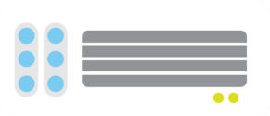

Point-to-Site VPNs
Azure
<subnet 1>
<subnet 2>
<subnet 3>
Virtual Network
DNS Server
On-premises
VPN Gateway
VPN Gateway
Route-based
VPN
Point-to-Site VPN
Your datacenter
Individual computers behind corporate firewall
Remote workers
Notes:
Connect from anywhere securely
No software installation required!
Easy to setup and use
Ideal for prototyping, development, demos
P2S and S2S coexist

Slide 18
Site-to-Site Connectivity
Extend your premises to the cloud securely
On-ramp for migrating services to the cloud
Use your on-premise resources in Azure (monitoring, AD, …)
Azure
<subnet 1>
<subnet 2>
<subnet 3>
Virtual Network
DNS Server
Site-to-Site VPN
On-premises
VPN Gateway
VPN Gateway
Hardware VPN or Windows RRAS
Your datacenter
Notes:
Extend your premises to the cloud securely
On-ramp for migrating services to the cloud
Use your on-premise resources in Azure (monitoring, AD, …)
Reference: https://azure.microsoft.com/en-in/documentation/articles/vpn-gateway-site-to-site-create/

Slide 19


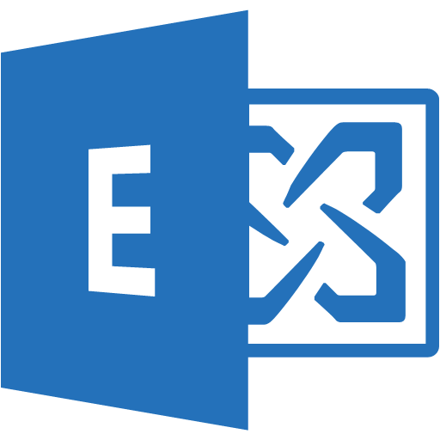
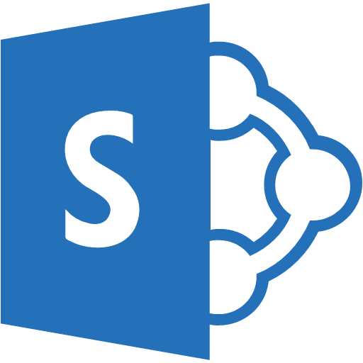

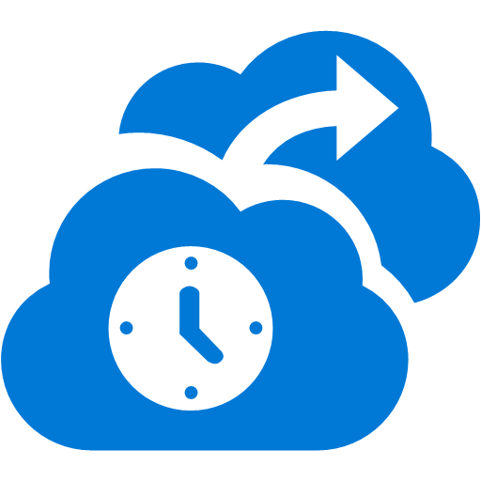



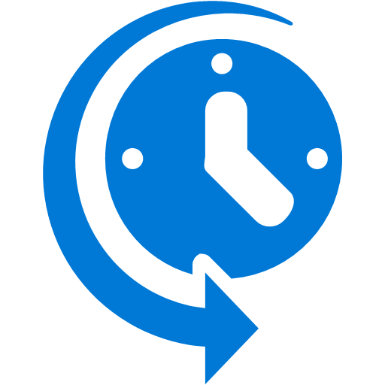
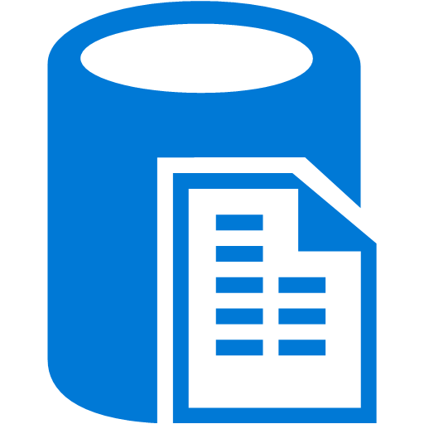
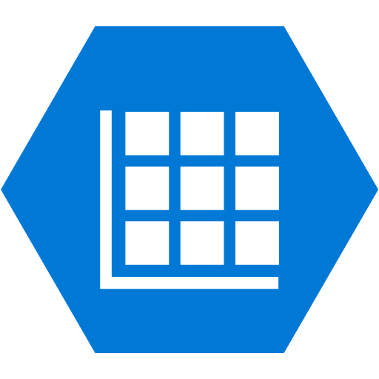
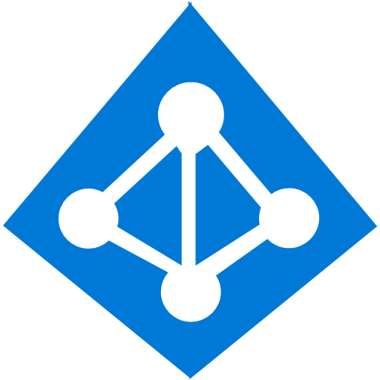
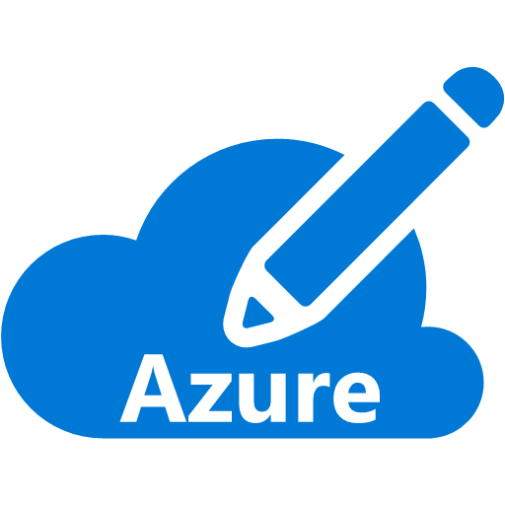


ExpressRoute Connectivity
Partner Edge
Microsoft Edge
Customer’s network
Customer’s connection
Traffic to Office 365 Services
Traffic to public IP addresses in Azure
Traffic to Virtual Networks
Notes:
Microsoft Azure ExpressRoute lets you extend your on-premises networks into the Microsoft cloud over a dedicated private connection facilitated by a connectivity provider. With ExpressRoute, you can establish connections to Microsoft cloud services, such as Microsoft Azure, Office 365, and CRM Online.
Express route is logical component between your data center and Microsoft Azure eco system (azure cloud services, office 365 and CRM online (soon)).
Predictable Performance
Not under the mercy of your ISP
Secure – Packets don’t go over the open internet
High throughput – Given circuit can be up to 10 gigs, can have multiple circuits, highly available
Lower cost if you’re pushing a lot of data
Also the way to connect to Microsoft in general. So far, only to connect to Azure but now it is the service to connect to all Microsoft Services. O365, Skype for Business, etc.
Can be used to carry traffic for all these MS services. Same circuit will work. May choose multiple circuits for redundancy or more throughput.

Slide 20
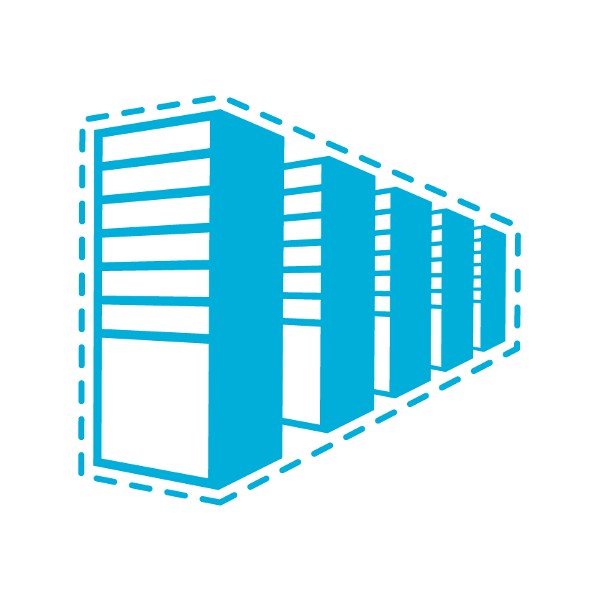
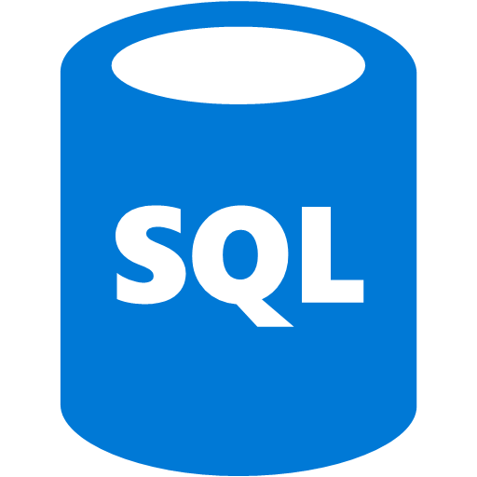
ExpressRoute and S2S VPN Coexistence
S2S VPN as a backup for ExpressRoute
S2S connectivity to branch offices
Connecting Virtual Networks in other Azure regions
Internet
Contoso HQ
VPN Gateway
(Internet Edge)
SQL Farm
IIS Servers
Services on public IPs
ExpressRoute
AD/DNS
Monitoring
Exchange
Contoso virtual networks/VMs
Notes:
Multiple circuits but want to be able to fail over VPN
Through routing can determine which route is best way to get there and if all else fails, use VPN functionality
Multi-nationals have been asking for this.

Slide 21
ER Premium add-on and Standard GW
ExpressRoute Premium
Increased route limit from 4,000 to 10,000 routes per ExpressRoute peering
Increased number of VNets per circuit
Global connectivity – Link a VNet in 1 geo to an ExpressRoute circuit in a different geo
Standard Gateways
Supports ExpressRoute and VPN Gateways coexistence
Improved throughput for ExpressRoute
Gateway SKU | ExpressRoute Throughput | S2S Throughput | Max Tunnels
Default | 500 Mbps | 100 Mbps | 10
Standard | 1000 Mbps | 100 Mbps | 10
Performance | 2000 Mbps | 200 Mbps | 30
Circuit Size | # VNet links | VNet links with Premium Add on
10 Mbps | 10 | Not Supported
50 Mbps | 10 | 20
100 Mbps | 10 | 25
200 Mbps | 10 | 25
500 Mbps | 10 | 40
1 Gbps | 10 | 50
10 Gbps | 10 | 100
Notes:
Use our wide area network, enter in any region of the world and hit the other regions. Enter US West and travel to Singapore across Microsoft’s network.
Increased number of routes, now 10000 up from 4000 (which was more than anyone else)
Connect up to 100 virtual networks to express route
--
Standard pricing tier added to give you more options.

Slide 22
Traffic Manager
Traffic Manager Policies
Performance routes to the “closest” service.
Weighted distributes traffic across services.
Priority routes to backup service(s) if the primary is unreachable.
www.contoso.com
Notes:
Microsoft Azure Traffic Manager allows you to control the distribution of user traffic to your specified endpoints, which can include Azure cloud services, websites, and other endpoints. Traffic Manager works by applying an intelligent policy engine to Domain Name System (DNS) queries for the domain names of your Internet resources.
Traffic Manager can help you
Improve availability of critical applications
Improve responsiveness for high performing applications
Upgrade and perform service maintenance without downtime
Traffic distribution for large, complex deployments
Weighted allows you to customize weights (great for A/B testing, etc.)
Priority allows you to order services
Also works with external endpoints
Traffic Management Policies:
Latency – Direct to “closest” service
Round Robin – Distribute across all services
Failover – Direct to “backup” if primary fails
Nested – Flexible multi-level policies
Reference: https://azure.microsoft.com/en-in/documentation/articles/traffic-manager-overview/

Slide 23
Azure Traffic Manager
Notes:
Slide Title : Demo – Azure Traffic Manager
Demo Details: 0_Traffic_Manager.docx
Speaker Notes: Demo Azure Traffic Manager

Slide 24
Summary
Azure Virtual Network
Internet Connectivity
Securing Network
Cross Premises Connectivity

Slide 27
What’s New in Azure Networking

Slide 28
Azure DNS – Globally Distributed DNS Service
New
A service enabling Azure customers to host their DNS domains and manage their DNS records in Azure
Offers Edge-based name servers for fast global service
Currently in Private Preview
DNS
Notes:
Azure Domain Name System (DNS) allows you to host your domains with your Azure apps. By hosting your domains in Azure, you can manage your DNS records by using your existing Azure subscription.
Host your DNS alongside your apps
Ultra-high availability
Fast DNS queries
Rapid updates to DNS records
Supports all common DNS record types
References: https://azure.microsoft.com/en-in/services/dns/

Slide 29
Multiple VIPs per VM/Cloud Service
New
Support multiple SSL website hosted in the same VM/Cloud Service
VM/Cloud Service
443
443
VIP1
A
Z
U
R
E
L
B
SSL Website 1
443
444
SSL Website 2
Internet
VIP2
443
445
SSL Website 3
VIP3
446
SSL Website 4
443
VIP4
Notes:
For the scenarios in which you may need more than one VIP as an entry point to the same cloud service. For instance, your cloud service may host multiple websites that requires SSL connectivity using the default SLSL port of 443, each site being hosted for a different customer, or tenant. In such a scenario, you need to have a different public facing IP address for each website.
Limitations:
At this time, multi VIP functionality is limited to the following scenarios:
IaaS only: You can only enable multi VIP for cloud services that contain VMs. You cannot use multi VIP in PaaS scenarios, with role instances.
PowerShell only: You can only manage multi VIP by using PowerShell.
Reference: https://azure.microsoft.com/en-in/documentation/articles/load-balancer-multivip/

Slide 30
Regional scope
VNET spans to an entire region
Fully connected private and secure network across datacenters
New services requiring specific SKUs (A8, A9) can be added to same VNet – Seamless expansion
Portal
Azure Front End
API
US West
South East Asia
RNM
RNM
VNet scope
VNet scope

Slide 31

Internal Load Balancing
Enables load balancing among VMs with private IP addresses
Accessible only by customer’s virtual network and on-premises networks
Multi-tier applications with internal facing tiers require load balancing
HA LOB apps
SQL Always On
RDP to internal endpoints for added default security
Replaces “Floating IPs”
Internet
Microsoft Azure
Public VIP
Customer Virtual Network
External load balancer
Customer on-premises
Internal VIP
Internal
load balancer
Back end
Front end
Web frontend tier
Logic tier

Slide 32









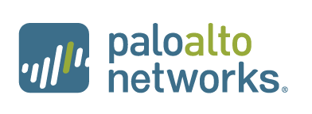
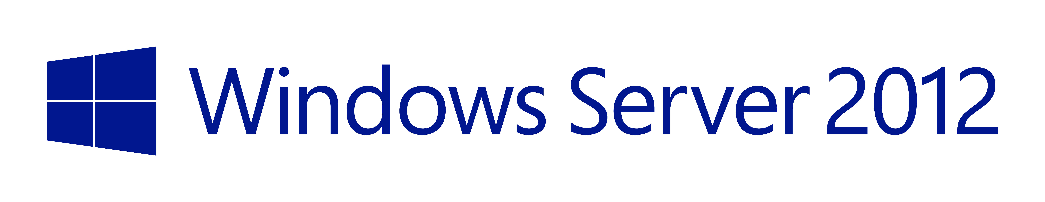
On-premises VPN Ecosystem

Slide 33








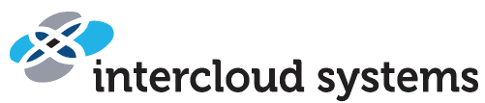













ExpressRoute Partners
Exchange Provider
Network Service Provider
Microsoft
Microsoft
Public
internet
Customer site 3
Customer site 2
WAN
Public
internet
Customer site
Exchange
Customer site 1
Notes:
Can have one or more providers. A large organization will already have a relationship.
Ethernet exchange provider or MPLS wide area network, can use both of these. Can mix and match

