Slide 1
Azure Architect Workshop
Lift & Shift Case Study
SAP Netweaver workload
Notes:
This workshop uses SAP as a sample application because it is in some ways a typical multi-tier application that uses SQL Server as the data layer. There are very few SAP specific requirements, but some students with SAP implementation backgrounds may want to add these specifics to their solution. That is acceptable as long as it doesn’t take too much time because the time is limited already.

Slide 2
Lift & Shift
Step 1: Review the Customer Case Study
Outcome
Analyze your customer’s needs
Timeframe
10 minutes

Slide 3
Customer Situation Duwamish Group
Lift & Shift
The Duwamish Group is a Spanish telecommunications company with worldwide operations serving almost 150 million mobile subscribers.
It has made large investments using SAP Business Suite on Windows Server 2012 R2 with a SQL Server 2014 Database, but its development and production organizations are struggling to keep up with the pace of business because of the time it takes for them to move through development and testing phases of feature development and finally to put new business process in production.

Slide 4
Customer Situation
Lift & Shift
Agility of the organization is hampered by time to acquire and provision project-related SAP development and testing environments
Concerned about managing test/dev infrastructure costs
Concern about aging data center and hardware from dev/tst to production
Would like to lower TCO for the SAP landscape, start with just production ECC

Slide 5
Customer Requirements
Lift & Shift
Reduce time to deploy new business processes to have competitive customer offers
Reduce time required to provision development and test environments
Manage costs incurred by the development, test, and production environments
Need to know the monthly infrastructure cost for operating your solution

Slide 6
Technical Requirements
2-tier configuration throughput
VM TypeD | VM Size | 2-tier SAPS | 3-tier SAPS
A5 | 2 CPU, 14 GB | 1,500 | 12,000
A8/A10 | 8 CPU, 56 GB | 11,000
A9/A11 | 16 CPU, 112 GB | 22,000
D12/DS13 | 4 CPU, 28 GB | 4,650
D14/DS14 | 16 CPU, 112 GB | 18,600
DS12v2 | 4 CPU, 28 GB | 6,680
DS14v2 | 16 CPU, 112 GB | 24,180
GS1** | 2 CPU, 28 GB | 3,580 | 34,415
GS3** | 8 CPU, 112 GB | 11,870 | 137,520
GS4** | 16 CPU, 224 GB | 11,270 | 247,880
GS5 ** | 32 CPU, 448 GB | 41,670
SAP ECC NetWeaver (app server) is the application tier
SQL Server is the data tier
Need port 32xx open for SAP NetWeaver
Primary network access is through Site to Site VPN
SAP requires SQL Server collation SQL_Latin1_General_Cp850_BIN2
Application tier requires 21,000 SAPS, Database tier needs 6000 SAPS
Specific IO requirements
PROD servers need SQL Server with:
400 MB/sec throughput on transaction logs
6000 IOPs on data drives
2 TB capacity with max growth to 3 TB
SLA (Availability=99.9%, RPO=15 min, RTO=2 hour)
FEEL FREE TO BING!
** The GS series (2-tier and 3-tier) is only supported with DB data files and DB transaction log files placed on Azure Premium Storage
Notes:
If the students need a hint on the VM sizes, show them the Azure Pricing Page.

Slide 7
Potential Customer Q’s
Lift & Shift
If I have already paid for my hardware to run my dev/test environment, how am I getting any cost savings by moving it to Azure? How much more is your cloud solution costing me?
What if I need my cloud resources to access on-premises resources?
Will Azure meet our security and compliance requirements?
How do you handle features that may not work on Azure?
Do I have to pay for resources when they are stopped?
For my DEV environment, can I automate the shut down at periodic times of day?
Notes:
Suggested answers are in the proctor guide. Note to the proctor: if the students give great answers, please update the proctor guide.

Slide 8
Preferred Target Audience
Lift & Shift
BDM or Application Sponsor (CFO) - Funds projects & apps
Most interested in public cloud
BUIT / Developers (Director of SAP Business Analysts, Director of SAP Operations)
Reports to BDM and is responsible for coding and testing apps
Big influencer of public cloud strategy
Central IT (VP of IT Operations)
Reports into CIO and responsible for operating datacenter
Concerned about shadow IT created issues: security/compliance, server sprawl, and lack of control
Notes:
The student’s final presentation should be geared to this audience.

Slide 9
Step 2: Call to action – Design the solution
Lift & Shift
Outcome
Design a solution and prepare to present the solution to the target customer a 10-minute chalk-talk format.
Timeframe
50 minutes
Business Needs (10 minutes) | Respond to questions outlined in your guide and list the answers on a flipchart
Design (30 minutes) | Design a solution for as many of the stated requirements as time allows. Show the solution on a flipchart. Estimate the cost
Prepare (10 minutes) | Identify any customer needs that are not addressed with the proposed solution Identify the benefits of your solution Determine how you will respond to the customer’s objections Prepare to verbally brief presentation to the customer

Slide 10
Design Flow
Lift & Shift
Know all technical requirements
Evaluate datacenter locations
Know SAPS # for app and db and decide if you need a 2 or 3 tier solution architecture
Download SAP note 1928533
Review your sizing scenarios from the presentation
Draw solution on flip chart
Ask if your solution meet SAPS, IOPS, and SLA
Evaluate components options for a lowest cost solution
Itemize all components on an Excel sheet
Present and defend your design

Slide 11
Step 3: Call to action – Present the solution
Lift & Shift
Outcome Present a solution
Timeframe
10 minutes
Directions
Switch proctors and two members of your team with another table
Present proposed solution to the customer
The customer asks one of the objections from the list of objections in the case-study

Slide 12
Wrap-Up
Lift & Shift
Outcomes
Identify the potential solution for the case-study
Identify solutions designed by other teams
Timeframe
10 minutes

Slide 13
Requirements Recap
Lift & Shift
Requirement | (Y/N)
Windows based | Yes, Window 2012 R2
Load balanced front-end for ABAP only | Yes
Need HA/DR configuration? | Yes
Caching layer for session management | No
Secure on-premises connectivity | Yes
Large volume of static content hosting | No
Need cost figure? | Yes
Specific IO requirements? | Yes
Password-less SSH setup | No

Slide 14
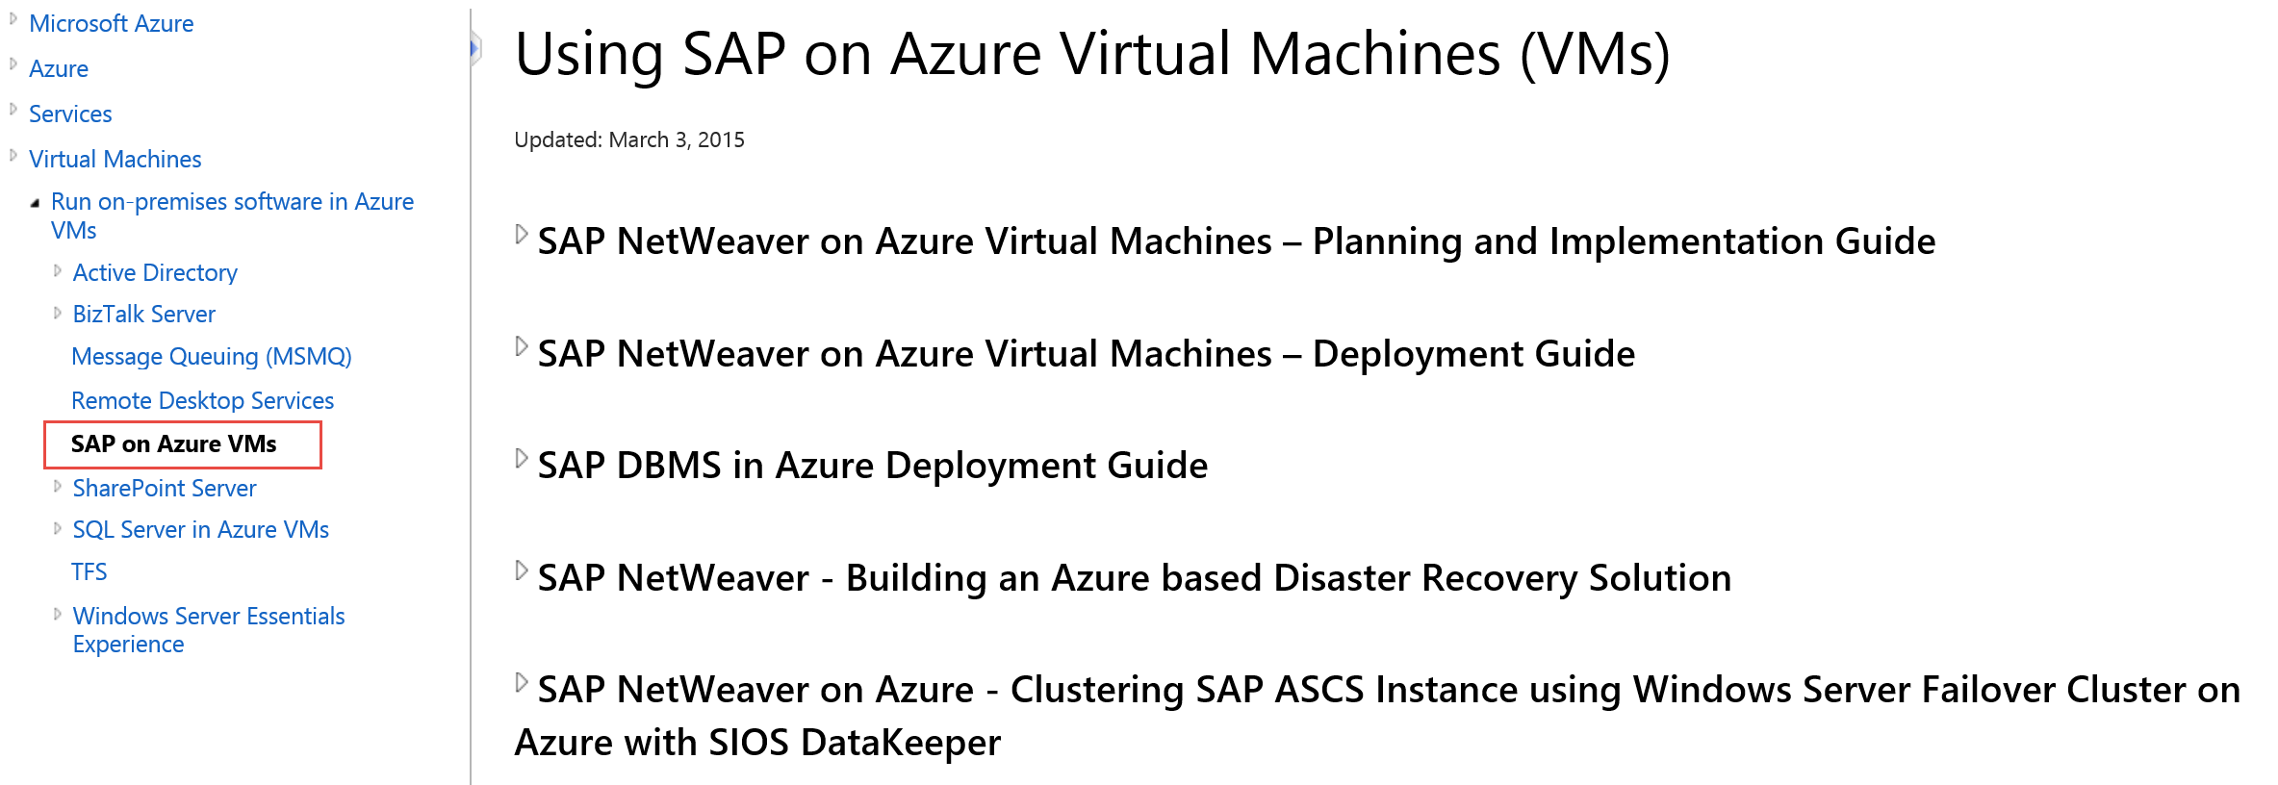
Did you “bing” it?
Lift & Shift
https://msdn.microsoft.com/en-us/library/azure/dn745892.aspx

Slide 15
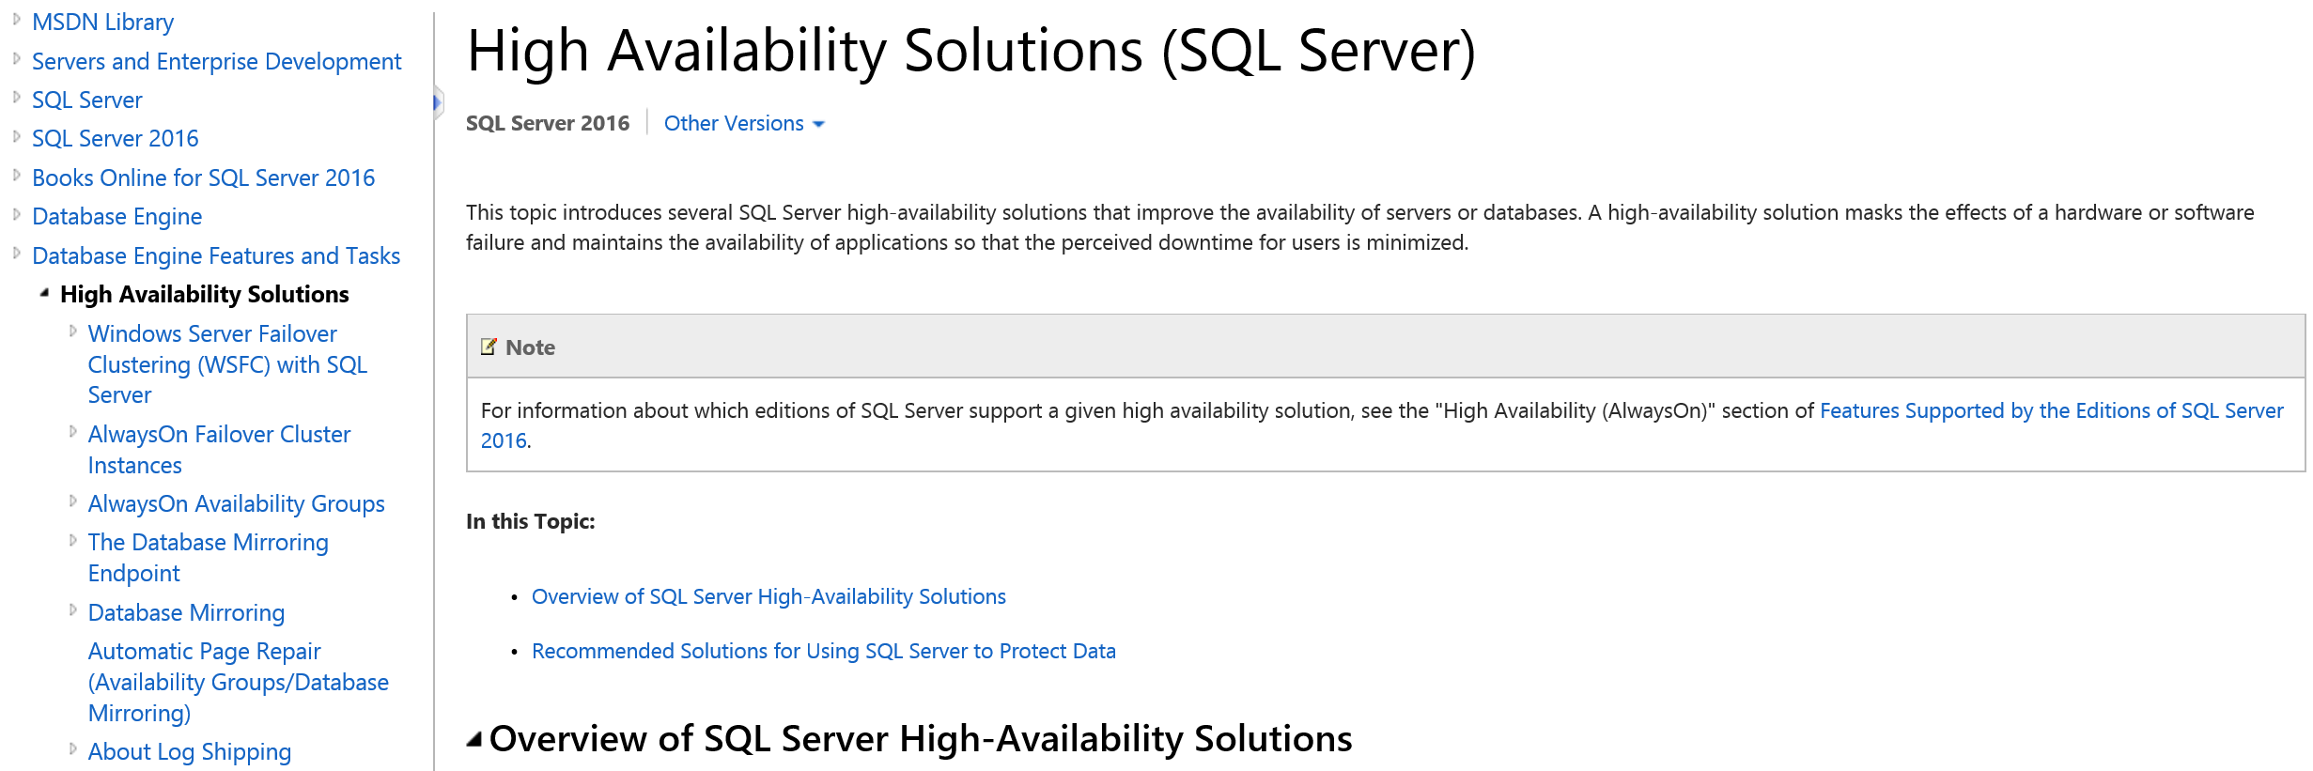
Did you “bing” it?
Lift & Shift
https://msdn.microsoft.com/en-us/library/ms190202.aspx

Slide 16





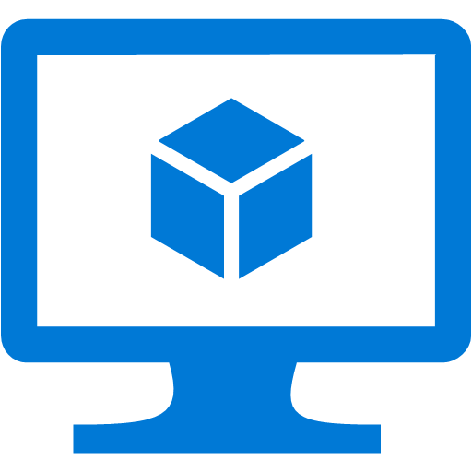
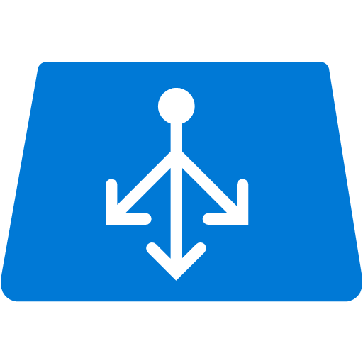

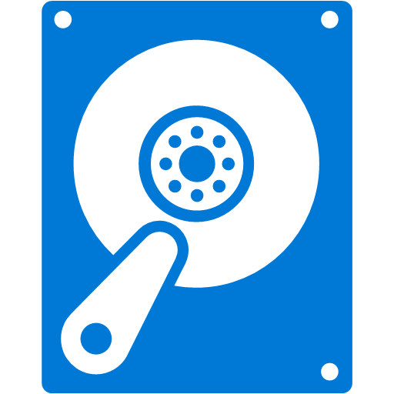
Potential Solution
PROD
DR
SAP clients, app servers connection endpoint
2xA3 VM
SQL listener
Fileshare Witness
Replicated SCS
DC
PRD Shop-floor Systems
Replicated
DC
Replicated App Server
Azure ILB
Azure ILB
Av. Set
Av. Set
F: Storage pool SQL logs, tempdb, datafiles
Av. Set
DS11v2 VM
C:\ OS+SAP
C:\ OS+SAP
DS12v2 VM
Secondary Alwayson replica
C:\ OS
VPN
Gateway
6680 SAPS
2X DS13v2 VM
@24600 SAPS
Prem strg 3xP30
VPN
Gateway
C:\ OS
10000 IOPS
6680 SAPS
DS11v2 VM
C:\ OS+SAP
* (A)SCS replicated via batch job to copy the /sapmnt share. App Servers replicated with ASR
C:\ OS+SAP
DS12v2 VM
5000 IOPS
SCS Cluster
w. SIOS
SAP App Servers
SQL AlwaysOn Cluster
Azure to Azure ASR GA expected Q3 FY16
Notes:
Azure Site Recovery doesn’t support Azure to Azure replication yet as of 2/2/2016. We have a TAP program started recently. So to provide DR for Azure VMs, part of them need to be replicated by batch jobs.
The AlwaysOn Availability Group replica is a feature of SQL Server.
For production systems running on-premises, ASR can be used to replicate App Servers, and to support SQL Server Alwayson DR orchestration. The SCS still needs to be replicated by batch jobs if the on-prem SCS nodes are clustered with shared disks because Azure doesn’t support shared disks.
Talking points:
Locally Redundant
DR solutions – stick with SQL Always On or other SQL solutions
Start up and shut down, if you shut down more than 4 weeks, you have to join the domain again. It is the default setting. No different than on-premises. You can change.
Can use automation to start and stop instances at scheduled times.
SAP Deployment Guide
https://msdn.microsoft.com/en-us/library/azure/dn745892.aspx
Note: for dev/test environment, Premium Storage is usually not needed. The above suggested disk volumes are for standard storage.
SAPNOTE: 1612283
SAP Software on Windows Hardware Configuration for Optimal Performance
-Recommends multiple smaller machines rather than 1 large machine.

Slide 17
Solution Cost
Component | Quantity | Op. hrs/month | Unit cost/mo. | Ext. cost/mo.
VM – DS1v2 | 2 | 744 | 54.31 | 108.62
VM – DS11v2 | 2 | 744 | 137.64 | 275.28
VM – DS12v2 | 2 | 744 | 276.02 | 552.04
VM – DS13v2 | 2 | 744 | 551.30 | 1102.60
Data disks SSD P30 | 3 |  | 135.17 | 405.51
OS disk HDD LRS | 6 | ~100GB used ea. VM | 0.050/GB | 30.00
Azure Site Recovery
Azure Backup up
Total cost |  |  |  | $2,474.05
This sample doesn’t include software licensing (SIOS, SQL, SAP, ASR), data egress, backup, and DR

Slide 18
GEO DR Solution
For best performance, choose alternate site in same geo-bubble
For DB, use the database specific DR solution, not Azure Geo-DR
SQL Server
Always On
Log Shipping
Mirroring
Replication
Backup/Restore
Notes:
Geo-Bubble refers to different data centers at least 400 miles apart. Usually in the same continent.
https://msdn.microsoft.com/en-us/library/ms190202.aspx

Slide 19
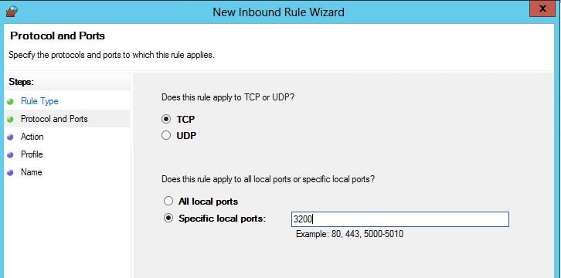
Sample Solution - specific port config
Lift & Shift
Notes:
Mention that this is a very specific requirement for NetWeaver.

Slide 20
Benefits
Lift & Shift
Reduce time to deploy new business processes to have competitive customer offers
Reduce time required to provision development and test environments
Manage costs incurred by the development and test environments
Lower production environment cost

Slide 21
Handling Customer Questions
Lift & Shift
If I have already paid for my hardware to run my dev/test environment, how am I getting any cost savings by moving it to Azure?
What if I need my cloud resources to access on-premises resources?
Will Azure meet our security and compliance requirements?
How do you handle features that may not work on Azure?
Do I have to pay for resources when they are stopped?
Can I automate the shut down at periodic times of day?
Notes:
Why should I choose Microsoft Azure over AWS for my scenario?
VHD VMs can be moved back and forth between Azure and on-premises, allowing SAP dev/test on Azure and production on-premises; AWS locks customers into proprietary
AMI format
Common Engineering criteria used by Microsoft Engineering teams ensures that Azure is the best platform for SQL Server, and consequently SAP on SQL Server; Microsoft does not support SharePoint and SQL Server on AWS
With Microsoft, customers get one point of support for SQL Server, SharePoint, AD, Windows Server and Azure; well-defined hand-off process to SAP for application level issues
SAP and Microsoft have had a 20-year long partnership and have jointly served enterprise customers around the world
If I have already paid for my hardware to run my dev/test environment, how am I getting any cost savings by moving it to Azure?
A Global audit, tax and consulting company reduced TCO by 40-75% by hosting SAP systems on Azure and turning off unused resources; A global snack food company reduced TCO by 40-75% by moving 126 historic SAP systems on Azure; A medical supply company reduced TCO by 50% by moving SAP training environment to Azure
Use the TCO tool (http://aka.ms/azuretco) to uncover all categories of potential cost savings (e.g., hardware, software, maintenance, admin, power, facility)
Because of the large scale of Microsoft’s datacenters, we realize ongoing cost efficiencies that we have been passing to customers in the form of price cuts
For very large customers, highlight other benefits (e.g., agility, focus) of using Azure
What if I need my dev/test environment to access on-premises resources?
Microsoft supports a hybrid solution, with symmetry between on-premises applications and those on the public cloud.
Windows Azure Virtual Network allows them to create a logically isolated section in
Azure and securely connect it to their on-premises datacenter;
If customer needs dedicated connectivity, talk to them about ExpressRoute
Will Azure meet our security and compliance requirements?
Microsoft policy is to be the most transparent about security and compliance policies, procedures, and certifications on the public facing Azure Trust Center
Dev/Test workload usually has limited security/compliance requirements
Encourage the customer to visit our Azure data centers.
How do you handle features that may not work on Azure?
Email your issue to winazrtt@microsoft.com
Share NDA Roadmap
Engage your local STU to evaluate a POC, there are many workaround solutions.
Do I have to pay for resources when they are stopped?
Yes, the VM must be deallocated before the charges cease. If the VM is stopped it will continue to incur charges.
Deallocating does not mean deleting the VM as it still exists in storage.
You will still incur storage charge even if the VM is deallocated.
Can I automate the shut down at periodic times of day?
Yes, Powershell or CLI or other scripting tools can be used to stop and deallocate any instance.
Same tools can be used to start the instance on a scheduled time.

Slide 22
Customer Quote
Lift & Shift
“Azure has untied our hands with regards to quickly provisioning development and user acceptance testing environments for our various SAP workloads.”
VP of IT Operations, Duwamish Group

Slide 23
Gallery of Solutions
Lift & Shift
Directions Upon completion of the workshop, post the flipchart page showing your team’s solution on the gallery wall.

Slide 24
References
Azure References
Case Studies: http://azure.microsoft.com/en-us/case-studies/
Microsoft Cloud Strategy Site: http://www.microsoft.com/enterprise/microsoftcloud/platform/default.aspx?WT.mc_id=Search_bing_OneCom__cloud%20migration&OCID=COM_SEM_bing_#fbid=Z8GQ6fU0RjV
Azure Migration Accelerator (formerly InMage): http://azure.microsoft.com/blog/2014/09/04/introducing-microsoft-migration-accelerator/
Azure Data Center Migration Solution: https://github.com/persistentsystems/adcms
SAP Specific References
SAP on Azure | Guides for using SAP on Azure | http://go.microsoft.com/fwlink/p/?LinkId=397566
Blog | Running SAP applications on the Microsoft Platform | http://blogs.msdn.com/b/saponsqlserver/
Notes:
The Azure Migration Accelerator is likely going to have a major overhaul soon and will probably be called something else. (4/23/2015). Give a strong recommendation that these partners develop in-house expertise in the Migration Accelerator (and it’s successors). There is actually very little expertise on this inside Microsoft except for the product team. Microsoft will rely heavily on our partners.

Slide 25
Thank you!
Please rate this session at the end of the day.
http://bit.ly/SAPRedmondDay2

