Slide 1
Azure Compute, Storage, and
Network for SAP

Slide 2
Agenda
Azure Virtual Machines and Compute Capacity
VM Storage Architecture
Managed Disks and Premium Storage
Azure network and security
Cross-premises connectivity

Slide 3
Azure Virtual Machines
Notes:
Azure Virtual Machines lets you create and use virtual machines in the cloud. This is one of Azure’s Infrastructure as a Service (IaaS) features. The A virtual machine technology can be used in variety of ways.

Slide 4
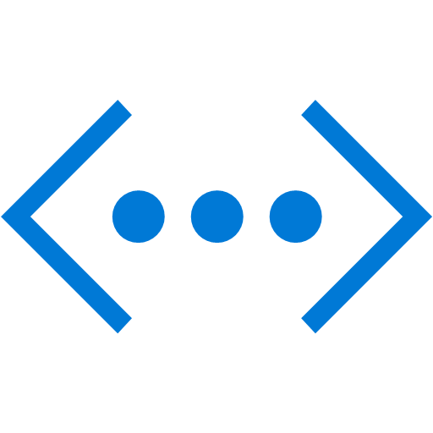
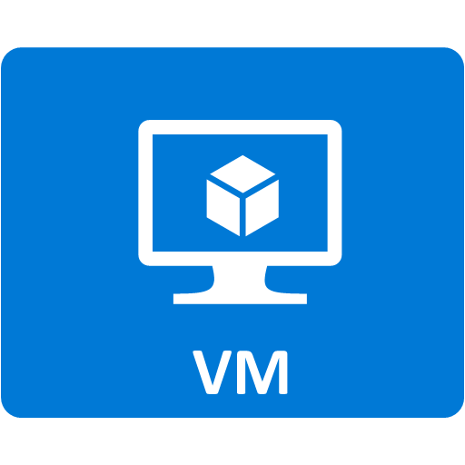

Virtual Machine Architecture
Bootable OS Disk (.vhd)
Windows, Linux, Server SKUs
Optional 1+ data disks
Virtual Network isolation
Network Security Groups allow access, such as Remote Desktop (RDP)
Virtual Network
Storage Account
OS Disk
Data Disk(s)
30GB – 4TB
Up to 4 TB
Notes:
So, now that you know have some context for where Virtual Machines are useful, let’s take a high-level look at the architecture of a Virtual machine.
A VM has a bootable OS Disk that can contain Windows or Linux. This OS Disk is just a .vhd. So, if you’re familiar with on-premises virtual machines using Hyper-V, then these are essentially the same.
A VM can optionally have one or more data disks attached to it. A data disk is where your application data would be stored. For example, if you were running Windows Server Active Directory, it is recommended that you attach a data disk to store the directory database. A data disk can be as large as 1 TB. And since you only pay for data actually stored (not the allocated size), it is recommended that you allocate the full 1 TB for your data disks.
The OS disk and Data Disks are persisted in your Azure Storage Account. In the next session you will learn more about how Azure Storage Accounts function. For now, just understand that this is where your disks are stored.
<click>
A VM is contained in a Virtual Network. This virtual network provides an additional layer of isolation from other VM’s and services running in your Azure subscription. For you to actually use the virtual machine (connect to it), a Network Security Group is configured to allow common traffic to it, such as Remote Desktop (RDP) for a Windows VM. You will learn more about virtual networks in the networking session. For now, understand that your VM instances are part of a Virtual network.

Slide 5
Virtual Machine Disk
Drive C (/dev/sda) is always the OS Disk (30GB+)
Drive D (/dev/sdb) is a temporary data disk
Physical storage in the rack the VM is running on
Ideal for caching local data that does not need to be persisted
Only store data here that you can tolerate losing
Drive E is mapped to DVD drives
Drive F, G, H (/dev/sdc, /dev/sdd)… used for data disks (up to 4TB)
Notes:
An OS disk is by default 127 GB. You could increase it but generally you will leave it alone. If you need storage, then you should attach a data disk. The reason is that the OS disk is optimized for the OS and therefore has host-mode caching enabled for Reads and Writes. Host-mode caching is not recommended for common VM workloads such as SQL Server, Active Directory, or SharePoint workloads. In most cases, you should attach a data disk and disable caching to properly support the workload.
Drive D is temporary. This is physical storage on the server/rack the VM is currently running on. If the VM get’s recycled due to failure or service upgrade, data on this drive is lost because the VM will likely be hosted on a different physical server. So, use data disks for persistent storage.

Slide 6


Compute Size Options
Optimized for large
SAP HANA Workloads
General Purpose &
Application Workloads
GPU
Workloads
Optimized for
Memory & Storage
Optimized for
Database Workloads*
A
D
F
G
A
Av2
D
Dv2
Dv3
F
N
L
G
H
Ev3
M
Av2
Av2
Av2
Av2
Av2
Av2
HIGHEST VALUE
LARGEST SCALE-UP
Entry Level & Dev/Test Workloads
Optimized for Compute Workloads
Optimized for Storage Workloads
High Performance Computing
Optimized for Enterprise Workloads
Notes:
Azure provides many different virtual machines sizes. These vary in price and performance characteristics.
<click>
A-series VMs are typically used for entry level and Dev/Test workloads.
D-series VMs are general purpose VMs for most common workloads.
F-series VMs are optimized for compute workloads. These have fast CPUs and limited memory.
N-series VMs have GPUs that make these VMs optimal for visualization or calculation scenarios.
L-series VMs are storage optimized with high disk throughput.
G-series VMs are storage and memory optimized. These provide high disk throughput and up to 448 GB of RAM.
H-series VMs are specifically designed for High Performance Computing scenarios.
Ev3-series VMs are optimized for database workloads.
M-series VMs are the largest VM sizes available for large enterprise workloads such as SAP HANA. These VMs provide up to 128 cores and 3.5 TB of memory.
SAP HANA Large Instances provide a bare metal solution specifically for HANA workloads.
SAP does not supports all VM sizes.

Slide 7
Different for SAP HANA on Azure
Approach
SAP BW on SAP HANA, SAP Business Suite on HANA, and S/4HANA running on purpose-built SAP HANA on Azure large instance hardware.
Solution
Virtualized: production SAP BW and S/4 HANA workloads¹
Microsoft offers SAP-certified SAP HANA capabilities on GS5 VM in Azure public cloud. Non-production workloads can be run on other SAP-certified Azure VM types.
Large Instances: for production and non-production workload
Microsoft offers certified SAP HANA capabilities via purpose-built hardware specifically tuned for SAP HANA.
SAP HANA instance runs in a non-virtualized environment on SAP HANA TDI certified hardware in an Azure-certified data center
SAP HANA is connected to the SAP application tier running on Azure VMs
The two environments are connected via Azure ExpressRoute
Azure Region
Tenant VNets
Tenant VNets
Router
Router
ExpressRoute to Azure Region
ExpressRoute to Azure Region
On-Premises Datacenter Tenant 1
ExpressRoute to Azure Tenant to Datacenter Tenant 1
ExpressRoute to Azure Tenant to Datacenter Tenant 2
On-Premises Datacenter Tenant 2
SAP HANA Deployment in Azure-certified Datacenter
¹ in controlled availability
Notes:
This slide is only high level to outline that for HANA, with Azure Large Instances we have an option which differs in some aspects from our Virtual Machine based approach. However this will be covered in all detail in the later session about SAP HANA

Slide 8
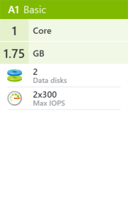
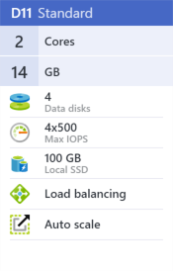
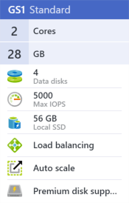
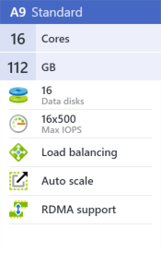
Capacity and Features
VM size determines compute capacity
# of cores, RAM, # of disks, local SSD
VM size determines features
Auto-scale, load balancing, RDMA, Premium storage support
Notes:
The size of your virtual machine also determines the features available to your VM instance. For example, if you need support for load balancing, or want to be able to auto-scale the number of instances up or down based on server load, then you will need to choose a VM size that offers those features.
High Performance Computing workload can take advantage of bringing their own images to Azure and leverage the higher memory, increased number of cores per VM and the unique capability of a second backend network. This network supports remote direct memory access (RDMA) up to 40Gbps for lower latency and high-throughput communication between compute nodes.
SAP supports only A5 and up and only STANDARD VMs.

Slide 9
Documentation portal with VM sizes

Slide 10
Virtual Machine Tiers
Standard Tier VMs
Different series for different workloads
Check latest SAP certifications to ensure VM is supported
Most flexible – full feature support
Basic Tier VMs
General purpose compute
No support for load balancing, auto-scale, or high memory requirements
Notes:
Virtual Machine sizes are grouped into two tiers; Standard and Basic Tier VM’s.
The Standard Tier VM’s are most common for production workloads. Within the standard tier, there are multiple series (or classes) of VM’s available that offer increasing compute capacity across the tiers. The Standard Tier VM’s is feature rich as well, providing support for load-balancing and high-memory workloads.
The Basic tier offers more affordable general compute options, but without the features that a production environment typically require. These are ideal for Dev/Test scenarios or small workloads that don’t require features such as load-balancing.
For SAP Database Servers workload, we recommend using the DS and GS series VMs to take advantage of the premium storage.

Slide 11
Azure Virtual Machine Marketplace
OS Images
Windows & Linux
Custom – create your own flavor of Windows or Linux
Windows Server Images
SQL Server, Dynamics, SharePoint, Oracle
Supported server workloads on Azure VMs available at https://support.microsoft.com/en-us/kb/2721672
Windows Client Images (w/MSDN)
Windows 7, 8.1, 10
Visual Studio 2015 and 2017

Slide 12
Availability Sets
Recommended for workloads with 2+ VMs
Azure has knowledge of your server topology – won’t shut down all instances during host upgrades.
Provides physical redundancy at the server, power, and network level
Required to achieve 99.95% SLA with Standard Storage
Fault Domain
Fault Domain
Server Rack
Server Rack
Availability Set
Availability Set
Notes:
When deploying virtual machines where more than one VM will service a workload such as a set of web servers or domain controllers it is highly recommended to create them in an availability set.
By doing so, Azure has some basic knowledge about the structure of your application topology. When updating the underlying host, Azure will perform rolling updates across the instances in the available set, taking down only a portion of your servers for the actual update.
<click>
Putting VMs in an availability also tells Azure to provision the VM’s on separate physical racks in the data center so your servers have physical redundancy at the server, power and network level. If a failure even at the rack level occurs, a minimum of half of your applications servers will still be available on separate physical hardware.
Shown here is what we call a Fault Domain in Azure. A Fault Domain isolates virtual machine instances for faults.
To achieve the 99.95% SLA Availability Sets are required.

Slide 13
Azure Virtual Machines
Notes:
1_Virtual_Machines.docx

Slide 14
Azure Storage Overview
Notes:
This section will be a very brief introduction of the core services offered in Azure Storage.

Slide 15
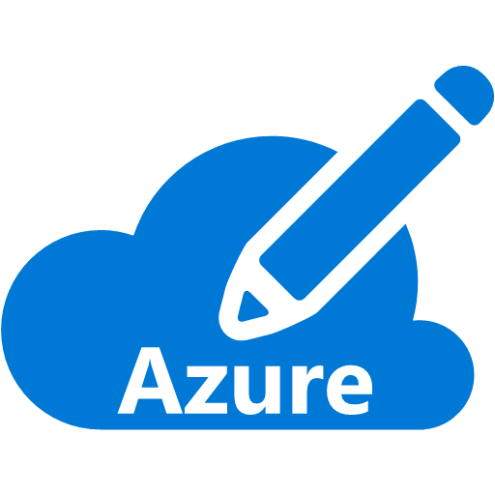
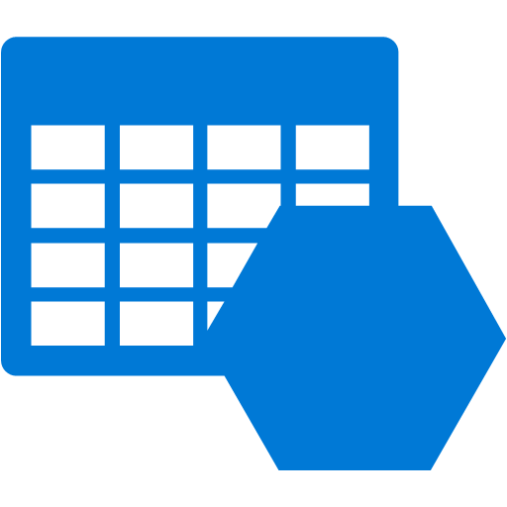
Azure Storage Accounts
An Azure Subscription can have up to 200 storage accounts.
Soft limit – contact support if you need more
Store up to 500TB per storage account
A storage account is uniquely addressable.
https://<account name>.<service name>.core.windows.net
Available from anywhere using REST API’s
Open source client libraries available for .NET, Native C++, Java, Android, Node.js, PHP, Python, Ruby, PowerShell, iOS
Storage Account
Storage Account
Storage Account
Max. 250 Storage Accounts
Notes:
An Azure subscription provides capacity for up to 100 storage accounts, each of which can store up to 500TB. So, you have basically 50 Petabytes of storage in a single subscription.
Each of your storage accounts have a globally unique DNS name. The structure of the DNS name is the name of your storage account, the service endpoint within the storage account (which we’ll cover in the next slide), followed by core.windows.net.
<click>
This means your data is accessible from anywhere using REST API’s and HTTPS. So, if you can speak REST then there are hundreds of REST API’s available that you can use to store and access your data.
If REST is not your thing, then consider the many language specific client libraries that Microsoft provides. These libraries are open source so you can see the code and even contribute to them if you like.
Azure Storage is a massively scalable service. For example, it processes over 6 million transactions per second. It stores over 50 trillion objects.

Slide 16
Storage Replication
Replication Strategy | LRS | ZRS | GRS | RA-GRS
Data is replicated across multiple facilities | No | Yes | Yes | Yes
Data can be read from the secondary location as well as from the primary location | No | No | No | Yes
Number of copies of data maintained on separate nodes | 3 | 3 | 6 | 6
LRS – Locally Redundant
ZRS - Zone Redundant (only for Block Blob)
GRS – Globally Redundant
RA-GRS – Read Access Geo Redundant
Notes:
We have also had questions about what types of data replication push data in what quantity, so here is a table representing the numbers across the types of replication.
For GRS When you create a storage account, you select the primary region for the account. The secondary region is determined based on the primary region, and cannot be changed.

Slide 17
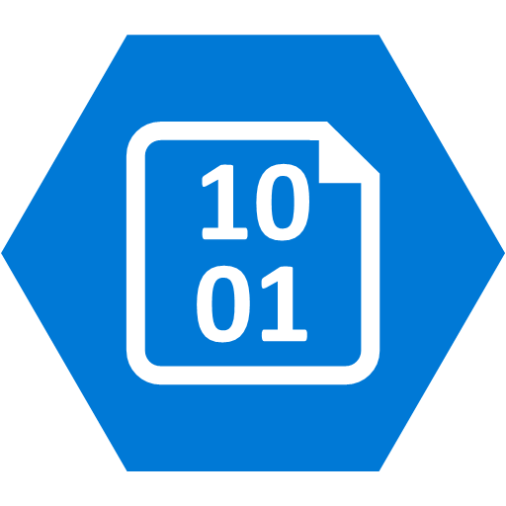
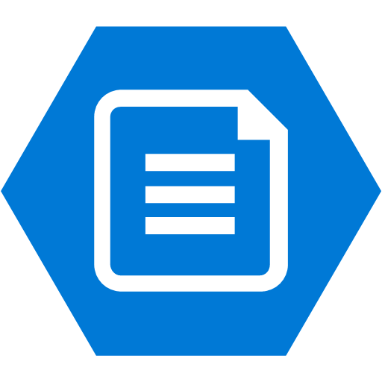
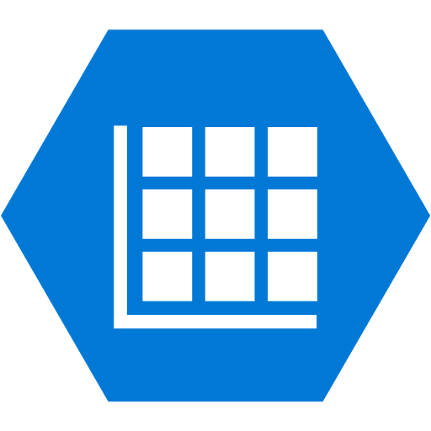

Azure Storage Account Services
Blobs
File Shares
Block: Text or binary data (.log, .exe, .jpg, etc.).
Up to 4.75TB.
Page: Optimized for disks (.vhd). Supports random read-write. Up to 4TB.
Supports SMB 2.1, 3.0 protocol.
Can be accessed like a traditional file share.
Share files between multiple Virtual Machines.
A single file share can be up to 5TB.
Append Blob: Writes to end of the blob (4MB max) up to 50k times (~195GB)
Tables
Queues
NoSQL storage of structured data (entities).
Key/value storage.
A single entity can have up to 255 properties and be up to 1MB.
Durable messaging.
Provides asynchronous communication between application tiers and components.
A single message can be up to 64KB.
Notes:
There are 4 services in an Azure Storage account. The first we will cover is the Blob service. The blob service supports two types of blobs, block blobs and page blobs. Block blobs are used for streaming content and storage of text or binary data. Essentially anything you want to store in it. The size limit for a single block blob is 200GB.
Page blobs are optimized for random read/write operations. Disks that are used to back Azure Virtual Machine’s use page blobs. The size limit for a single page blob can be 1TB.
They managed in containers. Containers allow you to group blobs together.
Block blobs are for sequential reads. Read or write at one time like photos. logs, files
Page blobs are for random reads. 3 copies in the same region. This is what backs the VM service and VM storage.
There is also a new blob type called append only blob. An append blob is comprised of blocks and is optimized for append operations. When you modify an append blob, blocks are added to the end of the blob only, via the Append Block operation. Updating or deleting of existing blocks is not supported. Unlike a block blob, an append blob does not expose its block IDs.
Each block in an append blob can be a different size, up to a maximum of 4 MB, and an append blob can include up to 50,000 blocks. The maximum size of an append blob is therefore slightly more than 195 GB (4 MB X 50,000 blocks).
<click>
The File service is a new service in preview that supports the SMB protocol. This allows you to access Azure Storage like you would a traditional file share. It also enables you to share files between multiple Virtual Machines, which is not something you can do with a disk.
Once created, you can mount the SMB share just like a regular file share
<click>
The Table service provides extremely fast storage of structured data. It is a NoSQL storage solution – don’t confuse it with SQL tables (not even close). It is a key/value storage solution. When using Azure Tables, think of “entities”. An entity can have up to 255 properties associated with it, which includes 3 system properties required by the service. And a single entity cannot exceed 1MB.
Really flexible storage.
<click>
The Queue service provides a durable messaging store that can be used for asynchronous messaging between application tiers or components. FIFO is typical, but not guaranteed. If you need a more robust messaging system than the Azure Service Bus should be considered. For simple messaging requirements, Azure Queues is extremely effective.

Slide 18
Managed Disks and Premium Storage

Slide 19
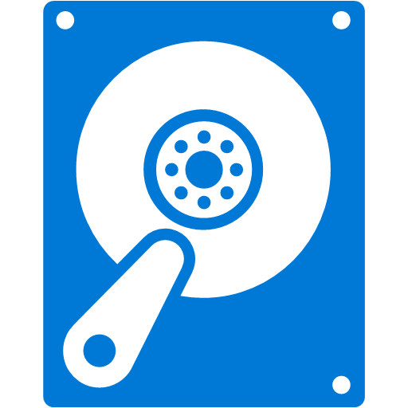
Managed disks
Simplified management for performance and scale
Avoid capacity planning mistakes
Integrates directly with virtual machine scale sets and availability sets
Recommended for VM workloads
Storage costs incurred based on the size of the disk instead of amount of data
WHAT THE ADMINISTRATOR SEES
BEHIND THE SCENES
500 IOPS PER DISK
MANAGED DISK (2000 IOPS)
STORAGE ACCOUNT
Notes:
Key talking points:
Managed disks is a new feature that is cross cutting. You will see different aspects of it when we discuss security and flexibility improvements later in the presentation.
Managed disks simplifies scale by taking away the need for the administrator to know about service limits of storage accounts and ensure that IOPS and throughput capabilities are easy to understand.
Managed disks also integrate directly with virtual machine scale sets to automatically scale the front end compute and the backend storage.

Slide 20
Premium Storage
High Performance, low-latency storage for VMs
Ideal for I/O intensive workloads on *S-Series VMs
DS-Series VM can support up to 32 data disks and deliver up to 50K IOPS
GS-Series VM can support up to 64 data disks and deliver up to 80K IOPS
Provisioned IOPS and throughput covered by SLA

Slide 21
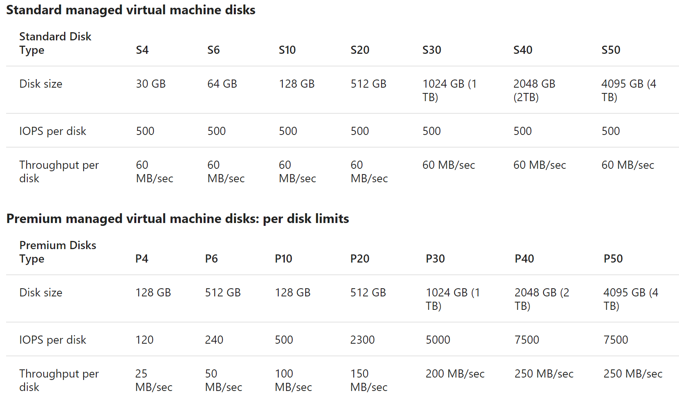
Premium compared to Standard Storage
Backed by SSDs instead of HDDs
Different sizes of disks available, starting from 30 GB up to 4 TB
IOPs per disk vary by size of disk up 7,500 IOPS
Throughput per disk varies by size up to 250 MB/sec
Storage analytics is not supported
https://docs.microsoft.com/en-us/azure/storage/storage-scalability-targets
Notes:
Reference
https://azure.microsoft.com/en-us/documentation/articles/storage-premium-storage-preview-portal/#pricing-and-billing-when-using-premium-storage
Azure Storage Analytics performs logging and provides metrics data for a storage account. You can use this data to trace requests, analyze usage trends, and diagnose issues with your storage account.
Storage analytics is not currently supported for Premium Storage. To analyze the performance metrics of VMs using disks on Premium Storage accounts, use the operating system based tools, such as Windows Performance Monitor for Windows VMs and IOSTAT for Linux VMs. You can also enable the Azure VM Diagnostics on Azure Preview Portal. Refer to Microsoft Azure Virtual Machine Monitoring with Azure Diagnostics Extension for details.

Slide 22
Scalability Targets
Notes:
2_Storage_Disk_IOPS.docx

Slide 23
Storage Access Control and Encryption

Slide 24
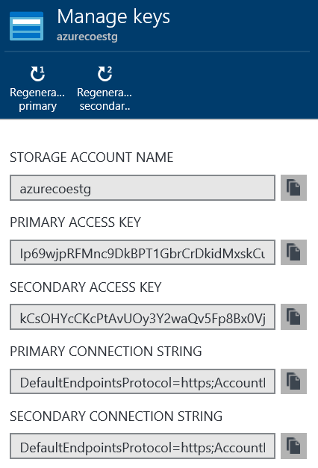


Storage account security
A storage account is protected by dual access keys
The storage account name and access key collectively are used to authenticate to the account
Access keys gives you full access to the storage account
RBAC is an effective way to limit this.
Rotate access keys regularly
Authentication
Acct Name + Key
Client
Web App
Storage Account
Notes:
When you create a storage account you must provide a unique name. During account creation Azure will generate a set of access keys for your storage account. Collectively, the storage account name and an access key provide the credentials you need to authenticate and access objects in your storage account.
By default, access keys give you full control of the storage account and allows you to do virtually anything you want in the account. Therefore, it is a security best-practice to regenerate your access keys periodically.
Question: Notice in the screen capture here there are two access keys generated; a primary and a secondary. Would anyone care to guess why there are two?
Answer: As mentioned previously, it is a security best practice to regenerate your keys regularly since these keys give you essentially full access to the account. There are two keys associated with the storage account for HA reasons. The idea is simply this… suppose you have web applications and virtual machines that use Azure storage for various activities. Also assume that the applications are currently using the primary access key. If you regenerate the keys for the storage account you will break those applications. So, the intent here is to first notify application owners to update their applications to use the secondary access key. After the applications are updated, then you can regenerate the primary access key. After 30 days or so, repeat the process but this time have the application owners switch back the primary access key.
Also, note that this notion of two access keys is not unique to Azure storage. You will see this in other parts of the platform such as Service Bus, Media Services, and others. So, when you see this understand that this is how the two keys are intended to be used.
Finally, as the graphic at the bottom of the screen shows, typically applications will be the primary consumers of the access keys. Or, it could be a management tool that you use to manage your azure storage account. You never want to give these keys to clients or end-users.

Slide 25
Shared Access Signatures (SAS)
A URI containing information to grant limited or full access to objects in your storage account
SAS tokens identify a resource, active date/time, expiration date/time, granular permissions and IP
Shared Access Policies (SAP) can be applied to containers, tables, queues and file shares
Authentication
Username + Password
Authentication
Acct Name + Key
Client
SAS Token
Web App
Storage Account w/CORS
Read/Write using SAS
Notes:
A common architecture for a web app is one where data is proxy’d through the web application instance. For example, if I want to retrieve data then a request is made to the web app, which in turn retrieves the data from storage, and then responds to the client with the data. For small data this is generally not a problem. However, as the size of the data grows it is often times necessary to scale up and/or out the web application to support user demand.
A better approach could be to offload R/W operations to storage such that the client directly accesses the storage. This is where SAS tokens can be extremely useful. When the client requests to read/write data, the web application instead returns a SAS token that contains the information necessary to authenticate access to a resource in storage.
In this scenario, a client authenticates to the web application as usual using a set of credentials. When the authenticated user does something on the site that requires a R/W operation on data, the site returns a SAS token to the client and then client performs the operation directly against storage using the SAS token to authenticate against the storage service.
Not stored, they are computed on the fly. Can store a stored access policy on containers
Improvements made (HTTPS only, Account SAS and IP ACL SAS)
Reference
https://azure.microsoft.com/en-us/documentation/articles/storage-dotnet-shared-access-signature-part-1/

Slide 26
Storage Service Encryption
At-rest, server-side, transparent encryption
Available for block and page blobs
Enabled or disabled for entire storage account
Does not affect existing blobs
Microsoft manages the generation, storage and rotation of keys
Custom key management in public preview
Notes:
https://docs.microsoft.com/en-us/azure/storage/storage-service-encryption-customer-managed-keys

Slide 27
Azure Disk Encryption
Encryption for OS and data disk
BitLocker for Windows VM
DM-Crypt for Linux VM
Available for Managed and Unmanaged Disk
Leverages Azure KeyVault to protect and ensure key integrity
Integrates with Azure Security Center
Notes:
https://docs.microsoft.com/en-us/azure/security/azure-security-disk-encryption

Slide 28
Cool Blob Storage
Low-cost storage for object data that is infrequently accessed and long lived
Price as low as $0.01 per GB/month
Charged for each individual retrieval ($0.01/GB) and update ($0.0025/GB)
Similar performance with slightly lower availability
99% for LRS/ZRS/GRS
99.9% for RA-GRS
Same durability as standard hot storage
Ideal for SAP backup and archival

Slide 29
Azure Networking

Slide 30
The Big Networking Picture
Virtual Network
“Bring Your Own Network”
Segment with subnets and security groups
Control traffic flow with User Defined Routes
Azure
Virtual Network
Users
Internet
Front-End Access
Dynamic/Reserved Public IP addresses
Direct VM access, ACLs for security
Load balancing
DNS services: hosting, traffic management
DDoS protection
Backend Connectivity
Point-to-site for dev / test
VPN Gateways for secure site-to-site connectivity
ExpressRoute for private enterprise grade connectivity
Backend Connectivity
ExpressRoute
VPN Gateways
Notes:
Let’s talk about the big networking picture.
Virtual network: An Azure virtual network (VNet) is a representation of your own network in the cloud.
Bring your own network: Microsoft lets you bring you own network (BYON) into Windows Azure. You can connect your local area network (LAN) to Azure and an unlimited number of computers on your corporate networks can seamlessly communicate with VMs in Azure. You can specify private network spaces (such as 192.168.x.x and 10.x.x.x) in any range, size, and starting number to suit your existing network topology.
Segment with subnets and security groups: You can also further segment your VNet into subnets and deploy Azure IaaS virtual machines (VMs) and PaaS role instances, in the same way you can deploy physical and virtual machines to your on-premises datacenter. Network Security Groups provide control over network traffic flowing in and out of your services running in Azure.
Control traffic flow with User Defined Routes: With user defined routes, you now have complete control over the traffic flow in your virtual network. Virtual network by default provides system routes for traffic flow between virtual machines. You can now customize the routing table by defining routes allowing you to direct traffic through network appliances.
<Click>
Front-End Access: for the front end access, Microsoft Azure Virtual Private Network (VPN) provides multiple options to secure and manage VPN like, dynamic/reserved public IP address, ACL for security, load balancing etc…
<Click>
Backend Connectivity: With Microsoft Azure Virtual Private Network (VPN), you can create point-to-site VPN for your dev/test, create secure site-to-site connectivity with Azure VPN gateways and can opt for ExpressRoute for private enterprise grade connectivity.

Slide 31
Azure Virtual Network
Provides connectivity and isolation for resources
Allows for segmentation through subnets
Enables traffic filtering and custom routing rules
VNet in same region can be peered
No impact on bandwidth or latency
VNet across region connected through Gateway
Gateway bandwidth limit, impact on latency

Slide 32





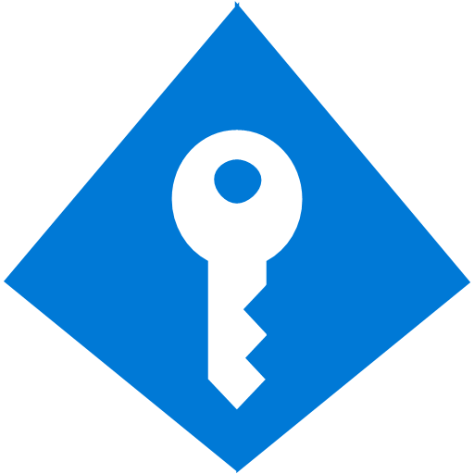

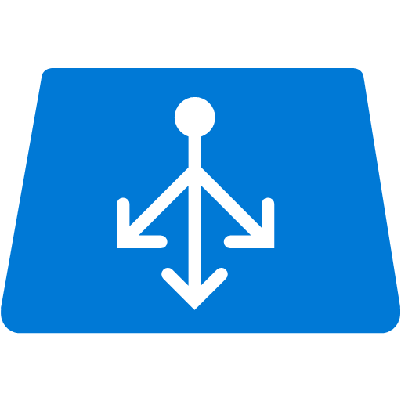


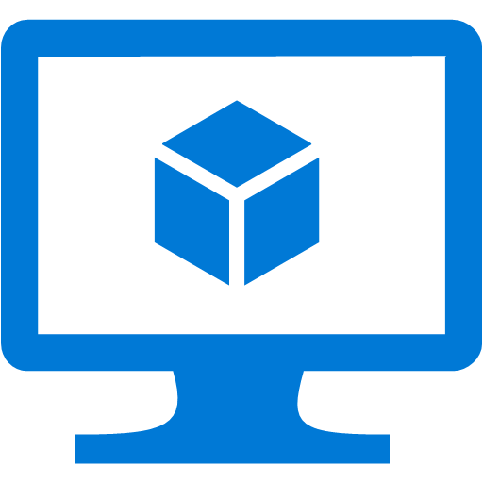

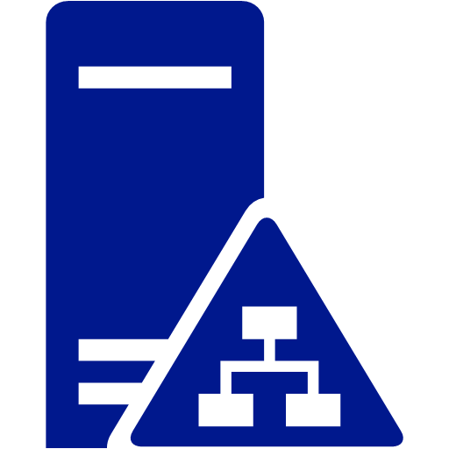
On-Premises (Physical) -2- Cloud (Virtual)
Internet
Router
Azure Infrastructure
Firewall
NSG
DMZ
Public Facing LB
Frontend Subnet
Public Facing LB
Web Servers
DNS
Web Server VM’s
DNS
Firewall
NSG
Backend Subnet
Internal LB
Internal
Internal LB
Database Server VM’s
DC VM
Database Servers
DC
Virtual Network
Notes:
An Azure virtual network (VNet) is a representation of your own network in the cloud. You can control your Azure network settings and define DHCP address blocks, DNS settings, security policies, and routing. You can also further segment your VNet into subnets and deploy Azure IaaS virtual machines (VMs) and PaaS role instances, in the same way you can deploy physical and virtual machines to your on-premises datacenter. In essence, you can expand your network to Azure, bringing your own IP address blocks.
To better understand VNets, take a look at the figure below, which shows a simplified on-premises network.
<Click>
The same network can be hosted in Azure as shown in the figure on right.

Slide 33

User Defined Routes (UDR)
Internet
Control traffic flow in your network with custom routes
Attach route tables to subnets
Set default route to force tunnel all traffic to on-premises or appliance
Appliance Subnet
3rd Party
Virtual
Appliance
UDR
UDR
Subnet A
Subnet B
System-defined Route
Virtual Network
Notes:
Details:
For each subnet you can attach a routing table
256 routes per subnet
Depending on address prefix – go to the next hop
Can build topologies where you can put things like virtual network appliance, your own firewalls, force certain traffic to certain places

Slide 34

Network Security Groups
On Premises 10.0/16
Segment network to meet security needs
Can protect Internet and internal traffic
Enables DMZ subnets
Associated to subnets/VMs and now NICs
Internet
ExpressRoute and VPNs
√
√
√
√
VPN GW
Backend
10.3/16
Mid-tier
10.2/16
Frontend
10.1/16
Virtual Network
Notes:
When you segment the network, you can have access control lists on the network
Apply to each subnet or VMs within the subnet
Allow or deny rules
Apply to the subnet, they’re automatically applied to the subnet
NSGs + UDRs + Multiple NICS – total flexibility
Reference: https://azure.microsoft.com/en-in/documentation/articles/virtual-networks-nsg/
NIC: You can create virtual machines (VMs) in Azure and attach multiple network interfaces (NICs) to each of your VMs. Multi NIC is a requirement for many network virtual appliances, such as application delivery and WAN optimization solutions. Multi NIC also provides more network traffic management functionality, including isolation of traffic between a front end NIC and back end NIC(s), or separation of data plane traffic from management plane traffic.

Slide 35
Network Security Groups
Notes:
Slide Title : Demo – Network Security Groups
Details: TBD
Speaker Notes: Demo VNet with 3 Subnets, Frontend, App Subnet and Database subnet, three Network Security groups one per each subnet.
Demo Script: 2.0_NSG.docx
Reference URL: https://azure.microsoft.com/en-in/documentation/articles/virtual-networks-create-nsg-arm-pportal/
Notes: refer existing demo script (2_Demo_NSG.docx) + http traffic to compute VM

Slide 36
Cross Premises Connectivity

Slide 37


Point-to-Site VPNs
Azure
<subnet 1>
<subnet 2>
<subnet 3>
Virtual Network
DNS Server
On-premises
VPN Gateway
VPN Gateway
Route-based
VPN
Point-to-Site VPN
Your datacenter
Individual computers behind corporate firewall
Remote workers
Notes:
Connect from anywhere securely
No software installation required!
Easy to setup and use
Ideal for prototyping, development, demos
P2S and S2S coexist

Slide 38
Site-to-Site Connectivity
Extend your premises to the cloud securely
On-ramp for migrating services to the cloud
Use your on-premise resources in Azure (monitoring, AD, …)
Azure
<subnet 1>
<subnet 2>
<subnet 3>
Virtual Network
DNS Server
Site-to-Site VPN
On-premises
VPN Gateway
VPN Gateway
Hardware VPN or Windows RRAS
Your datacenter
Notes:
Extend your premises to the cloud securely
On-ramp for migrating services to the cloud
Use your on-premise resources in Azure (monitoring, AD, …)
Reference: https://azure.microsoft.com/en-in/documentation/articles/vpn-gateway-site-to-site-create/

Slide 39
Multi-Site VPN - Things to know
Compatible VPN devices
Externally facing public IPv4 IP address for each VPN device
The IP address ranges that you want to use for your virtual network
The IP address ranges for each of the local network sites that you'll be connecting to – no overlap
Max IPSec tunnels limits: Basic 10, VpnGw1 through 3, Performance 30
Notes:
VPN Gateway SKUs and limits:
https://azure.microsoft.com/en-us/documentation/articles/vpn-gateway-about-vpngateways/

Slide 40
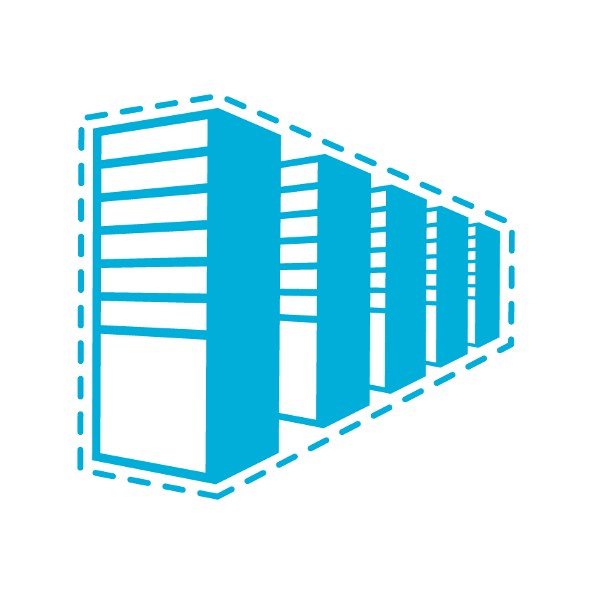
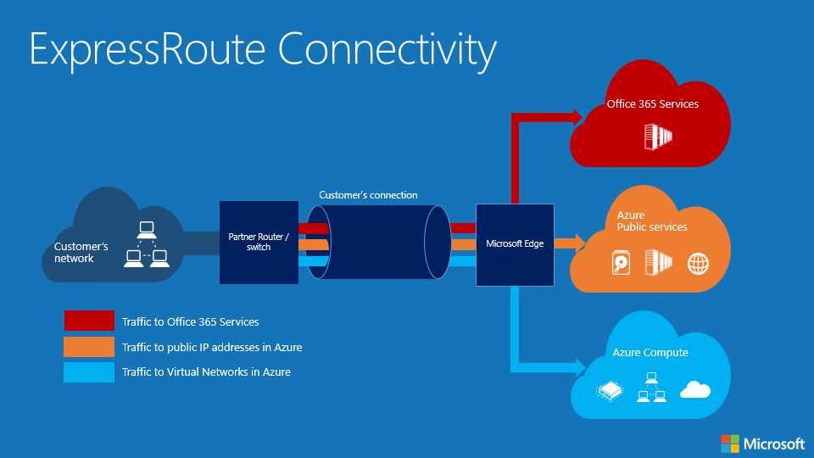
ExpressRoute Connectivity
Office 365 Services
Customer’s connection
Partner Router / switch
Microsoft Edge
Azure Public services
Customer’s network
Traffic to Office 365 Services
Traffic to public IP addresses in Azure
Azure Compute
Traffic to Virtual Networks in Azure
Notes:
Predictable Performance
Not under the mercy of your ISP
Secure – Packets don’t go over the open internet
High throughput – Given circuit can be up to 10 gigs, can have multiple circuits, highly available
Lower cost if you’re pushing a lot of data
Also the way to connect to Microsoft in general. So far, only to connect to Azure but now it is the service to connect to all Microsoft Services. O365, Skype for Business, etc.
Can be used to carry traffic for all these MS services. Same circuit will work. May choose multiple circuits for redundancy or more throughput.

Slide 41
Azure ExpressRoute
Dedicated private Layer 3 connectivity between Azure datacenters and on-premises infrastructure
Bandwidth from 50 Mbps to 10 Gbps
ExpressRoute connections do not go over the public Internet
Offer more reliability, faster speeds, lower latencies, and higher security than typical connections over the Internet
Connect ExpressRoute in one peering location and have access to all regions within the geopolitical region
If you connected to Microsoft in Amsterdam through ExpressRoute, you have access to all Microsoft cloud services hosted in Northern Europe and Western Europe
Enable ExpressRoute premium add-on feature to extend connectivity across geopolitical boundaries

Slide 42
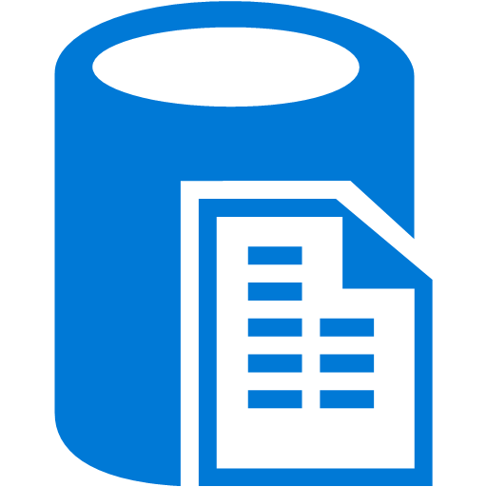

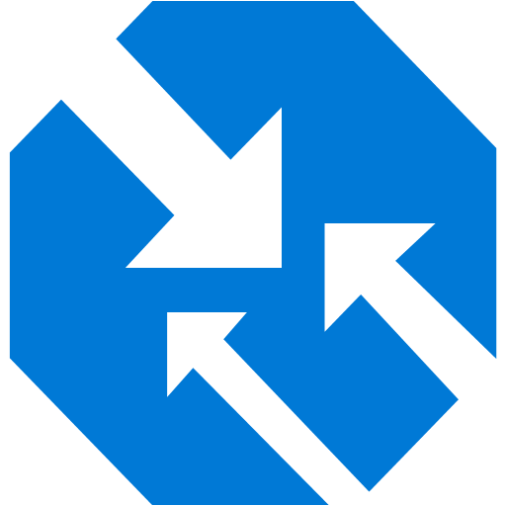
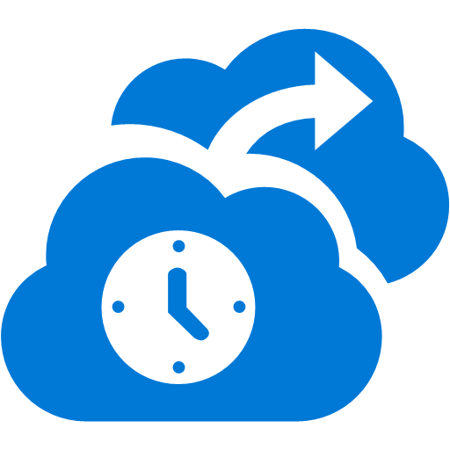
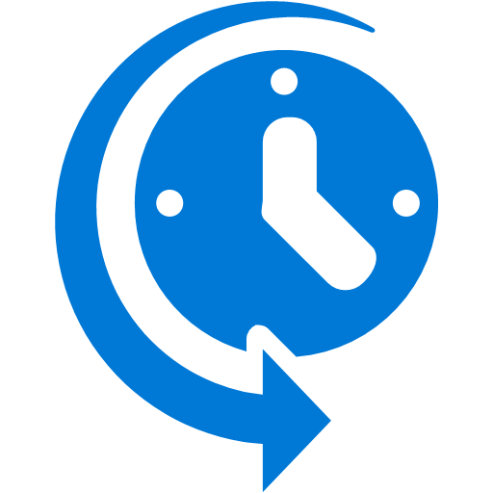
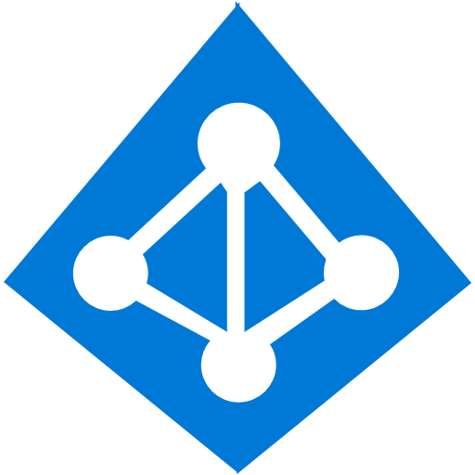


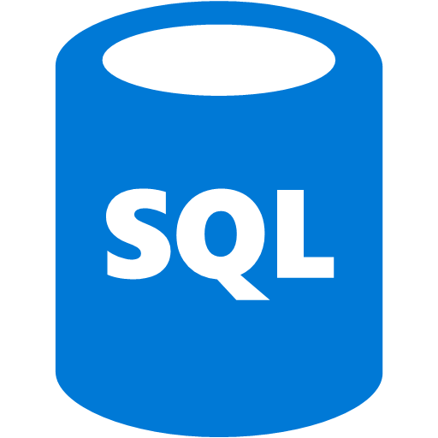
ExpressRoute and S2S VPN Coexistence
S2S VPN as a backup for ExpressRoute
S2S connectivity to branch offices
Connecting Virtual Networks in other Azure regions
Internet
Contoso HQ
VPN Gateway
(Internet Edge)
SQL Farm
IIS Servers
Services on public IPs
ExpressRoute
AD/DNS
Monitoring
Exchange
Contoso virtual networks/VMs
Notes:
Multiple circuits but want to be able to fail over VPN
Through routing can determine which route is best way to get there and if all else fails, use VPN functionality
Multi-nationals have been asking for this.

Slide 43
Using the Azure portal to deploy VPN Gateways

Slide 44
Conclusion
Azure Compute, Storage and Networking are fundamental pillars of the Azure platform
Building blocks to enable higher level services

