Slide 1
SAP Netweaver on Azure ADS
Ben Trinh
bentrin@Microsoft.com

Slide 2
Agenda
Key components of an SAP ADS
Business and technical drivers and requirements
SAP/Microsoft certified products for Azure
Capacity planning and resource sizing
Solution design
Solution cost estimate

Slide 3
What’s an ADS?
An ADS includes mutual discovery, tailored product and technology drill-downs. It culminates with the delivery of a clear and actionable picture or architecture of how Microsoft and partner technologies can help customers reach their business goals.
Notes:
At MS, we call the above described activity an Architecture Design Session. An ADS is generally a presales activity. Some partners call that an assessment. What are some other terms you call an ADS?

Slide 4
Business Drivers & Tech. Requirements
Business drivers help limit or extend project scope for current or future phases, and ensure alignment
Technical requirements expressed in Service Level Agreement: availability, scalability range
Others: landscape and current architecture, technology deployed
Notes:
Understanding customers’ business drivers help the delivery team either set proper boundary for solutions or create solutions in phases to align with customers’ business initiatives.
High level technical (or non-functional) requirements are commonly expressed in performance, reliability, scalability
Other components also influences the approach of a solution. Things like current architecture and technology. E.g., on-premises deployment of Oracle will require an SAP migration process while SQL Server ‘migration’ to SQL on Azure IaaS can be a much simpler process.

Slide 5
SAP on Microsoft Azure
Microsoft Azure is certified for the following SAP products, with full support from Microsoft and SAP.
SAP Product | Guest OS | RDBMS | VM Types
SAP Business Suite | Windows, SLES | SQL Server, Oracle, DB2, SAP ASE | A5-9, D11-D14, DS11-14, DS11-14V2, GS1-5
SAP Business All-in-One | Windows, SLES | SQL Server, Oracle, DB2, SAP ASE | A5-9, D11-D14, DS11-14, DS11-14V2, GS1-5
SAP NetWeaver App Server | Windows, SLES | SQL Server, Oracle, DB2, SAP ASE | A5-9, D11-D14, DS11-14, DS11-14V2, GS1-5
SAP HANA Base, Platform, Entr. Editions | SLES | N/A | GS5, S72-72m, S144-144m
Key SAP certifications listed only. See SAP note 1928533 for full list and supported OS/DB combo
Notes:
On May 19, 2015, Microsoft and SAP announced the full support of the SAP products list on the table @ right
Only NetWeaver 7.00 and later SAP releases of NetWeaver are supported for deployment in Azure
Customers can try SAP HANA Developer Edition on Azure using the SAP Cloud Appliance Library. (including the HANA Client software comprised of SQLDBC, ODBO (Windows only), ODBC, AND JDBC drivers), HANA Studio, and HANA Database
Oracle Database 11g R2 Patchset 3 (11.2.04 ), Single Instance
SAP Adaptive Server Enterprise 16
On May 17, 2016 at SAPphire Orlando, SAP/Microsoft jointly announced the SAP HANA (Base, Enterprise, and Platform editions) certification on Azure

Slide 6
Licensing and Support
SAP applications migrated to Azure require new licenses to be applied – SAP note 2035875
Microsoft support premier contract required - SAP note 2015553
To request support: open an SAP Online Software Support (OSS) ticket at component BC-OP-NT-AZR
Notes:
With SAP Applications, it’s a bring your own licenses scenario. After migrating to Azure, a new SAP application license will need to be requested from SAP Support Portal and reapplied.
If you have a SQL Software Assurance (SA), you have license mobility benefit on Azure. Deploy Windows VMs without SQL installed.
If you deploy a Windows server with SQL installed, the run rate will be higher than one without SQL. So if you already purchase SQL license from SAP or have SQL SA, you should only use gallery image with the OS only.
SAP on Azure support can be requested via the SAP Support portal by creating a ticket with the component BC-OP-NT-AZR

Slide 7
Solution Design
Authentication
Capacity plan and layout for Network, Compute, and Storage
SAP Central Service HA/DR
SAP Application Server HA/DR
Oracle on Azure HA/DR and backup
SQL Server on Azure HA/DR and backup

Slide 8

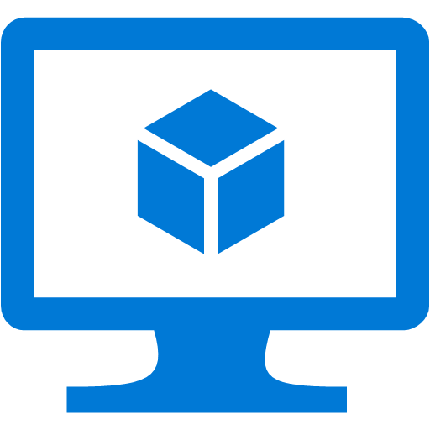

SAP on Azure Authentication
On-premises Windows Domain Controller replicated to Azure
Benefits:
DR protection for on-premises DC
Fast performance for SAP on Azure authentication
Bidirectional updates
Azure VNET
S2S VPN or ER
RW Domain Controllers
Domain Controller
AD replication
Notes:
SAP’s operations will require a RW DC. Some points to consider if you are asked to do an RODC: firstly without contact with a writable domain controller the RODC, cannot update itself and will start to cause issues such as password changes, group policy updates, and authenticating new users to the domain from the remote office. Read only DNS also relies on the writable DNS server to update its records. Without a connection to the RWDC, name resolution issues start to surface.

Slide 9
Planning and Capacity

Slide 10
Network Planning
VNET address space
Subnets address ranges:
Data, Applications, Web, Management, and gateway
NSGs for subnets
Site-to-Site
ExpressRoute
Notes:
Have a network topology and IP address space plan in mind before you start laying out the Azure infrastructure
Separate servers in subnets by functions: Web, App, Data, Management etc
Plan security policy for each layer and public endpoints. Example in next slide.
Work with customers’ network team to plan for network bandwidth and security requirements to choose between S2S or ER and its bandwidth

Slide 11
Network Address Space Example
Address Space: DEV 10.11.130.0 /23 (510 IPs) | Purpose
8 Subnets
10.11.130.0 /26 (62) | Management or Shared Services
10.11.130.64 /26 (62) | Web portals
10.11.130.128 /26 (62) | App1
10.11.130.192 /26 (62) | App2
10.11.131.0 /26 (62) | Data1
10.11.131.64 /26 (62) | Data2 (sensitive data)
10.11.131.128 /26 (62) | Reserved
10.11.131.240 /28 (12) Gateway | Gateway
Notes:
A project stood up a DEV environment on Azure with the address space specified. Servers are connected to the appropriate subnets base on roles. The address space for this DEV environment should not overlap with your on-premises network

Slide 12



Sample NSG Setup
Internet
DMZ
Block Internet
RDP
TCP/80
Block Internet
Block RDP
✓
✓
Block RDP
SAPFE_NSG
SAPApp_NSG
SAPDB_NSG
SAP Ent. Portal
✓
✓
SAP App. Servers
SAP DB Servers
443
1433
FE Subnet (10.0.0.0/24)
App Subnet (10.0.1.0/24)
DB Subnet (10.0.3.0/24)
Block FE
Notes:
App servers and DB servers are backend services so block incoming and out-going internet connection.
Frontend portal servers should only connect to the backend servers over allowed ports
Security Guide for SAP on SQL 2012 http://www.bing.com/search?q=Security+Guide+for+SAP+on+SQL+Server+2012+cameron&qs=n&form=QBLH&pq=security+guide+for+sap+on+sql+server+2012+cameron&sc=0-49&sp=-1&sk=&cvid=BBFD6C6FCACD42459D9BE6A04216CEF7

Slide 13
Cross Site Connectivity (Site-to-Site)
Secure IPSec VPN over internet using VPN devices
Work with your network administrator to:
Obtain an externally facing IPv4 IP for your VPN device
Verify that the VPN device meets requirements necessary to create a cross-premises virtual network connection
https://azure.microsoft.com/en-us/documentation/articles/vpn-gateway-about-vpn-devices/
Configure a Site-to-Site VPN in the Azure Management Portal
https://azure.microsoft.com/en-us/documentation/articles/vpn-gateway-howto-site-to-site-resource-manager-portal/
Test network latency with Azure Speed Test
http://www.azurespeed.com/
Notes:
Discuss these key items in Azure network planning and introduce the resources on the provided links

Slide 14
Cross Site Connectivity (ExpressRoute)
Use ExpressRoute when inter-sites traffic near 100 Mbps and application criticality demands deterministic latency
Network bandwidth/speed
Network Service Provider : 10Mbps to 1Gbps
Exchange Provider : 200Mbps to 10Gbps
http://azure.microsoft.com/en-us/services/expressroute/
Customer site 2
Azure
Private, Dedicated Network
Customer site 1
ExpressRoute
Customer DC

Slide 15
SAP App. Performance Std. (SAPS)
A hardware-independent unit of measurement that describes the performance of a system configuration in the SAP environment. It is derived from the Sales and Distribution (SD) benchmark, where 100 SAPS is defined as 2,000 fully business processed order line items per hour.

Slide 16
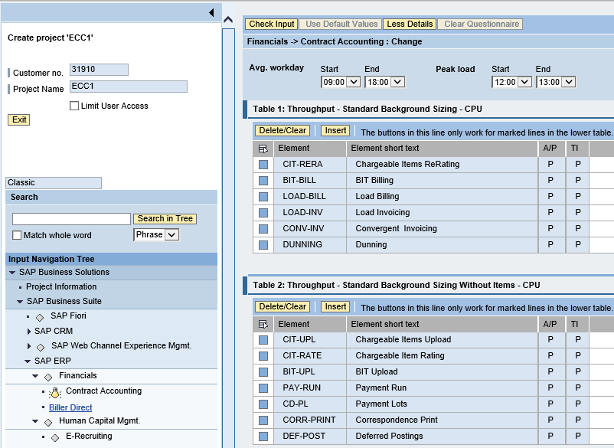
SAP System Sizing
SAP Quick Sizer
Reference sizing
Reference on-prem configuration
Use resource utilization data
Early Watch Report
SAP Quick Sizer sizing for new systems
Notes:
For on-prem existing systems, reference system config and resource utilization data. The system utilization information is collected by the SAP OS Collector and can be reported against via transaction OS07N and/or the Early Watch Report. Similar information can be retrieved from any system performance and statistics gathering tools.
For details see https://blogs.msdn.microsoft.com/saponsqlserver/2015/06/19/how-to-size-sap-systems-running-on-azure-vms/
For net new systems, use SAP quick sizer. The Quick Sizer can be found at https://service.sap.com/quicksizer. Access requires an OSS account.

Slide 17
SAP System Utilization Info
ABAP
SAP operating system monitor transaction OS07N
CPU
Memory Management
File systems and LAN
JAVA
SAP Netweaver Administrator (NWA)
Notes:
For ABAP stack servers, transaction OS07N reports CPU, memory, IO, and LAN information
You can use the operating system monitor to display operating system data from monitored hosts on which an operating system collector SAPOSCOL is running. You have the following options for selecting the data to be displayed:
You can determine the time period for which data is to be displayed. More information: Selecting Current Values and History of Operating System Data > http://help.sap.com/saphelp_nw70ehp3/helpdata/en/45/d0446d01ef0b00e10000000a1553f7/content.htm
You can determine the system and instance about the hosts of which data is displayed. More information: Selecting Operating System Data of Systems, Instances, and Hosts > http://help.sap.com/saphelp_nw70ehp3/helpdata/en/45/d043b401ef0b00e10000000a1553f7/content.htm
You can use different analysis views to determine which topic area of the monitored operating system data is to be displayed.
For Java stack application servers, the tool for monitoring and management is Netweaver Administrator (NWA). The Availability and Performance work center in SAP NetWeaver Administrator enables you to monitor different parameters of a system operation. Among other things, It includes the AS Java Statistics which allows you to measure and analyze the performance of AS Java system activities. It provides important performance metrics such as response time, CPU time, memory consumption, and so on.
After all, you can also rely on 3rd party system management tools available in the market to report on capacity and resource consumption for SAP sizing purposes.

Slide 18
Selected Azure VMs SAPS Rating
VM Type | VM Size | 2-Tier SAPS | 3-Tier SAPS | DB Server for 3-Tier Supported | Required Azure Storage for Database Files
A5 | 2 CPU, 14 GB | 1,500 | 12,000 | Yes | Standard
A8 / A10 | 8 CPU, 56 GB | 11,000 |  | No | Standard
A9 / A11 | 16 CPU, 112 GB | 22,000 |  | No | Standard
D11 | 2 CPU, 14 GB | 2,325 |  | Yes | Standard
D14 | 16 CPU, 112 GB | 18,600 |  | No | Standard
DS11 | 2 CPU, 14 GB | 2,325 |  | Yes | Premium
DS14 | 16 CPU, 112 GB | 18,600 |  | Yes | Premium
DS11v2 | 2 CPU, 14 GB | 3,530 |  | Yes | Premium
DS14v2 | 16 CPU, 112 GB | 24,180 |  | Yes | Premium
GS1 | 2 CPU, 28 GB | 3,580 | 34,415 | Yes | Premium
GS4 | 16 CPU, 224 GB | 22,680 | 247,880 | Yes | Premium
GS5 | 32 CPU, 448 GB | 41,670 |  | Yes | Premium
* See SAP note 1928533 for full list

Slide 19
SAP Azure Benchmark Certs
2-Tier SAP benchmark certification for DS14v2 VM http://global.sap.com/campaigns/benchmark/assets/Cert16018.pdf
3-Tier SAP benchmark certification for GS4 as the DB server http://global.sap.com/campaigns/benchmark/assets/Cert15045.pdf
Notes:
Click on the links to show the certificates and discuss the configuration of each and how one should size with this knowledge
Reference this blog for how to > https://blogs.msdn.microsoft.com/saponsqlserver/2015/06/19/how-to-size-sap-systems-running-on-azure-vms/

Slide 20
3-tiers sizing samples
SAP systems size category | Generic sizing potential configuration
1). 13,000 – 45,000 SAPS | 1 x DS11v2 VM DBMS Server: 3,530 SAPS Between 2 - 5 x DS12v2 VM App Servers at 6,680 SAPS
2). 45,000 – 90,000 SAPS | 1 x DS13v2 VM DBMS Server: 12,300 SAPS Between 2 - 4 x DS14v2 VM App Servers each rated at 24,180 SAPS
3). 90,000 – 150,000 SAPS | 1 x GS3 VM DBMS Server: 11,870 SAPS Between 6 - 10 x DS13v2 VM App Servers at 12,300 SAPS
4). 150,000 - 250,000 SAPS | 1 x GS4 VM DBMS Server: 22,680 SAPS Between 2 - 7 x GS5 VM App Servers each rated at 41,670 SAPS

Slide 21
VM Sizing Tips
Know # of SAPS for SAP application and database tiers
Know system active period, use Azure Auto Scale to lower cost
For SAP App servers, prefer a few smaller VM vs one large VM
Use premium storage for database
Ensure the selected VM supports the IOPS required by db server
Quicksizer assumes max server utilization at 65% while benchmarks run at near 100%. Need to either up Quicksizer # or adjust down VM benchmark SAPS # before VM selection
If size by reference system, know the resource utilization and SAPS rating
Notes:
See https://blogs.msdn.microsoft.com/saponsqlserver/2015/12/01/new-white-paper-on-sizing-sap-solutions-on-azure-public-cloud/ for details on sizing SAP system on Azure IaaS

Slide 22
Storage Planning Tips
General on-premises files layout recommended practices applied for cloud deployment
Observe storage account constraints and use multiple storage accounts if needed
Use premium storage for SAP databases
Host cache settings:
Configure host-cache as None for write-only and write-heavy disks
Configure host-cache as ReadOnly for read-only and read-write disks
Configure host-cache as ReadWrite only if your application properly handles writing cached data to persistent disks when needed
Notes:
https://azure.microsoft.com/en-us/documentation/articles/storage-premium-storage-performance/

Slide 23
Storage Planning Tips
Choose standard or premium storage based on IOPS and disk transfer throughput caps
Use Windows storage pool to stripe standard disks to extend IOPS capacity
Have a landscape level view for IOPS requirement
Standard storage accounts have 20,000 IOPS cap
No IOPS cap for premium storage accounts but max disks at 280, 140, 35 drives for P10, P20, P30 respectively
SAP application servers don’t need premium storage
Use separate storage account for diagnostics and logs
Don’t use GRS for data, log, and tempdb files
Notes:
https://azure.microsoft.com/en-us/documentation/articles/storage-scalability-targets/

Slide 24
SAP Architecture

Slide 25
SAP AS HTTP(S) & Logon Load Balancing
Clients (Browsers)
Clients (SAPGUIs)
HTTP(S) Load balancing between many SAP NetWeaver AS requires external load balancers
SAPGUI logons to ABAP stack load balanced by ABAP Central Service’s message server
1
Internet or Intranet
Web Dispatcher
ABAP SCS
2
1
2
Netweaver Dual-Stack AS
Netweaver Dual-Stack AS
Internet Comm. Mgr.
Internet Comm. Mgr.
Java Dispatcher
ABAP Dispatcher
ABAP Dispatcher
Java Dispatcher
Java Serv. Procs
Work Procs
Work Procs
Java Serv. Procs
Notes:
This slide describes SAP load balancing for both SAP ABAP and Java stacks
1. You can bring up an SAP system with many Java Application Servers, for which the SAP Web Dispatcher (SWD) is used as the load balancer routing HTTP(s) traffic to either the ABAP or Java stack. For more information, see Load Balancing Between Many Java Instances. The SWD routes requests to an AS. The ICM then routes the HTTP(s) requests to a Dispatcher for connecting with either an ABAP or a Java work process to perform work
2. The message server in the ABAP SCS load-balances user logons for the ABAP stack only
This diagram shows only the SAP Application Server, next we will look at components of an SAP system, ECC for example.

Slide 26
SAP App Server HA DR
SAP NW app servers achieve HA with load balancers
SAPlogon group for SAPGUI traffic
SAP Web Dispatcher for http(s) traffic
Replicate VM to remote region for DR via ASR
Notes:
The application server does not contain any business data and does not need to be replicated to Azure very often. The only content that changes periodically is the SAP kernel after a kernel upgrade. Replication every 15 minutes is recommended.
ASR Planner tool link> https://gallery.technet.microsoft.com/Azure-Recovery-Capacity-d01dc40e
How to use the ASR Planner tool> https://azure.microsoft.com/en-us/documentation/articles/site-recovery-capacity-planner/

Slide 27


SAP Central Services HA DR
Azure VNET
Azure VNET
S2S VPN or ER
SAP App Server
SCS DR VM
Domain controller
WSFC Cluster VNN
Domain controller
Azure ILB for SCS
>> Schedule a job to ROBOCOPY the on-premises ASCS’ \sapmnt to a directory on a designated Azure VM once per day. At failover, change the VM’s IP to that of the on-premises SCS cluster VNN IP
SCS DR Cluster
Notes:
ASR doesn’t yet support clusters. To help protect the SAP components of ASCS/SCS/Central Services, you should:
Have an Active Directory server running in Azure. This Active Directory server would be the primary Active Directory server in case of a failover to the DR site. The Active Directory domain controller in Azure must be regularly synchronized with the on-premises Active Directory domain controllers.
While not running in Azure (the normal case), have a VM in Azure which is up and running for every running SAP ASCS/SCS/Central Services. If a DR event occurs, these VMs will take over the role of the ASCS/SCS/Central Services. You would need to make sure that the content of the sapmnt share(s) of the VMs running on-premises is copied on a regular basis into the VM(s) in Azure.
In case of a failover to the DR site, assume that the Active Directory server that has been in Azure or is rebuilt in Azure is taking over the Windows Domain services.
NOTE In this procedure, you make a change to the DNS entries for the Virtual Windows Cluster names by changing their IP addresses to the IP addresses of the VMs in Azure that should run ASCS/SCS/Central Services. You also assign the virtual name of the cluster to the VMs in Azure designated to run ASCS/SCS/Central Services.

Slide 28
Recovery Services for SAP

Slide 29
Backup
Size Backup Server VM
VM type : A2 (S), A3 (M), A4 (L) – scale out as needed
In case of Azure Backup Server (SCDPM) : https://technet.microsoft.com/en-US/library/jj852163.aspx
Size backup storage for both short-term and long-term
Short term : Fileshare or Backup Server’s local storage (e.g. every 15 mins for 7 days)
Don’t dump backup locally @ DB servers
For Azure Backup Server (SCDPM) storage, 2-3 times the size of the protected data
Consider VM data disks cap: 4 disks per A2 VM, 8 disks per A3 VM, and 16 disks per A4 VM
Long term : Azure Backup Vault (e.g. daily for 1 month, monthly for 1 year, yearly for XX years)
Azure Backup Server (SCDPM) protection groups: https://technet.microsoft.com/en-US/library/hh758007.aspx

Slide 30
Backup tips
Be mindful of network consumptions by Backup operation
Control network bandwidth as needed
Resource Governor for SQL Server backup or configure backup agent
Initial backup always takes longer
Use Azure VM Backup for non-production systems
Granularity for DB backup not fine enough for PRD, only 3 times per day
https://azure.microsoft.com/en-us/documentation/articles/backup-azure-vms/
http://azure.microsoft.com/en-us/blog/azure-backup-enables-backup-of-large-volumes-vms-databases-and-more/
Test restore @ sandbox environment

Slide 31
Azure Backup
Announcing Microsoft Azure Backup Server
https://azure.microsoft.com/en-us/blog/announcing-microsoft-azure-backup-server/
Back up Azure ASM & ARM virtual machines
https://azure.microsoft.com/en-us/documentation/articles/backup-azure-arm-vms/
Azure Backup enables backup of large volumes, VMs, databases and more
https://azure.microsoft.com/en-us/blog/azure-backup-enables-backup-of-large-volumes-vms-databases-and-more/
Preparing to back up workloads using Azure Backup Server
https://azure.microsoft.com/en-us/documentation/articles/backup-azure-microsoft-azure-backup/

Slide 32

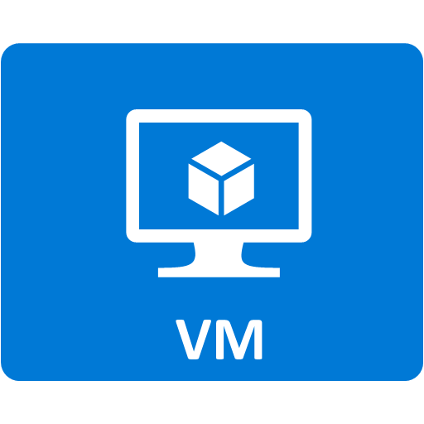
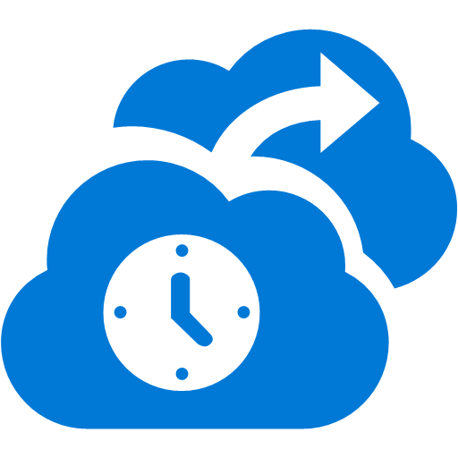
Managing unplanned downtime - Azure Backup
SAP Cen. Serv.
SCDPM
Application level consistency for Windows OSes
File system level consistency for Linux OSes
2 backup options: DPM and MARS agent
SAP App1
Azure Backup supports Windows and Linux VMs
SAP Database Server
File Server backed up with MARS agent

Slide 33
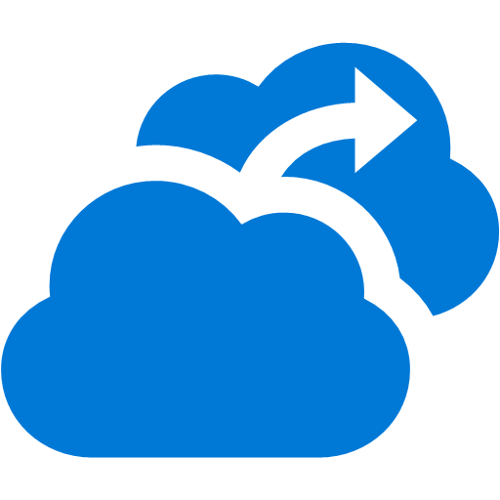


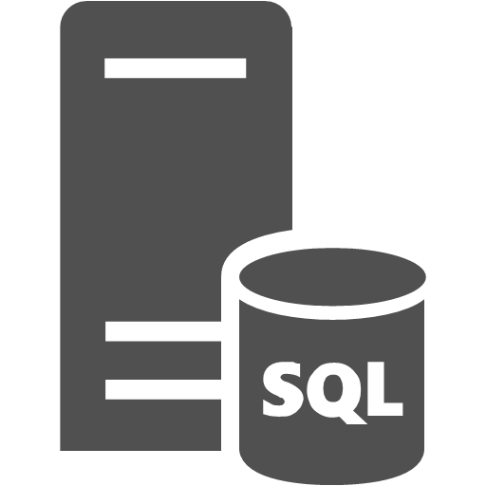
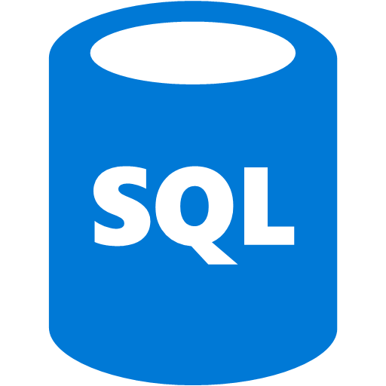
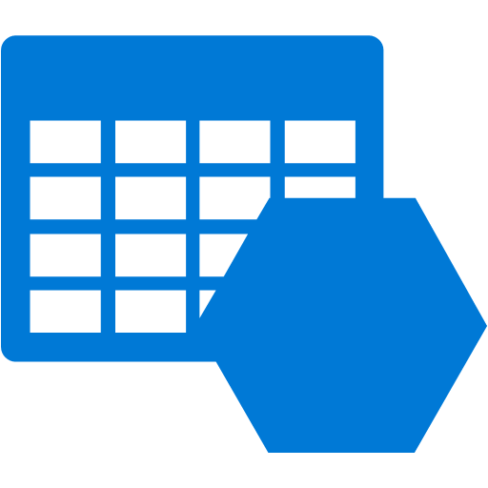

Managing unplanned downtime - ASR
DR Orchestration
DR Orchestration
Microsoft Azure Site Recovery
S2S or ER
Async. SQL AG replication
SQL AG secondary replica
SQL AG
Storage Acct.
Async. VM replication
SAP rep’ed app servers
SAP app servers
Notes:
ASR new features as of May 2016 > https://azure.microsoft.com/en-us/updates/general-availability-azure-site-recovery-in-new-azure-experience-with-support-for-arm-and-csp/
The SAP Database service should be protected by native database management systems (DBMS) level replication technologies.
SQL Server 2012 (and later) includes SQL Server AlwaysOn. In addition to SQL Server AlwaysOn, you can use database mirroring and log shipping to synchronize on-premises databases to Azure. In general, the replication technology for Azure is asynchronous—transactions are committed on-premises before they are confirmed on the DR system on Azure.
SAP application servers running on Hyper-V can be replicated to Azure using the Azure Recovery Services framework and agents. The application server does not contain any business data and does not need to be replicated to Azure very often. The only content that changes periodically is the SAP kernel after a kernel upgrade. Replication every 15 minutes is recommended.
Azure Site Recovery now provides native support for SQL Server AlwaysOn. SQL Server Availability Groups can be added to a recovery plan with virtual machines. All the capabilities of your recovery plan—including sequencing, scripting, and manual actions—can be leveraged to orchestrate the failover of a multitier applications by using a SQL Server database that is configured with AlwaysOn replication. See https://azure.microsoft.com/en-us/updates/public-preview-azure-site-recovery-integration-with-sql-server-alwayson/ for more details

Slide 34
Azure site recovery (newly GA features)
ASR supports:
ARM & ASM VMs for both Hyper-V VMM and VMWare
Replicate to premium storage supported for VMWare
Recovery service vault managed on new portal
Notes:
https://azure.microsoft.com/en-us/updates/general-availability-azure-site-recovery-in-new-azure-experience-with-support-for-arm-and-csp/

Slide 35
Oracle HA/DR for SAP on Azure

Slide 36
Oracle Database on Azure
11g and 12c Supported on Windows for SAP
Standard Windows images include license (pay per use)
Linux images and custom images require BYOL
Oracle RAC not supported
Scaling limit determined by largest available VM
High Availability requires Data Guard or Fail Safe
Consider cross region Disaster Recovery
Notes:
Oracle Database is supported on Azure with versions 11g and 12c. The standard Oracle images available in the Azure portal based on Windows include the Oracle license fees. As a result, these licenses are pay per use, which is useful for projects with a limited life span, development and test scenario’s, and other types of systems that don’t need to be on all the time. The Linux based images do not include the Oracle license fees, so you will have to acquire the needed licenses from Oracle directly. The same of course applies when you install the Oracle software yourself on a basic Windows image. Be aware that because you can scale instances easily, you can also easily violate your license agreement with Oracle in BYOL situations. As of YE 2015, SAP/Oracle/Linux on Azure is NOT yet supported! SAP Netweaver on SLES (planned for Feb 2016), SAP Netweaver on RHEL (planned for mid 2016), HANA enterprise edition on SLES (planned for summer 2016)
Oracle Real Application Cluster (RAC) requires a shared disk pool, and this is not available in Azure. This has two major consequences:
Scalability through RAC is not possible, all databases run on a single instance.
Scaling can be achieved by using larger VMs. Current limit is a GS5 VM with 32 cores, 448 GB RAM, and up to 80,000 IOPS
Otherwise you need to build (or change) applications to use partitioning/sharding.
High Availability through RAC is not possible. To achieve HA, you need to use Data Guard.

Slide 37
Oracle Database High Availability
Uptime SLA in Azure requires multiple instances
VM restarts governed by Azure
Enterprise Edition: Oracle Data Guard
Notes:
For production workloads on Oracle High Availability is very important. In an on-prem data center the hardware is usually built to give very high uptime guarantees, and system administration is typically done in specific time windows. By contrast, in Azure you need to have at least two instances in an Availability Set to get an uptime SLA, because the hardware is not built for high uptime. Also because of host updates, VM relocation, or other reasons, a VM may need to be restarted by Azure. System administrators do not control this. As a result, achieving High Availability requires software level mechanisms. With Oracle Database, you have two options: Data Guard or Fail Safe. Real Application Cluster (RAC) is not possible because there are no shared disk clusters in Azure
Data Guard is a well understood solution with different configuration options depending on your HA needs. For workloads running Oracle Enterprise Edition, this is the preferred solution. Oracle Standard Edition (SAP requires Enterprise Edition) doesn’t support Data Guard, and therefore must rely on Oracle Fail Safe. Oracle Fail Safe requires Windows Server Failover Cluster (WSFC), and this usually works with a shared SAN. Because this is not available in Azure, you need a third party tool to perform disk replication like SIOS DataKeeper. SIOS is certified for Azure and Oracle. One can use Oracle EE and Failsafe for SAP but we recommend using Data Guard.

Slide 38
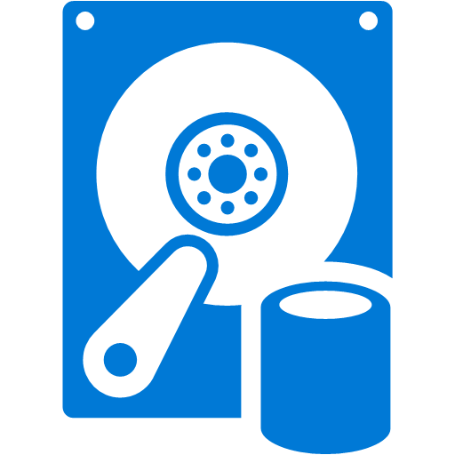
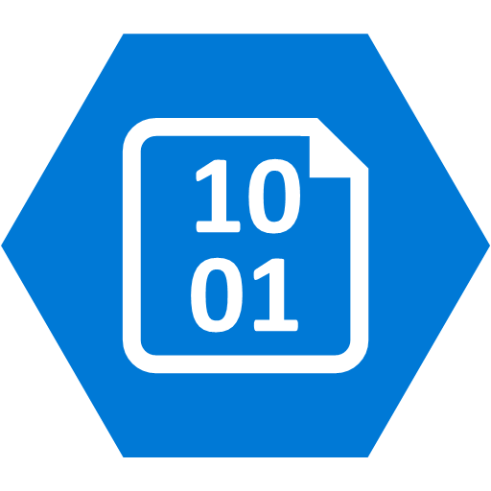
Oracle Database HA - Data Guard (1)
Client
Port: 1521 (TNS)
Standby
Primary
Availability Set
Primary
Standby
Redo Stream
Storage Account
Storage Account
Observer
Notes:
With Data Guard you deploy a Primary database, and up to 30 Standby databases. As with Fail Safe, each Data Guard instance has its own set of disks, preferably in a different storage account. However, where with Fail Safe the disk replication is performed outside of the control of Oracle, with Data Guard Oracle takes care of transporting a Redo Stream to the Standby databases, so the changes to the Primary database can be applied to the Standby databases.
Standby databases can be Physical standby, Logical standby, or Snapshot standby databases. A Physical Standby database has the same disk and file configuration, which is the best option for a HA configuration because you then work with an exact replica on which the Redo Stream will directly be applied using Redo Apply. With Logical standby databases the Redo Stream is first converted to SQL statements that are executed against the standby using SQL Apply, and Snapshot standby databases are not updated constantly. Because Physical standby databases have the same physical layout, the performance will also be consistent with the Primary database.
In a HA configuration you usually work with a single Standby database, but you can use multiple standby databases as read-only replica’s to lighten the load on the primary database. As these serve a different function, it is possible to host these on a smaller VM size.
An Observer process is needed to accommodate automatic failover. The observer should be run on a separate VM, and by putting that VM in the same Availability Set as the Primary and Standby databases, you ensure it is in a different Update Domain and Fault Domain, and as such can’t be down at the same time as either the Primary or Standby databases.
<click> When a failure of the Primary database occurs.
<click> The Observer comes in action and turns the Standby database into the Primary database.
<click> When the original Primary database comes back online, it becomes the Standby database.
What you will see during the lifetime of the cluster is that the Primary and Standby function switches periodically as updates to the Azure platform are rolled out. There is no deterministic way in which hosts are updated, so sometimes the Standby is updated first, resulting in one failover when the Primary is updated. In other cases the Primary is updated first, causing a failover, followed by another failover a while later when the new Primary is also updated.
Note that the client actually is aware of both instances. There is no load balancer in play directing traffic. The connectionstring points to both instances, and the designated Primary is the one the client talks to. When a failover occurs the client switches to using the new Primary. Most Oracle clients are capable of this behavior.

Slide 39
Oracle Database HA - Data Guard (2)
Client
Port: 1521 (TNS)
Client
Port: 1521 (TNS)
Availability Set
Availability Set
Failover
Failover
Availability Set
Failover
Observer
Observer
Notes:
If you have multiple Data Guard configurations you can have an Observer that monitors all those configurations. Because this moves the Observer outside the Availability Set, you need to create two Observer nodes in a separate Availability Set and use Oracle Enterprise Manager to create a failover configuration for the Observer. Especially in situations where the database instances are running on DS or GS series, this is very cost beneficial, because an A1 instance is enough to run an Observer. An A1 is much cheaper than a DS1 or GS1, and it does not carry the extra cost of Premium Storage.

Slide 40

Oracle Database DR - Data Guard
VNET – Region 2
VNET – Region 1
Availability Set
Availability Set
Primary
Standby
Redo Stream
Redo Stream
RemoteStandby
Site-to-Site VPN
Observer
Notes:
Data Guard supports up to 30 Standby databases and you can use at least one of these for Disaster Recovery. For Disaster Recovery a Standby database is typically located in a different data center. In Azure you use a different region where you setup a second VNET, which you connect via Site-to-Site VPN. If your RPO lets you get away with data loss between minutes and an hour, a single Standby database in the second Azure region will suffice. Otherwise, you should setup two Standby databases in an Availability Set, so you ensure the least amount of data loss. Because the remote standby database is in a different region and the connection is over VPN, there is considerable latency involved. This means updates to the remote standby database(s) need to be done asynchronously, because the performance impact of synchronous updates would kill the performance of the Primary database.

Slide 41
Oracle Data Guard Considerations
HA: Maxium Protection or Maximum Availability
Redo Apply (Physical Standby)
SYNC Transport
AFFIRM vs NOAFFIRM (FastSync)
DR: Maximum Performance (ASYNC/NOAFFIRM)
Data Guard: http://bit.ly/Oracle12cDG
Protection Mode: http://bit.ly/Oracle12cDGPM
Notes:
Data Guard can be configured in different ways. For HA you need to have Zero Data Loss, and this is achieved by setting the right Protection Mode. Maximum Protection or Maximum Availability with SYNC Transport and Redo Apply ensure Zero Data Loss. The use of Redo Apply means that for HA you must use a Physical Standby. SYNC Transport ensures changes are sent to the Standby database immediately. You can then still choose when the Primary database continues processing. With AFFIRM it waits until the Redo Stream for a transaction is persisted to disk. With NOAFFIRM, a.k.a. FastSync, the Redo Stream can only be in memory of the Standby database before the Primary database continues. This obviously improves performance, but in case of dual failure could result in minor data loss.
For Disaster Recovery you use the Maximum Performance Protection Mode, which results in asynchronous transport and NOAFFIRM, so the Primary database can continue without waiting for the Standby database.

Slide 42
Oracle Database DR Alternatives
Azure Backup
Requires syncing Oracle backup timing
Windows: up to 3 backups per day
Linux: daily backups
Copy backups & archive logs to (RA-)GRS Storage
Higher frequency than Azure Backup
Non-deterministic geo-replication
Notes:
Data Guard is a great solution for DR, but it comes at a price because of the secondary location. If the RTO and RPO is relaxed enough, you can use Azure Backup instead. With Azure Backup you can backup up to every 8 hours on Windows and daily on Linux. If you need a better RPO and thus a higher frequency, you could opt for copying the Archive Logs to an offsite location separately. Alternatively, you can attach additional disks with GRS or RA-GRS, and copy backups and archive logs there. A downside to this approach is that geo-replication is non-deterministic.

Slide 43
SAP on Oracle/Azure Considerations
Verify Oracle and corresponding OS versions support for SAP
Only single instance Oracle using NTFS format, Azure page blob VHDs are supported
Other network drivers or remote shares including Azure file shares are not supported
Backup/restore to/from disks via SAP BR*tools for Oracle supported
Oracle Data Guard is supported for HA
Oracle RAC, ASM are not supported

Slide 44
SQL Server HA/DR for SAP on Azure

Slide 45

SAP/SQL DR w. Log Shipping
Vnet region 1
Vnet region 2
SAP App Serv
SAP App Serv
S2S VPN
SQL source instance
Apply logs to standby instance
Log backup to source folder by SQL agent jobs
Copy log files to target folder

Slide 46


SAP/SQL DR w. AG Replicas on Azure
Run backups to Azure Storage
Azure VNET
Azure Storage
SAP App Servers
Domain controller
DR SAP SQL DB Sec. Replica
S2S VPN or ER
WSFC SQL AG Listener
Sync
Commit
SAP SQL DB Prim. Replica WSFC node 1
SAP SQL DB Sec. Replica WSFC node 2
Cluster FSW
Asynchronous commit
Notes:
One of the most powerful hybrid scenarios we are making even easier to implement with SQL Server 2014 is a low recovery time objective (RTO) disaster recovery solution for your on-premises SQL Servers. You can do this by now being able to add AlwaysOn replicas directly to Microsoft Azure Virtual Machines. Now as you see in the diagram, we recommend having your asynchronous replicas residing in Azure VMs and your synchronous replica hosted in the same location. Again the reason for that is you want to minimize the impact on your primary, so having the synchronous close by is ideal. Now this is still a low RTO solution as the way asynchronous replication works, is as soon as the transaction is committed it is on it’s was to the replica in Azure, so data loss in minimal.
The other big gain in this scenario is that AlwaysOn replicas are readable so you can take advantage of the global Azure data center to strategically place the replicas (remember you can have up to 8 now with SQL Server 2014, double that of SQL Server 2012). This means faster global BI reporting in addition to a more cost effective disaster recovery solution.
We have built UI into SQL Server management studio to make the deployment of AlwaysOn replicas even easier regardless of the hosting location. Also SQL Database on-prem or on Azure can backup directly to Azure storage.

Slide 47
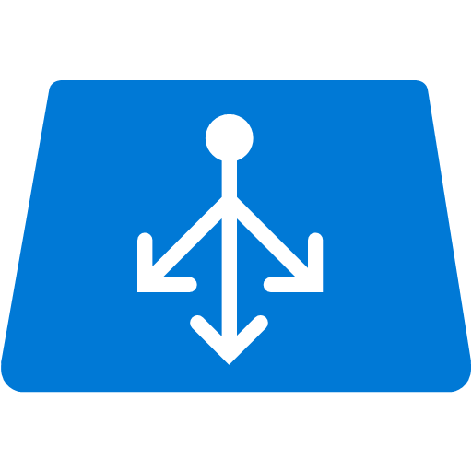
Azure infra. for a sample HA SAP system
Azure VNET
SIOS DataKeeper for WSFC without need of clustered shared disks
SAP App Server – ABAP/Java dual or single stack. Preferred smaller VMs
SAP Web Dispatcher installed on Azure VM, performs HTTP(S) load balancing
SQL DB with AlwaysOn Availability Group
Need to deploy in 3-tiers for HA DR
Av. Set 3, WSFC
SAP Cen. Serv. Node 1
SAP Cen.. Serv. Node 2
Azure ILB
SAP SCS Cluster VNN
Av. Set 2
Domain Controller
SAP App Server
SAP App Server
Av. Set
Azure VM SAP Web Dispatcher
Av. Set 1, WSFC SQL AG
Sync Commit
Azure ILB AG Listener
SAP SQL DB WSFC node 1
SAP SQL DB WSFC node 2
Notes:
A highly available SAP system typically has the above layout
The SCS is protected with Window Server Failover Cluster. The SIOS DataKeeper (3rd party solution) enable the creation of a cluster on Azure without shared disks.
SAP Application servers are protected by virtue of multiplicity. The HTTP(S) load balancing is handled by the SAP Web Dispatcher built on an Azure VM. The SAP Logon load balancing is handled by the SCS message server.
The DB layer, for SQL Server DB, we use AlwaysOn Availability Group (AG) built on a WSFC leveraging node majority with a file share witness quorum.

Slide 48
SAP on SQL Server Considerations
Great resource: SAP note 555223 - FAQ: Microsoft SQL Server
WORST Practices for Maintaining SQL Server SAP systems (i.e. Things to AVOID)

Slide 49
SQL AlwaysOn Failover
Notes:
See demo script in SQL AlwaysOn Failover.docx

Slide 50
Moving Large Files
3 key factors to consider when doing system refreshes or migration
Size of the database
Acceptable downtime
Source and target database version (migration)
>> 1-2 TB: use AzCopy
2-3 TB: use SQL log shipping, mirroring, or AlwaysOn AG (SQL Server source)
>3 TB: use Azure import/export (long down time)
Notes:
If the compressed database size is less than 1-2TB then experience has shown most customers can upload to Azure using tools such as AzCopy in an acceptable timeframe.
If the compressed database size is larger in 2-3TB range then some customers are using SQL Server Log Shipping, Mirroring or AlwaysOn to synchronize databases between on-premises and Azure. A brief outage can then be taken, final transaction log backup and restore done and then switch over to the copy of the database in Azure.

Slide 51
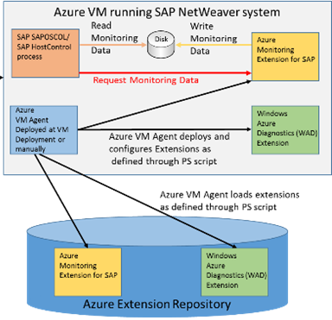
SAP on Azure Extension
SAP requires Monitoring solution that allows SAP instance running in the VM to get essential data from Azure
SAP Azure Extension is:
Configured and deployed by a PowerShell script after the deployment of the VM
Collecting data from ‘Windows Azure Diagnostics’ Framework
Contacted by SAPOSCOL to deliver monitoring counters on a periodic basis
Notes:
This extension was developed to enable SAP to collect important performance counters and display those in SAP transactions ST06 and OS07. Data that very often helps to investigate performance experiences and also provide a great base for volume planning. Therefore it is very important to open this channel of performance counter collection. The important aspect about the Azure Monitoring Extension for SAP is that it collects performance counters which are collected on the Azure host and diagnostics framework. Data that is usually not available within a VM, but that can be highly important to analyze performance aspects.
As you see the only direct interaction between the Azure Monitoring Extension for SAP and SAP are the SAP Host Agent components. The Host Agent components are standalone component which do NOT require a complete exchange of the SAP kernel when updating those components. Therefore it should not be a problem to exchange the existing SAP Host Agent components to the patch level of components necessary to support Azure.

Slide 52
Update SAP Monitoring Configuration
When:
Adding more counters
Azure monitoring infrastructure update
Adding disks to your VMs
Changing sizes for your Azure VMs
Notes:
The SAP monitoring extension made configuration settings during its installation. When the VM hosting this extension (or agent) configuration is changed, the agent needs to be updated to update the configuration.

Slide 53
Azure Cost Calculator

Slide 54

Compute and store – pricing metrics
item
unit of measurement
cost per unit*
Compute hours by instance size
A5 VM - $0.33/hr
D11 VM - $0.33/hr
GS5 VM – $9.65 /hr.
VM
Sample price for standard disks
LRS – 0.024, 0.0236, 0.0232, 0.0228, …
GRS – 0.048, 0.0472, 0.0464, 0.0456, …
RA-GRS – 0.061, 0.0599, 0.0589, 0.0579, …
R/W Transactions - $0.0036 per 100,000
Terabytes stored, measured per GB used
Transactions measured at 100,000 counts
Blob storage
LRS – 0.08
GRS – 0.1
Discounted R/W transactions pricing now. Standard charge ($0.0036/100K trans) in effect 03/01/2016
Terabytes stored, measured per GB used
Transactions measured at 100,000 counts
File storage
All pricing subject to change.
RA-GRS minimum charge is 30 days
Premium storage billed at allocated capacity
Notes:
Blob and file storage is charged the same way at different rates. Storage capacity is billed in units of the average daily amount of data stored, in gigabytes (GB), over a monthly period. For example, if you consistently utilized 10 GB of storage for the first half of the month and none for the second half of the month, you would be billed for your average usage of 5 GB of storage. We charge $0.0036 per 100,000 transactions for Tables & Queues. Transactions include both read and write operations to storage.
File Storage - Starting on March 1, 2016, File Storage read operations will be charged at $0.015 per 100,000 operations for both LRS and GRS accounts. File Storage write operations will be charged at $0.15 per 100,000 operations for LRS accounts; and $0.30 per 100,000 operations for GRS accounts. The promotional price of $0.0036 per 100,000 read and write operations for both LRS and GRS accounts will be effective through Feb 29, 2016.
For RA-GRS, Storage accounts will be charged for a minimum of 30 days from the time the service is enabled. For example, if RA-GRS is turned on May 1 and turned off May 5, the storage account will be charged for RA-GRS through May 30. After that, GRS pricing would start.
If RA-GRS is turned on May 1 and turned off June 14, RA-GRS would be charged through June 14. On June 15, GRS pricing would take effect.
Premium storage is charged at the allocated capacity regardless of usage. Billing for any provisioned disk is prorated hourly using the monthly price for the Premium Storage offer. For example, if you provisioned a P10 disk and deleted it after 20 hours, you are billed for the P10 offering prorated to 20 hours. This is regardless of the amount of actual data written to the disk or the IOPS/throughput used.

Slide 55
Network – pricing metrics
Item
unit of measurement
cost per unit*
Gateway hours
$0.19/hr (standard gw)
$0.49/hr (High Perf gw)
VPN Gateway
GB
$0.035/GB in Zone 1
Outbound inter-VNET transfer
Reserved pub IP
Number of IP per month
First 5 Ips: Free
Ea additional IP → $3/Mo
0100100
5 GB - 10 TB / month → $0.087 / GB
Next 40 TB / month → $0.083 / GB
Next 100 TB / month → $0.07 / GB
Next 350 TB / month → $0.05 / GB
GB
Egress Traffic
* All pricing subject to change
Notes:
VPN Gateway
Egress traffic is the traffic to a destination outside the region receiving the field data caused by the ingestion of the message. An example would be forwarding data to Azure Table Storage which is located in a different region. Data egress pricing: https://azure.microsoft.com/en-us/pricing/details/data-transfers/
Inter-VNET transfer - Data transfers between 2 Virtual Networks are charged at the Inter-VNET rates noted above. Other data transfers over the VPN connections to your on-premises sites or the Internet in general are charged separately at the regular Data Transfer rate. https://azure.microsoft.com/en-us/pricing/details/vpn-gateway/
Reserved Public IP https://azure.microsoft.com/en-us/pricing/details/ip-addresses/

Slide 56
Recovery Services – pricing metrics
item
unit of measurement
cost per unit*
Instance count and size catagory
<50 GB instance -> $5/mo
50GB-500GB instance -> $10/mo
>500 GB instance -> $10/mo
Backup Service
Recover to customer’s own site -> $16/mo/inst.
Recover to Azure -> $54/mo/inst.
Instance count and target destination
Site Recovery
Backup storage charge based on storage type of the backup vault either at LRS or GRS rate
All pricing subject to change
Notes:
Need to consider Process Server, Configuration Server, and Master Target component cost if ASR is for VMWare

Slide 57
Sample solution volumetry
Item | Metrics | Item | Metrics
1. G5 VM | Active: 24x7 Hrs./mo. =744 | 5. HDD Storage | Average utilization 10 TB/mo
2. Egress data | 1 TB between regions | 6. SSD Storage | 4 P30 disks, 6 P10
3. Network | VPN or ER
Notes:
To calculate cost of the IoT solution, we need to know the volume of data and component capacity. This information is provided by the customer from their design of the solution. For each component listed above, a URL is provided for detailed pricing information.

Slide 58
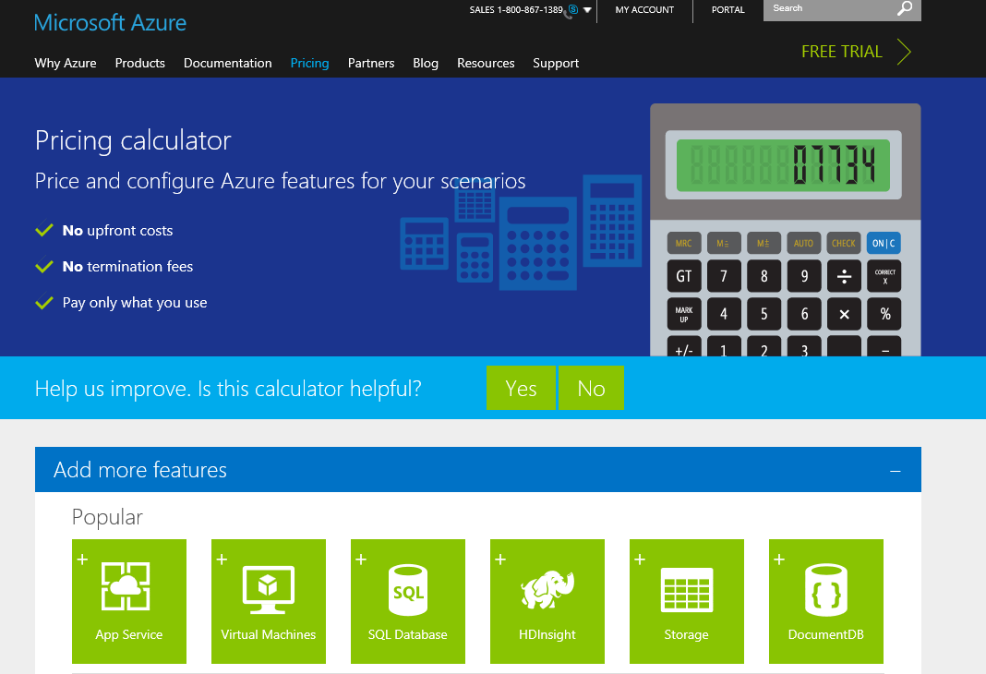
Demo - Online Azure Pricing Calculator
Notes:
https://azure.microsoft.com/en-us/pricing/calculator/?scenario=full

Slide 59
Summary
Planning and Capacity
Verify every SAP application release and patch level
Know customer’s performance objectives
HA & DR
Know customer’s RPO, RTO
Cost calculator

Slide 60
Resources
https://msdn.microsoft.com/library/azure/dn745892.aspx
Includes the following SAP on Azure documents
SAP NetWeaver on Azure Virtual Machines – Planning and Implementation Guide
SAP NetWeaver on Azure Virtual Machines – Deployment Guide
SAP DBMS in Azure Deployment Guide
SAP NetWeaver - Building an Azure based Disaster Recovery Solution
SAP NetWeaver on Azure - Clustering SAP ASCS/SCS Instances using Windows Server Failover Cluster on Azure with SIOS DataKeeper

Slide 61
Backup
If backup target is primarily databases use database built-in backup feature
Backup plan example : Full backup daily, log backup every 15 mins
Retention plan example : log for 7 days, daily for 1 month, monthly for 1 year, yearly for XX years
If OS states, files are also within scope use enterprise backup solutions instead
E.g. Azure Backup Server, System Center Data Protection Manager, or Partner solutions (e.g. Commvault, Arcserve)

Slide 62
Four Backup Solutions
 | Standard DB backup (e.g. SQL Server, Oracle) |  | Azure Backup Server (=SCDPM) | 3rd party solutions (e.g. Commvault, Arcserve) | Azure IaaS VM Backup
Backup type | Database |  | Network/Agent | Network/Agent | Snapshot
Backup target | DBs within Azure VMs |  | SQL Server DBs, Files and OS States (Windows) within Azure VMs (link) | SQL Server/Oracle etc DBs, Files and OS States (Windows, Linux) within Azure VMs | Azure VMs (Windows, Linux) running SQL Server (link)
Linux (Guest OS) support | No |  | No | Yes | Yes
SQL Server database backup capability | Transaction log every minute, differential, full |  | Differential every 15 minutes and full (express) |  | Up to 3 times per day
Oracle database backup | No |  | No | Yes | File consistent backup with RMAN
Compression | Supported |  | Supported (storage sizing : link) | Supported | None
Backup servers running on | DB Server |  | Microsoft Azure Backup Server (on VM) (installation kits downloadable from Azure Portal) (VM sizing : link) | Backup Server (on VM) | None (Backup as a Service)
Agent software required | No |  | Agent in backup target VMs and Azure Backup Agent in Azure Backup Server VMs | Yes | No (* Only Azure VM Agent)
Network bandwidth required | Yes but controllable |  |  |  | None
Short term retention | Yes (on local storage) |  |  |  | None
Long term retention | Possible
Point-in-time recovery | Possible
Recovery speed | Depend on I/O speed of local storage or Backup Vault
Monitoring/alerting console | Database console | Azure Backup Server Console |  | Backup Server Console | Azure Management Portal
Reporting | None | System Center Service Manager |  | Backup Server Reporting | None
licensing | None | Pay-per-use on Azure (link) |  | Check vendor | Pay-per-use on Azure (link)

Slide 63
Thank you!
Please rate this session at the end of the day.
http://bit.ly/sapworkshopday1

