Slide 1
Agenda, Speakers, Housekeeping

Slide 2
Agenda
Who we are
Agenda
Other

Slide 3
Speakers

Slide 4
Who we are
Team, members/speakers

Slide 5
Agenda

Slide 6
Agenda Day 1
Sample

Slide 7
Agenda Day 2
Sample

Slide 8
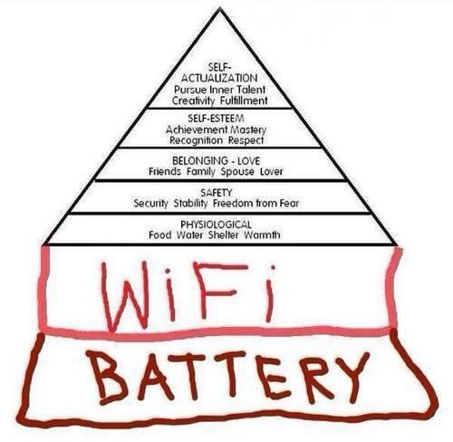
Logistics
Restrooms
Food
  Breakfast
  Morning snack
  Lunch
  Afternoon snack
WiFi

Slide 9
Questions?

