Slide 1
SAP NetWeaver on Azure ADS
Notes:
Suggested introduction:
Faced with _______
We did _______
And discovered_______

Slide 2
Agenda
Key components of an SAP ADS
Capacity planning and resource sizing
Solution design
Estimating solution costs
Anatomy of an SAP Migration

Slide 3
Key components of an SAP ADS

Slide 4
What is an ADS
An ADS includes mutual discovery and tailored product and technology drill-downs. It culminates with the delivery of a clear and actionable picture or architecture of how Microsoft and partner technologies can help customers reach their business goals.
Notes:
At MS, we call the above described activity an Architecture Design Session. An ADS is generally a presales activity. Some partners call that an assessment. What are some other terms you call an ADS?

Slide 5
Business Drivers & Tech. Requirements
Business drivers help limit or extend project scope for current or future phases, and ensure alignment
Technical requirements expressed in Service Level Agreement: availability, scalability range
Others: landscape and current architecture, technology deployed
Notes:
Understanding customers’ business drivers help the delivery team either set proper boundary for solutions or create solutions in phases to align with customers’ business initiatives.
High level technical (or non-functional) requirements are commonly expressed in performance, reliability, scalability
Other components also influences the approach of a solution. Things like current architecture and technology. E.g., on-premises deployment of Oracle will require an SAP migration process while SQL Server ‘migration’ to SQL on Azure IaaS can be a much simpler process.

Slide 6

Certified SAP NW Solutions on Azure
SAP and Microsoft have tested and certified Microsoft Azure IaaS against the same standards used for on-premises infrastructure, with full support from Microsoft and SAP.
SAP NetWeaver based solutions e.g. Business Suite (ERP), BW, SCM, ERP, etc.
SQL Server
Oracle
SAP ASE (Sybase)
MaxDB
IBM DB2
SAP ASE (Sybase)
IBM
DB2
Oracle
Windows Server
Linux (SLES, RHEL)
Oracle Linux*
Azure VMs: A5-A11, D(S)11-14, D(S)v211-14, GS1-5
Additional certified SAP solutions:
Business Objects
TREX
SAP Content Server
SAP Live Cache
SAP Hybris Commerce
See SAP OSS Note #1928533 for version details and further info
SQL IaaS only (no SQL Azure yet)
* Planned

Slide 7
SAP on Microsoft Azure
Microsoft Azure is certified for the following SAP products, with full support from Microsoft and SAP.
SAP Product | Guest OS | RDBMS | VM Types
SAP Business Suite | Windows, SLES, RHEL | SQL Server, Oracle, DB2, SAP ASE | A5-9, D11-D14, DS11-14, DS11-14V2, GS1-5
SAP Business All-in-One | Windows, SLES, RHEL | SQL Server, Oracle, DB2, SAP ASE | A5-9, D11-D14, DS11-14, DS11-14V2, GS1-5
SAP NetWeaver App Server | Windows, SLES, RHEL | SQL Server, Oracle, DB2, SAP ASE | A5-9, D11-D14, DS11-14, DS11-14V2, GS1-5
SAP HANA Base, Platform, Entr. Editions | SLES, RHEL | N/A | GS5, S72-72m, S144-144m
Key SAP certifications listed only. See SAP note 1928533 for full list and supported OS/DB combo
Notes:
On May 19, 2015, Microsoft and SAP announced the full support of the SAP products list on the table @ right
Only NetWeaver 7.00 and later SAP releases of NetWeaver are supported for deployment in Azure
Customers can try SAP HANA Developer Edition on Azure using the SAP Cloud Appliance Library. (including the HANA Client software comprised of SQLDBC, ODBO (Windows only), ODBC, AND JDBC drivers), HANA Studio, and HANA Database
Oracle Database 11g R2 Patchset 3 (11.2.04 ), Single Instance
SAP Adaptive Server Enterprise 16
On May 17, 2016 at SAPphire Orlando, SAP/Microsoft jointly announced the SAP HANA (Base, Enterprise, and Platform editions) certification on Azure

Slide 8
Licensing and Support
SAP applications migrated to Azure require new licenses to be applied – SAP note 2035875
Microsoft support premier contract required - SAP note 2015553
To request support: open an SAP Online Software Support (OSS) ticket at component BC-OP-NT-AZR
Notes:
With SAP Applications, it’s a bring your own licenses scenario. After migrating to Azure, a new SAP application license will need to be requested from SAP Support Portal and reapplied.
If you have a SQL Software Assurance (SA), you have license mobility benefit on Azure. Deploy Windows VMs without SQL installed.
If you deploy a Windows server with SQL installed, the run rate will be higher than one without SQL. So if you already purchase SQL license from SAP or have SQL SA, you should only use gallery image with the OS only.
SAP on Azure support can be requested via the SAP Support portal by creating a ticket with the component BC-OP-NT-AZR

Slide 9
Solution Design Components
Authentication
Capacity plan and layout for Network, Compute, and Storage
SAP Central Service HA/DR
SAP Application Server HA/DR
Oracle on Azure HA/DR and backup
SQL Server on Azure HA/DR and backup

Slide 10

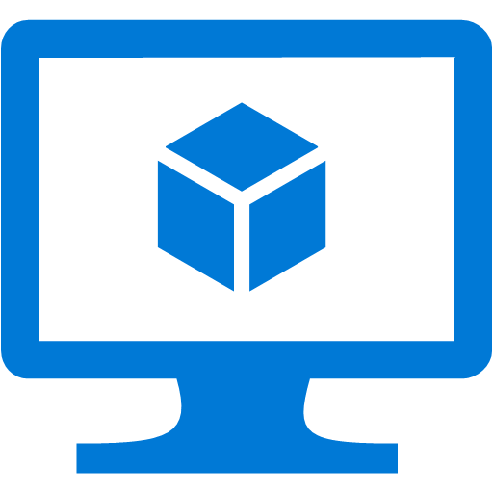

SAP on Azure Authentication
On-premises Windows Domain Controller replicated to Azure
Benefits:
DR protection for on-premises DC
Fast performance for SAP on Azure authentication
Bidirectional updates
Azure VNET
S2S VPN or ER
RW Domain Controllers
Domain Controller
AD replication
Notes:
SAP’s operations will require a RW DC. Some points to consider if you are asked to do an RODC: firstly without contact with a writable domain controller the RODC, cannot update itself and will start to cause issues such as password changes, group policy updates, and authenticating new users to the domain from the remote office. Read only DNS also relies on the writable DNS server to update its records. Without a connection to the RWDC, name resolution issues start to surface.

Slide 11
Security considerations
Windows server hardening
Stop unnecessary services
Install only needed software
Patch regularly
Use storage encryption for backup and VHDs
Guard your storage account keys and rotate/regenerate them regularly
Use NSG, network appliance, avoid well-known ports
Leverage the Security Center to identify exposure

Slide 12
Planning and Capacity

Slide 13
Network Planning
VNET address space
Subnets address ranges:
Data, Applications, Web, Management, and Gateway
NSGs for subnets
Site-to-Site connection
ExpressRoute
Notes:
Have a network topology and IP address space plan in mind before you start laying out the Azure infrastructure
Separate servers in subnets by functions: Web, App, Data, Management etc
Plan security policy for each layer and public endpoints. Example in next slide.
Work with customers’ network team to plan for network bandwidth and security requirements to choose between S2S or ER and its bandwidth

Slide 14
Network Address Space Example
Address Space: DEV 10.11.130.0 /23 (510 IPs) | Purpose
8 Subnets
10.11.130.0 /26 (62) | Management or Shared Services
10.11.130.64 /26 (62) | Web portals
10.11.130.128 /26 (62) | App1
10.11.130.192 /26 (62) | App2
10.11.131.0 /26 (62) | Data1
10.11.131.64 /26 (62) | Data2 (sensitive data)
10.11.131.128 /26 (62) | Reserved
10.11.131.240 /28 (12) Gateway | Gateway
Notes:
A project stood up a DEV environment on Azure with the address space specified. Servers are connected to the appropriate subnets base on roles. The address space for this DEV environment should not overlap with your on-premises network

Slide 15



Sample NSG Setup for SAP
Internet
DMZ
Block Internet
RDP
TCP/80
Block Internet
Block RDP
✓
✓
Block RDP
SAPFE_NSG
SAPApp_NSG
SAPDB_NSG
SAP Ent. Portal
✓
✓
SAP App. Servers
SAP DB Servers
443
1433
FE Subnet (10.0.0.0/24)
App Subnet (10.0.1.0/24)
DB Subnet (10.0.3.0/24)
Block FE
Notes:
App servers and DB servers are backend services so block incoming and out-going internet connection.
Frontend portal servers should only connect to the backend servers over allowed ports
Security Guide for SAP on SQL 2012 http://www.bing.com/search?q=Security+Guide+for+SAP+on+SQL+Server+2012+cameron&qs=n&form=QBLH&pq=security+guide+for+sap+on+sql+server+2012+cameron&sc=0-49&sp=-1&sk=&cvid=BBFD6C6FCACD42459D9BE6A04216CEF7

Slide 16
Cross Site Connectivity (Site-to-Site)
Secure IPSec VPN over internet using VPN devices
Work with your network administrator to:
Obtain an externally facing IPv4 IP for your VPN device
Verify that the VPN device meets requirements necessary to create a cross-premises virtual network connection
https://azure.microsoft.com/en-us/documentation/articles/vpn-gateway-about-vpn-devices/
Configure a Site-to-Site VPN in the Azure Management Portal
https://azure.microsoft.com/en-us/documentation/articles/vpn-gateway-howto-site-to-site-resource-manager-portal/
Test network latency with Azure Speed Test
http://www.azurespeed.com/
Notes:
Discuss these key items in Azure network planning and introduce the resources on the provided links
VPN max bandwidth is 100 Mbits/sec and usually you see effective throughput of 80 Mbits/sec

Slide 17
Cross Site Connectivity (ExpressRoute)
ExpressRoute recommended to ensure predictable throughput and latency
Network bandwidth/speed
ExpressRoute: 50Mbps to 10Gbps
S2S VPN: 100Mbps to 1.25Gbps
Customer site 2
Azure
Private, Dedicated Network
Customer site 1
ExpressRoute
Customer DC

Slide 18
Selection criteria of Azure VMs for SAP
Not all Azure VM types are certified for SAP
Minimum requirements for VMs:
At least 2 vCPUs
Ratio between memory and vCPU at least 6GB:1vCPU
→Not all Azure VMs qualify
Other rules for certification of VM SKUs:
Some of the VM SKUs are exclusively certified with Premium Storage. i.e. No SAP certification for G-series, but certification of GS-Series
If the largest VM of a series does not provide sufficient results with Standard Storage, we do not certify any of the VMs of the series and rather wait for VM series being available with Premium Storage. E.g.: Dv2 series
We are not making any difference between VMs for the SAP application layer (as good as no storage interaction) and DBMS VMs (sensitive to storage latency and throughput)

Slide 19
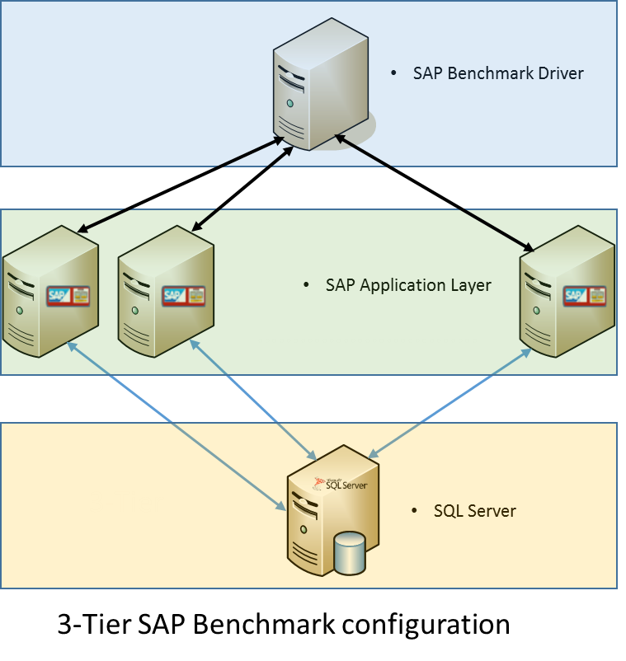
Supported VM Sizes for SAP on Azure
SAPS are used for SAP sizing framework.
Ratings are documented in SAP Note 1928533 – SAP Applications on Azure
2-Tier SAP benchmark certification for DS14v2 VM http://global.sap.com/campaigns/benchmark/assets/Cert16018.pdf
3-Tier SAP benchmark certification for GS4 as the DB server http://global.sap.com/campaigns/benchmark/assets/Cert15045.pdf
DBMS VM Type | VM size | SAPS | Storage
GS1 | 2 CPU, 28GB | 38415 | Premium
GS2 | 4 CPU, 56GB | 78620 | Premium
GS3 | 8 CPU, 112GB | 137520 | Premium
GS4 | 16 CPU, 224GB | 247880 | Premium
DS12 | 4 CPU, 28GB | 48750 | Premium
DS13 | 8 CPU, 56GB | 91050 | Premium
Notes:
SAPS: A hardware-independent unit of measurement that describes the performance of a system configuration in the SAP environment. It is derived from the Sales and Distribution (SD) benchmark, where 100 SAPS is defined as 2,000 fully business processed order line items per hour.

Slide 20
SAP App. Performance Std. (SAPS)
A hardware-independent unit of measurement that describes the performance of a system configuration in the SAP environment
It is derived from the Sales and Distribution (SD) benchmark, where 100 SAPS is defined as 2,000 fully business processed order line items per hour

Slide 21
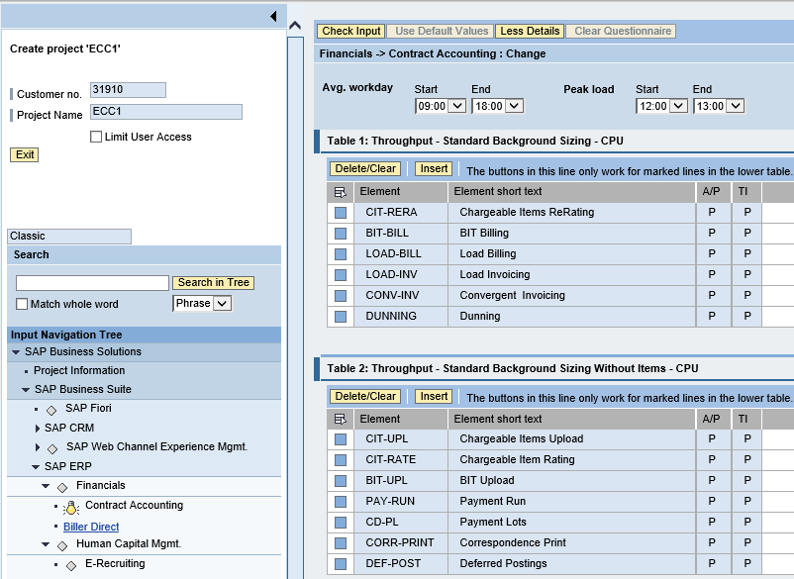
SAP System Sizing
SAP Quick Sizer
Reference sizing
Reference on-premises configuration
Use resource utilization data
Early Watch Report
SAP Quick Sizer sizing for new systems
Notes:
For on-prem existing systems, reference system config and resource utilization data. The system utilization information is collected by the SAP OS Collector and can be reported against via transaction OS07N and/or the Early Watch Report. Similar information can be retrieved from any system performance and statistics gathering tools.
For details see https://blogs.msdn.microsoft.com/saponsqlserver/2015/06/19/how-to-size-sap-systems-running-on-azure-vms/
For net new systems, use SAP quick sizer. The Quick Sizer can be found at https://service.sap.com/quicksizer. Access requires an OSS account.

Slide 22
SAP System Utilization Info
ABAP
SAP operating system monitor transaction OS07N
CPU
Memory Management
File systems and LAN
JAVA
SAP NetWeaver Administrator (NWA)
Notes:
For ABAP stack servers, transaction OS07N reports CPU, memory, IO, and LAN information
You can use the operating system monitor to display operating system data from monitored hosts on which an operating system collector SAPOSCOL is running. You have the following options for selecting the data to be displayed:
You can determine the time period for which data is to be displayed. More information: Selecting Current Values and History of Operating System Data > http://help.sap.com/saphelp_nw70ehp3/helpdata/en/45/d0446d01ef0b00e10000000a1553f7/content.htm
You can determine the system and instance about the hosts of which data is displayed. More information: Selecting Operating System Data of Systems, Instances, and Hosts > http://help.sap.com/saphelp_nw70ehp3/helpdata/en/45/d043b401ef0b00e10000000a1553f7/content.htm
You can use different analysis views to determine which topic area of the monitored operating system data is to be displayed.
For Java stack application servers, the tool for monitoring and management is Netweaver Administrator (NWA). The Availability and Performance work center in SAP NetWeaver Administrator enables you to monitor different parameters of a system operation. Among other things, It includes the AS Java Statistics which allows you to measure and analyze the performance of AS Java system activities. It provides important performance metrics such as response time, CPU time, memory consumption, and so on.
After all, you can also rely on 3rd party system management tools available in the market to report on capacity and resource consumption for SAP sizing purposes.

Slide 23
Azure VM Options for SAP
VM Type | VM Size | Temp SSD | 2-Tier SAPS | 3-Tier SAPS | # of v-disks | Max IOPS | Max Disk Bandwidth | Max Network Bandwidth
A5 | 2 CPU, 14 GB |  | 1,500 | 12,000 | 4 | 4 x 500
A6 | 4 CPU, 28 GB |  | 3,000 | 25,000 | 8 | 8 x 500
A7 | 8 CPU, 56 GB |  | 6,000 | 50,000 | 16 | 16 x 500
A8 / A10 | 8 CPU, 56 GB |  | 11,000 | *** | 16 | 16 x 500
A9 / A11 | 16 CPU, 112 GB |  | 22,000 | *** | 16 | 16 x 500
D11 | 2 CPU, 14 GB | 100 GB | 2,325 | *** | 4 | 4 x 500 |  | High
D12 | 4 CPU, 28 GB | 200 GB | 4,650 | *** | 8 | 8 x 500 |  | High
D13 | 8 CPU, 56 GB | 400 GB | 9,300 | *** | 16 | 16 x 500 |  | High
D14 | 16 CPU, 112 GB | 800 GB | 18,600 | *** | 32 | 32 x 500 |  | Very high
DS11* | 2 CPU, 14 GB | 28 GB | 2,325 | *** | 4 | 6,400 | 64 MB/sec | High
DS12* | 4 CPU, 28 GB | 56 GB | 4,650 | 48,750 | 8 | 12,800 | 128 MB/sec | High
DS13* | 8 CPU, 56 GB | 112 GB | 9,300 | 91,050 | 16 | 25,600 | 256 MB/sec | High
DS14* | 16 CPU, 112 GB | 224 GB | 18,600 | *** | 32 | 50,000 | 512 MB/sec | Very high
D11_v2 | 2 CPU, 14 GB | 100 GB | 3,530 | *** | 4 | 4 x 500 |  | High
D12_v2 | 4 CPU, 28 GB | 200 GB | 6,680 | *** | 8 | 8 x 500 |  | High
D13_v2 | 8 CPU, 56 GB | 400 GB | 12,300 | *** | 16 | 16 x 500 |  | High
D14_v2 | 16 CPU, 112 GB | 800 GB | 24,180 | *** | 32 | 32 x 500 |  | Very high
DS11_v2 | 2 CPU, 14 GB | 28 GB | 3,530 | *** | 4 | 6,400 | 96 MB/sec | High
DS12_v2 | 4 CPU, 28 GB | 56 GB | 6,680 | *** | 8 | 12,800 | 192 MB/sec | High
DS13_v2 | 8 CPU, 56 GB | 112 GB | 12,300 | *** | 16 | 25,600 | 384 MB/sec | High
DS14_v2 | 16 CPU, 112 GB | 224 GB | 24,180 | *** | 32 | 50,000 | 768 MB/sec | Very high
DS15_v2 | 20 CPU, 140 GB | 280 GB | 30,430 | *** | 40 | 62,500 | 960 MB/sec | Very high
GS1** | 2 CPU, 28 GB | 56 GB | 3,580 | 34,415 | 4 | 5,000 | 125 MB/sec | High
GS2** | 4 CPU, 56 GB | 112 GB | 6,900 | 78,620 | 8 | 10,000 | 250 MB/sec | High
GS3** | 8 CPU, 112 GB | 224 GB | 11,870 | 137,520 | 16 | 20,000 | 500 MB/sec | Very high
GS4** | 16 CPU, 224 GB | 448 GB | 22,680 | 247,880 | 32 | 40,000 | 1,000 MB/sec | Extremely high
GS5** | 32 CPU, 448 GB | 896 GB | 41,670 | *** | 64 | 80,000 | 2,000 MB/sec | Extremely high
*) The DS series in a 3-tier configuration is only supported with DB data files and DB transaction log files placed on Azure Premium Storage. **) The GS series (2-tier and 3-tier) is only supported with DB data files and DB transaction log files placed on Azure Premium Storage.
***) Please check with through SAP customer message on specifics of this configuration
Notes:
https://azure.microsoft.com/en-us/documentation/articles/virtual-machines-windows-sizes/
*) The DS series in a 3-tier configuration is only supported with DB data files and DB transaction log files placed on Azure Premium Storage. **) The GS series (2-tier and 3-tier) is only supported with DB data files and DB transaction log files placed on Azure Premium Storage.
***) Please check with through SAP customer message on specifics of this configuration

Slide 24
3-tiers sizing samples
SAP systems size category | Generic sizing potential configuration
1). 13,000 – 45,000 SAPS | 1 x DS11v2 VM DBMS Server: 3,530 SAPS Between 2 - 5 x DS12v2 VM App Servers at 6,680 SAPS
2). 45,000 – 90,000 SAPS | 1 x DS13v2 VM DBMS Server: 12,300 SAPS Between 2 - 4 x DS14v2 VM App Servers each rated at 24,180 SAPS
3). 90,000 – 150,000 SAPS | 1 x GS3 VM DBMS Server: 11,870 SAPS Between 6 - 10 x DS13v2 VM App Servers at 12,300 SAPS
4). 150,000 - 250,000 SAPS | 1 x GS4 VM DBMS Server: 22,680 SAPS Between 2 - 7 x GS5 VM App Servers each rated at 41,670 SAPS

Slide 25
VM Sizing Tips
Know # of SAPS for SAP application and database tiers
Know system active period, use Azure Auto Scale to lower cost
For SAP App servers, prefer a few smaller VM vs one large VM
Use premium storage for database
Ensure the selected VM supports the IOPS required by database server
Quick Sizer assumes max server utilization at 65% while benchmarks run at near 100%. Need to either up Quick Sizer # or adjust down VM benchmark SAPS # before VM selection
If size by reference system, know the resource utilization and SAPS rating
Notes:
See https://blogs.msdn.microsoft.com/saponsqlserver/2015/12/01/new-white-paper-on-sizing-sap-solutions-on-azure-public-cloud/ for details on sizing SAP system on Azure IaaS

Slide 26
Storage Planning Tips
Choose standard or premium storage based on IOPS and disk transfer throughput caps
Use premium storage for SAP databases (and other IO intensive load)
Use Windows storage pool to stripe standard disks to extend IOPS capacity
Have a landscape level view for IOPS requirement
SAP application servers don’t need premium storage
Provide separate storage account for diagnostics and logs
Don’t use GRS for VM disks
Not even possible with Premium and/or Managed Disks
Notes:
https://azure.microsoft.com/en-us/documentation/articles/storage-scalability-targets/

Slide 27
Storage Planning Tips
General on-premises files layout recommended practices applied for cloud deployment
Use Managed Disks
Or carefully review storage account constraints and use multiple storage accounts if needed
Standard storage accounts have 20,000 IOPS cap
No IOPS cap for premium storage accounts but max bandwidth reached at 280, 140, 35 drives for P10, P20, P30 respectively
Host cache settings:
Configure host-cache as None for write-only and write-heavy disks
Configure host-cache as ReadOnly for read-only and read-write disks
Configure host-cache as ReadWrite only if your application properly handles writing cached data to persistent disks when needed
Notes:
https://azure.microsoft.com/en-us/documentation/articles/storage-premium-storage-performance/

Slide 28
Solution Design

Slide 29
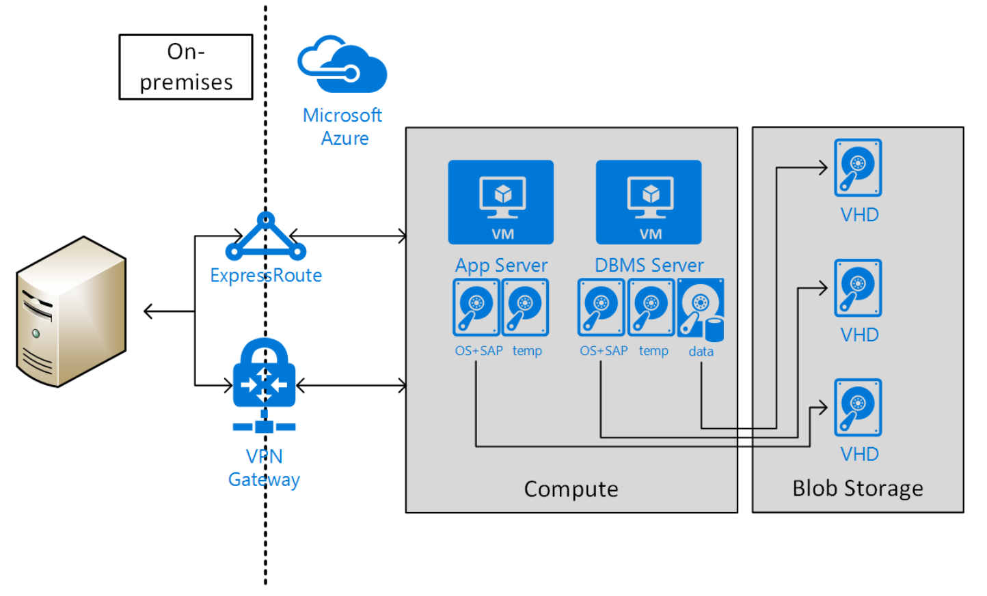
SAP on Azure in Hybrid IT scenario
ExpressRoute or VPN connection
Transparent communication for SAP systems
On-premises AD/DNS extended into Azure
SAP systems located on-premises and Azure in same domain/AD
Every customer using SAP on Azure is using this setup with VPN/ExpressRoute
Supported for Hybrid and productive SAP landscapes in Azure

Slide 30

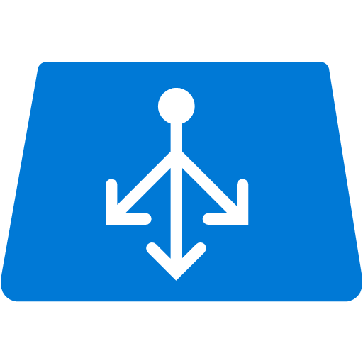
Azure infrastructure for a HA SAP system
Azure VNET
SIOS DataKeeper for WSFC without need of clustered shared disks
SAP App Server – ABAP/Java dual or single stack. Prefer smaller VMs
SAP Web Dispatcher installed on Azure VM, performs HTTP(S) load balancing
SQL DB with AlwaysOn Availability Group
Need to deploy in 3-tiers for HA and DR
Av. Set 3, WSFC
SAP Cen. Serv. Node 1
SAP Cen.. Serv. Node 2
Azure ILB
SAP SCS Cluster VNN
Av. Set 2
Domain Controller
SAP App Server
SAP App Server
Av. Set
Azure VM SAP Web Dispatcher
Av. Set 1, WSFC SQL AG
Sync Commit
Azure ILB AG Listener
SAP SQL DB WSFC node 1
SAP SQL DB WSFC node 2
Notes:
A highly available SAP system typically has the above layout
The SCS is protected with Window Server Failover Cluster. The SIOS DataKeeper (3rd party solution) enable the creation of a cluster on Azure without shared disks.
SAP Application servers are protected by virtue of multiplicity. The HTTP(S) load balancing is handled by the SAP Web Dispatcher built on an Azure VM. The SAP Logon load balancing is handled by the SCS message server.
The DB layer, for SQL Server DB, we use AlwaysOn Availability Group (AG) built on a WSFC leveraging node majority with a file share witness quorum.

Slide 31
SAP on SQL Server Considerations
Great resource: SAP note 555223 - FAQ: Microsoft SQL Server
WORST Practices for Maintaining SQL Server SAP systems (i.e. Things to AVOID)

Slide 32
Oracle Database on Azure
11g and 12c Supported on Windows for SAP
Standard Windows images require BYOL
Linux images and custom images require BYOL
Oracle RAC not supported
Scaling limit determined by largest available VM
High Availability requires Data Guard or Fail Safe
Consider cross region Disaster Recovery
Notes:
Oracle Database is supported on Azure with versions 11g and 12c. The standard Oracle images available in the Azure portal based on Windows include the Oracle license fees. As a result, these licenses are pay per use, which is useful for projects with a limited life span, development and test scenario’s, and other types of systems that don’t need to be on all the time. The Linux based images do not include the Oracle license fees, so you will have to acquire the needed licenses from Oracle directly. The same of course applies when you install the Oracle software yourself on a basic Windows image. Be aware that because you can scale instances easily, you can also easily violate your license agreement with Oracle in BYOL situations. As of YE 2015, SAP/Oracle/Linux on Azure is NOT yet supported! SAP Netweaver on SLES (planned for Feb 2016), SAP Netweaver on RHEL (planned for mid 2016), HANA enterprise edition on SLES (planned for summer 2016)
Oracle Real Application Cluster (RAC) requires a shared disk pool, and this is not available in Azure. This has two major consequences:
Scalability through RAC is not possible, all databases run on a single instance.
Scaling can be achieved by using larger VMs. Current limit is a GS5 VM with 32 cores, 448 GB RAM, and up to 80,000 IOPS
Otherwise you need to build (or change) applications to use partitioning/sharding.
High Availability through RAC is not possible. To achieve HA, you need to use Data Guard.

Slide 33
SAP on Oracle/Azure Considerations
Verify Oracle and corresponding OS versions support for SAP
Only single instance Oracle using NTFS format, Azure page blob VHDs are supported
Other network drivers or remote shares including Azure file shares are not supported
Backup/restore to/from disks via SAP BR*tools for Oracle supported
Oracle Data Guard is supported for HA
Oracle RAC, ASM are not supported

Slide 34
SAP AS HTTP(S) & Logon Load Balancing
Clients (Browsers)
Clients (SAPGUIs)
HTTP(S) Load balancing between many SAP NetWeaver AS requires external load balancers
SAPGUI logons to ABAP stack load balanced by ABAP Central Service’s message server
1
Internet or Intranet
Web Dispatcher
ABAP SCS
1
2
2
NetWeaver Dual-Stack AS
NetWeaver Dual-Stack AS
Internet Comm. Mgr.
Internet Comm. Mgr.
Java Dispatcher
ABAP Dispatcher
ABAP Dispatcher
Java Dispatcher
Java Serv. Procs
Work Procs
Work Procs
Java Serv. Procs
Notes:
This slide describes SAP load balancing for both SAP ABAP and Java stacks
1. You can bring up an SAP system with many Java Application Servers, for which the SAP Web Dispatcher (SWD) is used as the load balancer routing HTTP(s) traffic to either the ABAP or Java stack. For more information, see Load Balancing Between Many Java Instances. The SWD routes requests to an AS. The ICM then routes the HTTP(s) requests to a Dispatcher for connecting with either an ABAP or a Java work process to perform work
2. The message server in the ABAP SCS load-balances user logons for the ABAP stack only
This diagram shows only the SAP Application Server, next we will look at components of an SAP system, ECC for example.

Slide 35

HA/DR for SAP Central Services
Azure VNET
Azure VNET
S2S VPN or ExpressRoute
SCS DR VM
SAP App Server
Domain controller
Domain controller
WSFC Cluster VNN
Azure ILB for SCS
>> Schedule a job to ROBOCOPY the on-premises ASCS’ \sapmnt to a directory on a designated Azure VM once per day. At failover, change the VM’s IP to that of the on-premises SCS cluster VNN IP
SCS DR Cluster
Notes:
ASR doesn’t yet support clusters. To help protect the SAP components of ASCS/SCS/Central Services, you should:
Have an Active Directory server running in Azure. This Active Directory server would be the primary Active Directory server in case of a failover to the DR site. The Active Directory domain controller in Azure must be regularly synchronized with the on-premises Active Directory domain controllers.
While not running in Azure (the normal case), have a VM in Azure which is up and running for every running SAP ASCS/SCS/Central Services. If a DR event occurs, these VMs will take over the role of the ASCS/SCS/Central Services. You would need to make sure that the content of the sapmnt share(s) of the VMs running on-premises is copied on a regular basis into the VM(s) in Azure.
In case of a failover to the DR site, assume that the Active Directory server that has been in Azure or is rebuilt in Azure is taking over the Windows Domain services.
NOTE In this procedure, you make a change to the DNS entries for the Virtual Windows Cluster names by changing their IP addresses to the IP addresses of the VMs in Azure that should run ASCS/SCS/Central Services. You also assign the virtual name of the cluster to the VMs in Azure designated to run ASCS/SCS/Central Services.

Slide 36
SAP App Server HA and DR
SAP NW application servers achieve HA with load balancers
SAPlogon group for SAPGUI traffic
SAP Web Dispatcher for http(s) traffic
Replicate VM to remote region for DR via ASR
Notes:
The application server does not contain any business data and does not need to be replicated to Azure very often. The only content that changes periodically is the SAP kernel after a kernel upgrade. Replication every 15 minutes is recommended.
ASR Planner tool link> https://gallery.technet.microsoft.com/Azure-Recovery-Capacity-d01dc40e
How to use the ASR Planner tool> https://azure.microsoft.com/en-us/documentation/articles/site-recovery-capacity-planner/

Slide 37

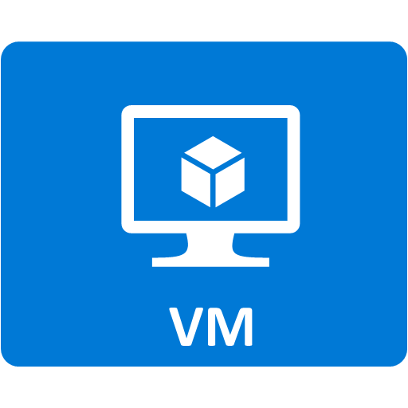
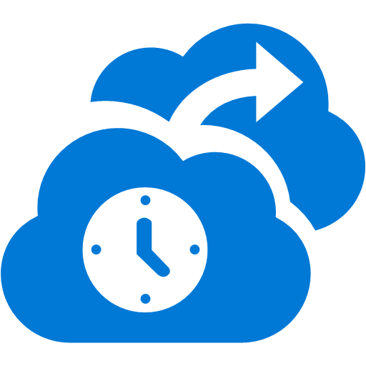
Managing unplanned downtime using Backup
SAP Cen. Serv.
SCDPM
Application level consistency for Windows OS
File system level consistency for Linux OS
2 backup options: DPM and MARS agent
SAP App1
Azure Backup supports Windows and Linux VMs
SAP Database Server
File Server backed up with MARS agent

Slide 38
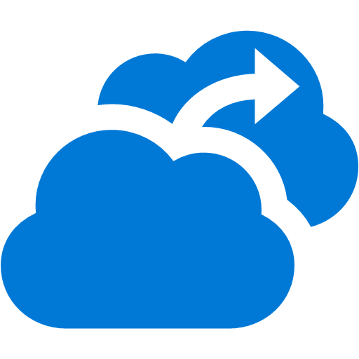


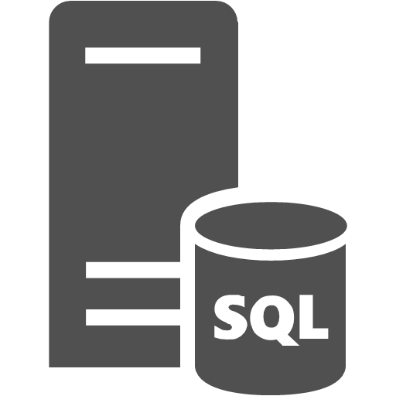
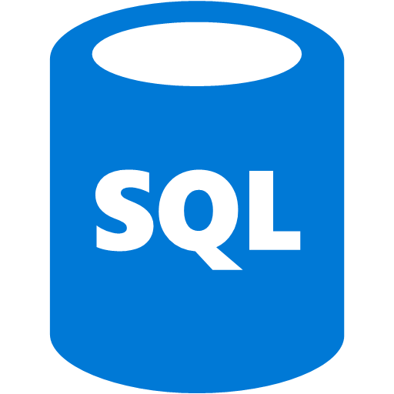
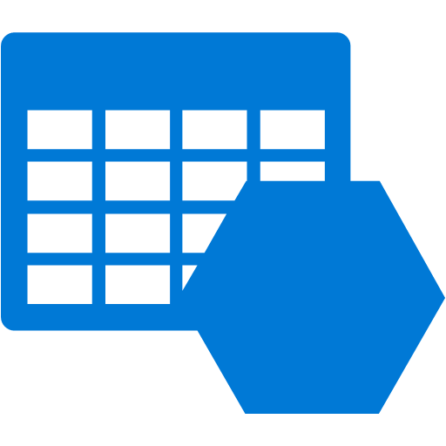

Managing unplanned downtime using ASR
DR Orchestration
DR Orchestration
Azure Site Recovery
S2S or ER
Async. SQL AG replication
SQL AG secondary replica
SQL AG
Storage Acct.
Async. VM replication
SAP rep’ed app servers
SAP app servers
Notes:
The SAP Database service should be protected by native database management systems (DBMS) level replication technologies.
SQL Server 2012 (and later) includes SQL Server AlwaysOn. In addition to SQL Server AlwaysOn, you can use database mirroring and log shipping to synchronize on-premises databases to Azure. In general, the replication technology for Azure is asynchronous—transactions are committed on-premises before they are confirmed on the DR system on Azure.
SAP application servers running on Hyper-V can be replicated to Azure using the Azure Recovery Services framework and agents. The application server does not contain any business data and does not need to be replicated to Azure very often. The only content that changes periodically is the SAP kernel after a kernel upgrade. Replication every 15 minutes is recommended.
Azure Site Recovery now provides native support for SQL Server AlwaysOn. SQL Server Availability Groups can be added to a recovery plan with virtual machines. All the capabilities of your recovery plan—including sequencing, scripting, and manual actions—can be leveraged to orchestrate the failover of a multitier applications by using a SQL Server database that is configured with AlwaysOn replication. See https://azure.microsoft.com/en-us/updates/public-preview-azure-site-recovery-integration-with-sql-server-alwayson/ for more details

Slide 39
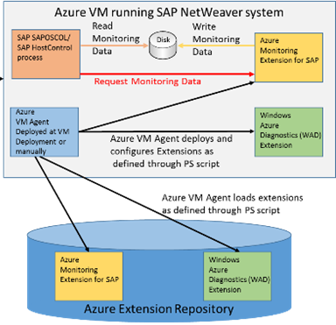
SAP on Azure Monitoring Extension
SAP requires Monitoring solution that allows SAP instance running in the VM to get essential data from Azure
SAP Azure Extension is:
Configured and deployed by a PowerShell script after the deployment of the VM
Collecting data from ‘Windows Azure Diagnostics’ Framework
Contacted by SAPOSCOL to deliver monitoring counters on a periodic basis
Notes:
This extension was developed to enable SAP to collect important performance counters and display those in SAP transactions ST06 and OS07. Data that very often helps to investigate performance experiences and also provide a great base for volume planning. Therefore it is very important to open this channel of performance counter collection. The important aspect about the Azure Monitoring Extension for SAP is that it collects performance counters which are collected on the Azure host and diagnostics framework. Data that is usually not available within a VM, but that can be highly important to analyze performance aspects.
As you see the only direct interaction between the Azure Monitoring Extension for SAP and SAP are the SAP Host Agent components. The Host Agent components are standalone component which do NOT require a complete exchange of the SAP kernel when updating those components. Therefore it should not be a problem to exchange the existing SAP Host Agent components to the patch level of components necessary to support Azure.

Slide 40
Update SAP Monitoring Configuration
When:
Adding more counters
Azure monitoring infrastructure update
Adding disks to your VMs
Changing sizes for your Azure VMs
Notes:
The SAP monitoring extension made configuration settings during its installation. When the VM hosting this extension (or agent) configuration is changed, the agent needs to be updated to update the configuration.

Slide 41
Estimating solution costs

Slide 42

Compute and store – pricing metrics
item
unit of measurement
cost per unit*
Compute hours by instance size
A5 VM - $0.33/hr
D11 VM - $0.33/hr
GS5 VM – $9.65 /hr.
VM
Sample price for standard disks
LRS – 0.024, 0.0236, 0.0232, 0.0228, …
GRS – 0.048, 0.0472, 0.0464, 0.0456, …
RA-GRS – 0.061, 0.0599, 0.0589, 0.0579, …
R/W Transactions - $0.0036 per 100,000
Terabytes stored, measured per GB used
Transactions measured at 100,000 counts
Blob storage
LRS – 0.08
GRS – 0.1
Standard charge ($0.0036/100K trans) in effect 03/01/2016
Terabytes stored, measured per GB used
Transactions measured at 100,000 counts
File storage
All pricing subject to change.
RA-GRS minimum charge is 30 days
Premium storage billed at allocated capacity
Notes:
Blob and file storage is charged the same way at different rates. Storage capacity is billed in units of the average daily amount of data stored, in gigabytes (GB), over a monthly period. For example, if you consistently utilized 10 GB of storage for the first half of the month and none for the second half of the month, you would be billed for your average usage of 5 GB of storage. We charge $0.0036 per 100,000 transactions for Tables & Queues. Transactions include both read and write operations to storage.
File Storage - Starting on March 1, 2016, File Storage read operations will be charged at $0.015 per 100,000 operations for both LRS and GRS accounts. File Storage write operations will be charged at $0.15 per 100,000 operations for LRS accounts; and $0.30 per 100,000 operations for GRS accounts. The promotional price of $0.0036 per 100,000 read and write operations for both LRS and GRS accounts will be effective through Feb 29, 2016.
For RA-GRS, Storage accounts will be charged for a minimum of 30 days from the time the service is enabled. For example, if RA-GRS is turned on May 1 and turned off May 5, the storage account will be charged for RA-GRS through May 30. After that, GRS pricing would start.
If RA-GRS is turned on May 1 and turned off June 14, RA-GRS would be charged through June 14. On June 15, GRS pricing would take effect.
Premium storage is charged at the allocated capacity regardless of usage. Billing for any provisioned disk is prorated hourly using the monthly price for the Premium Storage offer. For example, if you provisioned a P10 disk and deleted it after 20 hours, you are billed for the P10 offering prorated to 20 hours. This is regardless of the amount of actual data written to the disk or the IOPS/throughput used.

Slide 43
Network – pricing metrics
Item
unit of measurement
cost per unit*
Gateway hours
$0.19/hr (standard gw)
$0.49/hr (High Perf gw)
VPN Gateway
GB
$0.035/GB in Zone 1
Outbound inter-VNET transfer
Reserved
public IP
Number of IP per month
First 5 IPs: Free
Each additional IP → $3/Mo
0100100
5 GB - 10 TB / month → $0.087 / GB
Next 40 TB / month → $0.083 / GB
Next 100 TB / month → $0.07 / GB
Next 350 TB / month → $0.05 / GB
GB
Egress Traffic
All pricing subject to change.
Notes:
VPN Gateway
Egress traffic is the traffic to a destination outside the region receiving the field data caused by the ingestion of the message. An example would be forwarding data to Azure Table Storage which is located in a different region. Data egress pricing: https://azure.microsoft.com/en-us/pricing/details/data-transfers/
Inter-VNET transfer - Data transfers between 2 Virtual Networks are charged at the Inter-VNET rates noted above. Other data transfers over the VPN connections to your on-premises sites or the Internet in general are charged separately at the regular Data Transfer rate. https://azure.microsoft.com/en-us/pricing/details/vpn-gateway/
Reserved Public IP https://azure.microsoft.com/en-us/pricing/details/ip-addresses/

Slide 44
Recovery Services – Pricing metrics
item
unit of measurement
cost per unit*
Instance count and size catagory
<50 GB instance -> $5/mo
50GB-500GB instance -> $10/mo
>500 GB instance -> $10/mo
Backup Service
Recover to customer’s own site -> $16/mo/inst.
Recover to Azure -> $54/mo/inst.
Instance count and target destination
Site Recovery
Backup storage charge based on storage type of the backup vault either at LRS or GRS rate
Also recommended to use Cool Storage tier for backup
All pricing subject to change.
Notes:
Need to consider Process Server, Configuration Server, and Master Target component cost if ASR is for VMWare

Slide 45
Sample solution volumetry
Item | Metrics | Item | Metrics
1. G5 VM | Active: 24x7 Hrs./mo. =744 | 5. HDD Storage | Average utilization 10 TB/mo
2. Egress data | 1 TB between regions | 6. SSD Storage | 4 P30 disks, 6 P10
3. Network | VPN or ER
Notes:
To calculate cost of the IoT solution, we need to know the volume of data and component capacity. This information is provided by the customer from their design of the solution. For each component listed above, a URL is provided for detailed pricing information.

Slide 46
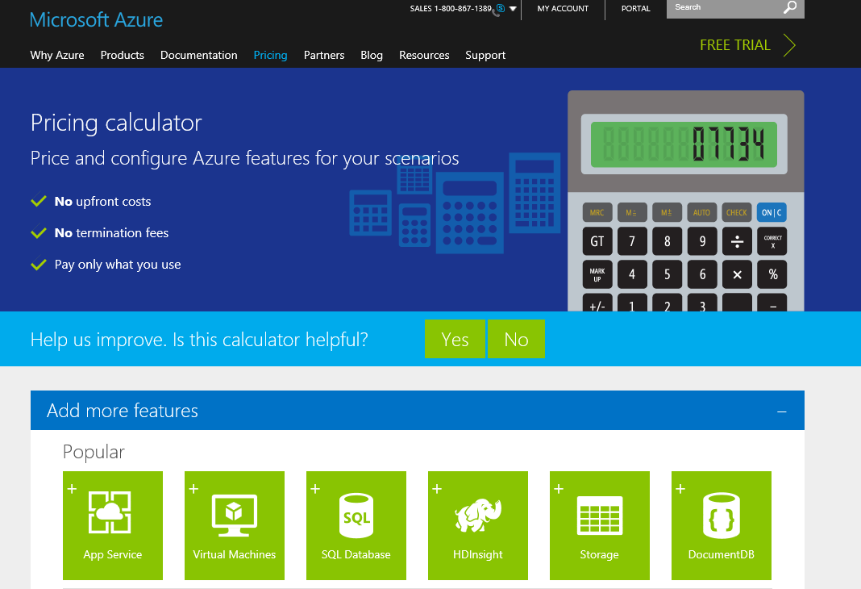
Online Azure Pricing Calculator
Notes:
https://azure.microsoft.com/en-us/pricing/calculator/?scenario=full

Slide 47
Anatomy of an SAP migration

Slide 48
What compels an SAP system migration
Hardware refresh
SAP version upgrade
Datacenter moves

Slide 49
Options for SAP migration
Like for like OS/DB migration
Uses SAP homogeneous system copy
Uses RDBMS specific method, e.g., SQL backup/restore
Dissimilar OS/DB migration
Uses SAP heterogeneous system copy

Slide 50
SAP Migration Project – Overview
Installation of
SQL software
SAP software
Export / Import
Installation of
SQL software
SAP software
Export / Import
Preparation
1.Test Migr.
2.Test Migr.
HW Partner
Sizing
HW Order
Migration Partner
Staffing
Project planning
SAP contracts
Export / Import
Switch over to new landscape
Test Phase
Technical Tests
Basis functionality, Performance
Printing, 3rd party tools
Application Tests
Key user test
Data consistency
Train the SAP teams
Final Migr.
Post go-live hypercare
Optimization
Support
Timeline (typically 3 to 9 months)

Slide 51
Technical Migration Phases
Preparations
Data Export
Transport of the data to the target system
Data Import
Post Activities
Notes:
Preparations
Source System: Installation of the tools, Checks (open updates, transport requests, etc), Un-scheduling of batch jobs, Application “closing”, Backup
Target System: Installation of the tools, Installation MSSQL, SAP Central Instance, Build up of the empty database
Transfer
Transport of the export data to the target server. Size of the export is approximately 10 % of the source database
Possibilities: FTP, Tape, Portable devices (Laptop or hard disks)
Post Activities

Slide 52
Technical Migration Process
Preparations
Shutdown SAP system (Log off users)
Export
Transfer
Import
Startup the system
Post activities
Friday,
6 pm
Time
Monday,
6 am

Slide 53
Problems & Risks - Overview
Missing Data or Inconsistency of the database
“Duplicate Keys”, Missing tables
Printing
Changing of the print server from Unix to Windows
Third-party tools
Ensure availability on the new platform
Interfaces to external programs
Absence of functionality after the migration
Runtime of the migration

Slide 54
Potential Problems & Risks
Missing Data or Inconsistency of the database
“Duplicate Keys”, Missing tables
Printing
Changing of the print server from Unix to Windows
Third-party tools
Ensure availability on the new platform
Interfaces to external programs
Absence of functionality after the migration
Runtime of the migration

Slide 55
Moving Large Volumes of Data
3 key factors to consider when doing system refresh or migration
Size of the database
Acceptable downtime
Source and target database version (migration)
1-2 TB: use AzCopy
2-3 TB: use DB replication, like SQL log shipping, mirroring, AlwaysOn AG for SQL Server
>3 TB: use Azure import/export (long down time)
Notes:
If the compressed database size is less than 1-2TB then experience has shown most customers can upload to Azure using tools such as AzCopy in an acceptable timeframe.
If the compressed database size is larger in 2-3TB range then some customers are using SQL Server Log Shipping, Mirroring or AlwaysOn to synchronize databases between on-premises and Azure. A brief outage can then be taken, final transaction log backup and restore done and then switch over to the copy of the database in Azure.

Slide 56
Summary
Planning and Capacity
Verify every SAP application release and patch level
Know customers’ performance objectives
Remember HA & DR
Know customers’ RPO, RTO
Cost calculator
Test migration

Slide 57
Resources
https://msdn.microsoft.com/library/azure/dn745892.aspx
Includes the following SAP on Azure documents
SAP NetWeaver on Azure Virtual Machines – Planning and Implementation Guide
SAP NetWeaver on Azure Virtual Machines – Deployment Guide
SAP DBMS in Azure Deployment Guide
SAP NetWeaver - Building an Azure based Disaster Recovery Solution
SAP NetWeaver on Azure - Clustering SAP ASCS/SCS Instances using Windows Server Failover Cluster on Azure with SIOS DataKeeper

Slide 60
Backup
If backup target is primarily databases use database built-in backup feature
Backup plan example : Full backup daily, log backup every 15 mins
Retention plan example : log for 7 days, daily for 1 month, monthly for 1 year, yearly for XX years
If OS states, files are also within scope use enterprise backup solutions instead
E.g. Azure Backup Server, System Center Data Protection Manager, or Partner solutions (e.g. Commvault, Arcserve)

Slide 61
Four Backup Solutions
 | Standard DB backup (e.g. SQL Server, Oracle) |  | Azure Backup Server (=SCDPM) | 3rd party solutions (e.g. Commvault, Arcserve) | Azure IaaS VM Backup
Backup type | Database |  | Network/Agent | Network/Agent | Snapshot
Backup target | DBs within Azure VMs |  | SQL Server DBs, Files and OS States (Windows) within Azure VMs (link) | SQL Server/Oracle etc DBs, Files and OS States (Windows, Linux) within Azure VMs | Azure VMs (Windows, Linux) running SQL Server (link)
Linux (Guest OS) support | No |  | No | Yes | Yes
SQL Server database backup capability | Transaction log every minute, differential, full |  | Differential every 15 minutes and full (express) |  | Up to 3 times per day
Oracle database backup | No |  | No | Yes | File consistent backup with RMAN
Compression | Supported |  | Supported (storage sizing : link) | Supported | None
Backup servers running on | DB Server |  | Microsoft Azure Backup Server (on VM) (installation kits downloadable from Azure Portal) (VM sizing : link) | Backup Server (on VM) | None (Backup as a Service)
Agent software required | No |  | Agent in backup target VMs and Azure Backup Agent in Azure Backup Server VMs | Yes | No (* Only Azure VM Agent)
Network bandwidth required | Yes but controllable |  |  |  | None
Short term retention | Yes (on local storage) |  |  |  | None
Long term retention | Possible
Point-in-time recovery | Possible
Recovery speed | Depend on I/O speed of local storage or Backup Vault
Monitoring/alerting console | Database console | Azure Backup Server Console |  | Backup Server Console | Azure Management Portal
Reporting | None | System Center Service Manager |  | Backup Server Reporting | None
licensing | None | Pay-per-use on Azure (link) |  | Check vendor | Pay-per-use on Azure (link)

