Slide 1
SAP Infrastructure as Code

Slide 2
Agenda
Infrastructure-as-Code with ARM
SAP Hana Reference Architecture (RA)

Slide 3
Infrastructure as Code using Azure Resource Manager

Slide 4





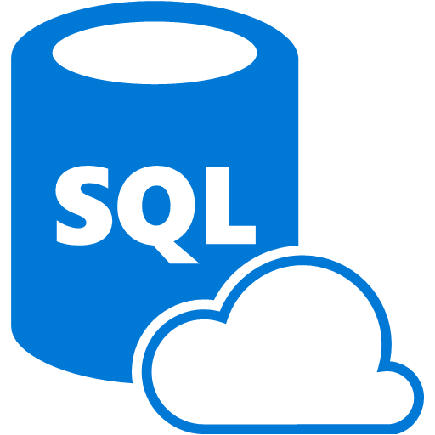




Azure Resource Manager Overview
Microsoft Azure
Azure Subscription
A resource always belongs to a resource group
Resource group is a unit of management
A Resource provider knows how to provision 1 or more resource types
Resource Group
LOB App
Resource Group
IaaS Workload
Resource Providers
Azure Resource Manager (ARM)
REST API Endpoints
Notes:
Start off explaining that ARM is a service layer inside the Azure platform. It enables you to provision, configure, and update resources in Azure. Hanging off of it are REST API endpoints that you can call to provision various resources. Whether your provisioning resources using the Azure portal, PowerShell, CLI, or custom code using the ARM SDK’s, your essentially calling these endpoints to do the work.
<click>
Sitting behind ARM is a massive collection of Resource Providers. Each resource provider knows how to create/update a very small set of resources. These resource providers are bound to a particular namespace that you reference when you’re provisioning a resource. For example, to create a virtual machine, you would reference the “Microsoft.Compute/virtualMachines” namespace and provide properties/settings that the resource provider expects to provision the virtual machine, such as type of OS, size of OS disk, number of data disks, sign-in credentials, and so on.
<click>
Shown here are a couple of scenarios: The first is the provisioning of a line-of-business application. This application consists of a web application, storage account, and a SQL database. Each of these resources are provisioned by a separate resource provider and with unique property settings.
Another example is a tradition IaaS workload, consisting of a couple of virtual machines, storage account, virtual network, and a key vault (for storing keys – perhaps for disk encryption as an example).
In both cases, the resources to support the workload are contained in a resource group. Resource groups provide a host of benefits but the main advantage here is that a resource group is a unit of management. In other words, if you were the admin responsible for administering the LOB App, you would need to manage all the resources that make up that application, not just a single resource such as the SQL Database.

Slide 5
Infrastructure-as-code (IaC) with ARM
Declarative model
Outside: Describe the infrastructure such as virtual network, virtual machine(s), storage accounts, etc.
Inside: Describe the configuration of a specific resource such as a virtual machine, web application, etc.
Parallel resource provisioning
Idempotent
Code (Outside)
Resource Group
Code (Inside)
Notes:
So now that you have some background on ARM, resources, and resource groups, let’s talk about how this applies to the notion of infrastructure-as-code.
ARM introduced the ability to provision resources in a declarative model. So, rather than provisioning resources one at a time and trying to stitch them together to create an application or infrastructure, we’re instead able to describe the application / infrastructure we want and have ARM go and make it happen.
We describe the application/infrastructure using JSON files and effectively tell ARM what to go build and within which resource group to build the infrastructure in.
<click>
This can be thought of as IaC for the outside. In other words, it simply describes what resources should exist in a deployment, but it doesn’t describe anything about how those resources should be configured.
<click>
For that, we can think of IaC from the inside. That is, the code and configuration to be applied to a particular resource after ARM has provisioned it. That “code” could be really anything – script, JSON, YML, or custom apps. The reason why is that it will be directly dependent on the type of resource that is provisioned as to what the options are for further configuring the resource.
Later, we’ll talk more about IaC from the inside. For now, just understand there are sometimes two phases when provisioning a resource; one, the provisioning the resource in Azure, and two, configuring that resource further to support the application workload.
<click>
With the declarative model, ARM is able to further optimize the deployment by provisioning some resources in parallel instead of sequentially. It is able to do this because it looks at the entire infrastructure you describe in your code, and figures out which resources it can provision simultaneously and which resources have dependencies on other resources that need to be provisioned first. In the example shown here, ARM would look at the resources in this resource group and provision the storage account, virtual network, and key vault all at the same time because they have no dependencies on one another. Then, it would provision the two virtual machines because the virtual machines have dependencies on the storage account (for VHDs), virtual network, and key vault (ie: for disk encryption keys or admin credentials).
<click>
The declarative model also gives us idempotency, which simply means, you can deploy the same IaC repeatedly and get the same result. And in the event that a single resource may fail to provision, you can simply re-run the deployment and ARM will figure out which resources have already been provision and which ones still need to be provisioned and then continue until the described infrastructure is complete.

Slide 6
Infrastructure-as-code artifacts
JSON Files
ARM Template Files
ARM Template Parameter Files
Artifacts (optional)
Configuration scripts used to configure resources
Application code
Third-party tools
Examples:
Web Deployment Package
Desired State Configuration (DSC) script
DSC resources
Notes:
When we say “IaC with ARM”, there are certain artifacts that are assumed. For example, we use JSON files to describe the infrastructure. And there are two JSON files that are implied
The ARM template file is the one that describes the infrastructure. Within the template file can be parameters that are used to parameterize the infrastructure.
The ARM template parameter file is used to provide parameter values to any of the parameters defined in the ARM template file.
Question to audience:
It is very common to have multiple ARM template parameter files. Can you think of why? Answer: multiple deployment environments. For example, suppose you have a Dev/Test and Prod environment. For Dev/Test you probably want to use smaller virtual machines and standard storage. But, for Prod, you want to user larger virtual machines and premium storage. Having two separate ARM template parameter files enables you to describe the infrastructure one time but support multiple environments.
There are also “optional” artifacts that can exist as part of you infrastructure-as-code and this is where “IaC from the inside” comes back into the discussion. For example, as part of your infrastructure code, you may have scripts you use to further configure a resources such as a virtual machine. Or, perhaps there are third-party tools you need to install. Again, it all depends on the type of resource you’re working with. But, there is often times a need to configure the internals of that resources and the scripts / configuration you use to do that can also be thought of as “infrastructure as code”.

Slide 7
What is an ARM Template?
JSON files – “Infrastructure-as-Code”
Artifacts (optional depending on resources)
Configuration files to apply to resources
Examples:
Desired State Configuration (DSC) Script and DSC Resources
Also “Infrastructure-as-Code”
Web Deployment Packages

Slide 8
ARM Template Structure
{
"$schema": "https://schema.management.azure.com/schemas/2015-01-01/deploymentTemplate.json#",
"contentVersion": "1.0.0.0",
"parameters": {
// Parameters referenced by resources (parameterize your template)
},
"variables": {
// Variables referenced by resources
},
"resources": [
// Virtual Machine, Web App, Virtual Network, SQL Azure, Storage Account, etc.
],
"outputs": {
// Optional outputs from deployment
}
}
Notes:
In the previous slide we introduced the ARM template file and said this is where you describe your infrastructure. But, what does that mean? What is the structure of the file.
That’s what this slide is showing you. Every ARM template file comes down to 4 sections as shown here.
Parameters is where you can define parameters parameterize your deployments. For example, if you’re deploying a virtual machine, then the size of the virtual machine could be a parameter.
Variables are used to define values that are used repeatedly throughout the template. Just like in traditional code, if you can provide the value once and reference your code is more flexible.
Resources is where you actually describe the infrastructure. Notice the array “ [ ] “ syntax for this section. Here, you describe each of the resources (virtual network, storage account, virtual machine, etc.) that you want deployed. Look at any ARM template and this section will be the bulk of what you see.
Outputs are optional and give you a way to get an output from ARM after it has deployed your infrastructure. For example, you may deploy a virtual machine with a public IP address that you use to access and manage the virtual machine. However, that IP address is dynamically generated at the time of deployment. So, you could have an output value that returns what that IP address is. This output value could be further referenced in downstream deployments, tools, or other IT functions as needed.

Slide 9
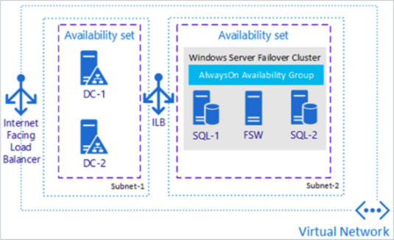
Finding Existing Templates
Azure Quick-Start Templates
http://aka.ms/qst
Azure Marketplace via Portal
Examples:
SQL Server Always-On Cluster
SharePoint 2013 HA Farm

Slide 10





Author & Deploy ARM Templates
Deployment template (JSON)
Deployment template parameters (JSON)
Microsoft Azure
Deployment script (PowerShell)
Azure Subscription
Push Deployment template and parameters to ARM
Resource Group
Resource Group
ARM

Slide 11
ARM Template Overview
Notes:
Options:
Create a new Azure Resource Group project in Visual Studio and show something really simple like a virtual machine, or
Use this quickstart template. https://github.com/Azure/azure-quickstart-templates/blob/master/101-vm-simple-rhel/azuredeploy.json
The goal of the demo is to just introduce the audience to what a JSON ARM Template really looks like. Explain the four resources : virtual network, NIC, PIP, and Virtual Machine.
Also make sure to talk through the parameters section of the template and show how different parameter files can be created for different environments. https://github.com/Azure/azure-quickstart-templates/blob/master/101-vm-simple-rhel/azuredeploy.parameters.json
If time permits, might be helpful to have this already deployed so you can show the resources in Azure as well.

Slide 12
Outside
Up to now everything has been IaC (outside)…
Code (Outside)
Resource Group
Notes:
So far, we’ve been talking only about the provisioning of Azure resources to implement the underlying infrastructure, such as virtual networks, virtual machines, storage accounts, etc.

Slide 13
Inside
…Now we will look at IaC (inside)
Resource Group
Code (Inside)
Notes:
Now, we’re going to shift our discussion to the configuration that you can apply within a virtual machine.

Slide 14
IaC (Inside) Resources
Virtual machine extensions are the vehicle that enables us to make configuration changes to a virtual machine instance
Add Windows server role / feature
Initialize data disks
Install LOB applications
Join the virtual machine to a domain
Apply endpoint monitoring
… more …
Notes:
What do we mean by configuration within a virtual machine? Essentially, it comes down to extending the base image that you get from say the Azure gallery to something that is further configured to support your workload. We achieve this using a resource called a virtual machine extension.
A virtual machine extension enables you to make configuration changes to a virtual machine instance after it is provisioned. For example, if this were a Windows Server instance, you may want to make it an IIS Server or maybe an Active Directory Domain Service server with DNS by adding Windows Server Roles/Features.
Or, you may want to initialize data disks or create a storage pool to support your workload.
You can even install line-of-business applications if that’s the requirement.
The point is, it is the virtual machine extension that supports this granular level of configuration. And there are many flavors of virtual machine extensions to do various tasks.

Slide 15
Flavors of virtual machine extensions
# Get a list of virtual machine extensions using PowerShell
Get-AzureVMAvailableExtension | `
Sort-Object ExtensionName -Unique | `
Format-Table ExtensionName, Description
( ... output abbreviated ... )
ExtensionName Description
------------- -----------
AzureCATExtensionHandler Extension to enable SAP Host Monitoring
AzureDiskEncryption AzureDiskEncryption Extension performs encryption operations
ChefClient Chef Extension that sets up chef-client on VM
CustomScriptExtension Windows Azure Script Handler Extension for IaaS
DockerExtension Microsoft Azure Docker Extension for Linux Virtual Machines
DSC PowerShell DSC (Desired State Configuration) Extension
DSCForLinux Microsoft Azure DSC Extension for Linux Virtual Machines
QualysAgent Qualys Vulnerability and Compliance Scanner
SiteRecovery Azure plugin for site recovery.
Notes:
If you’re at your computer, run this command to get a list of the hundreds of VM extensions that are available to you. We’ve abbreviated the output here to highlight a couple of extensions that are particularly useful when deploying SAP workloads.
<Click>
For example, the AzureCATExtensionHandler is available to enable host monitoring for the SAP workload.
<Click>
The CustomScriptExtension is extremely powerful as it essentially gives you means for deploying a script to perform configuration on the virtual machine. That script could be a PowerShell script for a Windows virtual machine or a bash script for a Linux virtual machine. There are separate versions of this for Windows and Linux machines, but the concept is the same.
<Click>
DSC stands for Desired State Configuration. DSC gives you a way to declaratively describe the configuration you want applied to a virtual machine instance. So, just like you can declaratively describe the infrastructure of Azure resources using an ARM Template, you can do the same to virtual machine instances using DSC.

Slide 16
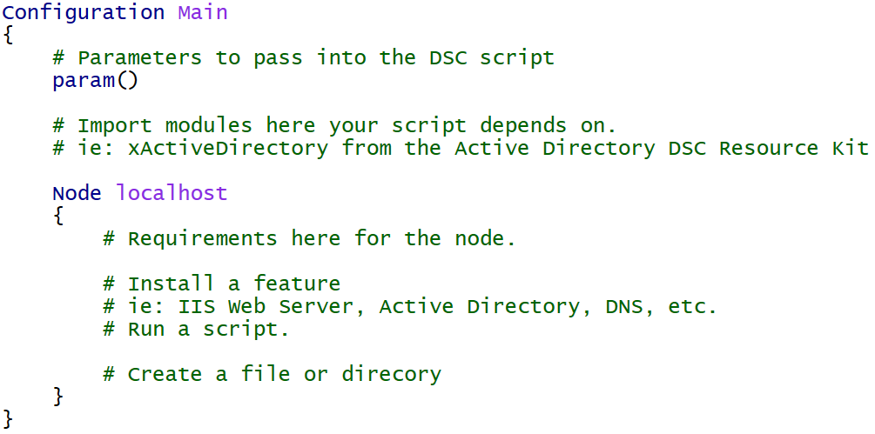
DSC for Azure Virtual Machines
Declarative configuration of the virtual machine
Windows Features and Roles
Custom application configuration

Slide 17
DSC Resources
Built-in
WindowsFeature, File, Package, Service, Script, etc.
DSC Resource Kit (~500 resources)
https://blogs.msdn.microsoft.com/powershell/2016/02/11/dsc-resource-kit-gets-even-bigger/
Experimental Resources
xNetworking, xStorage, xSqlServer, xActiveDirectory, etc.
Community Resources
cUserRightsAssignment, cNtfsAccessControl, etc.

Slide 18
DSC using ‘Built-in’ Resources
Configuration Main {
Param ( [string] $nodeName )
Import-DscResource -ModuleName PSDesiredStateConfiguration
Node $nodeName {
WindowsFeature WebServerRole {
Name = "Web-Server"
Ensure = "Present"
}
Package InstallWebDeploy {
Ensure = "Present"
Path = "C:\WindowsAzure\WebDeploy_amd64_en-US.msi"
Name = "Microsoft Web Deploy 3.6"
ProductId = "{ED4CC1E5-043E-4157-8452-B5E533FE2BA1}"
Arguments = "ADDLOCAL=ALL"
}
Service StartWebDeploy {
Name = "WMSVC"
StartupType = "Automatic"
State = "Running"
DependsOn = "[Package]InstallWebDeploy"
}
}
}

Slide 19
DSC using ‘Built-in’ Resources
Configuration Main {
Param ( [string] $nodeName )
Import-DscResource -ModuleName PSDesiredStateConfiguration
Node $nodeName {
WindowsFeature WebServerRole {
Name = "Web-Server"
Ensure = "Present"
}
Package InstallWebDeploy {
Ensure = "Present"
Path = "C:\WindowsAzure\WebDeploy_amd64_en-US.msi"
Name = "Microsoft Web Deploy 3.6"
ProductId = "{ED4CC1E5-043E-4157-8452-B5E533FE2BA1}"
Arguments = "ADDLOCAL=ALL"
}
Service StartWebDeploy {
Name = "WMSVC"
StartupType = "Automatic"
State = "Running"
DependsOn = "[Package]InstallWebDeploy"
}
}
}

Slide 20
DSC using ‘Resource-Kit’ Resources
Configuration Main {
Param ( [string] $nodeName )
Import-DscResource -ModuleName PSDesiredStateConfiguration, xNetworking, cUserRightsAssignment
Node $nodeName {
WindowsFeature DNS {
Ensure = "Present"
Name = "DNS"
}
xDnsServerAddress DnsServerAddress {
Address = "127.0.0.1"
InterfaceAlias = "Ethernet"
AddressFamily = "IPv4"
DependsOn = "[WindowsFeature]DNS"
}
cUserRight GrantIncreaseQuotaPrivilege
{
Ensure = "Present"
Constant = "SeIncreaseQuotaPrivilege"
Principal = "CONTOSO\AdminUser"
}
}
}

Slide 21
SAP Hana Reference Architecture

Slide 22
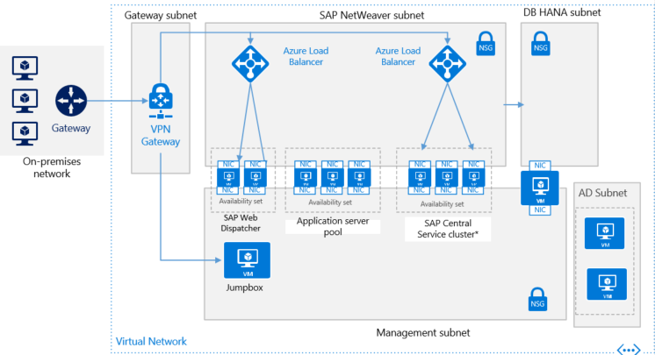
SAP Hana Reference Architecture
https://github.com/rickrain/reference-architectures/tree/larry/sap/sap/sap-hana
Notes:
Note: The link is temporary until PnP can get this merged into their repo, which will be later this week. But, this has been tested and aligns to the group’s latest round of feedback.
Explain that this is an early draft of the reference architecture that will ultimately be released in a week or so. Some things in this architecture that are different from what will be released are:
There is a 3rd server in the SAP Central Service cluster that will be the WSFC file share witness to the WSFC configured on the two SCS machines.
At the time of this writing, the template building blocks from PnP don’t support managed disks. So, standard disks still apply for now.
Point out the dual NIC’s on the SAP servers. This aligns with SAP guidance whereby SAP traffic is on it’s own dedicated NIC and administrative traffic is on a separate NIC.
Azure Load Balancers are internal load balancers.
Network Security Groups are used on each subnet to allow/deny traffic to/from the subnets.
If time allows, then open the GitHub repo and explore the structure of the templates with the audience.
PowerShell script to deploy the templates.
Show how deployment is split into two parts; one for infrastructure and one for the SAP workload
References to v1 of the template “building blocks” located at https://github.com/mspnp/template-building-blocks

Slide 23
Deploying the Reference Architecture
$subscriptionId = “<your subscription id>”
# Deploy the virtual network, Active Directory servers, and jumpbox
# Resources are deployed in resource group “sap-hana-infrastructure”
.\Deploy-ReferenceArchitecture.ps1 -SubscriptionId $subscriptionId `
-Location westus -Mode Infrastructure
# Deploy the SAP virtual machines: Web Dispatcher, App servers, SCS, Hana DB
# Resources are deployed in resource group “sap-hana-workload”
.\Deploy-ReferenceArchitecture.ps1 -SubscriptionId $subscriptionId `
-Location westus -Mode Workload
Notes:
It’s important that you deploy the SAP reference architecture as shown.
If later, you want to delete and redeploy, you can delete just the SAP workload resource group.

Slide 24
Stopping and Starting
$infrastructureRGName = “sap-hana-infrastructure”
$sapWorkloadRGName = “sap-hana-workload”
# Stop virtual machines
Get-AzureRmVM -ResourceGroupName $infrastructureRGName | Stop-AzureRmVM -Force
Get-AzureRmVM -ResourceGroupName $sapWorkloadRGName | Stop-AzureRmVM -Force
# Start virtual machines
Get-AzureRmVM -ResourceGroupName $infrastructureRGName | Start-AzureRmVM -Force
Get-AzureRmVM -ResourceGroupName $sapWorkloadRGName | Start-AzureRmVM -Force
You can further automate this by putting these commands into an Azure Automation Account / Runbook:
https://docs.microsoft.com/en-us/azure/automation/automation-intro

Slide 25
SAP Hana Reference Architecture
Notes:
Show the resources in the sap-hana-infrastructure and sap-hana-workload resource groups.

Slide 26
Summary
Infrastructure-as-Code with ARM
SAP Hana Reference Architecture (RA)

