Slide 1
Business Continuity for SAP
Notes:
Suggested introduction:
Faced with _______
We did _______
And discovered_______

Slide 2
Disaster Recovery for SAP applications
Business requirements
Minimum data loss in case of a disaster
Failover complete within hours including SAP application layer
Clear failover process
Failover transparent to users and sub systems
Minimum costs for DR
IT requirements
Production environment is on virtualization, bare metal or cloud
Minimum overhead on Production systems and network
Retire traditional SAN/Tape-based solutions
1
2
Database Replication (e.g. HANA System/Storage Replication)
File Replication (e.g. OS File Copy)
Application VM Replication (Azure Site Recovery)

Slide 3
Agenda
HA/DR with SAP AnyDB
HA/DR with SAP HANA
Azure Site Recovery

Slide 4
Protecting SAP AnyDB on Azure

Slide 5
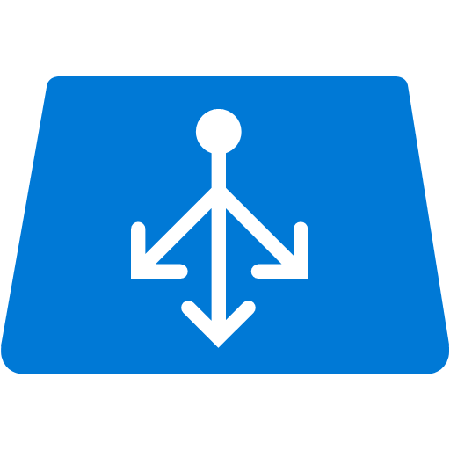

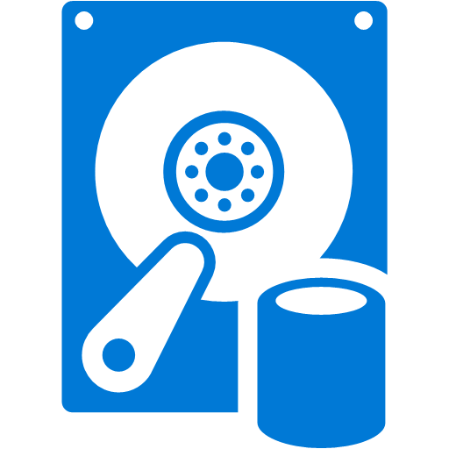
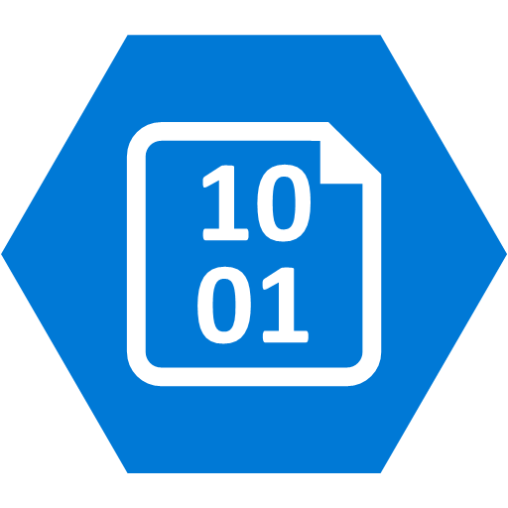
Database HA Architecture in Azure
traffic
probe
Availability Set
Witness
Primary
Secondary
Managed Disks
Storage Account
Storage Account
Storage Account
Notes:
To qualify for the high availability SLA of 99.95% in Azure, you need to have at least two VMs and place these in a single Availability Set. This ensures the VMs are spread of over multiple Fault Domains. If a failure occurs in a Fault Domain, the VMs in other Fault Domains are not affected. An Availability Set contains up to 3 Fault Domains, so 3 VMs in the same Availability Set are all separated from each other.
In a Farm configuration all VMs in the Availability Set are active and can be reached by a client. If one fails, the other(s) just pickup more load. By contrast, database systems usually have an active-passive cluster, only one VM is actively handling requests and the other is dormant. The Azure Load Balancer should only send traffic to the active node (or Primary). This is usually achieved by using a load balancer probe that checks for a response on a specific probe port. The passive node (or Secondary) should only respond if it has become the active node because the Primary is no longer active due to failure or updates. Failover configurations like this often include a Witness or observer that monitors for failure in the active node, and which initiates a failover if something goes wrong. The Witness should also be in the Availability Set unless you have a high available Witness configuration that monitors multiple systems. Note that each of the VMs uses a separate storage account. This too is a resiliency measure, as this ensures failure in a storage account only affects a single VM.
What you will see during the lifetime of a cluster is that the Primary and Secondary function switches periodically as updates to the Azure platform are rolled out. There is no deterministic way in which hosts are updated, so sometimes the Standby is updated first, resulting in one failover when the Primary is updated. In other cases the Primary is updated first, causing a failover, followed by another failover a while later when the new Primary is also updated.
Note that with some software the client is aware of both the Primary and Secondary instances. In that case there is no load balancer in play directing traffic. When a failover occurs the client switches to using the new Primary. Oracle Dataguard is an example where this is the case.
Although you could setup the right storage architecture manually, the recommended way to setup storage for High Availability is using Managed Disks. With Managed Disks, take away complexity and ensures disks are spread over storage accounts as needed to maintain High Availability of VMs in an Availability Set or VM Scale Set.

Slide 6

Database HA/DR Architecture in Azure
VNET – Region 1
ExpressRoute
or S2S VPN
On-premises network
ER
Client
VNET – Region 2
Primary
Availability Set
Standby
Availability Set
Transaction log
RemoteStandby
Witness
Site-to-Site VPN
Notes:
In a HA configuration you usually work with a single Standby database, but you can use multiple standby databases as read-only replica’s to lighten the load on the primary database. As these serve a different function, it is possible to host these on a smaller VM size.
A witness (or in Oracle terms an Observer) process is needed to accommodate automatic failover. The witness should be run on a separate VM, and by putting that VM in the same Availability Set as the Primary and Standby databases, you ensure it is in a different Update Domain and Fault Domain, and as such can’t be down at the same time as either the Primary or Standby databases.
When a failure of the Primary database occurs. The witness comes in action and turns the Standby database into the Primary database. When the original Primary database comes back online, it becomes the Standby database.
What you will see during the lifetime of the cluster is that the Primary and Standby function switches periodically as updates to the Azure platform are rolled out. There is no deterministic way in which hosts are updated, so sometimes the Standby is updated first, resulting in one failover when the Primary is updated. In other cases the Primary is updated first, causing a failover, followed by another failover a while later when the new Primary is also updated.
For Disaster Recovery a Standby database is typically located in a different data center. In Azure you use a different region where you setup a second VNET, which you connect via Site-to-Site VPN or through ExpressRoute. If your RPO lets you get away with data loss between minutes and an hour, a single Standby database in the second Azure region will suffice. Otherwise, you should setup two Standby databases in an Availability Set, to you ensure the least amount of data loss. Because the remote standby database is in a different region and the connection is over VPN or ExpressRoute, there is network latency to contend with. This means updates to the remote standby database(s) need to be done asynchronously, because the performance impact of synchronous updates would kill the performance of the Primary database. The latency and throughput ultimately determine the RPO you can achieve.

Slide 7
Considerations to protect SAP Systems
ASR to protect SAP Application Servers and SCS Servers
Native DBMS replication to protect DB layer
Works best with 3 tier configurations
DR DBMS server in Azure may be scaled down
Active Directory and DNS on DR site first
Select appropriate network bandwidth
Regularly test Failovers
SQL Server Transparent Data Encryption
Use Azure Premium Storage

Slide 8

Azure infrastructure for a HA SAP system
Azure VNET
SIOS DataKeeper for WSFC without need of clustered shared disks
SAP App Server – ABAP/Java dual or single stack. Prefer smaller VMs
SAP Web Dispatcher installed on Azure VM, performs HTTP(S) load balancing
SQL DB with AlwaysOn Availability Group
Need to deploy in 3-tiers for HA and DR
Av. Set 3, WSFC
SAP Cen. Serv. Node 1
SAP Cen.. Serv. Node 2
Azure ILB
SAP SCS Cluster VNN
Av. Set 2
Domain Controller
SAP App Server
SAP App Server
Av. Set
Azure VM SAP Web Dispatcher
Av. Set 1, WSFC SQL AG
Sync Commit
Azure ILB AG Listener
SAP SQL DB WSFC node 1
SAP SQL DB WSFC node 2
Notes:
A highly available SAP system typically has the above layout
The SCS is protected with Window Server Failover Cluster. The SIOS DataKeeper (3rd party solution) enable the creation of a cluster on Azure without shared disks.
SAP Application servers are protected by virtue of multiplicity. The HTTP(S) load balancing is handled by the SAP Web Dispatcher built on an Azure VM. The SAP Logon load balancing is handled by the SCS message server.
The DB layer, for SQL Server DB, we use AlwaysOn Availability Group (AG) built on a WSFC leveraging node majority with a file share witness quorum.

Slide 9




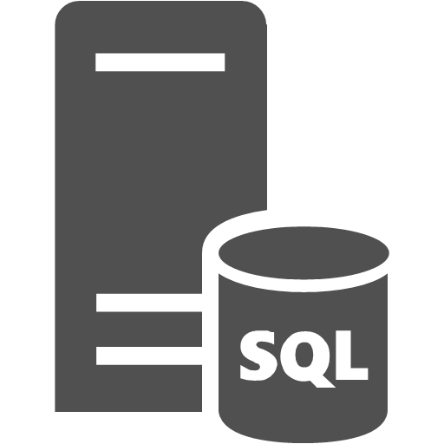
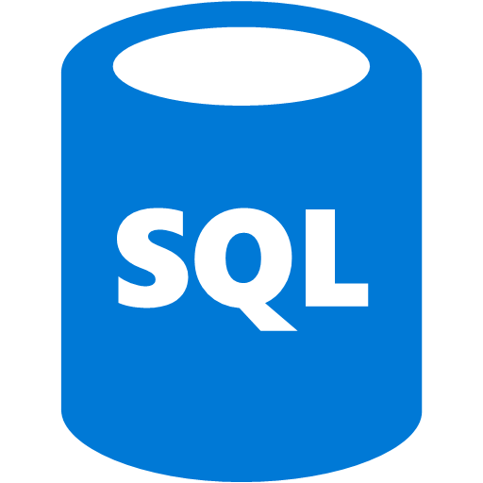
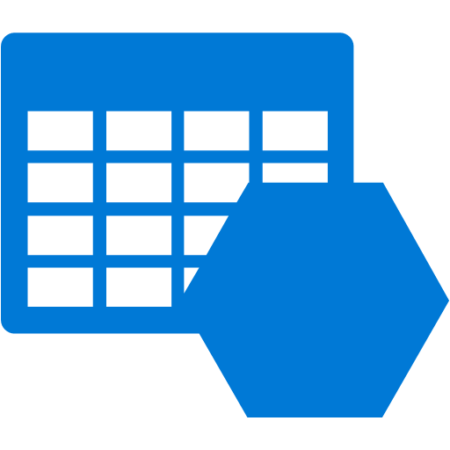

Managing unplanned downtime using ASR
DR Orchestration
DR Orchestration
Azure Site Recovery
S2S or ER
Async. SQL AG replication
SQL AG secondary replica
SQL AG
Storage Acct.
Async. VM replication
SAP rep’ed app servers
SAP app servers
Notes:
The SAP Database service should be protected by native database management systems (DBMS) level replication technologies.
SQL Server 2012 (and later) includes SQL Server AlwaysOn. In addition to SQL Server AlwaysOn, you can use database mirroring and log shipping to synchronize on-premises databases to Azure. In general, the replication technology for Azure is asynchronous—transactions are committed on-premises before they are confirmed on the DR system on Azure.
SAP application servers running on Hyper-V can be replicated to Azure using the Azure Recovery Services framework and agents. The application server does not contain any business data and does not need to be replicated to Azure very often. The only content that changes periodically is the SAP kernel after a kernel upgrade. Replication every 15 minutes is recommended.
Azure Site Recovery now provides native support for SQL Server AlwaysOn. SQL Server Availability Groups can be added to a recovery plan with virtual machines. All the capabilities of your recovery plan—including sequencing, scripting, and manual actions—can be leveraged to orchestrate the failover of a multitier applications by using a SQL Server database that is configured with AlwaysOn replication. See https://azure.microsoft.com/en-us/updates/public-preview-azure-site-recovery-integration-with-sql-server-alwayson/ for more details

Slide 10

HA/DR for SAP Central Services
Azure VNET
Azure VNET
S2S VPN or ExpressRoute
SCS DR VM
SAP App Server
Domain controller
Domain controller
WSFC Cluster VNN
Azure ILB for SCS
>> Schedule a job to ROBOCOPY the on-premises ASCS’ \sapmnt to a directory on a designated Azure VM once per day. At failover, change the VM’s IP to that of the on-premises SCS cluster VNN IP
SCS DR Cluster
Notes:
ASR doesn’t yet support clusters. To help protect the SAP components of ASCS/SCS/Central Services, you should:
Have an Active Directory server running in Azure. This Active Directory server would be the primary Active Directory server in case of a failover to the DR site. The Active Directory domain controller in Azure must be regularly synchronized with the on-premises Active Directory domain controllers.
While not running in Azure (the normal case), have a VM in Azure which is up and running for every running SAP ASCS/SCS/Central Services. If a DR event occurs, these VMs will take over the role of the ASCS/SCS/Central Services. You would need to make sure that the content of the sapmnt share(s) of the VMs running on-premises is copied on a regular basis into the VM(s) in Azure.
In case of a failover to the DR site, assume that the Active Directory server that has been in Azure or is rebuilt in Azure is taking over the Windows Domain services.
NOTE In this procedure, you make a change to the DNS entries for the Virtual Windows Cluster names by changing their IP addresses to the IP addresses of the VMs in Azure that should run ASCS/SCS/Central Services. You also assign the virtual name of the cluster to the VMs in Azure designated to run ASCS/SCS/Central Services.

Slide 11
SQL Server HA/DR

Slide 12
SQL Server Recovery Options
Cold standby. A secondary data center that can provide availability within hours or days
SQL Backup in Azure
Warm standby. A secondary data center that can provide availability within minutes or hours
SQL Log Shipping
Hot standby. A nearby secondary instance that can provide availability within seconds or minutes and another remote replica for DR with longer recovery time
SQL AlwaysOn Availability Group

Slide 13

SAP/SQL DR using Log Shipping
VNET region 1
VNET region 2
SAP App Serv
SAP App Serv
S2S VPN
SQL source instance
Apply logs to standby instance
Log backup to source folder by SQL agent jobs
Copy log files to target folder

Slide 14


SAP/SQL DR using AG Replicas on Azure
Run backups to Azure Storage
VNET region 1
Azure Storage
VNET region 2
SAP App Servers
WSFC SQL AG Listener
Sync
Commit
S2S VPN or ER
Domain controller
DR SAP SQL DB Sec. Replica
SAP SQL DB Prim. Replica WSFC node 1
SAP SQL DB Sec. Replica WSFC node 2
Cluster FSW
Asynchronous commit
Notes:
One of the most powerful hybrid scenarios we are making even easier to implement with SQL Server 2014 is a low recovery time objective (RTO) disaster recovery solution for your on-premises SQL Servers. You can do this by now being able to add AlwaysOn replicas directly to Microsoft Azure Virtual Machines. Now as you see in the diagram, we recommend having your asynchronous replicas residing in Azure VMs and your synchronous replica hosted in the same location. Again the reason for that is you want to minimize the impact on your primary, so having the synchronous close by is ideal. Now this is still a low RTO solution as the way asynchronous replication works, is as soon as the transaction is committed it is on it’s way to the replica in Azure, so data loss in minimal.
The other big gain in this scenario is that AlwaysOn replicas are readable so you can take advantage of the global Azure data center to strategically place the replicas (remember you can have up to 8 now with SQL Server 2014, double that of SQL Server 2012). This means faster global BI reporting in addition to a more cost effective disaster recovery solution.
We have built UI into SQL Server management studio to make the deployment of AlwaysOn replicas even easier regardless of the hosting location. Also SQL Database on-prem or on Azure can backup directly to Azure storage.

Slide 15
Azure SQL AG Replica – Things to know
Remember network latency
Be careful about failing resources over via cluster manager
Manage failover from AG Dashboard or T-SQL
Infrastructure admin trained on AlwaysOn AG

Slide 16
Oracle Database HA/DR

Slide 17
Oracle Database High Availability
Enterprise Edition: Oracle Data Guard
Active/Passive (Read-Only)
Standard Edition: Oracle Fail Safe
With Windows Failover Cluster and SIOS DataKeeper
GoldenGate
Active/Active
Allows heterogenous replication
Notes:
For production workloads on Oracle, High Availability is very important. In an on-prem data center the hardware is usually built to give very high uptime guarantees, and system administration is typically done in specific time windows. By contrast, in Azure you need to have at least two instances in an Availability Set to get an uptime SLA. Because of host updates, VM relocation, or other reasons, a VM may need to be restarted by Azure. System administrators do not control this. As a result, achieving High Availability requires software level mechanisms. With Oracle Database, you have two options: Data Guard or Fail Safe. Real Application Cluster (RAC) is not possible because there are no shared disk clusters in Azure.
Data Guard is a well understood solution with different configuration options depending on your HA needs. For workloads running Oracle Enterprise Edition, this is the preferred solution. Oracle Standard Edition doesn’t support Data Guard, and therefore must rely on Oracle Fail Safe. Oracle Fail Safe requires Windows Server Failover Cluster (WSFC), and this usually works with a shared SAN. Because this is not available in Azure, you need a third party tool to perform disk replication like SIOS DataKeeper. SIOS is certified for Azure and Oracle.
GoldenGgate provides logical data(base) replication. It is basically separate software from the DBMS, and may in some cases be preferable over a solution using Data Guard.

Slide 18
Oracle Database HA - Fail Safe
Port: 1521 (TNS)
Client
Port: 1521 + Probe port
10.0.0.8
Port: 1521 + Probe port
Availability Set
Node 1: 10.0.0.4
Node 2: 10.0.0.5
Windows Server Failover Cluster
Managed Disks
Managed Disks
Notes:
Oracle Fail Safe works in conjunction with Windows Server Failover Cluster (WSFC). With WSFC you setup an Internal Load Balancer (ILB), and tie it to a reserved internal IP address. The ILB exposes the required ports to the client. In the case of Oracle port 1521 for TNS traffic. The ILB forwards traffic to the primary node over this port. It also uses a secondary port as a probe to see if the node is responding. This is TCP traffic, usually over port 59999. The probe checks the availability of both nodes at regular intervals (usually 10 seconds). On the secondary node port 59999 is not reachable unless the primary node is down. The nodes in the WSFC are in an Availability Set to ensure at least one of the two nodes is active. This ensures that an update or failure does not bring the cluster down.
Because there is no shared SAN, SIOS DataKeeper needs to be used to replicate the disk state to the other node. To minimize the possibility that issues with the storage account brings down both nodes, we recommend putting disks for the different nodes in different storage accounts.

Slide 19
Oracle Database HA - Data Guard
Client
Port: 1521 (TNS)
Standby
Primary
Availability Set
Primary
Standby
Redo Stream
Managed Disks
Managed Disks
Observer
Notes:
With Data Guard you deploy a Primary database, and up to 30 Standby databases. As with Fail Safe, each Data Guard instance has its own set of disks, preferably in a different storage account. However, where with Fail Safe the disk replication is performed outside of the control of Oracle, with Data Guard Oracle takes care of transporting a Redo Stream to the Standby databases, so the changes to the Primary database can be applied to the Standby databases.
Standby databases can be Physical standby, Logical standby, or Snapshot standby databases. A Physical Standby database has the same disk and file configuration, which is the best option for a HA configuration because you then work with an exact replica on which the Redo Stream will directly be applied using Redo Apply. With Logical standby databases the Redo Stream is first converted to SQL statements that are executed against the standby using SQL Apply, and Snapshot standby databases are not updated constantly. Because Physical standby databases have the same physical layout, the performance will also be consistent with the Primary database.
In a HA configuration you usually work with a single Standby database, but you can use multiple standby databases as read-only replica’s to lighten the load on the primary database. As these serve a different function, it is possible to host these on a smaller VM size.
An Observer process is needed to accommodate automatic failover. The observer should be run on a separate VM, and by putting that VM in the same Availability Set as the Primary and Standby databases, you ensure it is in a different Update Domain and Fault Domain, and as such can’t be down at the same time as either the Primary or Standby databases.
<click> When a failure of the Primary database occurs.
<click> The Observer comes in action and turns the Standby database into the Primary database.
<click> When the original Primary database comes back online, it becomes the Standby database.
What you will see during the lifetime of the cluster is that the Primary and Standby function switches periodically as updates to the Azure platform are rolled out. There is no deterministic way in which hosts are updated, so sometimes the Standby is updated first, resulting in one failover when the Primary is updated. In other cases the Primary is updated first, causing a failover, followed by another failover a while later when the new Primary is also updated.
Note that the client actually is aware of both instances. There is no load balancer in play directing traffic. The connection string points to both instances, and the designated Primary is the one the client talks to. When a failover occurs the client switches to using the new Primary. Most Oracle clients are capable of this behavior.

Slide 20
Oracle DB HA – Multiple Data Guard
Client
Port: 1521 (TNS)
Client
Port: 1521 (TNS)
Availability Set
Availability Set
Failover
Failover
Availability Set
Failover
Observer
Observer
Notes:
If you have multiple Data Guard configurations you can have an Observer that monitors all those configurations. Because this moves the Observer outside the Availability Set, you need to create two Observer nodes in a separate Availability Set and use Oracle Enterprise Manager to create a failover configuration for the Observer. Especially in situations where the database instances are running on DS or GS series, this is very cost beneficial, because an A1 instance is enough to run an Observer. An A1 is much cheaper than a DS1 or GS1, and it does not carry the extra cost of Premium Storage.

Slide 21
Oracle Database DR - Data Guard
VNET – Region 1
VNET – Region 2
Availability Set
Availability Set
Primary
Standby
Redo Stream
Redo Stream
Site-to-Site VPN
RemoteStandby
Observer
Notes:
Data Guard supports up to 30 Standby databases and you can use at least one of these for Disaster Recovery. For Disaster Recovery a Standby database is typically located in a different data center. In Azure you use a different region where you setup a second VNET, which you connect via Site-to-Site VPN. If your RPO lets you get away with data loss between minutes and an hour, a single Standby database in the second Azure region will suffice. Otherwise, you should setup two Standby databases in an Availability Set, so you ensure the least amount of data loss. Because the remote standby database is in a different region and the connection is over VPN, there is considerable latency involved. This means updates to the remote standby database(s) need to be done asynchronously, because the performance impact of synchronous updates would kill the performance of the Primary database.

Slide 22
Oracle Data Guard Considerations
HA: Maxium Protection
Redo Apply (Physical Standby)
SYNC Transport
AFFIRM
DR: Maximum Performance (ASYNC/NOAFFIRM)
Data Guard: http://bit.ly/Oracle12cDG
Protection Mode: http://bit.ly/Oracle12cDGPM
Notes:
Data Guard can be configured in different ways. For HA you need to have Zero Data Loss, and this is achieved by setting the right Protection Mode. Maximum Protection or Maximum Availability with SYNC Transport and Redo Apply ensure Zero Data Loss. The use of Redo Apply means that for HA you must use a Physical Standby. SYNC Transport ensures changes are sent to the Standby database immediately. You can then still choose when the Primary database continues processing. With AFFIRM it waits until the Redo Stream for a transaction is persisted to disk. With NOAFFIRM, a.k.a. FastSync, the Redo Stream can only be in memory of the Standby database before the Primary database continues. This obviously improves performance, but in case of dual failure could result in minor data loss.
For Disaster Recovery you use the Maximum Performance Protection Mode, which results in asynchronous transport and NOAFFIRM, so the Primary database can continue without waiting for the Standby database.

Slide 23
SAP on Oracle/Azure Considerations
Verify Oracle and corresponding OS versions support for SAP
Only single instance Oracle using NTFS format, Azure page blob VHDs are supported
Other network drivers or remote shares including Azure file shares are not supported
Backup/restore to/from disks via SAP BR*tools for Oracle supported
Oracle Data Guard is supported for HA
Oracle RAC is not supported

Slide 24
Protecting SAP HANA on Azure

Slide 25
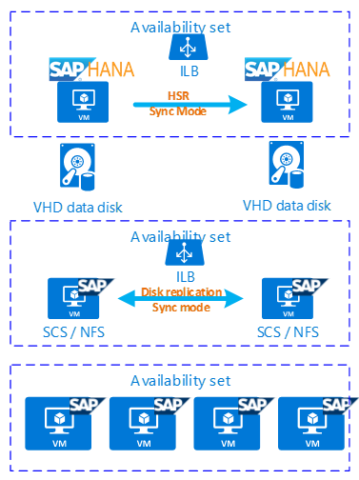
High availability - overview
Azure Region
SUSE Cluster software for SAP:
Automatic failover of Hana
Automatic failover of SAP SCS components & NFS
SUSE cluster software to be used (Pacekeeper)
SUSE fencing agent for Azure to SLES 12 SP1+
Storage replication done with DRDB technology
Availability set:
VMs are positioned on different HW (racks), power, network separation. Protection against HW failures

Slide 26

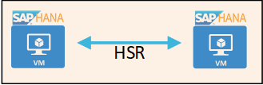
SAP Hana High Availability
HANA high availability:
Guide published at: https://docs.microsoft.com/en-us/azure/virtual-machines/workloads/sap/sap-hana-high-availability
SAP HANA installed as local installation on both nodes
SUSE Clusterware is managing primary/secondary Hana system – Hana system replication:
Automatic failover in case primary goes down
Managing of probe port for Azure load balancer
Client connects to Azure load balancer – redirects client to primary Hana.
Virtual IP:
Client connection to HANA
SUSE Cluster-Pace keeper :
Managing HSR for automatic failover

Slide 27
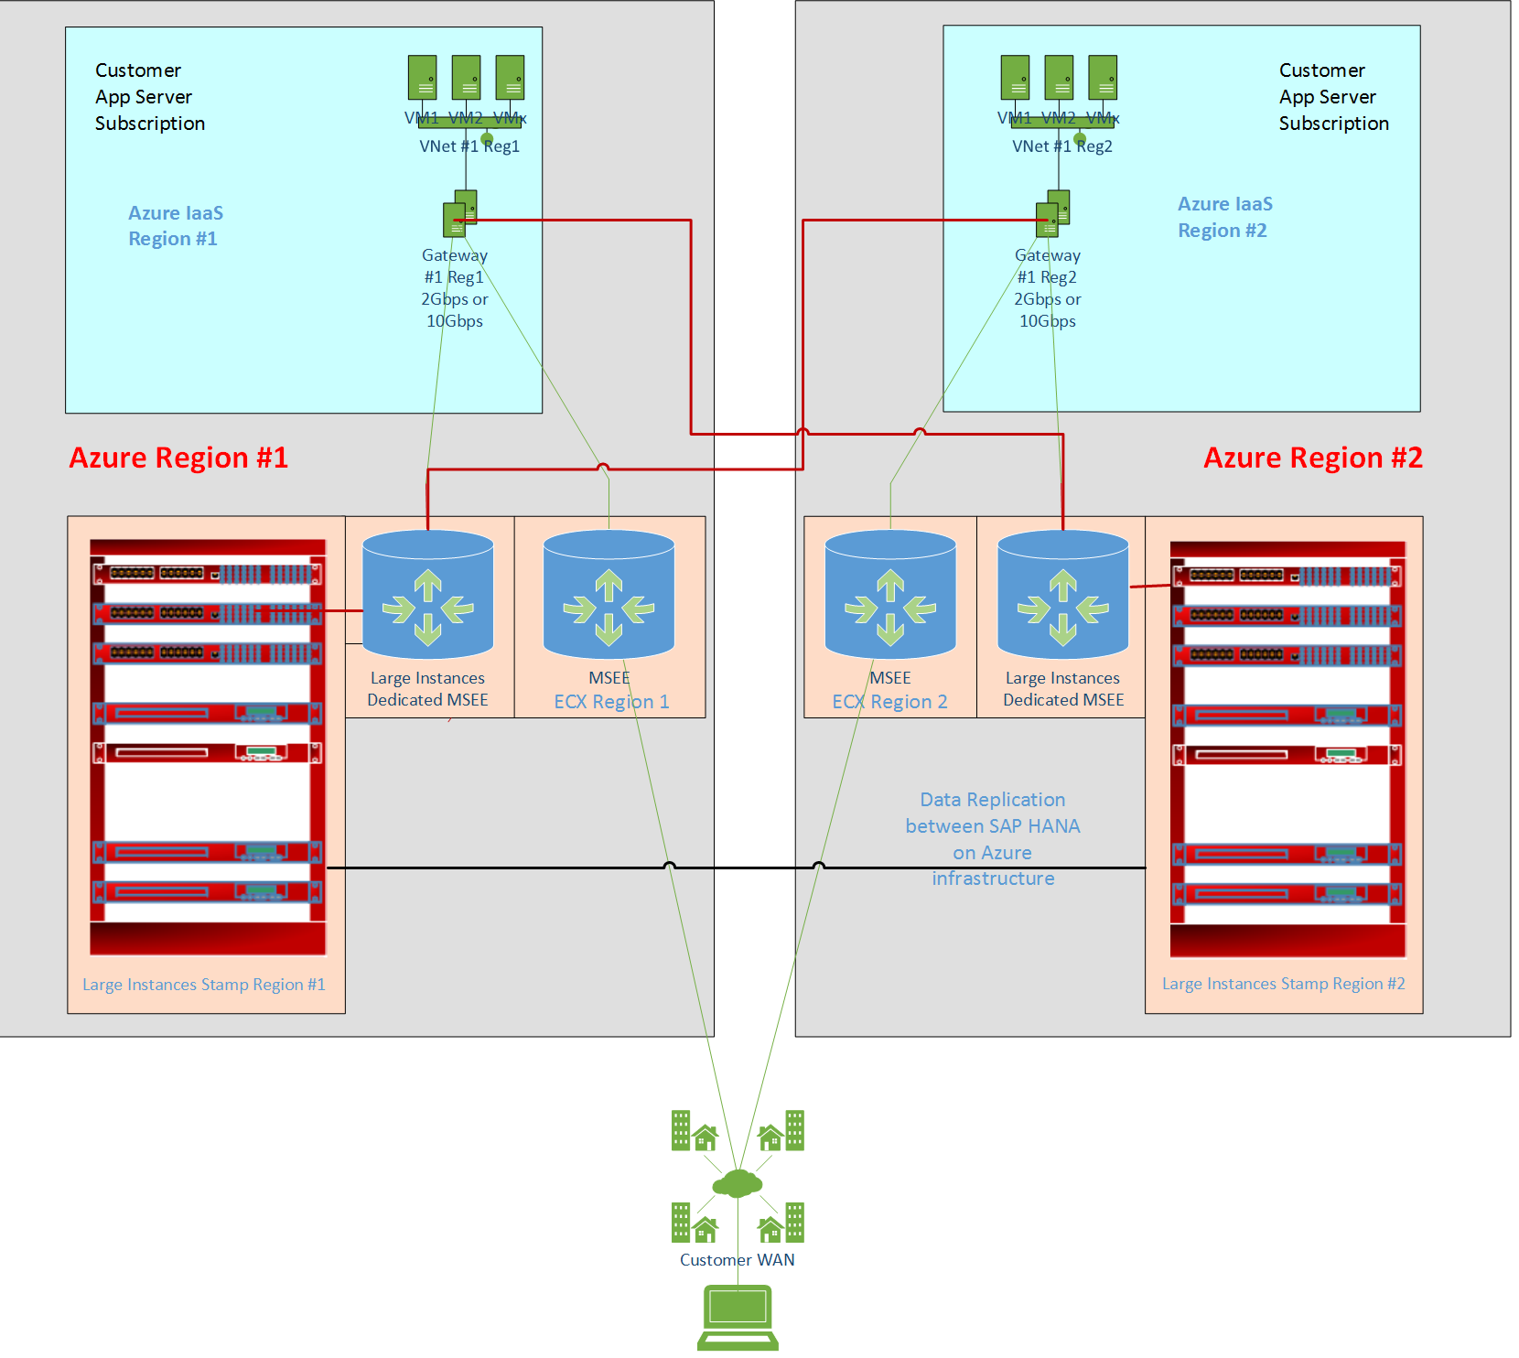
Disaster recovery for SAP HANA

Slide 28
SAP HANA Business Continuity
Availability Techniques
Disaster Recovery Techniques
SAP HANA Host Auto-Failover
Approach based on +1 node (might be up to +3)
Additional nodes CANNOT be used for non-prod
SAP HANA System Replication
Additional compatible environment required
Additional nodes CAN be used for non-prod
Failover can be automated for single-node
Passive Spare (Backup/Restore)
Backups must be replicated across both sites
SAP HANA System Replication
Requires identical hardware on the primary and secondary nodes
Storage Replication
Continuous replication of data between storage subsystem on primary and secondary side

Slide 29
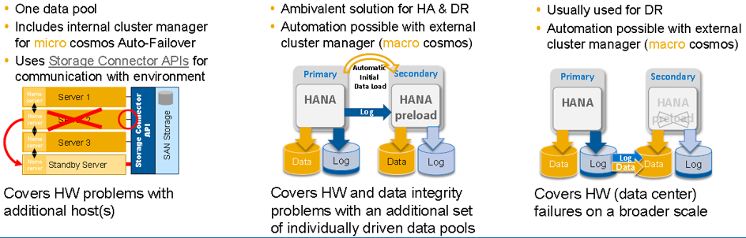
SAP HANA Business Continuity
Host Auto Failover
System Replication
Storage Replication
Cluster like solution
Shadow DB like Solution
Common DR Solution
Notes:
SAP HANA Host Auto-Failover for SAP HANA Scale-out: One node will fail (data-set is not complete anymore), Stand-by node will take over data and log files of failed node and will replace it (data-set is complete again).
SQL query can again retrieve data from all nodes in parallel. Multiple stand-by nodes are allowed but not common. One stand-by node is serving as fail-over target for any of the worker nodes – no data preloading possible
SAP HANA System Replication for SAP HANA Single-node Each SAP HANA node represents running instance. Only active node is having own data and log files. There are no data and log files on standby node. Data is written only to active node. SQL query will retrieve data from active node

Slide 30
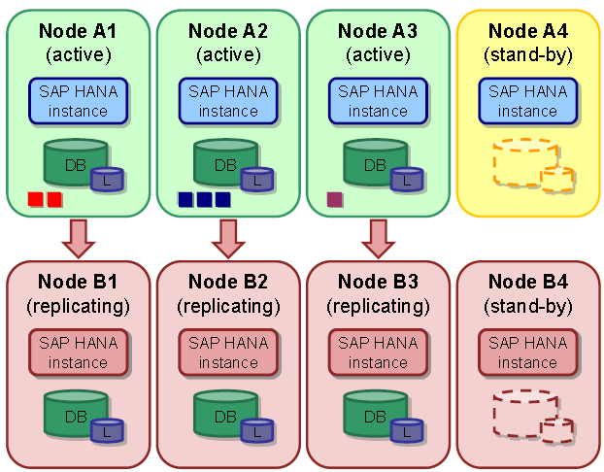
More Complex HANA System Replication
Notes:
SAP HANA System Replication for SAP HANA Scale-out
• SAP HANA System Replication needs additional “compatible” environment
• During System Replication each primary worker node is paired with one dedicated node on secondary side
• Stand-by node is not required on secondary side
• When data is written on primary node then related change is replicated to secondary node
• This replication is performed on database level

Slide 31
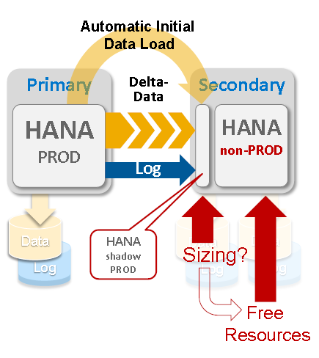
More Complex HANA System Replication
Cost Optimized, Dual purpose use – running non-PROD on Secondary
Worst case memory requirement for shadow PROD operation:
Depends on the size of the RowStore
Shadow operation is only active to take streams (data & log) for local storage
Preload is deactivated because resources are blocked by the non-PROD operation
Notes:
Sizing formula to predict resource demands for PROD shadow operation:
Size of RowStore + 20 GB or 20% of RowStore size (take is bigger one) for shadow operation
RowStore size:
select host,round(sum(page_size * USED_BLOCK_COUNT)/1024/1024/1024,2) as "RowStore Size GB“ from m_data_volume_page_statistics where page_sizeclass = '16k-RowStore' group by host;

Slide 32
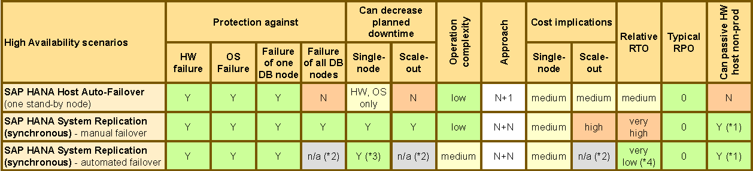
SAP HANA HA Comparison
(*1) Non-productive system will be stopped in case of failover, separate storage for non-productive system is required
(*2) Currently in testing (contact SUSE or Red Hat)
(*3) Special treatment is required to prevent cluster to takeover during maintenance

Slide 33
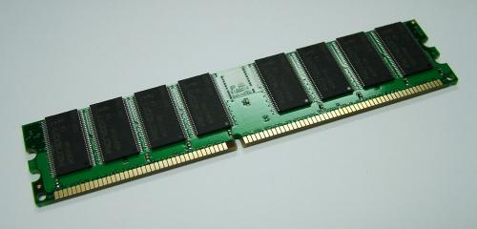
Integrated Backup/Restore/DR
Save Points
Logs
SAP HANA Memory
LOGS
DATA
Local storage
Log Backup
LOGS
Full backup
DATA
Backup storage
Backup Log Backup
LOGS
Storage replication
DATA
DR storage
Sub-Second consistent full backups, restore to any point in time

Slide 34
Azure Site Recovery

Slide 35


Azure Site Recovery One solution for multiple infrastructures
Replication
Replication
SAN
SAN
Replication
Microsoft Azure
Hyper-V
Hyper-V
Hyper-V
Hyper-V
1
Hyper-V to Hyper-V (on-premises)
2
Hyper-V to Hyper-V (on-premises)
5
Hyper-V to Azure
Replication
Replication
Replication
VMware or Physical
Microsoft Azure
Microsoft Azure
Microsoft Azure
VMware
VMware or Physical
4
VMware or Physical to VMware (on-premises)
5
VMware or Physical or AWS to Microsoft Azure
6
Azure to Azure
(*) In these on-premises scenarios, ASR is the Orchestrator only. No data travels to/from Azure cloud platform.
*

Slide 36

ASR SAP Scenario
Azure Site Recovery
DR Orchestration
DR Orchestration
SQL Backend
IaaS VM
SQL Availability Group
App Tier
SCS Tier
ASR Replication
Azure Storage
Active Directory
AD & ASR Replication
IaaS VM
S2S VPN
DR Site(Azure)
Primary Site(Azure)
Notes:
Additionally AD Replication and SQL Availability Group

Slide 37

Resource mapping - networks
Primary Site
DR Site
Network Marketing
Network Marketing Recovery
Network Mapping
Failover
Failover
Microsoft Azure
Microsoft Azure
Network Mapping
Network Sales
Network Sales Recovery

Slide 38
Why Azure Site Recovery
Automatic deployment
Control regions
Automated replication
RTO and RPO
Testing/DR drills
Recovery plans
Notes:
Automatic deployment. Unlike an active-active replication model, there's no need for an expensive and complex infrastructure in the secondary region. When you enable replication, Site Recovery automatically creates the required resources in the target region, based on source region settings.
Control regions. With Site Recovery you can replicate from any region to any region within a continent. Compare this with RA-GRS (read-access geo-redundant storage), which replicates asynchronously between standard paired regions only, and provides read-only access to the data in the target region.
Automated replication. Site Recovery provides automated continuous replication. Failover and failback can be triggered with just a single click.
RTO and RPO. Site Recovery takes advantage of the Azure network infrastructure that connects regions, to keep RTO and RPO very low.
Testing. You can run disaster recovery drills with on-demand test failovers, as and when needed, without impacting your production workloads or ongoing replication.
Recovery plans. You can use recovery plans to orchestrate failover and failback of the entire application running on multiple VMs. Recovery plan feature has rich first class integration with Azure automation runbooks.

Slide 39
How to Set up ASR
Create a Recovery Services vault
The vault contains configuration settings, and orchestrates replication
Azure portal > Site Recovery New > Monitoring & Management > Backup and Site Recovery
Enable replication for the Azure VMs
Run a test failover to make sure everything's working as expected

Slide 40
ASR – Things to know
Linux is supported at OS level, applications need to be tested at failover
ASR is available in ALL regions (including Gov.)
Network bandwidth is key, ExpressRoute is a good idea
VM OS drive support limited to 1 disk up to 1TB in size
VM data disks supports up to 32 drives
Hyper-V VMs replicated to V2 VMs supported
VMWare VMs to V2 VMs dues soon
Azure to Azure DR in public preview
Notes:
Considerations >> https://azure.microsoft.com/en-us/documentation/articles/site-recovery-vmware-to-azure-classic-legacy/
For old WS 2003 systems:
Windows Server 2003 32-bit and 2008 32-bit support on Azure for CSA customers
Customers must have migrations plans from Windows Server 2003 to more modern versions before deploying to Azure. Migration Only, not DR for now?
Ensure CS can communicate with MT, PS, and source
Configure endpoints and vNets after migration

Slide 41
Azure Site Recovery A2A

Slide 42
Summary
Understand the different layers and type of data to protect
Plan failover
Test recovery

