Slide 1
ERP6 eHP8 for HANA Automation
Ben Trinh – AzureCAT Principal Program Manager
Ross Sponholtz - AzureCAT Principal Program Manager

Slide 2
Automation Objectives
Able to stand up many SAP HANA based applications in a short time
Lower impacts of frequent system deletion by security requirement

Slide 3
Assumptions
Deploy onto existing vNet and Resource Group
Use local users (non domain-joint)
Provisioned 2 NICs per VM
Standard system (SCS+PAS on 1 VM, HDB on another)

Slide 4
Misc. callouts
This automation process is done without applying specific customer security restrictions
It’s customers’ responsibility to integrate this process into their environment
This IP remains a piece of Microsoft asset

Slide 5
Tools
ARM templates for VM auto-provisioning
Puppet Enterprise used for VM configuration
Hdblcm used for HDB installation
SWPM used for SAP Application installation

Slide 6
Planning
System attributes
SIDs for HDB & Application
Instance numbers for HDB, SCS, PAS (DI)
HDB and application server hostnames
Decide which Auzre RG to deploy to, network layout, and storage account to use
Consider NSG ports implication to corp net

Slide 7
Automation Process Highlights
Provision Azure VMs on RHEL via ARM templates for both the DB server and the application server
Automated configuration of these RHEL VMs by the Puppet Master
Automated installation of the SAP HANA instance onto the DB server
Automated installation of the SAP ERP6 Enhancement Pack 8 (aka Business Suites 7i 2016) application onto the app server

Slide 8
ARM Templates

Slide 9
Provisioning Azure VMs
Driven by a Powershell command
Azure Template to create VMs with attached disk
Configuration based on parameters file
Adds to predefined Virtual Network
Can register machine with Puppet master automatically

Slide 10
HANA Server Configuration

Slide 11
Puppet Configuration of Azure VMs
For HANA machine:
Configure the VM Operating System
Attach & Provision premium disk
Attach Azure Disk share
Prepare for Hana Installation
Perform HDBLCM installation

Slide 12
Hdblcm install in batch mode
Have the SAP software media
Generate config files templates with hdblcm
# ./hdblcm –action install –dump_configfile_template=/root/HDB_BatchInst (arbitrary filename)
Edit config file with specific SID, hostname, passwords etc.
Run the hdblcm command in batch mode
# ./hdblcm -b --configfile /root/HDB_BatchInst

Slide 13
App Server Configuration

Slide 14
Puppet Configuration of Azure VMs
For DI/CI machine:
Configure the VM Operating System
Attach & Provision premium disk (to speed installation)
Attach Azure Disk share
Prepare for App Server installation
Starting the actual installation is a command line task, to separate deployment of the VM from the software install

Slide 15
SWPM Setup process
Step through SAPinst interactively to generate the inifile.xml
Create the start_dir.cd file by listing all paths to install media
Create an install directory at any location with any name
Drop the inifile.xml, doc.dtd, keydb.dtd, start_dir.cd files onto the install directory just created
Find the PRODUCT_ID from the inifile.xml embedded in the installation service statement at the beginning of the file (tail- end of a long string)

Slide 16
Silent install directory
Make a dir for the silent install
It will start with the below files:
Inifile.xml (generated via SAPInstgui, contains parameters)
Keydb.dtd (copied from /tmp/sapinst_instdir)
Doc.dtd (copied from /tmp/sapinst_instdir)
start_dir.cd (created, contains paths to install media)

Slide 17
Creating the SAP inifile.xml
The inifile.xml captures your SAP installation configuration parameter values
Generated by SAPInst install interaction
Specific to the SAP application
Specific to the underlying infrastructure and file structure

Slide 18
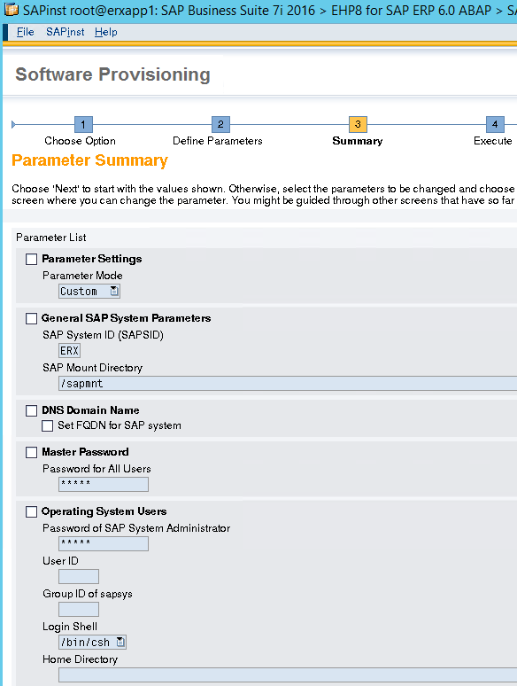
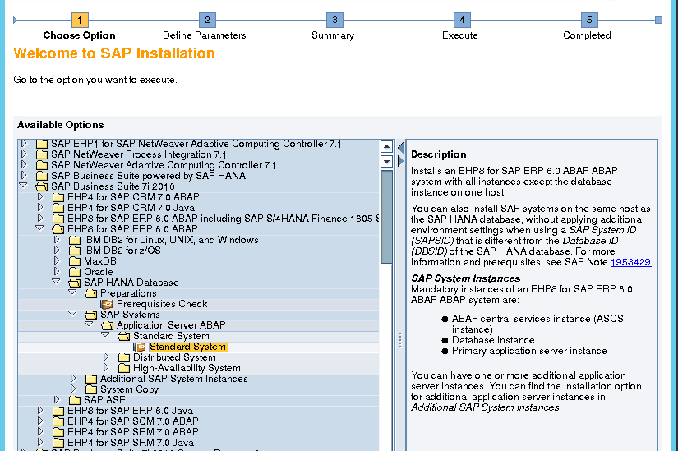
SAPInst sample steps
Stop your interaction with SAPinst at the Summary screen and go copy the inifile.xml file from your SAP installation directory by default is at \tmp\sapinst_instdir and drop it in your silent install directory. Then terminate SAPinst and ensure it completely exit

Slide 19
Sample inifile.xml
<?xml version="1.0" encoding="UTF-8" standalone="no"?>
<?xml-stylesheet type="text/xsl" href="keydb.xsl" ?>
<!DOCTYPE tables SYSTEM "keydb.dtd" >
<!-- Installation service 'SAP Business Suite 7i 2016 > EHP8 for SAP ERP 6.0 ABAP > SAP HANA Database > SAP Systems > Application Server ABAP > Standard System > Standard System', product id 'NW_ABAP_OneHost:BS2016.ERP608.HDB.PD' -->
<tables>
<tableset srcid="created_by_controler">
<table name="INIFILE_MANAGER" namespaces="INFILE_MANAGER_NS">
<columns>
<column name="CONFIG">
</column>
</columns>
</table>
<table name="-NW_ABAP_OneHost-ind-ind-ind-ind-0-0-NW_First_Steps-ind-ind-ind-ind-firstSteps-0-Preinstall-ind-ind-ind-ind-Preinstall-0" namespaces="INIFILE_PARAMETER">
<columns>
<column name="installationMode">
<defaultproperties>
<property name="SAPINST_ORIGINAL_TABLE_NAME" value="t_pre"/>
</defaultproperties>

Slide 20
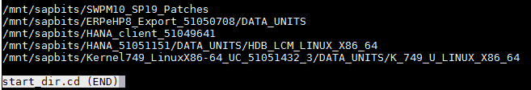
Create the Start_dir.cd file
Start_dir.cd file lists the paths to the SAP installation media (install DVDs)

Slide 21
Install execution
This is done via a Linux shell script
Change directory to the install dir you created
Execute SAPinst with variables:
SAPINST_PARAMETER_CONTAINER_URL=inifile.xml
SAPINST_EXECUTE_PRODUCT_ID (found in inifile.xml)
SAPINST_SKIP_DIALOGS=true
-nogui
-noguiserver

Slide 22
Installation runtime
Greatly depends on the storage layout. Stripe your /hana/shared, /hana/data, and /hana/logs
For application installs, keep media on VM attached data disks
In our runs, HDB installation ran for 20 min. ERP6 eHP8 installation ran around 4-5 hours.

