Slide 1
AzureFoundation Identity Pattern
Speaker

Slide 2
AzureFoundation Value Proposition
Billing Structure for categorizing cloud computing spending across the enterprise.
Account Structure for separating managed and sandbox workloads
Security structure to help secure Application Lifecycle Management roles.
Identity services, which will give a foundation for establishing robust applications in the cloud, including Office365 single sign-on.

Slide 3
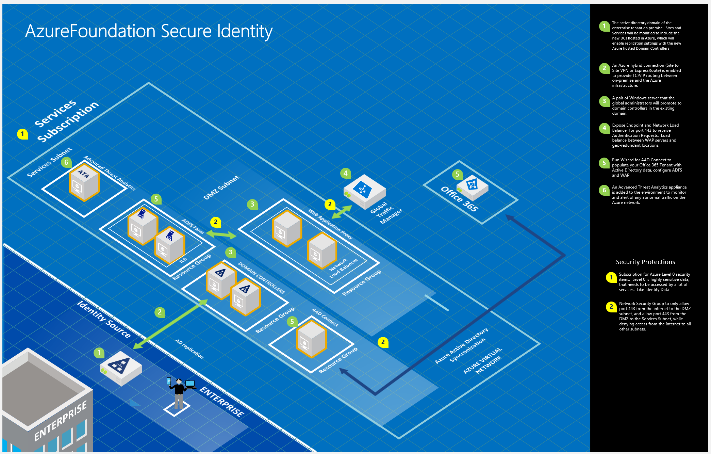

Slide 4

Summary
A secure copy of an agency’s Active Directory environment in the Azure cloud.
Enable single sign-on (SSO) for agency users to O365 and other Modern SaaS
Azure Services Partner can deploy in 2 Weeks using defined pattern based on Meta Data captured in interviews.
Operations Management Suite will be used on each VM for operational excellence.
The Active Directory environment in Azure will enable other IaaS servers to be added.
A secure design for highly sensitive data (users and passwords) that must be accessed by every user and system that isn’t accessed anonymously.
Foundational elements of your Azure network environment could be bolted on

Slide 5
Overview of Azure Services

Slide 6
AzureFoundation Identity Service
The AzureFoundation is a prescribed implementation of Azure tailored to the enterprise customer.
The services required to deploy the pattern can be performed by the enterprise or a qualified Microsoft partner.
The services expected:
Setting up billing and department controls
Setting up subscriptions and organizational separation of duties
Setting up hybrid network connection and an enterprise network deployment
Assisting in the configuration of Active Directory and AAD Connect to work with O365
Documentation and Knowledge transfer of how to support the configuration

Slide 7
Summary of Azure Services
AzureFoundation Identity Pattern
Service type | Custom name | Region | Description | SKU | Estimated Cost
Virtual Machines | Virtual Machines for Identity Pattern | US Gov Iowa | 8 Standard virtual machine(s), A2 (2 cores, 3.5 GB RAM, 135 GB disk, $0.166/hr) size: 744 hours | N7H-02629 | $988.03
VPN Gateway | VPN Gateway | US Gov Iowa | standard tier, 744 gateway hour(s), 1000 GB outbound vpn | N7H-04005, Q5H-00025 | $287.56
Storage | DR Backups | US Gov Iowa | 1500 GB storage Page Blob and Disk type. Basic tier, LRS redundancy, 100 x100,000 transactions | N9H-00114, N9H-00803 | $92.31
OMS | Monitoring, Backup, and Site Recovery | US Gov Iowa | 8 instance(s) of Operations Management Suite | 7U9-00008, 7U9-00003 | $248.00
Support |  |  | Free level | Support | $0.00
 |  |  |  | Monthly Total | $1,615.90
 |  |  |  | Annual Total | $19,390.82
Disclaimer
All prices shown are in US Dollar ($). This is a summary estimate, not a quote. For up to date pricing information please visit https://azure.microsoft.com/pricing/calculator/channel/
MICROSOFT CONFIDENTIAL - SUBJECT TO NON-DISCLOSURE AGREEMENT NOTICE AND DISCLAIMER Prices and other terms of purchase are controlled by the agreement you enter with Microsoft, not this document. While we strive for accuracy the content is believed to be accurate as of the date of listed above, this information is subject to change at any time without Notice and should not be interpreted to be a commitment, guarantee, or offer by Microsoft. MICROSOFT MAKES NO WARRANTIES, EXPRESS, IMPLIED OR STATUTORY, AS TO THE INFORMATION IN THIS DOCUMENT
If you would like to share this information externally, please copy and paste only the necessary content into a customer ready presentations or models.
This estimate was created at 11/15/2016 5:37:15 PM UTC for willst@microsoft.com.

Slide 8
General Assumptions
Operational Costs include Azure Site Recovery, Azure Backup, Operations Management Suite
Add 10% to host a preproduction environment
There are MSDN subscriptions for Preproduction work, no server licenses were considered for preproduction.
No Oracle licenses were considered in the estimate.
Locally Redundant Page Block Storage per VM, 127GB for OS drive, 50GB for Data
Services Subscription will have VPN connections to other foundational subscriptions
No services were considered to implement the environment. It should be expected that the deployment, documentation and knowledge transfer of services should be two weeks.
The estimates included are for budgetary purposes only and reflect pricing at a point in time.
Final pricing will come from the License Reseller (LAR), SHI.

