Slide 1
Connectivity modes

Slide 2
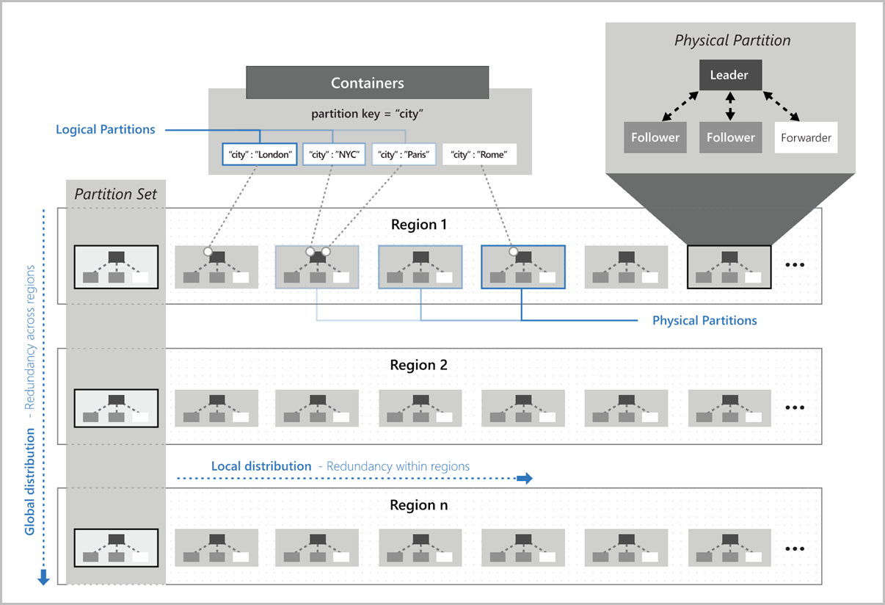

Slide 3


Topology
Routing
Consistency
Gateway
Replicas
REST API
R
R
R
R

Slide 4
Connectivity mode - Gateway
Gateway
Replicas
REST API
R
HTTP
TCP
R
R
R

Slide 5
Connectivity mode - Direct
Replicas
R
TCP
R
R
R

Slide 6
What’s the difference?
Gateway
Direct
HTTP protocol
Compatible with enterprise environment with proxies or hard network rules.
Single port (443) and known domains.
Less number of connections.
Higher latency due to extra network hop
TCP protocol
SLA-backed low latency
Higher port range
Higher number of connections
Notes:
https://docs.microsoft.com/en-us/azure/cosmos-db/sql-sdk-connection-modes

Slide 7
P 1
R
R
R
R
Op
P 2
R
R
R
R

Slide 8
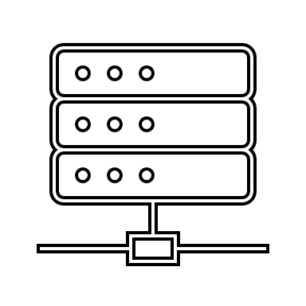
P 1
Gateway
R
HTTP
R
Account info
Container info
Routing info
R
R
Op
P 2
R
R
R
R

Slide 9
P 1
Gateway
R
R
TCP
Account info
Container info
Routing info
R
R
Op
P 2
Cache
R
R
R
R

Slide 10
P 1
R
R
TCP
R
R
Op
P 2
Cache
R
R
R
R

Slide 11
P 1
R
R
TCP
R
R
Op
P 2
Cache
R
TCP
R
R
R

Slide 12
When things don’t go as planned

Slide 13
Diagnostics
.NET
try
{
ItemResponse<MyItem> response = await container.ReadItemAsync<MyItem>(
partitionKey: new PartitionKey("MyPartitionKey"),
id: "MyId");
string diagnostics = response.Diagnostics.ToString();
TimeSpan elapsedTime = response.Diagnostics.GetElapsedTime();
IReadOnlyList<(string region, Uri uri)> regions = response.Diagnostics.GetContactedRegions();
}
catch (CosmosException cosmosException) {
string diagnostics = cosmosException.Diagnostics.ToString();
TimeSpan elapsedTime = cosmosException.Diagnostics.GetElapsedTime();
IReadOnlyList<(string region, Uri uri)> regions = cosmosException.Diagnostics.GetContactedRegions();
Console.WriteLine(cosmosException.ToString());
}
Both Java and .NET expose diagnostic information.
Includes all service interactions, time spent on the SDK (serialization or initialization), server side latency, and connectivity troubleshooting.

Slide 14
Diagnostics
Java
try
{
CosmosItemResponse<MyObject> createResponse = container.createItem(myObject);
String diagnostics = createResponse.getDiagnostics().toString();
Duration elapsedTime = createResponse.getDiagnostics().getDuration();
Set<URI> regions = createResponse.getDiagnostics().getRegionsContacted();
}
catch (CosmosException cosmosException) {
String diagnostics = cosmosException.getDiagnostics().toString();
Duration elapsedTime = cosmosException.getDiagnostics().getDuration();
Set<URI> regions = cosmosException.getDiagnostics().getRegionsContacted();
string asString = cosmosException.toString();
}
Both Java and .NET expose diagnostic information.
Includes all service interactions, time spent on the SDK (serialization or initialization), server side latency, and connectivity troubleshooting.

Slide 15
On the client

Slide 16
High latency – cold start
Gateway
R
Account info
Container info
Routing info
TCP
R
R
Op
R
Cache

Slide 17
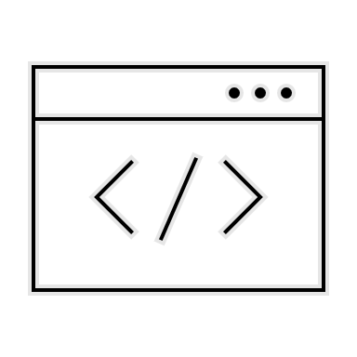

High latency – regional preference
Region 1
Region 2

Slide 18

High latency – regional preference
Region 1
Region 2

Slide 19
High latency – regional preference
{
"name": "Microsoft.Azure.Documents.ServerStoreModel Transport Request",
"id": "0e026cca-15d3-4cf6-bb07-48be02e1e82e",
"start time": "12: 58: 20: 032",
"duration in milliseconds": 1638.5957
}

Slide 20
Regional preference
.NET
CosmosClientOptions options = new CosmosClientOptions() {
ApplicationName = “MyApp”,
ApplicationRegion = Regions.WestUS
};
CosmosClient client = new CosmosClient(“endpoint”, “key”, options);
CosmosClientOptions options = new CosmosClientOptions() {
ApplicationName = “MyApp”,
ApplicationPreferredRegions = new List<string>() {
Regions.WestUS,
Regions.CentralUS
}
};
CosmosClient client = new CosmosClient(“endpoint”, “key”, options);
Both Java and .NET SDKs allow the user to set regional preference upon initialization.
Particularly in .NET, there is an API to indicate on which Azure region the app is running on.

Slide 21
Regional preference
Java
Both Java and .NET SDKs allow the user to set regional preference upon initialization.
Particularly in .NET, there is an API to indicate on which Azure region the app is running on.
CosmosAsyncClient client = new CosmosClientBuilder()
.key(“key”)
.endpoint(“endpoint”)
.userAgentSuffix("MyApp")
.preferredRegions(Collections.singletonList("West US", "East US")) .buildAsyncClient();

Slide 22
High latency – retries
HTTP 429
Op
HTTP 429
HTTP 200

Slide 23
High latency – retries
[
{
"ResponseTimeUTC": "2021-05-10T20:20:04.3221389Z",
"ResourceType": "Document",
"OperationType": "Read",
"LocationEndpoint": "https://myaccount.documents.azure.com/",
"StoreResult": {
"ActivityId": "d0e640ee-553b-4c3b-ae31-752d947a0b3b",
"StatusCode": "TooManyRequests",
"BELatencyInMs": null
}
},
{
"ResponseTimeUTC": "2021-05-10T20:20:04.3221389Z",
"ResourceType": "Document",
"OperationType": "Read",
"LocationEndpoint": "https://myaccount.documents.azure.com/",
"StoreResult": {
"ActivityId": "d0e640ee-553b-4c3b-ae31-752d947a0b3b",
"StatusCode": "Ok",
"BELatencyInMs": "0.513"
}
}
]

Slide 24

Timeouts
Gateway
HTTP
R
TCP
R
R
R

Slide 25
Timeouts
Gateway
X
HTTP
R
X
TCP
R
R
R

Slide 26
Timeouts – common client issues
CPU
Connection limiting
Notes:
https://docs.microsoft.com/en-us/azure/cosmos-db/troubleshoot-dot-net-sdk-request-timeout#troubleshooting-steps

Slide 27
Timeouts – common client issues (CPU)
CPU history:
(2021-05-21T00:40:09.1769900Z 60.114),
(2021-05-21T00:40:19.1763818Z 60.732),
(2021-05-21T00:40:29.1759235Z 70.000),
(2021-05-21T00:40:39.1763208Z 100.063),
(2021-05-21T00:40:49.1767057Z 100.648),
(2021-05-21T00:40:59.1689401Z 100.137),
CPU count: 8)
High CPU
CPU history:
(2021-05-21T00:40:09.1769900Z 5.231),
(2021-05-21T00:40:59.1763818Z 6.721),
(2021-05-21T00:41:16.1759235Z 4.000),
(2021-05-21T00:41:26.1763208Z 17.063),
(2021-05-21T00:41:48.1767057Z 10.648),
(2021-05-21T00:42:03.1689401Z 5.137),
CPU count: 8)
Thread Starvation
Notes:
https://docs.microsoft.com/en-us/azure/cosmos-db/troubleshoot-dot-net-sdk-request-timeout#troubleshooting-steps

Slide 28
Timeouts – common client issues (connection)
{
"ResponseTimeUTC": "2021-05-10T20:20:04.3221389Z",
"ResourceType": "Document",
"OperationType": "Read",
"LocationEndpoint": "https://myaccount.documents.azure.com/",
"StoreResult": {
"ActivityId": "d0e640ee-553b-4c3b-ae31-752d947a0b3b",
"StatusCode": "Gone",
"BELatencyInMs": null,
"TransportException": "A client transport error occurred: The connection attempt timed out. (Time: 2021-05-10T20:20:04.3221389Z, activity ID: d0e640ee-553b-4c3b-ae31-752d947a0b3b, error code: ConnectTimeout [0x0006], base error: HRESULT 0x80131500, URI: rntbd://<somevalue>.documents.azure.com:14155/, connection: <not connected> -> rntbd://<somevalue>.documents.azure.com:14155/, payload sent: False, CPU history: (2021-05-10T20:18:56.4258031Z 0.000), (2021-05-10T20:19:06.4265621Z 0.000), (2021-05-10T20:19:16.4295823Z 0.000), (2021-05-10T20:19:26.4279937Z 0.000), (2021-05-10T20:19:46.4240876Z 0.000), (2021-05-10T20:19:56.4208742Z 0.000), CPU count: 4)"
}
}
Notes:
https://docs.microsoft.com/en-us/azure/cosmos-db/troubleshoot-dot-net-sdk-request-timeout#troubleshooting-steps

Slide 29
Timeouts – common client issues (connection)
Client as a Singleton – one instance reused across the entire application lifetime.
Connection limit on the instance – different Azure services might have limits in terms of maximum established connections.
Use Gateway mode – if the environment has a low connection limit, like Azure Functions on Consumption Plane.
Customize TCP configurations for sporadic loads:
CosmosClientOptions.PortReuseMode = PrivatePortPool
CosmosClientOptions.IdleConnectionTimeout = TimeSpan.FromMinutes(30)
Client as a Singleton.
Notes:
https://docs.microsoft.com/en-us/azure/cosmos-db/troubleshoot-dot-net-sdk-request-timeout#troubleshooting-steps

Slide 30
On the service

Slide 31
High latency – service side latency
{
"ResponseTimeUTC": "2021-05-21T20:20:04.3221389Z",
"ResourceType": "Document",
"OperationType": "Read",
"LocationEndpoint": "https://myaccount.documents.azure.com/",
"StoreResult": {
"ActivityId": "d0e640ee-553b-4c7b-ae31-752d947a0b3b",
"StatusCode": "Ok",
"IsValid": true,
"RequestCharge": 1,
"BELatencyInMs": "300.366"
}
}
Notes:
https://docs.microsoft.com/en-us/azure/cosmos-db/monitor-server-side-latency

Slide 32
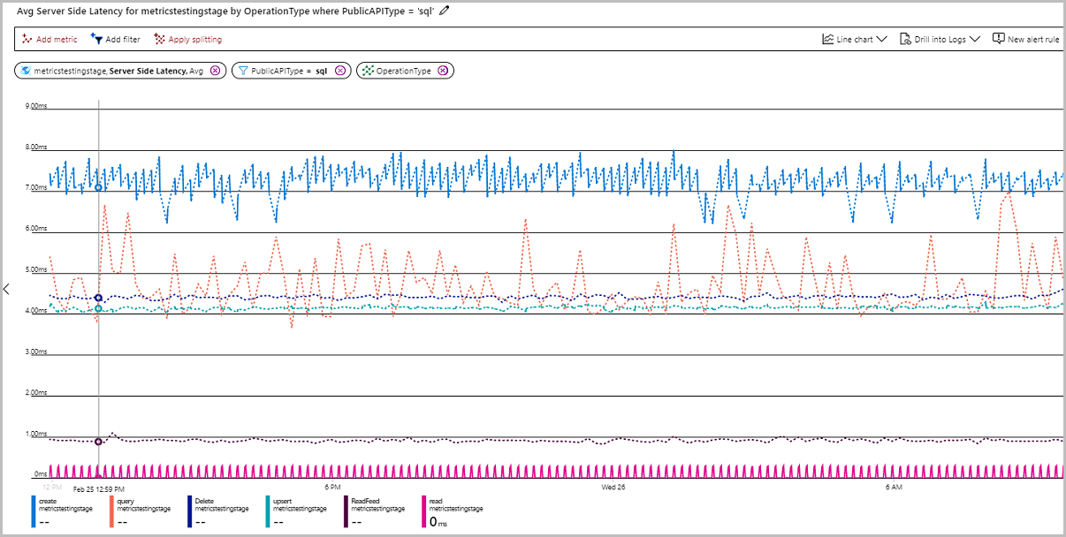
High latency – service side latency
Notes:
https://docs.microsoft.com/en-us/azure/cosmos-db/monitor-server-side-latency

Slide 33
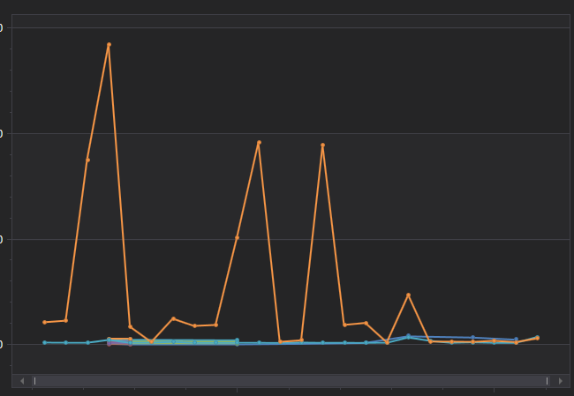
Timeouts – service side latency
Timeout
Notes:
https://docs.microsoft.com/en-us/azure/cosmos-db/monitor-server-side-latency

Slide 34
RequestTimeout
.NET
CosmosClientOptions options = new CosmosClientOptions() {
ApplicationName = “MyApp”,
RequestTimeout = TimeSpan.FromSeconds(20)
};
CosmosClient client = new CosmosClient(“endpoint”, “key”, options);
// Definir un tiempo maximo para la operacion incluyendo reintentos
CancellationTokenSource = cancellationTokenSource = new CancellationTokenSource(20000);
ItemResponse<MyItem> response = await container.ReadItemAsync<MyItem>(
partitionKey: new PartitionKey("MyPartitionKey"),
id: "MyId",
cancellationToken: cancellationTokenSource.Token);
The SDKs expose ways to define request and operation level timeouts.
Request level timeouts do not cover retries
Notes:
https://docs.microsoft.com/en-us/azure/cosmos-db/troubleshoot-dot-net-sdk-request-timeout

Slide 35
Common error responses
StatusCode | Meaning | Retry?
400 | Invalid content https://aka.ms/CosmosDB/sql/errors/wrong-pk-value https://aka.ms/CosmosDB/sql/errors/missing-id | No
401 | Invalid auth. https://aka.ms/cosmosdb-tsg-mac-signature | No
403 | Blocked by Access control. https://aka.ms/cosmosdb-tsg-forbidden | Maybe.
404 | Resource does not exist. https://aka.ms/cosmosdb-tsg-not-found | No
408 | Timeout https://aka.ms/cosmosdb-tsg-request-timeout https://aka.ms/cosmosdb-tsg-request-timeout-java | For reads, the SDK already retries, but further retries are valid. For writes, the operation is idempotent, retry can cause 409.

Slide 36
Common error responses
StatusCode | Meaning | Retry?
409 | Conflict | No
412 | Optimistic concurrency. | Yes. Requires a read to get a new Etag, apply update, and retry.
413 | Max document size reached | No.
429 | Throttling | Yes. SDKs already retry.
449 | RetryAfter. Múltiples operaciones de escritura sobre el mismo recurso. | Yes.
500 | Internal server error. | Maybe, 1 retry.
503 | Service Unavailable. Multiple timeouts on TCP layer, the client cannot connect. https://aka.ms/cosmosdb-tsg-service-unavailable https://aka.ms/cosmosdb-tsg-service-unavailable-java | Similar to timeouts.

Slide 37
Availability during regional failures
Notes:
https://docs.microsoft.com/azure/cosmos-db/troubleshoot-sdk-availability

Slide 38
Removing a region
A
B
Preference:
Region A
Region C
Region B
C

Slide 39
Removing a region
X
X
A
HTTP 403 – Sub status 1008
B
Preference:
Region A
Region C
Region B
C

Slide 40
Removing a region
X
X
A
DNS
B
Preference:
Region A
Region C
Region B
C

Slide 41
Removing a region
X
X
A
B
Preference:
Region A
Region C
Region B
C
Gateway

Slide 42
Removing a region
X
A
B
Preference:
Region A
Region C
Region B
C

Slide 43


Adding a region
A
B
Preference:
Region A
Region C
Region B
C

Slide 44
Adding a region
A
B
Preference:
Region A
Region C
Region B
C

Slide 45
Adding a region
A
B
Preference:
Region A
Region C
Region B
C

Slide 46
Adding a region
HTTP 403 – Sub status 3
X
A
B
Preference:
Region A
Region C
Region B
C

Slide 47
Failover of write region
X
A
B
Preference:
Region A
Region C
Region B
C

Slide 48
Failover of write region
A
B
Preference:
Region A
Region C
Region B
C

Slide 49
Session consistency
A
B
Preference:
Region A
Region C
Region B
C

Slide 50
Session consistency
TR 1
A
SessionToken 2
TR 2
B
Preference:
Region A
Region C
Region B
C

Slide 51
Session consistency
SessionToken 2
TR 1
A
SessionToken 2
TR 2
B
Preference:
Region A
Region C
Region B
C

Slide 52
Session consistency
HTTP 404 – Sub status 1002
TR 1
X
A
SessionToken 2
TR 2
B
Preferencia:
Región A
Región C
Región B
C

Slide 53
Session consistency
TR 1
X
A
SessionToken 2
TR 2
B
Preference:
Region A
Region C
Region B
C

Slide 54
Temporary connectivity problems (HTTP 503)
#1
X
A
#2
HTTP 503
B
Preference:
Region A
Region C
Region B
C

Slide 55
Temporary connectivity problems (HTTP 503)
A
#2
B
Preference:
Region A
Region C
Region B
C

Slide 56
Temporary connectivity problems (HTTP 503)
A
#3
B
Preference:
Region A
Region C
Region B
C

Slide 57

Conclusion
Use the client as Singleton
Define regional preference when initializing the client
There could always be timeouts, define retry strategy.
Capture Diagnostics on errors and/or high latency requests.
Review expected behavior during regional unavailability.

Slide 58
Conclusion
Usar el cliente como Singleton
Definir Preferencia Regional al inicializar el cliente
Tener en cuenta que siempre puede haber timeouts y definir estrategias de reintentos si es necesario
Capturar los Diagnostics en errores y/o en casos donde la latencia sea superior a algun umbral
Entender como se comporta el cliente ante fallas regionals.

