Slide 1

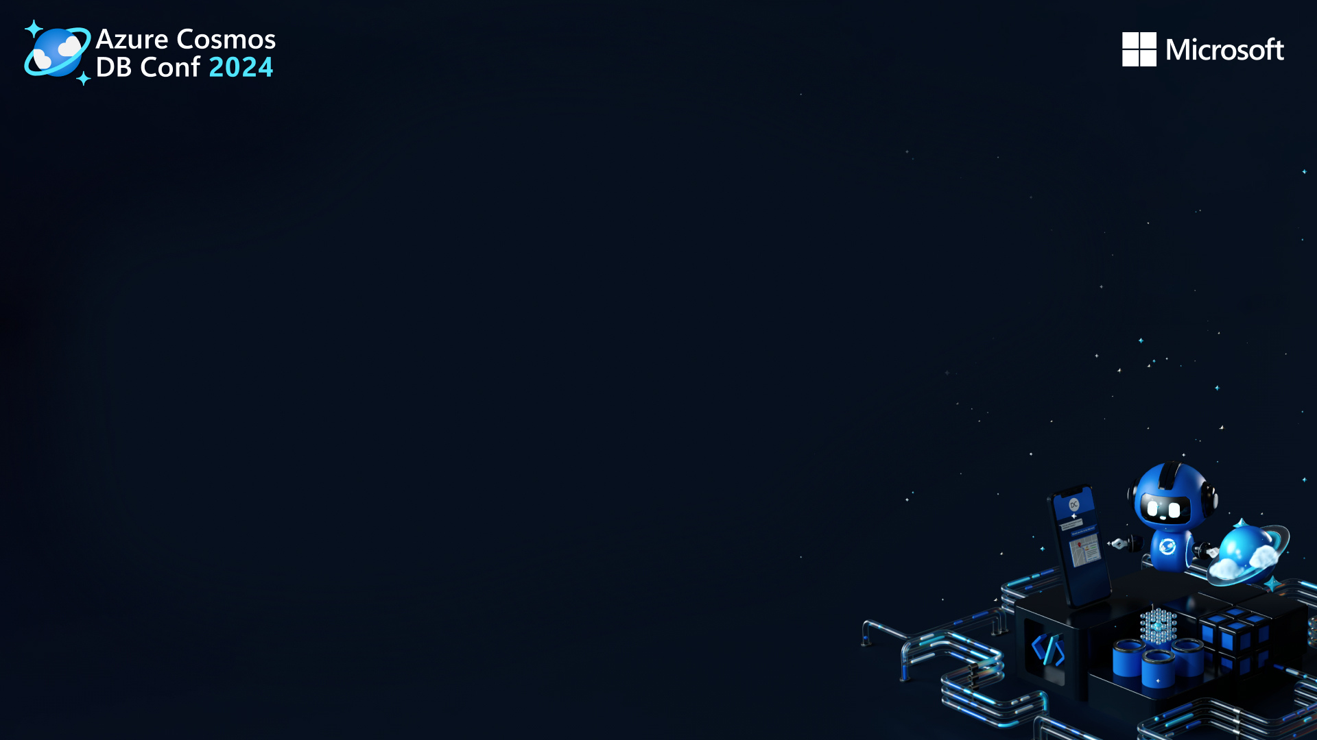
Building Intelligent Data Analysis Applications with OpenAI's LLMs and Azure Cosmos DB
Classified as Microsoft Confidential

Slide 2
I’m Farah Abdou
Machine Learning Engineer
Specialized in NLP, LLM and Building Chatbots Experienced in developing end-to-end machine learning pipelines, from data preprocessing to model deployment.
Specialize in developing cutting-edge solutions in Machine Learning and Natural Language Processing that seamlessly integrate advanced technologies.
Classified as Microsoft Confidential

Slide 3
Understanding the Power of Language Models in Data Analysis
1
Uncover Insights
2
Enhance Understanding
3
Enable Automation
Language models can provide valuable insights by analyzing unstructured data and identifying patterns and trends that may not be immediately apparent.
By processing and interpreting natural language, these models can enhance the understanding of textual data, enabling more accurate and efficient analysis.
Language models can automate repetitive tasks such as summarizing large volumes of text, freeing up valuable time for more strategic analysis.
Classified as Microsoft Confidential

Slide 4
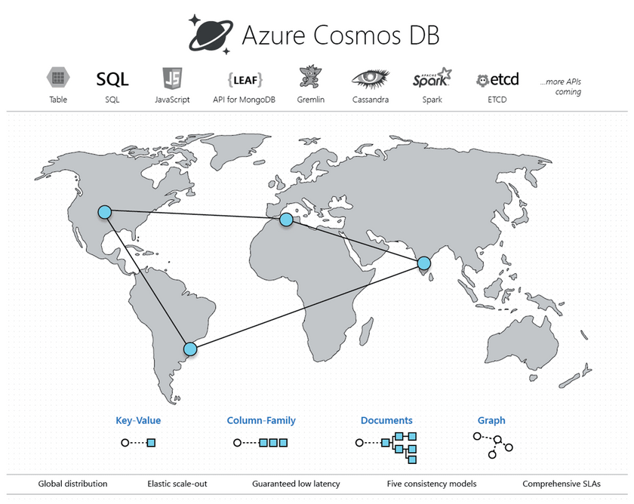
Overview of Azure Cosmos DB and Its Capabilities
Global Distribution
Azure Cosmos DB offers global distribution, providing low-latency access to data for users across the globe.
Multi-Model Database
Scalability
It is a multi-model database service, supporting document, key-value, graph, and column-family data models.
With elastic scalability, Azure Cosmos DB allows you to scale storage and throughput independently, providing flexibility for evolving data needs.
Classified as Microsoft Confidential

Slide 5
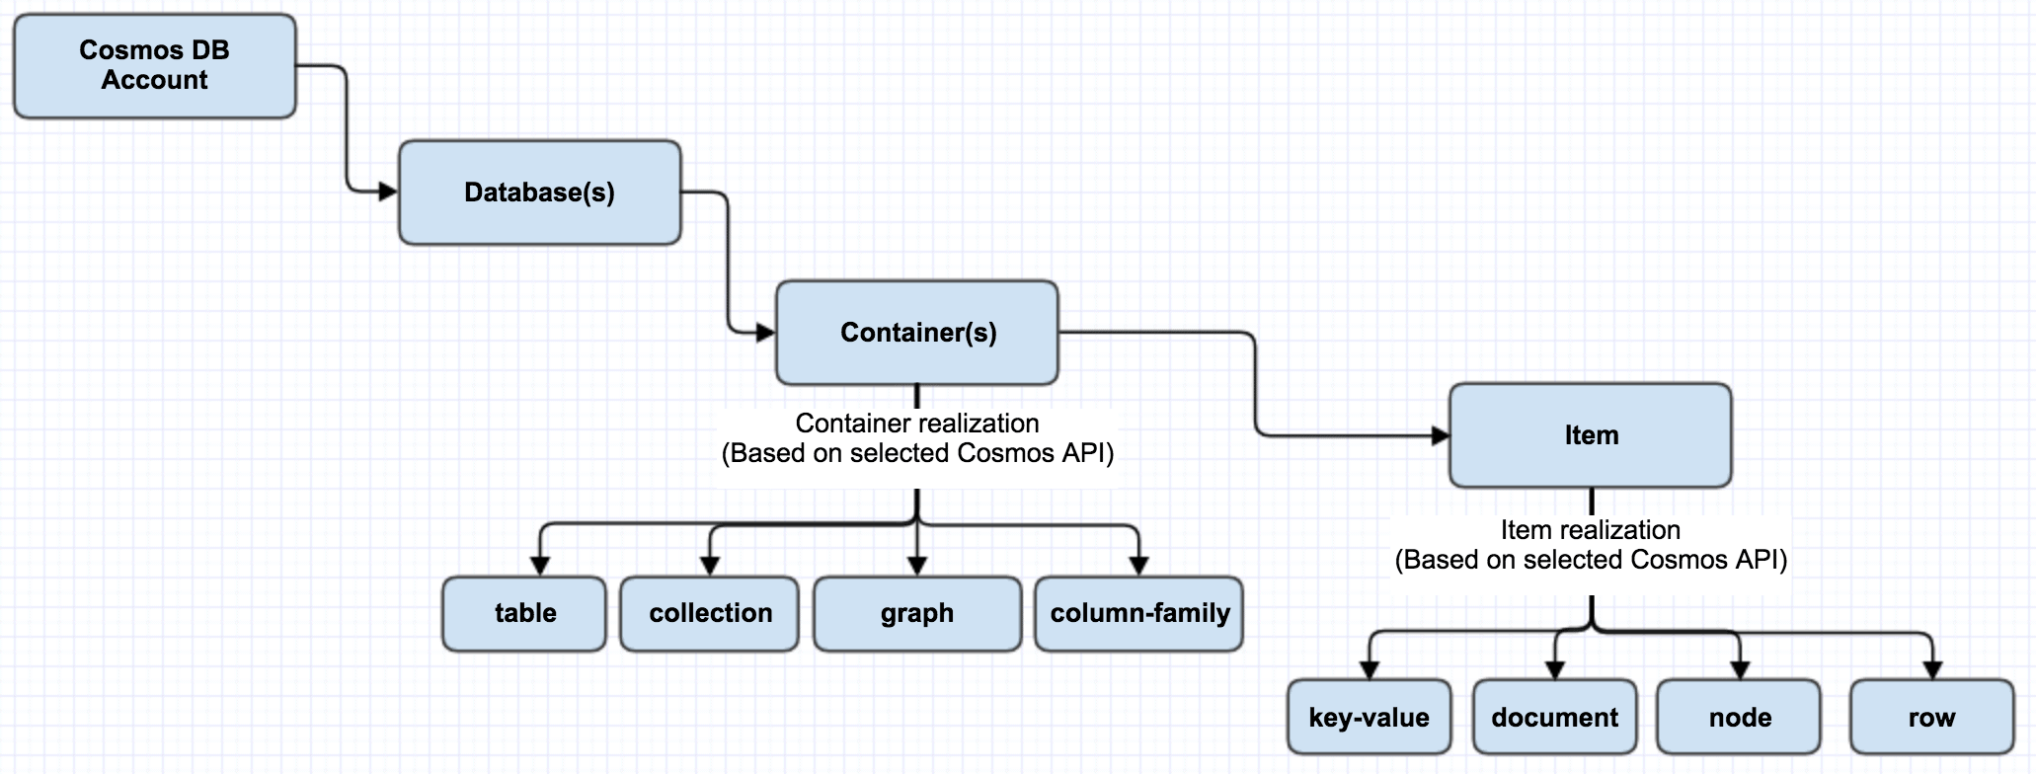
Classified as Microsoft Confidential

Slide 6

Building a Data Analysis Application Using OpenAI's LLMs and Azure Cosmos DB
1
Identify the specific use case for the data analysis application and the insights required.
DEFINE USE CASE
2
Integrate OpenAI's LLMs with Azure Cosmos DB to access and process relevant data.
DEVELOP INTEGRATION
3
Create an intuitive and user-friendly interface for accessing and visualizing the analyzed data.
DESIGN USER INTERFACE
4
Incorporate automation features to streamline data analysis processes and reporting
IMPLEMENT AUTOMATION
Classified as Microsoft Confidential

Slide 7
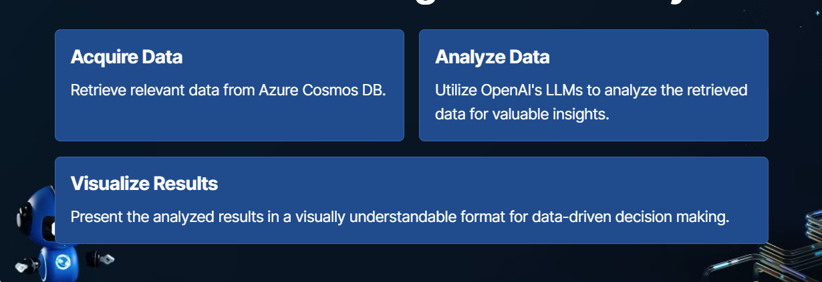
What will we do in this session?
Integrating OpenAI's LLMs with Azure Cosmos DB for Intelligent Data Analysis
Classified as Microsoft Confidential

Slide 8
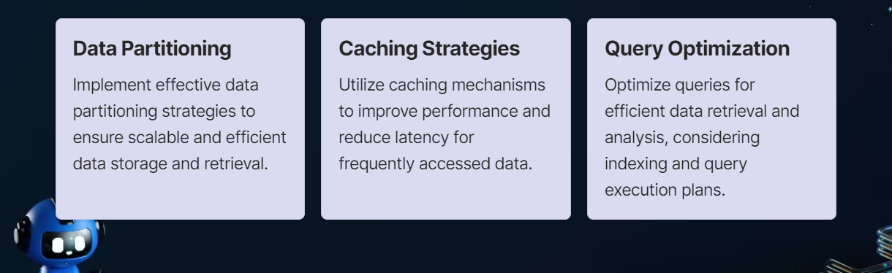
Best Practices for Optimizing Performance and Scalability
Classified as Microsoft Confidential

Slide 9
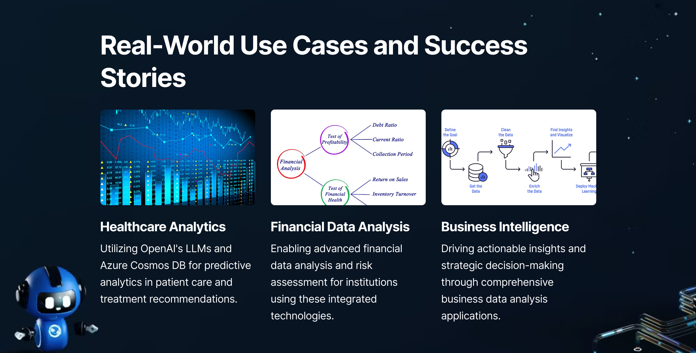

Slide 10
Demo
Classified as Microsoft Confidential

