Slide 1
Build & Modernize AI Applications
Vector Search & AI Assistant Solution Walk Through
https://github.com/Azure/Build-Modern-AI-Apps
Notes:
Hello. Today I’m going to walk you through the Vector Search & AI Assistant solution accelerator we created as part of the Build & Modernize AI Applications solutions for Microsoft.
The source code for what you are about to see is available for you to download. You can use this to explore the concepts for building AI Applications in Azure. You can also take this code to use as a starting point to build your own Proof of Concept. You can also use it to simply demo the application itself and see how it works.
This solution is available at github.com/azure/build-modern-ai-apps

Slide 2
Data Copilot
Technologies
Azure OpenAI Service
Semantic Kernel
Azure Cosmos DB
Azure Cognitive Search
Azure Container Apps or Azure Kubernetes Service
is a broad term used to describe technological solutions using GPT Large Language Models that enable users to query, analyze, summarize and reason about their data using natural language in a chat like interface. The data integrated can range in shape from frequently changing, structured transactional data to infrequently changing unstructured data and in volumes from small to large.
Notes:
This type of solution we’re going to explore today is what we call a Data Copilot.
Data Copilot is a somewhat broad term. In short what it describes is the ability for users to ask natural language questions from Large Language Models such as GPT with their own enterprise data enrich the response.
The data used here can be anything from text documents to images to transactional data in a database. The underlying pattern for this is called Retrieval Augmented Generation or RAG Pattern. The extra data sent to GPT along with the users’ question and even prior questions and responses, enriches GPT’s ability to generate a response or completion to the user.

Slide 3
RAG Pattern
Retrieval Augmented Generation (RAG)
Intelligently retrieve a subset of data from data stores to provide specific, contextual knowledge to the large language model to support how it answers a user’s prompt.
Notes:
RAG Pattern or Retrieval Augmented Generation is essentially a fancy way of saying we’re going to add some contextually relevant data to a user prompt to use in a generated response. For our solution we are going to employ a different method of indexing and search called a vector search that is based upon something called, embeddings.

Slide 4
What are embeddings?
Embeddings are a technique for representing words or data as vectors in a high-dimensional space, allowing us to measure their relatedness.
In AI models, embeddings help computers understand the meaning and context of words or data. To use embeddings, the text is transformed into vectors, and a search query is converted into its vector representation to find similar vectors. This process resembles searching on a search engine, providing ranked matches based on similarity.
Azure OpenAI embeddings utilize cosine similarity, measuring the angle between vectors in a multi-dimensional space, even when documents are far apart by Euclidean distance.
Notes:
Before we go much further it’s important to explain what embeddings are.
Embeddings are a method of representing words or data as vectors in a high-dimensional space. Vectors are mathematical entities that resemble arrows, having both direction and length. In this context, highly-dimensional means that the space has numerous dimensions beyond what we can perceive. Embeddings aim to assign similar words or data with similar vectors, while different words or data are assigned different vectors. This allows us to measure the relatedness or unrelatedness of words or data. Embeddings are particularly valuable for AI models as they enable computers to comprehend and process the meaning and context of words or data. In fact, they are at the heart of AI models like GPT and are how they decipher what you are asking and how to respond.
To utilize embeddings, a sentence, paragraph, or page of text is transformed into an embedding vector. When a search query is conducted or more specifically, a vector search, the natural language text of that query is converted into its corresponding embedding representation. Then, a search is performed among the existing embedding vectors to find the most similar ones.
This process resembles making a search query on a search engine, which provides multiple results that are closely related to the query. Semantic memory may not yield an exact match, but it will always provide a set of matches ranked based on how similar the query is to other text pieces.
Azure OpenAI embeddings employ cosine similarity to calculate the similarity between documents and a query. Cosine similarity measures the cosine of the angle between two vectors projected in a multi-dimensional space. This approach is advantageous because even if two documents are far apart in terms of Euclidean distance due to their size, they may still exhibit a smaller angle between them, resulting in higher cosine similarity.

Slide 5
Scenario
The scenario centers around a consumer retail "Intelligent Agent" that allows users to ask questions on vectorized product, customer and sales order data stored in a database. The data in this solution is the Cosmic Works sample for Azure Cosmos DB. This data is an adapted subset of the Adventure Works 2017 dataset for a retail Bike Shop that sells bicycles, biking accessories, components and clothing.
BUT you can bring your own data instead.
Notes:
The scenario our solution presents is one of a retailer that sells bikes and accessories. The data for this is adapted from the classic SQL Server, Adventure Works 2017 dataset.
We used this dataset because it is simple to use and allows us to explain the key concepts for building this type of solution so you can go do this for yourself, using your own data.

Slide 6
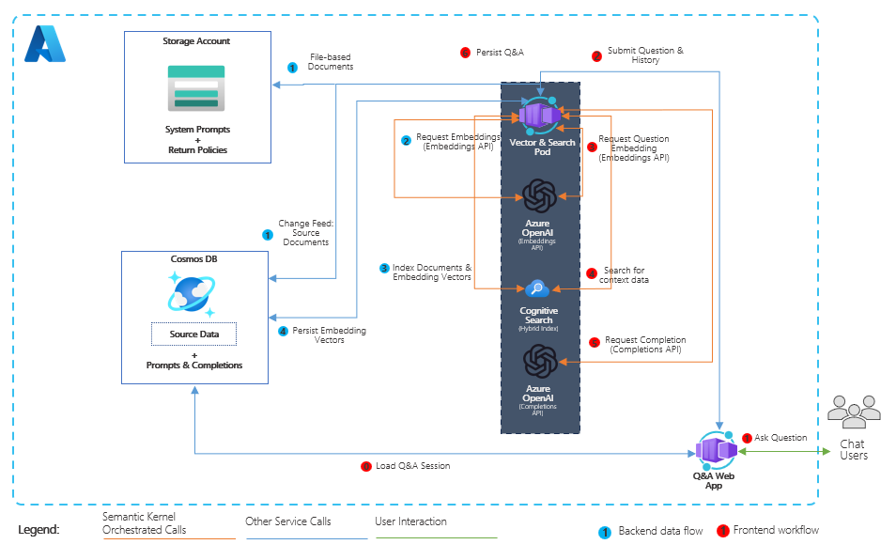
Reference Architecture
Notes:
Let’s take a look at the architecture diagram for our solution.
On the left-hand side is our database. We are using Azure Cosmos DB for NoSQL. This stores all the data for our solution including the retail bike shop data for products, customers and sales orders. It also critically stores all of the user prompts (or questions from users) AND the completions (or responses from OpenAI).
We also have Azure Storage. This stores all the files we use in this solution. Most notably our system prompts as well as our return and shipping policies.
In the middle is the service layer. This includes the containers for our Web application and services. Azure OpenAI which generates vectors on data and queries and generates responses.
Azure Cognitive Search indexes the vectorized and JSON data stored in Cosmos DB and provides both vector and semantic search capabilities on top of it.
Although Azure Cognitive Search is is technically a data service, we’ve included it here in the middle-service layer because much of the orchestration with Semantic Kernel happens in this service layer.
On the right is our Web UX which is a simple chat application built as an ASP.NET Blazor Server application.

Slide 7
Where to Start
github.com/Azure/Build-Modern-AI-Apps
Notes:
Where to Start (Slide 7)
Let’s me take you to the repository where this solution sits.
[Stop Presenting slide show, go to repo home page]
To get started you can go to our GitHub repository github.com/Azure/Build-Modern-AI-Apps.
In addition to the solution, this page has other solutions including Payment and Transaction Processing and Medical Claims.
There are also hackathons we have developed for these solutions that you and your teams can use to develop your skills building these applications.
This page also includes links to the Intelligent App Workshop created by our Apps GBB team and is a great resource for learning even more.
[Scroll back up to Vector Search and AI Assistant link]
Clicking on the link for the Vector Search and AI Assistant will take you to the repository where this solution lives and includes all the information you need including an introduction to the concepts we will cover in this session as well as how to deploy and run the solution.

Slide 8
Sample PowerShell install command
./scripts/Unified-Deploy.ps1 -resourceGroup <rg> `
-location <location> `
-subscription <subscription id> `
-openAiName <open ai account> `
-openAiRg <open ai resource group> `
-openAiCompletionsDeployment <completions model> `
-openAiEmbeddingsDeployment <embeddings model>
-openAiEmbeddingsDeployment <embeddings model> `
-deployAks 1
Notes:
You can deploy this solution in three different ways. You can deploy from Cloud Shell if you are simply looking to set this up as a demo. You can also deploy this and run from a VM in Azure or you can do a Standard deployment to deploy into Azure and run in debug on your local machine.
By default, the script will create a new Azure OpenAI account and deploy two models GPT 3.5 Turbo and TEXT-ADA-002 for completions and embeddings.
<Click> If your organization has already deployed Azure OpenAI and you wish to utilize it, you can specify an existing account name and models as well. In this example I’m providing an existing OpenAI account name and resource group where the account has been deployed. I’m also specifying existing deployed models which I’ve called completions and embeddings. The names here should match what has been deployed for you already.
The script will deploy the web application and service layer containers into Azure Container Apps.
<click>You can optionally deploy using AKS by just adding this flag at the end.

Slide 9
What gets deployed
Notes:
In addition to deploying the services in Azure, the install script will also load and vectorize sample data, and make the solution ready to use.
Let’s go into the Azure portal and explore the services.
[Return to browser to Azure portal tabs]
Show each of the services within the portal.
OpenAI – click on Models, click on completions show GPT 35, click on embeddings, show ada-002.
Cosmos DB – show the containers with the data, call out the embeddings container which gets indexed by Cog Search. Click and show completions container with the messages within it.
Cog Search – show the index and the vectorized data within it.
Storage – click containers, show return policy, go into system prompts, show that as well.
Container registry – simply mention it.
ACA - show one for API and one for Web, click into web api, click containers, show environment variables.
[Return to PPT deck]

Slide 10
Meet the lightweight Kernel of Semantic Kernel.
“
I’ve been designed to orchestrate complicated LLM AI prompts combined with native code, use multiple AI models, and use a goal-oriented approach to achieving asks.”
STEPS
👋
PLANNER
1
2
3
…
ernel
ASK
K
“
I take a user’s ask and generate a step-by-step plan that draws upon available skills.”
Planner generates steps that use available Skills
SKILLS
Notes:
Before we get into the application, I want to introduce something called Semantic Kernel.
<click> Semantic Kernel is an open-source SDK that acts as an AI orchestrator for building these types of Copilot applications. Semantic Kernel provides the glue to bring together AI models and data with a set of connectors and Skills which you can use to instruct an AI model how to behave, like as an AI Assistant or how to Summarize text.
The SDK provides an extensible framework that you can use to build your AI applications and will be central to the work you do to build this type of application. There are others like it as well such as Lang Chain which I encourage you to explore. Semantic Kernel is available for both .NET and Python users.
For our scenario here, we are going to combine data from files that include shipping and return policies with transactional data from our database. This is a key scenario we wish to highlight in helping you understand how to design and build applications that can provide near real-time AI capabilities to your own scenarios.

Slide 11
Key Concepts
Connectors:
Azure OpenAI
Plug-ins:
Azure Cognitive Search
Skills:
Semantic Memory (Search via ACS)
Summarize
Memories:
Short-Term Memories
Long-Term Memories
Notes:
Some key words and concepts you’ll hear here include:
First are Connectors:
In this solution we are utilizing the Semantic Kernal Connector for Azure OpenAI which we use for generating embeddings as well as chat completions.
There are also Plug-ins:
These used to be called connectors but in version 1 they are now called plugins. In this solution we will be using a plug-in for Azure Cognitive Search.
There are two Skills in this solution:
First is our semantic memory skill. This is used to perform the vector search for our solution.
Next is a Summarize skill. This is used to summarize the text you see in the chat interface on the left hand nav in the web application.
Memories are the source for where data is stored. We have two types.
Long Term memories are what is stored in Azure Cognitive Search.
Short term memories are what is referred to as volatile memory in Semantic Kernel. As the name suggests these memories do not persist, they are loaded into memory. In our solution here we use these to store some aggregate data that can be used to generate completions for user prompts. Specifically, we store the count of products per product category and a total count of all products in the product catalog.
I need to point out that at the time of this recording in November of 2023 there were a number of changes to Semantic Kernel. Some of the things here mentioned may change when you watch this video.

Slide 12
Application Flow
User enters a Prompt
Retrieve conversation history for the chat
Vectorize the Prompt and history
Execute the Vector Search
Prepare the Completion (token management)
Generate the Completion
Save and return the results
Notes:
There are four key elements of this solution: generating vectors, searching vectors, generating chat completions and storing conversations.
Users ask natural language questions using the web-based chat user interface (User Prompts).
These prompts are then vectorized and used to search the vectorized data.
The results are then sent, along with some of the conversation history, to Azure OpenAI Service to generate a response (Completion) back to the user.
All the User Prompts and Completions are stored in a Cosmos DB container, along with the number of tokens consumed, by each Prompt and Completion.

Slide 13
Tour the User Experience Live code walk through
Notes:
Let’s walk through how we do each of these.
We’ll first do a tour of the user experience for users.
Then we will dive into the source code for our solution and finally we will start the debugger and walk through a user prompt from start to completion.
We will also walk through the process for adding data in real-time to the solution. Since this solution is built around a transactional workload, this is a key concept we want to demonstrate.
Return to

Slide 14
Additional Resources
Solution Repository:
github.com/Azure/Build-Modern-AI-Apps
Azure OpenAI:
learn.microsoft.com/azure/ai-services/openai/overview
Vector Search & Cosmos DB:
learn.microsoft.com/azure/cosmos-db/vector-search
Semantic Kernel:
learn.microsoft.com/semantic-kernel/overview/
Azure Container Apps:
learn.microsoft.com/azure/container-apps/overview

Slide 15
Thank you!

