Slide 1
Build & Modernize AI Applications
Medical Claims Transaction Processing Solution Walk Through
https://github.com/Azure/Build-Modern-AI-Apps
Notes:
Hello. Today I’m going to walk you through the Medical Claims Transaction Processing reference application we created as part of the Build & Modernize AI Applications solutions for Microsoft.
The source code for what you are about to see is available for you to download. You can use this to explore the concepts for building AI Applications in Azure. You can also take this code to use as a starting point to build your own Proof of Concept. You can also use it to simply demo the application itself and see how it works.
This solution is available at github.com/azure/build-modern-ai-apps

Slide 2
Claims Management
Technologies
Azure Cosmos DB
Azure OpenAI Service
Semantic Kernel
Azure Container Apps
Event Hubs
Azure Static Website
Azure Storage
Are a category of solutions that include medical, home, and auto insurance applications.

Slide 3
Scenario
The scenario centers around a medical claims management solution. Members having coverage and making claims, providers who deliver services to the member and payers who provide the insurance coverage that pays providers for services to the members.
Claims are submitted in a stream and loaded into the backing database for review and approval.
Business rules govern the automated or human approval of claims.
An AI powered co-pilot empowers agents with recommendations on how to process the claim.

Slide 4












Reference Architecture
DATA
SOURCES
CONSUMERS
Completions API
Azure OpenAI
Claims Ingestion / Claims Events
Event Hubs
External System
Databases
Apps
Data Management / Loading
Azure Synapse Analytics
Claims API /
Worker Service
Azure Kubernetes Service (AKS) or Azure Container Apps (ACA)
Claims
Management
Static Web App
Agents
Files
Claims Data
Azure Cosmos DB
Notes:
(Display the architecture diagram while speaking to the below points)
The front end is a React web application deployed to an Azure Static Web app. This is how users interact with the solution.
The API is an ASP.NET Core API app that serves as a lightweight layer for the business logic that lives inside of a .NET 7 class library. It is containerized in Docker and deployed to an Azure Container App (ACA) or Azure Kubernetes Service (AKS).
The background worker service is a Microsoft.NET.Sdk.Worker project that also references the .NET 7 class library and is deployed into a different Docker container within the same AKS service or a dedicated ACA instance.
All data is stored in Azure Cosmos DB. The background worker service acts as the Azure Cosmos DB change feed processor, which executes as data within the monitored Cosmos DB containers are inserted or updated, allowing for the application of business rules and automated updating of data within various containers.
There is an Event Hubs instance that helps us simulate stream processing of incoming medical claims data from a fictitious external system. The background worker service also acts as the Event Hubs processor to write incoming claims added through Event Hubs into Cosmos DB.
There is an Azure OpenAI deployment that provides a completion model, orchestrated by Semantic Kernel. This enables the application to provide recommendations to a claims adjudicator on whether to approve or reject a claim, based on the claims data and business rules.

Slide 5
Where to Start
github.com/Azure/Build-Modern-AI-Apps
Notes:
Where to Start (Slide 7)
Let me take you to the repository where this solution site.
[Stop Presenting slide show, go to repo home page]
To get started you can go to our GitHub repository github.com/Azure/Build-Modern-AI-Apps.
Once there you can scroll down and click on the Navigate to Medical Claims Processing link on this page.
This page has other solutions as well, including Payment and Transaction Processing and Vector Search/AI Assistant scenarios.
This page also includes links to the Intelligent App Workshop created by our Apps GBB team.
[Scroll back up to Medical Claims Processing link]
Clicking on the link for the Medical Claims Processing will take you to the repository where this solution lives and includes all the information you need including an introduction to the concepts we will cover in this session as well as how to deploy and run the solution.

Slide 6
Sample PowerShell install command
./scripts/Unified-Deploy.ps1 -resourceGroup <rg> `
-location eastus `
-subscription <subscription id> `
-openAiName <open ai account> `
-openAiRg <open ai resource group> `
-openAiCompletionsDeployment completions `
-openAiEmbeddingsDeployment embeddings
-openAiEmbeddingsDeployment embeddings `
-deployAks 1
Notes:
There are three flavors of deployment, you can deploy from Cloud Shell, a VM in Azure or Standard from your local dev environment. * When running the Standard deployment, make sure that you have Docker Desktop and Helm installed on your system. The repo includes documentation on how to deploy, along with system requirements.
By default, the script will create a new Azure OpenAI account and deploy two models GPT 3.5turbo and ADA-002 for completions and embeddings.
<Click> If your organization has already deployed Azure OpenAI and you wish to utilize it, you can specify an existing account name and models as well. In this example I’m providing an existing OpenAI account name and resource group where the account has been deployed. I’m also specifying existing deployed models which I’ve called completions and embeddings. The names here should match what has been deployed for you already.
The script will deploy the web application and service layer containers into Azure Container Apps.
<click>You can optionally deploy using AKS by just adding this flag at the end.
* Mention that because we’re using Docker images, it’s important to install Docker Desktop and have it running before debugging the solution locally.

Slide 7
What gets deployed
Notes:
Let’s go into the Azure portal and explore the services.
[Return to browser to Azure portal tabs]
Show each of the services within the portal.
OpenAI – click on Models, click on completions show GPT 35turbo.
Cosmos DB – show the containers with the data, show the data in the Adjudicator and Claim containers, making note of the types (ClaimDetail, ClaimHeader, etc.)
Event Hubs – show the Event Hubs within the namespace for capturing new claims and specific events.
Storage – Open webcoreclaims* storage account and show the static website and where to find the endpoint.
Container registry – simply mention it.
ACA - show one for API and one for Background Worker, click into web api, click containers, show environment variables.
Synapse ( sample dataset, linked services, notebooks, pipeline)

Slide 8
Meet the lightweight Kernel of Semantic Kernel
“
I’ve been designed to orchestrate complicated LLM AI prompts combined with native code, use multiple AI models, and use a goal-oriented approach to achieving asks.”
STEPS
👋
PLANNER
1
2
3
…
ernel
ASK
K
“
I take a user’s ask and generate a step-by-step plan that draws upon available skills.”
Planner generates steps that use available Skills
SKILLS
Notes:
Before we get into the application, I want to introduce something called Semantic Kernel.
<click> Semantic Kernel is an open-source SDK that acts as an AI orchestrator for building these types of Copilot applications. Semantic Kernel provides the glue to bring together AI models and data with a set of connectors and Skills which you can use to instruct an AI model how to behave, like as an AI Assistant or how to Summarize text.
It all starts from an Ask. The user has a need that needs to be filled. Kernel, in Semantic Kernel, is the orchestrator for the Ask. It sends the Ask over to the Planner to the right skills can be found and the right steps can be created from the Ask and Skills.
The SDK provides an extensible framework that you can use to build your AI applications and will be central to the work you do to build this type of application. There are others like it as well such as Lang Chain which I encourage you to explore. Semantic Kernel is available for both .NET and Python users.
For our scenario here, we are going to combine data from a user’s medical claim with a system prompt that explains the adjudication rules. This is a key scenario we wish to highlight in helping you understand how to design and build applications that can provide near real-time AI capabilities to your own scenarios.

Slide 9
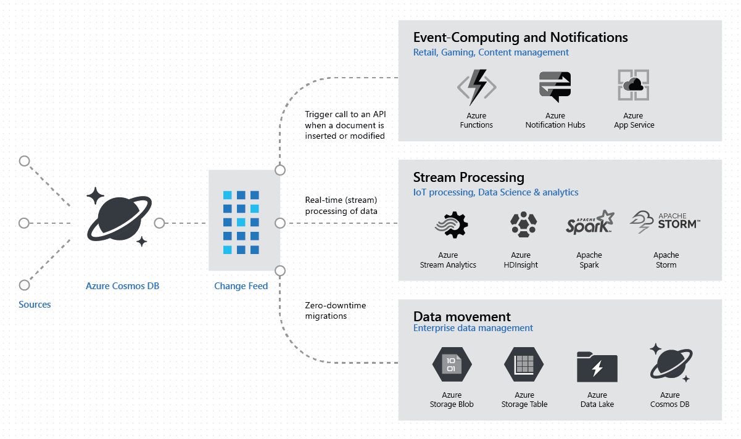
Common Change Feed scenarios
Notes:
The Azure Cosmos DB change feed enables efficient processing of large datasets that have a high volume of writes. Change feed also offers an alternative to querying an entire dataset to identify what has changed. With it, we can implement common patterns, like Event Sourcing.
Generally speaking, Azure Cosmos DB is well-suited for IoT, gaming, retail, and operational logging applications. A common design pattern in these applications is to use changes to the data to trigger other actions. Examples of these actions include:
Triggering a notification or a call to an API when an item is inserted, updated, or deleted.
Real-time stream processing for IoT or real-time analytics processing on operational data.
Data movement such as synchronizing with a cache, a search engine, a data warehouse, or cold storage.
The change feed in Azure Cosmos DB enables you to build efficient and scalable solutions for each of these patterns, as shown in this image.

Slide 10

How Claims Processing uses the Change Feed
Worker Service creates three leases on the Claim container
Each of the three change feed processors react to different events:
Adjudication
Claim Complete
Claim Updated
The change feed processors each manage their own feed processing checkpoints (through lease container) and have access to the entire change feed history to replay document changes from the beginning if needed
Read incoming claim header
Retrieve claim detail for adjustment
Call Assign Claim business rule for Initial/Resubmitted
Call Adjudicate Claim business rule for Proposed and trigger Adjudicator Changed event
Update claim header & details in Claim container
Event:
Adjudication
Worker Service Event Processor
Creates Leases
Read incoming claim detail
If claim status Approved: Increment member totals in the Member container and trigger approved event
If claim status Denied: Trigger denied event
Claims Data
Azure Cosmos DB
Worker Service
Azure Kubernetes Service (AKS) or Azure Container Apps (ACA)
Event:
Claim Complete
Read incoming claim header
If the claim header includes a Member ID, upsert it to the Member container
If the claim header includes an Adjudicator ID, upsert it to the Adjudicator container
Event:
Claim Updated

Slide 11
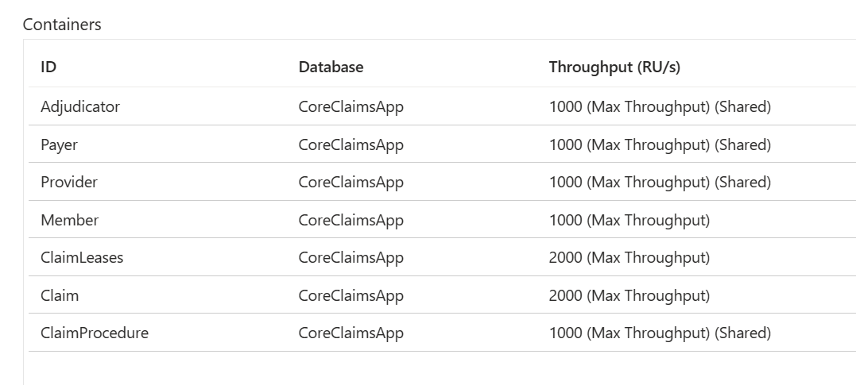
Azure Cosmos DB flexible throughput configuration
The Member and Claim containers have their own provisioned throughput vs. shared
This helps meet scale requirements and keep cost under control

Slide 12
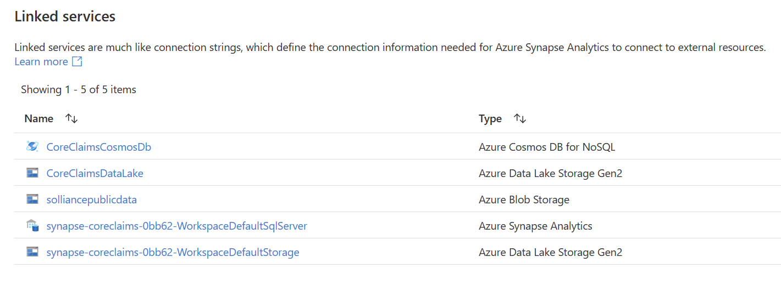
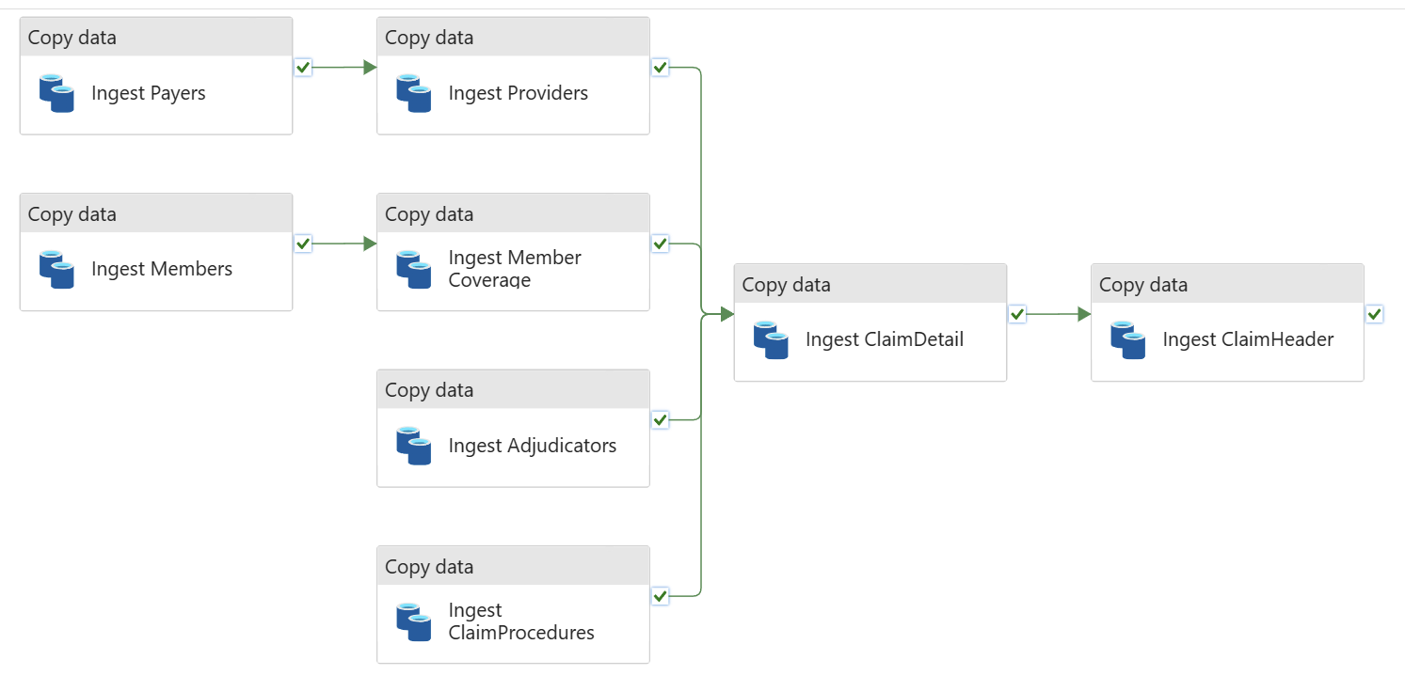
Bulk load data with Azure Synapse Analytics

Slide 13
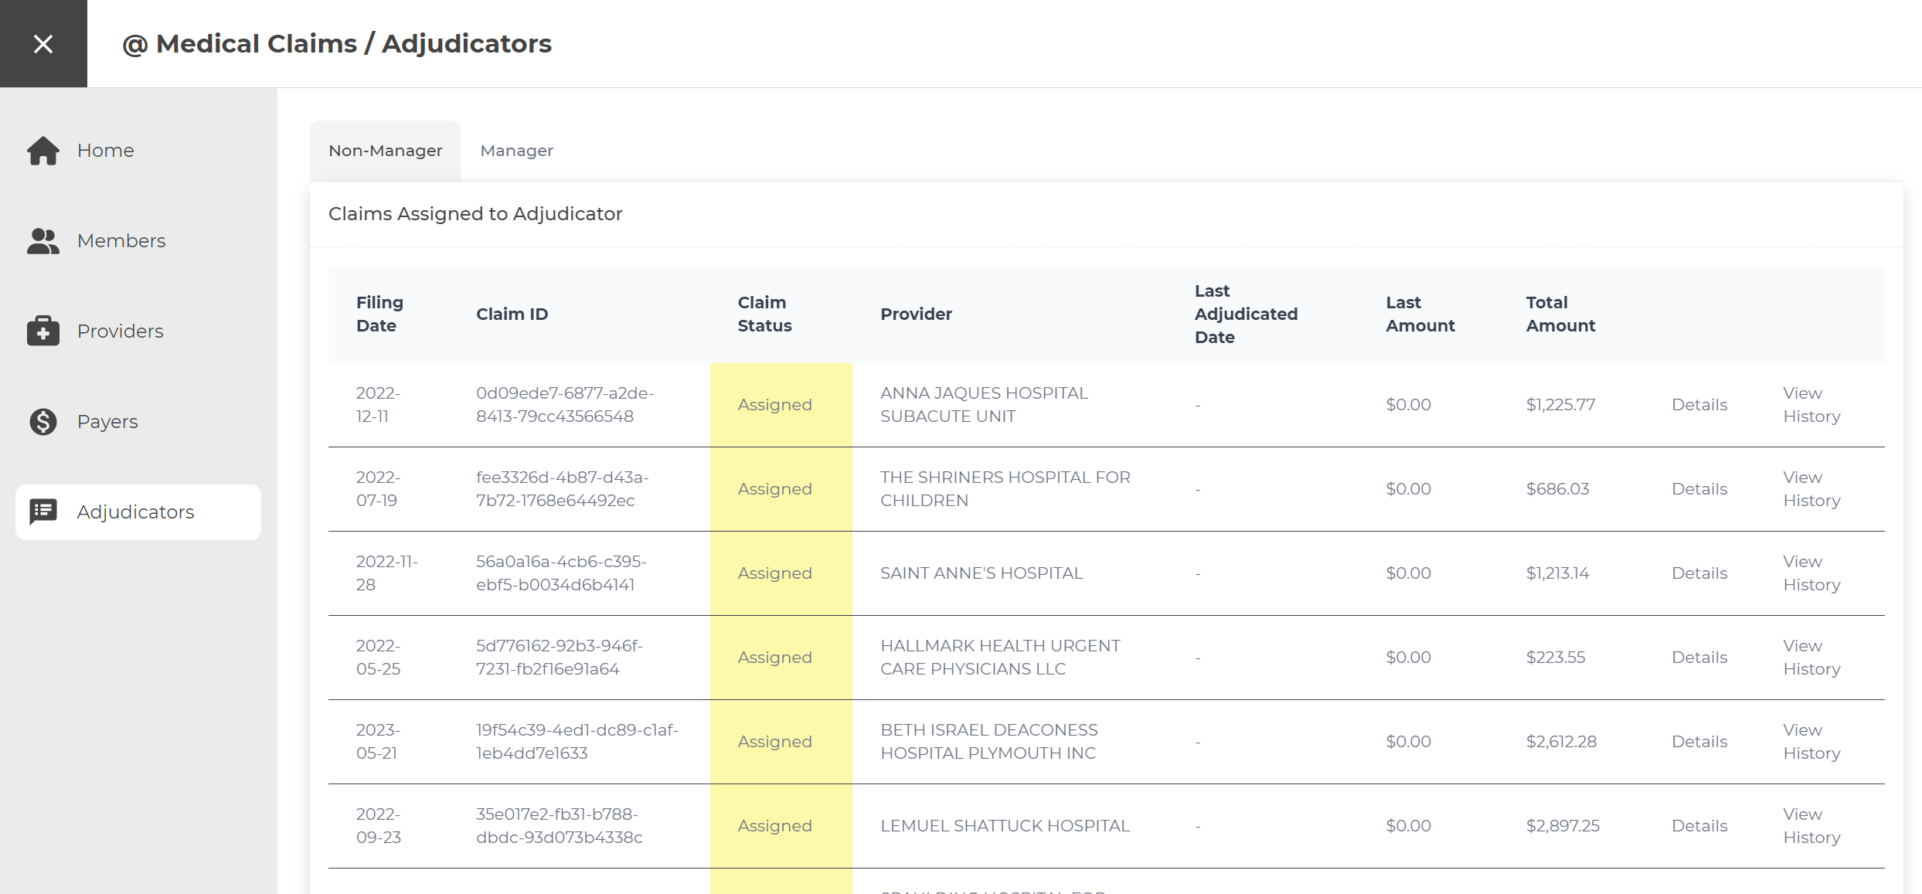
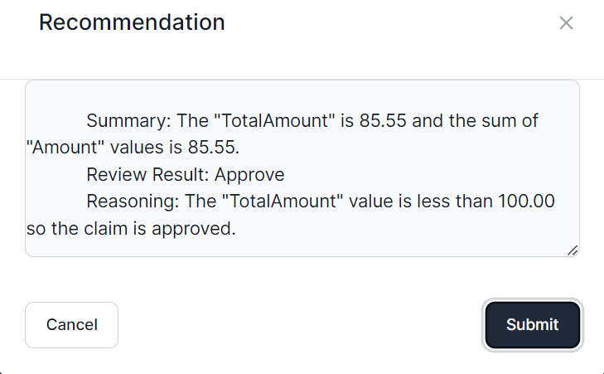
User Interface
Notes:
The application frontend is a React single-page application with Intelligent Agent UI functionality.

Slide 14
Azure Cosmos DB container partition keys
Container | Partition Key | Details
Adjudicator | /adjudicatorId | Adjudicator documents as well as Claim Header documents that are replicated to this container provide efficient access to Adjudicator and related Claim Header documents by filtering on adjudicatorId
Claim | /claimId | Claim Header and Claim Detail records ingested into this container. Lookups for Claim Detail records occur within this container. Claim Header and Claim Detail records both filtered by claimId
ClaimProcedure | /code | Reference/lookup data for claim procedures. Both the id and code fields share the same value for efficient point lookups and high cardinality
Member | /memberId | Member, Coverage, and Claim Header documents that are replicated to this container provide efficient access to Member, Coverage, and related Claim Header documents by filtering on memberId
Payer | /payerId | Reference/lookup data for payers. Both the id and payerId fields share the same value for efficient point lookups and high cardinality
Provider | /providerId | Reference/lookup data for providers. Both the id and providerId fields share the same value for efficient point lookups and high cardinality

Slide 15
Live code walk through
Notes:
Let’s walk through how we do each of these.

Slide 16
Additional Resources
Solution Repository:
github.com/Azure/Build-Modern-AI-Apps
Azure OpenAI:
learn.microsoft.com/azure/ai-services/openai/overview
Azure Cosmos DB Best Practices for Scaling:
learn.microsoft.com/azure/cosmos-db/scaling-provisioned-throughput-best-practices
Semantic Kernel:
learn.microsoft.com/semantic-kernel/overview/
Azure Container Apps:
learn.microsoft.com/azure/container-apps/overview

Slide 17
Thank you!

