Slide 1
Build & Modernize AI Applications
Payment Transaction Processing Solution Walk Through
https://github.com/Azure/Build-Modern-AI-Apps
Notes:
Hello. Today I’m going to walk you through the Payment Transaction Processing reference application we created as part of the Build & Modernize AI Applications solutions for Microsoft.
The source code for what you are about to see is available for you to download. You can use this to explore the concepts for building AI Applications in Azure. You can also take this code to use as a starting point to build your own Proof of Concept. You can also use it to simply demo the application itself and see how it works.
This solution is available at github.com/azure/build-modern-ai-apps

Slide 2
Payments & Transactions
Technologies
Azure Cosmos DB
Azure OpenAI Service
Semantic Kernel
Azure Container Apps
Azure Front Door
Azure Static Website
Azure Storage
Are a category of solutions that include loyalty programs, merchant services, payments, banking and statement analysis.

Slide 3
Scenario
The scenario centers around a payments and transactions solution. Members having accounts, each account with corresponding balances, overdraft limits and credit/debit transactions.
Transaction data is replicated across multiple geographic regions for both reads and writes, while maintaining consistency. Updates are made efficiently with the patch operation with ACID guarantees, an important feature when dealing with payments.
Business rules govern if a transaction is allowed.
An AI powered co-pilot enables agents to analyze transactions using natural language.
Notes:
In this solution, members manage their accounts, engage with transaction histories, and set overdraft limits to navigate their financial activities. The system assures that all transaction data is dependably replicated across multiple geographic regions, ensuring data consistency and reliable updates through efficient patch operations. Business rules are in place to validate each transaction, ensuring transactions do not exceed overdraft limits and Azure Cosmos DB Transactional Batch ensures ACID scope between new transactions and balance changes . We've incorporated an AI co-pilot to assist our agents by providing them with a live, detailed view into every transaction, enabling robust analysis and decision-making support. As we walk through the demo, we will explore how these features work cohesively to not only manage but also enhance the member experience, ensuring reliability and satisfaction in every interaction. Transactional Batch is an important feature to highlight in this demo

Slide 4




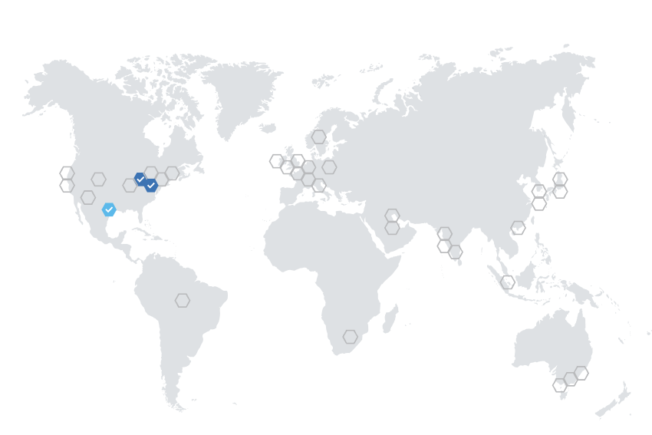






Reference Architecture
DATA
SOURCES
CONSUMERS
Completions API
Azure OpenAI
Databases
Apps
Account Data
Azure Cosmos DB
Payments API /
Worker Service
Azure Kubernetes Service (AKS)
Azure Front Door
Account
Management
Static Web App
Agents
Files
Account Data
Azure Cosmos DB
Account Data
Azure Cosmos DB
Notes:
(Display the architecture diagram while speaking to the below points)
All services are deployed across three regions to ensure high availability and to demonstrate Azure Cosmos DB replication and concurrency features.
The front end is a React web application deployed to an Azure Static Web app. This is how users interact with the solution.
The static web app sends all requests through Azure Front Door, which routes the requests to a Payments API instance, according to routing rules.
The API is an ASP.NET Core API app that serves as a lightweight layer for the business logic that lives inside of a .NET 7 class library. It is containerized in Docker and deployed to an Azure Container App (ACA) or Azure Kubernetes Service (AKS).
The background worker service is a Microsoft.NET.Sdk.Worker project that also references the .NET 7 class library and is deployed into a different Docker container within the same AKS service or a dedicated ACA instance.
All data is stored in Azure Cosmos DB. The background worker service acts as the Azure Cosmos DB change feed processor, which executes as data within the monitored Cosmos DB containers are inserted or updated, allowing for the application of business rules and automated updating of data within various containers. For this architecture, a CQRS pattern is in place to allow independent scalability between writes (new transactions) and reads (balances or statement queries) and Azure Cosmos DB change feed is the key to replicate data between containers.
There is an Azure OpenAI deployment that provides a completion model, orchestrated by Semantic Kernel. This enables users to ask questions about transactions in an account.
CQRS pattern is also important to mention to explain why there are 2 containers storing transactions and why change feed is the key.

Slide 5
Where to Start
github.com/Azure/Build-Modern-AI-Apps
Notes:
Where to Start (Slide 7)
Let me take you to the repository where this solution site.
[Stop Presenting slide show, go to repo home page]
To get started you can go to our GitHub repository github.com/Azure/Build-Modern-AI-Apps.
Once there you can scroll down and click on the Navigate to Payment and Transaction Processing link on this page.
This page has other solutions as well, including Medical Claims Processing and Vector Search/AI Assistant scenarios.
This page also includes links to the Intelligent App Workshop created by our Apps GBB team.
[Scroll back up to Payment and Transaction Processing link]
Clicking on the link for the Payment and Transaction Processing will take you to the repository where this solution lives and includes all the information you need including an introduction to the concepts we will cover in this session as well as how to deploy and run the solution.

Slide 6
Sample PowerShell install command
./scripts/Unified-Deploy.ps1 -resourceGroup <rg> `
-location eastus `
-subscription <subscription id> `
-openAiName <open ai account> `
-openAiRg <open ai resource group> `
-openAiCompletionsDeployment completions `
-openAiEmbeddingsDeployment embeddings
-openAiEmbeddingsDeployment embeddings `
-deployAks 1
Notes:
There are three flavors of deployment, you can deploy from Cloud Shell, a VM in Azure or Standard from your local dev environment. * When running the Standard deployment, make sure that you have Docker Desktop and Helm installed on your system. The repo includes documentation on how to deploy, along with system requirements.
By default, the script will create a new Azure OpenAI account and deploy two models GPT 3.5 and ADA-002 for completions and embeddings.
<Click> If your organization has already deployed Azure OpenAI and you wish to utilize it, you can specify an existing account name and models as well. In this example I’m providing an existing OpenAI account name and resource group where the account has been deployed. I’m also specifying existing deployed models which I’ve called completions and embeddings. The names here should match what has been deployed for you already.
The script will deploy the web application and service layer containers into Azure Container Apps.
<click>You can optionally deploy using AKS by just adding this flag at the end.
* Mention that because we’re using Docker images, it’s important to install Docker Desktop and have it running before debugging the solution locally.

Slide 7
What gets deployed
Notes:
Let’s go into the Azure portal and explore the services.
[Return to browser to Azure portal tabs]
Show each of the services within the portal.
OpenAI – click on Models, click on completions show GPT 35.
Cosmos DB – show the containers with the data, show the data in the Adjudicator and Claim containers, making note of the types (ClaimDetail, ClaimHeader, etc.)
Event Hubs – show the Event Hubs within the namespace for capturing new claims and specific events.
Storage – Open webcoreclaims* storage account and show the static website and where to find the endpoint.
Container registry – simply mention it.
ACA - show one for API and one for Background Worker, click into web api, click containers, show environment variables.

Slide 8
Meet the lightweight Kernel of Semantic Kernel.
“
I’ve been designed to orchestrate complicated LLM AI prompts combined with native code, use multiple AI models, and use a goal-oriented approach to achieving asks.”
STEPS
👋
PLANNER
1
2
3
…
ernel
ASK
K
“
I take a user’s ask and generate a step-by-step plan that draws upon available skills.”
Planner generates steps that use available Skills
SKILLS
Notes:
Before we get into the application, I want to introduce something called Semantic Kernel.
<click> Semantic Kernel is an open-source SDK that acts as an AI orchestrator for building these types of Copilot applications. Semantic Kernel provides the glue to bring together AI models and data with a set of connectors and Skills which you can use to instruct an AI model how to behave, like as an AI Assistant or how to Summarize text.
It all starts from an Ask. The user has a need that needs to be filled. Kernel, in Semantic Kernel, is the orchestrator for the Ask. It sends the Ask over to the Planner to the right skills can be found and the right steps can be created from the Ask and Skills.
The SDK provides an extensible framework that you can use to build your AI applications and will be central to the work you do to build this type of application. There are others like it as well such as Lang Chain which I encourage you to explore. Semantic Kernel is available for both .NET and Python users.
For our scenario here, we are going to combine data from a user’s medical claim with a system prompt that explains the adjudication rules. This is a key scenario we wish to highlight in helping you understand how to design and build applications that can provide near real-time AI capabilities to your own scenarios.

Slide 9
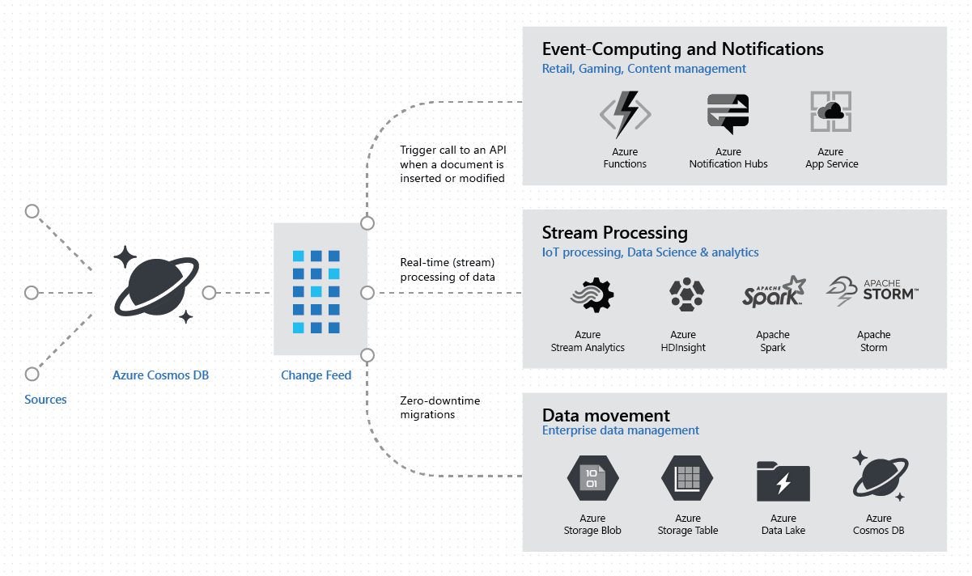
Common Change Feed scenarios
Notes:
The Azure Cosmos DB change feed enables efficient processing of large datasets that have a high volume of writes. Change feed also offers an alternative to querying an entire dataset to identify what has changed. With it, we can implement common patterns, like Event Sourcing.
Generally speaking, Azure Cosmos DB is well-suited for IoT, gaming, retail, and operational logging applications. A common design pattern in these applications is to use changes to the data to trigger other actions. Examples of these actions include:
Triggering a notification or a call to an API when an item is inserted, updated, or deleted.
Real-time stream processing for IoT or real-time analytics processing on operational data.
Data movement such as synchronizing with a cache, a search engine, a data warehouse, or cold storage.
The change feed in Azure Cosmos DB enables you to build efficient and scalable solutions for each of these patterns, as shown in this image.
In our architecture for the Payment Transaction Processing solution, we implement a CQRS pattern to allow independent scalability between writes (new transactions) and reads (balances or statement queries). CQRS stands for Command and Query Responsibility Segregation, a pattern that separates read and update operations for a data store to maximize performance, scalability, and secuirty. Azure Cosmos DB change feed is the key to replicate data between containers.

Slide 10
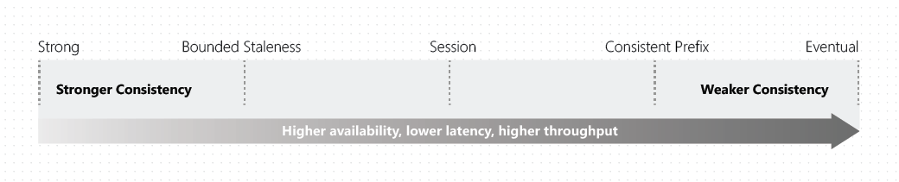
Strong Consistency
Notes:
Cosmos DB provides consistency levels on a spectrum. Each level provides availability and performance tradeoffs.
In our solution, we are using a single write region and two additional read regions for global distribution, with the default consistency level set to Strong.
Strong Consistency means that reads are guaranteed to see the most recent write. This offers the simplest programming model out of the five consistency levels and is also ideal for applications where seeing the latest version of data that in the correct chronological order is critically important.
Strong consistency offers a linearizability guarantee. Linearizability refers to serving requests concurrently. The reads are guaranteed to return the most recent committed version of an item. A client never sees an uncommitted or partial write. Users are always guaranteed to read the latest committed write. Since we are using a single write region, our solution benefits from a recovery point objective (RPO) of zero, because strong consistency guarantees a global majority on writes.
The following graphic illustrates the strong consistency with musical notes. After the data is written to the "West US 2" region, when you read the data from other regions, you get the most recent value:

Slide 11
Eventual Consistency
Notes:
In Eventual consistency, the client issues read requests against any one of the four replicas in the specified region. This replica may be lagging and could return stale or no data.
Eventual consistency is the weakest form of consistency because a client may read the values that are older than the ones it read in the past. Eventual consistency is ideal where the application doesn't require any ordering guarantees. Examples include count of Retweets, Likes, or non-threaded comments. The following graphic illustrates the eventual consistency with musical notes.

Slide 12
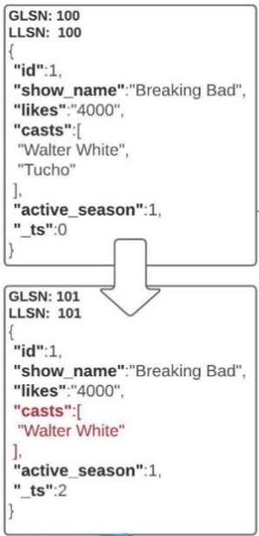
PATCH Operation
Allows partial updates to documents in Cosmos DB
With PATCH you can update select document properties instead of having to replace the entire document.
Notes:
Partial document update feature improves this experience significantly. The client can only send the modified properties/fields in a document without doing a full document replace operation. Key benefits of this feature include:
Improved developer productivity: Provides a convenient API for ease of use and the ability to conditionally update the document.
Performance improvements: Avoids extra CPU cycles on the client side, reduces end-to-end latency and network bandwidth.
Multi-region writes: Supports automatic and transparent conflict resolution with partial updates on discrete paths within the same document.
Ref.: Partial document update - Azure Cosmos DB for NoSQL | Microsoft Learn

Slide 13
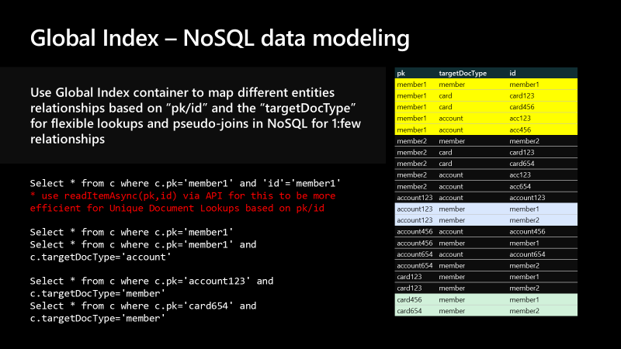
Reverse Lookups With Global Index

Slide 14
ACID Guarantees With Cosmos DB Transactional Batch
var batch = Container.CreateTransactionalBatch(pk);
batch.PatchItem(account.id, new List<PatchOperation>()
{
PatchOperation.Increment("/balance", transaction.type.ToLowerInvariant() == Constants.DocumentTypes.TransactionDebit ? -transaction.amount : transaction.amount)
},
new TransactionalBatchPatchItemRequestOptions()
{
IfMatchEtag = responseRead.ETag
}
);
batch.CreateItem<Transaction>(transaction);
var responseBatch = await batch.ExecuteAsync();
Notes:
Transactional batch describes a group of point operations that need to either succeed or fail together with the same partition key in a container.
A transaction in a typical database can be defined as a sequence of operations performed as a single logical unit of work. Each transaction provides ACID (Atomicity, Consistency, Isolation, Durability) property guarantees.
Atomicity guarantees that all the operations done inside a transaction are treated as a single unit, and either all of them are committed or none of them are.
Consistency makes sure that the data is always in a valid state across transactions.
Isolation guarantees that no two transactions interfere with each other – many commercial systems provide multiple isolation levels that can be used based on the application needs.
Durability ensures that any change that is committed in a database will always be present. Azure Cosmos DB supports full ACID compliant transactions with snapshot isolation for operations within the same logical partition key.
Within the TransactionRepository class of our application, we create a transactional batch to update the account balance using a Patch Increment operation on the Account document, then insert the new Transaction record. Notice that the Transactional Batch operation is scoped to the same Partition Key. All batch operations must occur on the same partition.
* ETags (Entity Tags) are used for concurrency checking when updating resources.

Slide 15
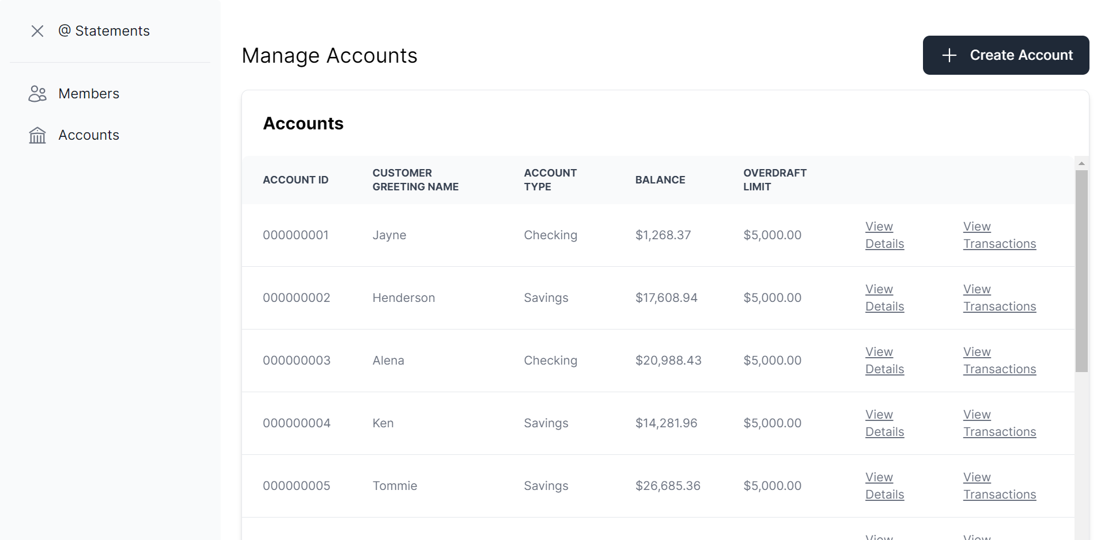
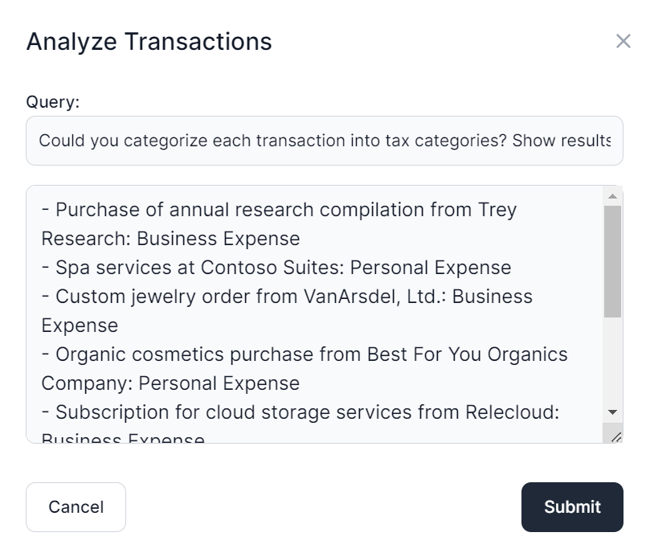
User Interface
Notes:
The application frontend is a React single-page application with Intelligent Agent UI functionality.

Slide 16
Live code walk through
Notes:
Let’s walk through how we do each of these.

Slide 17
Additional Resources
Solution Repository:
github.com/Azure/Build-Modern-AI-Apps
Azure OpenAI:
learn.microsoft.com/azure/ai-services/openai/overview
Azure Cosmos DB Consistency Levels:
learn.microsoft.com/azure/cosmos-db/consistency-levels
Semantic Kernel:
learn.microsoft.com/semantic-kernel/overview/
Azure Container Apps:
learn.microsoft.com/azure/container-apps/overview

Slide 18
Thank you!

