Slide 1
Technical Overview of Azure Cosmos DB
Presenter Name

Slide 2
In this session…
Azure Cosmos DB Core Concepts and new stuff
TL;DR High-Level Overview
Resource Model
Request Units
Partitioning
Replication
Automatic Indexing
New Goodies
Q&A

Slide 3



Azure Cosmos DB
A globally distributed, massively scalable, multi-model database service
SQL
MongoDB
Table API
Column-family
Document
Key-value
Graph
Guaranteed low latency at the 99th percentile
Elastic scale out
of storage & throughput
Five well-defined consistency models
Turnkey global distribution
Comprehensive SLAs

Slide 4
Cosmos DB 101: Resource Model

Slide 5
Resource Model
Leveraging Azure Cosmos DB to automatically scale your data across the globe
This module will reference partitioning in the context of all Azure Cosmos DB modules and APIs.
Account
Database
Database
Database
Database
Database
Container
Database
Database
Item

Slide 6
Account URI and Credentials
Account
********.azure.com
Database
Database
Database
IGeAvVUp …
Database
Database
Container
Database
Database
Item

Slide 7
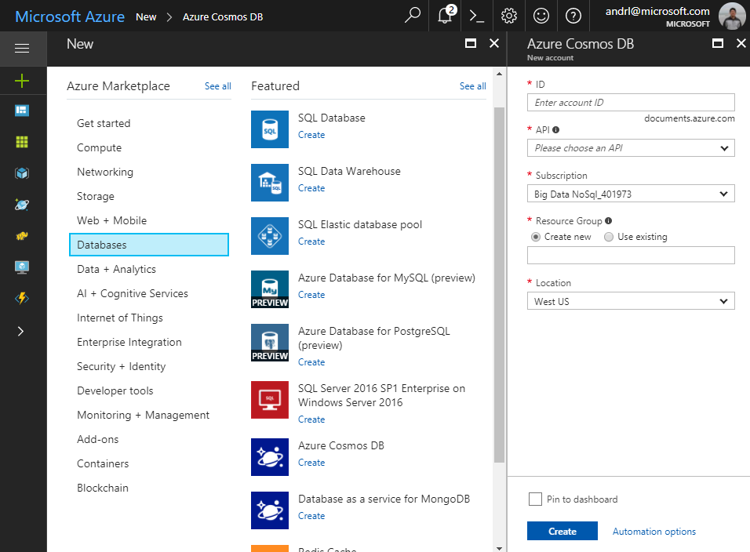
Creating Account
Account
Database
Database
Database
Database
Database
Container
Database
Database
Item

Slide 8
Database Representations
Account
Database
Database
Database
Database
Database
Database
Database
Container
Container
Database
Database
Database
Database
Item
Item

Slide 9
Container Representations
Account
Database
Database
Database
Database
=
Database
Container
Collection
Graph
Table
Database
Database
Item

Slide 10
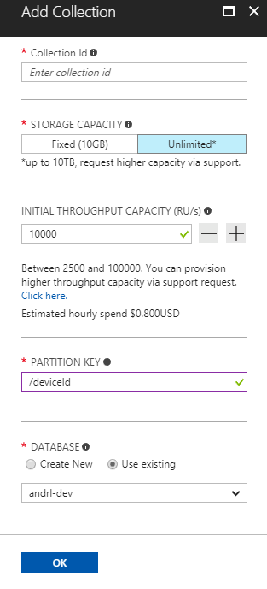
Creating Collections – SQL API
Account
Database
Database
Database
Database
Database
Container
Database
Database
Item

Slide 11
Container-Level Resources
Account
Database
Database
Database
Database
Database
Container
Database
Database
Sproc
Trigger
UDF
Conflict
Item

Slide 12
System Topology (Behind The Scenes)
Planet Earth
Azure regions
Datacenters
Stamps
Fault domains
Container
Resource Manager
RSM
…
Resource Governor
Index Manager
Language Runtime(s) Hosts
…
Transport
Bw-tree++/ LLAMA++
Admission control
Log Manager
Query Processor
Various agents
Database engine
IO Manager
Cluster
Machine
Replica
Database engine

Slide 13
Resource Hierarchy
CONTAINERS
Logical resources “surfaced” to APIs as tables, collections or graphs, which are made up of one or more physical partitions or servers.
RESOURCE PARTITIONS
Consistent, highly available, and resource-governed coordination primitives
Consist of replica sets, with each replica hosting an instance of the database engine
Tenants
Follower
Tables
Collections
Graphs
Follower
Leader
Forwarder
To remote resource partition(s)
Containers
Replica Set
Resource Partitions

Slide 14
Demystifying “Request Units”

Slide 15
Request Units
Request Units (RUs) is a rate-based currency
Abstracts physical resources for performing requests
Key to multi-tenancy, SLAs, and COGS efficiency
Foreground and background activities
% Memory
% CPU
% IOPS

Slide 16
Request Units
Normalized across various access methods
1 read of 1 KB document from a single partition
Each request consumes fixed RUs
Applies to reads, writes, query, and stored procedures
GET
=
POST
=
PUT
=
Query
=
…

Slide 17
Request Units
Provisioned in terms of RU/sec
Rate limiting based on amount of throughput provisioned
Can be increased or decreased instantaneously
Metered Hourly
Background processes like TTL expiration, index transformations scheduled when quiescent
Rate limit
Max RU/sec
Incoming Requests
No rate limiting
Min RU/sec
Replica Quiescent

Slide 18
On to something more interesting: Scaling Outwards aka Partitioning

Slide 19
ELASTIC SCALE OUT OF STORAGE AND THROUGHPUT
SCALES AS YOUR APPS’ NEEDS CHANGE
Database elastically scales storage and throughput
How? Scale-out!
Collections can span across large clusters of machines
Can start small and seamlessly grow as your app grows

Slide 20
ELASTIC SCALE OUT OF STORAGE AND THROUGHPUT
SCALES AS YOUR APPS’ NEEDS CHANGE
Database elastically scales storage and throughput
How? Scale-out!
Collections can span across large clusters of machines
Can start small and seamlessly grow as your app grows

Slide 21
Partitions
Partition Key: User ID
Cosmos DB Container (e.g. Collection)
Logical Partitioning Abstraction
Behind the Scenes:
Physical Partition Sets
hash(User ID)
Psuedo-random distribution of data over range of possible hashed values

Slide 22
Partitions
hash(User ID)
Pseudo-random distribution of data over range of possible hashed values
Andrew
Mike
…
Bob
Dharma
Shireesh
Karthik
Rimma
Alice
Carol
…
…
Partition 1
Partition 2
Partition n
Frugal # of Partitions based on actual storage and throughput needs
(yielding scalability with low total cost of ownership)

Slide 23
Partitions
hash(User ID)
Pseudo-random distribution of data over range of possible hashed values
Andrew
Mike
…
Bob
Dharma
Shireesh
Karthik
Rimma
Alice
Carol
…
…
Partition 1
Partition 2
Partition n
What happens when partitions need to grow?

Slide 24
Partitions
hash(User ID)
Pseudo-random distribution of data over range of possible hashed values
Partition Ranges can be dynamically sub-divided to seamlessly grow database as the application grows while simultaneously maintaining high availability.
Partition management is fully managed by Azure Cosmos DB, so you don't have to write code or manage your partitions.
Dharma
Shireesh
Karthik
Rimma
Alice
Carol
…
Dharma
Shireesh
…
Rimma
Karthik
…
+
Partition x
Partition x1
Partition x2

Slide 25
Partitions
Best Practices: Design Goals for Choosing a Good Partition Key
Distribute the overall request + storage volume
Avoid “hot” partition keys
Partition Key is scope for multi-record transactions and routing queries
Queries can be intelligently routed via partition key
Omitting partition key on query requires fan-out
Steps for Success
Ballpark scale needs (size/throughput)
Understand the workload
# of reads/sec vs writes per sec
Use pareto principal (80/20 rule) to help optimize bulk of workload
For reads – understand top 3-5 queries (look for common filters)
For writes – understand transactional needs
General Tips
Build a POC to strengthen your understanding of the workload and iterate (avoid analyses paralysis)
Don’t be afraid of having too many partition keys
Partitions keys are logical
More partition keys  more scalability

Slide 26
Demo: Elastic Scale

Slide 27
The other side of distributed databases: Replication (ft. Multi-Master)

Slide 28
Turnkey Global Distribution
High Availability
Automatic and Manual Failover
Multi-homing API removes need for app redeployment
Low Latency (anywhere in the world)
Packets cannot move fast than the speed of light
Sending a packet across the world under ideal network conditions takes 100’s of milliseconds
You can cheat the speed of light – using data locality
CDN’s solved this for static content
Azure Cosmos DB solves this for dynamic content

Slide 29
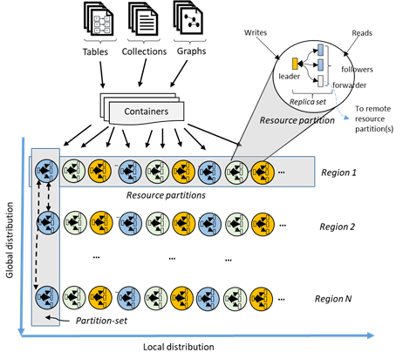
Turnkey Global Distribution
Automatic and transparent replication worldwide
Each partition hosts a replica set per region
Customers can test end to end application availability by programmatically simulating failovers
All regions are hidden behind a single global URI with multi-homing capabilities
Customers can dynamically add / remove additional regions at any time

Slide 30
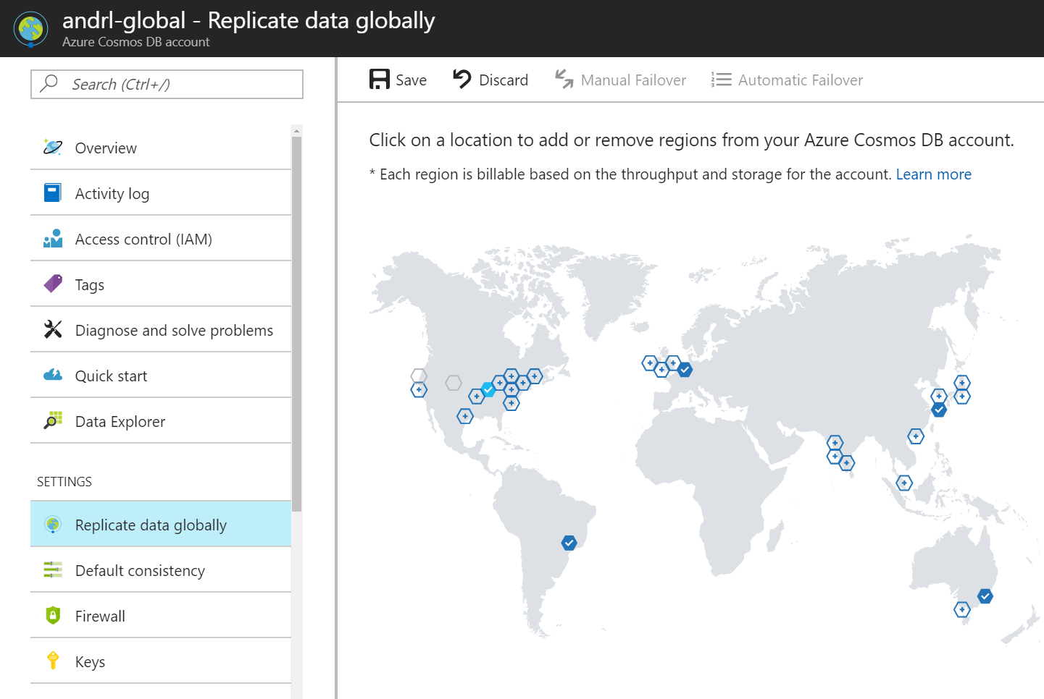
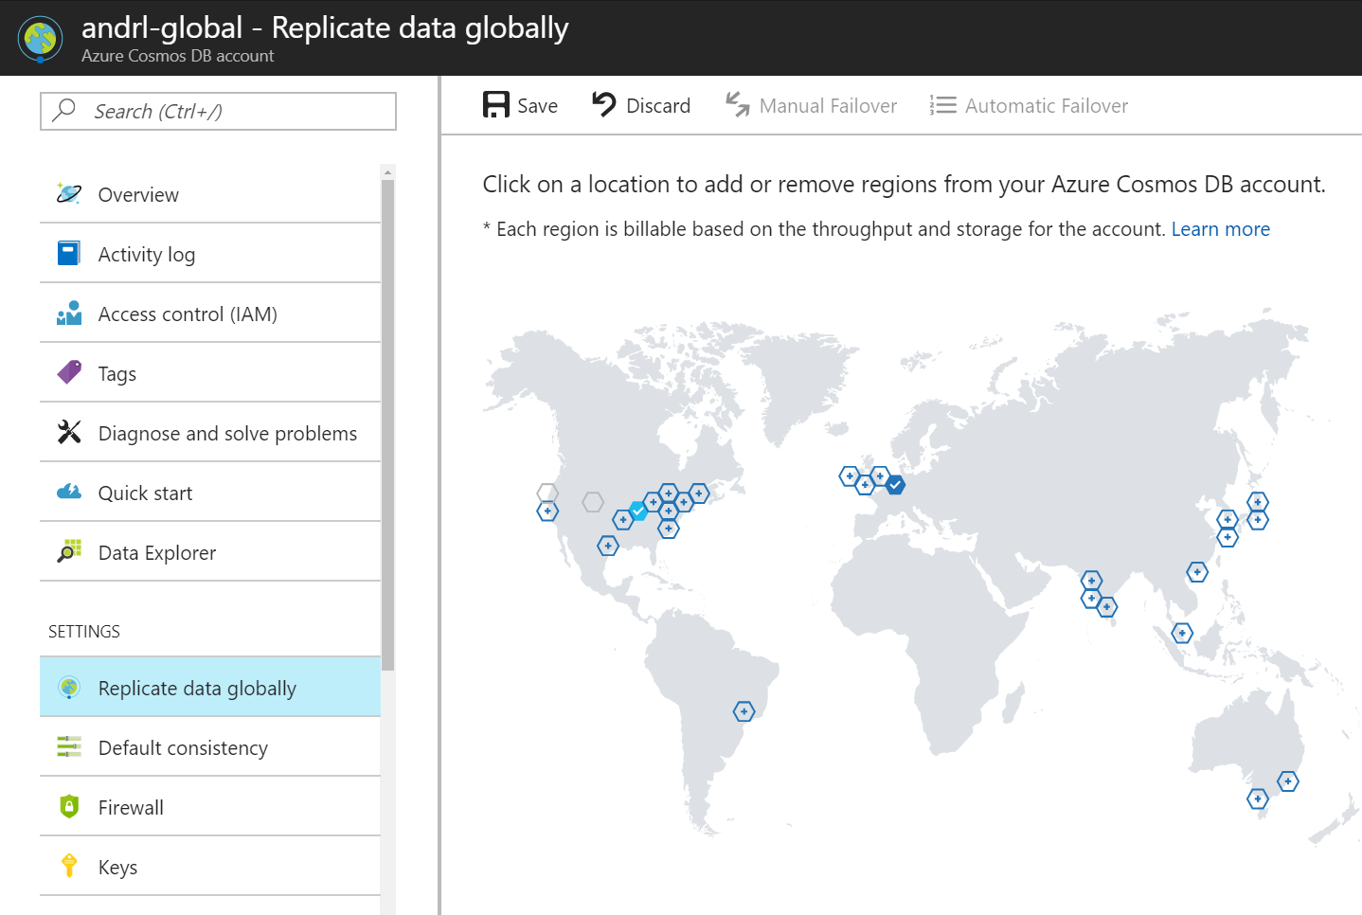

Replicating Data Globally

Slide 31
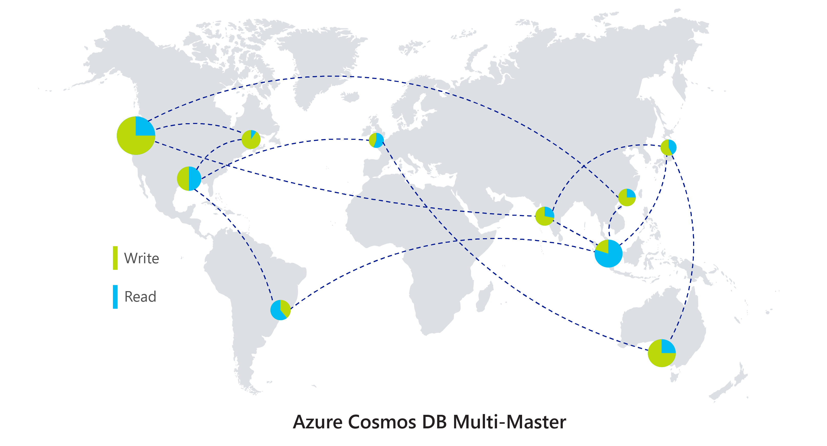
Multi-Master
Perfect for Intelligent Cloud
and Intelligent Edge Applications
Write scalability around the world
Low latency writes around the world
99.999% High Availability around the world
Well-defined consistency models
Comprehensive conflict management

Slide 32
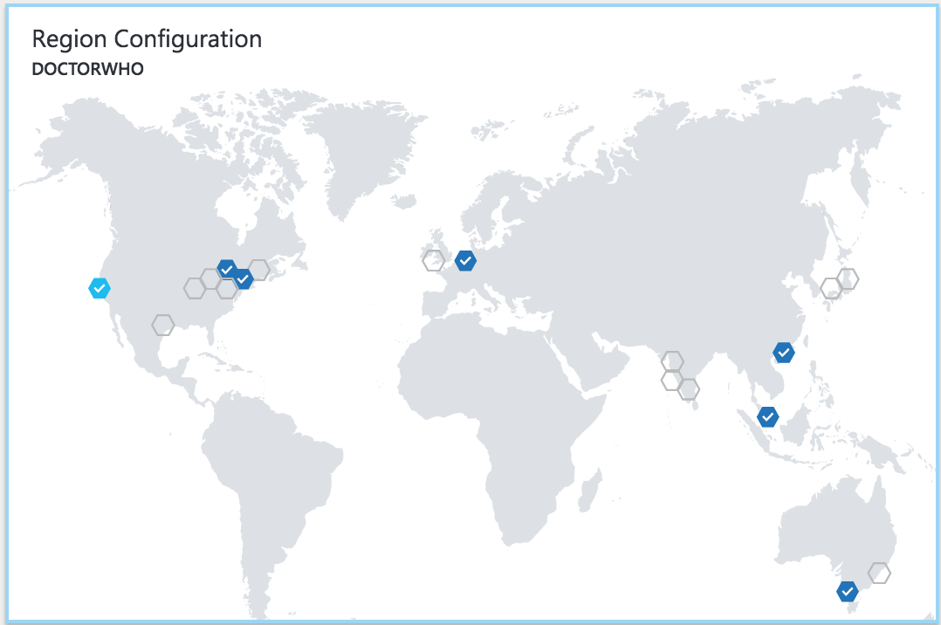
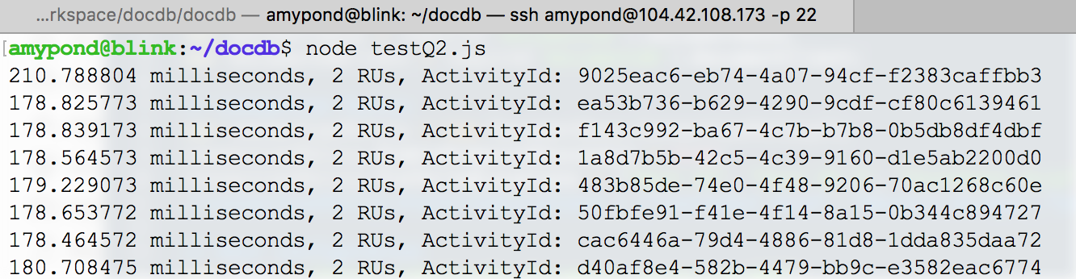
Replicating Data Globally

Slide 33
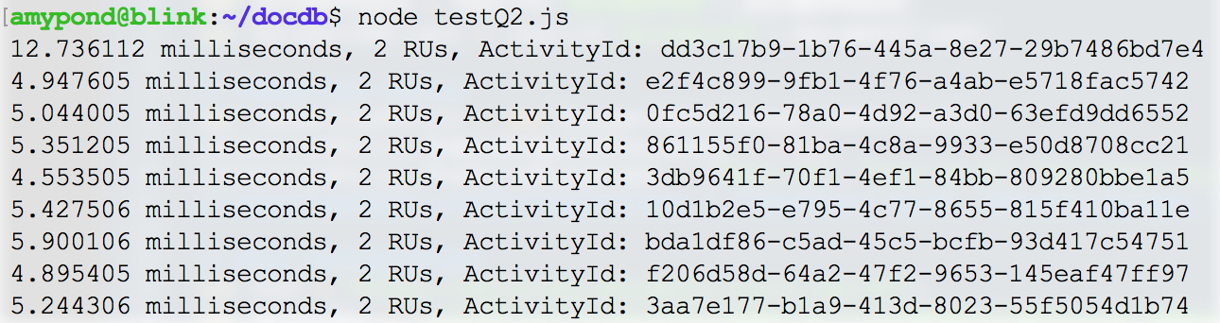
Replicating Data Globally

Slide 34
Automatic Failover
DocumentClient client;
ConnectionPolicy policy = new ConnectionPolicy()
{
ConnectionMode = ConnectionMode.Direct,
ConnectionProtocol = Protocol.Tcp
};
policy.PreferredLocations.Add(LocationNames.CentralUS); //first preference
policy.PreferredLocations.Add(LocationNames.SoutheastAsia); //second preference
policy.PreferredLocations.Add(LocationNames.NorthEurope); //third preference
client = new DocumentClient(new Uri(endpointUri), PrimaryKey, connectionPolicy: policy);

Slide 35
FIVE WELL-DEFINED CONSISTENCY MODELS
CHOOSE THE BEST CONSISTENCY MODEL FOR YOUR APP
CLEAR TRADEOFFS
Latency
Availability
Throughput
Five well-defined, consistency models
Overridable on a per-request basis
Provides control over performance-consistency tradeoffs, backed by comprehensive SLAs.
An intuitive programming model offering low latency and high availability for your planet-scale app.
Strong
Bounded-staleness
Session
Consistent prefix
Eventual

Slide 36
Demo: Multi-Master

Slide 37
The icing on the cake: Schema Agnostic Indexing

Slide 38
Handle any data with no schema or indexing required
Azure Cosmos DB’s schema-less service automatically indexes all your data, regardless of the data model, to delivery blazing fast queries.
Automatic index management
Synchronous auto-indexing
No schemas or secondary indices needed
Works across every data model
GEEK
Item | Color | Microwave safe | Liquid capacity | CPU | Memory | Storage
Geek mug | Graphite | Yes | 16ox | ??? | ??? | ???
Coffee Bean mug | Tan | No | 12oz | ??? | ??? | ???
Surface book | Gray | ??? | ??? | 3.4 GHz Intel Skylake Core i7-6600U | 16GB | 1 TB SSD

Slide 39
INDEXING JSON Documents
{
"locations": [
{
"country": "Germany",
"city": "Berlin"
},
{
"country": "France",
"city": "Paris"
}
],
"headquarter": "Belgium",
"exports": [
{ "city": "Moscow" },
{ "city": "Athens" }
]
}
locations
headquarter
exports
0
1
Belgium
0
1
country
city
country
city
city
city
Germany
Berlin
France
Paris
Moscow
Athens

Slide 40
INDEXING JSON Documents
{
"locations": [
{
"country": "Germany",
"city": "Bonn",
"revenue": 200
}
],
"headquarter": "Italy",
"exports": [
{
"city": "Berlin",
"dealers": [
{ "name": "Hans" }
]
},
{ "city": "Athens" }
]
}
locations
headquarter
exports
0
Italy
0
1
country
city
revenue
city
dealers
city
Germany
Bonn
200
Berlin
0
name
Hans

Slide 41
INDEXING JSON Documents
locations
headquarter
exports
locations
headquarter
exports
+
0
1
Belgium
0
1
0
Italy
0
1
country
city
country
city
city
city
country
city
revenue
city
dealers
city
Germany
Berlin
France
Paris
Moscow
Athens
Germany
Bonn
200
Berlin
0
Athens
name
Hans

Slide 42
Inverted Index
{1, 2}
{1, 2}
locations
{1, 2}
headquarter
{1, 2}
exports
{1, 2}
0
{1}
1
{1}
Belgium
{2}
Italy
{1, 2}
0
{1, 2}
1
{1, 2}
country
{1, 2}
city
{1, 2}
revenue
{1, 2}
country
{1, 2}
city
{1, 2}
city
{2}
dealers
{1, 2}
city
{1}
Berlin
{1}
France
{1}
Paris
{1}
Moscow
{1, 2}
Germany
{2}
Bonn
{2}
200
{2}
Berlin
{2}
0
{2}
Athens
{2}
name
{2}
Hans

Slide 43
Index POLICIES
CUSTOM INDEXING POLICIES
Though all Azure Cosmos DB data is indexed by default, you can specify a custom indexing policy for your collections. Custom indexing policies allow you to design and customize the shape of your index while maintaining schema flexibility.
Define trade-offs between storage, write and query performance, and query consistency
Include or exclude documents and paths to and from the index
Configure various index types
{
"automatic": true,
"indexingMode": "Consistent",
"includedPaths": [{
"path": "/*",
"indexes": [{
"kind": "Hash",
"dataType": "String",
"precision": -1
}, {
"kind": "Range",
"dataType": "Number",
"precision": -1
}, {
"kind": "Spatial",
"dataType": "Point"
}]
}],
"excludedPaths": [{
"path": "/nonIndexedContent/*"
}]
}

Slide 44
Demo: Schema Agnostic Indexing

Slide 45
Other Goodies

Slide 46
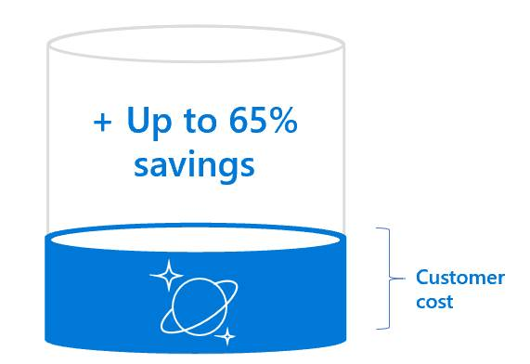
Reserved Capacity
Upfront commitment on Request Units
Calculating how much to reserve
Tiered discounts
More request units = more discounts
Discounts applied immediately
Region agnostic, will apply discounts to all regions and all APIs
Applies to Cosmos DB usage only
For EAs refer to Service Type, Additional Info in billing file. Or…
Open Metrics blade in portal, get average throughput/sec
Add up for every Cosmos DB account
Be sure to include future instances too
Use as your reservation amount
To purchase Azure Cosmos DB Reserved capacity, go to https://aka.ms/cosmosdbri

Slide 47
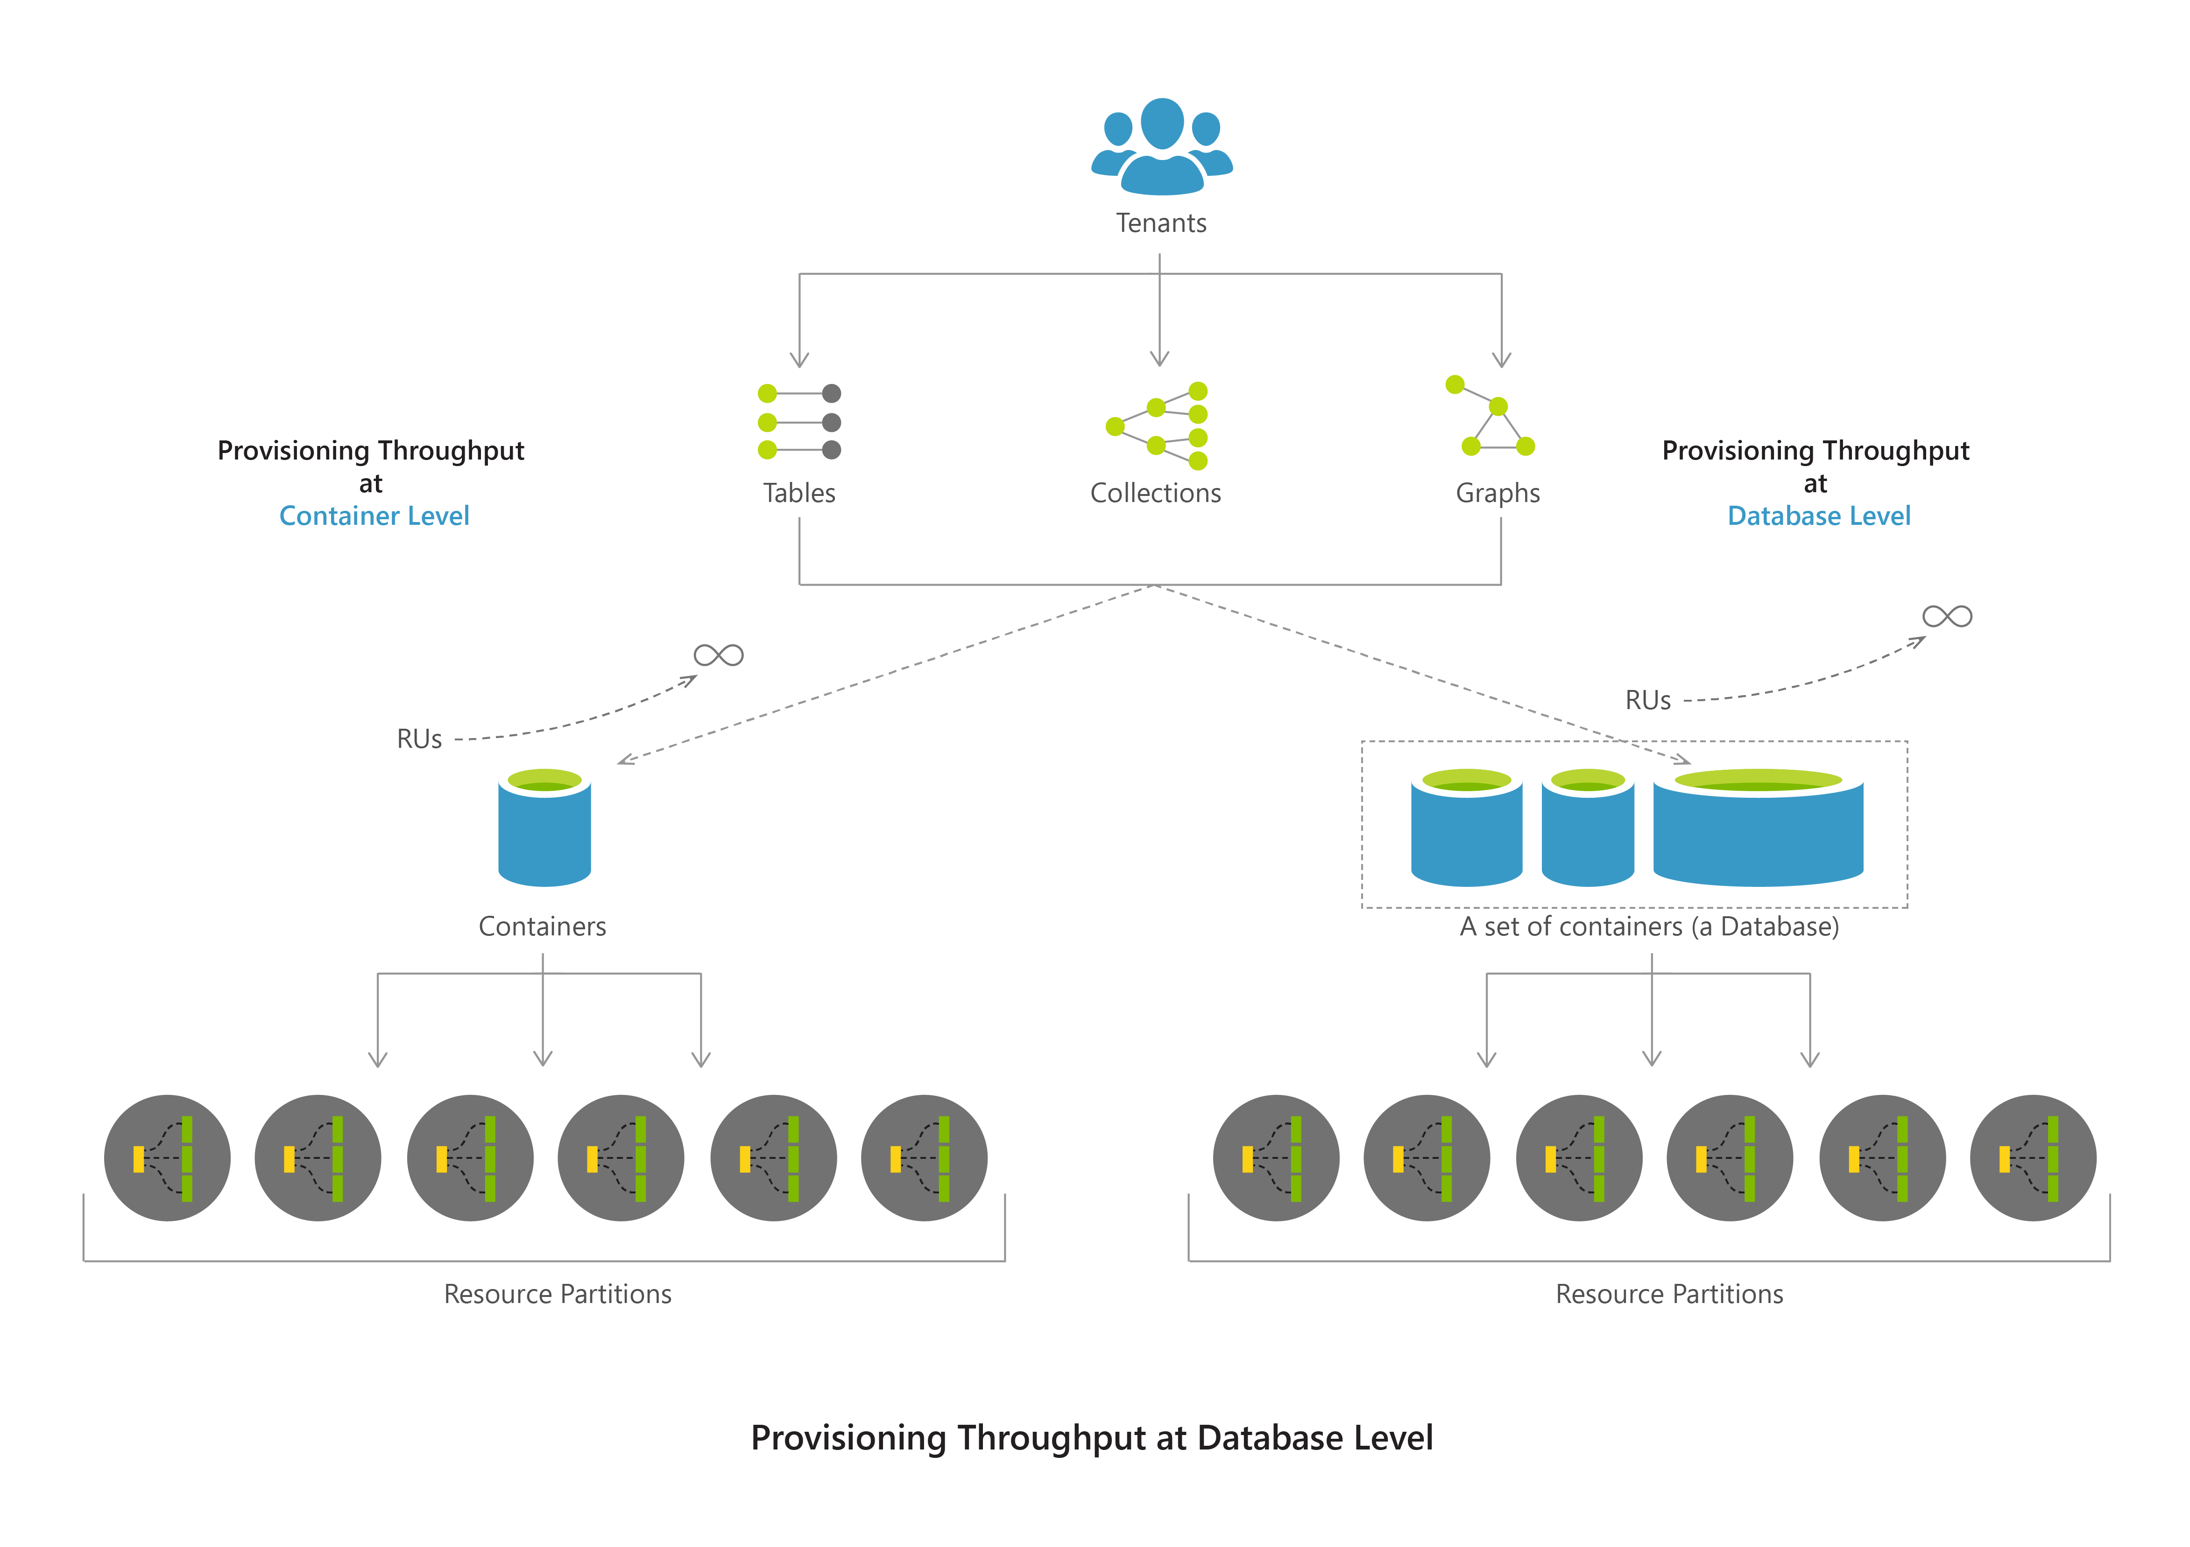
Lower entry-point
Database offer now starting at 400 RU/s

Slide 48
Recap
TL;DR High-Level Overview
Resource Model
Request Units
Partitioning
Replication
Automatic Indexing
Other Goodies
Q&A

