Slide 1
Notes (hidden)
The demos for this session can be found here.
https://github.com/markjbrown/cosmos-global-distribution-demos

Slide 2

Multi-Master and Global Distribution with Azure Cosmos DB
Name
Contact info

Slide 3
Session learning objectives
At the end of this session, you should be better able to…
Understand how the multi-master and global distribution capabilities in Cosmos DB make building modern applications easier.
Demonstrate and implement multi-master capabilities in Cosmos DB.
Understand the relationship between consistency, availability and latency when building modern applications.
Notes:
Really what I want everyone to walk away with here is to really understand the relationship between consistency, availability and latency.

Slide 4



Azure Cosmos DB
A globally distributed, massively scalable, multi-model database service
SQL
MongoDB
Table API
Column-family
Document
Key-value
Graph
Guaranteed low latency at the 99th percentile
Elastic scale out
of storage & throughput
Five well-defined consistency models
Turnkey global distribution
Comprehensive SLAs
Notes:
Cosmos DB was born in the cloud and was designed from the ground up to run modern cloud-scale applications.
Provides turn key distribution with replication built into the heart of its core.
Easily scale storage and throughput.
With guaranteed low latency, 5-9’s availability, all backed by SLAs.

Slide 5
Notes (hidden)
This section sets the business case for why customers want/need to build globally distributed apps and points to the global distribution capabilities of Cosmos DB for providing both high availability and low latency.
NEXT: <next slide title>

Slide 6
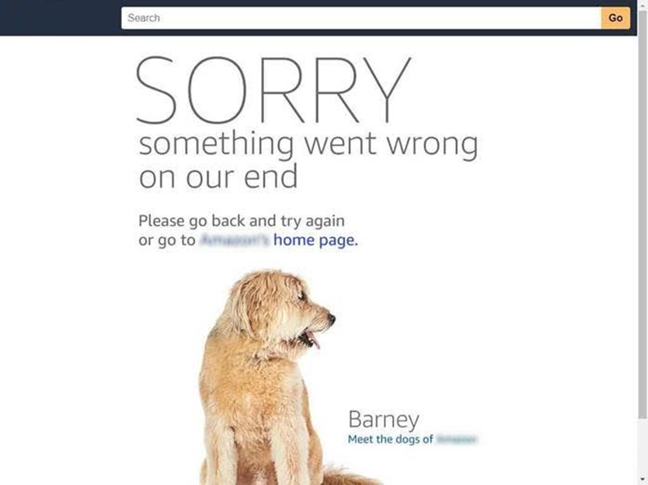
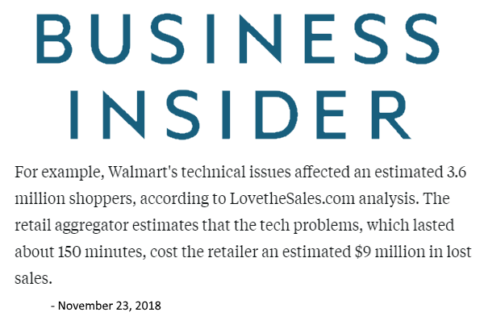
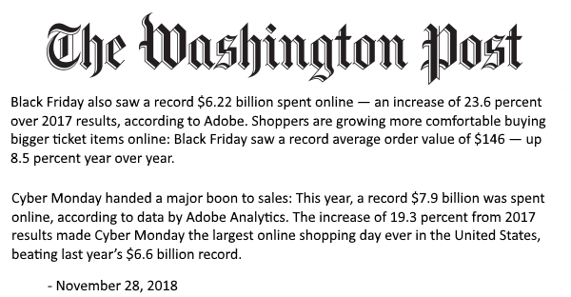
Availability
Thanksgiving: $3.7B
Black Friday: $6.2B
Cyber Monday: $7.9B
In addition to the revenue impact of lost sales, the bigger impact is the loyal customers a brand might lose from having a non-functioning website on one of the biggest shopping days of the year.
- Mehdi Daoudi, CEO Catchpoint
Multiple active replicas
+ Availability
+ Scale
Notes:
So to our themes for this talk. Let’s start with Availability. Companies build distributed applications because it increases availability. And to illustrate this fact I’m going to pick on retailers.
Thanksgiving in the US in 2018 was the start of a record holiday shopping season last year. Thanksgiving nearly $4B. Black Friday over $6B and the biggest sales EVER in the history of humans was Cyber Monday 2018 which saw nearly $8B in online retail sales in 24 hours.
$91K/second, $5.5M/minute, $329M/hour.
If you’re an online retailer, how much do you care about availability?
<click>
For a retailer, the entire year rests on the shoulders of these three days as to whether they make a profit or not for the year. Still many had issues with availability. Experienced retailers, Walmart, Jcrew, Old Navy, Macy’s, Lowes, all had significant downtime at some point during this important 3-day period.
<click>
Even an online retailer that I won’t name here was hit by an outage on it’s “Primo” Day in July 2018. By some estimates they lost $1.2M/minute. Outage lasted about 75 minutes so estimate loss at $90M.
<click>
But these losses aren’t just to holiday sales. Long term damage to brand if you can’t maintain availability. Lost loyalty and customers.
To be clear, these outages were not all database related. The point here is to illustrate the impact of availability. However, in nearly every case the underlying reasons were tied to not being able to scale to demand.
<click>
Globally distributing your database with multiple active replicas increases availability by eliminating single points of failure AND helps with scale because you can load balance across many instances.

Slide 7
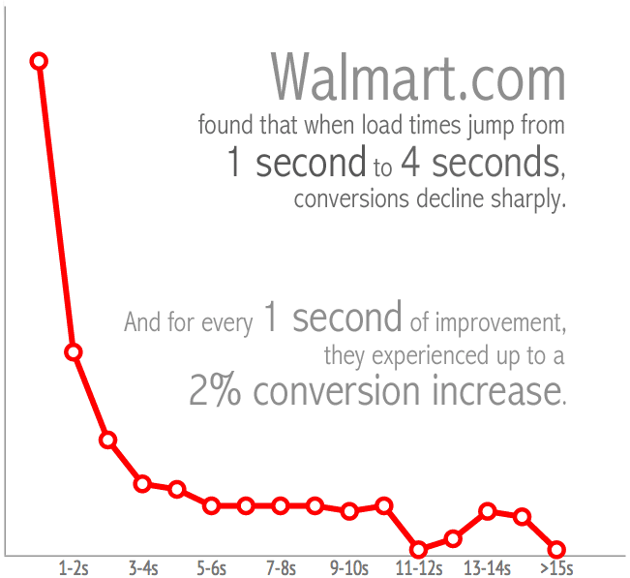
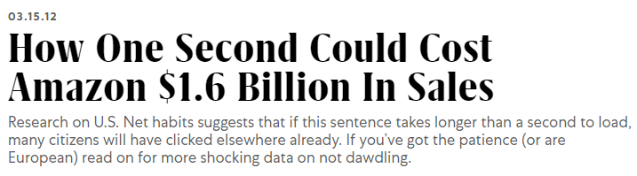
Latency
Latency = Performance
Performance = User Experience
User experience = $ and loyalty
Notes:
Next let’s talk about Latency. Along with availability it is why companies build globally distributed apps.
Latency IS performance.
The lower the latency the higher the performance.
Perf = UX
And UX = revenue
Performance is key for success. When apps are slow revenue is lost. Customers will abandon shopping carts and brands entirely if they have to wait too long.
If apps are too slow, they will think the company is too cheap to invest, reducing brand value.
<click>
Amazon’s calculated that a page load slowdown of just one second could cost it $1.6 billion in sales each year.
For every 100ms faster, 1% additional revenue.
<click>
This Walmart study is striking. If your site doesn’t load in less than 1-2 seconds conversions drop drastically.
Clearly latency is super important.
Web developers use CDN’s to make sites faster by bringing content local.
But if your site or app has a database you need to bring that local too.
True high-performance requires replicating the database to bring as close to users as possible.
So you might be thinking. Just put replicas everywhere and we’re good right?
Well, not exactly…

Slide 8
Notes (hidden)
This section introduces the concepts of CAP + PACELC.
These concepts are reinforced throughout the rest of this talk in slides and demos.
Am using extensive illustrations to help audience understand.
NEXT: <next slide title>

Slide 9
Science Time
Notes:
Time for some science.
Remember the three concepts we talked about at the beginning for what I wanted everyone to understand? Availability, Latency and Consistency?
Well we are going to dive into a little computer science here.
These concepts are key to understanding something fundamental to building distributed applications and databases in the cloud.

Slide 10
Defining consistency
A
Atomicity
C
Consistency
I
Isolation
D
Durability
Notes:
First, I want to define consistency.
For many, this is the “C” in ACID for a relational database in the context of a transaction.
<click>
But for distributed databases this word means something different.

Slide 11
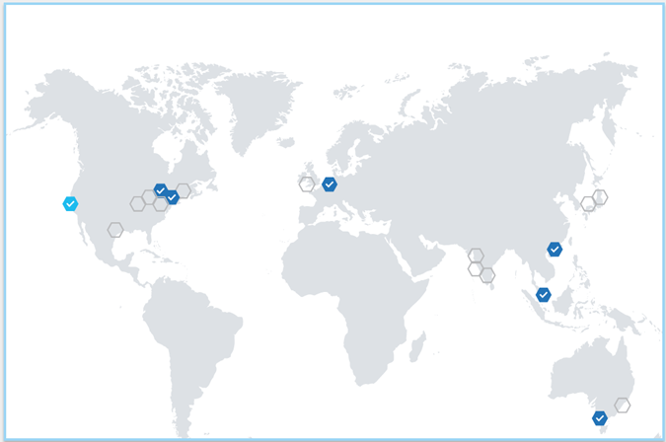
Defining consistency
Notes:
For a distributed database, consistency means the uniformity of data between replicas separated by hundreds or thousands of miles. This has nothing to do with a transaction.
Ok, with that definition let’s dive in.

Slide 12
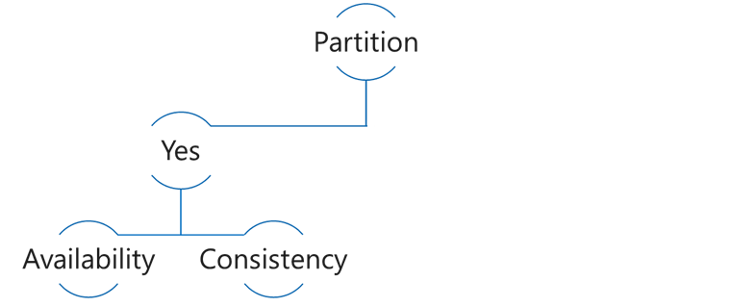
CAP Theorem
Consistency: Always get the most recent write, or an error
Availability: Every request receives a response, even if not the latest data
Partition tolerance: Continues to work even if replica connectivity lost
Choose Availability
5
5
6
5
Notes:
The first thing I want to explore with you is CAP theorem.
CAP theorem states it is impossible for a distributed computer system to simultaneously provide more than two out of the following three guarantees:
Consistency: Every read receives the most recent write or an error
Availability: Every request receives a (non-error) response – without the guarantee that it contains the most recent write
Partition tolerance: The system continues to operate despite an arbitrary number of messages being dropped (or delayed) by the network between nodes
<click>
Simply put: CAP says that if the network goes down between two replicas, you must choose between consistency or availability.
If I prioritize consistency and the network is cut, then I sacrifice availability because I cannot serve requests.
If I prioritize availability and the network is cut, then I sacrifice consistency because I cannot replicate changes.
Let’s explore what this looks like in practice.
<click>
In this example I have a database and a replica.
I am going to prioritize availability, meaning that no matter what, I always return requests.
<click>
So when the network is running fine, no problems.
<click>
<Audience question>
However, when the network is cut and I get a new insert. What result do users get?
Answer: Users are not going to get a consistent result.

Slide 13
CAP Theorem
Choose Consistency
5
5
6
Notes:
Ok, so what happens if you optimize for consistency.
Same example. But in this scenario I am prioritizing consistency.
This means that any writes to this database must be replicated before returning as committed to the user.
<click>
All good when the network is working.
<click> [Audience question] But what happens then if the network is cut?
<click> You are essentially down because the system cannot not replicate to remain consistent.
So CAP Theorem does a good job describing the choice users must make when the network is cut. But it actually doesn’t provide a full picture for customers when designing distributed systems.

Slide 14
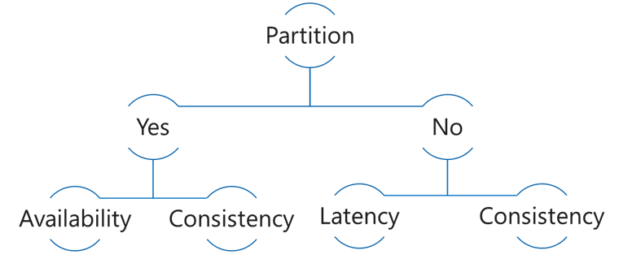
PACELC Theorem
In the case of network Partitioning in a distributed computer system, one has to choose between Availability and Consistency, but Else, even when the system is running normally in the absence of partitions, one has to choose between Latency and Consistency.
Choose Consistency
5
5
6
6
Notes:
That picture was completed with the introduction of the PACELC theorem which reads…
In the case of network Partitioning in a distributed computer system, one has to choose between Availability and Consistency, but Else, even when the system is running normally in the absence of partitions, one has to choose between Latency and Consistency.
<click>
Simply put: If the network goes down you choose between Consistency and Availability.
But even if the network is running you STILL have to choose between Latency and Consistency. You cannot have both.
So why is that?
<click>
Because when you use Strong consistency, writes must replicate to every region before being committed, thereby increasing latency (making you slower).
What’s more, the further the distance between the replicas, the worse the latency! Believe it or not, the speed of light is a factor in all this.
<click>To illustrate, in this example I’m choosing consistency.
<click>In this scenario when an update is written, the system must replicate it to every other region
<click>before it can ack as committed to the client.
<click>But because you can’t go faster than the speed of light, this effort to remain consistent introduces latency, making your applications slower.

Slide 15
PACELC Theorem
Choose Latency
5
5
6
6
7
7
Notes:
So next let’s choose Latency.
In this scenario you are willing to accept lower consistency.
The upside here is your you are faster because you don’t care if your data is consistent across all replicas.
Now you may think hey why would I want that. But it’s actually quite normal. When you ask the bank for your account balance it never goes back to your ledger and counts every transaction. It batches any changes periodically and calculates a new total and writes that to a materialized view. So it’s not as uncommon as people think, especially for an operational workload or where you are ingesting huge volumes of data.

Slide 16
Notes (hidden)
Reinforce Latency.
Highlight Cosmos DB enables low latency via single click replication.
Emphasize how multi-master makes this even better with low latency on writes from every region.
Show demo for single and multi-master accounts that shows the difference in write latency.
NEXT: <next slide title>

Slide 17
Latency
Notes:
Ok, so in the next few sections I’m going to recap Latency, Consistency and Availability and I’m going to use some demos to illustrate exactly what the PACELC theorem says.

Slide 18
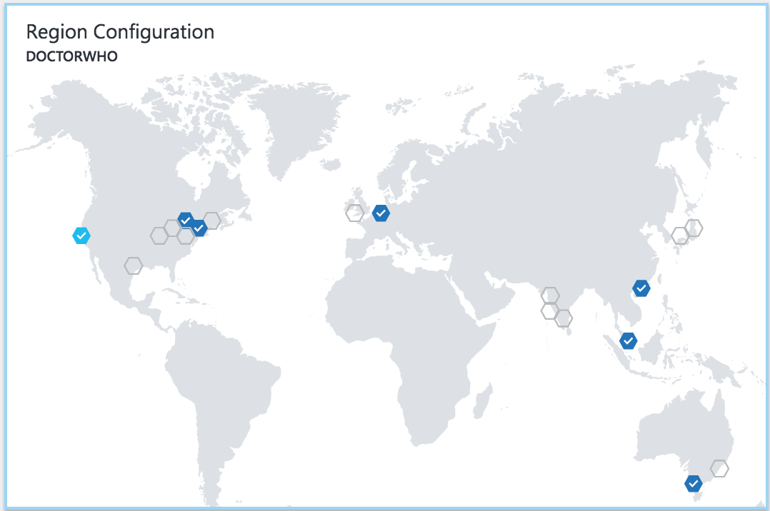
Latency
The lower the latency, the better the performance and experience
Notes:
So as described earlier, Latency = Performance and is critical for providing a better experience for their customers.
To reduce latency and increase performance, you put data closer to users by creating replicas.
This will have the biggest impact on latency for your applications.
Cosmos was built from the ground up with replication built into its core. You need only click your mouse to replicate data to any region making it extremely well suited for building modern applications for the cloud today.

Slide 19
Demo
Latency with single region, vs multi-region
Notes:
So I’d like to highlight what a difference replicating data can make on latency with a little demo.
Run demo 1. Read latency between single region and multi-region replicated accounts

Slide 20
Notes (hidden)
Reinforce Consistency.
Highlight Cosmos DB features.
Reinforce PACELC and emphasize/illustrate the tradeoff between consistency and latency
Show demo that shows what these differences actually look like for Eventual and Strong consistency for a multi-master account.
NEXT: <next slide title>

Slide 21
Consistency

Slide 22
FIVE WELL-DEFINED CONSISTENCY MODELS
Five consistency models to choose from
Choose the best consistency model for your app
Provides control over performance-consistency tradeoffs, backed by comprehensive SLAs
An intuitive programming model offering low latency and high availability for your planet-scale app
Strong
Bounded-staleness
Session
Consistent prefix
Eventual
Notes:
In the distributed database category, vendors such as AWS or Google provide only Strong and Eventual or Strong and Bounded Staleness consistency to choose from.
Cosmos provides 5 consistency levels to choose from including:
Strong: This model forces all data to be committed in every replicated region before returning to the user.
Bounded Staleness - Reads lag behind writes by k updates or t interval.
Session - Monotonic reads, monotonic writes, read-your-writes, write-follows-reads.
Consistent Prefix - Updates returned are in order, with no gaps.
Eventual – All writes are eventually consistent, with no guaranteed order.
So lots of choice but it goes further. You can configure a stronger consistency at the account level, then relax it in your app when you need to insert a bunch of data.
Also, no matter what consistency level, you get <10ms latency and 5-9’s availability!!! HUGE!!!

Slide 23
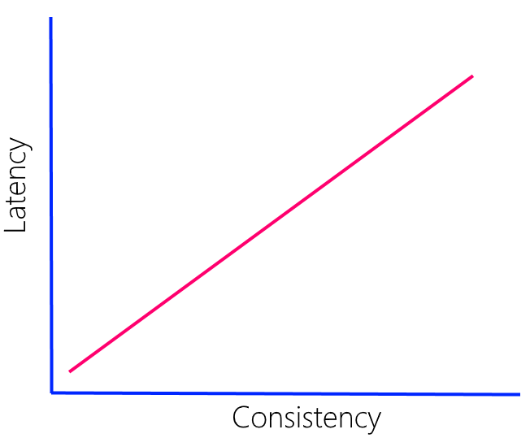
Latency vs. Consistency
Direct relationship
More pronounce with greater distance
Speed of light
WAN 10-15% slower
Strong consistency - multiple regions (<5000 miles)
Notes:
As I showed in the earlier slide on PACELC, customers must trade-off Latency for Consistency.
The stronger the consistency, the higher the latency.
In a distributed system with strong consistency, the speed of light can become a problem.
Packets cannot move faster than speed of light and in a WAN they move considerably slower. Packets can take >300 ms to travel between the furthest regions in Azure.
So in a strong consistency scenario, latency is going to be higher.
In addition, the greater the distance between the replicas, the worst the latency will be.
In Cosmos you can set up multiple regions with strong consistency. However these regions need to be within 5000 miles of each other.
Btw, there is no latency SLA on writes when you do this. You must trade off latency to gain the higher consistency.

Slide 24
Demo
Consistency vs. Latency
Notes:
I’d like to demonstrate the impact that Consistency can have on Latency.
In this demo I’ll show you the latency for two replicas with eventual consistency that are 1000 miles apart.
Then two with strong consistency that are the same distance.
Then to show the impact that distance and the speed of light has on this I’ll show two with strong consistency that is are about 2500 miles apart.
Demo: 2. Write latency for accounts with Eventual consistency vs. Strong consistency + impact of distance on Strong consistency

Slide 25
Notes (hidden)
Focus on Availability.
Highlight Cosmos DB SLAs for single and multi-master
Introduce RPO and RTO concepts.
Highlight deployment topologies for HA
Show RPO/RTO numbers highlighting Multi-master.
Tie everything back to PACELC.
NEXT: <next slide title>

Slide 26
Availability

Slide 27
Availability
SLA
Replicating increases availability
No single point of failure
99.999%
Notes:
How does being globally distributed mean greater availability?
<click>
The more replicas, the greater the availability as it eliminates single points of failure should a region become unavailable.
Clients simply redirect to the next closest region.
<click>
Cosmos DB provides 99.999% availability, guaranteed for read operations in multi-region deployments.

Slide 28
Durability and Recovery time
RTO = how long are you down
RPO = how long did you lose data
Notes:
For customers building distributed applications in the cloud understanding their needs around data durability and recovery time are key. There are two metrics that are used to measure both of these, RPO and RTO.
RTO = how long are you down.
RPO = how long did you lose data.
These terms are sometimes not well understood by developers building applications in the cloud. But they are essential to understand as they dictate what you must optimize for to meet the needs of your business or application.

Slide 29
High Availability – Single Master
Replicate across regions
Load balance at DNS level
Configure Failover:
Manual or Automatic
In Failover ->Read-only
RTO < 15 min
Notes:
To design for high availability (with SLA’s) using a single-master your architecture should generally look like this.
Traffic Manager
Load Balancer
Multiple Cosmos replicas
<click>
In single-master, if region goes down, app read-only for <15 min if automatic failover
<click> or until you fail over manually.
After that you are fully back online.

Slide 30
Notes (hidden)
Introduce multi-master, talk about its benefits and how to provision and configure in apps.
The rest of the talk expands on the benefits.
NEXT: <next slide title>

Slide 31
Cosmos DB Multi-Master
Notes:
So up to this point I’ve been talking about Cosmos DB and distributed databases with just a single-master or writable database and multiple read replicas.
I now want to talk about multi-master databases.

Slide 32




Azure Cosmos DB Multi Master​
Every region now writable​
<10 ms read AND write latency​
99.999% HA for reads AND writes​
Unlimited endpoint scalability
Flexible conflict resolution​​
Master
(read/write)
Region A
Master
(read/write)
Master
(read/write)
Region B
Replica
(read)
Azure Traffic Manager
Master
(read/write)
Region C
Replica
(read)
Notes:
In September 2018 MS GA’d Azure Cosmos DB Multi-master.
Multi-master makes every replica both readable and writable.
This gives you both <10 ms read AND write latency
with 5-9s availability for reads and writes
Providing unlimited endpoint scalability for applications
As well as flexible conflict resolution

Slide 33
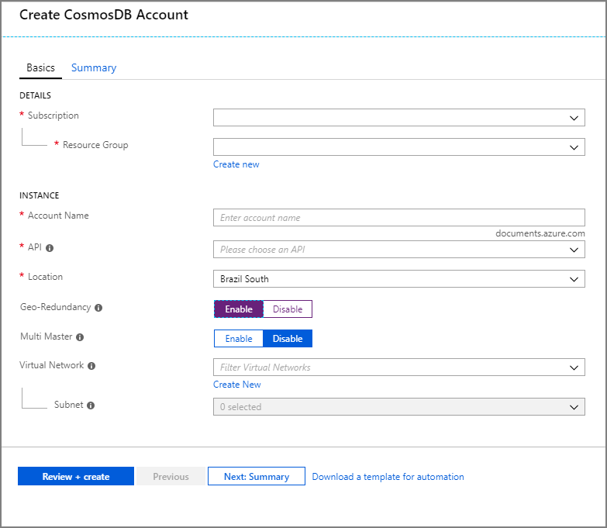
Adding multi master support
Create new Cosmos DB account
Enable Multi Master
Notes:
To get started with Multi-master support in Cosmos DB, customers first must create a new Cosmos DB account.
Simply enter your subscription, resource group, a new account name, API type and location or region.
Then select Multi-Master and click Create to provision a new account.

Slide 34
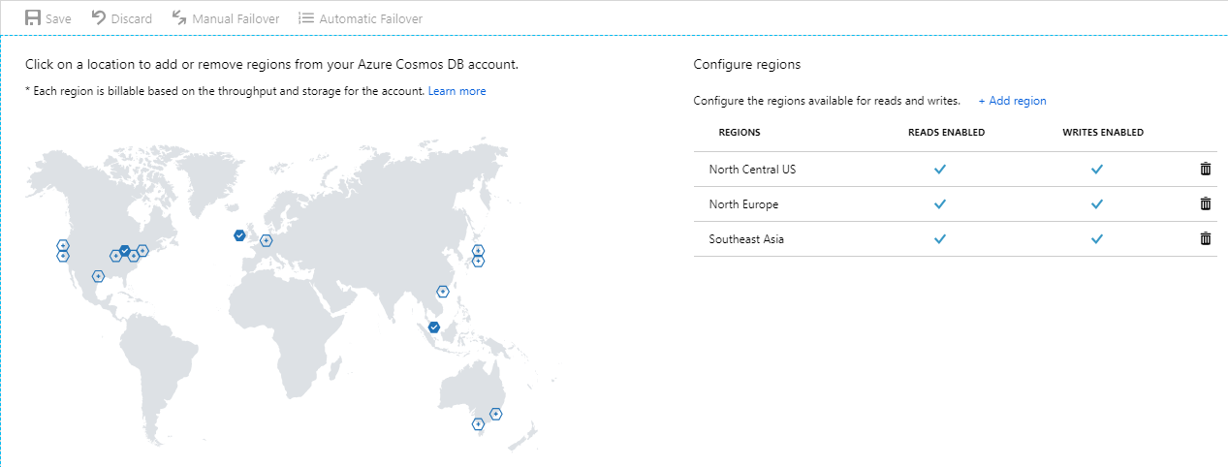
Configure regions
Add regions
Notes:
After your account is provisioned you can add regions to it.
Notice here how every region is now read and write in your account.

Slide 35
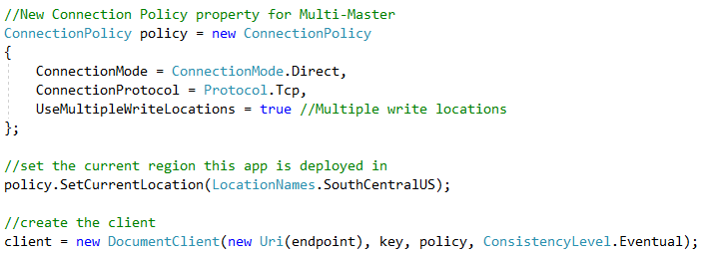
In your apps
UseMultipleWriteLocations
SetCurrentLocation
Notes:
Writing apps using multi-master enabled accounts is easy.
Simple add UseMultipleWriteLocations and set it to true.
Also call SetCurrentLocation. Cosmos will failover to the next closest region you are deployed to should a region become unresponsive.

Slide 36
High Availability – Multi Master
Same architecture
No failover to configure
No Failover:
Fully Writable
RTO = 0
Notes:
Apps using Multi-master are designed the same as single-master. No difference but TON of benefits.
First, there is no failover.
Because Multi-master makes every region writeable.
If region goes down, Cosmos client automatically redirects to next closest region.
So with multi-master, you effectively have zero RTO or downtime.
Let that sink in. A properly designed distributed app using Multi-master, customers can get an RTO of ZERO for their applications should a region go down.

Slide 37
Data Durability and Availability
Partition
Yes
Latency
Availability
Consistency
No
Consistency
Region(s) | Mode | Consistency | RPO | RTO
1 | Any | Any | < 240 minutes | < 1 week
>1 | Single Master | Session, Consistent Prefix, Eventual | < 15 minutes | < 15 minutes
>1 | Single Master | Bounded Staleness | K & T* | < 15 minutes
>1 | Single Master | Strong | 0 | < 15 minutes
>1 | Multi Master | Session, Consistent Prefix, Eventual | < 15 minutes | 0
>1 | Multi Master | Bounded Staleness | K & T* | 0
>1 | Multi Master | Strong | 0 | < 15 minutes
*Number of "K" updates of an item or "T" time. In >1 regions, K=100,000 updates or T=5 minutes.
Notes:
This table is Microsoft’s published RPO and RTO for Cosmos DB for Single and Multi-Master accounts across all consistency levels.
Single region, RPO 240 minutes or 4 hours. RTO of less than a week.
Don’t run Cosmos (or anything) in a single region.
Only get 5-9’s SLA if you run in multi-region.
With 1+ regions, great Cosmos DB availability.
Multi-master is where things start to get exiting.
You may be wondering. Why not RPO=0 and RTO=0? The reason is the CAP theorem.
<click>Remember this graphic?
When the network is cut you MUST choose between availability and consistency. If you are using Strong consistency then you must trade availability. This is why you have an RTO of greater than zero.
Another way to view this is RPO equals consistency and RTO equals availability.
The last thing I want to say here is the RTO here is orders of magnitude better than what you would get on any RDBMS. The best you will get for RTO and RPO for Azure SQL DB is RPO of 5 seconds with an RTO of an hour.
If availability is your customer’s priority, then the choice is Cosmos, because even with strong consistency you are back online in less than 15 minutes versus an hour in a regional event.

Slide 38
Demo
Latency for single-master vs. multi-master
Notes:
So let me do a demo to show just how awesome multi-master is.
In this demo I’ll show you the difference between two accounts Session Consistency in same regions.
Single master: Write: East US 2 and Read: West US 2
Multi-Master: Read/Write: East US 2, West US 2 and North Europe
Demo: 3. Read and write latency for Single-Master account versus Multi-Master account

Slide 39
Notes (hidden)
Focus on conflict resolution.
Describe each method.
Demo LWW and None.
NEXT: <next slide title>

Slide 40
Managing conflicts

Slide 41
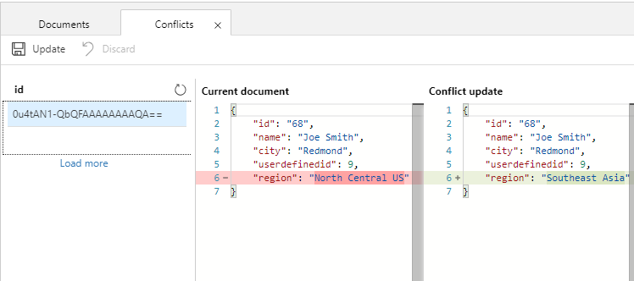
Flexible conflict management
Last Writer Wins
Custom Merge Stored Procedure
None – Conflict Feed
Notes:
Having fully writable replicas introduces the potential for conflicts.
We’ve made it easy for developers manage conflicts with flexible models to choose from including:
Last writer wins
Custom Merge Stored Procedure
None, write to the Conflict feed

Slide 42
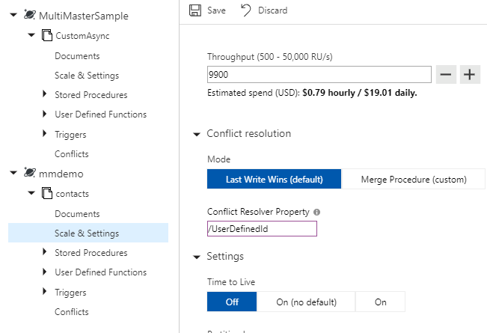
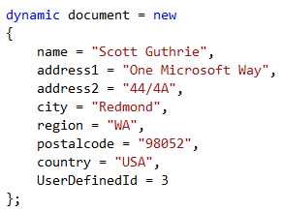
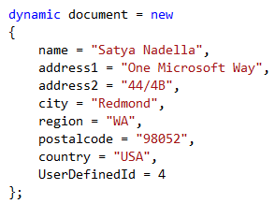
Last Writer Wins
Default
User defined numeric value or _ts
Available for all APIs
Notes:
Last-Writer-Wins is the default resolution mode.
In this mode, conflicts are resolved based on a numeric value passed in a property on the document.
Available for all API’s.
What happens:
Insert and update conflicts -> the item with the largest value becomes the winner.
Deletes, the delete always wins. We don’t resurrect deleted items.

Slide 43
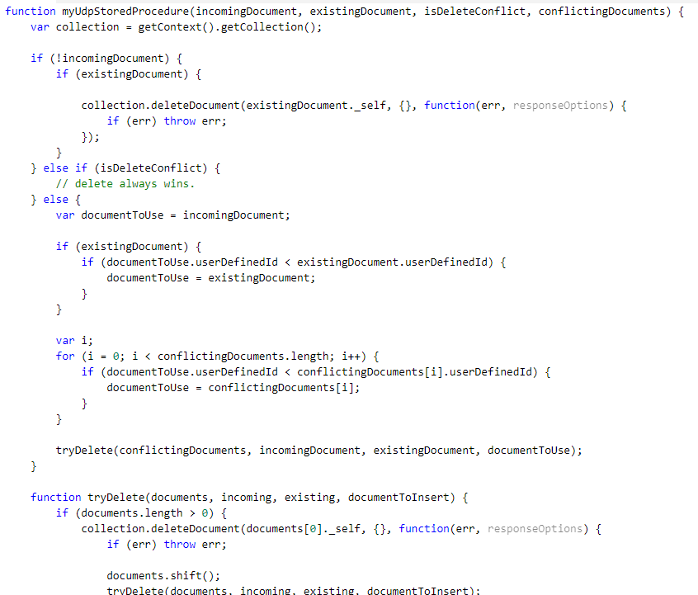
Custom Merge Stored Procedure
Register stored procedure
Special signature
Scope to container only
Exactly once guarantee
Executed as part of commit
Available for SQL API only
Notes:
The next resolution mode is Custom Merge Procedure.
Writes a stored procedure
Registers with the container.
Scoped to a container and partition key value
Specific signature that must be implemented.
After runs the system will drop the conflict.
If the proc throws exception we add to the conflicts feed.

Slide 44
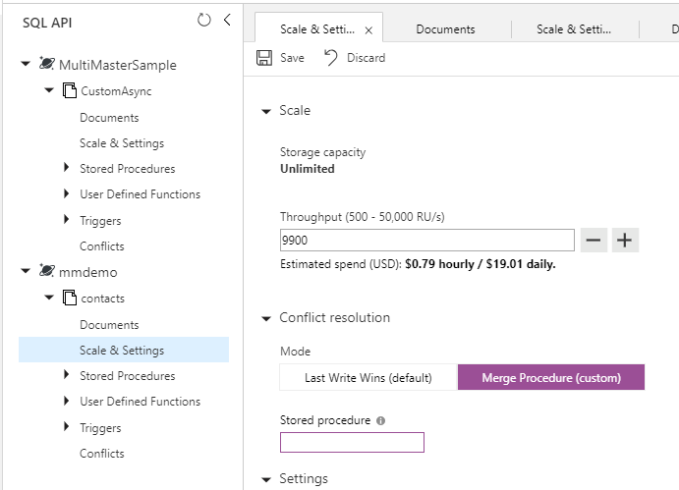
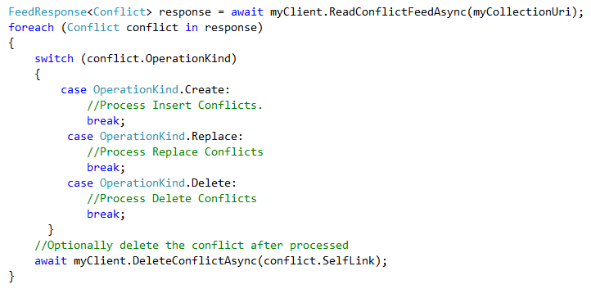
Conflict Feed
Leave procedure blank
Or exception in stored proc
Manually resolve
Notes:
Last there is No conflict resolution where we will write all conflicts to the Conflict Feed
Where you can resolve conflicts with custom app.
While this is more difficult, there is the benefit you as you can leverage any data or service you can access via your custom app.
After you process it you then can delete the conflict from the conflict feed.

Slide 45
Demo
Multi-Master Conflict Resolution
Notes:
Demo: 4. Multi-Master Conflict Resolution

Slide 46
Notes (hidden)
Focus on custom synchronization.
Describe the scenario and benefits
Demo by showing the code for how to implement.
Demo comparing strong for three regions vs. Session with strong between just two.
This section may get cut depending on run time.
NEXT: <next slide title>

Slide 47
Custom Synchronization
5 well defined consistency levels
Defined at account level, span all regions
Notes:
So as I’ve said earlier in this session, Cosmos offers 5 well-defined consistency level for customers to choose from to balance the tradeoff between the consistency, latency, and availability.
Strong consistency ensures data is synchronously persisted in every region the account is configured with. This provides the highest level of durability, but it comes at the cost of performance and availability.
However, you can employ a custom synchronization technique at the application layer that will give you higher data durability but not cost so much in performance and availability.

Slide 48
Demo
Custom Synchronization
Notes:
Demo: Custom Synchronization

Slide 49
Session takeaways
The relationship between availability, consistency and latency in designing modern apps.
Why Cosmos DB is the best choice for distributed cloud apps or where customers demand high availability and/or low latency.
The advantages of using Cosmos DB Multi-Master for HA and Latency.
How to employ a custom synchronization to increase data durability and limiting tradeoffs in latency.

Slide 50
Session resources
Demos: https://aka.ms/cosmos-global-demos
Global Distribution: https://aka.ms/cosmos-global-distribution
Consistency: https://aka.ms/cosmos-consistency-levels
High Availability: https://aka.ms/cosmos-high-availability

