Slide 1

Query with SQL API

Slide 2
Querying
Tuning query techniques and parameters to make the most efficient use of a globally distributed database service.
This module will reference querying in the context of the SQL API for Azure Cosmos DB.

Slide 3
SQL Query Syntax
Basic Query Syntax
The SELECT & FROM keywords are the basic components of every query.
SELECT
tickets.id,
tickets.pricePaid
FROM tickets
SELECT
t.id,
t.pricePaid
FROM tickets t
Notes:
https://www.documentdb.com/sql/demo

Slide 4
SQL Query Syntax - Where
Filtering
WHERE supports complex scalar expressions including arithmetic, comparison and logical operators
SELECT
tickets.id,
tickets.pricePaid
FROM tickets
WHERE
tickets.pricePaid > 500.00 AND
tickets.pricePaid <= 1000.00
Notes:
https://www.documentdb.com/sql/demo

Slide 5
SQL Query Syntax - Projection
JSON Projection
If your workloads require a specific JSON schema, Azure Cosmos DB supports JSON projection within its queries
SELECT {
"id": tickets.id,
"flightNumber": tickets.assignedFlight.flightNumber,
"purchase": {
"cost": tickets.pricePaid
},
"stops": [
tickets.assignedFlight.origin,
tickets.assignedFlight.destination
]
} AS ticket
FROM tickets
[
{
"ticket": {
"id": "6ebe1165836a",
"purchase": {
"cost": 575.5
},
"stops": [
"SEA",
"JFK"
]
}
}
]
Notes:
https://www.documentdb.com/sql/demo

Slide 6
SQL Query Syntax - Projection
Select Value
The VALUE keyword can further flatten the result collection if needed for a specific application workload
SELECT {
"id": tickets.id,
"flightNumber": tickets.assignedFlight.flightNumber,
"purchase": {
"cost": tickets.pricePaid
},
"stops": [
tickets.assignedFlight.origin,
tickets.assignedFlight.destination
]
} AS ticket
FROM tickets
[
{
"ticket": {
"id": "6ebe1165836a",
"purchase": {
"cost": 575.5
},
"stops": [
"SEA",
"JFK"
]
}
}
]
Notes:
https://www.documentdb.com/sql/demo

Slide 7
Intra-Document Join
Azure Cosmos DB supports intra-document JOIN’s for de-normalized arrays
Let’s assume that we have two JSON documents in a collection:
{
"pricePaid": 575.5,
"assignedFlight": {
"number": "F125",
"origin": "SEA",
"destination": "JFK"
},
"seat": “12A",
"requests": [
"kosher_meal",
"aisle_seat"
],
"id": "6ebe1165836a"
}
{
"pricePaid": 234.75,
"assignedFlight": {
"number": "F752",
"origin": "SEA",
"destination": "LGA"
},
"seat": "14C",
"requests": [
"early_boarding",
"window_seat"
],
"id": "c4991b4d2efc"
}
We are interested in querying an array internal to the document
SQL

Slide 8
Intra-Document Join
We can filter on a particular array index position without JOIN:
[
{
"number":"F125","seat":"12A",
"requests": [
"kosher_meal",
"aisle_seat"
]
}
]
SELECT
tickets.assignedFlight.number,
tickets.seat,
ticket.requests
FROM
tickets
WHERE
ticket.requests[1] == "aisle_seat"
SQL

Slide 9
Intra-Document Join
JOIN allows us to merge embedded documents or arrays across multiple documents and returned a flattened result set:
[
{
"number":"F125","seat":"12A",
"requests":"kosher_meal"
},
{
"number":"F125","seat":"12A",
"requests":"aisle_seat"
},
{
"number":"F752","seat":"14C",
"requests":"early_boarding"
},
{
"number":"F752","seat":"14C",
"requests":"window_seat"
}
]
SELECT
tickets.assignedFlight.number,
tickets.seat,
requests
FROM
tickets
JOIN
requests IN tickets.requests
SQL

Slide 10
Intra-Document Join
Along with JOIN, we can also filter the cross products without knowing the array index position:
[
{
"number":"F125","seat":"12A“,
"requests": "aisle_seat"
},
{
"number":"F752","seat":"14C",
"requests": "window_seat"
}
]
SELECT
tickets.id, requests
FROM
tickets
JOIN
requests IN tickets.requests
WHERE
requests
IN ("aisle_seat", "window_seat")
SQL

Slide 11
Paginated Query Results
Straightforward approach to paginate the results:
var query = client.CreateDocumentQuery<ExampleEntity>(collectionUri, options);
var docQuery = query.AsDocumentQuery();
List<ExampleEntity> results = new List<ExampleEntity>();
while (docQuery.HasMoreResults)
{
foreach (ExampleEntity item in await query.ExecuteNextAsync())
{
results.Add(item);
}
}

Slide 12
Paginated Query Results
Pagination with ToList():
var query = client.CreateDocumentQuery<ExampleEntity>(collectionUri, options);
var docQuery = query.AsDocumentQuery();
List<ExampleEntity> results = new List<ExampleEntity>();
results = query.ToList();
ToList() automatically iterates through all pages

Slide 13

Paginated Query Results
Pagination with hasNext() in Java:
Iterator<Document> documents = client.queryDocuments(
collectionLink,
queryString,
options
).getQueryIterator();
while(documents.hasNext()) {
Document current = documents.next();
}

Slide 14
Sql Query Parametrization
var query = client.CreateDocumentQuery<ExampleEntity>(collectionUri,
new SqlQuerySpec
{
QueryText = "SELECT * FROM dataset s WHERE (s.id = @id)",
Parameters = new SqlParameterCollection
{
new SqlParameter("@id", “exampleIdentifier")
}
}, options
);
List<ExampleEntity> results = new List<ExampleEntity>();
results = query.ToList<ExampleEntity>();

Slide 15
SQL Query In Linq
var query = client.CreateDocumentQuery<ExampleEntity>(collectionUri, options);
var docQuery = query
.Where(s => s.LastName == "Andersen")
.Select(s => new { Name = s.LastName })
.AsDocumentQuery();
List<ExampleEntity> results = new List<ExampleEntity>();
results = query.ToList<ExampleEntity>();

Slide 16
Query Tuning
Some important Cosmos DB query performance factors include:
Provisioned throughput
Measure RU per query, and ensure that you have the required provisioned throughput for your queries
Partitioning and partition keys
Favor queries with the partition key value in the filter clause for low latency
SDK and query options
Follow SDK best practices like direct connectivity, and tune client-side query execution options
Network latency
Account for network overhead in measurement, and use multi-homing APIs to read from the nearest region

Slide 17
Query Tuning
Additional important Cosmos DB query performance factors include:
Indexing Policy
Ensure that you have the required indexing paths/policy for the query
Query Complexity
Use simple queries to enable greater scale.
Query execution metrics
Analyze the query execution metrics to identify potential rewrites of query and data shapes
Notes:
Query Complexity: avoid using complex queries (such as MongoDB aggregation pipeline) whenever simpler queries are possible (such as find/SELECT with filter condition). Simpler queries scale much better.

Slide 18
Client Query Parallelism
Cross-Partition queries can be parallelized to use as many threads as possible
Modern processors ship with both physical and virtual (hyper-threading) cores. For any given cross-partition query, the SDK can use concurrent threads to issue the query across the underlying partitions.
By default, the SDK uses a slow start algorithm for cross-partition queries, increasing the amount of threads over time. This increase is exponential up to any physical or network limitations.
Primary Thread
Concurrent Thread
DOP = 4
Concurrent Thread
Concurrent Thread
Query Thread
DOP = 1

Slide 19
Client Response Buffer
2
First Request
1
3
First Response
6
4
Concurrent Request
5
Client Buffer
Concurrent Response
Notes:
The client device’s code using an SDK to issue a request
The SDK issues the first request for query results to the Azure Cosmos DB service
The Azure Cosmos DB service returns the first set of results to be processed by the client (serialization, etc)
While the client is processing the first set of results, a concurrent request is sent to pre-fetch additional results
The items returned as a response of the current request are then stored in a client-side buffer
Buffered items are processed by the client SDK

Slide 20
SDK Query Options
These two options can be tuned through the sdk. While there are tradeoffs for each, it is important to understand that neither has any impact on total RU’s consumed
Decreased Thread Usage
Slower Performance
Increased Thread Usage
Faster Performance
0
Max Degree of Parallelism
∞
Smaller Memory Footprint
Slower Performance
Larger Memory Footprint
Faster Performance
0
Max Buffered Item Count
∞

Slide 21
SDK Query Options
Setting | Value | Effect
MaxDegreeofParallelism | -1 | The system will automatically decide the number of items to buffer
 | 0 | Do not add any additional concurrent threads
 | >= 1 | Add the specified number of additional concurrent threads
MaxBufferedItemCount | -1 | The system will automatically decide the number of concurrent operations to run
 | 0 | Do not maintain a client-side buffer
 | >= 1 | Specify the maximum size (items) of the client-side buffer

Slide 22
Review Of Request Units
Request Units (RUs) is a rate-based currency
Abstracts physical resources for performing requests
Key to multi-tenancy, SLAs, and COGS efficiency
Foreground and background activities
% Memory
% CPU
% IOPS

Slide 23
Measuring RU Charge
Analyze Query Complexity
The complexity of a query impacts how many Request Units are consumed for an operation. The number of predicates, nature of the predicates, number of system functions, and the number of index matches / query results all influence the cost of query operations.
Measure Query Cost
To measure the cost of any operation (create, update, or delete):
Inspect the x-ms-request-charge header
Inspect the RequestCharge property in ResourceResponse or FeedResponse in the SDK
Number Of Indexed Terms Impacts Write RU Charges
Every write operation will require the indexer to run. The more indexed terms you have, the more indexing will be directly having an effect on the RU charge.
You can optimize for this by fine-tuning your index policy to include only fields and/or paths certain to be used in queries.

Slide 24
Measuring RU Charge
Stabilized Logical Charges
Azure Cosmos DB uses information about past runs to produce a stable logical charge for the majority of CRUD or query operations.
Since this stable charge exists, we can rely on our operations having a high degree of predictability with very little variation. We can use the predictable RU charges for future capacity planning.
Bulk Of Query RU Charges is IO
Query RU is directly proportional to the quantity of query results.
Notes:
Azure Cosmos DB uses ML to produce a stable logical charge for vast majority of operations (CRUD and query). This gives a high degree of predictability for capacity planning (if creating document X costs 5 RU’s today, we can rely on the fact that it will cost 5 RU’s tomorrow). This isolates RU charge from variability in physical resource utilization due to other noisy processes like garbage collection

Slide 25
RU Charge Measurement Example
ResourceResponse<Document> response = await client.CreateDocumentAsync(
collectionLink,
document
);
var requestUnits = response.RequestCharge;

Slide 26

RU Charge Measurement Example
client.createDocument(
collectionLink,
documentDefinition,
function (err, document, headers) {
if (err) {
console.log(err);
}
var requestData = headers['x-ms-request-charge'];
}
);

Slide 27
RU Charge Measurement Example
ResourceResponse<Document> response = client.createDocument(
collectionLink,
documentDefinition,
null,
false
);
Double requestCharge = response.getRequestCharge();

Slide 28
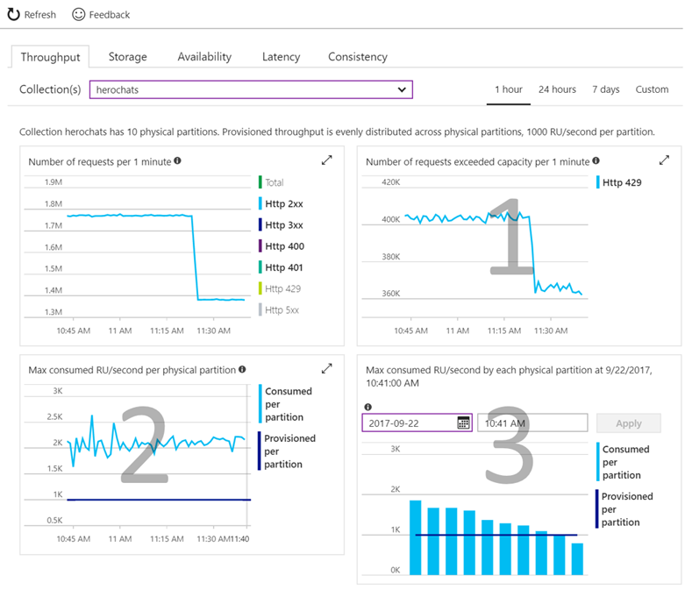
Validating Provisioned Throughput Choice
Check if your operations are getting rate limited.
Requests exceeding capacity chart
Check if consumed throughput exceeds the provisioned throughput on any of the physical partitions
Max RU/second consumed per partition chart
Select the time where the maximum consumed throughput per partition exceeded provisioned on the chart
Max consumed throughput by each partition chart
Notes:
Check if your operations are getting throttled.
Look at the "Requests exceeding capacity" chart on the throughput tab.
Check if consumed throughput exceeds the provisioned throughput on any of the physical partitions
Look at the "Max RU/second consumed per partition" metric.
Select the time where the maximum consumed throughput per partitions exceeded provisioned on the chart
Look at the "Max consumed throughput by each partition" chart

Slide 29

Cross-Partition Aggregate
Low-Latency Aggregations:
You can submit a simple SQL query and Azure Cosmos DB handles the routing of the query among data partitions and merges results to return the final aggregate values.
SELECT VALUE
COUNT(1)
FROM
telemetry t
WHERE
t.deviceId = "craft267_seat17"
Example – Contoso Connected Car
Notes:
Regardless of the size or number of partitions in your collection, you can submit a simple SQL query and Azure Cosmos DB handles the routing of the query among data partitions, runs it in parallel against the local indexes within each matched partition, and merges intermediate results to return the final aggregate values.

Slide 30
Bounded Location Search Using Geo-Data
{
"type":"Point",
"coordinates":[ 31.9, -4.8 ]
}
{
"type":"Polygon",
"coordinates":[[
[ 31.8, -5 ],
[ 31.8, -4.7 ],
[ 32, -4.7 ],
[ 32, -5 ],
[ 31.8, -5 ]
]]
}
GEOJSON SPECIFICATION
Azure Cosmos DB supports indexing and querying of geospatial point data that's represented using the GeoJSON specification.
SEARCH BY DISTANCE FROM POINT
The ST_DISTANCE built-in function returns the distance between the two GeoJSON Point expressions.
SEARCH WITHOUT BOUNDED POLYGON
The ST_WITHIN built-in function returns a Boolean indicating whether the first GeoJSON Point expression is within a GeoJSON Polygon expression.
Notes:
GeoJSON data structures are always valid JSON objects, so they can be stored and queried using Azure Cosmos DB without any specialized tools or libraries. The Azure Cosmos DB SDKs provide helper classes and methods that make it easy to work with spatial data.
Both the ST_DISTANCE and ST_WITHIN functions can be used with Polygons and LineStrings in addition to Points.
f you include spatial indexing in your indexing policy, then "distance queries" will be served efficiently through the index. For more details on spatial indexing, see the section below. If you don't have a spatial index for the specified paths, you can still perform spatial queries by specifying x-ms-documentdb-query-enable-scan request header (or FeedOptions.EnableScanInQuery using the SDK) with the value set to "true".

Slide 31
Distance From Center Point Search
SELECT *
FROM flights f
WHERE ST_DISTANCE(f.origin.location, {
"type": "Point",
"coordinates": [-122.19, 47.36]
}) < 100 * 1000
ST_DISTANCE
ST_DISTANCE can be used to measure the distance between two points. Commonly this function is used to determine if a point is within a specified range (meters) of another point.

Slide 32
Polygon Shape Search
SELECT *
FROM flights f
WHERE ST_WITHIN(f.destination.location, {
"type": "Polygon",
"coordinates": [[
[-124.63, 48.36],
[-123.87, 46.14],
[-122.23, 45.54],
[-119.17, 45.95],
[-116.92, 45.96],
[-116.99, 49.00],
[-123.05, 49.02],
[-123.15, 48.31],
[-124.63, 48.36]
]]
})
ST_WITHIN
ST_WITHIN can be used to check if a point lies within a Polygon. Commonly Polygons are used to represent boundaries like zip codes, state boundaries, or natural formations.
Polygon arguments in ST_WITHIN can contain only a single ring, that is, the Polygons must not contain holes in them.
Notes:
Again if you include spatial indexing in your indexing policy, then "within" queries will be served efficiently through the index.

