Slide 1

Change Feed

Slide 2
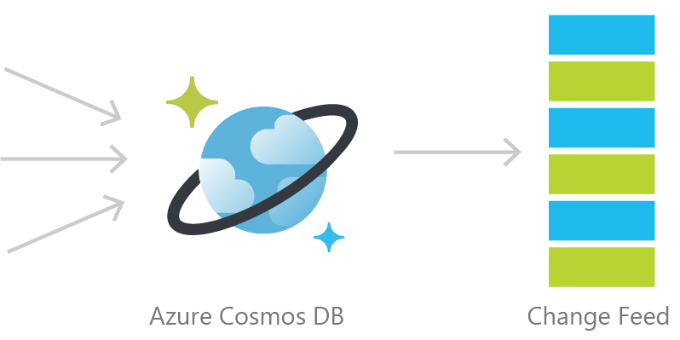
Cosmos DB Change Feed
Persistent log of documents within an Azure Cosmos DB collection in the order in which they were modified

Slide 3
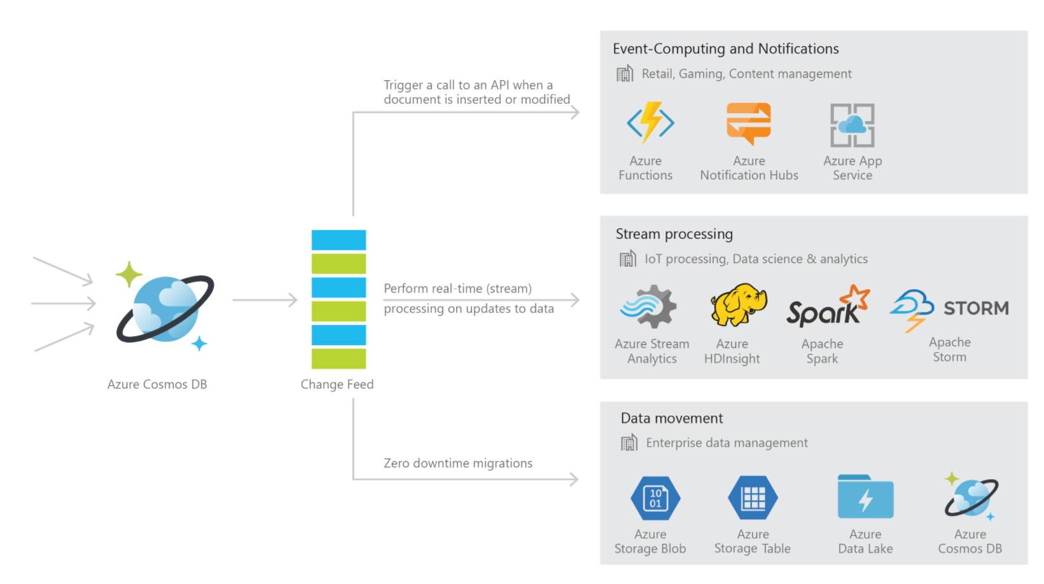

Slide 4


Common Scenarios
Event Sourcing (Microservices)
Read From Change Feed
Persistent Event Store
Microservice
#1
Microservice #2
New Order
Microservice #3
Trigger Action From Change Feed

Slide 5



Retail Order Processing Pipelines
Azure Functions
(E-Commerce Checkout API)
Azure Cosmos DB (Order Event Store)
. . .
Azure Functions
(Microservice 1: Tax)
Azure Functions
(Microservice 2: Payment)
Azure Functions
(Microservice N: Fulfillment)

Slide 6
Common Scenarios
Backup Collection
Data Movement / Backup
Access upon main collection failure
Replicate Updates
Main Collection
Secondary Collections
CRUD Data
Read access, e.g. for analytics
…

Slide 7
Common Scenarios
3 Materialized View
Application
Cosmos DB
Materialized View
SubscriptionID | UserID | Create Date | …
123abc | Ben6 | 6/17/17
456efg | Ben6 | 3/14/17
789hij | Jen4 | 8/1/16
012klm | Joe3 | 3/4/17
UserID | Total Subscriptions
Ben6 | 2
Jen4 | 1
Joe3 | 1

Slide 8
3 Different ways to use the Change Feed
Implementation | Use Case | Advantages
Azure Functions | Serverless applications | Easy to implement. Used as a trigger, input or output binding to an Azure Function.
Change Feed Processor Library | Distributed applications | Ability to distribute the processing of events towards multiple clients. Requires a “leases collection”.
SQL API SDK for .NET or Java | Not recommended | Requires manual implementation in a .NET or Java application.

Slide 9
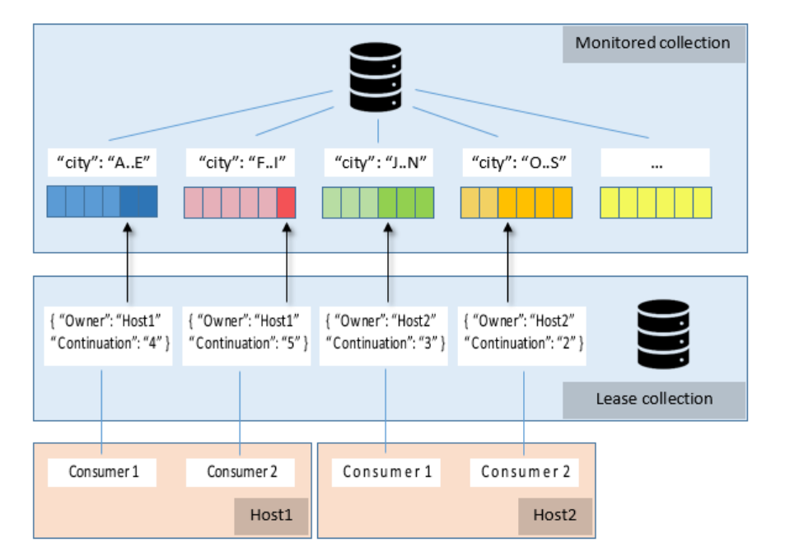
Using the Change Feed Processor Library
Spin up instances of the processor as needed
Each host has consumers = observer to implement
Each host assigns itself leases on partitions to monitor
On each change, logic in consumers gets triggered
1 lease collection stored in Cosmos DB

Slide 10
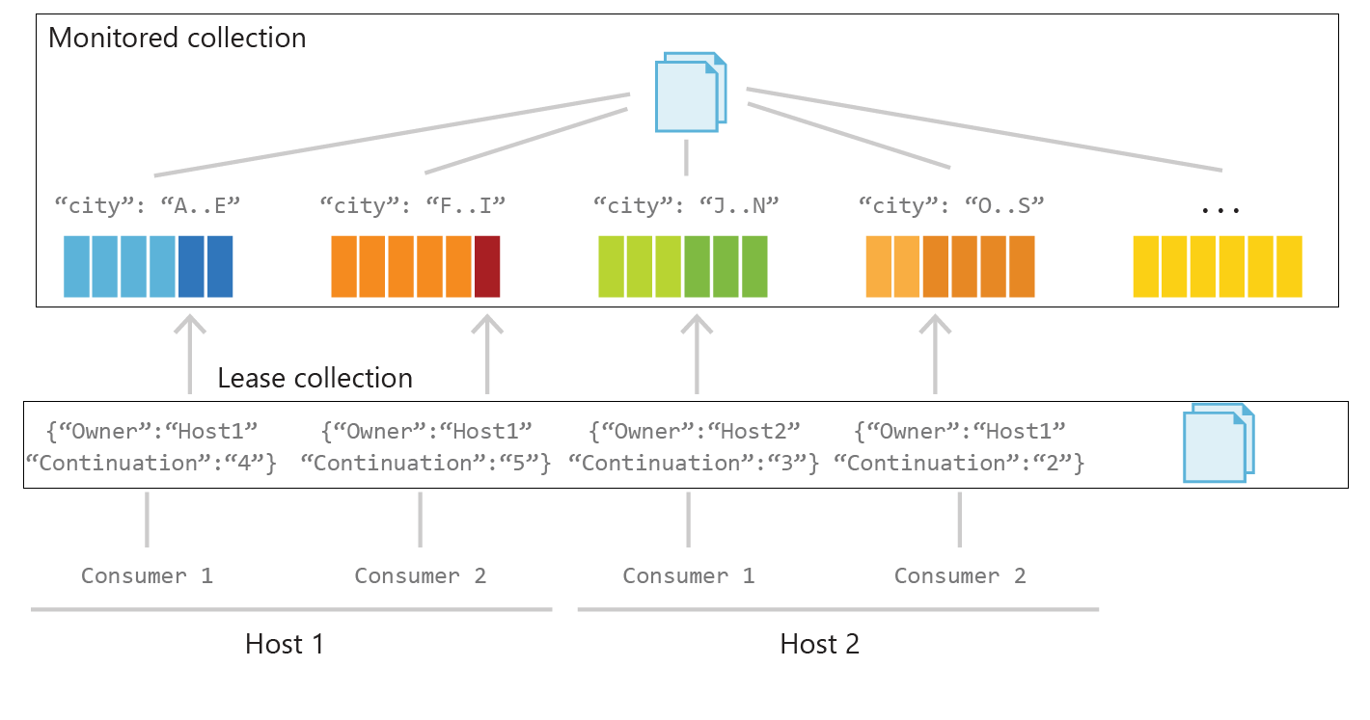

Slide 11
Change Feed Processor – Interface Implementation
public class DocumentFeedObserver : IChangeFeedObserver
{
...
public Task IChangeFeedObserver.ProcessChangesAsync(ChangeFeedObserverContext context, IReadOnlyList<Document> docs)
{
Console.WriteLine("Change feed: {0} documents", Interlocked.Add(ref totalDocs, docs.Count));
foreach(Document doc in docs)
{
Console.WriteLine(doc.Id.ToString());
}
return Task.CompletedTask;
}
}

Slide 12
Change Feed Processor - Registration
DocumentFeedObserver docObserver = new DocumentFeedObserver();
ChangeFeedEventHost host = new ChangeFeedEventHost(
hostName,
documentCollectionLocation,
leaseCollectionLocation,
feedOptions,
feedHostOptions
);
await host.RegisterObserverAsync(docObserverFactory);

Slide 13
Azure Cosmos DB Change Feed FAQ
Automatically enabled in any Cosmos DB database account.
Uses the existing allocated request units for processing events
Executed on insert and update operations. Delete support can be implemented with a flag.

