Slide 1

Global Distribution

Slide 2
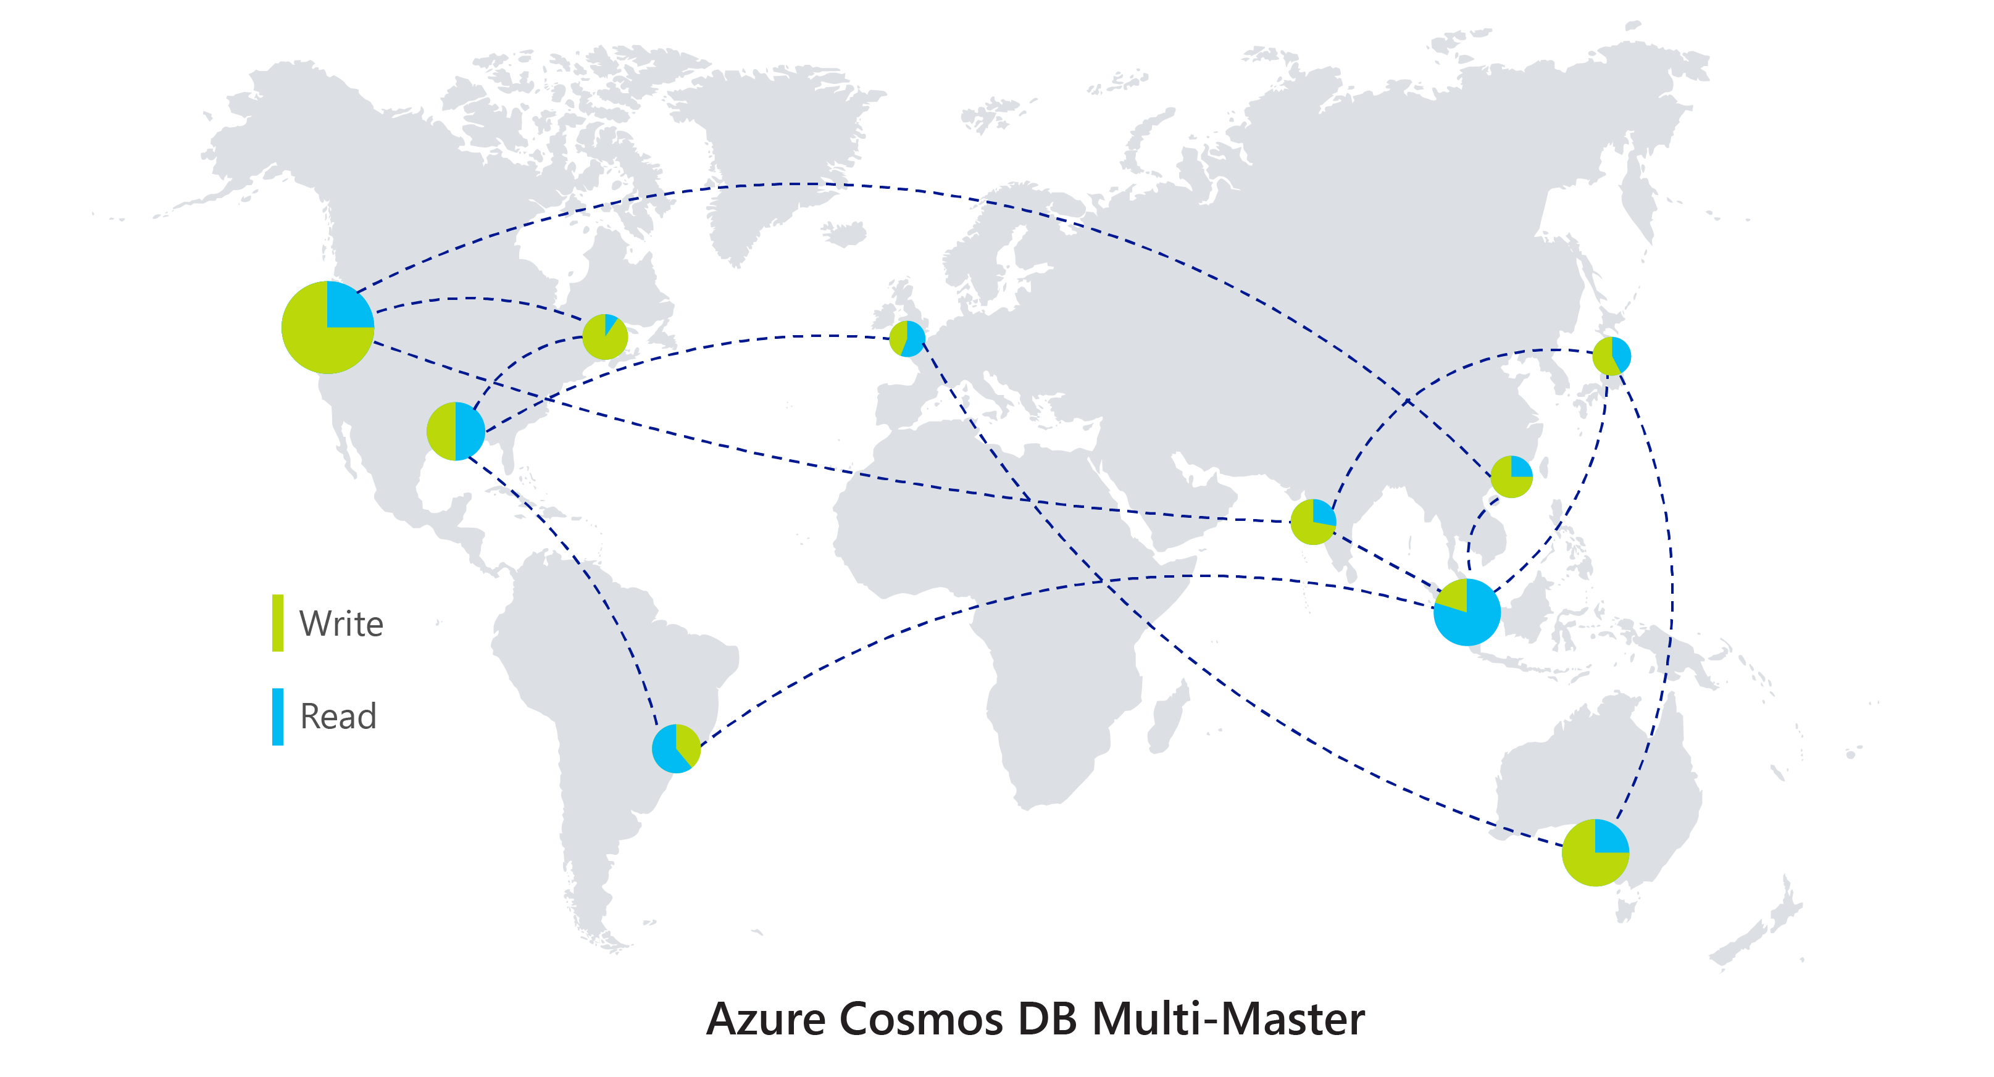
Multi-Master – Read/Write in any region
Benefits
Write scalability around the world
Low latency (<10ms P99 for 1kb document) writes around the world
99.999% High Availability around the world
Well-defined consistency models
Automatic conflict management

Slide 3
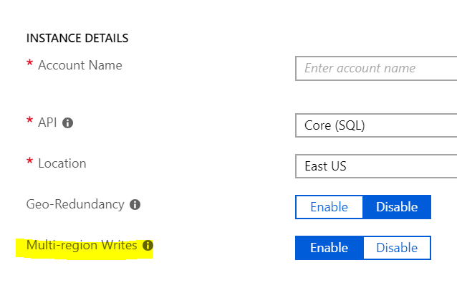
How to use it
Enable multi-master upon account creation

Slide 4
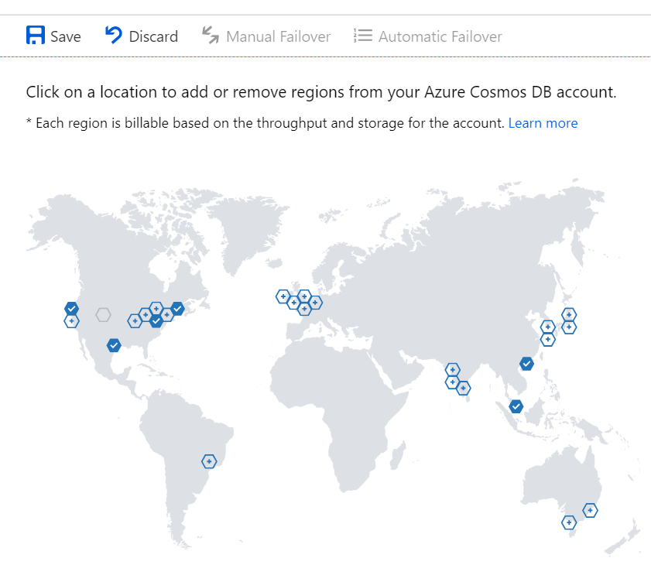
How to use it
Add desired regions via Portal

Slide 5
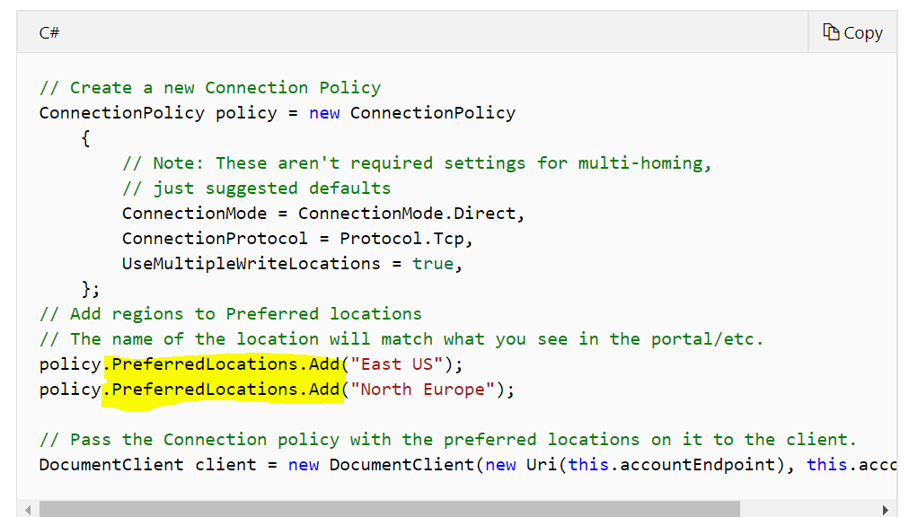
How to use it
Add preferred regions in SDK

Slide 6
What happens if region goes down?
Account type | Region goes down | What happens?
Single-master | Write | Customer needs to enable automatic failover Read region will be promoted to write region
 | Read | SDK routes to next preferred region, or write region if none set
Multi-master | Write | SDK routes to next preferred region
 | Read

Slide 7
Consistency
In a distributed system, where data is being replicated across regions, what version of data do readers see?
Latest version?
Old version?
Answer: Depends on consistency level

Slide 8
ACID != CAP
Consistency w.r.t. Transactions is NOT the same thing as Consistency w.r.t. Replication.
this is about moving from one valid state to another for a single given transaction
this about getting a consistent view across replicated copies of data

Slide 9
CAP Theorem
Brewer’s CAP Theorem: impossible for distributed data store to simultaneously provide more than 2 out of the following 3 guarantees:
Consistency, Availability, Partition Tolerance (in the face of network failures)
In reality, we need to ensure partition tolerance, so tradeoff is between consistency and availability

Slide 10
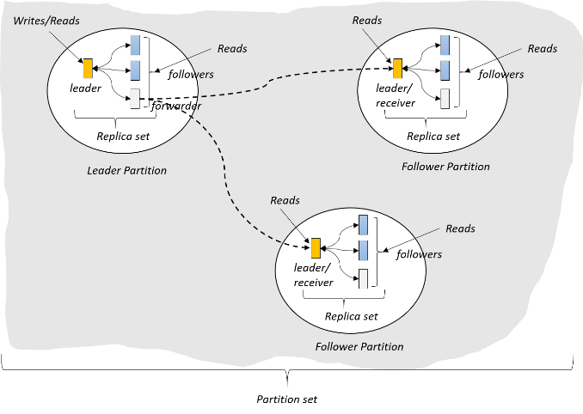
3 different regions
(West US)
(East US)
A
C
B
(North Europe)

Slide 11
3 different regions – value of record = 5
Value = 5
Value = 5
A
C
B
Value = 5

Slide 12
3 different regions – Value updated to 6 in Region A
Value = 5 6
Update 5 => 6
Value = 5
A
C
B
Value = 5

Slide 13
3 different regions – Network failure between A and B
Value = 5 6
Update 5 => 6
Value = 5 6
A
C
B
Value = 5
What happens when a network partition is introduced?

Slide 14
What should Region B see?
See 5: (prioritize availability)
Go offline until network is back: (prioritize consistency
Value = 5 6
Update 5 => 6
Value = 5 6
A
C
B
Value = 5
What happens when a network partition is introduced?
Region B does a read

Slide 15
CAP Theorem
Brewer’s CAP Theorem: impossible for distributed data store to simultaneously provide more than 2 out of the following 3 guarantees:
Consistency, Availability, Partition Tolerance (in the face of network failures)
In reality, we need to ensure partition tolerance, so tradeoff is between consistency and availability

Slide 16
What about in a normally functioning system?
PACELC Theorem: In the case of network partitioning (P) in a distributed computer system, one has to choose between availability (A) and consistency (C) (CAP Theorem)
but else (E), even when the system is running normally in the absence of network failures, one has to choose between latency (L) and consistency (C).

Slide 17
Region A updates 5->6, replicates to region C
Value = 5 6
Update 5 => 6
Value = 5 6
A
C
B
Value = 5
Latency: packet of information can travel as fast as speed of light.
Replication between distant geographic regions can take 100’s of milliseconds

Slide 18
Region A updates 5->6, replicates to region C. What value does B see?
Reader C: What is the value?
Value = 5 6
Update 5 => 6
Value = 5 6
A
C
B
Value = 5
Reader B: What is the value?

Slide 19
See 5 immediately: (prioritize latency)
Wait for 6 to propagate: (prioritize consistency
What value does B see?
Reader A: What is the value?
Value = 5 6
Update 5 => 6
Value = 5 6
Value = 5

Slide 20
What about in a normally functioning system?
PACELC Theorem: In the case of network partitioning (P) in a distributed computer system, one has to choose between availability (A) and consistency (C) (CAP Theorem)
but else (E), even when the system is running normally in the absence of network failures, one has to choose between latency (L) and consistency (C).

Slide 21

Programmable Data Consistency
Choice for most distributed apps
Strong consistency High latency
Eventual consistency, Low latency

Slide 22
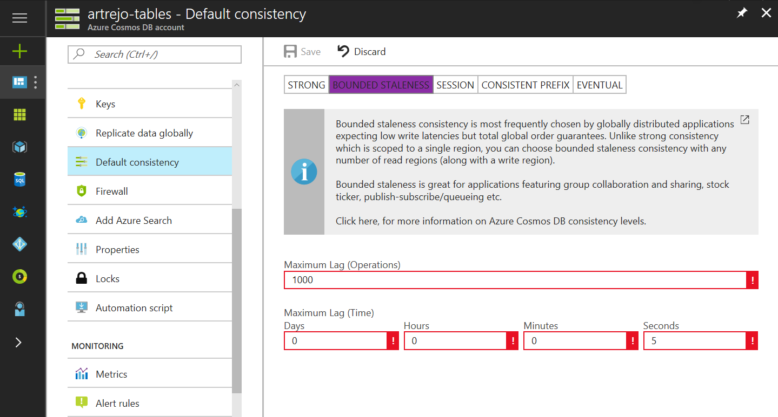
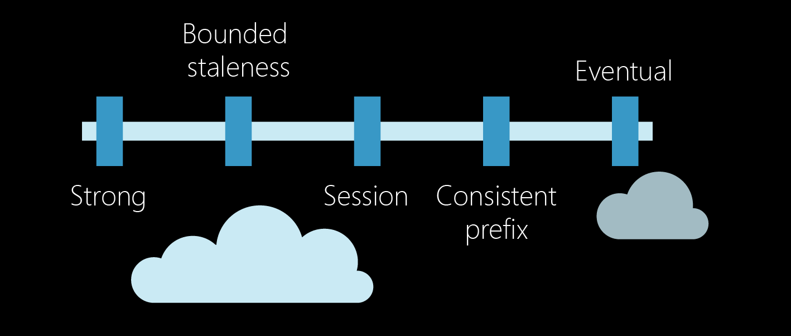
Well-Defined Consistency Models
Well-Defined Consistency Models
Intuitive programming model
5 Well-defined, consistency models
Overridable on a per-request basis
Clear tradeoffs
Latency
Availability
Throughput

Slide 23
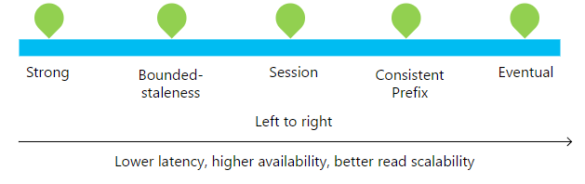
Well-Defined Consistency Models
Well-Defined Consistency Models

Slide 24
Well-Defined Consistency Models
Well-Defined Consistency Models
Consistency Level | Guarantees
Strong | Linearizability (once operation is complete, it will be visible to all)
Bounded Staleness | Consistent Prefix. Reads lag behind writes by at most k prefixes or t interval Similar properties to strong consistency (except within staleness window), while preserving 99.99% availability and low latency.
Session | Consistent Prefix. Within a session: monotonic reads, monotonic writes, read-your-writes, write-follows-reads Predictable consistency for a session, high read throughput + low latency
Consistent Prefix | Reads will never see out of order writes (no gaps).
Eventual | Potential for out of order reads. Lowest cost for reads of all consistency levels.

Slide 25
Bounded-Staleness
Bounds set server-side via the Azure Portal - Reads lag behind writes are by at most k prefixes or t interval

Slide 26
Session Consistency
Session is controlled using a “session token”. – Read your own writes within a session
Session tokens are automatically cached by the Client SDK
Can be pulled out and used to override other requests (to preserve session between multiple clients)
string sessionToken;
using (DocumentClient client = new DocumentClient(new Uri(""), ""))
{
ResourceResponse<Document> response = client.CreateDocumentAsync(
collectionLink,
new { id = "an id", value = "some value" }
).Result;
sessionToken = response.SessionToken;
}
using (DocumentClient client = new DocumentClient(new Uri(""), ""))
{
ResourceResponse<Document> read = client.ReadDocumentAsync(
documentLink,
new RequestOptions { SessionToken = sessionToken }
).Result;
}

Slide 27
Bounded-Staleness
Bounds set server-side via the Azure Portal - Reads lag behind writes are by at most k prefixes or t interval

Slide 28
Relaxing Consistency
Consistency can be relaxed on a per-request basis
client.ReadDocumentAsync(
documentLink,
new RequestOptions { ConsistencyLevel = ConsistencyLevel.Eventual }
);

Slide 29
Music notes visualization

