Slide 1

Server-Side Programming

Slide 2
Programming
Run native JavaScript server-side programming logic to performic atomic multi-record transactions.
This module will reference programming in the context of the SQL API.
GEEK

Slide 3

Stored Procedures
Benefits
Familiar programming language
Atomic Transactions
Built-in Optimizations
Business Logic Encapsulation
Notes:
The fact that JSON is intrinsically mapped to the Javascript language type system and is also the basic unit of storage in Cosmos DB allows for a number of optimizations like lazy materialization of JSON documents in the buffer pool and making them available on-demand to the executing code.
Azure Cosmos DB precompiles stored procedures, triggers and user defined functions (UDFs) to avoid JavaScript compilation cost for each invocation. The overhead of building the byte code for the procedural logic is amortized to a minimal value.

Slide 4
Simple Stored Procedure
function createSampleDocument(documentToCreate) {
var context = getContext();
var collection = context.getCollection();
var accepted = collection.createDocument(
collection.getSelfLink(),
documentToCreate,
function (error, documentCreated) {
context.getResponse().setBody(documentCreated.id)
}
);
if (!accepted) return;
}
Notes:
This stored procedure takes as input documentToCreate, the body of a document to be created in the current collection. All such operations are asynchronous and depend on JavaScript function callbacks. The callback function has two parameters, one for the error object in case the operation fails, and one for the created object. Inside the callback, users can either handle the exception or throw an error. In case a callback is not provided and there is an error, the Azure Cosmos DB runtime throws an error.
In the example above, the callback throws an error if the operation failed. Otherwise, it sets the id of the created document as the body of the response to the client. Here is how this stored procedure is executed with input parameters.

Slide 5
Multi-Document Transactions
Database Transactions
In a typical database, a transaction can be defined as a sequence of operations performed as a single logical unit of work. Each transaction provides ACID guarantees.
In Azure Cosmos DB, JavaScript is hosted in the same memory space as the database. Hence, requests made within stored procedures and triggers execute in the same scope of a database session.
Stored procedures utilize snapshot isolation to guarantee all reads within the transaction will see a consistent snapshot of the data
Create New Document
Query Collection
Update Existing Document
Delete Existing Document
Notes:
ACID
Atomicity guarantees that all the work done inside a transaction is treated as a single unit where either all of it is committed or none.
Consistency makes sure that the data is always in a good internal state across transactions.
Isolation guarantees that no two transactions interfere with each other – generally, most commercial systems provide multiple isolation levels that can be used based on the application needs.
Durability ensures that any change that’s committed in the database will always be present.
Since requests made within stored procedures and triggers execute in the same scope of a database session, we guarantee ACID for all operations that are part of a single stored procedure/trigger. Consider the following stored procedure definition.

Slide 6
Bounded Execution
Execution Within Time Boundaries
All Azure Cosmos DB operations must complete within the server-specified request timeout duration. If an operation does not complete within that time limit, the transaction is rolled back.
Helper Boolean Value
All functions under the collection object (for create, read, replace, and delete of documents and attachments) return a Boolean value that represents whether that operation will complete:
If true, the operation is expected to complete
If false, the time limit will soon be reached and your function should end execution as soon as possible.
Notes:
The request timeout constraint also applies to JavaScript functions (stored procedures, triggers and user-defined functions).
If the boolean value is false, it is an indication that the time limit is about to expire and that the procedure must wrap up execution.
Operations queued prior to the first unaccepted store operation are guaranteed to complete if the stored procedure completes in time and does not queue any more requests.

Slide 7
Transaction Continuation Model
CONTINUING LONG-RUNNING TRANSACTIONS
JavaScript functions can implement a continuation-based model to batch/resume execution
The continuation value can be any value of your own choosing. This value can then be used by your applications to resume a transaction from a new “starting point”
Bulk Create Documents
Each Document
Try Create
Observe
Return
Value
Done
Return a “pointer” to resume later

Slide 8
CONTROL FLOW
Javascript Control Flow
Stored procedures allow you to naturally express control flow, variable scoping, assignment, and integration of exception handling primitives with database transactions directly in terms of the JavaScript programming language.
ES6 Promises
ES6 promises can be used to implement promises for Azure Cosmos DB stored procedures. Unfortunately, promises “swallow” exceptions by default. It is recommended to use callbacks instead of ES6 promises.
Notes:
http://es6-features.org/#PromiseUsage

Slide 9
Stored Procedure Control Flow
function createTwoDocuments(docA, docB) {
var ctxt = getContext(); var coll = context.getCollection(); var collLink = coll.getSelfLink();
var aAccepted = coll.createDocument(collLink, docA, docACallback);
function docACallback(error, created) {
var bAccepted = coll.createDocument(collLink, docB, docBCallback);
if (!bAccepted) return;
};
function docBCallback(error, created) {
context.getResponse().setBody({
"firstDocId": created.id,
"secondDocId": created.id
});
};
}
Notes:
The focus here is on identifying nested callbacks.

Slide 10
Stored Procedure Control Flow
function createTwoDocuments(docA, docB) {
var ctxt = getContext(); var coll = context.getCollection(); var collLink = coll.getSelfLink();
var aAccepted = coll.createDocument(collLink, docA, function(docAError, docACreated) {
var bAccepted = coll.createDocument(collLink, docB, function(docBError, docBCreated) {
context.getResponse().setBody({
"firstDocId": docACreated.id,
"secondDocId": docBCreated.id
});
});
if (!aAccepted) return;
});
if (!bAccepted) return;
}
Nesting your callbacks is just as valid of a method as using named callback functions
Notes:
The focus here is on identifying nested callbacks.

Slide 11
Rolling Back Transactions
Transaction Roll-Back
Inside a JavaScript function, all operations are automatically wrapped under a single transaction:
If the function completes without any exception, all data changes are committed
If there is any exception that’s thrown from the script, Azure Cosmos DB’s JavaScript runtime will roll back the whole transaction.
Implicit BEGIN TRANSACTION
Implicit COMMIT TRANSACTION
Create New Document
Query Collection
Update Existing Document
Delete Existing Document
Implicit ROLLBACK TRANSACTION
Transaction Scope
If exception, undo changes
Notes:
Transactions are deeply and natively integrated into Cosmos DB’s JavaScript programming model.
In effect, the “BEGIN TRANSACTION” and “COMMIT TRANSACTION” statements in relational databases are implicit in Cosmos DB.
Throwing an exception is effectively equivalent to a “ROLLBACK TRANSACTION” in Cosmos DB.

Slide 12
Transaction Rollback in Stored Procedure
collection.createDocument(
collection.getSelfLink(),
documentToCreate,
function (error, documentCreated) {
if (error) throw "Unable to create document, aborting...";
}
);
collection.createDocument(
documentToReplace._self,
replacementDocument,
function (error, documentReplaced) {
if (error) throw "Unable to update document, aborting...";
}
);

Slide 13
Debugging Stored Procedures
CONSOLE LOGGING
Much like with traditional JavaScript applications, you can use console.log() to capture various telemetry and data points for your running code.
VIEWING SCRIPT LOGS
.NET
You must opt-in to viewing and capturing console output using the EnableScriptLogging boolean property available in the client SDK. The SDK has a ScriptLog property on the StoredProcedureResponse class that contains the captured output of the JavaScript console log.

Slide 14
Debugging Stored Procedures
var response = await client.ExecuteStoredProcedureAsync(
document.SelfLink,
new RequestOptions
{
EnableScriptLogging = true
}
);
String logData = response.ScriptLog;

Slide 15
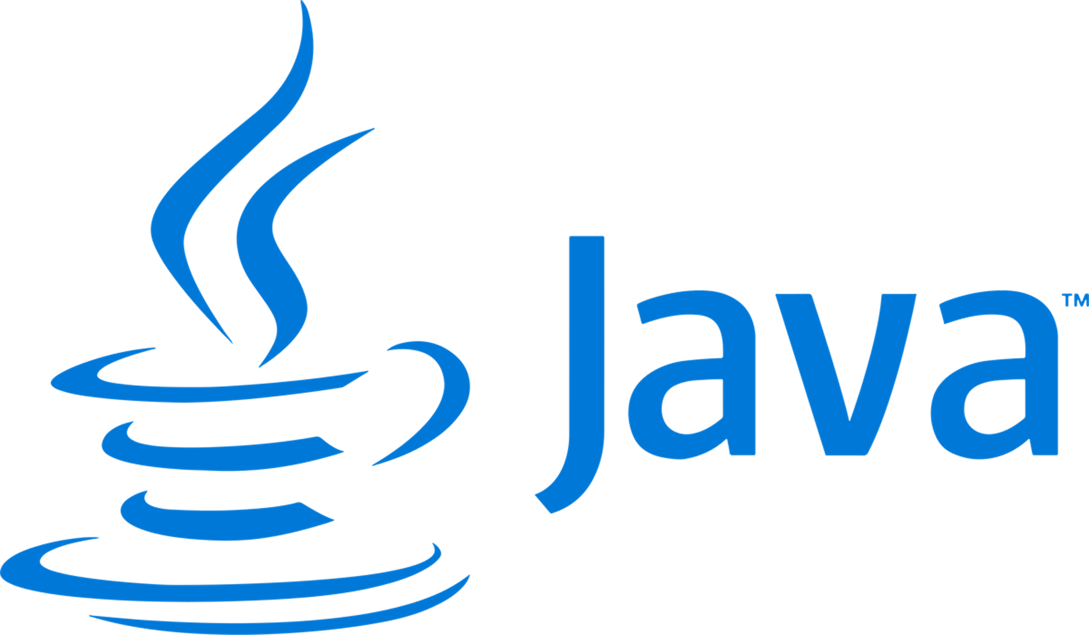
Debugging Stored Procedures
RequestOptions requestOptions = new RequestOptions();
requestOptions.EnableScriptLogging = true;
StoredProcedureResponse response = client.executeStoredProcedure(
storedProcLink,
requestOptions,
new Object[]{}
);

Slide 16
Authoring Stored Procedures

Slide 17
User-Defined Functions
UDF
User-defined functions (UDFs) are used to extend the Azure Cosmos DB SQL API’s query language grammar and implement custom business logic. UDFs can only be called from inside queries
They do not have access to the context object and are meant to be used as compute-only code
Notes:
UDFs can be run on secondary replicas of the Cosmos DB service.

Slide 18
User-Defined Function Definition
var taxUdf = {
id: "tax",
serverScript: function tax(income) {
if (income == undefined)
throw 'no input’;
if (income < 1000)
return income * 0.1;
else if (income < 10000)
return income * 0.2;
else
return income * 0.4;
}
}

Slide 19
User-Defined Function Usage In Queries
SELECT
*
FROM
TaxPayers t
WHERE
udf.tax(t.income) > 20000
SQL

Slide 20
Authoring User-Defined Functions

