Slide 1
Azure Cosmos DB Technical Deep Dive
<Speaker>
<date>

Slide 2
Azure Cosmos DB
A FULLY-MANAGED GLOBALLY DISTRIBUTED DATABASE SERVICE BUILT TO GUARANTEE
EXTREMELY LOW LATENCY AND MASSIVE SCALE FOR MODERN APPS

Slide 3
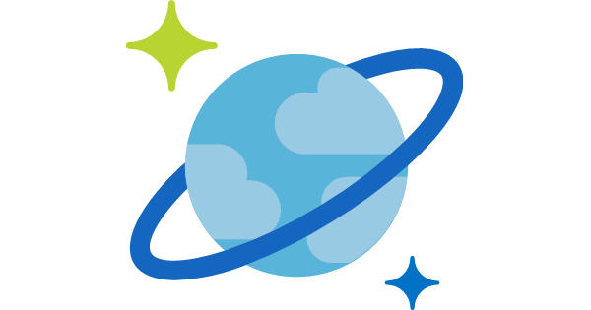

Azure Cosmos DB
A globally distributed, massively scalable, multi-model database service
Elastic scale out
of storage & throughput
Guaranteed low latency at the 99th percentile
Five well-defined consistency models
Turnkey global distribution
Comprehensive SLAs
Notes:
Azure Cosmos DB offers the first globally distributed, multi-model database service for building planet scale apps. It’s been powering Microsoft’s internet-scale services for years, and now it’s ready to launch yours.
Only Azure Cosmos DB makes global distribution turn-key.
You can add Azure locations to your database anywhere across the world, at any time, with a single click. Cosmos DB will seamlessly replicate your data and make it highly available.
Cosmos DB allows you to scale throughput and storage elastically, and globally! You only pay for the throughput and storage you need – anywhere in the world, at any time.

Slide 4
Azure Cosmos DB
A globally distributed, massively scalable, multi-model database service
Column-family
Document
Key-value
Graph
Elastic scale out
of storage & throughput
Guaranteed low latency at the 99th percentile
Five well-defined consistency models
Turnkey global distribution
Comprehensive SLAs
Notes:
Azure Cosmos DB offers the first globally distributed, multi-model database service for building planet scale apps. It’s been powering Microsoft’s internet-scale services for years, and now it’s ready to launch yours.
Only Azure Cosmos DB makes global distribution turn-key.
You can add Azure locations to your database anywhere across the world, at any time, with a single click. Cosmos DB will seamlessly replicate your data and make it highly available.
Cosmos DB allows you to scale throughput and storage elastically, and globally! You only pay for the throughput and storage you need – anywhere in the world, at any time.

Slide 5



Azure Cosmos DB
A globally distributed, massively scalable, multi-model database service
Cosmos DB’s API for
MongoDB
Table API
Column-family
Document
Key-value
Graph
Elastic scale out
of storage & throughput
Guaranteed low latency at the 99th percentile
Five well-defined consistency models
Turnkey global distribution
Comprehensive SLAs
Notes:
Azure Cosmos DB offers the first globally distributed, multi-model database service for building planet scale apps. It’s been powering Microsoft’s internet-scale services for years, and now it’s ready to launch yours.
Only Azure Cosmos DB makes global distribution turn-key.
You can add Azure locations to your database anywhere across the world, at any time, with a single click. Cosmos DB will seamlessly replicate your data and make it highly available.
Cosmos DB allows you to scale throughput and storage elastically, and globally! You only pay for the throughput and storage you need – anywhere in the world, at any time.

Slide 6

Overview & Value Proposition

Slide 7
Elastically Scale Storage and Throughput
Independently and elastically scale storage and throughput across regions – even during unpredictable traffic bursts – with a database that adapts to your app’s needs.
Elastically scale throughput from 10 to 100s of millions of requests/sec across multiple regions
Support for requests/sec for different workloads
Pay only for the throughput and storage you need
Notes:
Elastic Scale out -> Tunable Consistency
Small storage – large throughput (e.g. notification broadcast/poll)
Large storage – small throughput (e.g. classic data/log store)

Slide 8
Guaranteed Low Latency
Provide users around the world with fast access to data
Serve <10 ms read and <10 ms write requests at the 99th percentile from the region nearest to users, while delivering data globally.
Notes:
Single digit latency -> SLA

Slide 9
Turnkey Global Distribution
Put your data where your users are in minutes
Automatically replicate all your data around the world, and across more regions than Amazon and Google combined.
Available in all Azure regions
Manual and automatic failover
Automatic & synchronous multi-region replication
Configure multiple write regions to further reduce latency and increase availability
Notes:
Elastic Scale out -> Tunable Consistency
Small storage – large throughput (e.g. notification broadcast/poll)
Large storage – small throughput (e.g. classic data/log store)

Slide 10
Five Well-Defined Consistency Models
Choose the best consistency model for your app
Offers five consistency models
Provides control over performance-consistency tradeoffs, backed by comprehensive SLAs.
An intuitive programming model offering low latency and high availability for your planet-scale app.
Strong
Bounded-stateless
Session
Consistent prefix
Eventual
Notes:
Tunable Consistency -> Single digit latency
Instead of forcing you to choose between eventual and strong consistency, Cosmos DB gives you many additional useful options.
Bounded Staleness - Consistent Prefix. Reads lag behind writes by k prefixes or t interval
Session - Consistent Prefix. Monotonic reads, monotonic writes, read-your-writes, write-follows-reads
Consistent Prefix - Updates returned are some prefix of all the updates, with no gaps

Slide 11


Multiple Data Models and API’s
Use the model that fits your requirements, and the apis, tools, and frameworks you prefer
Cosmos DB offers a multitude of APIs to access and query data including, SQL, various popular OSS APIs, and native support for NoSQL workloads.
Use key-value, columnar, graph, and document data
Data is automatically indexed, with no schema or secondary indexes required
Blazing fast queries with no lag
MongoDB
Table API
SQL
Column-family
Document
Key-value
Graph
Notes:
Multi – Model -> Elastic Scale out
No need to convert you data to meet any particular model

Slide 12
Handle any Data with no Schema or Indexing Required
Azure Cosmos DB’s schema-less service automatically indexes all your data, regardless of the data model, to delivery blazing fast queries.
Automatic index management
Synchronous auto-indexing
Freedom from schema + index management
Works across every data model
Ingest and serve data back out in milliseconds
GEEK
Item | Color | Microwave safe | Liquid capacity | CPU | Memory | Storage
Geek mug | Graphite | Yes | 16ox | ??? | ??? | ???
Coffee Bean mug | Tan | No | 12oz | ??? | ??? | ???
Surface book | Gray | ??? | ??? | 3.4 GHz Intel Skylake Core i7-6600U | 16GB | 1 TB SSD
Notes:
Automatic and synchronous indexing of all ingested content - hash, range, geo-spatial, and columnar
No schemas or secondary indices ever needed
Resource governed, write optimized database engine with latch free and log structured techniques
Online and in-situ index transformations
While the database is fully schema-agnostic, schema-extraction is built in
Customers can get Avro schemas from the database

Slide 13
Comprehensive SLA’s
Run your app on world-class infrastructure.
Azure Cosmos DB is the only service with financially-backed SLAs for millisecond latency at the 99th percentile, 99.999% HA and guaranteed throughput and consistency
Latency
HA
Throughput
Consistency
<10 ms
99.999%
Guaranteed
Guaranteed
99th percentile
Notes:
HA 99.999% for multi-region read; 99.99% for single region deployments

Slide 14
Trust your Data to Industry-Leading Security & Compliance
Azure is the world’s most trusted cloud, with more certifications than any other cloud provider.
Enterprise grade security
Encryption at Rest and Transit
Encryption is enabled automatically by default
Comprehensive Azure compliance certification
Notes:
Encryption at Rest
Always encrypted at rest and in motion
Data, index, backups, and attachments encrypted
Encryption is enabled automatically by default
No impact on performance, throughput or availability
Transparent to your application
Comprehensive Azure compliance certification
ISO 27001, ISO 27018, EUMC, HIPAA, PCI
SOC1 and SOC2 (Audit complete, Certification in Q2 2017)
FedRAMP, IRS 1075, UK Official (IL2) (Q2 2017)
HITRUST (H2 2017)
Updated and added to monthly

Slide 15
Use Cases

Slide 16








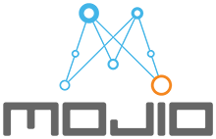


































Serving Industry-Leading Enterprise Customers

Slide 17
Top 10 Reasons Why Customers Use Azure Cosmos DB
The 1st and only database with global distribution turnkey capability
Deliver massive storage/throughput scalability database
Provides guaranteed single digit millisecond latency at 99th percentile worldwide
Natively supports different types of data at massive scale
Boasts 5 well-defined consistency models to pick the right consistency/latency/ throughput tradeoff
Enables mission critical intelligent applications
Gives high flexibility to optimize for speed and cost
Tackles big data workloads with high availability and reliability
Provides multi-tenancy and enterprise-grade security
Naturally analytics-ready and perfect for event-driven architectures

Slide 18
Retail

Slide 19

Handle Peak Sales Periods with Ease
Azure CDN
Azure Storage (files)
Offer customers fast and reliable service quality during seasonal and other high-traffic sales periods.
Instant, elastic scaling handles traffic and sales bursts
Provisioned throughput ensures predictable performance for mission critical microservices (e.g. shopping cart)
Low-latency data access from anywhere in the world for fast, robust user experiences
High availability across multiple data centers
Azure API Apps (backend)
Azure Cosmos DB (database)
Apache Spark
(analytics)
Azure Functions
Azure Notification Hub (Push notifications)

Slide 20

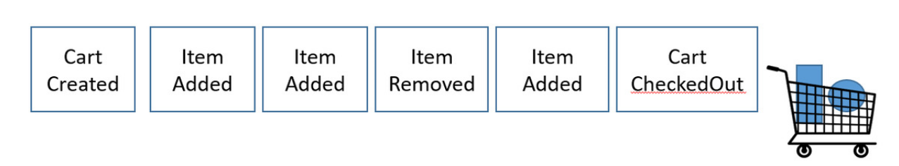


Order & Inventory Management Systems
Event-sourcing architecture, with Cosmos DB Change Feed
Moved from IaaS to PasS for inventory system
Chosen to handle high write-ingest for events & low latency guarantees
Scaled for Black Friday: 1 trillion RU’s over 24 hours
Walmart Labs (aka jet.com) ensures reliable app experience for customers on Black Friday, Cyber Monday, and other high traffic periods
Notes:
https://blogs.msdn.microsoft.com/azurecat/2018/05/17/azure-cosmos-db-customer-profile-jet-com/

Slide 21

Deliver Relevant Real-time Recommendation Systems
Online Recommendations Service
HOT path
Azure Service Fabric
(Personalization Decision Engine)
Azure Cosmos DB
(distributed model store)
Help customers discover items they’ll love with real-time personalization and product recommendations.
Machine learning models generate real-time recommendations across product catalogues
High volumes of product data can be analyzed in milliseconds
Low-latency ensures high app performance worldwide
Tunable data consistency models for rapid insight
Azure Data Factory
(scheduled job to refresh persisted models)
Shoppers
.com
(Product Details Page)
Azure Event Hub
Azure Data Lake Storage
(offline raw data)
Apache Spark
Offline Recommendations Engine COLD path
ASOS deliver personalized shopping experiences and real-time order updates to 15 Million customers. Helping them grow and win with millennial shoppers.

Slide 22
IoT + Manufacturing

Slide 23


Leverage IoT Telemetry to Build Differentiated Experiences
Diverse and unpredictable IoT sensor workloads require a responsive data platform
Real-time vehicle diagnostics
Instant elastic scaling
No loss in ingestion or query performance
Azure IoT Hub
Apache Storm on Azure HDInsight
Azure Cosmos DB
(Telemetry & device state)
Azure Web Jobs (Change feed processor)
Azure Storage (archival)
Azure Cosmos DB was chosen due to its ability to ingest data at massive scale with high availability (99.99%) guarantee.
Logic apps
Notes:
Toyota’s connected-car platform collects massive volumes of sensor data in Azure Cosmos DB to deliver real-time customer service and vehicle diagnostics
Elastically scale instantly to accommodate diverse and unpredictable IoT workloads without sacrificing ingestion or query performance
Seamlessly integrates car to the digital life of customers that is safe, productive and fun.

Slide 24
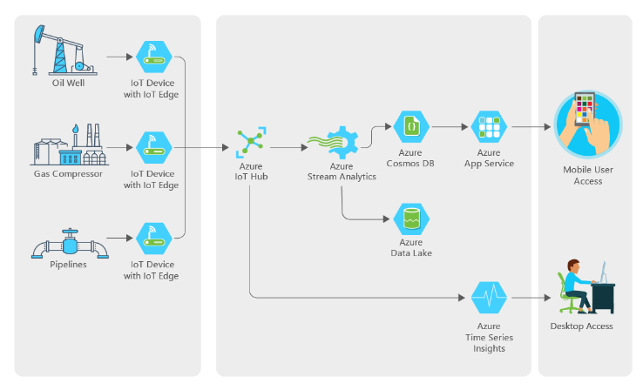

IoT, Big Data Optimize Operations at an Exxon Mobil Subsidiary
Find a better way to monitor remote wells and collect data on performance
Must be cost efficient
Unified device management and streaming
Automate IOT and analytics
“We had a team of five people working on this, and they built it from scratch. The ease of use of the Azure services and the support we got from Microsoft made that possible. .”
Notes:
Another IOT scenario is in the oil and gas industry.
XTO energy is a subsidiary of ExxonMobil, they specialize in gas production from low margin fields. Their equipment is often in extreme and remote locations with spotty connectivity which makes gathering telemetry a manual and expensive process.
Working with Microsoft we helped them design a system that would allow them a better, and cheaper way to gather this telemetry and automate much of the work behind it providing data both to uses at the home office as well as to users in the field working on the equipment.

Slide 25
Gaming

Slide 26


Deliver High-Quality Experiences at any Scale Globally
Azure CDN
Azure Storage (files)
Need for a DB that to seamlessly respond to massive scale and performance demands
Multi-player game play with low latency
Instant capacity scaling from launch onward
Uninterrupted global user experience
Azure API Apps (backend)
Azure Cosmos DB (database)
Apache Spark
(analytics)
Azure Functions
Azure Notification Hub (Push notifications)
The Walking Dead: No Man’s Land chose Azure Cosmos DB because of its extremely low latency and massive scale worldwide.
Notes:
Gaming is another scenario where Cosmos DB provides some unique capabilities you won’t find in other data services.
When you combine our global distribution with low latency this is ideally suited to supporting high-volume gaming use cases where you have millions of players located all over the globe.
The Walking Dead: No Man’s Land chose Azure Cosmos DB to manage massive traffic spikes at its launch and as its popularity increased

Slide 27
Financial Services

Slide 28

A Financial Trend SaaS Engine for Investors
Need for a DB that can handle any schema and adapt quickly to rapid changes
Financial SAAS engine with no dev ops
Super fast to handle financial data
Scalable on demand, globally distributed
Business models are under attack, especially in the financial industry. Azure Cosmos DB is a technology that can adapt, evolve, and allow a business to innovate faster in order to turn opportunities into strategic advantages.
Notes:
Another customer story is clearTrend who has built a financial trend engine as Software as a Service for investment professionals that is completely managed, with zero dev ops.
Their use of Cosmos DB was centered around a few things. First, being schema agnostic allowed them to ingest and analyze very different kinds of data and also evolve their own schemas over time for their analytics. Second, clearTrend needed a service that would be super fast. In the investment world seconds can make the difference so they needed a back end that could deliver the kind of performance they needed to run their service for their customers, these investment professionals. Lastly, they needed to be able to programmatically re-size capacity to handle workload bursts. They have predictable workloads and the ability to easily scale Cosmos DB up and down was a great benefit to them.

Slide 29
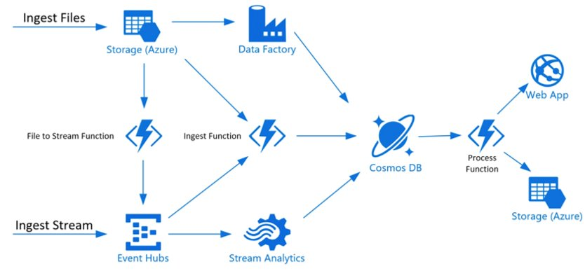

Real-time Payments Pipeline
Steady state - 10M transactions/day, peak hours - 3-4K transactions/sec
Financial SAAS engine with no dev ops
Super fast to handle financial data
Scalable on demand, globally distributed
Centralize payment pipelines, build real time processing, analytics. Goal to introduce a common pipeline accepting transactions from all different sources and distributing them to the right pipeline and also other sources like analytics.​
Notes:
Yet another use case scenario is in real-time payments processing.
In this scenario DnB has built a centralized payment processing pipeline with analytics. Here too the goal was to build a complete solution on PaaS to ensure zero Dev Ops in offering a SaaS solution to their customers. Important characteristics here too is the solution need also to be incredibly fast, scale on demand and provide for global distribution of data, both for business continuity but also for low latency.

Slide 30

Fidelity Built Mortgage Insurance App To Enhance Customer
Fidelity built a new application – EXOS – it is the only mobile digital mortgage application designed specifically to extend and enhance every critical consumer touchpoint throughout the entire mortgage lending life cycle.
EXOS offers a real-time personalized experience for customers across the entire mortgage process including
Appointment scheduling and communications – enhancing customer experience and process .
Ensuring consistent , personalized and accurate information for customer throughout the process.
EXOS Closing offers unmatched consumer satisfaction and transparency in to the closing process.
Fidelity chose Cosmos DB due to the Ease global distribution, ability to scale and fully managed service reducing the database management overhead.
Notes:
Fidelity built a new mortgage insurance application service for its customer using Cosmos DB.
Here too Fidelity chose Cosmos DB due to our global distribution capabilities that also provided low latency for fast application response times, high availability too. In addition, because Cosmos DB is schema agnostic, Cosmos DB is ideally suited for this type of scenario where you are fundamentally dealing with unstructured or rapidly changing data.
Lastly, implementing a service like this which has multiple steps during the process is a natural fit for our Change Feed feature which allows customers to create event-driven, micro-service architectures. In the case of a loan application process here, there are multiple steps in the process from initial application to submitting supporting documents, signing, etc. This is well suited for Cosmos DB.

Slide 31
Solve Industry Specific Needs
Highlight areas where data-driven app innovation can transform customer business
Solution
Areas
Financial Services
Manufacturing & Resources
Retail
Government
Health
Education
Transactional
Customer experience management
Retail management system
Connected field service
Citizen services tracking
Care coordination
Educational lifecycle management
Real-time experiences
Seamless services
Commerce experience
Supply chain visibility
Secure global platform
Customer care experience
Global collaboration
Big data processing
Risk compute
Demand forecasting
Server logs
Enterprise grade control
Genomic data
Student analytics
AI
Risk mitigation
Learn customer habits
Predictive processes
Smart buildings
Automated appointments
Intelligent resources for students
Examples of
SaaS apps
Customer Service
Banking Screen
Compliance Assessments
Pricing & Promotion
Retail Personalization
Inventory Optimization
Quote-to-cash system
Sales automation
Predictive Maintenance
Citizen Service Requests
Grants Management
Patient Coordination
Risk prediction
Medical Claim Analytics
Learning Management System
Personalized learning
Unique need
Security
User experience
Scale
Security
Compliance
Innovation
Notes:
Here, we you can see some of the ways customers in different industries are using the scenarios we just talked about to solve their industry-specific needs and reach their goals.

