Slide 1

Change Feed

Slide 2
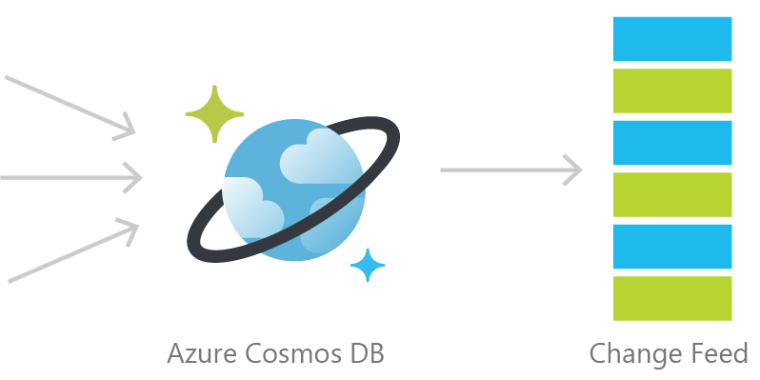
Cosmos DB Change Feed
Persistent log of documents within an Azure Cosmos DB collection in the order in which they were modified

Slide 3
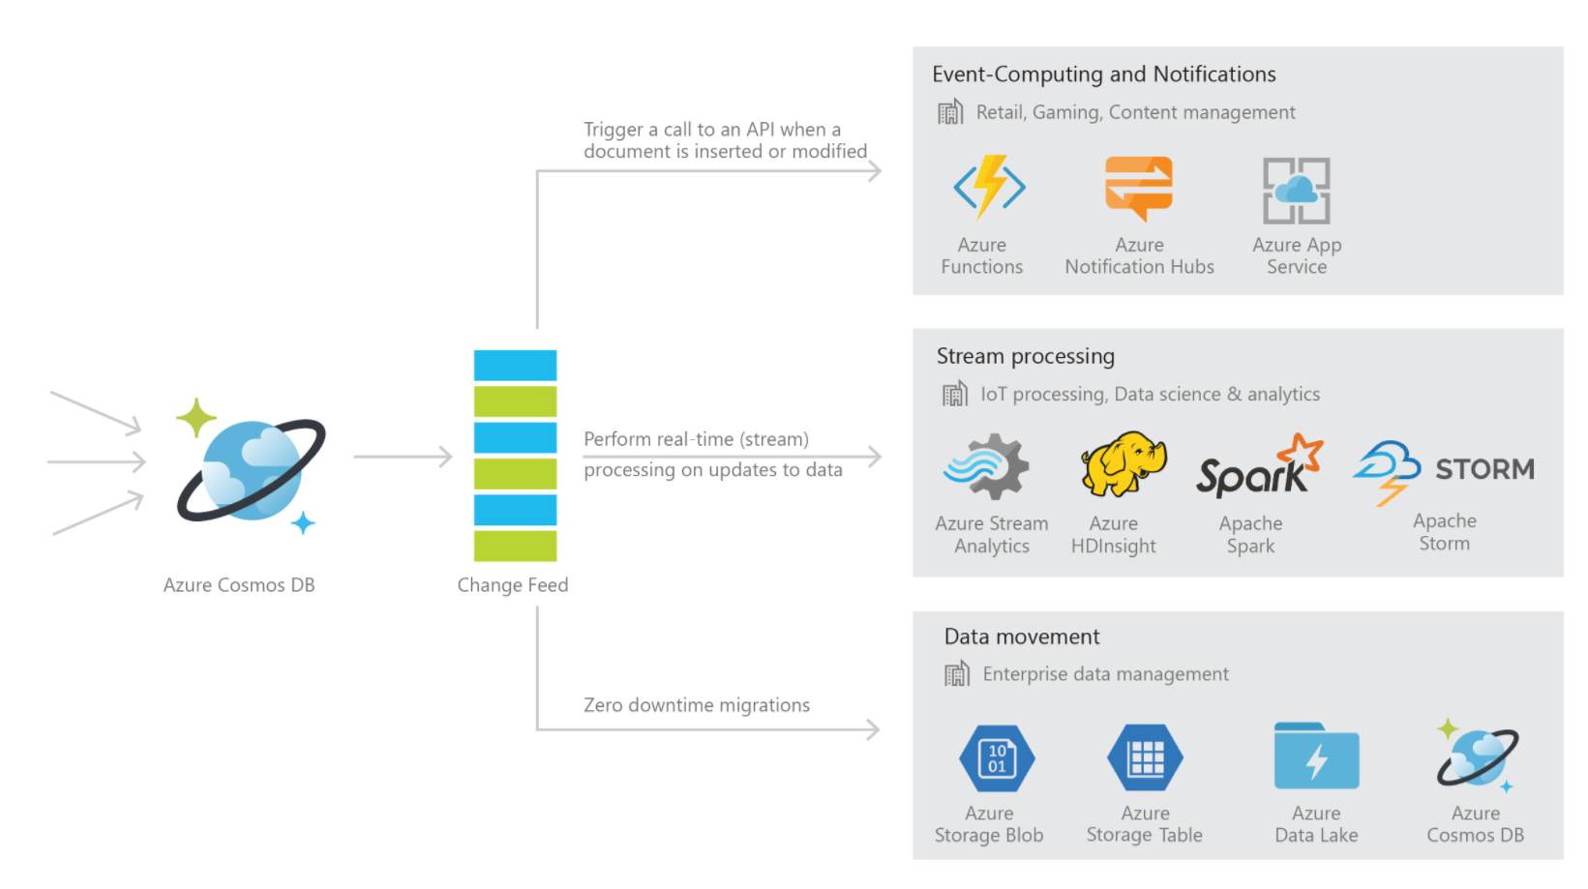
Common Change Feed Scenarios

Slide 4


Common Scenarios
Event Sourcing (Microservices)
Read From Change Feed
Persistent Event Store
Microservice
#1
Microservice #2
New Order
Microservice #3
Trigger Action From Change Feed

Slide 5



1. Retail Order Processing Pipelines
Azure Functions
(E-Commerce Checkout API)
Azure Cosmos DB (Order Event Store)
. . .
Azure Functions
(Microservice 1: Tax)
Azure Functions
(Microservice 2: Payment)
Azure Functions
(Microservice N: Fulfillment)

Slide 6
2. Real-time data movement
Backup Collection
Data Movement / Backup
Access upon main collection failure
Replicate Updates
Main Collection
Secondary Collections
CRUD Data
Read access, e.g. for analytics
…

Slide 7
2. Real-time data movement
This is useful for:
Performing a live migration from one Cosmos container to another
For example, to a container with a different partition key
Replicating data to another collection optimize for different read operations
For read-heavy workloads, sometimes it makes sense to replicate the same data two or more times (with different schema or different partition keys) to optimize for different read operation
Replicating data to another type of storage (colder storage with less-rich query capabilities such as Azure Blob Storage)
You can ingest data directly into Azure Cosmos DB and keep another data source synchronized. Then, you can set a TTL (time-to-live) on your Cosmos containers to have documents automatically deleted from Cosmos DB when the data is no longer “hot” and heavily accessed.

Slide 8
3. Materialized View
Application
Azure Cosmos DB
Materialized View
SubscriptionID | UserID | Create Date | …
123abc | Ben6 | 6/17/17
456efg | Ben6 | 3/14/17
789hij | Jen4 | 8/1/16
012klm | Joe3 | 3/4/17
UserID | Total Subscriptions
Ben6 | 2
Jen4 | 1
Joe3 | 1
Notes:
Demo available here: https://github.com/Azure-Samples/cosmosdb-materialized-views

Slide 9
Building a materialized view using the Azure Cosmos DB Change Feed
Notes:
Demo available here: https://github.com/Azure-Samples/cosmosdb-materialized-views.

Slide 10
Three different ways to use the Change Feed
Implementation | Use Case | Advantages
Azure Functions | Serverless applications | Easy to implement. Used as a trigger, input or output binding to an Azure Function.
Change Feed Processor Library | Distributed applications | Ability to distribute the processing of events towards multiple clients. Requires a “leases collection”.
SQL API SDK for .NET or Java | Not recommended | Requires manual implementation in a .NET or Java application.

Slide 11
Lease collection
Required when you consume the change feed through the Change Feed Processor Library or an Azure Function Cosmos DB Trigger
In the lease collection, a document is created for each physical partition to bookmark the latest document that was processed
In general, 400 RU’s should be enough for the lease collection. For very large workloads, you may need to increase up to a few thousand RU’s.
You should partition your lease collection by “id”

Slide 12
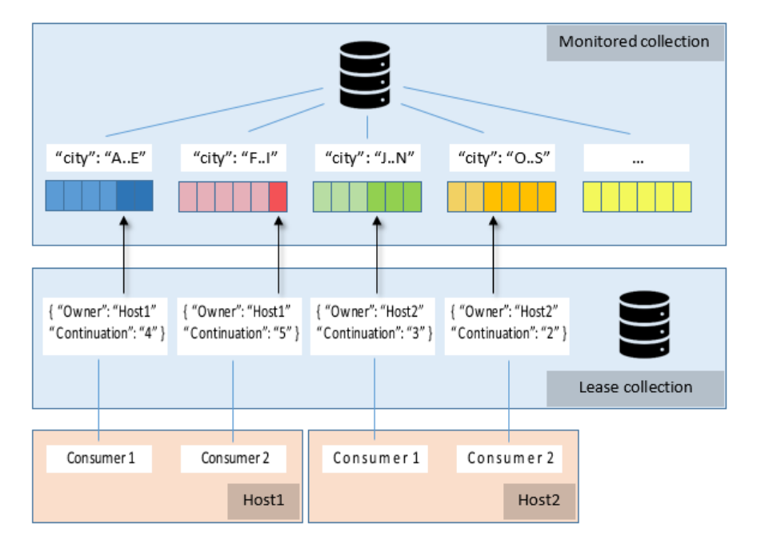
Change Feed Processor Library – Behind the scenes
Spin up instances of the processor as needed
Each host has consumers = observer to implement
Each host assigns itself leases on partitions to monitor
On each change, logic in consumers gets triggered
1 lease collection stored in Cosmos DB

Slide 13
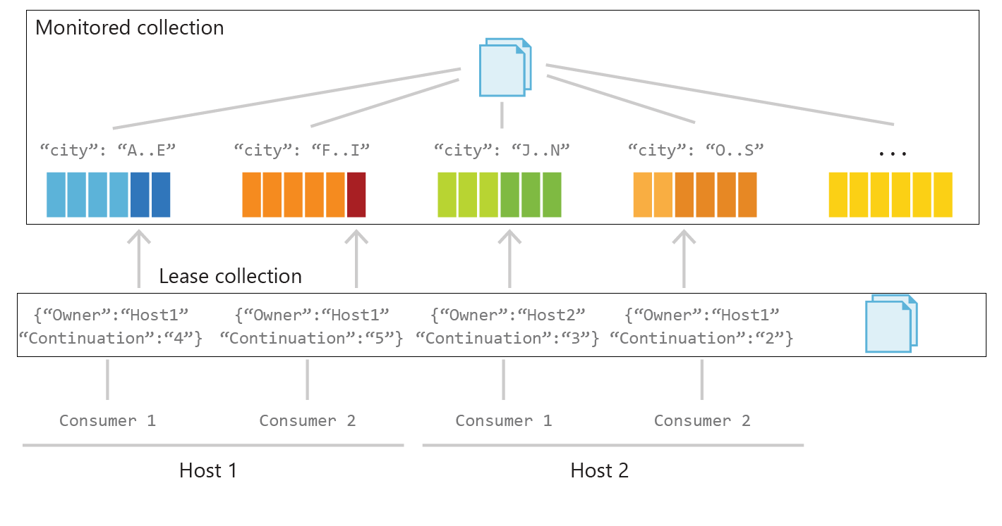

Slide 14
Change Feed Processor – Interface Implementation
public class DocumentFeedObserver : IChangeFeedObserver
{
...
public Task IChangeFeedObserver.ProcessChangesAsync(ChangeFeedObserverContext context, IReadOnlyList<Document> docs)
{
Console.WriteLine("Change feed: {0} documents", Interlocked.Add(ref totalDocs, docs.Count));
foreach(Document doc in docs)
{
Console.WriteLine(doc.Id.ToString());
}
return Task.CompletedTask;
}
}

Slide 15
Change Feed Processor - Registration
DocumentFeedObserver docObserver = new DocumentFeedObserver();
ChangeFeedEventHost host = new ChangeFeedEventHost(
hostName,
documentCollectionLocation,
leaseCollectionLocation,
feedOptions,
feedHostOptions
);
await host.RegisterObserverAsync(docObserverFactory);

Slide 16
Azure Cosmos DB Change Feed Summary
Automatically enabled in any Cosmos DB database account
Uses the existing allocated request units for processing events
Executed on insert and update operations. Delete support can be implemented by creating a property called isDeleted (or similar), modifying this property (to act as an update), and then setting a TTL on the document to delete it.

