Slide 1
Graph database workshop
Using Azure Cosmos DB Gremlin API

Slide 2
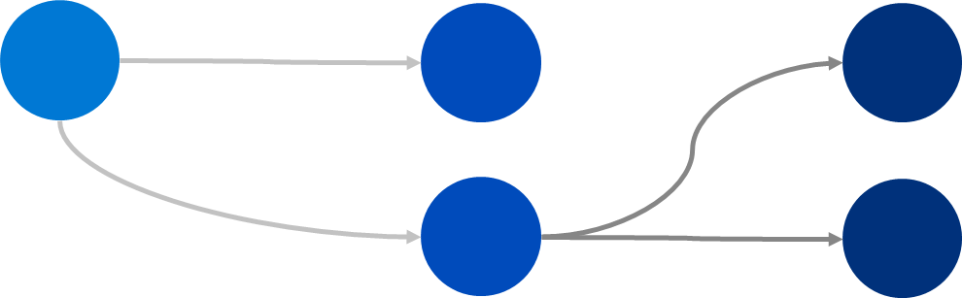
Introduction to graph databases
"Database engine optimized for storing and querying entities and relationships."
Non-relational standard
Schema-less: No need to pre-define the data structure.
Specify schema for reads, not writes.
Objects
Relationships

Slide 3
Introduction to graph databases
Main technology types:
Property Graph vs Resource Description Framework (RDF)
Rich entities vs descriptive relationships
Graph data modeling and query language implications
Biggest technologies:
Apache Tinkerpop, Gremlin (Property graph)
Cypher (Property graph)
SPARQL (RDF graph)
https://db-engines.com/en/ranking/graph+dbms

Slide 4
Introduction to graph databases
Engine operations are optimized for graph traversals.
RDBMS query engines focused on table scans vs graph related operations.
Query language designed around traversals.
Traversal: Running collection of objects that follow the graph's topology.
Compute runtime attached to a storage engine:
Graph traversals can be computationally heavy operations.
Usually persistence layer is a separate database.

Slide 5
Property Graphs
Two main objects: Vertices (nodes) and edges (relationships).
Entities and relationships enriched with embedded properties.
Mutable key-value pairs.
Property | Data Type | Details
ID | String | Unique identifier. Auto-generated if not provided
Label | String | Entity type identifier. Query filtering clause.
Partition Key | Integer, String | Horizontal data distribution key. Query filtering clause.
https://markorodriguez.com/2011/02/08/property-graph-algorithms/

Slide 6
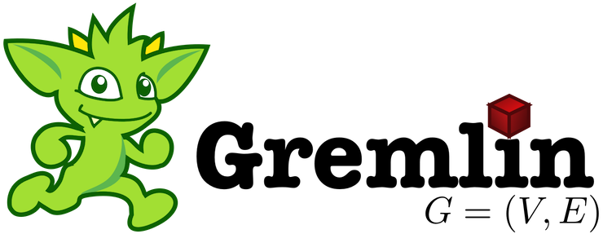
Apache Tinkerpop Standard Graph objects
Luis
vertex
id: Luis
label: person
properties:
age: 27
edge
id: edgeId
label: worksAt
properties:
distance: 10miles
g.V('id').out('rel').has('attr')
http://tinkerpop.apache.org

Slide 7
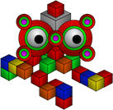
Apache Tinkerpop Standard
Open-source connectivity libraries:
Java, Python, .NET, Javascript, PHP, Go, etc...
Frameworks and tooling:
Data processing, visualization utilities, etc...
Large number of on-premise vendors
Vendor-specific implementation
Full list of OSS integrations: http://tinkerpop.apache.org/#graph-systems

Slide 8
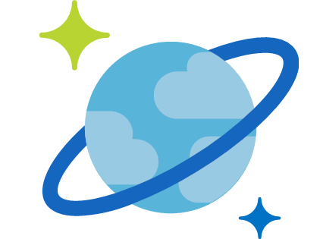
Azure Cosmos DB Gremlin API
Only fully-managed horizontally-scalable PaaS graph database service.
Graph engine based on Apache Tinkerpop standard
Adapted to a horizontally-scalable distributed storage system
Extended with Cosmos DB specific features: resource throttling, retry logic, and distributed runtime diagnostics.
Wire-protocol compatibility with OSS connectors and libraries.
Cosmos DB Gremlin API support: https://docs.microsoft.com/en-us/azure/cosmos-db/gremlin-support

Slide 9
Fully-managed graph database
PaaS deployment model
No management of physical-level infrastructure
Request-based capacity model
Request Units (RU) as the main currency for capacity management
Horizontally-scalable storage and throughput via partitioning
Automated partitioning system, transparent to application layer
Elastically-scalable capacity
Capability to set request capacity by the hour
Cosmos DB Gremlin API support: https://docs.microsoft.com/en-us/azure/cosmos-db/gremlin-support

Slide 10
Apache Tinkerpop Compatibility
Platform | Source | Getting Started | Version
.NET | Gremlin.NET on GitHub | Create Graph using .NET | 3.4.0-RC2
Java | Gremlin JavaDoc | Create Graph using Java | 3.2.0+
Node.js | Gremlin-JavaScript on GitHub | Create Graph using Node.js | 3.3.4+
Python | Gremlin-Python on GitHub | Create Graph using Python | 3.2.7
PHP | Gremlin-PHP on GitHub | Create Graph using PHP | 3.1.0
Gremlin console | TinkerPop docs | Create Graph using Gremlin Console | 3.2.0 +
Cosmos DB Gremlin API support: https://docs.microsoft.com/en-us/azure/cosmos-db/gremlin-support

Slide 11
Apache Tinkerpop Compatibility
Cosmos DB supported Gremlin steps:
CRUD
Aggregation
Computation
Projection
Cosmos DB specific steps
Partitioning Strategy
Execution Profile
Cosmos DB Gremlin API support: aka.ms/cosmosdb-gremlin-steps

Slide 12
Multi-model capabilities
App
Cosmos DB
SQL API SDK
Document
Gremlin SDK
Graph
Application-layer
with dual connectivity patterns
Database endpoints
Cosmos DB
Partitioned storage
https://github.com/LuisBosquez/azure-cosmos-db-graph-working-guides/blob/master/graph-backend-json.md

Slide 13
Multi-model capabilities
Advantages for using document endpoint
Cost-efficient point-reads and point-writes
Direct mode bypasses query engine
Paginated results for index-based queries
Use continuation tokens
Compatibility with Cosmos DB server-layer programmability :
Change Feed Processor
Stored procedures, UDF, Triggers
Azure service compatibility: Azure Search, Data Factory, etc.

Slide 14
Demo
Using Azure Cosmos DB Gremlin API in Notebooks

Slide 15
Gremlin query primer
Kinds of Gremlin query operations:
Data modification (DML)
Point lookup functions
Filtering functions
Traversal functions
Aggregation functions
First stop: https://docs.microsoft.com/en-us/azure/cosmos-db/gremlin-support

Slide 16
DML Gremlin queries
Create vertices and add properties
Create edges with to() or from()
Add/modify properties for vertices or edges
g.addV(<label>).property([...])
g.V(<id>).addE(<label>).to(g.V(<id>))
g.V(<id>).property(<key>, <value>)

Slide 17
Point-lookups
Vertex point-lookup by ID
Edges point-lookup by ID
Vertex point-lookup by ID and partition key
g.V(<id>)
g.E(<id>)
g.V([<pk>,<id>])

Slide 18
Filtering functions
Property filtering using .has()
Traversal condition filtering using .where()
Comparison parameters
g.V().has('name', 'Luis')
g.V(<id>).outE(<id>).where(inV().has('distance', '3'))
g.V().has('distance', gt(300))

Slide 19
Filtering functions
Result set filtering using .range() or .limit()
x
g.V().limit(100)
g.V().range(1, 100)

Slide 20
Traversal functions
Adjacency exploration .out()
The .repeat() function with .until() predicate.
The .repeat() function with .times() predicate.
g.V(<id>).out().has('name', 'Luis')
g.V(<id>).repeat(out()).until(has('name', 'Luis'))
g.V(<id>).repeat(out()).times(8))

Slide 21
Traversal functions
Best practice is to include .simplePath() and .dedup() in all .repeat() traversals to avoid cyclic traversals and recursive results.
g.V(<id>)
.repeat(out().simplePath().dedup())
.until(has('distance', '3'))

Slide 22
Aggregation functions
g.V(<id>).sum() | .avg() | group().by() ...

Slide 23
Resources
Introduction to Gremlin API: https://1drv.ms/p/s!As-FsdCIqMmj7Svsns1TnygOFoIS
Support of Gremlin surface area: https://docs.microsoft.com/en-us/azure/cosmos-db/gremlin-support
Apache Tinkerpop 3.4.1 Reference: http://tinkerpop.apache.org/docs/3.4.1/reference/
Cosmos DB Gremlin API introduction: https://docs.microsoft.com/en-us/azure/cosmos-db/graph-introduction

