Slide 1
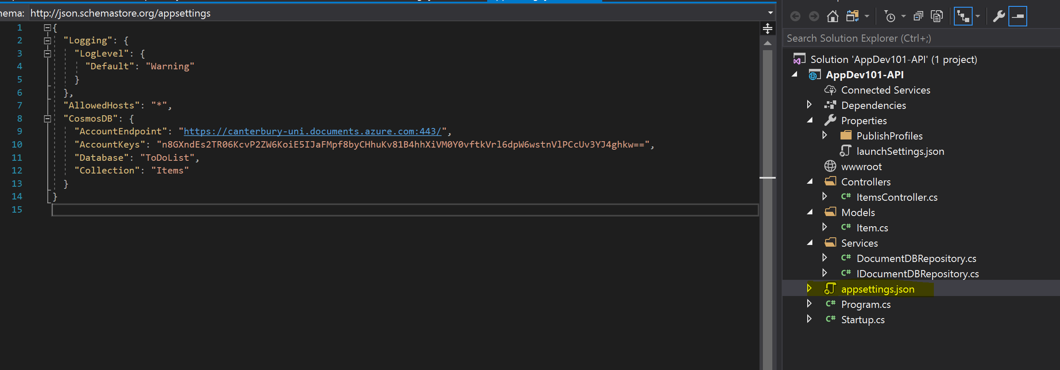
App Settings

Slide 2
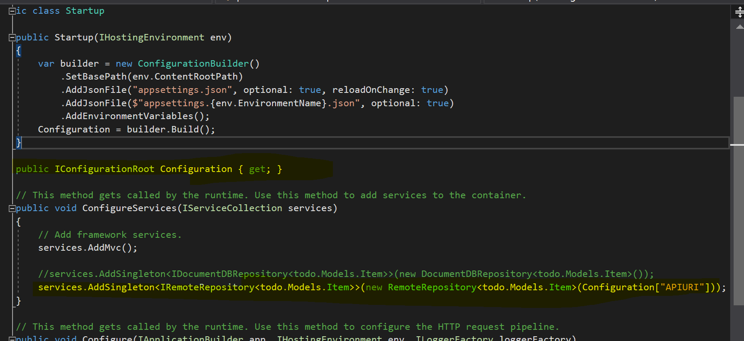
IOC Containers

Slide 3

IOC Containers

Slide 4


Dependency Injection

Slide 5
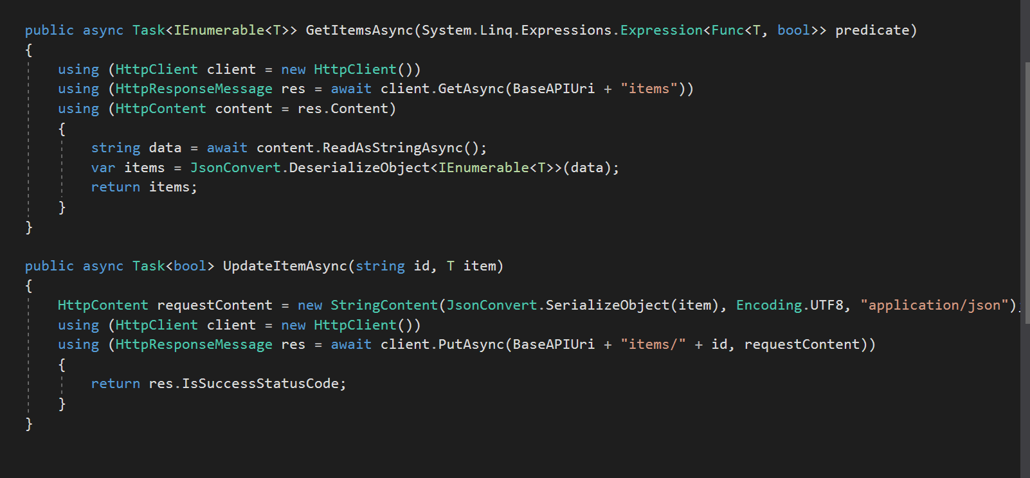
HTTP Clients

Slide 6

Serialisation

Slide 7
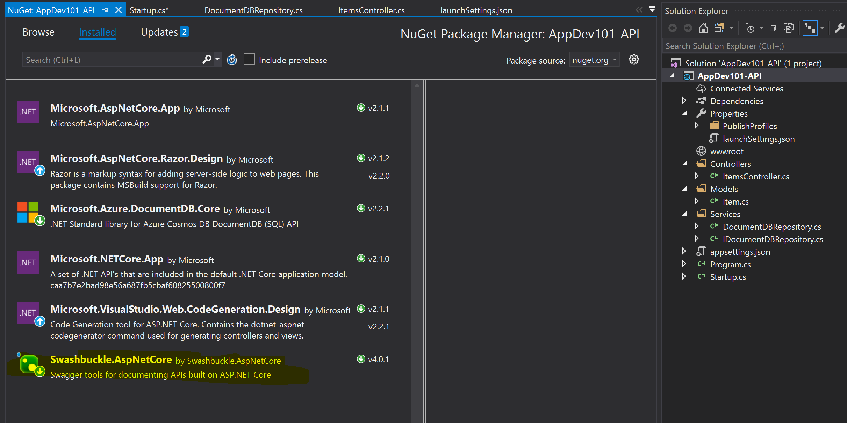
Nuget Package Management

Slide 8
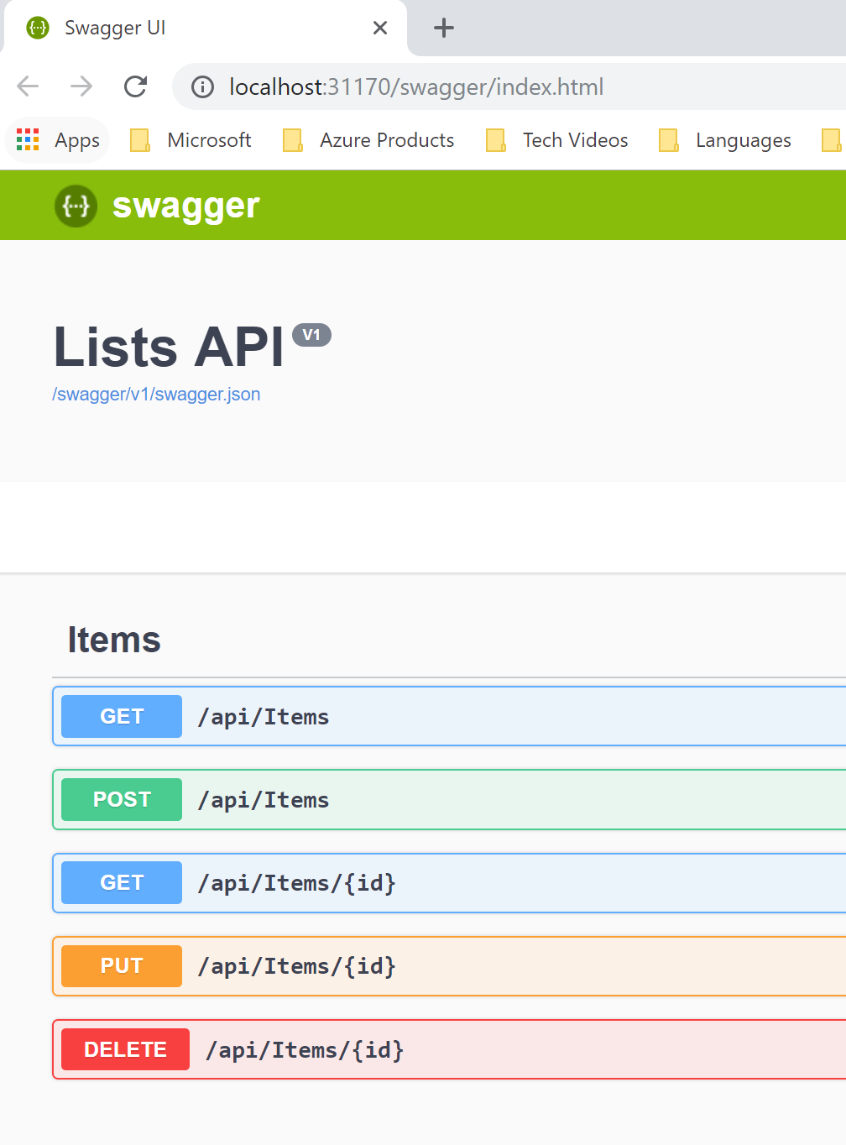
Swagger Open API Specification

