Slide 1



ISE to VSCode: Transition Your PowerShell Scripting NOW!
Tim Warner
Staff author, Pluralsight

Slide 2


Our Agenda
Accept the fate of PowerShell ISE
Introduce Visual Studio Code
Get productive with PowerShell development on VSCode

Slide 3

Session Materials
timw.info/summer2019

Slide 4
Fate of PowerShell ISE

Slide 5
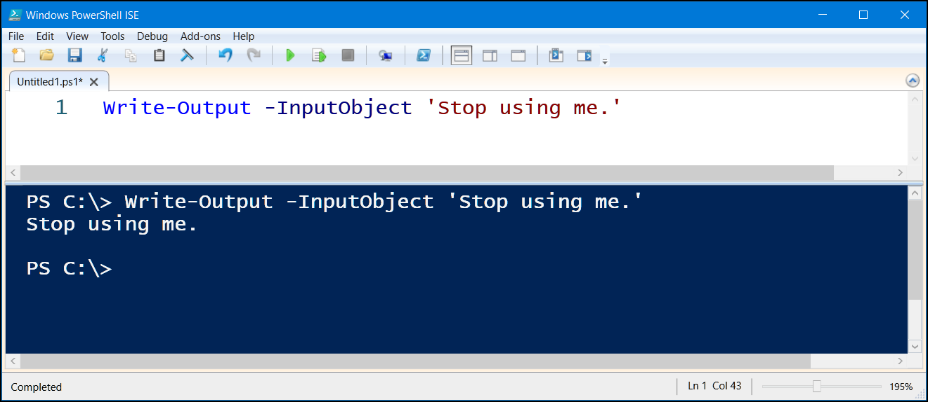

Slide 6
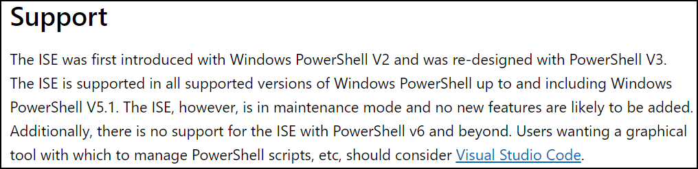
Context
http://timw.info/ised

Slide 7
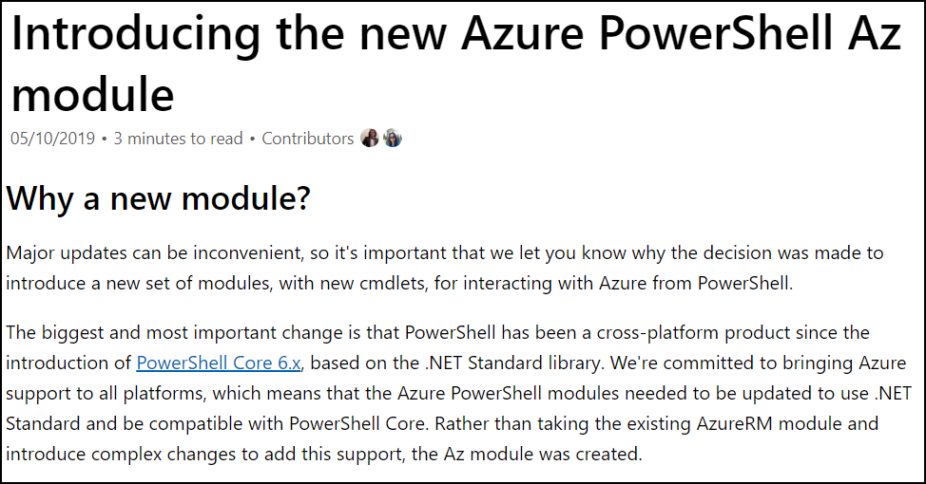
Context
http://timw.info/azm

Slide 8
Understand VSCode

Slide 9
Visual Studio Code Key Elements
Cross-platform code editor
Open source (timw.info/vsccode)
Multi-language
Extensible
Community supported

Slide 10



“A Specialized Web Browser…”
Node.js
Monaco
Chromium

Slide 11
VSCode for PowerShell Development

Slide 12

PowerShell Editor Services
Any editor!
Language Service (references, IntelliSense, PSScriptAnalyzer)
Debugging Service (breakpoints, variables, call stack)
$psEditor API (scripting of the host editor)
Integrated Console (interactive development and debugging)

Slide 13

High-Level Setup Workflow
VSCode
PowerShell extension
Settings/sync
Icons
Snippets
Key bindings

Slide 14

Let’s do this!

Slide 15
Summary/Takeaways
Learning curves are rarely fun
Get over your VSCode curve starting today
You will likely learn to love VSCode as I have
Please consider contributing!
Code base
Extensions/themes
Docs

Slide 16



Thank You/Contact Information
@TechTrainerTim
TechTrainerTim.com
timw.info/summer2019

