Slide 1



ISE to VSCode: Transition Your PowerShell Scripting NOW!
Tim Warner
Staff author, Pluralsight

Slide 2


Our Agenda
Accept the fate of PowerShell ISE
Introduce Visual Studio Code
Get productive with PowerShell development on VSCode

Slide 3

Session Materials
timw.info/summer2019

Slide 4
Fate of PowerShell ISE

Slide 5
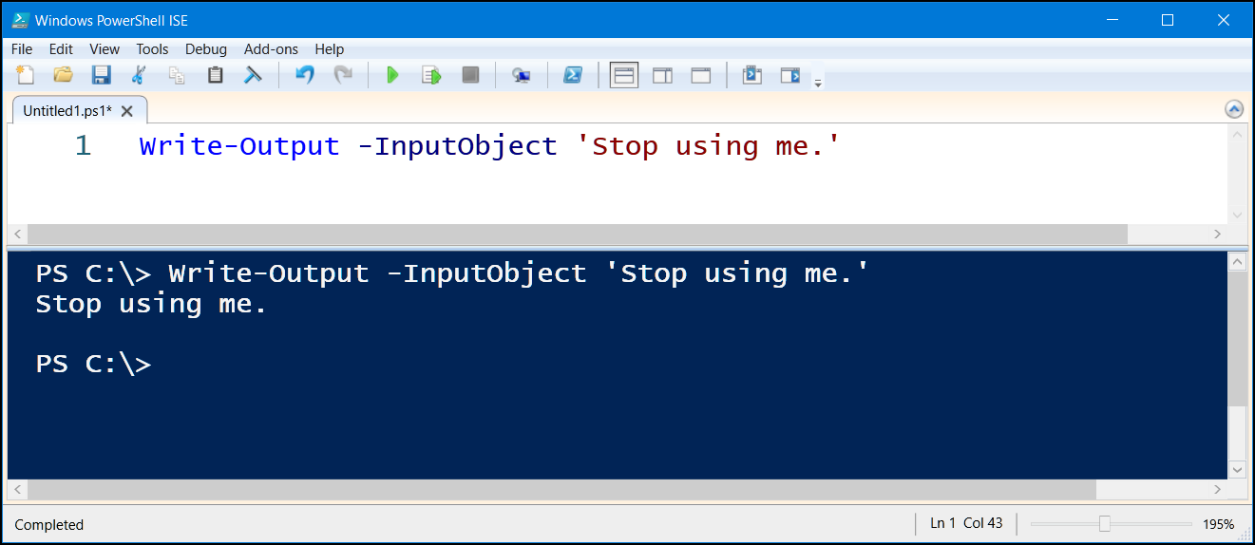

Slide 6
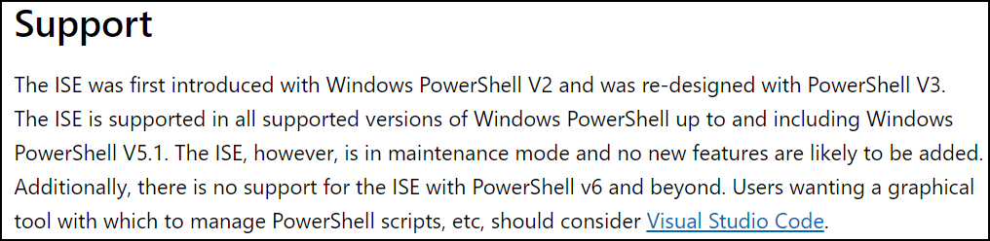
Context
http://timw.info/ised

Slide 7
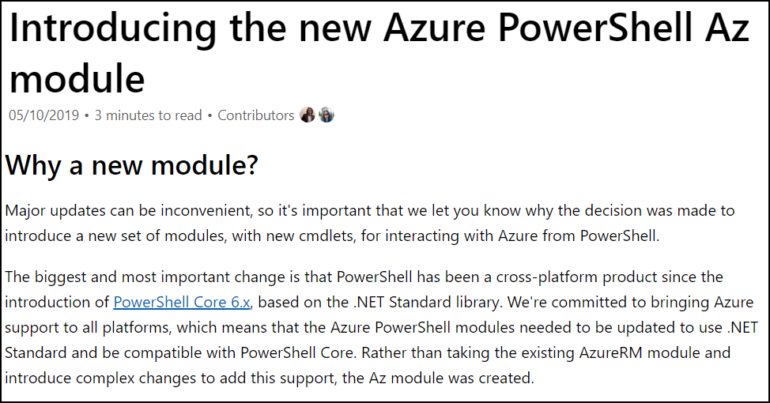
Context
http://timw.info/azm

Slide 8
Understand VSCode

Slide 9
Visual Studio Code Key Elements
Cross-platform code editor
Open source (timw.info/vsccode)
Multi-language
Extensible
Community supported

Slide 10



“A Specialized Web Browser…”
Node.js
Monaco
Chromium

Slide 11
VSCode for PowerShell Development

Slide 12

High-Level Setup Workflow
VSCode
PowerShell extension
Settings/sync
Icons
Snippets
Key bindings

Slide 13

Let’s do this!

Slide 14
Summary/Takeaways
Learning curves are rarely fun
Get over your VSCode curve starting today
You will likely learn to love VSCode as I have
Please consider contributing!
Code base
Extensions/themes
Docs

Slide 15



Thank You/Contact Information
@TechTrainerTim
TechTrainerTim.com
timw.info/summer2019

