Slide 1



Azure Automation – Your Administrative Swiss Army Knife
Tim Warner
Staff author, Pluralsight

Slide 2
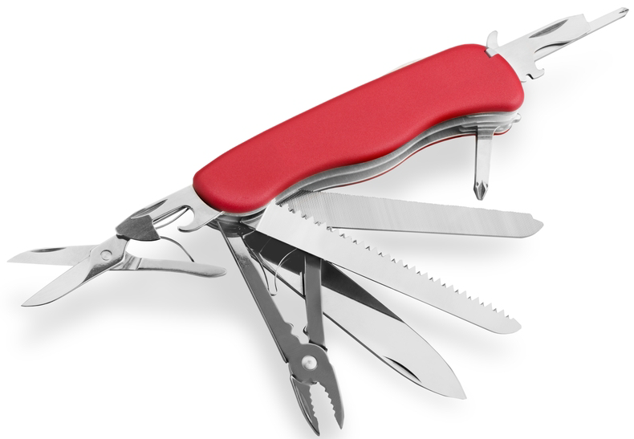

Our Agenda
Introduce Azure Automation
Tour its capabilities
Monitor the environment

Slide 3

Session Materials
timw.info/summer2019

Slide 4
Introduce Azure Automation

Slide 5

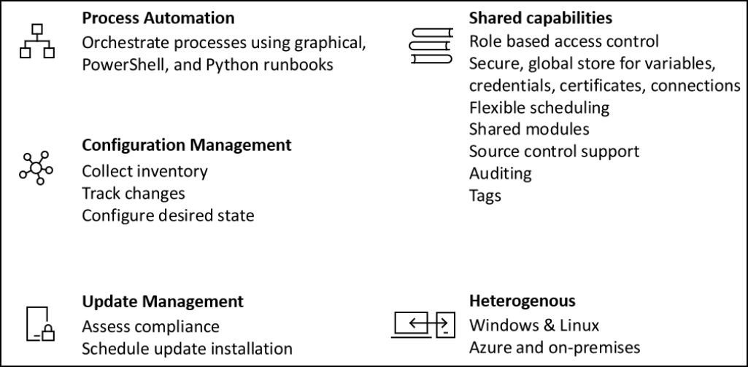
What is Azure Automation?

Slide 6
Historical Context
System Center Orchestrator (SCORCH)
Service Management Automation (SMA)
Azure Automation

Slide 7
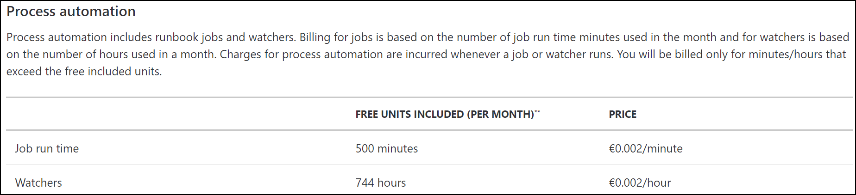
Yeah, But How Much Does it Cost?
Free/paid tiers based on job run time and watcher executions
http://timw.info/aap

Slide 8
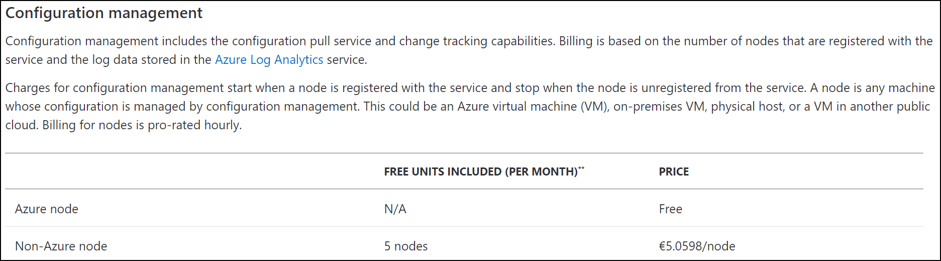
Yeah, But How Much Does it Cost?
Free/paid tiers based on whether the management node resides in Azure or on-prem
http://timw.info/aap

Slide 9
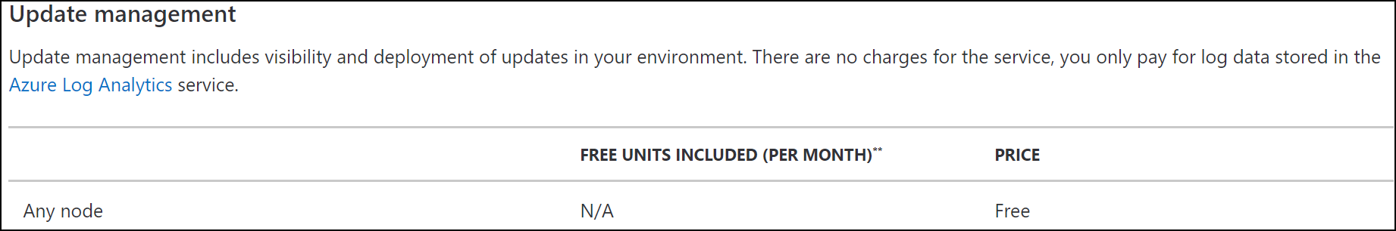
Yeah, But How Much Does it Cost?
Charged only on Azure Log Analytics data
http://timw.info/aap

Slide 10

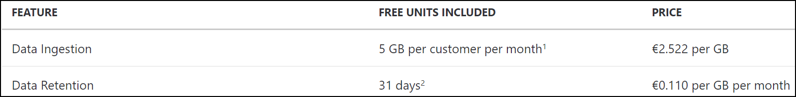
Azure Log Analytics Pricing
Free/paid tiers based data ingestion and retention
http://timw.info/alap

Slide 11

Comparison
Azure Automation
Azure Functions
Ad-hoc or scheduled execution (Watchers do support eventing)
PowerShell is first class citizen
Slower performance
Specialized App Services app
Faster performance
Highly constrained sandbox
PowerShell is afterthought (preview ATM)

Slide 12
Tour Azure Automation Capabilities

Slide 13

Understand the Azure Run As Connection
Provides security context for your runbooks
Service principal
Self-signed certificate
Contributor role membership at the subscription scope

Slide 14

Migrate to the Az PowerShell Modules
Check for dependences on higher-level solutions/resources
Stop/unscheduled AzureRm-based runbooks
Import the Az modules
Az.Accounts
Additional modules
Refactor and test runbooks
Do not import or update AzureRm modules anymore

Slide 15

Let’s do this!

Slide 16
Monitor Azure Automation

Slide 17

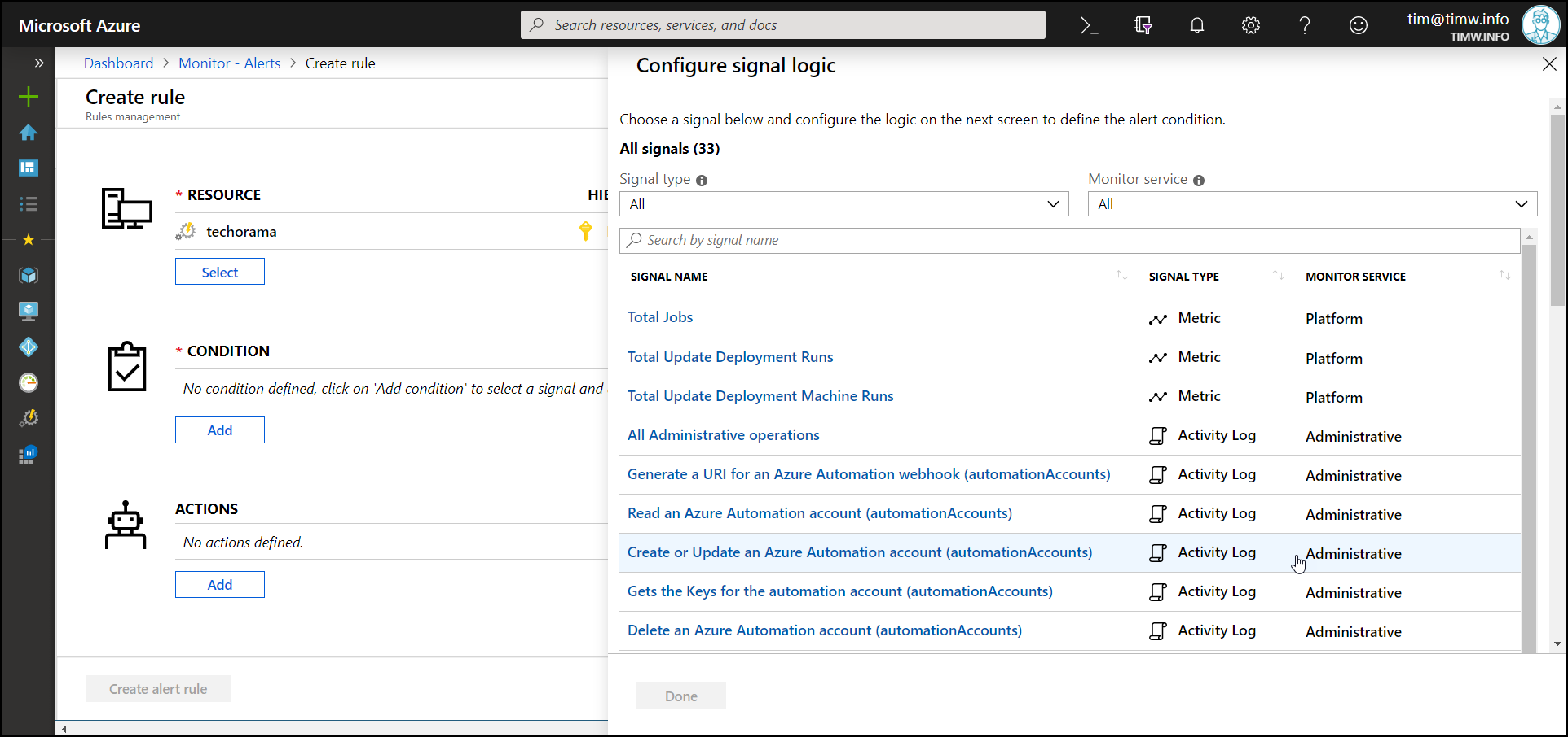
Azure Monitor Alerts

Slide 18
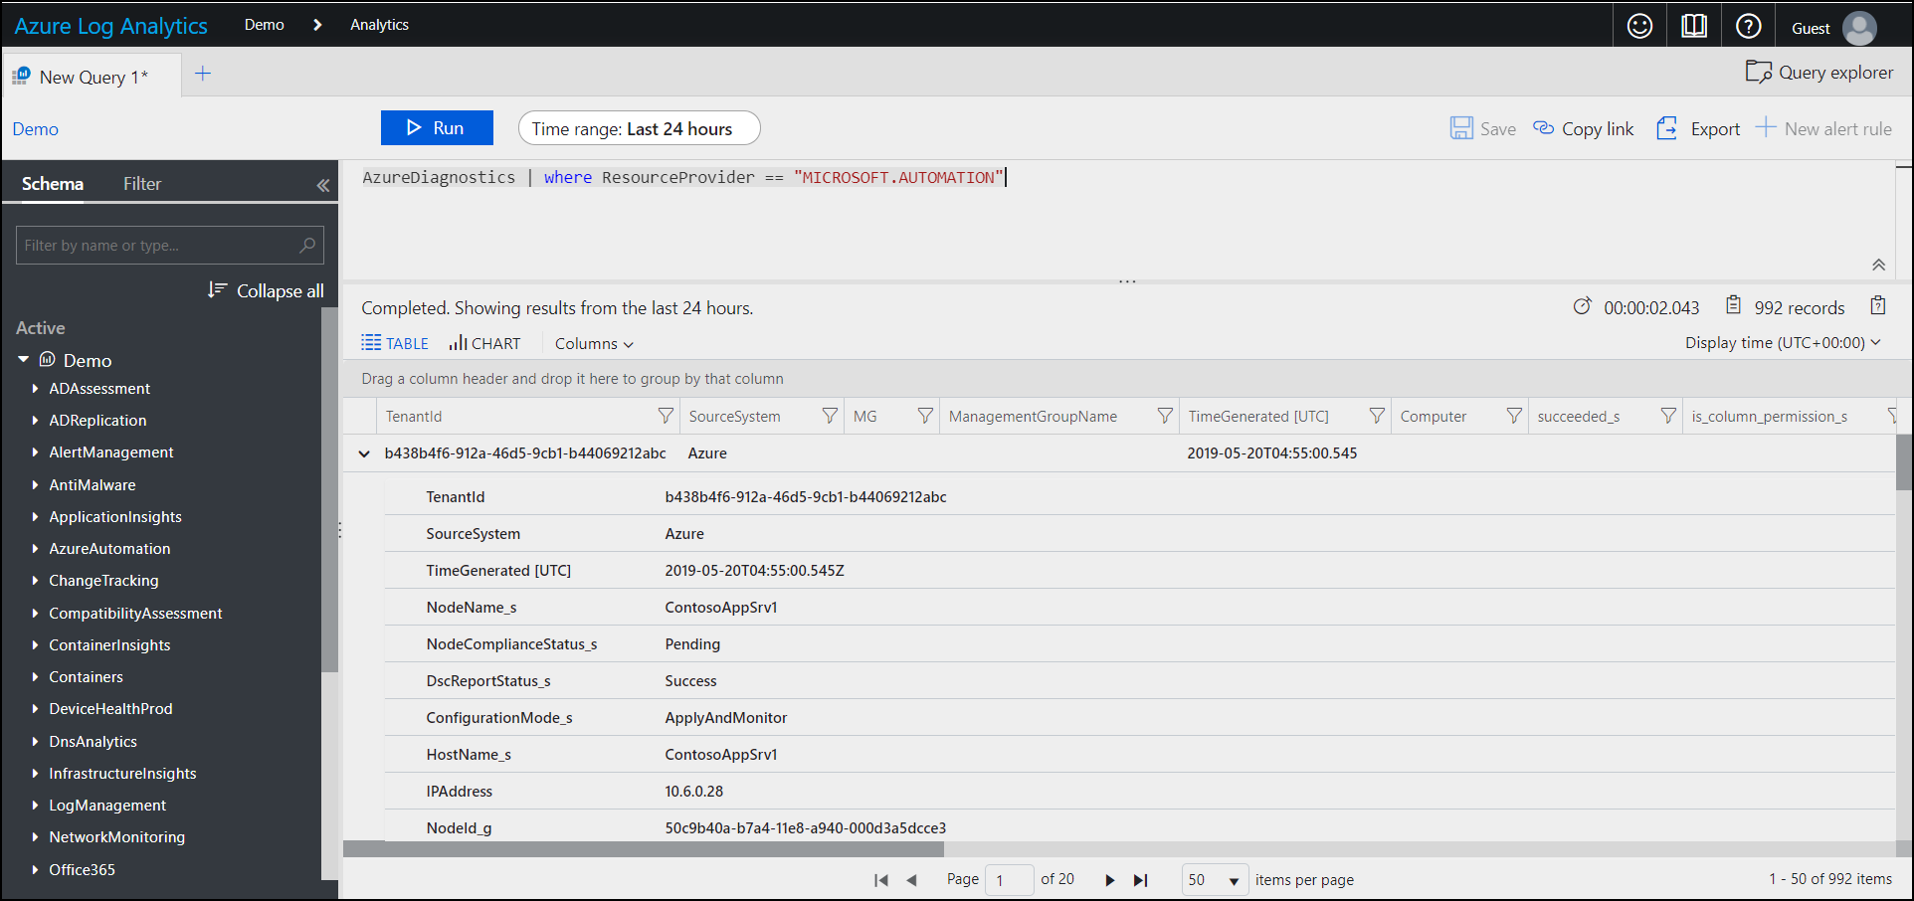
Azure Log Analytics KQL Queries

Slide 19
Let’s do this (Revisited)!

Slide 20
Summary/Takeaways
Azure Automation gives you a great excuse to master:
Azure PowerShell
Kusto Query Language
Your homework:
Hybrid worker groups
Watcher tasks
Update Management
Change Tracking

Slide 21



Thank You/Contact Information
@TechTrainerTim
TechTrainerTim.com
timw.info/summer2019

