Slide 1
.NET Core: Overview and Tools
Notes:
Agenda
- Introduce .NET Core
- Development
- Deployment
- .NET CLI

Slide 2
Introducing .NET Core

Slide 3

.NET platform
DESKTOP
.NET FRAMEWORK
WINDOWS UWP
.NET CORE
ASP.NET
MOBILE
CLOUD
XAMARIN
TOOLS
Visual Studio
.NET STANDARD LIBRARY
Visual Studio for Mac
COMMON INFRASTRUCTURE
Visual Studio Code
Compilers
Languages
Runtime components

Slide 4
.NET Core -- Cross-platform services
DESKTOP
.NET FRAMEWORK
WINDOWS UWP
.NET CORE
ASP.NET
MOBILE
CLOUD
XAMARIN
TOOLS
Visual Studio
.NET STANDARD LIBRARY
Visual Studio for Mac
COMMON INFRASTRUCTURE
Visual Studio Code
Compilers
Languages
Runtime components

Slide 5




.NET Core
Cross-platform
Windows, Linux and macOS
Fast
8x faster than Node.js in TechEmpower benchmark
Lightweight
No impact deployment and a modular development model perfect for containers
Open source
Runtime, libraries, compiler, languages and tools developed in the open in GitHub

Slide 6
ASP.NET Core is Fast!

Slide 7
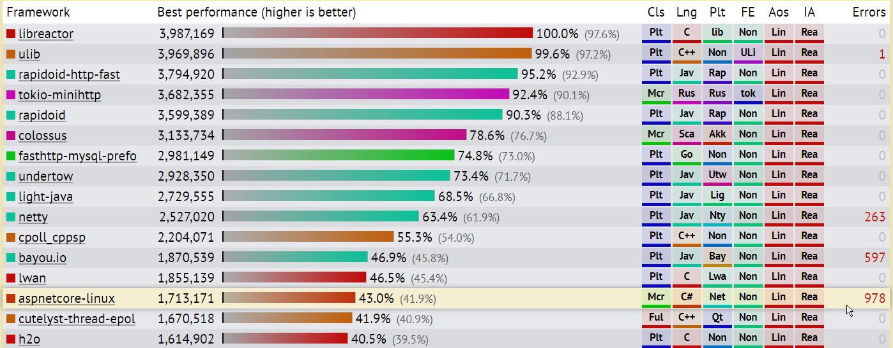
TechEmpower Framework Benchmarks – Round 14 – PlainText
https://techempower.com/benchmarks/

Slide 8
50% of .NET Core contributions are from the community

Slide 9
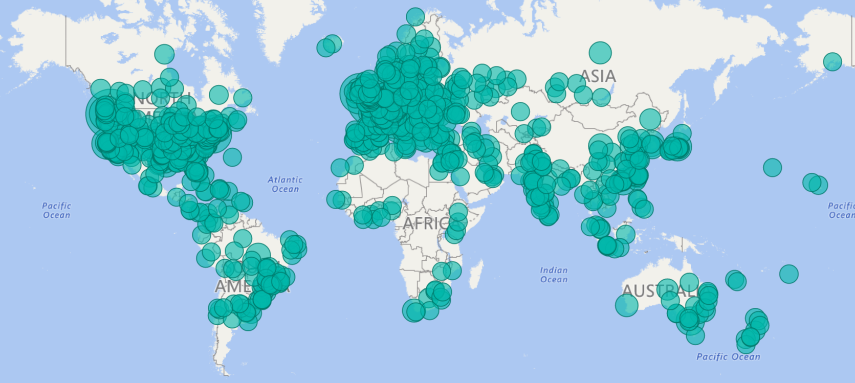
.NET Open Source Contributions as of 2017

Slide 10







Technical Steering Group
The following companies are helping to drive the future of .NET

Slide 11
.NET Core: product shape

Slide 12
.NET Core Distributions
.NET Core SDK
.NET Core Runtime

Slide 13
.NET Core Runtime Deployment Options
Framework Dependent Deployment (FDD)
Self-contained Deployment (SCD)
.NET Runtime
.NET Runtime

Slide 14

Workloads
>
Web
Console
Notes:
TODO: Show web browser, console

Slide 15



Developer Experiences
Notes:
TODO:
If you’re on Windows, use Visual Studio
If you’re on Mac, use Visual Studio for Mac
If you prefer a lightweight editor, we recommend Visual Studio Code
If you want to use another text editor, all you need is the .NET Core SDK which
includes a CLI

Slide 16

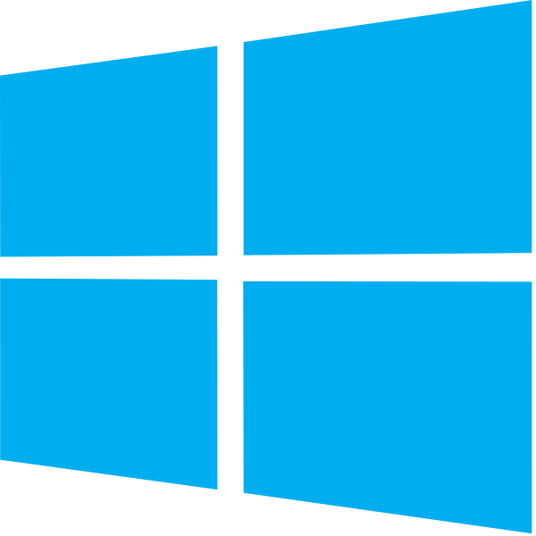



Developer Experiences
Visual Studio for Mac
Visual Studio Code
BYO Text Editor
.NET Core SDK (includes CLI)
Notes:
If you’re on Windows, we recommend Visual Studio
If you’re on Mac, we recommend Visual Studio for Mac
If you prefer a lightweight editor, we recommend Visual Studio Code
If you want to use another text editor, all you need is the .NET Core SDK which includes a CLI

Slide 17
Supported OSes
Windows
Windows 7 SP1+, 8.1
Windows 10 Client
Server 2008 R2 SP1+
Server 2016 (incl. Nano)
macOS
Sierra (10.12)
High Sierra (10.13)
Linux
RHEL 7
Fedora 25, 26
Centos 7
Debian 8.7+
Ubuntu 14.04, 16.04, 17.04
Linux Mint 17, 18
openSUSE 42.2+
Oracle Linux 7
SUSE Enterprise Linux 12 SP2+
https://github.com/dotnet/core/blob/master/release-notes/2.0/2.0-supported-os.md

Slide 18
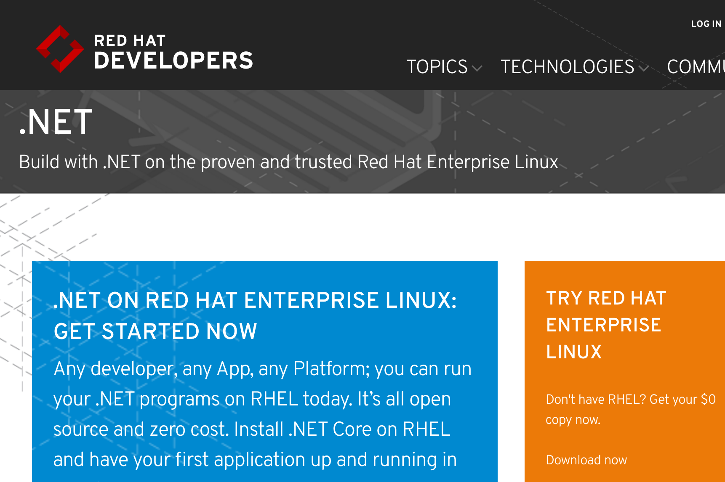
http://redhatloves.net

Slide 19
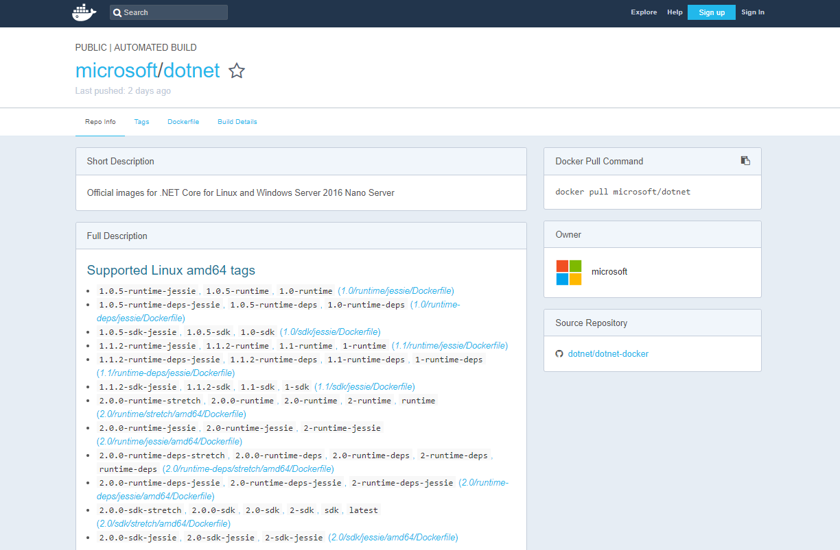
https://hub.docker.com/r/microsoft/dotnet/

Slide 20
.NET Core and .NET Framework
Similarities
Support the latest C#, VB.NET, F#
Implements .NET Standard API
Supports ASP.NET Core and EF Core
Best experience in Visual Studio
Great experience in Visual Studio Code
Can be used in/with Docker

Slide 21
.NET Core and .NET Framework
Differences
.NET Framework comes with Windows
.NET Core installs side-by-side
.NET Core is cross-platform and OSS
.NET Core works on Nano
.NET Core has a strong CLI experience
Notes:
F# and VB are coming for Core

Slide 22
.NET Core: Your First App

Slide 23
Sample Source Code
using System;
class Program
{
static void Main(string[] args)
{
Console.WriteLine("Hello World!");
}
}

Slide 24
CSProj – default console template
<Project Sdk="Microsoft.NET.Sdk">
<PropertyGroup>
<OutputType>Exe</OutputType>
<TargetFramework>netcoreapp2.0</TargetFramework>
</PropertyGroup>
</Project>
Notes:
Point out the following:
Microsoft.NET.SDK pulls in a set of default settings, such as including *.cs files in the project, and appropriate reference assemblies
Exe produces an EXE build. Libraries are the default
netcoreapp2.0 is the target framework, so defines the set of reference assemblies you get

Slide 25
CSProj – default Web template
<Project Sdk="Microsoft.NET.Sdk.Web">
<PropertyGroup>
<TargetFramework>netcoreapp2.0</TargetFramework>
</PropertyGroup>
<ItemGroup>
<Folder Include="wwwroot\" />
</ItemGroup>
<ItemGroup>
<PackageReference Include="Microsoft.AspNetCore.All" Version="2.0.0" />
</ItemGroup>
</Project>
Notes:
Point out the following:
Microsoft.NET.SDK.Web pulls in a set of default settings, including referencing Microsoft.Net.SDK under the hood
Demonstrates PackageReference syntax, the new way to reference NuGet packages. ASP.NET remains in NuGet.
Uses new AspNetCore.All metapackage

Slide 26
.NET Core CLI

Slide 27
What are the .NET Core command-line tools?
Cross-platform command-line set of tools that are…
…focused on building code…
…for both humans…
…and machines

Slide 28
Principles of design
Several principles inform CLI design:
NuGet (and $PATH-based) extensibility
Every command is a verb (“compile”, “run”, “restore” etc.)
The driver knows enough to run the command(s) and no more
All core commands are consumable by humans and machines
Notes:
We are applying several principles when it comes to designing the CLI:
NuGet (and $PATH-based) extensibility
Every command is a verb (“compile”, “run”, “restore” etc.)
The driver knows enough to run the command(s) and no more
All core commands are consumable by humans and machines

Slide 29
CLI commands: basic architecture
dotnet
build
--output [path]
the driver
verb (command)
verb arguments

Slide 30
CLI commands: architecture explained
Driver, dotnet, is invoked first, followed by a verb
The verb is a command that is implemented as:
A NuGet package
A binary in the $PATH
Driver invokes the command passing the arguments to it
The command is responsible for the arguments

Slide 31
.NET Core SDK Commandline Usage (1/2)
Command | Purpose
dotnet new | Initialize .NET projects.
dotnet restore | Restore dependencies specified in the .NET project.
dotnet run | Compiles and immediately executes a .NET project.
dotnet build | Builds a .NET project.
dotnet publish | Publishes a .NET project for deployment (incl. runtime).
dotnet test | Runs unit tests using the test runner specified in the project.
dotnet pack | Creates a NuGet package.
dotnet migrate | Migrates project.json project to msbuild based project.

Slide 32
.NET Core SDK Commandline Usage (2/2)
Command | Purpose
dotnet clean | Clean build output(s).
dotnet sln | Modify solution (SLN) files.
dotnet add | Add reference to the project.
dotnet remove | Remove reference from the project.
dotnet list | List reference in the project.
dotnet nuget | Provides additional NuGet commands.
dotnet msbuild | Runs Microsoft Build Engine (MSBuild).
dotnet vstest | Runs Microsoft Test Execution Command Line Tool.

Slide 33
Demo
.NET Core Getting Started

Slide 34
.NET Core Deployment

Slide 35
For Development
Install the .NET Core SDK. Includes:
.NET Core Tools
.NET Core Runtime(s)
Typically installed globally, via native installer
Can also download and copy as a zip to a private location
Type “which dotnet” or “where dotnet” to locate dotnet in your path.
Notes:
There are multiple types of deployment for .NET Core
Framework-dependent deployment (FDD) - require shared component on target
FDD w/ native dependencies - require shared component but has native dependencies
Self-contained deployment (SCD) - package all with them (what we currently have)

Slide 36
For Apps – two options
Framework Dependent Deployment (the default)
Called “framework-dependent app deployment”.
All apps share the same .NET Core runtime.
Apps can be OS and chip independent.
Great for controlled environments (memory usage and servicing).
Launched with .NET Core host: “dotnet path/to/myapp.dll”
Self-contained Deployment
Called “self-contained app deployment”
Each app has its own private .NET Core runtime; uses more space.
Apps are OS and chip dependent/specific.
Great for uncontrolled environments.
Launched as an executable: “myapp”
Notes:
There are multiple types of deployment for .NET Core
Framework-dependent deployment (FDD) - require shared component on target
FDD w/ native dependencies - require shared component but has native dependencies
Self-contained deployment (SCD) - package all with them (what we currently have)

Slide 37
Servicing Updates
.NET Core updates are installed centrally
Updates are shipped at least 1/quarter
Framework-dependent apps roll-forward to latest patch
Example: Apps built for 1.0.0 roll forward to 1.0.4 patch version
Example: Apps built for 1.0.0 do not roll forward to 1.1.x or 2.0.x versions
Self-contained apps must be re-published
Notes:
There are multiple types of deployment for .NET Core
Framework-dependent deployment (FDD) - require shared component on target
FDD w/ native dependencies - require shared component but has native dependencies
Self-contained deployment (SCD) - package all with them (what we currently have)

Slide 38
Deployment Examples
Check out dotnet/dotnet-docker-samples for working deployment examples.
Has both Docker and non-Docker instructions.
https://github.com/dotnet/dotnet-docker-samples
Notes:
There are multiple types of deployment for .NET Core
Framework-dependent deployment (FDD) - require shared component on target
FDD w/ native dependencies - require shared component but has native dependencies
Self-contained deployment (SCD) - package all with them (what we currently have)

Slide 39
Self-contained deployment
Project file must contain one or more runtime IDs, for the targeted architectures
<RuntimeIdentifiers>win7-x64; debian.8-x64</RuntimeIdentifiers>
Publish in terms of an architecture
dotnet publish -c release -r win7-x64
https://github.com/dotnet/dotnet-docker-samples/tree/master/dotnetapp-selfcontained
Notes:
There are multiple types of deployment for .NET Core
Framework-dependent deployment (FDD) - require shared component on target
FDD w/ native dependencies - require shared component but has native dependencies
Self-contained deployment (SCD) - package all with them (what we currently have)

Slide 40
Demo
Deploying Standalone apps with Docker

