Slide 1
ASP.NET Core
Notes:
Agenda
- Introduce .NET Core
- Development
- Deployment
- .NET CLI

Slide 2



ASP.NET Core in a Nutshell
Web
Forms
MVC
Web API
ASP.NET Core (MVC + Razor Pages + API)
ASP.NET 4.6
(System.Web)
ASP.NET Core 2.0
(Microsoft.AspNetCore)
.NET Framework
.NET Core
Platform for .NET applications on Windows
Cross-platform, modular libraries & runtime optimized for server and cloud workloads

Slide 3
ASP.NET Core features
Hosting
Kestrel, Startup
Middleware
Routing, authentication, static files, diagnostics, error handling, session, CORS, localization, custom
Dependency Injection
Configuration
Logging
Application frameworks
Razor Pages, MVC, Identity, SignalR (alpha release)

Slide 4
Middleware

Slide 5
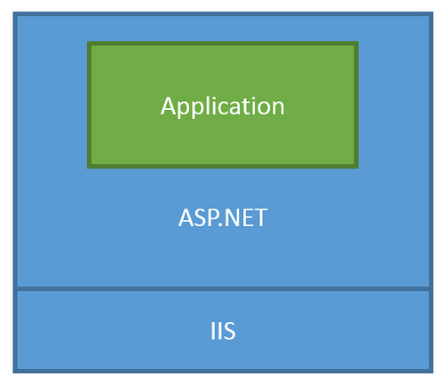
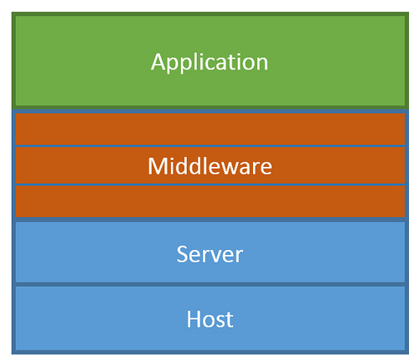
ASP.NET Core Middleware
Traditional ASP.NET Application Model
ASP.NET Core Middleware

Slide 6
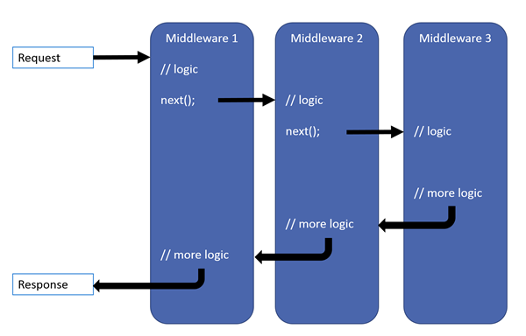
ASP.NET Core Middleware

Slide 7
MVC + Web API + Web Pages = ASP.NET Core MVC

Slide 8
Previous ASP.NET frameworks - similar, but different
Web Pages
MVC
Web API
Razor
HTML Helpers
HTML Helpers
Controllers
Controllers
Actions
Actions
Filters
Filters
Model binding
Model binding
DI
DI

Slide 9
ASP.NET = A unified web stack
ASP.NET 4.6 (WebForms, MVC, Web API, Web Pages - present but separate)
ASP.NET Core 1.0 Web API + MVC
ASP.NET Core 2.0 Web API + MVC + Razor Pages
Web Forms
MVC
Web Pages
Web API

Slide 10
ASP.NET = A unified web stack
ASP.NET 4.6 (WebForms, MVC, Web API, Web Pages)
ASP.NET Core 1.0 Web API+MVC
ASP.NET Core 2.0 Web API+MVC+Razor Pages
ASP.NET Core vNext Web API+MVC+Razor Pages +SignalR

Slide 11
Razor Pages

Slide 12
Razor Pages
Runs on all the same MVC infrastructure
Better encapsulation and grouping of UI details
Fewer folders and files
MVC
Razor Pages
/Controllers/CartController.cs
/ViewModels/CartViewModel.cs
/Views/Cart/Index.cshtml
3 Root Level Folders
/Pages/Cart/Index.cshtml
Index.cshtml.cs
1 Root Level Folder
Notes:
Reference (MSDN Magazine September 2017 - https://msdn.microsoft.com/en-us/magazine/mt842512)

Slide 13
@page
@using RazorPages
@model IndexModel
<p> @Model.Message </p>
using Microsoft.AspNetCore.Mvc.RazorPages;
using System;
namespace RazorPages {
public class IndexModel : PageModel
{
public string Message { get; private set; } = "Hello. ";
public void OnGet()
{
Message += $" Server time is { DateTime.Now }"; }
}
}
Notes:
https://docs.microsoft.com/en-us/aspnet/core/mvc/razor-pages/

Slide 14
MVC

Slide 15
What’s (pretty much) the same
MVC developer flow
Models / Views / Controllers
Routing / Attribute Routing
HTML Helpers

Slide 16
What’s Changed
No web.config (configuration)
No Global.asax or App_Start
No CSS / JS in project root (wwwroot)
bower and bowerrc
bundleconfig.json
New Program.cs / Startup.cs
Run with IISExpress / Kestrel

Slide 17
What’s new
(some aren’t MVC features but are useful for MVC dev)
Views get TagHelpers
DI more thoroughly integrated
Globalization / localization
MVC + APIs merged

Slide 18
TagHelpers
HTML helpers expressed as tags
Ex. Instead of:
@Html.LabelFor(m => m.UserName, new { @class = "col-md-2 control-label" })
Write this:
<label asp-for="UserName" class="col-md-2 control-label"></label>
Easier to customize with additional attributes
Work seamlessly with the HTML editor

Slide 19
TagHelpers
@using (Html.BeginForm(new { ReturnUrl = ViewBag.ReturnUrl })) {
@Html.AntiForgeryToken()
@Html.ValidationSummary(true)
<fieldset>
<legend>Log in Form</legend>
<ol>
<li>
@Html.LabelFor(m => m.UserName)
@Html.TextBoxFor(m => m.UserName)
@Html.ValidationMessageFor(m => m.UserName)
</li>

Slide 20
TagHelpers
<form anti-forgery=“true“ validation-summary=“true” action="Create“>
<fieldset>
<legend>Log in Form</legend>
<ol>
<li>
<label for=“UserName”>
<input for=“UserName”>
<span validation-for="Name" style="color:blue" />
</li>

Slide 21
TagHelpers: Create Your Own
public interface ITagHelper
{
int Order { get; }
Task ProcessAsync(TagHelperContext context, TagHelperOutput output);
}
Examples: https://github.com/aspnet/Mvc/tree/dev/src/Microsoft.AspNet.Mvc.TagHelpers

Slide 22
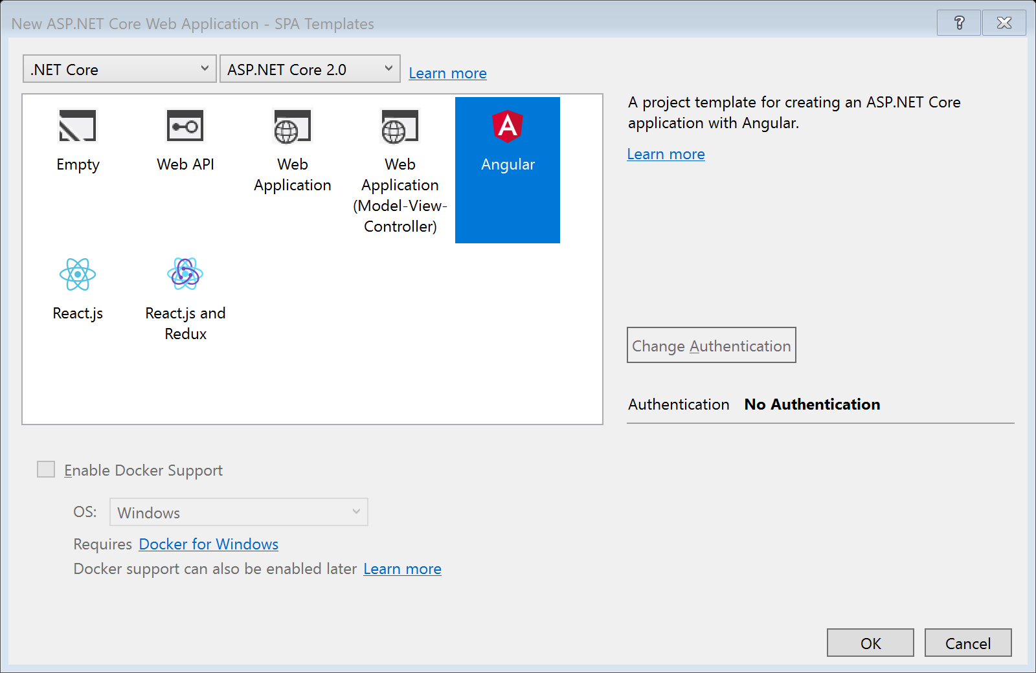
SPA Templates

Slide 23
SPA Templates: Built on JavaScriptServices
Useful infrastructure for SPA’s on ASP.NET Core
Hosts Webpack to compile and serve client-side code
Advanced features like Hot Module Reloading and client / server side routing integration
Can invoke arbitrary NPM packages from .NET code
https://github.com/aspnet/JavaScriptServices

Slide 24
Lab
Building an ASP.NET Core Site using CLI

Slide 25
Lab
Razor Pages

Slide 26
Lab
Tag Helpers

Slide 27
Lab
SPA Template

