Slide 1
Cross-Platform .NET Core
Notes:
Agenda
- Introduce .NET Core
- Development
- Deployment
- .NET CLI

Slide 2
Introducing .NET Core

Slide 3

.NET platform
DESKTOP
.NET FRAMEWORK
WINDOWS UWP
.NET CORE
ASP.NET
MOBILE
CLOUD
XAMARIN
TOOLS
Visual Studio
.NET STANDARD LIBRARY
Visual Studio for Mac
COMMON INFRASTRUCTURE
Visual Studio Code
Compilers
Languages
Runtime components

Slide 4
.NET Core -- Cross-platform services
DESKTOP
.NET FRAMEWORK
WINDOWS UWP
.NET CORE
ASP.NET
MOBILE
CLOUD
XAMARIN
TOOLS
Visual Studio
.NET STANDARD LIBRARY
Visual Studio for Mac
COMMON INFRASTRUCTURE
Visual Studio Code
Compilers
Languages
Runtime components

Slide 5




.NET Core
Cross-platform
Windows, Linux and macOS
Fast
8x faster than Node.js in TechEmpower benchmark
Lightweight
No impact deployment and a modular development model perfect for containers
Open source
Runtime, libraries, compiler, languages and tools developed in the open in GitHub

Slide 6
ASP.NET Core is Fast! Check TechEmpower.

Slide 7
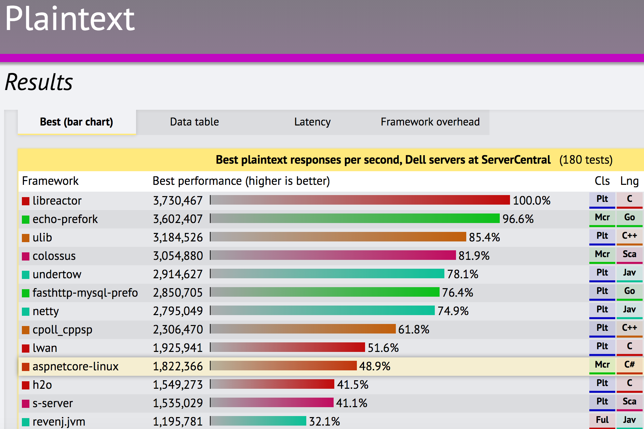
TechEmpower Framework Benchmarks – Round 13 – PlainText
https://techempower.com/benchmarks/

Slide 8
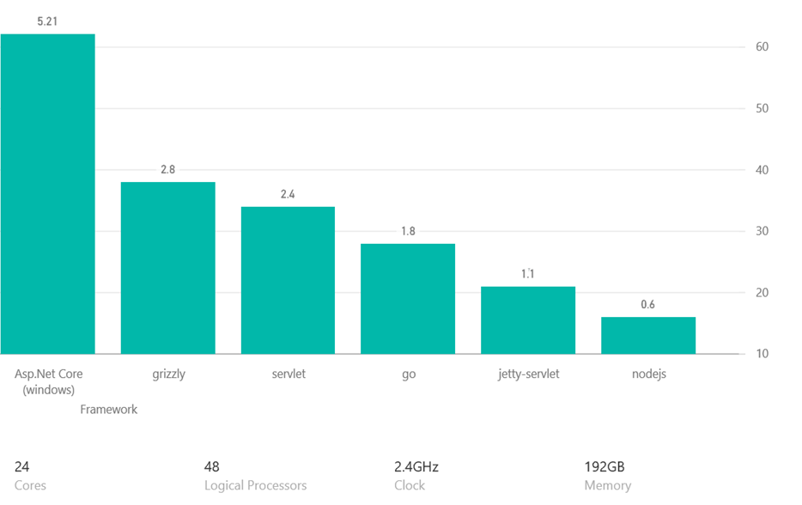
TechEmpower Framework Benchmarks (in our lab)

Slide 9
50% of .NET Core contributions are from the community

Slide 10

.NET Open Source Contributions as of 2016

Slide 11
Red Hat , Samsung, Google Unity and JetBrains join .NET Foundation Technical Steering Group

Slide 12
.NET Core: product shape

Slide 13
.NET Core Distributions
.NET Core
SDK
.NET Core Runtime

Slide 14
.NET Core Runtime Deployment Options
Global
Install
With App

Slide 15
Workloads
Web
Console

Slide 16
APIs
.NET Core 1.0
13.5k
.NET Core 2.0
> 30k

Slide 17
Developer Experiences
Visual Studio
VS Code
.NET CLI

Slide 18
Operating Systems
Windows
Linux
macOS

Slide 19
Supported OSes
Windows
Windows 7+
Server 2008 R2 SP1+
Server 2016 (incl. Nano)
macOS
Sierra
Linux
RHEL
Fedora
Centos
Debian
Ubuntu
Linux Mint
openSUSE
Oracle Linux

Slide 20

http://redhatloves.net

Slide 21
Chips
Intel
ARM

Slide 22
Isolation
Bare Metal
Containers

Slide 23
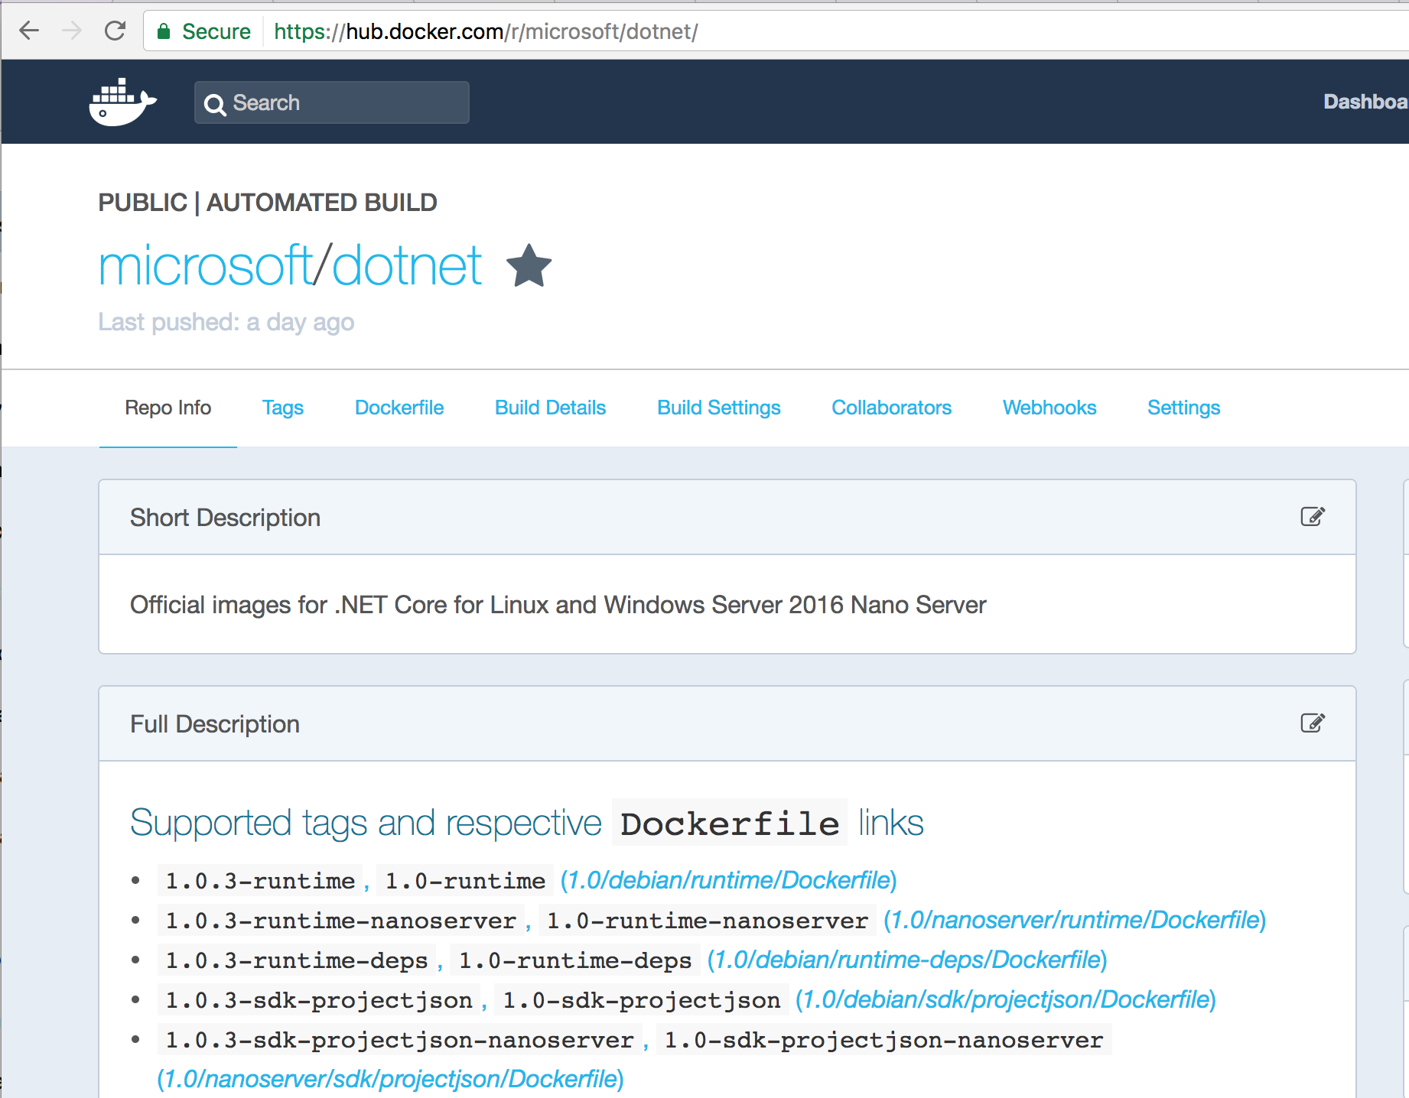
https://hub.docker.com/r/microsoft/dotnet/

Slide 24
.NET Core and .NET Framework
Similarities
Support the latest C#, F#
Implements .NET Standard API
Supports ASP.NET Core and EF Core
Best experience in Visual Studio
Great experience in Visual Studio Code
Can be used in/with Docker

Slide 25
.NET Core and .NET Framework
Differences
.NET Framework comes with Windows
.NET Core installs side-by-side
.NET Core is cross-platform and OSS
.NET Core works on Nano
.NET Core has a strong CLI experience
.NET Core doesn’t (yet) support VB
Notes:
F# and VB are coming for Core

Slide 26
.NET Core: source code

Slide 27
.NET Core source artifacts
Source code
Project
file

Slide 28
Sample Source Code
using System;
class Program
{
static void Main(string[] args)
{
Console.WriteLine("Hello World!");
}
}

Slide 29
CSProj – default console template
<Project Sdk="Microsoft.NET.Sdk">
<PropertyGroup>
<OutputType>Exe</OutputType>
<TargetFramework>netcoreapp1.0</TargetFramework>
</PropertyGroup>
</Project>
Notes:
Point out the following:
Microsoft.NET.SDK pulls in a set of default settings, such as including *.cs files in the project, and appropriate reference assemblies
Exe produces an EXE build. Libraries are the default
netcoreapp1.0 is the target framework, so defines the set of reference assemblies you get
Moving to removing .NET Core (runtime and fx) from NuGet

Slide 30
CSProj – default Web template
<Project Sdk="Microsoft.NET.Sdk.Web">
<PropertyGroup>
<TargetFramework>netcoreapp1.1</TargetFramework>
</PropertyGroup>
<ItemGroup>
<Folder Include="wwwroot\" />
</ItemGroup>
<ItemGroup>
<PackageReference Include="Microsoft.AspNetCore" Version="1.0.3" />
</ItemGroup>
</Project>
Notes:
Point out the following:
Microsoft.NET.SDK.Web pulls in a set of default settings, including referencing Microsoft.Net.SDK under the hood
Demonstrates PackageReference syntax, the new way to reference NuGet packages. ASP.NET remains in NuGet.

Slide 31
.NET Core SDK Commandline Usage
> dotnet new console // creates new project
> dotnet restore // restore NuGet dependencies
> dotnet build // builds your source into dlls
> dotnet path-to/yourapp.dll //loads and runs
> dotnet run // same thing as the last 2 lines
> dotnet test // runs your tests;reports pass/fail
> dotnet publish // prepares app for distribution
> dotnet pack // packages library as NuGet package

Slide 32
Demo
.NET Core Getting Started

Slide 33
.NET Core Deployment

Slide 34
For Development
Install the .NET Core SDK. Includes:
.NET Core Tools
.NET Core Runtime(s)
Typically installed globally, via native installer
Can also download and copy as a zip to a private location
Type “which dotnet” or “where dotnet” to locate dotnet in your path.
Notes:
There are multiple types of deployment for .NET Core
Framework-dependent deployment (FDD) - require shared component on target
FDD w/ native dependencies - require shared component but has native dependencies
Self-contained deployment (SCD) - package all with them (what we currently have)

Slide 35
For Apps – two options
Global .NET Core installation (the default)
Called “framework-dependent app deployment”.
All apps share the same .NET Core runtime.
Apps can be OS and chip independent.
Great for controlled environments; benefits memory usage and servicing.
Launched with .NET Core host: “dotnet path/to/myapp.dll”
Package .NET Core with app
Called “self-contained app deployment”
Each app has it’s own private .NET Core runtime; uses more space.
Apps are OS and chip dependent/specific.
Great for uncontrolled environments.
Launched as an executable: “myapp”
Notes:
There are multiple types of deployment for .NET Core
Framework-dependent deployment (FDD) - require shared component on target
FDD w/ native dependencies - require shared component but has native dependencies
Self-contained deployment (SCD) - package all with them (what we currently have)

Slide 36
Servicing Updates
.NET Core updates are installed centrally
Updates are shipped at least 1/quarter
Framework-dependent apps roll-forward to latest patch
Example: Apps built for 1.0.0 roll forward to 1.0.4 patch version
Example: Apps built for 1.0.0 do not roll forward to 1.1.x or 2.0.x versions
Self-contained apps must be re-published
Notes:
There are multiple types of deployment for .NET Core
Framework-dependent deployment (FDD) - require shared component on target
FDD w/ native dependencies - require shared component but has native dependencies
Self-contained deployment (SCD) - package all with them (what we currently have)

Slide 37
Deployment Examples
Check out dotnet/dotnet-docker-samples for working deployment examples.
Has both Docker and non-Docker instructions.
https://github.com/dotnet/dotnet-docker-samples
Notes:
There are multiple types of deployment for .NET Core
Framework-dependent deployment (FDD) - require shared component on target
FDD w/ native dependencies - require shared component but has native dependencies
Self-contained deployment (SCD) - package all with them (what we currently have)

Slide 38
Self-contained apps
Project file must contain one or more runtime IDs, for the targeted architectures
<RuntimeIdentifiers>win7-x64; debian.8-x64</RuntimeIdentifiers>
Publish in terms of an architecture
dotnet publish -c release -r win7-x64
https://github.com/dotnet/dotnet-docker-samples/tree/master/dotnetapp-selfcontained
Notes:
There are multiple types of deployment for .NET Core
Framework-dependent deployment (FDD) - require shared component on target
FDD w/ native dependencies - require shared component but has native dependencies
Self-contained deployment (SCD) - package all with them (what we currently have)

Slide 39
Demo
Deploying Standalone apps with Docker

Slide 40
ASP.NET Core

Slide 41



ASP.NET Core in a Nutshell
Web
Forms
MVC
Web API
ASP.NET Core MVC
ASP.NET 4.6
(System.Web)
ASP.NET Core 1.0
(Microsoft.AspNetCore)
.NET Framework
.NET Core
Platform for .NET applications on Windows
Cross-platform, modular libraries & runtime optimized for server and cloud workloads

Slide 42
ASP.NET Core features
Hosting
Kestrel, Startup
Middleware
Routing, authentication, static files, diagnostics, error handling, session, CORS, localization, custom
Dependency Injection
Configuration
Logging
Application frameworks
MVC, Identity, SignalR (future)

Slide 43
MVC + Web API + Web Pages = ASP.NET Core MVC

Slide 44
ASP.NET Core frameworks - similar, but different
Web Pages
MVC
Web API
Razor
HTML Helpers
HTML Helpers
Controllers
Controllers
Actions
Actions
Filters
Filters
Model binding
Model binding
DI
DI

Slide 45
Demo
Building an ASP.NET Core Site

Slide 46
.NET Core Versions

Slide 47
.NET Core Runtimes
.NET Core 1.0
Latest patch is 1.0.4
.NET Core 1.1 (recommended version)
Latest patch is 1.1.1
.NET Core 2.0
Will ship in 2017

Slide 48
.NET SDKs
.NET Core 1.0 SDK
Latest patch is 1.0.1
Contains .NET Core 1.0 and 1.1 runtimes
Comes with Visual Studio 2017

Slide 49
.NET Standard Library

Slide 50
.NET Standard Library
DESKTOP
.NET FRAMEWORK
WINDOWS UWP
.NET CORE
MOBILE
CLOUD
XAMARIN
TOOLS
Visual Studio
.NET STANDARD LIBRARY
Visual Studio for Mac
COMMON INFRASTRUCTURE
Visual Studio Code
Compilers
Languages
Runtime components

Slide 51
How do I write code that can be used by more than one of .NET platform?

Slide 52
.NET Standard Library
One library to rule them all
Learn one API specification
Reuse your code across .NET platforms
Easily consume third party / OSS libraries
Solves challenges with PCLs
.NET Standard is a pro-active spec. PCLs were reactive to platforms API choices.
.NET Standard has first class support in NuGet. PCL support is weak.
.NET Standard versions are linear. PCL versions are hard to grasp.

Slide 53
.NET FRAMEWORK
.NET CORE
XAMARIN
APP
MODELS
WPF
Windows Forms
UWP
ASP.NET Core
iOS
Android
ASP.NET
Headless
OS X
.NET STANDARD LIBRARY
One library to rule them all
COMMON INFRASTRUCTURE
Compilers
Languages
Runtime components

Slide 54
.NET Standard Analogy
.NET Standard is like HTML, a versioned spec.
.NET Core, .NET Framework and Xamarin are like Browsers, spec implementations.

Slide 55
.NET Standard Library 1.x
A bridge between past and future
Supports existing PCL profiles and target frameworks
You can distribute a PCL as a .NET Standard library!
Available now!
Limitations
API surface relatively small, because .NET Core was small
Can’t reference the vast number of libraries already available for .NET Framework

Slide 56
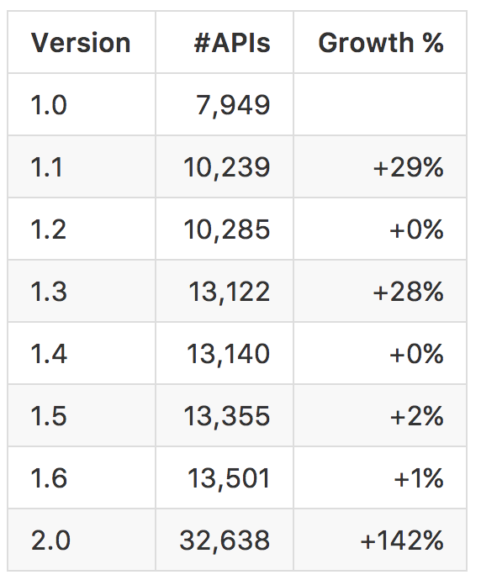
.NET Standard 2.0
Much bigger API surface
Extended to cover intersection between .NET Framework and Xamarin
.NET Core will implement .NET Standard 2.0
Using .NET Framework Libraries
No recompile required
Compatibility shim allows .NET Standard based libraries to reference existing .NET Framework binaries
Limited to .NET Framework libraries that only use APIs in .NET Standard (which are most of them)

Slide 57
APIs in .NET Standard 2.0
XML
XLinq • XML Document • XPath • Schema • XSL
SERILIZATION
BinaryFormatter • Data Contract • XML
NETWORKING
Sockets • Http • Mail • WebSockets
IO
Files • Compression • MMF
THREADING
Threads • Thread Pool • Tasks
CORE
Primitives • Collections • Reflection • Interop • Linq

Slide 58
.NET Standard 1.x allowable references
.NET FRAMEWORK
.NET CORE
XAMARIN
My Standard Library 1.x
Legend
Is able to reference
Application Type
.NET Standard Library
Portable Class Library
Via Portability

Slide 59
.NET Standard 2.x allowable references
.NET FRAMEWORK
.NET CORE
XAMARIN
Legend
My Standard Library 2.x
Is able to reference
Application Type
Via Portability
.NET Standard Library
Portable Class Library
.NET Framework Library
Via Compatibility Shim

Slide 60
.NET Core & .NET Standard
.NET Core is an implementation of .NET Standard
Separate GitHub repositories:
https://github.com/dotnet/corefx
https://github.com/dotnet/standard
.NET Standard updates are coordinated across all implementers
Coordinated by the .NET Standard Review Board and
.NET Foundation Technical Steering Committee
.NET Core can be updated independently of the Standard
Can be used to experiment and innovate

Slide 61
.NET Standard Version Rules
Additive - .NET Standard versions are logically concentric circles: higher versions incorporate all APIs from previous versions.
Immutable - Once shipped, .NET Standard versions are frozen. New APIs are added to a new version.
Compatible - There are no breaking changes between versions.
1.6
1.0

Slide 62
Demo
.NET Standard Libraries
Notes:
https://youtu.be/fOzcVwzkGP0?list=PLRAdsfhKI4OWx321A_pr-7HhRNk7wOLLY&t=177

Slide 63
.NET Core Backlog

Slide 64
.NET Core Backlog
Runtime
.NET Standard 2.0.
More Linux distros, including Alpine.
Linux distros package/offer .NET Core .
Support for ARM chips (Raspberry Pi)
Span<T> and Memory<T> and other performance features.
Native compilation (.NET Native).

Slide 65
.NET Core Backlog
Tools
Global commands.
Linker enables smaller apps.
Better offline experience.
Install new .NET Core versions from command line.
Better diagnostics on Windows and Linux.

Slide 66
.NET CLI

Slide 67
What are the .NET Core command-line tools?
Cross-platform command-line set of tools that are…
…focused on building code…
…for both humans…
…and machines

Slide 68
Principles of design
Several principles inform CLI design:
NuGet (and $PATH-based) extensibility
Every command is a verb (“compile”, “run”, “restore” etc.)
The driver knows enough to run the command(s) and no more
All core commands are consumable by humans and machines
Notes:
We are applying several principles when it comes to designing the CLI:
NuGet (and $PATH-based) extensibility
Every command is a verb (“compile”, “run”, “restore” etc.)
The driver knows enough to run the command(s) and no more
All core commands are consumable by humans and machines

Slide 69
CLI commands: basic architecture
dotnet
build
--output [path]
the driver
verb (command)
verb arguments

Slide 70
CLI commands: architecture explained
Driver, dotnet, is invoked first, followed by a verb
The verb is a command that is implemented as:
A NuGet package
A binary in the $PATH
Driver invokes the command passing the arguments to it
The command is responsible for the arguments

Slide 71
What is in the box: Core Commands
dotnet new Create minimal console app, library or a web project in a directory
dotnet restore Restore nuget references from project.json, update project.lock.json
dotnet run Run the application from source
dotnet build Compile the application, generating artifacts
dotnet publish Copy app/library + all dependencies to a directory for distribution
dotnet pack Pack up a NuGet package of your code
dotnet test Run tests using the configured test runner

